Slide 1
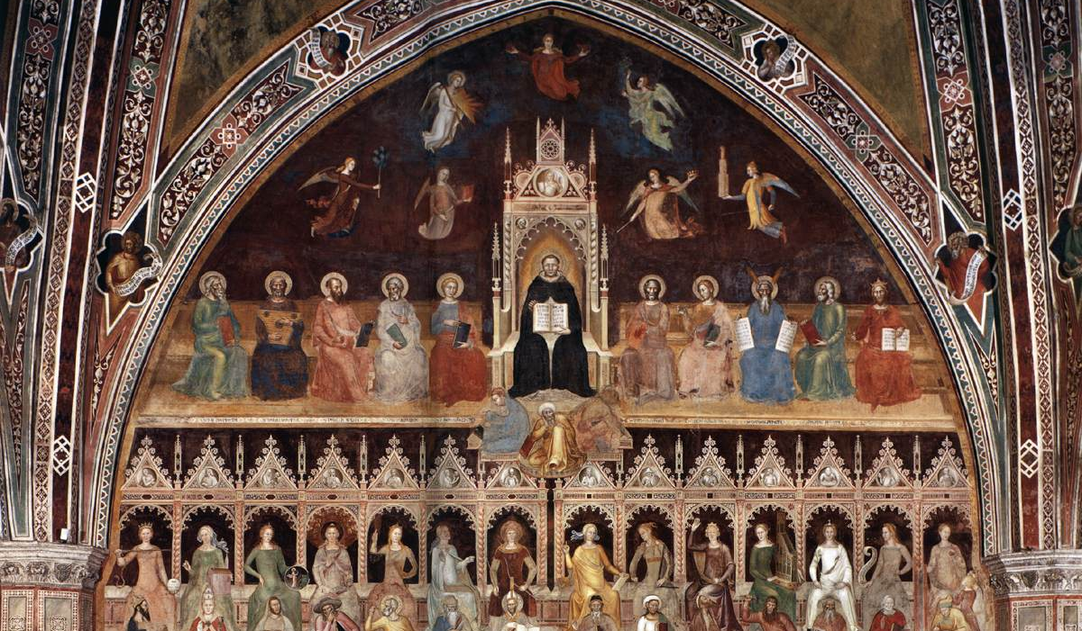
The Summa Theologiae
Genre, Structure, and Content

Slide 2
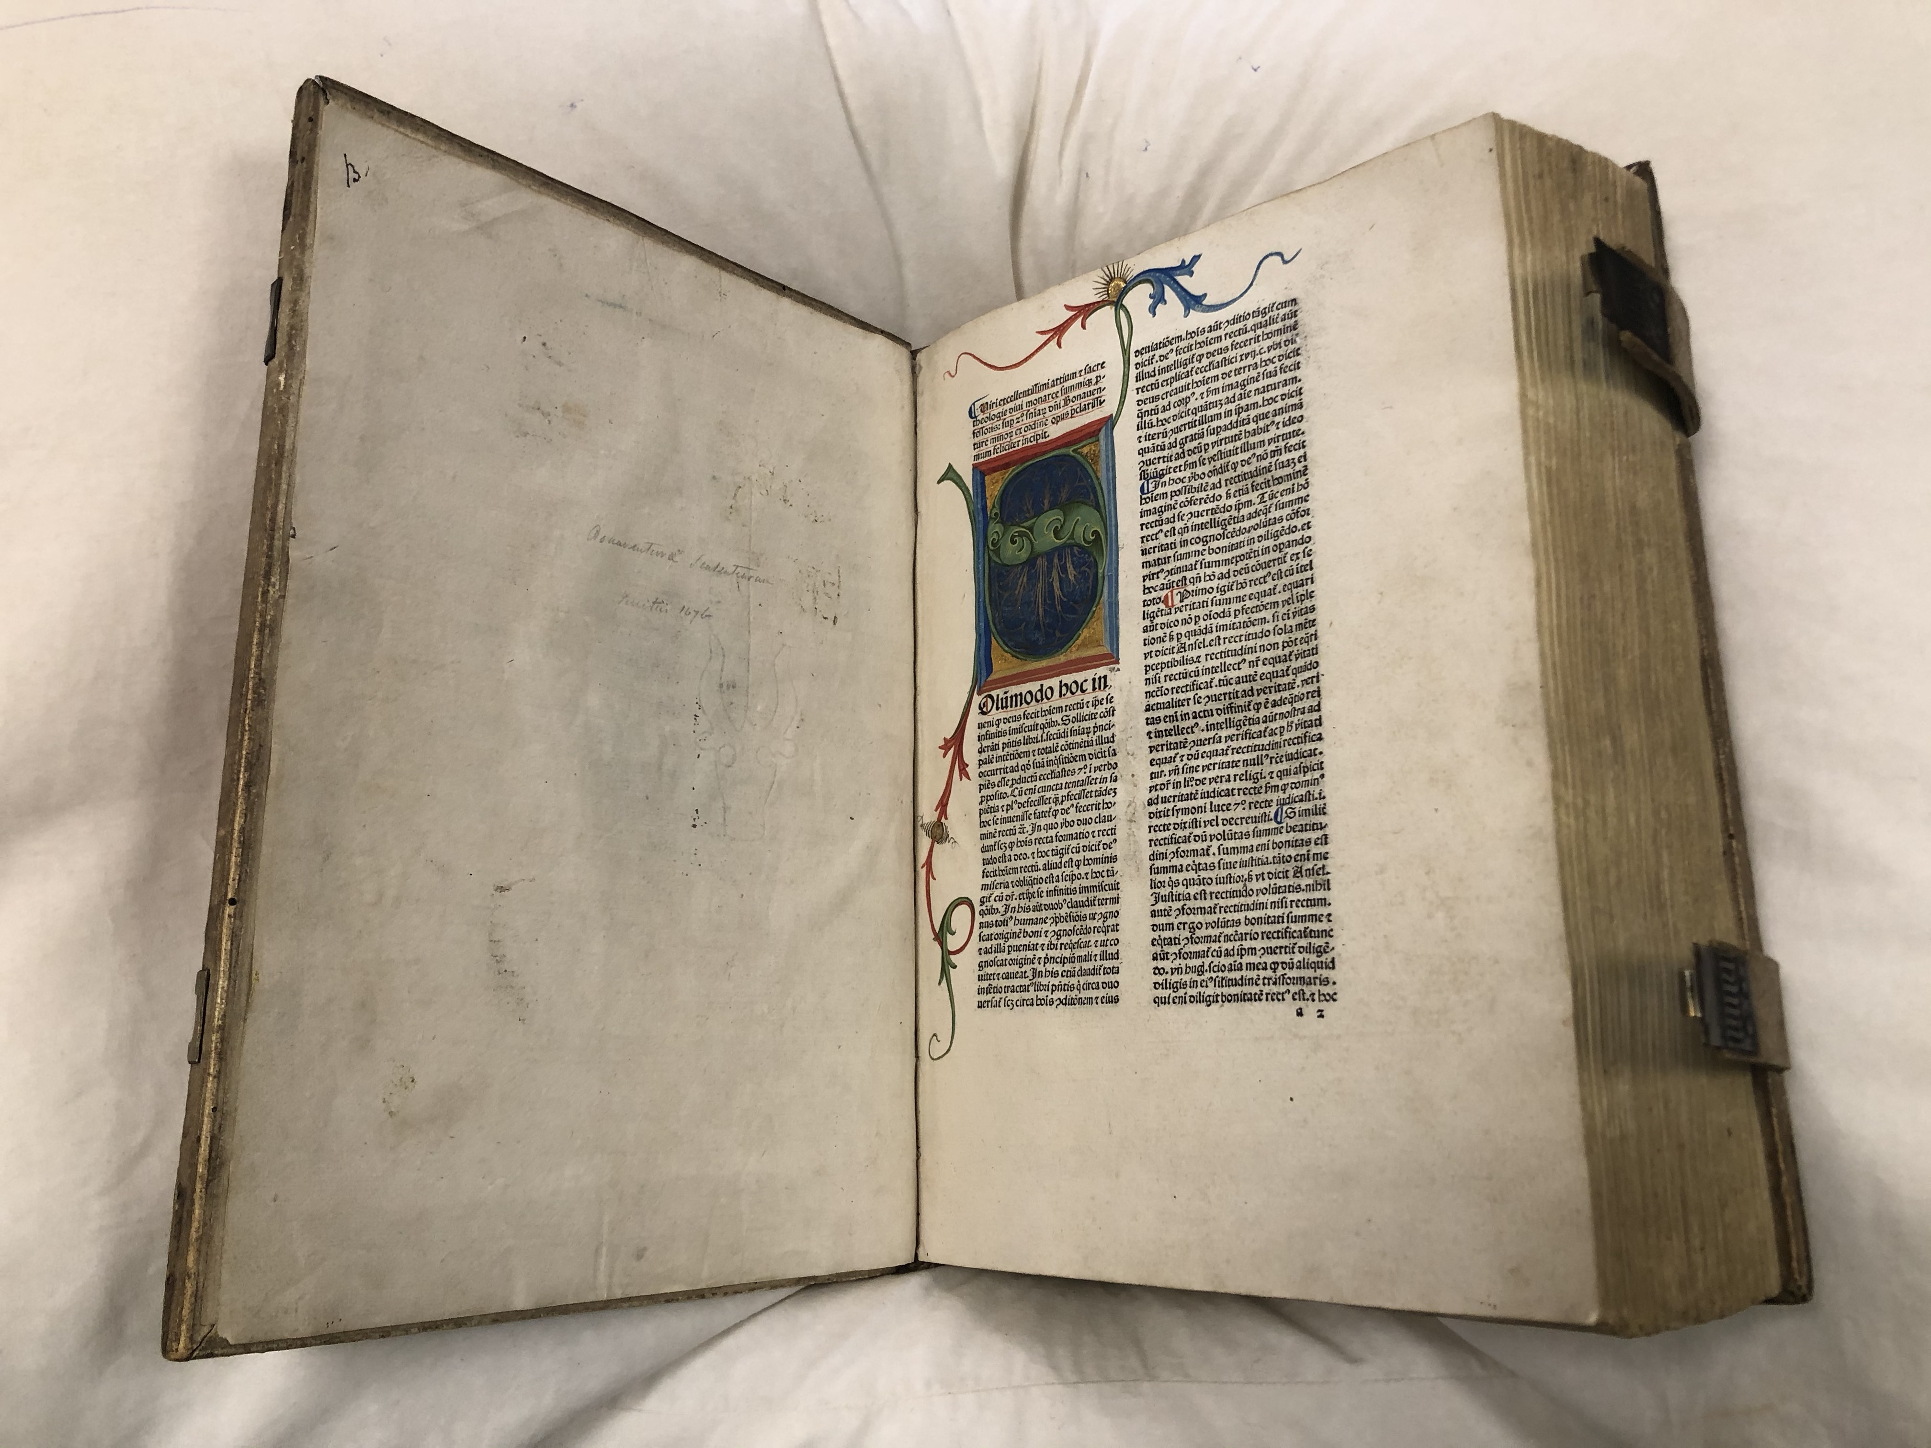
Scholastic Literatures
Lecture (Expositio et Lectura super Epistolas Pauli Apostili)
Disputed Questions: Ordinary & Quodlibet (Questiones Disputatae de Virtutibus)
Florilegia (Catena Aurea)
Commentary
  Biblical (Super Ioannem)
  Philosophical (Sententia Super Physicum)
  Theological (Super Boetium De Trinitatae)
Summa

Slide 3
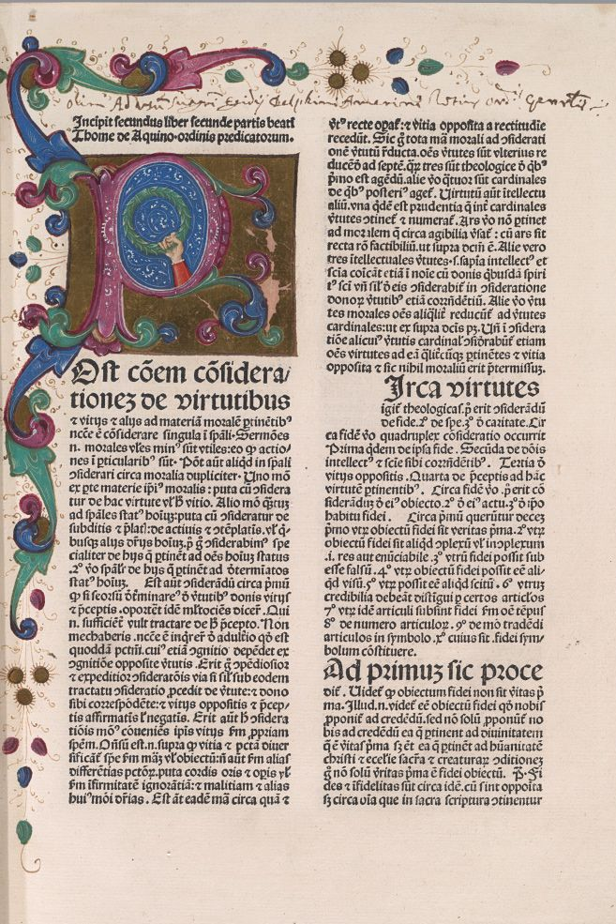
“Summa” as a Genre
Roughly means “the sum”, “whole”, or “summary”.
Used to title of works of medicine, law, liturgy, exegesis and theology.¹
3 Types of Summa:
  Encyclopaedic
  Synoptic
  Systematic — “They aim for an exact, complete, and especially organically structured presentation where nothing essential is missing.”²

Slide 4
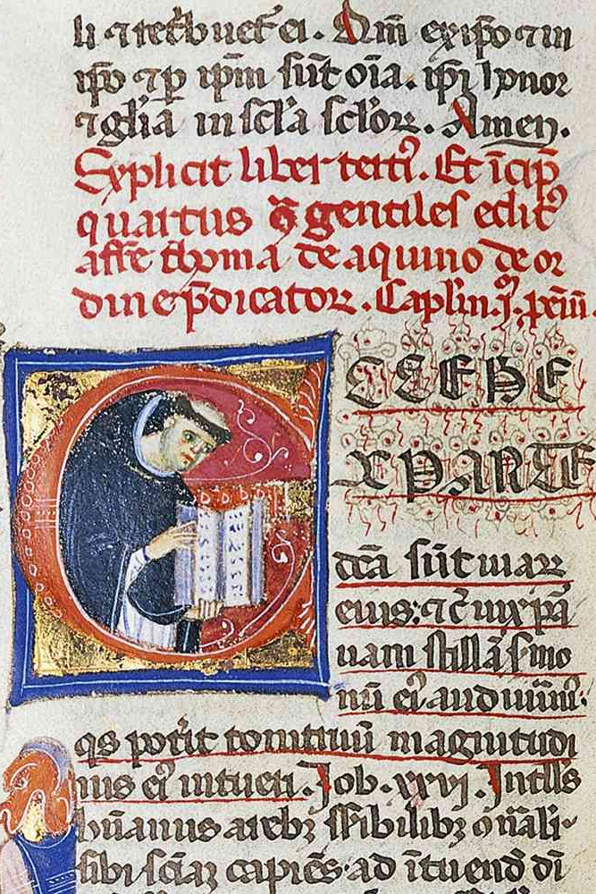
Thomas’s Three Summas
Summa Contra Gentiles
  Begun in Paris in 1259, completed in 1264/1265, probably while in Orvieto.
  An apologetic manual for mission to Muslims? Some mss describe the work as “Liber de ueritate cathoicae fidei contra errores infidelium”.
  An interest both to confute error and to unfold Christian wisdom.
  The first three books treat topics that “reason . . . can discover of God”: God’s existence and attributes, the emergence of creatures from God, and God’s providence over the world.
  The final book treats the Trinity and the work of salvation, truths which “exceed reason”.³

Slide 5
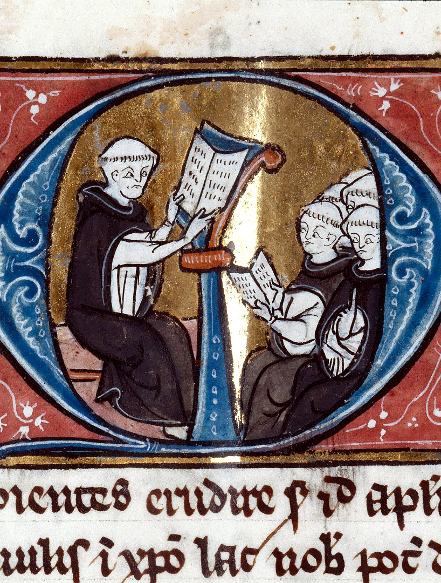
Thomas’s Three Summas
Compendium of Theology
  Written at the request of his friend Reginald, looking for some basic instruction in
  Begun during his time in Rome (1265), but never completed.
  Divided into three sections organised around the theological virtues:
  Faith is developed using the Apostle’s Creed.
  Hope using the Lord’s prayer.
  Love using the 10 commandments.

Slide 6
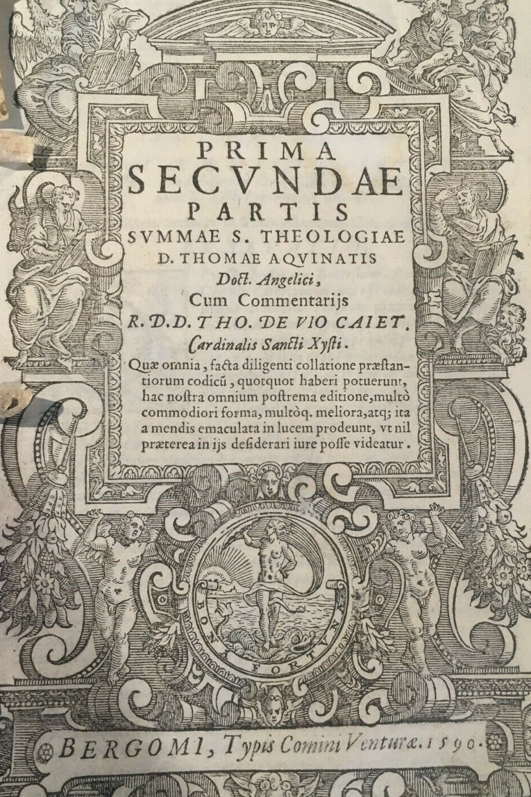
Thomas’s Three Summas
Summa Theologiae
  Written in Rome, Paris, and Naples over the final 7 years of Thomas’s life (1266-1273).
  Begun after Thomas abandoned attempts to develop a new commentary on Lombard’s Sentences.
  It was meant to provide instruction in theology for the training of priests.

Slide 7
The Purpose of the Summa
  “Because the doctor of Catholic truth ought not only to teach the proficient, but also to instruct beginners, we purpose in this book to treat of whatever belongs to the Christian religion, in such a way as may tend to the instruction of beginners. We have considered that students in this doctrine have not seldom been hampered by what they have found written by other authors, partly on account of the multiplication of useless questions, articles, and arguments, partly also because those things that are needful for them to know are not taught according to the order of the subject matter, but according as the plan of the book might require, or the occasion of the argument offer, partly, too, because frequent repetition brought weariness and confusion to the minds of readers.” — ST, prologue.

Slide 8
The Structure of the Summa Theologiae
Prima Pars (ST Ia)
Secunda Pars
  Prima Secundae (ST Ia-IIae)
  Secunda Secundae (ST IIa-IIae)
Tertia Pars (ST IIIa)
Supplementum (Sup.)
Exitus — Reditus Theme

Slide 9
Prima Pars
God in himself as the principle of all things, and the procession of creatures from God.
  The Knowledge of God
  The Nature and Attributes of God
  The Doctrine of the Trinity
  Creation
  Angels & Human Beings
  God’s Providence

Slide 10
Secunda Pars
The path of creatures returning to God.
  Prima Secundae:
    The Goal of Life
    Moral Action
    Human Emotion
    Sin, Law, and Grace
  Secunda Secundae:
    The Virtues
      Theological: Faith, Hope, Charity
      Natural: Prudence, Justice, Fortitude, Temperance
    Human Vocations

Slide 11
Tertia Pars
Christ as the way creatures return to God.
The Incarnation
Life of Christ
The Sacraments:
  Baptism
  Confirmation
  Eucharist
  Penance

Slide 12
The Supplementum
The Supplementum was compiled after Thomas’s death by his friend Rinaldo da Piperno. It is taken from Thomas’s commentary on Lombard’s Sentences in order to give a sense of what a “complete” Summa might look like.
The Sacraments:
  Penance Cont’d
  Extreme Unction
  Holy Orders
  Matrimony
The Resurrection

Slide 13
The Quaestio Method
Each part of the Summa is divided into “questions”, which are subdivided into “articles”.
Articles treat an aspect of the larger question of which they are a part and typically begin with “whether” (utrum).
Citation: ST Ia, q. 1, a. 1.

Slide 14
The Structure of an Article
Title of the Article, usually beginning with “whether” (utrum).
“Objections” (obj.) — these are usually 2-3 arguments that are, in some respect or another, contrary to the thesis of the article.
“Sed Contra” (s.c.) — means “on the other hand”. This sentence functions as a “hinge”. It typically appeals to an authority that orients the thesis of the article.
“Responsio” (resp.) — a positive elaboration and explanation of the substance of the article.
“Reply” (r./ad.) — arguments confirming, rebutting, or distinguishing the objections raised at the beginning of the article.

Slide 15
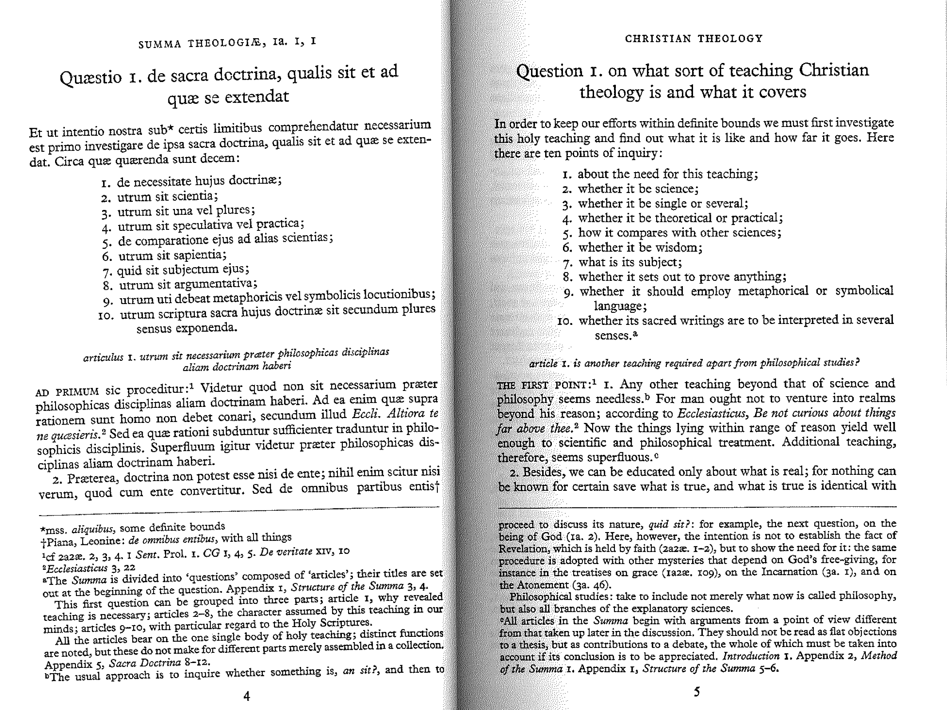

Slide 16
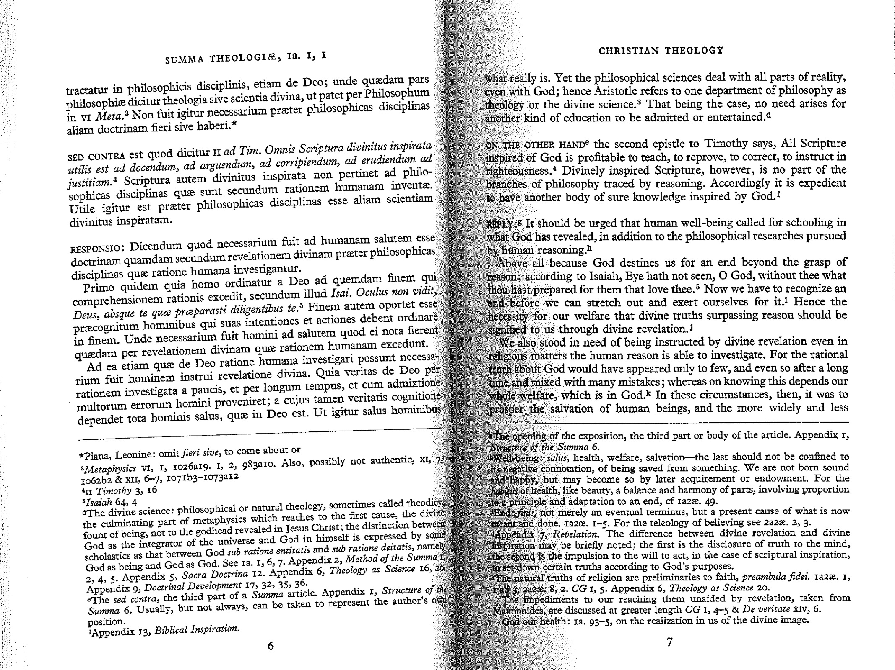

Slide 17
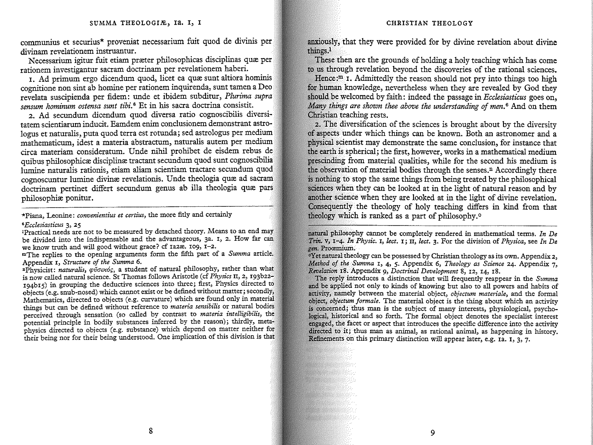

Slide 18
Citations
¹ Jean-Pierre Torrell, O. P., Aquinas’s Summa: Background, Structure, & Reception, translated by Benedict M. Guevin, O.S.B. (Catholic University of America, 2005), p. 69.
² Ibid., p. 70.
³ Summa Contra Gentiles, I.9.

