Slide 1


Time Managment
Sara Cirpaci

Slide 2


Content
ThePhoto by PhotoAuthor is licensed under CCYYSA.
Time Management and why it is essential
Time Mangement strategies in the digital world
Challenges in Time Management
Evidence-based solutions
Conclusion

Slide 3

Time Management and why it is essential
Time management means to plan and organise your time in a way for you to prioritze the important things while having time for activites.
essential :
Reduce stress
Better academic success
Productive
On time with deadlines
In control

Slide 4

Time Mangement strategies in the digital world
Google calendar
Plan your weekly schedule
Set reminders
Everything is more balanced
Makes a big difference

Slide 5
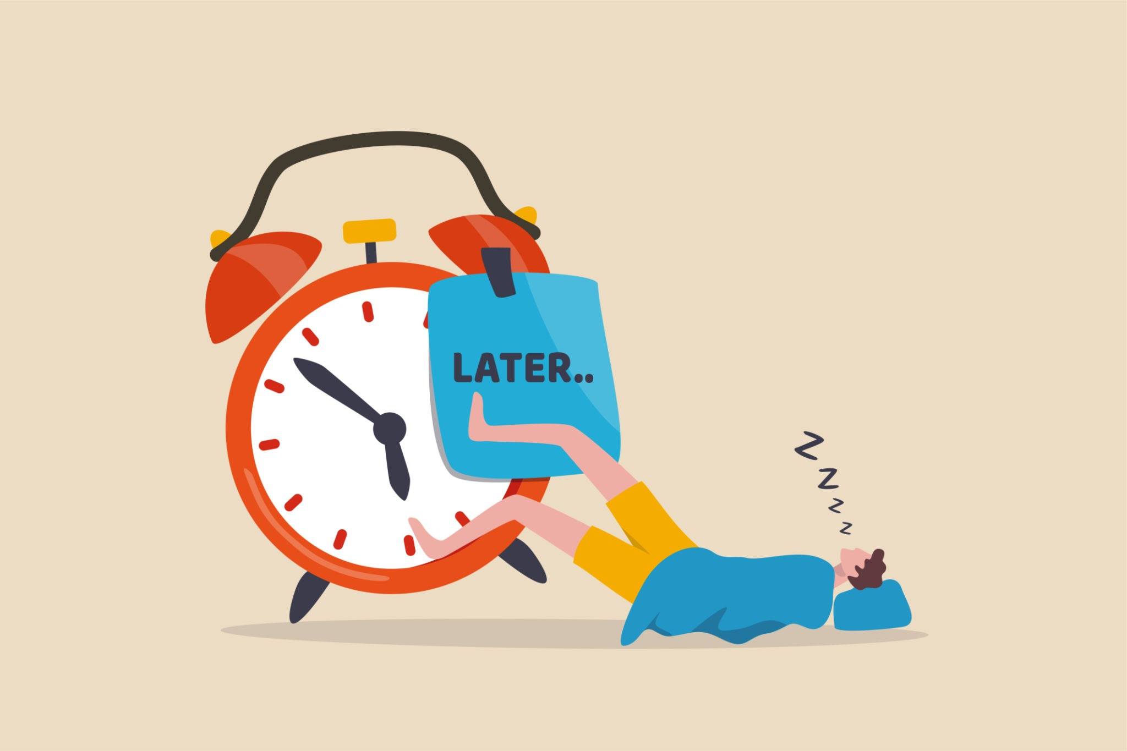
Challenges in Time Management
Procrastination
No idea where to start
Having distrations
Burnout

Slide 6
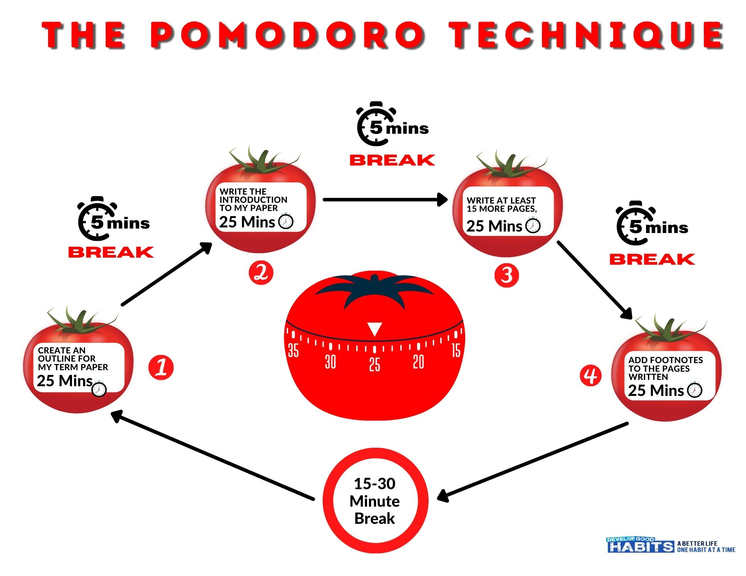
Evidence-based solutions
Helps you get started
Not wasting time
More encouraged
More likely to achieve goals

Slide 7

Conclusion
You have more freedom
Won't feel pressured
Will enjoy the experience
Successful student

Slide 8

Reference
N. Ephraim (2024)’’Time management impact on academic performance’’. Resources, Auditor Resources. Available at https://adiutor.co/blog/time-management-impact-on-academic-performance/
J. Tsuei (2023) ‘’How to use google calendar for time management’’. Resources, clockwise. Available at https://www.getclockwise.com/blog/google-calendar-time-management
G. Dhaka (2023) ‘’ Why time management is a challenge for students? Understanding the causes, consequences and solutions’’. Resources, Medium. Available at https://medium.com/@dgaurav/why-time-management-is-a-challenge-for-students-understanding-the-causes-consequences-solutions-b7e248ab59ff
S Gupta (2025) ‘’ Why the pomodoro technique is the productivity booster you need to try’’. Resources, very well mind. Available at https://www.verywellmind.com/pomodoro-technique-history-steps-benefits-and-drawbacks-6892111

