Slide 1


Student Name: Reema Hussain - 2127235
Meena Hussain - 2127234
Module: Digital Skills And Research Methods
Module Code: LCHS4002_BIRM
Lecturer Name: Muno Zuwirai

Slide 2




Introduction
Students use technology to collaborate at UWTSD because it has become easier to communicate and collaborate securely.
Students use different types of technology to collaborate at UWTSD such as
MS Teams
MS Word
MS PowerPoint
OneDrive
Moodle
Excel
Meena Hussain - 2127234

Slide 3

Rationale
Students can collaborate on Ms Teams in different ways such as live chats and calls.
It also allows you to work together using MS Word, Excel or PowerPoint Students have said MS Teams is the best way to collaborate because Ms Teams allows you to collaborate and communicate from one login programme.
MS Teams also saves and shares data securely
Meena Hussain - 2127234

Slide 4

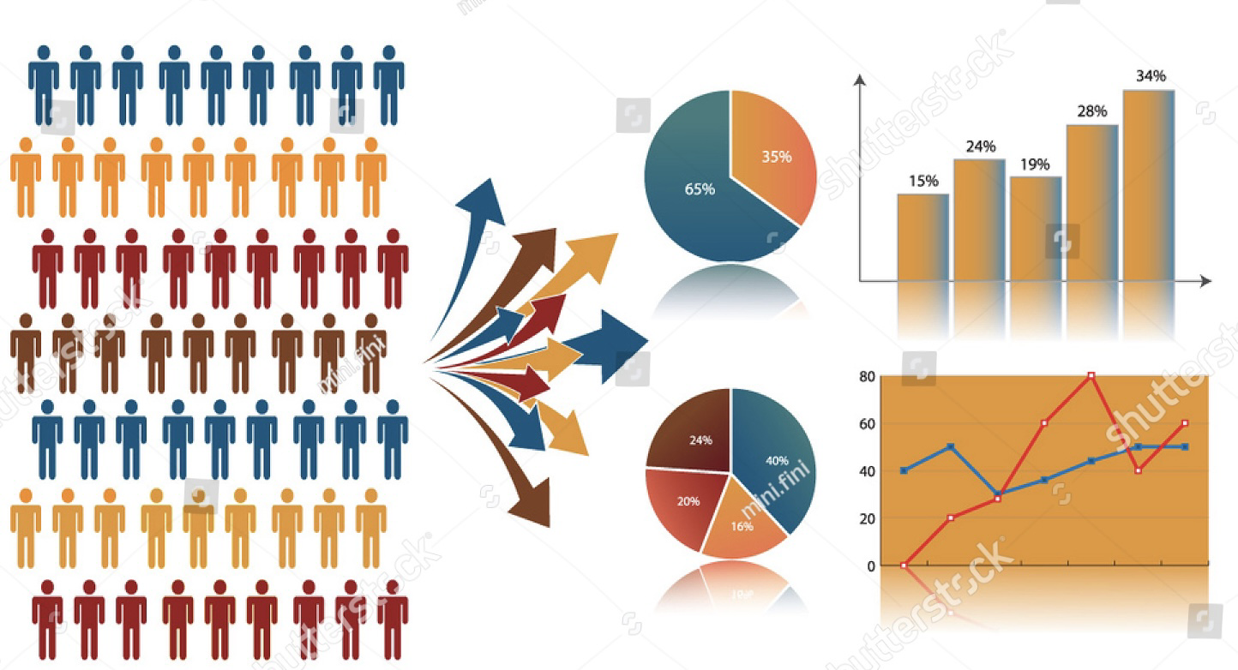
Proposed Method
How Do Students Use Technology To Collaborate At UWTSD?
We will be asking students at UWTSD how they use technology to collaborate with peers.
Students have used technology to collaborate by collecting data through face to face interviews, record keeping and focus groups.
Students have also used technology to collaborate by creating questionnaires & surveys. Also by creating tables and charts to collect data.
Meena Hussain - 2127234

Slide 5
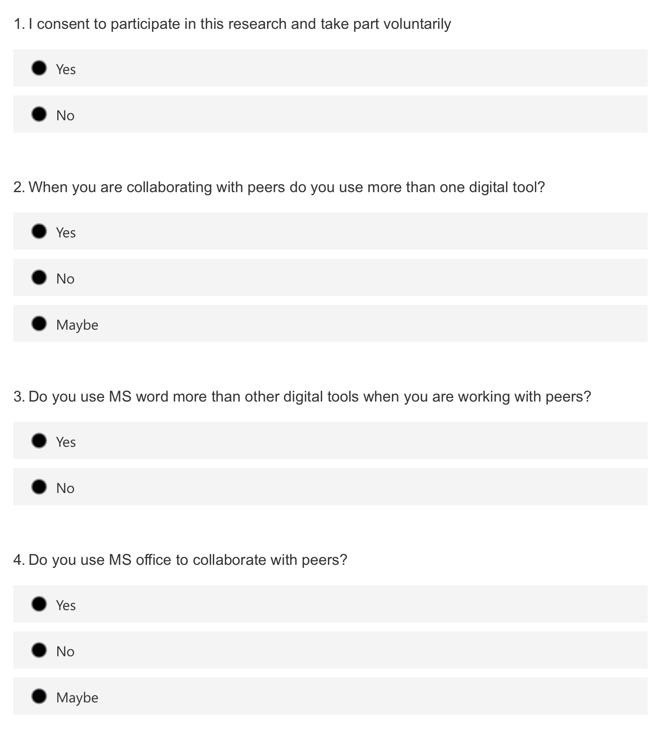
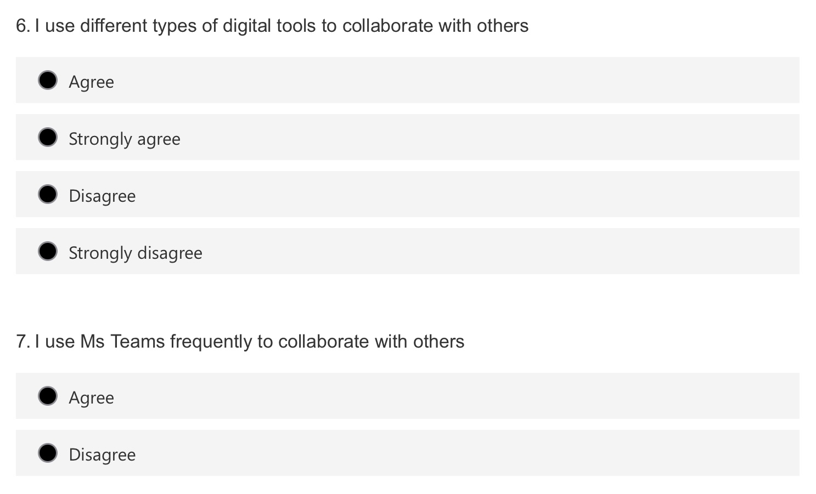

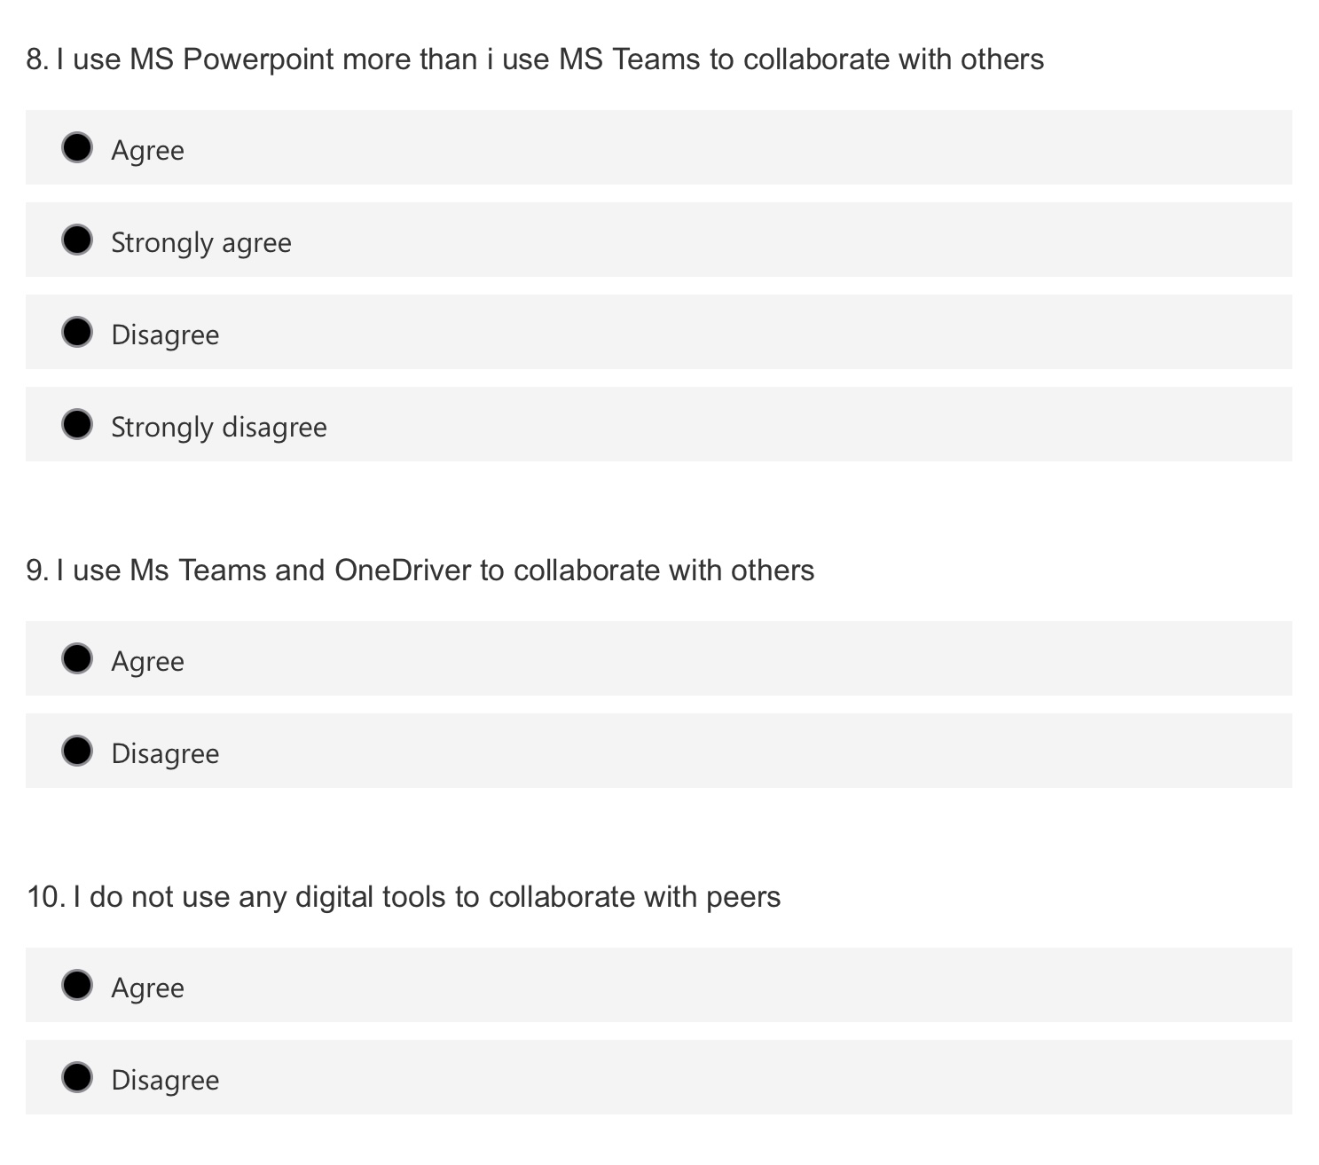

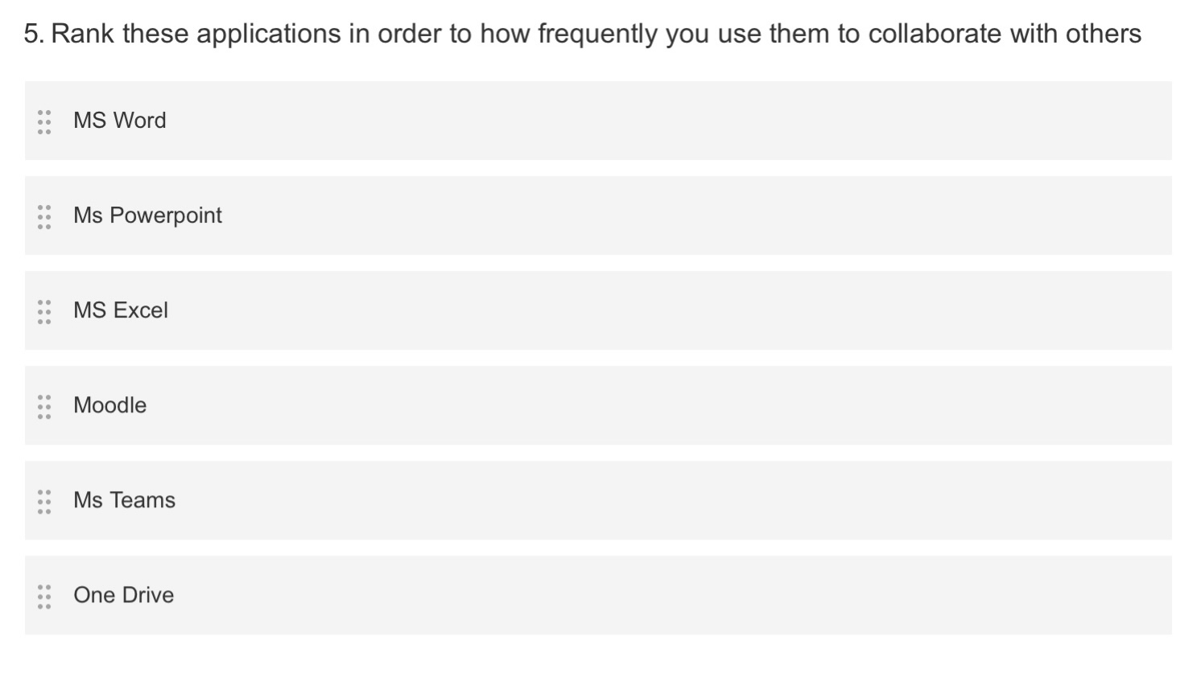
Reema Hussain - 2127235

Slide 6


Ethical Considerations
When I collect the data I will only use information for this research purpose
I will not share others personal information
I can keep your information secured in a email with a password
I will ask for consent before collecting data
I will not force people to give answers
Reema Hussain - 2127235

Slide 7

Research Timeline
1st July 2022 | Planning The Research
10th July 2022 | Collecting Data From Different Sources
15th July 2022 | Analyse All The Data That Has Been Collected
27th July 2022 | Write Up The Research
Reema Hussain - 2127235

Slide 8
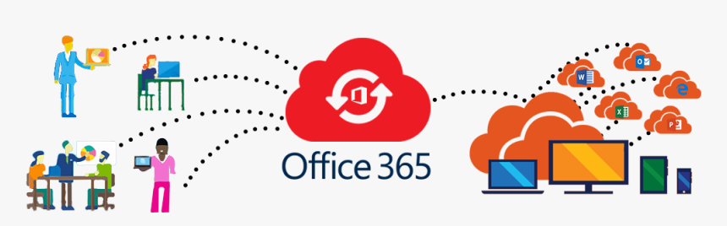


Hypothesis
How do students use technology to collaborate?
Students can use Office 365 to collaborate with peers in different ways You can access Microsoft Office 365 at any time whether you’re working from home or while you’re away from work.
Office 365 has different tools to help you wherever you are. You can access Microsoft 365 From a mobile device or a laptop, you can share files and attend meeting.
Reema Hussain - 2127235

Slide 9
Reference List
Team, W.R.B. (2016). Why Student Collaboration is More Effective with Tech. [online] EDUSPIRE. Available at: https://www.eduspire.org/technology-blog-for-teachers/why-student-collaboration-is-more-effective-with-tech/.
support.microsoft.com. (n.d.). Work together in Microsoft Teams. [online] Available at: https://support.microsoft.com/en-au/office/work-together-in-microsoft-teams-8066077a-e2a7-45b7-a8d1-adfd0a944b67 [Accessed 25 Jun. 2022].‌
wwlpublish (n.d.). Collaborate in teams and channels with Microsoft Teams - Learn. [online] docs.microsoft.com. Available at: https://docs.microsoft.com/en-us/learn/modules/collaborate-teams-channels-microsoft-teams/ [Accessed 25 Jun. 2022].‌

