Slide 1
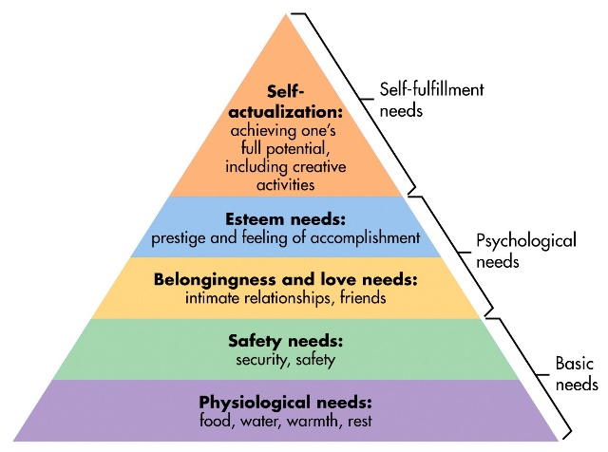
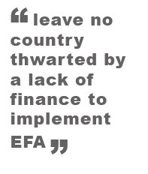
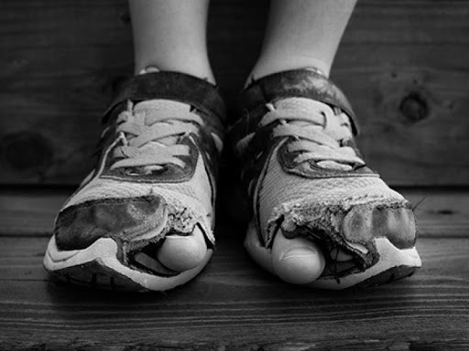
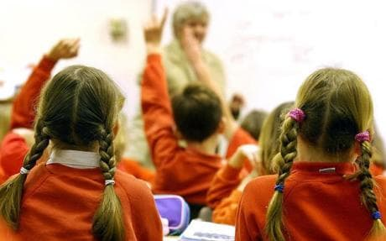

What is it?
The purpose of the Pupil Deprivation Grant is to improve outcomes for learners eligible for ‘FREE SCHOOL MEALS’(e-FSM) and looked after children (LAC). It is intended to overcome the additional barriers that prevent learners with disadvantaged backgrounds and many other indications that enable a child to lack within an educational setting, an example would be to the vulnerable children from a barrier stopping the child from achieving their full potential (Gov.Wales, 2019).
When did it come into practice?
The Pupil Deprivation Grant was established in 2012 and came into practice to help children to improve their learning outcomes The grant I paid for each learner aged 5-15 (Gov.wales, 2015).
Who developed it?
The welsh Government developed the PDG to be eligible for all schools across Wales that applied for the grant.
Where is it in place?
The PDG is in all schools across Wales however it is up to how many children have free school meal’s attending within their school as it is based on their total of how much they are eligible for.
(Google - Images, 2020)
Why is it in place?
The PDG is in place to be able to improve children’s learning despite their vulnerable backgrounds. Poverty can have a massive impact on a child’s learning simply because their family lack in money to be able buy the basic essential necessities of learning equipment. Theory to this would be Maslow’s hierarchy of basic needs (Maslow, 2013). It allows children to be able to get given an opportunity for success and help them grow and develop.
.
It is also our duty to be able to look after children to achieve a safe guarded and safe environment for children to be able to feel safe in a school setting. This also applies to the children act, (Legislation.gov.uk, 1989).
Schools across the nation particularity in Wales get given a grant to help Children’s attainment (Attained., 2020), within an education setting and help with provisions, interventions and allowing them the basics of learning to be able to achieve their full potential in a school setting. It is up to each individual school to apply what provisions, interventions and equipment that would be needed within their school and what applied most to them.
Pupil Deprivation Grant - PDG
The holistic approach is concerned with the development of every person's intellectual, emotional, social, physical, artistic, creative, and spiritual potentials. It seeks to engage students in the teaching/ and learning process and encourages personal and collective responsibility this also refers to living amongst poverty.
Child Poverty in Education can have a huge impact on their learning ability, by them not having food at home the impact of this allows them to come into school hungry. – Schools have funding off the Welsh Government to allow children a free breakfast, free snack, and a free lunch whilst in school 5 days a week.
The Welsh Government has a programme that runs throughout the summer term holidays is known as SHEP. It allows children the entitlement of a healthy meal and physical activity and enrichment sessions to children in areas of social deprivation. It is labelled as ‘food and fun’ which is used to promote clubs to children and families (Welsh Government, 2017).
We are the fifth wealthiest country in the UK but there is 185,000 Children living in poverty and there is 28% in WALES. Also looking at the UK Government welfare and tax reforms it is estimated that by 2021-2022 it will increase to 40% of children living in poverty in WALES. (Children's Commissioner For Wales, 2020)
The Welsh Government has set national indicators towards achieving the seven well-being goals as laid out in the Well-being of Future Generations (Wales) Act 2015 (wwf.org.com, 2015).
Comparing 2 schools within the local area about what they are entitled to, what they wish to do with the money, how it will help their children.
SCHOOL 1 – Critically exploring SCHOOL 1 it is in a local area amongst a deprived and vulnerable area. More than 44% of children are entitled to ‘FREE SCHOOL MEALS’ in school. (Pembrokeshire County Council, 2020)
SCHOOL 2 – Is in a more privileged area, however they also have percentages of ‘free school meal’ children but I cannot find the correct percentage for it. They have £33,515 less than school 1 as they have less LAC (Pembrokeshire County Council, 2020).
(Google - Images, 2020)
(Google - Images, 2020)
(Dakar, 2000)

Slide 2
Bibliography
Attained., 2020. Attainment in Education. [Online]
Available at: https://www.attainmentineducation.org/
[Accessed 22gnd July 2020].
Children's Commissioner For Wales, 2020. Protecting Welsh Children from the impact of Child Poverty. A Charter for Change, pp. 1-64.
Dakar, 2000. The Dakar Framework for Action:. 1st ed. USA: EFA Forum Secretariat, Unesco.
Google - Images, 2020. [Online]
Available at: https://www.google.co.uk/search?q=education+head&tbm=isch&ved=2ahUKEwirk6z21vLqAhX0DGMBHezyC-wQ2-cCegQIABAA&oq=education+head&gs_lcp=CgNpbWcQAzICCAAyAggAMgIIADIECAAQQzICCAAyAggAMgIIADICCAA6CAgAELEDEIMBOgUIABCxAzoHCAAQsQMQQ1DhS1iVXWDRX2gAcAB4AIABXIgB4QaSAQ
[Accessed 29th July 2020].
Gov.wales, 2015. Early Years Deprivation Grant. Welsh Government, pp. 1-15.
Gov.Wales, 2019. Achievement and entitlement to free school meals: 2019. Welsh Government, p. 1.
Legislation.gov.uk, 1989. Children Act 1989. [Online]
Available at: https://www.legislation.gov.uk/ukpga/1989/41/contents
[Accessed 29th July 2020].
Maslow, A. H., 2013. A Theory of Human Motivation. s.l.:s.n.
Pembrokeshire County Council, 2020. Monkton Priory Community School. [Online]
Available at: https://www.monktonpriory.co.uk/welcome/
[Accessed 29th July 2020].
Pembrokeshire County Council, 2020. Tenby Church in VC Primary School. [Online]
Available at: https://www.tenbyprimary.co.uk/
[Accessed 29th July 2020].
Welsh Government, 2017. Food and Fun’ School Holiday Enrichment Programme. [Online]
Available at: https://www.wlga.wales/food-and-fun-school-holiday-enrichment-programme
[Accessed 29th July 2020].
wwf.org.com, 2015. Success Stories - The Well Being Of Future Genarations Act (WALES). [Online]
Available at: https://www.wwf.org.uk/future-generations-act-2015?pc=AUT005007&gclsrc=aw.ds&&gclid=EAIaIQobChMI8PrX2sDy6gIVb4BQBh3hsQaiEAAYASAAEgIh7fD_BwE&gclsrc=aw.ds
[Accessed 29th July 2020].

