Slide 1

Student Name: Shivani Bharatbhai Patel
Student ID:
2508120
Programme:
MSc Public Health and Social Care in Practice
Module Code:
LCHS7008
Module Title:
Practice-Based Research
Assessment Title:
Component 1: Poster presentation
Lecturer:
Dr Zeno Leung
Submission Date:
15 June 2026

Slide 2
Title: EVALUATING THE EFFECTIVENESS OF FOOD FIRST APPROACH IN MALNUTRITION STATUS OF ELDERLY IN ENGLAND

Slide 3
1. Prevalence
In England, malnutrition in the older population is becoming a major and increasing public health problem.
Recent research by the Future Health Research Centre found that disease-related malnutrition contributes to hospitalisation of around 464,000 people in England every year, over 50 people per hour (danone.com, 2023).
Notes:
In England, malnutrition in the older population is becoming a major and increasing public health problem.
Recent research by the Future Health Research Centre found that disease-related malnutrition contributes to hospitalisation of around 464,000 people in England every year, over 50 people per hour (danone.com, 2023).

Slide 4
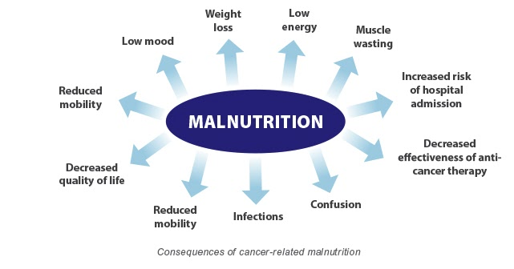
Moreover, disease-related malnutrition has a significant impact in England, affecting some 2.9 million people, and the costs of care for malnourished people are nearly three times as high as for well-nourished people (malnutritiontaskforce.org.uk, 2025).
Malnutrition costs the NHS almost £22.6bn a year, and a high proportion of NHS expenditure is attributable to hospital services, while malnutrition has an impact on social services and primary care (danone.com, 2023).
Notes:
Moreover, disease-related malnutrition has a significant impact in England, affecting some 2.9 million people, and the costs of care for malnourished people are nearly three times as high as for well-nourished people.
Malnutrition costs the NHS almost £22.6bn a year, and a high proportion of NHS expenditure is attributable to hospital services, while malnutrition has an impact on social services and primary care (danone.com, 2023).

Slide 5
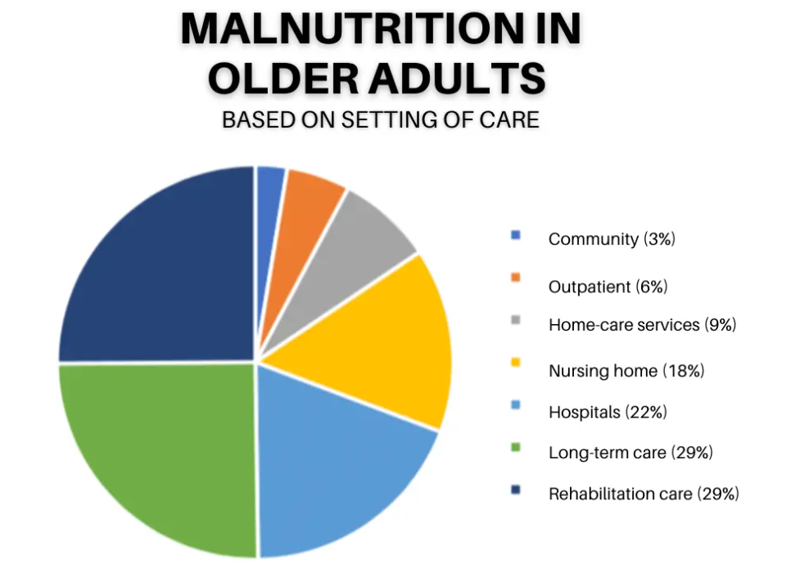
It is also more prevalent in older people, and estimates indicate that without action could cost up to an extra £4 billion by 2035.
Furthermore, the proportion of UK households reporting food insecurity reached 10% in 2023, indicating that the situation for nutrition access has deteriorated and raising the vulnerability of the elderly (gov.uk, 2024).
Notes:
It is also more prevalent in older people, and estimates indicate that without action could cost up to an extra £4 billion by 2035.
Furthermore, the proportion of UK households reporting food insecurity reached 10% in 2023, indicating that the situation for nutrition access has deteriorated and raising the vulnerability of the elderly (gov.uk, 2024).

Slide 6
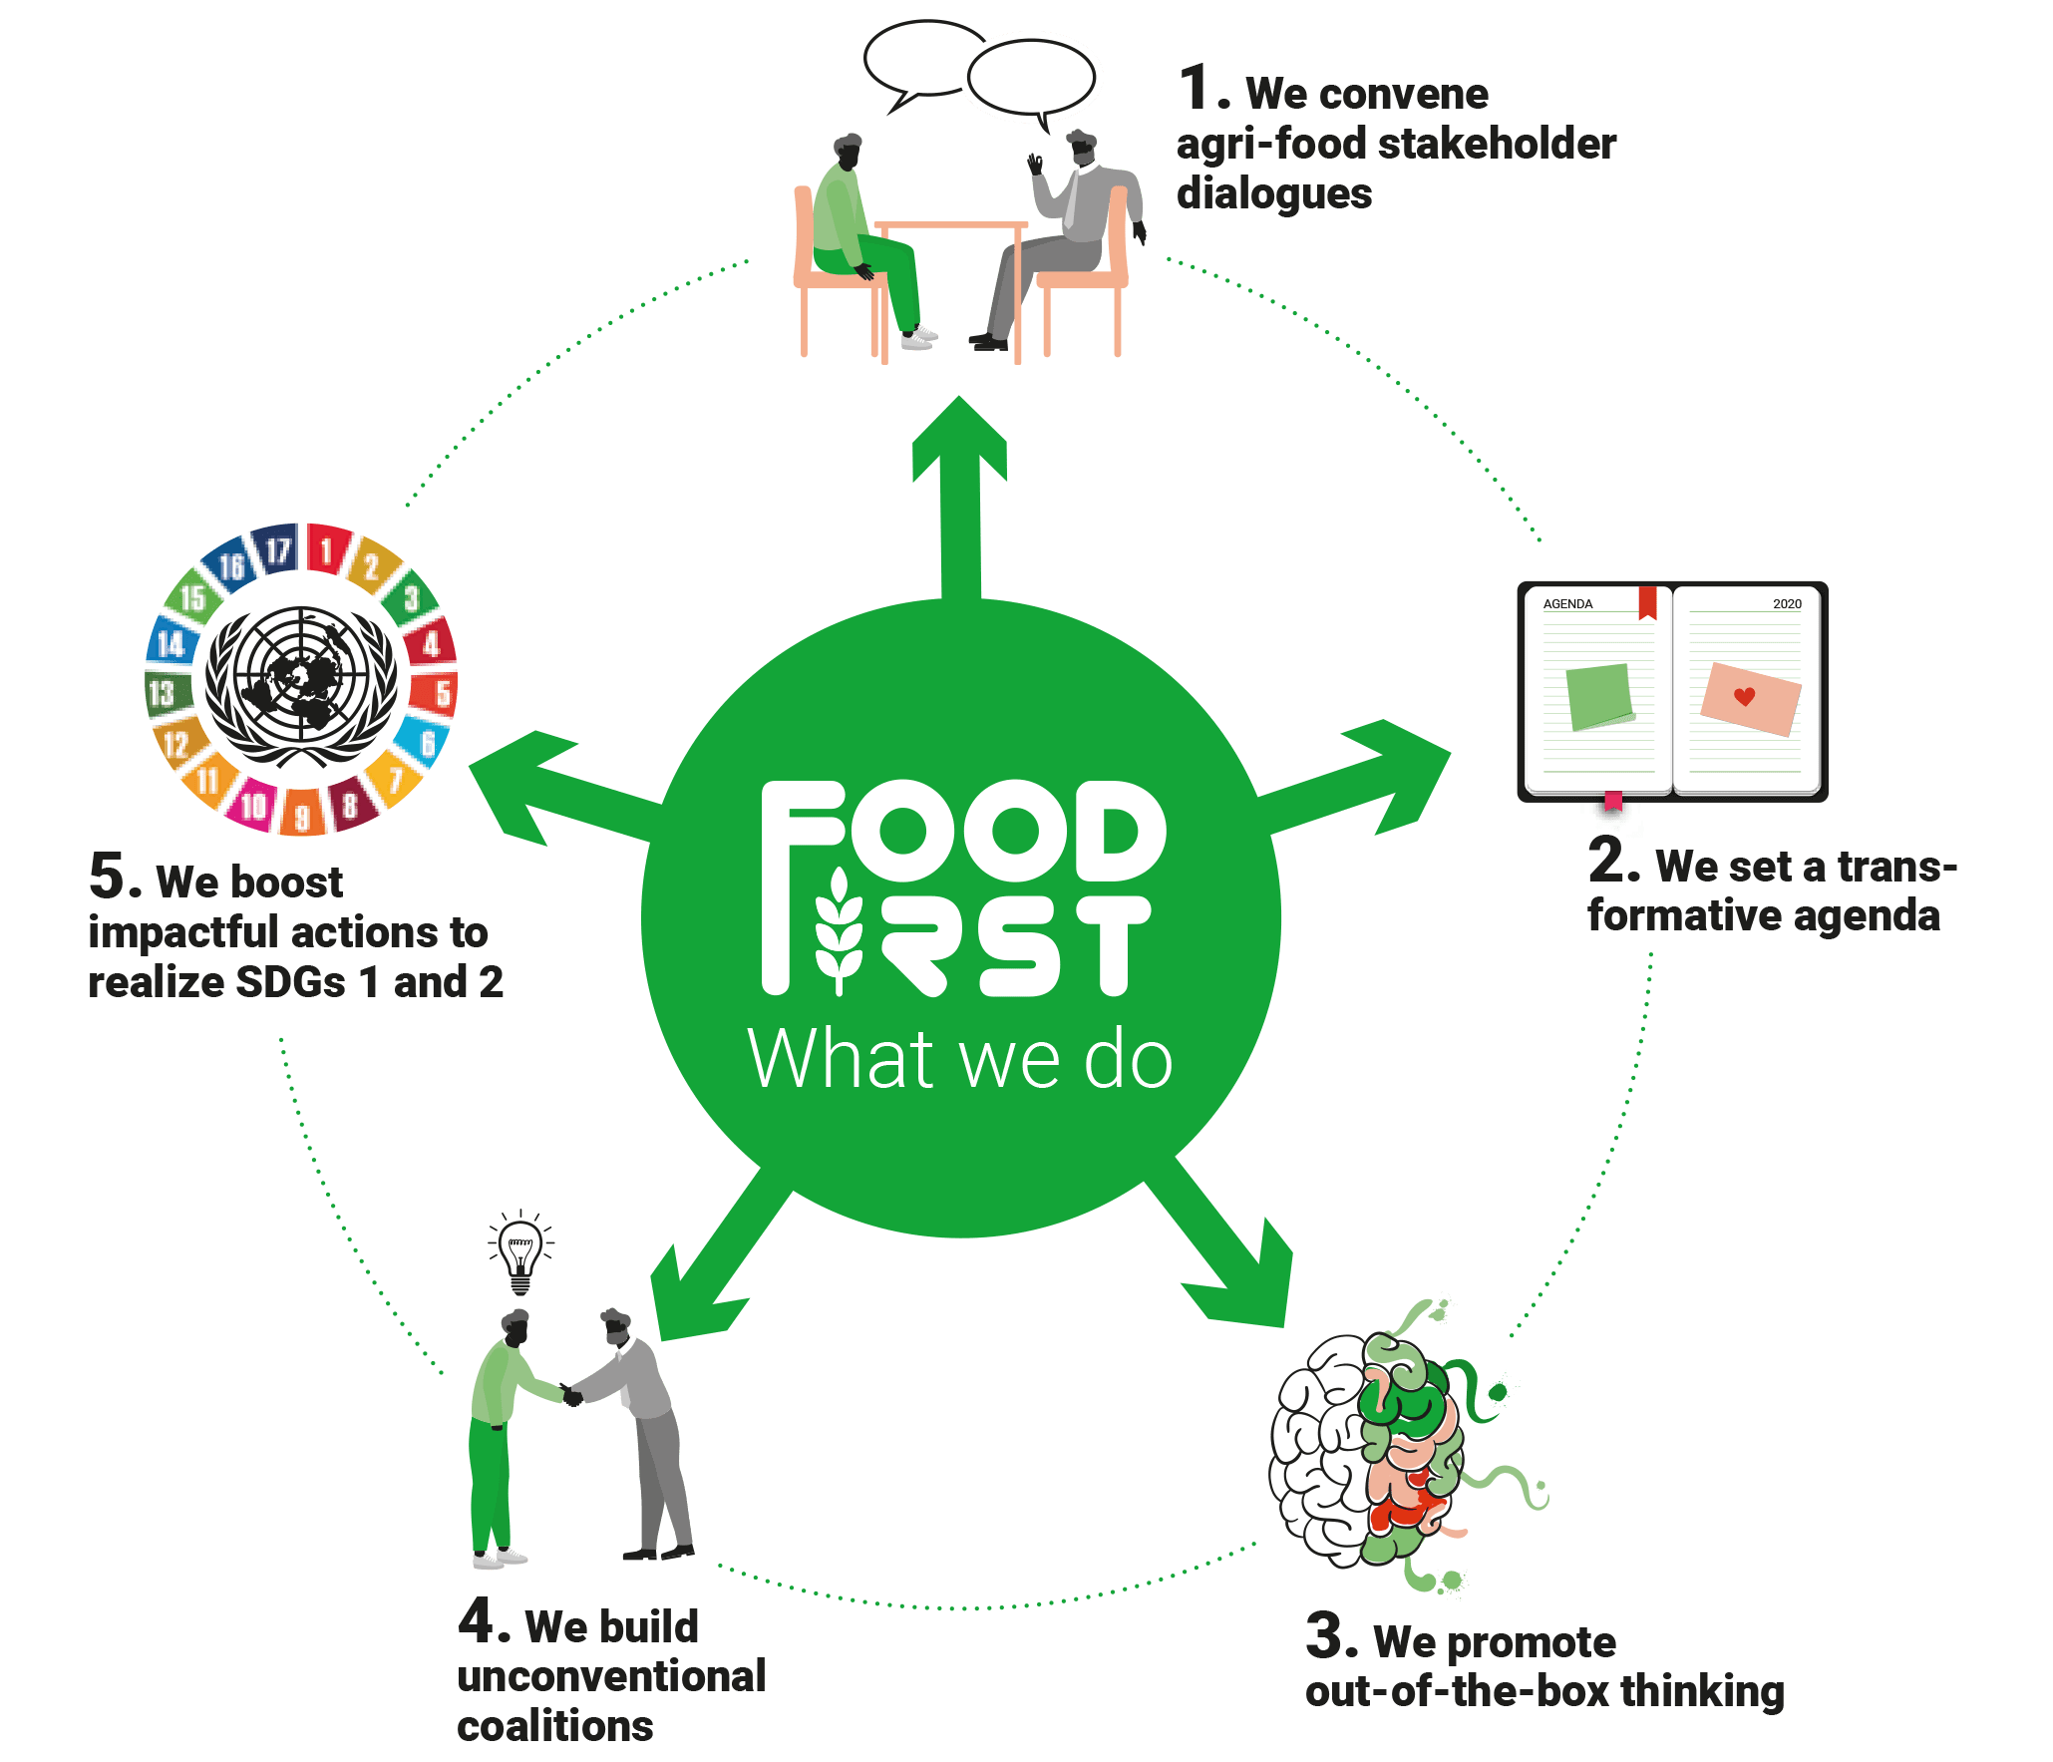
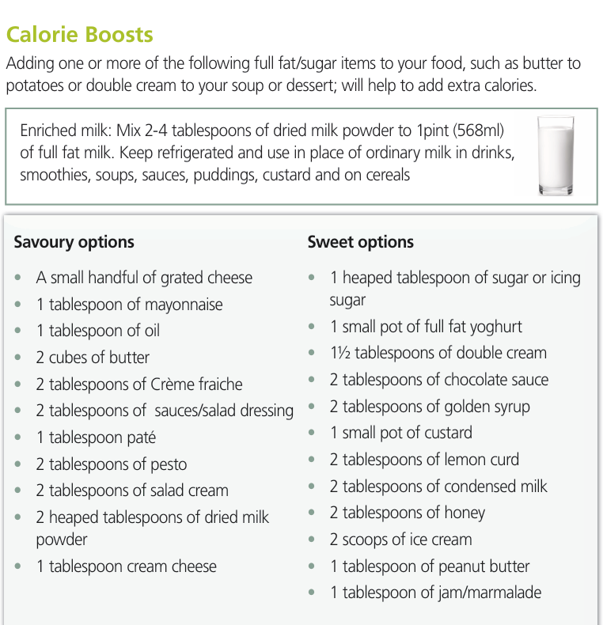
“Food First approach”
The food first approach is a strategy by the NHS in UK
The aim is to assist in weight recovery by promoting consumption of foods high in fat and sugar
This approach is aimed at reducing malnutrition in UK
The focus is to improve weight among malnourished people so that they can achieve a health BMI (malnutritionandfoodfirst.rdash.nhs.uk, 2026)
Notes:
The food first approach is a strategy by the NHS in UK
The aim is to assist in weight recovery by promoting consumption of foods high in fat and sugar
This approach is aimed at reducing malnutrition in UK
The focus is to improve weight among malnourished people so that they can achieve a health BMI

Slide 7
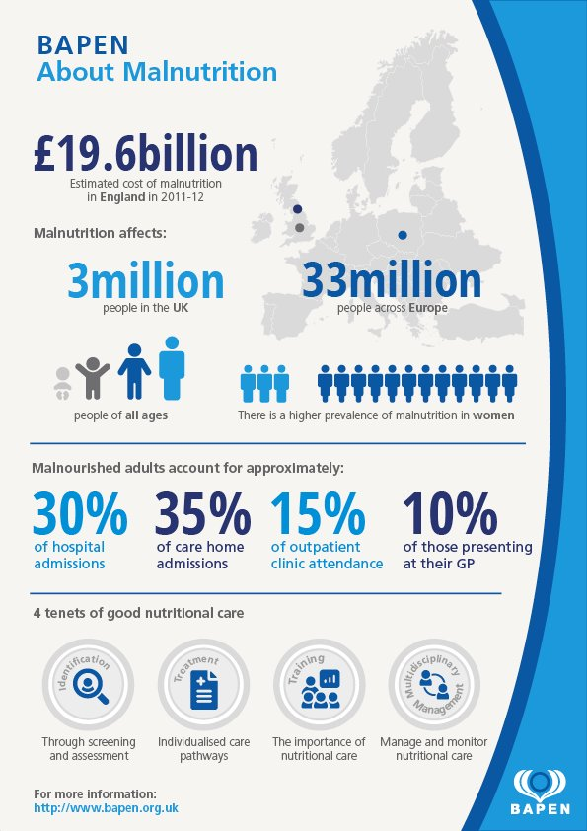
2. Rationale
This research is important because there is increasing awareness of the burden of malnutrition and social isolation in older people in England, especially those who live alone or within supported housing.
Despite interventions such as the NHS “Food First Approach” and the British Association for Parenteral and Enteral Nutrition (BAPEN), there is a widespread prevalence of malnutrition, with millions of people suffering from the condition and avoidable hospital admissions as a result of it, which leads to higher care costs (Menyawi et al. 2025).
Notes:
This research is important because there is increasing awareness of the burden of malnutrition and social isolation in older people in England, especially those who live alone or within supported housing.
Despite interventions such as the NHS “Food First Approach” and the British Association for Parenteral and Enteral Nutrition (BAPEN), there is a widespread prevalence of malnutrition, with millions of people suffering from the condition and avoidable hospital admissions as a result of it, which leads to higher care costs (Menyawi et al. 2025).

Slide 8
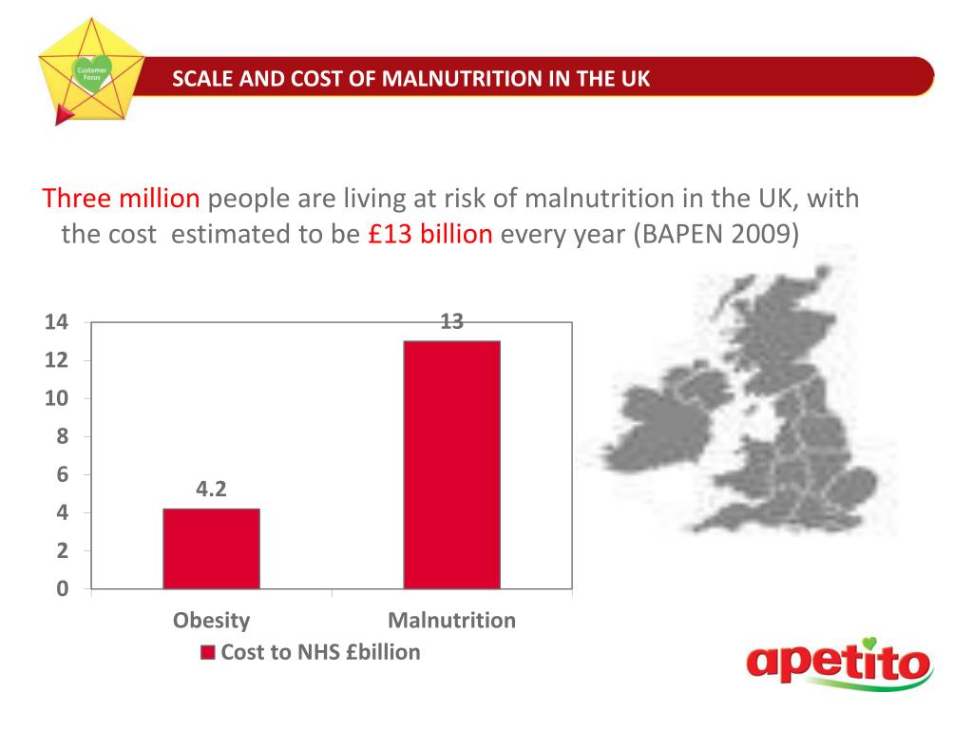
There is a lack of understanding of how nutritional and psychosocial conditions can be addressed together (Douglas, 2024). This study is significant in assessing the nutritional results as well as the Food First Approach's effect on minimising loneliness in elderly care.
Despite interventions such as the NHS “Food First Approach” and the British Association for Parenteral and Enteral Nutrition (BAPEN), there is a widespread prevalence of malnutrition, with millions of people suffering from the condition and avoidable hospital admissions as a result of it, which leads to higher care costs (Menyawi et al. 2025).
Notes:
There is a lack of understanding of how nutritional and psychosocial conditions can be addressed together. This study is significant in assessing the nutritional results as well as the Food First Approach's effect on minimising loneliness in elderly care.
Despite interventions such as the NHS “Food First Approach” and the British Association for Parenteral and Enteral Nutrition (BAPEN), there is a widespread prevalence of malnutrition, with millions of people suffering from the condition and avoidable hospital admissions as a result of it, which leads to higher care costs (Menyawi et al. 2025).

Slide 9
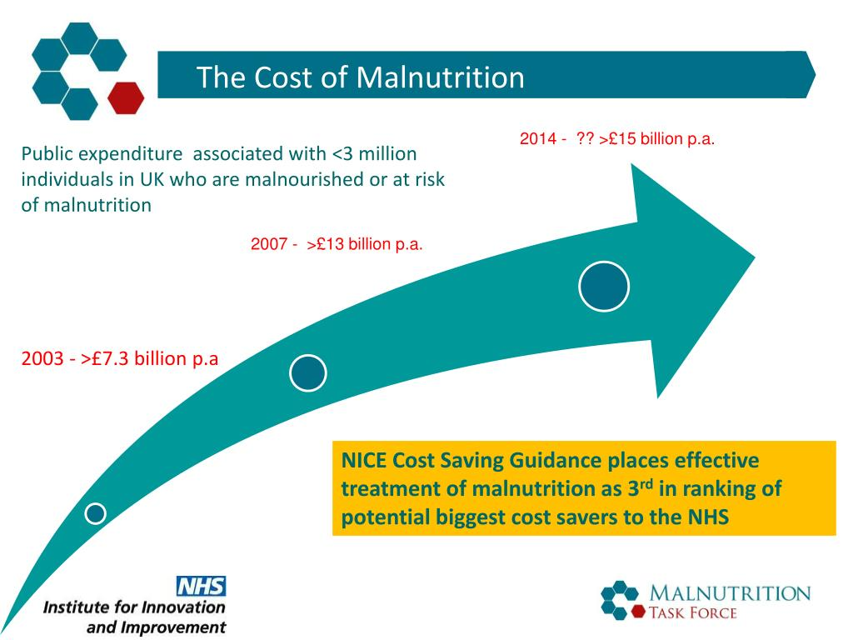
Disability caused by disease-related malnutrition is currently estimated to cost the NHS and social care services approximately 2.9 million people in England, for example. Current policies, including the Care Act 2014 and NHS Long Term Plan (2019), highlight the importance of preventing problems, early help, and asking where health and social care needs can be combined in the community (Marczak et al. 2024).
Notes:
Disability caused by disease-related malnutrition is currently estimated to cost the NHS and social care services approximately 2.9 million people in England, for example. Current policies, including the Care Act 2014 and NHS Long Term Plan (2019), highlight the importance of preventing problems, early help, and asking where health and social care needs can be combined in the community (Marczak et al. 2024).

Slide 10
3. Research Question, Aim and Objectives Research Question
What is the effectiveness of the Food First Approach in the context of malnutrition and social isolation for elderly people (65+) in England who are living by themselves and/or in supported housing?
Aim of the Research
To assess the effectiveness of the Food First Approach to increase nutrition and minimise social isolation amongst the elderly in England, using secondary qualitative research.
Objectives
To explore existing literature on the impact of the Food First Approach on nutritional outcomes in older adults.
To evaluate the effectiveness of the Food First Approach in elderly malnutrition.
To recognise the strengths and weaknesses of existing Food First programmes integrated within health and social care service provision in England.
Research Question
Notes:
Research Question
What is the effectiveness of the Food First Approach in the context of malnutrition and social isolation for elderly people (65+) in England who are living by themselves and/or in supported housing?
Aim of the Research
To assess the effectiveness of the Food First Approach to increase nutrition and minimise social isolation amongst the elderly in England, using secondary qualitative research.
Objectives
To explore existing literature on the impact of the Food First Approach on nutritional outcomes in older adults.
To evaluate the effectiveness of the Food First Approach in elderly malnutrition.
To recognise the strengths and weaknesses of existing Food First programmes integrated within health and social care service provision in England.

Slide 11
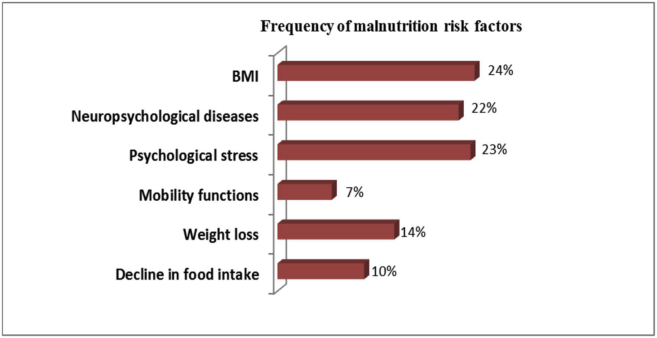
4. Research Impact
The findings of this research will be of importance to older people, health and social care services and policy making in England.
It will increase awareness among the target population of the opportunities to strengthen the understanding of the Food First Approach as a way to boost nutrition intake while reducing social isolation
Thus improving the physical health, emotional wellbeing and quality of life of the older adult living alone or in supported housing (Sen et al. 2025).
Notes:
4. Research Impact
The findings of this research will be of importance to older people, health and social care services and policy making in England.
It will increase awareness among the target population of the opportunities to strengthen the understanding of the Food First Approach as a way to boost nutrition intake while reducing social isolation
Thus improving the physical health, emotional wellbeing and quality of life of the older adult living alone or in supported housing (Sen et al. 2025).

Slide 12
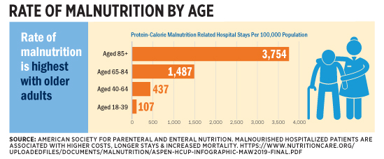
In public health, the results can help inform earlier intervention plans to counteract hospitalisation associated with malnutrition, estimated to impact some 2.9 million individuals in England at present (Basu et al, 2025).
The research will provide social care providers and professionals with evidence, contributing to the strengthening of person-centred care planning, with nutrition and social engagement delivered together.
It can provide an insight into gaps in existing practice to inform improvement in such policies as the implementation of the NHS Long Term Plan and the implementation of the Care Act 2014.
Notes:
In public health, the results can help inform earlier intervention plans to counteract hospitalisation associated with malnutrition, estimated to impact some 2.9 million individuals in England at present.
The research will provide social care providers and professionals with evidence, contributing to the strengthening of person-centred care planning, with nutrition and social engagement delivered together.
It can provide an insight into gaps in existing practice to inform improvement in such policies as the implementation of the NHS Long Term Plan and the implementation of the Care Act 2014.

Slide 13
References
danone.com, 2023. New research finds nearly half a million people admitted to NHS hospitals in England have malnutrition. Available at: https://www.danone.com/gb/en/newsroom/press-releases/new-research-finds-nearly-half-a-million-people-admitted-to-nhs-.html [Accessed on: 11/6/2024]
gov.uk, 2024. United Kingdom Food Security Report 2024: Theme 4: Food Security at Household Level. Available at: https://www.gov.uk/government/statistics/united-kingdom-food-security-report-2024/united-kingdom-food-security-report-2024-theme-4-food-security-at-household-level [Accessed on: 11/6/2024]
Marczak, J., Wistow, G. and Fernandez, J.L., 2024. Ready, willing and able? Local perspectives on implementing prevention in social care in England. The British Journal of Social Work, 54(3), pp.1297-1318.
Menyawi, E.A.I., Bader, A.I.H., Jarwan, N.O.M., Gusti, S.W.A., Alkali, E.A.O. and Alsalem, H.A., 2025. The Impact of Hospital Food Quality on Patient Experience and Satisfaction. Cultura: International Journal of Philosophy of Culture and Axiology, 22(8s), pp.240-260.
Sen, K., Kruse, C.S., Mileski, M. and Ramamonjiarivelo, Z., 2025. Interventions to reduce social isolation and food insecurity in older adults: a systematic review. Frontiers in Nutrition, 12, p.1607057.
Douglas, F., 2024. What qualitative research can tell us about food and nutrition security in the UK and why we should pay attention to what it is telling us. Proceedings of the Nutrition Society, 83(3), pp.170-179.
Basu, B., Das, K. and Palodhi, M., 2025. Impact of malnutrition on public health: A Community-Driven approach. In Dietary supplements and nutraceuticals (pp. 727-793). Singapore: Springer Nature Singapore.
malnutritiontaskforce.org.uk . (2025). Malnutrition in England factsheet. Available at: https://www.malnutritiontaskforce.org.uk/malnutrition-england-factsheet [Accessed on: 11/6/2024]
malnutritionandfoodfirst.rdash.nhs.uk. (2026). Food First Information for patients, relatives and carers. Available at: https://malnutritionandfoodfirst.rdash.nhs.uk/wp-content/uploads/2021/05/DP8201-Food-First-leaflet-02.21.pdf [Accessed on: 11/6/2024]

