Slide 1

Student Name: Hana Kiros
Student Number: 2316483
Psychopathological Classifications and Provisions (BMHP6029_BIRM)
Component 1
Feeding or eating disorders
6B80 Anorexia Nervosa
Lecturer Name: Kennedy Obohwemu

Slide 2





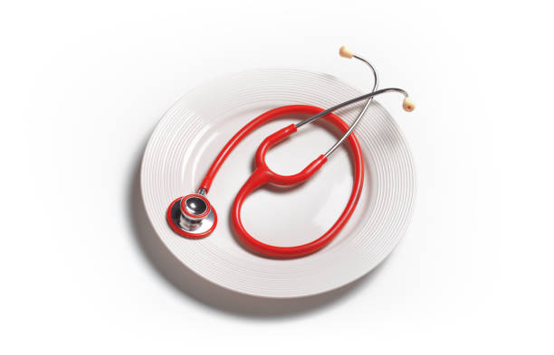


Feeding or eating disorders
6B80 Anorexia Nervosa
Statistics
Approximately 1 to 2 per cent of women and 0.3 per cent of men become victims of anorexia nervosa, first presenting itself in the age range of 15-19. It is the deadliest mental health disease in that it has a mortality rate of 510 per cent, with approximately 510 per percent being medical and the remainder being suicide. In the United Kingdom, anorexia nervosa contributes to approximately 10 per cent of eating disorder victims, 1.25 million. It is despite this that less than 40% of patients receive specialised care, which means that it has severe gaps in support services and access.
Political, Cultural, and Social Factors
Levine and Murnen (2009) assert that cultural ideals of thinness, which are perpetuated by the media and social media, continue to worsen eating disorders and body dissatisfaction among young women and gender nonconforming groups.Socioeconomic inequalities affect access to specialised care, and often, people cannot seek help because mental illness is stigmatised (Beat, 2023). Despite the fact that geographical discrepancies still remain, political policy frameworks such as the Eating Disorder Access and Waiting Time Standard (NHS England, 2020) aimed at reducing them.
Overview
Anorexia nervosa (AN) is classified as a type of eating disorder under code 6B80 in the International Classification of Diseases 11th Revision (ICD-11). It is marked by a distorted view of one's body, an intense fear of gaining weight, and eating very little food (WHO, 2022). The diagnostic features and issues identified by the DSM-5 (APA, 2013) and the ICD-11 are relatively similar, yet the ICD-11 requirements, which are focused on the psychological, behavioural and physiological inadvertencies, are given centre stage in this poster.
Current View and Treatment
Currently, AN has been recognised as a complex biopsychosocial condition. Treatment has been replaced by multidisciplinary care that involves family-based therapies, dietary rehabilitation, and psychological therapy (NICE, 2017). Maudsley Family Therapy and Cognitive Behavioural Therapy-Enhanced (CBT-E) have been considered the best practices. The rates of relapse are up to 30 per cent, and mortality rates remain among the highest of all mental diseases regardless of improvements (Treasure et al., 2020).
Critical Assessment
The medical system and patriarchal authority over treatments were reflected in the past; contemporary approaches are more concerned with autonomy and holistic curing in the patients. Nevertheless, institutional underinvestment, a lack of intersectionality, and a digital effect are still obstacles. One can interpret the ways in which the harm is reinforced through marginalisation and societal norms through a feminist and culturally aware perspective.
Historical Background
Early Anorexia Nervosa theories were medically recorded first in the 19th century by Sir William Gull and Ernest-Charles Lasègue, and embodied patriarchal and moral conceptions and perceived the disorder as hysteria or wilful behaviour in women (Brumberg, 2000). Forced feeding and seclusion were common in the institutional treatments in early 20 th century that proved to be uninformed and heavily biased towards gender (Vandereycken, 2011).
Conclusion and Suggestions
Future legislation should Include gender-inclusive and culturally competent care.
Increase funding of sociocultural and neurobiological research.
Design services to incorporate the lived experience point of view.
Medical and social, political reform is needed to deal with anorexia nervosa;
rehabilitation should be interpreted as both social and cultural besides therapeutic.

Slide 3
References
APA (2013) Diagnostic and Statistical Manual of Mental Disorders (5th ed.). Washington, DC: APA.
Arcelus, J. et al. (2011) ‘Mortality rates in patients with anorexia nervosa and other eating disorders: A meta-analysis of 36 studies’, Archives of General Psychiatry, 68(7), pp. 724–731.
Beat (2023) Eating Disorder Statistics. Beat Eating Disorders.
Brumberg, J. (2000) Fasting Girls: The History of Anorexia Nervosa. Harvard University Press.
Beat (2023) Eating Disorder Statistics. Available at: https://www.beateatingdisorders.org.uk (Accessed: 7 October 2025).
Levine, M. & Murnen, S. (2009) ‘Everybody knows that mass media are/are not [pick one] a cause of eating disorders’, Journal of Social and Clinical Psychology, 28(1), pp. 9–42.
NHS England (2020) Access and Waiting Time Standard for Children and Young People with an Eating Disorder.
NICE (2017) Eating Disorders: Recognition and Treatment (NG69).
Treasure, J. et al. (2020) ‘Anorexia Nervosa: A Clinical Review’, European Journal of Psychiatry, 35(3), pp. 173–182.
Vandereycken, W. (2011) ‘History of Anorexia Nervosa and Bulimia Nervosa’, Current Opinion in Psychiatry, 24(6), pp. 561–565.
WHO (2022) International Classification of Diseases, 11th Revision (ICD-11). Geneva: World Health Organization.
https://www.gettyimages.co.uk/search/2/image?phrase=anorexia+nervosa/

