Slide 1
Critical Thinking in Health and Social Care
Module Title: Professional Development within Health and Social Care
Module Code: LCHS4009
Student Name: Akua Oforiwaa Mfum
Student ID: 2509126
Lecturer's Name: Mr Tola Odugbesan

Slide 2
Introduction
Akua Oforiwaa Mfum a woman with empathy who really enjoy solving problems and helping people get what they need. and my presentation is on critical thinking in health and social care.
I chose this course because I want to gain the information, beliefs, and practical skills required to successfully support individuals in health and social care environments.
This presentation will highlight the importance of critical thinking in professional practice and demonstrate its practical application in health and social care settings.

Slide 3
What is Critical Thinking?
Critical thinking entails thoroughly examining information rather than accepting it immediately.
It entails challenging ideas, evaluating facts, and making informed judgements.
It enables professionals to make accurate judgements and respond properly in everyday health and social care practice (Aveyard, Sharp, and Woolliams, 2015).

Slide 4
Importance of Critical Thinking in Professional Practice
Critical thinking is necessary in health and social care because professionals frequently operate in difficult settings where information is partial, confusing, or contradictory.
It promotes safe and effective practice by assisting professionals in evaluating evidence, identifying risks, and making informed decisions.
It enhances person-centred care by allowing practitioners to prioritise individual needs, values, and results when making decisions.
Not thinking critically can lead to,medication error, misdiagnosis and communication errors.
As a result, critical thinking can enhance treatment quality, foster greater cooperation, and lead to improved results for service users (Sarbani et al., 2022).

Slide 5
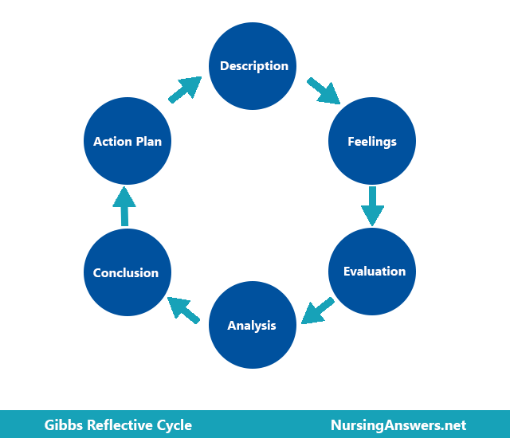
Model Linked to Critical Thinking: Gibbs’ Reflective Cycle
Gibbs' Reflective Cycle is a valuable paradigm for understanding critical thinking.
Gibbs created this technique to assist individuals learn from experience in an organised manner.
The process has six stages: description, feelings, assessment or evaluation, analysis, conclusion, and action plan.
This concept promotes critical thinking by encouraging professionals to thoroughly study events, learn from failures, and improve their future practices (Gibbs, 1988).

Slide 6
Applying Critical Thinking in Practice
A practical example may be seen at a residential care home, where a care assistant assists older persons with everyday activities.
If a resident seems confused and has an unexplained bruise, the professional should avoid making assumptions and instead consider potential hazards and safeguarding issues (Hillingdon Safeguarding Partnership, 2020).
The care assistant would observe the issue, review care records, communicate with the resident and coworkers, and adhere to reporting rules.
Critical thinking improves safety, decision-making, and protects residents from danger.

Slide 7
How Critical thinking is useful to my future career as healthcare worker.
critical thinking makes one saver and more confident in a high stake moment.
critical thinking reduced errors.
Reduce stress and prevent burnout through reflective practice.

Slide 8
Conclusion
Critical thinking is essential in health and social care to ensure safe, informed, and person-centred practice.
It enables professionals to thoroughly examine circumstances, make smart judgements, and enhance the quality of care they deliver.
Using models like Gibbs' Reflective Cycle can help practitioners learn from their experiences and enhance their future work (Bulman and Schutz, 2014).

Slide 9
References
Aveyard, H., Sharp, P. and Woolliams, M. (2015) A beginner’s guide to critical thinking and writing in health and social care. 2nd edn. Maidenhead: Open University Press.
Bulman, C. and Schutz, S. (2014) Reflective practice in nursing. 5th edn. Chichester: Wiley-Blackwell.
Gibbs, G. (1988) Learning by doing: A guide to teaching and learning methods. Oxford: Oxford Polytechnic.
Hillingdon Safeguarding Partnership (2020) 7-minute briefing: Critical thinking. Available at: https://hillingdonsafeguardingpartnership.org.uk/wp-content/uploads/2020/10/7-Minute-Briefing-Critical-thinking.pdf
Scott, I.A., Hubbard, R.E., Crock, C., Campbell, T. and Perera, M. (2021) ‘Developing critical thinking skills for delivering optimal care’, Internal Medicine Journal, 51(4), pp. 488–493. doi: 10.1111/imj.15272

