Slide 1
Strategies for Effective Communication in a Business Setting
Students:
Maria Graur 2024766
Adriana Vicol 2026785
Maria Prigoana 2028868
Florina-Catalina Asaftei 2026200
Group presentation

Slide 2
Introduction
The presentation will encompass the concept of effective communication and its relationship with the system of business processing.
The discussion will take place in the context of Tesco to understand the effectiveness of business communication.
The identification of the stakeholders and channels will also be there.
The identification of the stakeholders and channels of the organization will help to figure out the impacts of communication in the maintenance of relationship between the organisation and the stakeholders.
The effectiveness of communication and the barriers will be figured out to understand the entire process of communication.
Notes:
The aim of this presentation is to delineate the concept of business communication for the development of a business. The idea of effective communication, the implementation of the theory and model of communication will be followed in this presentation. The overall discussion will take place in the context of Tesco and the effectiveness's and barriers of communication will be followed by the terms of communication channels. The executed channels of the organisation for maintaining proper relationship with the stakeholders and also the area of betterment and development will be the area of discussion in this presentation.

Slide 3
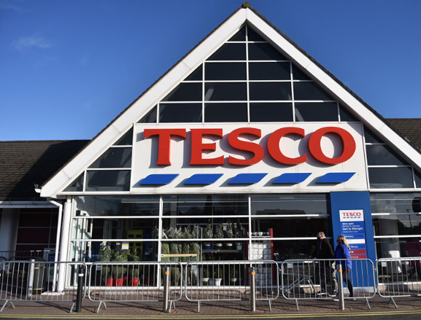
About the company
Tesco is one of the leading retailing organizations of the U.K. and it is headquartered in London.
It is a British multinational organisation and has different productivity areas like Supermarket, Hypermarket, Superstore and Convenience shop.
The revenue of the company is £64.760 billion and the workforce is 423,092.
Tesco provides the experiences of an entire range of shopping under the same roof in its retails stores.
Notes:
The retail industry of the UK is replete with several retailing organisations and Tesco is one of the leading brands. It is the multinational organisation that is headquartered in London and provides a range of products and services. The company has 423,092 employees and revenue is £64.760 billion. The main consideration of the organisation is to provide a wide range of services to the customers under the same roof.

Slide 4
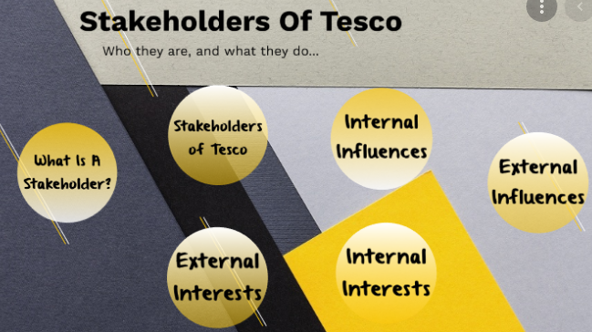
Stakeholders of Tesco
Stakeholders are important for looking into the system of business operations and also to rely on the ability of the stakeholders.
The external stakeholders of the organisation are customers, pressure groups, local communities, creditors, suppliers, competitors and the government.
The main internal stakeholders are managers, employees, shareholders and board and executive committee.
The internal stakeholders impact the system of business operations by focussing the system of several activities.
Notes:
Both internal and external stakeholders are maintaining the balance of the business of Tesco. The customers and the local communities and also the respective Government and the suppliers are the external stakeholders that maintain the business relationships. Employees, shareholders and managers are related to the process of providing proper services to the external stakeholders. The management of relationships and the practices of manufacturing and distribution are controlled by the external stakeholders.

Slide 5

Models of communication
The implementation of communication theories and its compatibility with the communication model are necessary to look into the system of organisation of betterment.
Tesco executes the Cognitive Dissonance Theory by following the transactional model of communication.
This theory helps to avoid the experience of dissonance by understanding the situation.
The process of cognitive dissonance relates to the model of transactional communication that ultimately leads to the alteration of attitudes by restoring the balance.
Notes:
The cognitive dissonance theory is implemented by Tesco to avoid any kinds of conflicts in the workplace and to maintain proper relationship with the stakeholders. The transactional model of communication is closely related to the experience of cognitive dissonance theory and the company is able to proceed with smooth development(Van Ruler, 2018).

Slide 6
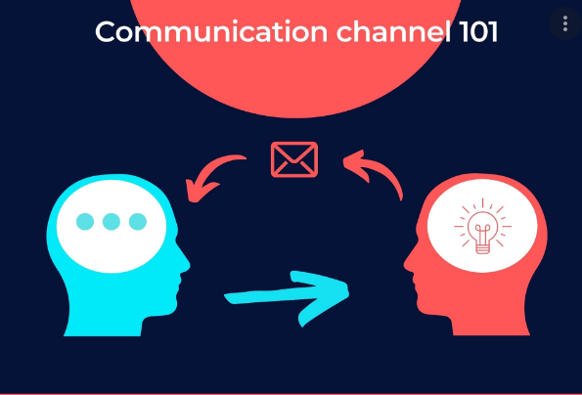
Communication channels of Tesco
The process of developing business operations is related to the determination of communication channels.
Both direct and indirect channels are used by Tesco to look into the process of maintaining relationships with the stakeholders.
The communication channels that are executed by Tesco for looking into the system of organisational process are Face-to-face communication, virtual communication, telephonic conversation etc.
Notes:
Tesco implements the process of both direct and indirect channels of communication to build a relationship with the stakeholders. Face to face communication, virtual communication and also the process of indirect communication through digital media are followed by the organisation to carry out the business properly. The indirect channels of communication are different kinds of emails, text messages, online messaging platforms and social media(Lasater, 2019).

Slide 7

Barriers of effective communication
The stakeholders of Tesco are related to the terms of the development of the business and one of the significant barriers is dissatisfaction with the job.
The absence of the practice of active listening also leads to the problems of developing proper communication.
Differences in the styles of communication also create a gap between the stakeholders and authority in some cases.
Several conflicts in the workplace are responsible for the communication problem with the internal stakeholders.
Notes:
The implementation of effective communication is necessary for maintaining the smooth process of business in an organisation. Different kinds of barriers are also discernible in the operations of Tesco and that are detrimental for the development of business. The destruction of the stakeholders with the policies of the organisation, lack of active listening, several styles of communication and organisational conflicts are the reasons behind the barriers of effective communication. Both the internal and external stakeholders need to have effective communication with the authority to avoid the possibilities of any type of confusions and workplace conflicts. The removal of the barriers can be done by the following process of communication channels (Al-Kinani, et al, 2018).

Slide 8

Channels to improve communication
Tesco has the provision of developing different kinds of communication channels to look for further development.
One of the significant and foremost ways of communication channel for business is digital communication that spreads information rapidly.
The improvement of the business will also be easier with the execution of written communication to serve the official purposes properly.
Informal communication channels are also suggested for some situations to address various issues quickly.
Notes:
The barriers of communication in Tesco can be resolved by the implementation of different kinds of innovative communication channels. The company has a provision of executing digital processes of communication in a more engaged way to save time. Digital communication helps in the process of spelling necessary information in a quick way which is necessary for the improvement of the business. According to the necessity of the situation, the implementation of informal communication is also important to address different kinds of workplace issues.

Slide 9
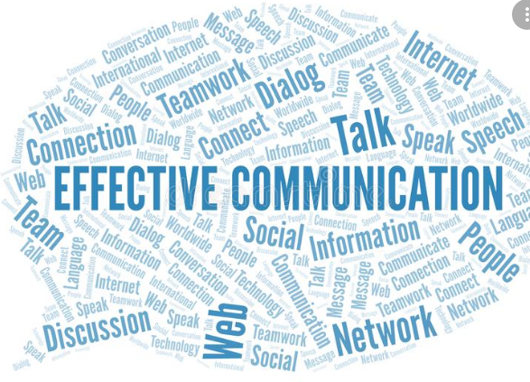
Impact of effective communication
The process of building trust between the stakeholders and the authority of the organisation becomes easier with the process of effective communication.
It also resolves different kinds of workplace problems by preventing the potential of conflicts.
The creation of better relationships and also the system of increasing engagement are also related to the process of developing productivity.
It also promotes the process of team building to increase the working efficiencies.
Notes:
Effective communication is beneficial for the development and improvement of an organisation. The stakeholders of Tesco are closely related to the authority of the organisation by building proper trust through two way communications. The maintenance of relationships and also the promotion of team building are followed by this. The process of removing several workplace conflicts and also the development of productivity are done through this(Radovic Markovic, et al, 2018).

Slide 10
Conclusion
The presentation helps in the process of understanding the effectiveness of communication in a business processing.
The example of Tesco helps to understand the coordination between theory and model of communication.
The effectiveness and barriers of communication are also related to the term of further improvement.
The provision of further development will be related to the terms of improving the communication channels.
Notes:
The presentation is done in the context of Tesco to carry out the concept of business communication and its effectiveness. The internal and external stakeholders of Tesco are related to the process of developing communication with the management to look for the development. The accumulation of the communication theory and model by Tesco helps to provide proper services to the customers. Different kinds of barriers are also found in lack of coordination that can be followed by the suggested area of improving the communication channels. Several effectiveness of communication are also found from the discussion that are also effective for the betterment of the organisation.

Slide 11
References
Al-Kinani, A., Wang, C.X., Zhou, L. and Zhang, W., 2018. Optical wireless communication channel measurements and models. IEEE Communications Surveys & Tutorials, 20(3), pp.1939-1962.
Lasater, I., 2019. Words that work in business: A practical guide to effective communication in the workplace. PuddleDancer Press.
Radovic Markovic, M. and Salamzadeh, A., 2018. The importance of communication in business management. In Radovic Markovic, M., & Salamzadeh, A.(2018). The Importance of Communication in Business Management, The 7th International Scientific Conference on Employment, Education and Entrepreneurship, Belgrade, Serbia.
Van Ruler, B., 2018. Communication theory: An underrated pillar on which strategic communication rests. International Journal of Strategic Communication, 12(4), pp.367-381.

