Slide 1
Object Analysis
By Eleanor Woolston

Slide 2
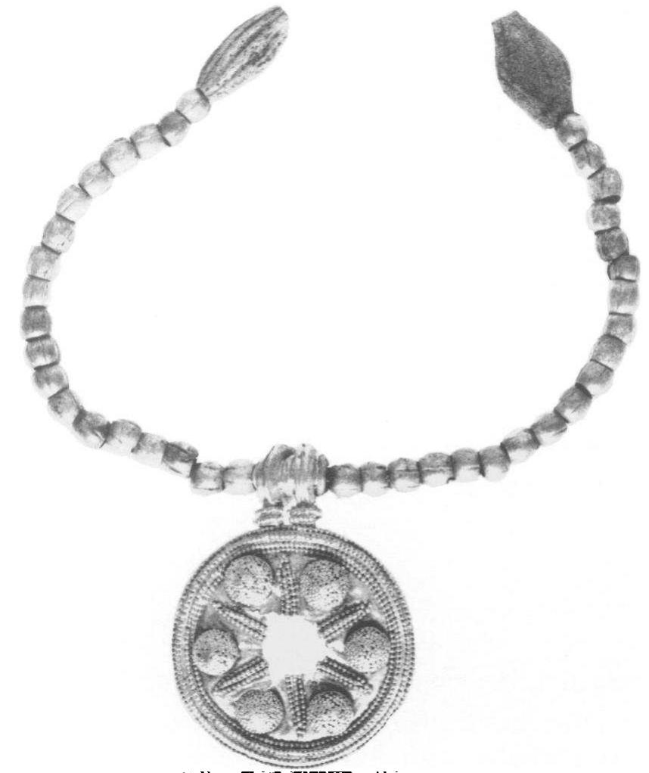
1 – Object & Description
Gold necklace with gold pendant
From Babylonia
Made circa. 2000 BC
Found in 10th century burial in Lefkandi (Euboea, Greece)
Possible string/rope to tie both ends together here?
Missing centrepiece – jewel/bright stone?
Academia.edu - A necklace found in a 10th-century B.C. burial at Lefkandi, Greece (photo: Mervyn Popham)

Slide 3
2 – Where was it found?
Found in Early Iron Age – 10th century BC – burial at Lefkandi
Lived in Greece?
Wealthy female burial:
  Gold pectoral & gold breast plates
  Bronze and iron gilt pins (used in sewing & crafting)
  Iron knife with ivory handle by her head
Double burial with wealthy male (cremation) and horses
  These were inside a chieftain's house (destroyed and covered)

Slide 4
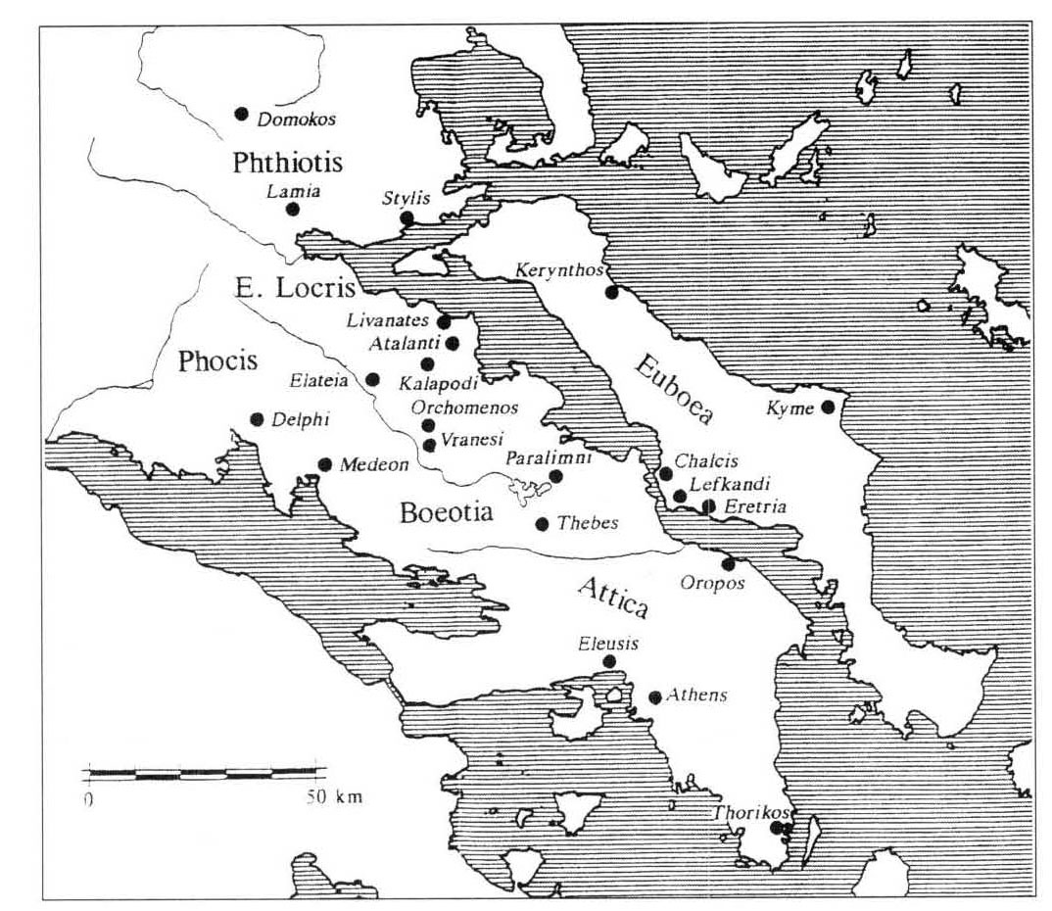
2 – Where was it found? (cont’d)
Located between Chalcis & Eretria
Was occupied from the Early Bronze Age (c. 2100 BC) to the end of the Iron Age (c. 700 BC)
https://www.classics.ox.ac.uk/lefkandi

Slide 5
4 – My theory
Socialised through people
  Handed down through family
  Buried with mother – possibly passed from mother to daughter
  Show status as wife of chieftain?
Agency
  Made from gold – possible enemies
  Given as a gift from husband to wife?
Other things found in burial
  Lots of gold & ivory – wealthy
  Gold pectoral/breast plates – wanting to be protected
  Iron knife with ivory handle – protection

Slide 6
5 – In conclusion
Gold necklace with gold pendant from Babylonia made c. 2000 BC
Life history – possibly used for status and symbol of wealth
Buried alongside body and other gold breastplates and ivory knife
Double burial with wealthy male – presumably husband – in chieftain’s house
May have been passed through family and given to wife from husband

