Slide 1
_{What is a Stakeholder?}

Slide 2
Stakeholder Theory - Basic Concepts &Definitions
“…any group or individual who can affect or is affected by the achievement of an organisation’s objectives.”
(Freeman, 1984)
There may be conflict between the expectations of different groups of stakeholders.

Slide 3
Edward Freeman’s stakeholder theory holds that a company’s stakeholders include just about anyone affected by the company and its workings. That view is in opposition to the long-held shareholder theory proposed by economist Milton Friedman that in capitalism, the only stakeholders a company should care about are its shareholders - and thus, its bottom line. Friedman’s view is that companies are compelled to make a profit, to satisfy their shareholders, and to continue positive growth.

Slide 4
Traditional View
Adam Smith’s The Wealth of Nations (1776) provided the basis for capitalism by focusing on specialisation and factors of production.
The general assumption is that organisations seek to maximise profit for their shareholders.

Slide 5
Alternative View
The alternative theory is that organisations seek to serve the interests of all its shareholders and owners.
Freeman (1984) defined stakeholders as being individuals or groups that affect or are affected by the achievement of an organisation’s objectives.

Slide 6
Definitions of stakeholders
Stakeholders
  Those who are affected by and affect the actions of a firm.
  These can be identified as internal or external stakeholders.
Primary Stakeholders
  Those who have a formal, official or contractual relationship with a firm e.g., stockholders, strategic customers, employees, communities, governmental agencies, …
Secondary Stakeholders
  All other stakeholders e.g. environmentalists, media, trade associations…

Slide 7
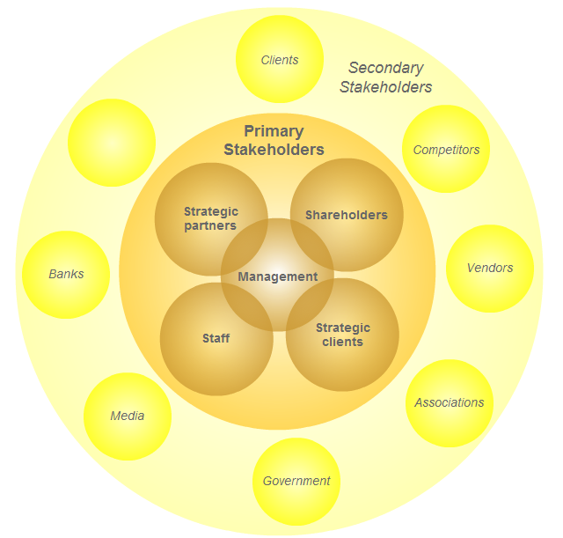
Stakeholders

Slide 8
Stakeholder Videos
https://www.youtube.com/watch?v=bIRUaLcvPe8
https://www.youtube.com/watch?v=_sNKIEzYM7M

Slide 10
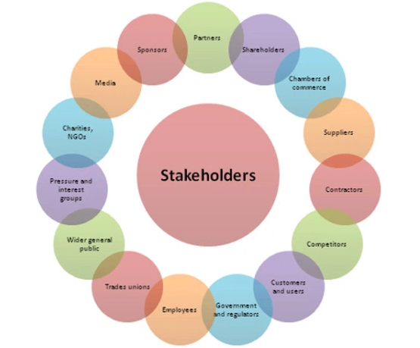

Slide 11
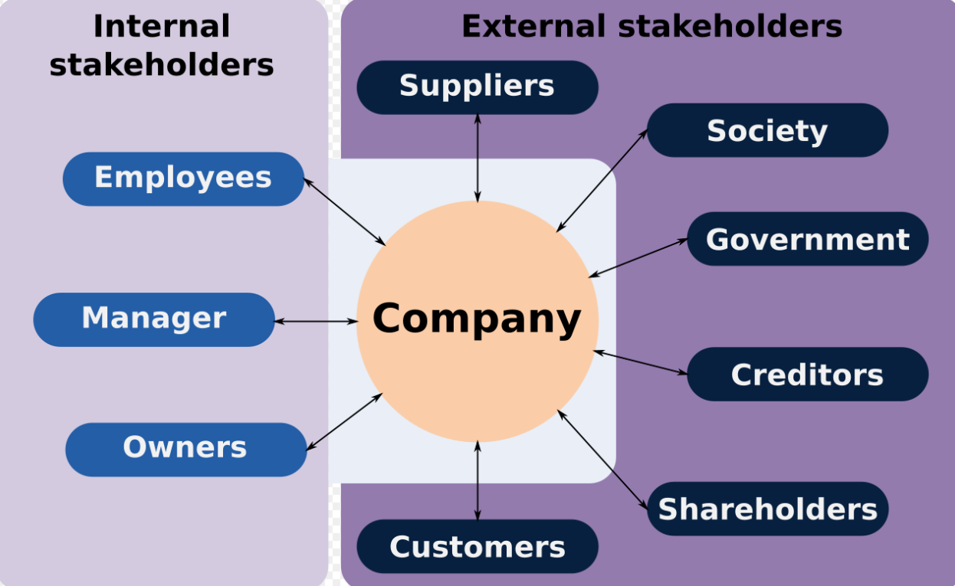

Slide 12
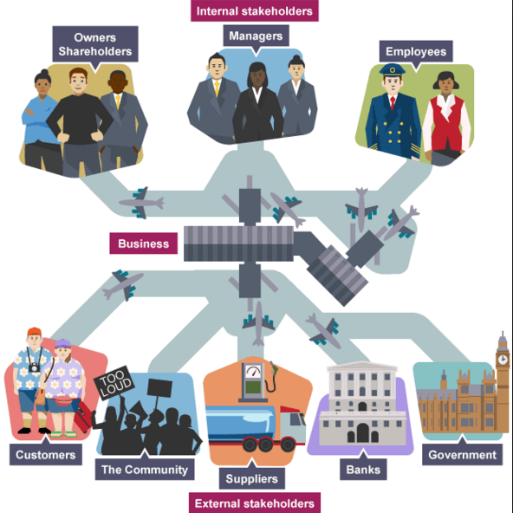
ddsf
Notes:
Internal Stakeholders
Internal stakeholders are intimately associated to the organisation and their objectives are likely to have a strong influence on how it is run.
The main two examples of internal stakeholders are:
Employees
Management
Connected Stakeholders
Connected stakeholders can be viewed as having a contractual relationship with the organisation.
The objective of satisfying the shareholders needs to be fulfilled, however, customers and finance objectives must be met if the company is to succeed.
Some examples of connected stakeholders may include:
Shareholders – interested in shareholders’ wealth measured by profitability, P/E ratios, market capitalisation
Response risk if interests are not recognised
Sell shares (e.g. to predator) or vote against management (e.g. at AGM)
Customers – interested in the company’s products
Response risk if interests are not recognised
Buy elsewhere
Damage reputation (e.g. bad publicity)
Legal action
Suppliers – interested in building long term relationship, on time payment of goods and profitable sales
Response risk if interests are not recognised
Refusal of credit
Stop supplying
Legal action (e.g. for unpaid debts)
Finance providers - like banks interested in loan security
Response risk if interests are not recognised
Denial of credit
Higher interest charges
External Stakeholders
External stakeholders have quite diverse objectives and have varying ability to ensure that the organisation meets its objectives.
Some examples of external stakeholders may include:
Non-governmental organisations
Interests to defend
Human rights
Response risk if interests are not recognised
Legal action
Environmental pressure groups
Interests to defend
Protecting the environment
Human rights
Response risk if interests are not recognised
Publicity
Direct action
Sabotage
Pressure on government
Government and regulatory agencies – interested in tax, compliance with legislation and employment opportunities
Response risk if interests are not recognised
Tax increases
Regulation
Legal action
Tariffs
Trade unions – interested in protecting their members.
Response risk if interests are not recognised
Legal action
Direct action

Slide 13
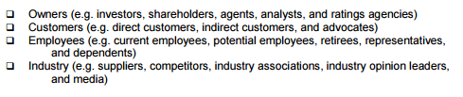
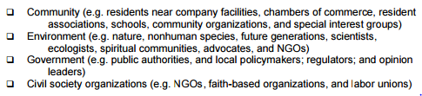
Types of Stakeholders

Slide 14
Stakeholder Characteristics
Owners and Shareholders
The number of owners and the roles they carry out differ according to the size of the firm
In small businesses there may be only one owner (sole trader) or perhaps a small number of partners (partnership)
In large firms there are often thousands of shareholders, who each own a small part of the business

Slide 15
Stakeholder Characteristics
Employees:
A business needs employees to carry out its activities
Employees agree to work a certain number of hours in return for a wage or salary.
Employees have invested their time and effort into the organisation.
Employees want the organisation to survive and thrive.
Notes:
Employees can be of many kinds, some of which are: management and executives; laboratory, factory and warehouse workers; office staff; sales and servicing staff; and transport staff. They may be concentrated in one building or scattered like ships’ crews, airline personnel, chain-store sales assistants or field-salesmen and servicemen. They may represent many different salary, wage, social and ethnic groups.

Slide 16
Stakeholder Characteristics
Customers:
Customers buy the goods or services produced by firms
They may be individuals (B2C) or other businesses (B2B)
Firms must understand and meet the needs of their customers, otherwise they will fail to make a profit or, indeed, survive

Slide 17
Stakeholder Characteristics
Suppliers
Firms source the resources required to produce goods and services from suppliers.
Businesses attempt to have effective relationships with suppliers in order to get quality resources on time & at reasonable prices.
This is a two-way process, as suppliers depend on the firms they supply
Notes:
Suppliers can be of two kinds, those who supply services such as water and energy, and those who supply raw materials, components, packaging and professional services.

Slide 18
Stakeholder Characteristics
Community
Companies and the communities they exist in are also in a two-way relationship
  The local community may often provide many of the firm’s staff and customers
  The business often supplies goods and services vital to the local area
  But at times the community can feel aggrieved by some aspects of what a firm does

Slide 19
Stakeholder Characteristics
The Central & Local Government & It’s Agencies:
Economic policies affect firms’ costs (through taxation and interest rates)
Legislation regulates what business can do in areas such as the environment and occupational safety and health.
The Police, Licensing Authority, Environmental Agency, DHSS.
Successful firms are good for governments as they create wealth and employment.

Slide 20
Stakeholder Characteristics
The Financial Publics
Local Bank.
Stock Exchange - investors will consist not only of personal buyers of securities but also of investment analysts (who advise on share buying) and big share buyers.
Willingness to buy shares, or invest in new issues, will depend on what is known about the company’s background, performance and prospects. A fall in share price could invite a take-over bid.

Slide 21
Effective Stakeholder Management
Five core questions an organisation needs to consider:
Who are our stakeholders?
What impact do they/ can they have on the organisation- increase profit, improve customer satisfaction, damage the brand/organisation name.

Slide 22
Continued
What opportunities or threats do stakeholders bring?
What responsibilities do they have to the stakeholder- economic, legal, ethical.
What strategies or actions should an organisation follow to ensure they manage stakeholders expectations

Slide 23
Stakeholder Analysis Model
Mendelow(1991) proposed a model that ranks stakeholders according to power and interest.
https://www.youtube.com/watch?v=4RvS-tWjVQs
https://www.youtube.com/watch?v=bOIT1GKVMd8

Slide 24
Stakeholder identification
Colour Code stakeholders identified:
  Green – Supporters & Advocates (public supporter)
  Red – Blockers and critics

Slide 25
Power/Interest Matrix
Stakeholders fall into 4 categories:
minimal effort - where both interest and power is low;
keep informed - where interest is high but power is low;
key players - where both interest and power is high;
keep satisfied - interest is low but power is high.

Slide 26
Power/Interest Matrix
(adapted, Mendelow (1991))
Level of Interest
Low
High
A
Minimal Effort
B
Keep Informed
Low
Power
C
Keep Satisfied
D
Key Players
High

Slide 27
Alternative View (adapted, Mandelow (1991))
Level of Interest
Low
High
Minimal effort – Their lack of interest and power makes them open to influence. More than likely to accept what they are told and follow instructions.
Keep informed – These stakeholders are interested in the strategy but lack in the power to do anything.
Keep satisfied – The key here is to keep these stakeholders satisfied to stop them moving to box D (key players). This could involve reassuring them of the outcomes of the strategy well in advance.
Key players – These stakeholders are the major drivers of change and could stop management plans if not satisfied. Management, therefore, needs to communicate plans to them and discuss implementation issues.
A
Minimal Effort
Stakeholders have low power and low interest.
B
Keep Informed
Stakeholders have low power and high interest.
Low
Power
C
Keep Satisfied
Stakeholders have high power and low interest.
D
Key Players
Stakeholders have high power and high interest.
High

Slide 28
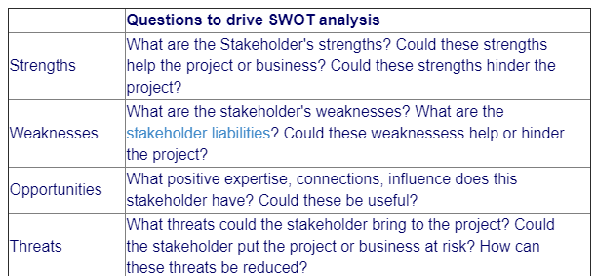
Using SWOT As A Stakeholder Tool

