Slide 1
Research Methods
ACDA5012
Lecture 2
Effective Referencing

Slide 2
Using references
The steps to avoid mistakes and hours spent chasing references at the end of the dissertation are simple and obvious, yet often ignored.
Always keep notes tidy and file them systematically
Understand what information you need to include in a bibliography and always put a full bibliographical reference on every note taken
  Include the page numbers of the reference
  Keep a card index of all references.

Slide 3
Using references
If you copy a quotation into your notes for later use in your dissertation be sure to do so fully and without abbreviations
  You can always abbreviate later
  Check the quote thoroughly to make sure that you have not misrepresented the author's views
  Remember to record the specific page number(s) the quote comes from

Slide 4
Using references
Be particularly careful when you copy statistical tables
  Set them out neatly in the notes and check every figure
If you are doing any statistical calculations, be particularly careful to set out the worksheets tidily and with plenty of spaces
  Check all calculations when you first make them
Do not over-use direct quotes from authors and always discuss quotes that you do use
Take time to clearly structure your review
  Coherent and logical sequence of sub headings
  Suitable summaries

Slide 5
Critical analysis
Students often fail to be analytical or evaluative and try to compensate with a greater amount of information instead
  Quantity is no substitute for quality of analysis.
The review should not be a simple recitation or list of what other authors have written
  Link ideas
  Compare and contrast the material
  Look for trends or themes
Literature cited must be up-to-date

Slide 6
Critical literature reviews should…
Refer to & assess research by recognised experts in the chosen topic area
Consider & discuss research that supports and opposes your idea
Make reasoned judgements regarding the value of others’ research, showing clearly how it relates to your research
Justify your arguments with valid evidence in a logical manner
Distinguish clearly between fact and opinion

Slide 7
Citation
Defined as:
  the acknowledgement of information obtained from a document you have read or the act of quoting text
Done by providing the reference to the source of the material
The reference allows the reader to find the original source

Slide 8
Why Referencing?
To support your statements and arguments
To give credit for your sources
  Would you like people to use your ideas without saying where they got them from?
  It is theft to use other peoples ideas as your own!
To demonstrate your academic research

Slide 9
Secondary Referencing
If, for some reason you have not been able to read or locate the original source, and you reference the source to the book you found the information in, it is termed as secondary referencing.
Should not normally be used in Masters or higher level work, and used sparingly at Undergraduate
Always use the original document if at all possible – inter-library loans and online sources help

Slide 10
When and Where?
Every time you use someone else’s ideas or words or illustrations, even if you change them a bit!
When you copy some lines of programme code
Whenever you make an assertion you need to justify your statements

Slide 11
Why?
To provide the academic credibility for your work
To reassure the reader that your work is not a fairy story that you have created

Slide 12
Plagiarism
This is the term used to describe the use of another author’s work in your own study (either intentionally or unintentionally) without acknowledging that it is not your own, or giving the other author the credit for it
This is a specific academic misconduct
For full details see the University website

Slide 13
Turnitin and Plagiarism
The Turnitin software assesses any submitted work against prior items in its database
  20+ billion web pages
  220+ million student papers – including work already submitted for that assignment
  90,000+ publications
If your work scores more than 15% similarity to any combination of the items, we investigate further
Cited quotations don’t count
Poor citation and referencing is plagiarism
  Don’t care if it is accident, incompetence or crime

Slide 14
Turnitin
The University uses software called Turnitin to check assessments for unfair practice
Turnitin* checks each submitted piece of work against
  20+ billion web pages
  220+ million student papers – including work already submitted for that assignment
  90,000+ publications
It then generates a report that highlights any sections that appear as if they may have been copied
* http://submit.ac.uk/en_gb/home

Slide 15
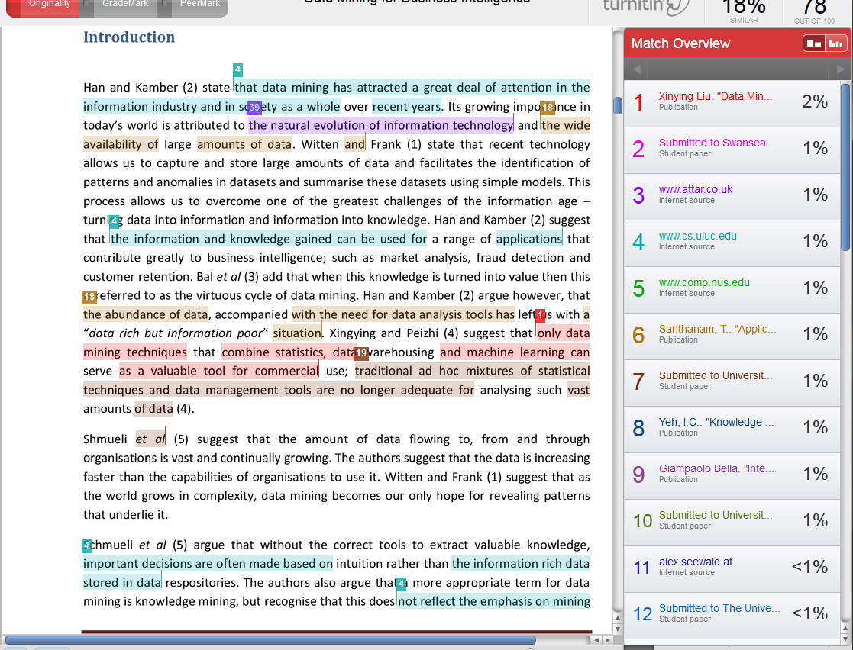

Slide 16
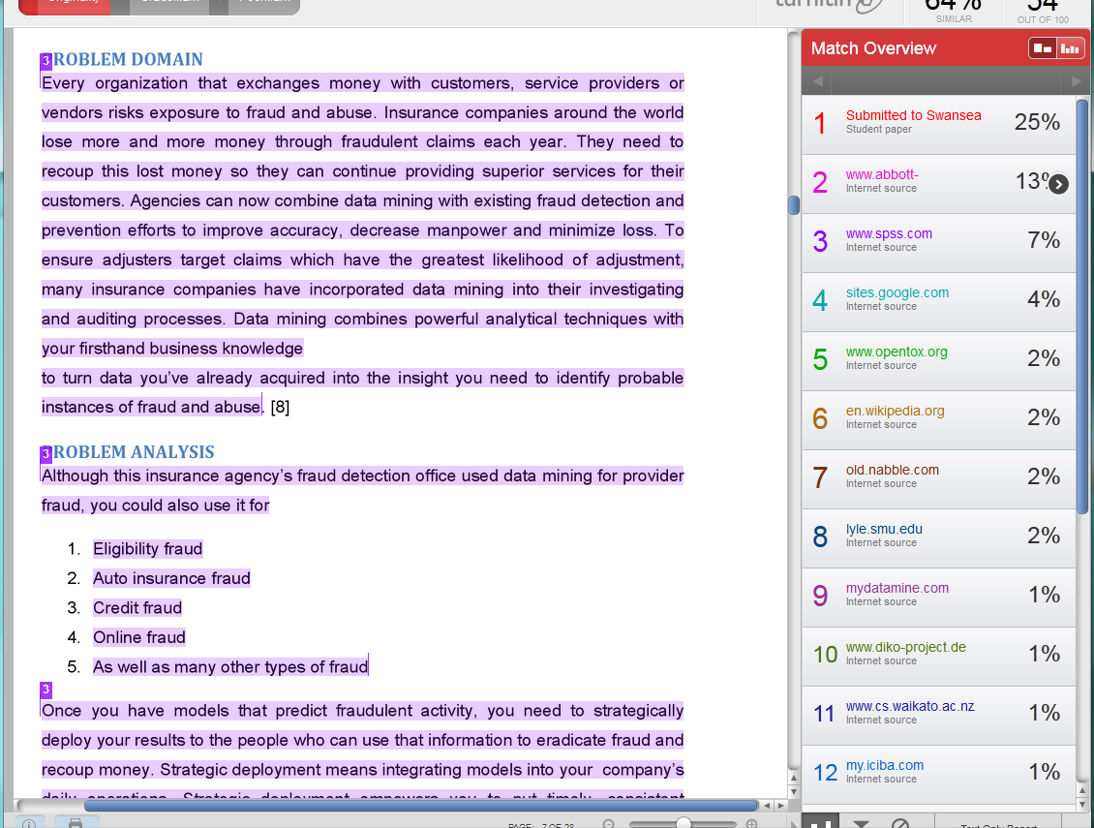

Slide 17
Referencing
UWTSD uses the Vancouver numerical referencing system (the IEEE version)
The system which uses numbers, in order of appearance in the text
More, and examples, later

Slide 18
Benefits of Referencing for the Student
Proves that the work has a factual/academic basis
  Shows the variety of sources you have used
  Shows that you have used relevant sources
  Supports the ideas and arguments that you discuss in your work
  Shows initiative and independent thought
  Shows depth of reading
  Shows ability to judge if information read is relevant
  Will help you to gain more marks

Slide 19
Benefits Cont.
Allows the reader to identify and retrieve the sources for their own use
  May be several sources with similar titles
  Helps tutor to find the information easily
  Helps you to retrace the sources you have used in the past, for future assignments.
Avoids plagiarism!

Slide 20
Citations in Text
A citation generally requires only the name of the author(s) and the number of the reference. E.g.:
One author of one work:
  As Williams [1] suggests, 'It would be dangerous to assume that students already know how to reference when they arrive in University.'
Two or three authors of one work:
  Robbins and Renaldo [2] recently stated ...
Four or more authors of one work:
  Charles et al [3] contend that…

Slide 21
Citations, Author Not Named
If the authors are not mentioned in the text, numbers are used to indicate the texts being referred to:
  A body of evidence contends that …[4-6].
Where possible, try to use author names within the text as this flags to the reader that you are citing the right sources

Slide 22
Multiple References to a Source
If you refer to an item of work more than once, you should use the first number given to that piece of work
  i.e. there will only need to be one entry in the reference list
If particular parts of the document are cited page numbers should be given after the numerals (3, pp. 23-24)
You will see Superscripts⁷, Brackets (8) or Square Brackets [9] used around reference numbers

Slide 23
Direct Quotations
This is where you quote somebody and use their exact words in order to support your point of view or argument
  Use single inverted commas ‘ ……’
  Introduce the quote - e.g. As Edworthy [6, p. 23] argues ‘…….’
  Use exact wording and punctuation
  Use three dots (…) if you omit some of the original words – also known as ellipsis
  Use square brackets if you insert words of your own
  Include page number(s)

Slide 24
Quotations
If the quotation is short, include it as part of the text
Example
  There has been some debate as to the actual causes of stress in teaching. However, as Edworthy argues ‘the main cause of stress in teaching is not related to the teaching itself’ [6, p.23]. She contends that there are many other factors, not least the increased administrative duties of teachers, that have a significant impact on stress levels.

Slide 25
Quotations
For a long quotation:
  Begin on a new line
  Indent one tab space for whole quotation
  Use single spacing
For example:
Jones [4, p. 45] suggests that
  ‘Students can undertake referencing quite easily if they are given the opportunity to practice … and to apply [whichever] system is preferred, to ‘real’ work, on a regular basis’.

Slide 26
Types of References
Some of the sources you may need reference include:
  Books
  A chapter from a set of edited readings
  Secondary references
  Journal articles
  Conference papers
  Theses and dissertations
  Online sources (e.g. an article in an electronic journal)

Slide 27
Books
Author(s) or editor(s) of book, Title of book: and sub-title if there is one (in italics). Edition (if not the first). Place of publication: Publisher, Year of publication.
Example entry in References list
  [1] W. Bush, Jr. and G. Brown, Errors in Running a Country, 9th ed., Parliament Press, London, 2008

Slide 28
Chapter from Edited Readings
Author(s) of chapter, "Title of chapter" (in quotes), in Title of book (in italics), Edition (if not the first). Editor(s) of book,. Place of publication: Publisher, Year of publication, Pages covered by chapter.
Example
  [2] H. O. Ming, “The Many Ways to Skin a Cat”, in New Developments in Technology, 2nd ed., R. Paul (Ed.), McGraw-Hill, London, 2001, pp. 8-34

Slide 29
Secondary References
A work that has not been read in the original, but has been summarised or discussed in some other work which you have studied, is known as a secondary reference.
Example within text:
  The exact nature of the problem was identified by Howell and McManus, cited in Stanley [3].
Example within the reference list:
  [3] Stanley, R. T., Principles of Emerging Technologies, Harlow: Prentice Hall, 2004, p. 49.

Slide 30
Journal Articles
Author(s) of article, "Title of article" (in quotes), Title of Journal (in italics), Volume number (and issue number if there is one), Pages covered by article, Date of Publication.
Example
  [4] T. Rogers, “Following on from Yesterday: The Internet Now”, Computing Weekly, vol. 3, no. 2, pp. 13-19, Jan. 2008

Slide 31
Conference Papers – Published
Author(s) of article, "Title of paper" (in quotes), in Title of proceedings (in italics), location and date of conference, pages covered by article
Example
  [5] R. Brown and J. Hale, “Iterative Learning and the Future Classroom”, in Teaching and Learning Conference, London, May 2002, pp. 33-59

Slide 32
Conference Papers - Unpublished
Author(s) of paper, "Title of paper" in quotes, presented at Title of conference, Location, date of conference.
Example
  [6] F. Connors and J. Orian, “Problems of Surfing”, presented at The Internet Today, London, UK, Nov. 1999

Slide 33
Theses and Dissertations
Author of thesis, "Title of thesis" (in quotes), Qualification and type of report, University/Institution, Year of award.
Example
  [7] B. Masters, “Virtual Reality is Here”, Ph.D. dissertation, Warwick University, UK, 2005

Slide 34
Online Sources
An online source may not always contain clear author or publisher details. Try to describe it in the same way you would describe a similar printed publication
The date of access is included since an online source may change between the time you cite it and the time it is accessed by a reader
Author(s), "Title of source“, Organization/Publisher/Date. [Online]. Available: access information. [Accessed: Date of access – Month. Date, Year]
Examples
  [8] “The Economics of the Internet”, The Business Journal Online, May, 2006. [Online]. Available: http://www.business-journal.com/LateMay06.html. [Accessed: March 2, 2014]
  [9] S. McCanne and S. Floyd, “The Internet Revolution”, 1997. [Online]. Available: http://www.mash.cs.berkeley.edu/ns/. [Accessed: Jan. 23, 2011]

Slide 35
In Summary
Learn to reference
Do it assiduously
It is your chance to prove to the lecturer
  You have done the necessary reading
  You have understood the domain
  You have the discrimination to choose good sources
  You are academically competent
All of which leads to GOOD GRADES!

Slide 36
Coming Soon…
Next session: Reading Journal Papers

