Slide 1
Julie Thomas
BMSW6007
Coaching and Mentoring
Week 8

Slide 2
Learning Outcomes
To understand the requirements of the second part of the assignment (the reflection)
Models of Reflection
Assignment Guidance
Learning Points from Practical assessment

Slide 3
Part 2 – Written Reflection
Following the practical exercise, you will be required to complete a 2000 word individual reflection, to be submitted to Turnitin by 3pm on Friday 6th December 2024.
You should critically evaluate your own performance in the peer coaching exercise, with reference to relevant reflective cycles and the coaching model used. You should present an honest and transparent reflection, highlighting your strengths and weaknesses. You should also include a personal development plan.
Note: this should be written in the first person and you should make reference to the coachee by their first name (e.g. ‘David’).

Slide 4
Part 2 Continued
As you reflect on your performance, you will need to provide a critical analysis of the following:
The importance of coaching, relative to other forms of learning interventions, including mentoring, in post-Covid workplaces. You should mention your own workplace, including how your employer currently uses coaching, or should use coaching, to develop its workforce. If you are not employed, you could use alternative organisational examples.
The skills required to be an effective coach.
How the model used compares with other well-known models of coaching.
You should reference at least 20 sources in your reflection, at least 10 of which should have been published in 2021 or later.

Slide 5
Reflection/Reflective Models
You will need to comment on the importance of reflection. For example:
‘Reflection is an important part of the learning process – both good and bad experiences in the workplace can be used to inform current and future practice and result in a professional who is on a journey of constant self-improvement, for the benefit of all (Ashwin, 2015).’

Slide 6
Reflective Frameworks/Models
Reflective frameworks tend to be based on a continuous cycle of planning, doing, reviewing and applying that learning to future situations (Gibbs, 1988; Norton and Campbell, 2007).
You can comment on your preparation, how the coaching session went, what you learnt, how you will apply this in the future and what your development needs are going forwards.

Slide 7
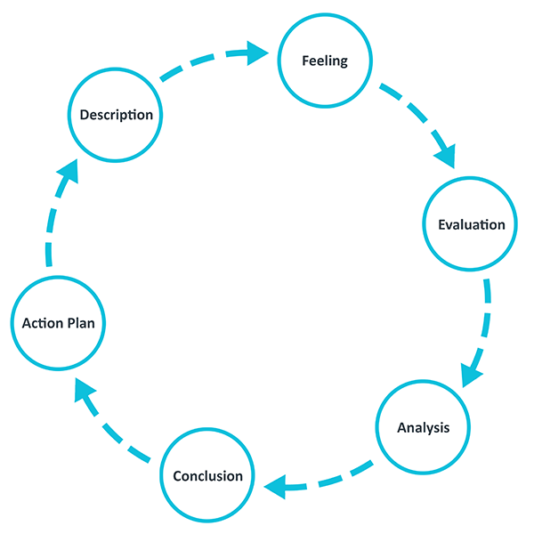
Gibbs Reflective Cycle
Description of the experience
Feelings and thoughts about the experience
Evaluation of the experience, both good and bad
Analysis to make sense of the situation
Conclusion about what you learned and what you could have done differently
Action plan for how you would deal with similar situations in the future, or general changes you might find appropriate.
(The University of Edinburgh, 2024)

Slide 8
Structuring your work using Gibbs
Introduction – what is coaching, how it compares to other learning interventions, importance post-Covid, tangible/intangible benefits, how your organisation is using/not using coaching
Description - describe the task and the model
Feelings - how did you feel during and after the exercise? What are your thoughts? Was it a valuable experience?
Evaluation - what went well and not so well, your strengths and weaknesses?
Analysis - how did you perform compared to best practice? (what’s in the books). Did you display the skills and knowledge required of a good coach? How does the Instant Payoff Model compare with other models?
Conclusion - your main learning points and what you could have done differently
Action plan - your personal development plan for the next 6 months

Slide 9
You need to underpin your work and build in theory/models
For example:
‘According to Landsberg (2015), individuals who coach benefit greatly from the experience themselves, and I certainly felt this to be the case. For example, . . .’
‘Coaches can structure coaching conversations using a four-stage process – Listen, Empathise, Appreciate, Design - LEAD (Tschannen-Moran, 2018). I incorporated this into my session, which resulted in . ‘.

Slide 10
More examples
‘According to Ellinger, Beattie and Hamlin (2018), the coaching relationship must be based on mutual trust and openness. I achieved this by introducing myself in detail, including commenting on my coaching experience . . . ‘.

Slide 11
Elements to Include:
Reflective cycle you have chosen to use (make sure you actually use it!)
Brief description of Instant Payoff Model
Good/not so good points of your performance
Your strengths and weaknesses
Personal Development Plan that logically follows your previous discussion

Slide 12
Elements to Include (continued)
In the introduction you need to emphasise the importance of coaching in post-Covid workplaces– compare it with other learning interventions such as training courses and mentoring. Why is coaching even more important post-Covid?
State the extent to which your employer uses coaching. Has it got a policy/framework?
Discuss the skills required to be an effective coach and how you demonstrated those skills
Provide a critical analysis of the Instant Payoff Model and compare it with other models.

Slide 13
General Guidance
Use at least 20 sources to underpin your points, at least 10 of which should have been published in 2021 or later (i.e. post Covid).
You should demonstrate knowledge of academic coaching models, such as OSCAR and GROW.
You should demonstrate knowledge of the required skillset, values and beliefs of a coach and mentor.
You should demonstrate your understanding of coaching and mentoring strategies in relation to organisational requirements.
Your work should illustrate your appreciation of the benefits that coaching and mentoring can bring to an organisation.
You should effectively evaluate the tangible and intangible benefits of coaching and mentoring within an organisation.
State how you will use the skills and knowledge you have learnt going forwards – e.g. as a line manager (or as a parent!).

Slide 14
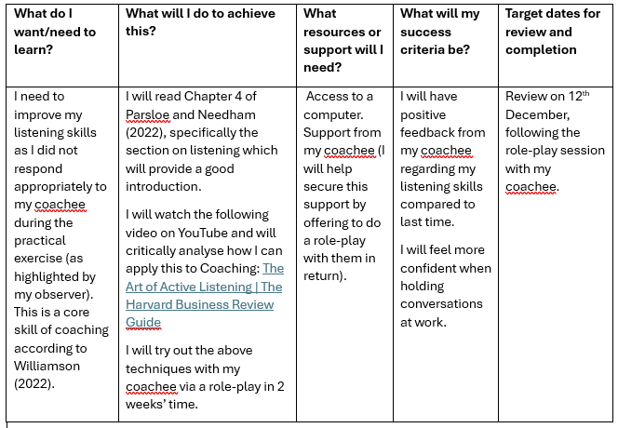
Personal Development Plan
Your reflection should end with a development plan for the next 6 months. The plan must be specific and contain the titles of books, articles, podcasts and online training (MOOC’s) that you will be using to aid your development. Include several entries covering several areas.

Slide 15
Development Plan
Use the template on Moodle
Be specific – give detail about which book you will read, what website you will consult, when etc.
List several detailed entries.

Slide 16
General Feedback from Practical Exercise
Strengths:
Mentioning a coaching contract at the beginning and building in elements of other models such as the ‘E’ in ELECTRIC. Saying why a contract is needed
Spending time building rapport, beyond ‘how are you?’
Giving your coachee a structure for the session – explaining Instant Payoff, how long the session will be (to reduce anxiety)
Probing problem and prioritising what to focus on (due to time)
Breaking down blocks into 3 types
Being assertive about actions and timescales. Explaining SMART
Smiling, using encouraging language, being positive, complimenting coachee
Responding well to the coachee by either summarising, reflecting back to show understanding or commenting positively
Showing coachee that you have confidence in them that they can achieve their goals

Slide 17
Areas for Improvement
Taking more time at the beginning to explain reasons for contract, why you are a credible coach, the structure of the session, plus building rapport
Summarising what coachee had said, to show understanding
Probing coachee to truly understand their perspective
Challenging coachee appropriately
Helping coachee to come up with own solutions, rather than jumping in with your own ideas
Agreeing specific actions at the end, with clear deadlines/time to review

Slide 18
Instant Payoff Coaching
Ask the coachee to describe the current issue or problem, with specific examples and a small amount of relevant background.
Ask him/her to describe the desired outcome – paint as specific a ‘picture’ as possible of how things would be if s/he had sorted out the problem. Do not try to solve the problem, but note the emerging ideas
With the coachee, list all the obstacles/blocks that lie between 1 and 2. Sort them into three groups:
  Blocks that exist in the coachee (lack of skill/knowledge, low motivation, attitude etc).
  Blocks that exist in others (anxious customer, manager stressed and panicking etc.)
  Blocks in the situation (inadequate resources, shift in deadline etc.
Jointly brainstorm ways around these blocks, and possible next steps. Agree an approach, actions and timing.
Instant Pay-off Coaching -Landsberg, M. (2015) .The Tao of Coaching Boost Your Effectiveness at Work by Developing Those Around You. London: Profile Books

Slide 19
Coaching Models
The GROW Model
G | Goal: Define and agree the goal or outcome to be achieved. You should assist the coachee in defining a goal that is SMART. Ask questions like:- How will you know the goal is achieved? Describe what your ideal outcome is in this situation?
R | Reality: Examine the current reality. In order to reach your goal you must fully consider your starting point. Ask questions like:- Where are you in relation to your goal? What is going well right now?
O | Options: Explore the options. Determine what the possible options are for reaching the goal. Ask questions like:- What else could you do? Give me 5 options?
W | Will: Gain commitment to specific actions. Ask questions like:- What will you do now, and when? How will you keep yourself motivated?
Notes:
1990’s 1992

Slide 20
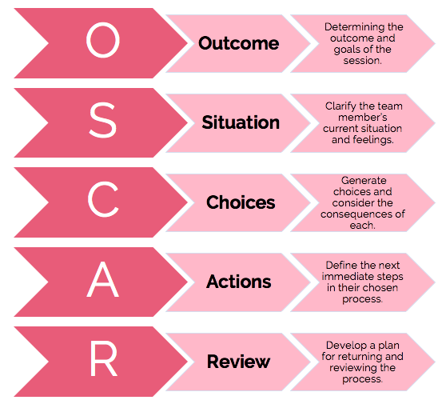
Coaching Models
The OSCAR Model

Slide 21

ELECTRIC Model (Williamson, 2015)
Engage
Listen
Explore
Challenge
Target
Review
Insights
Conclude
Notes:
Build rapport
Listen – underpinned by idea that coachee has ideas and solutions to move forwards
Use questions to explore their perspective
Challenge and check things
Target – end result
Review – recap
Insights – time to reflect
Acknowledge success

Slide 22
Learning from Previous Sessions
In its simplest form, coaching is a conversation
Utilises coach’s application of the skills of listening, asking questions and giving feedback
Models are available to guide the conversation
Whichever tools and models you use, it’s ultimately how you are with them that the coachee will remember (adopt an authentic coaching and mentoring style) – (Parsloe and Leedham, 2022)

Slide 23
Strengths and Weaknesses – Questions to ask yourself
How do you know they are strengths/weaknesses? What does the literature say about the most important skills for a coach? What feedback did you have from the lecturer and observer?
To what extent are they strengths/weaknesses? Do you still need to build on the strengths?
What do you need to prioritise for your development and why?
Don’t just describe – always explain – say why. My strengths are . . . because . . research states . . .

Slide 24
Activity
Read through my feedback on the practical and start planning out your reflection.
Were there differences in how you thought the practical went and the feedback?
What do you feel your strengths and weaknesses are?
What are you likely to focus on in your development plan?

