Slide 1


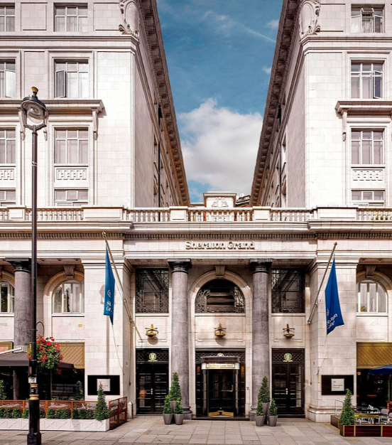

Sheraton Hotel and resorts
z
Tanjila Haque
Student Id :2210226
Module :BMIH4003
Lecturer: Lisa-Marie Bassler

Slide 2
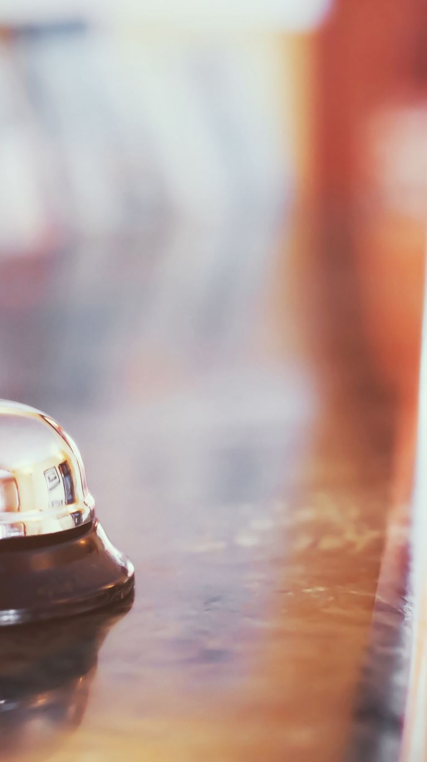
The roll and importance of quality service, hospitality ,And guest service for Sheraton hotel
z

Slide 3
AGENDA
Introduction.
Who are Sheraton and resorts consumer.
Business executives.
Facilities for VIP and middle classes.
Outlining nature ,scope and roll of guest service at Sheraton hotel.
The role and function of guest service in general.
Importance of hospitality and how guest expectations are met.
Summary.
Reference.

Slide 4
INTRODUCTION
Sheraton Hotel and Resorts is an international luxury hotel owned by Marriott international. Sheraton bringing people together since 1937 . Sheraton hotels and Resorts location( September 2020) in 463 including North America ,Africa, Asia , Central and South America, Europe, the middle East and in the Caribbean. Sheraton founders is Ernest Henderson Robert Moore and headquarters in Bethesda ,Maryland ,U.S ,information based on ,(Marriott international,2023).
z

Slide 5
Sheraton Hotel and resort consumer

Slide 6
consumer
​Businessmen | Honeymooner | Travellers | Vacationers

Slide 7

Sheraton Hotel and resort service variety
z

Slide 8
Facilities
Restaurants ,bar ,catering service, room service | Gym, spa ,wellness center
Car rental ,pick up and drop off to airport, mobile check in services, facilities for disabled people. | Party room, meeting room ,wedding center, internet access

Slide 9

Business Executives
Sheraton successfully serve business executives because of its great facilities and privacy also great for security.

Slide 10
Outlining nature ,scope and role of guest service at Sheraton hotel
Sheraton brand profile in the UK 2022
Sheraton popularity in uk
Sheraton is at 54% in the UK when it comes to hotel consumer, brand awareness,(Kunst,2022a).
In the uk 54% respondents who know Sheraton (Kunst,2022b).

Slide 11
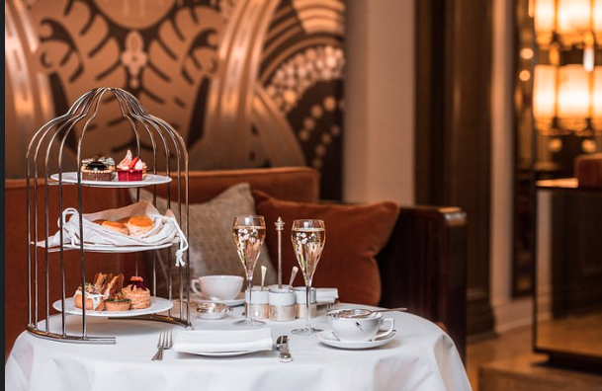
Function of guest services
Recruiting the best employee
Extra care of their guest
Sheraton get the best employee who can work with the guest and meet their needs
Sheraton known for its quality service

Slide 12
What is considered excellent customer service
To offer excellent service to the guest staff need constant work, ''Excellent customer service key not only solve problem but also actually understood them''(Hotello,2022). Sheraton hotel and resort known for their service and quality.
z

Slide 13
What is good service
Good service start from the time guest step through the door. Good service only happen when the staff love their job state at,(Garrahan.Eversham,2021).
Good service make the guest feel they are the most important person in the hotel.
Making a batter day for the guest is also ability of good services.

Slide 14
Importance of hospitality and how guest expectations are met
Comfortable ,secure ,safe
Staff communicates
Staff should feel safe and comfortable and met their needs.
It is very important employee listen to the guest patiently to fully understand what customer telling , Aslo important to communicate with the guest, according to,(Ward,2017).
Staff are trained to offer best service to their guest.
Staff will making sure if the guest met all the service they need.

Slide 15
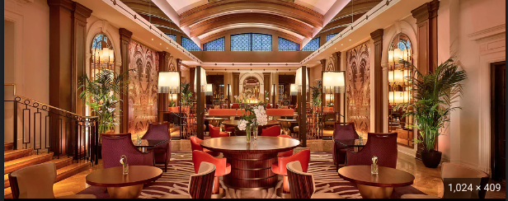
Use social platforms and content to award employees
Good services depends on employees. There for it is very important to praise the employee across the country and make them feel important and allowing them to receive praise publicly it will also reflect the brand name of the hotel ,state on (Kakroo,2023).

Slide 16
Refurbishment of 450 Sheraton
Sheraton refurbishment aim to introduce several new features around the world including a 1000 room Sheraton grant in phoenix, study shows at (Otley,2019).
Sheraton also will introduce Vip services for team player to make them feel professional.

Slide 17
Sheraton guest room features a signature Sheraton hotel bed
z
Sheraton is a luxury brand, all the service Sheraton provide to their guest is with premium quality. Sheraton keep their quality service beds to bring the home experience to their guest ,information based on ,(Olander,2022).

Slide 18
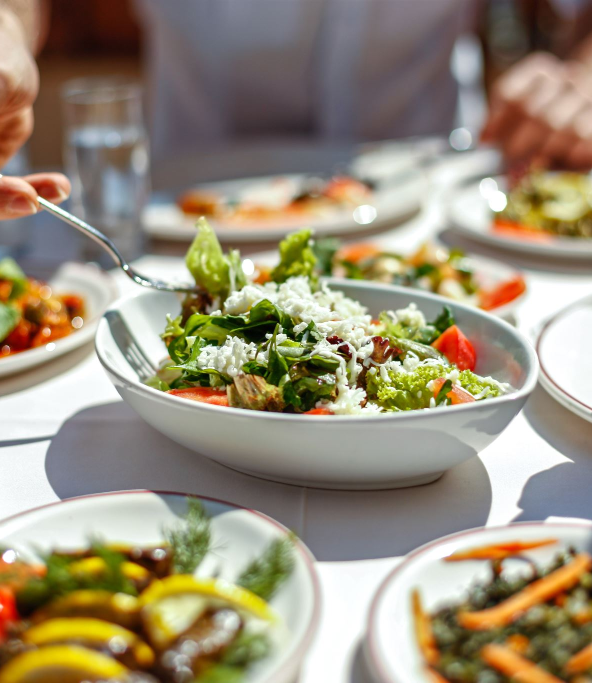
Catering
z
Sheraton build trust to their catering services experience, as they pay attention to the smallest details of their service. Sheraton focus on rich flavors of their dishes ,high quality product ,professional service ,table set up, decoration, equipment and transportation,(Sheraton catering services,2023).

Slide 19
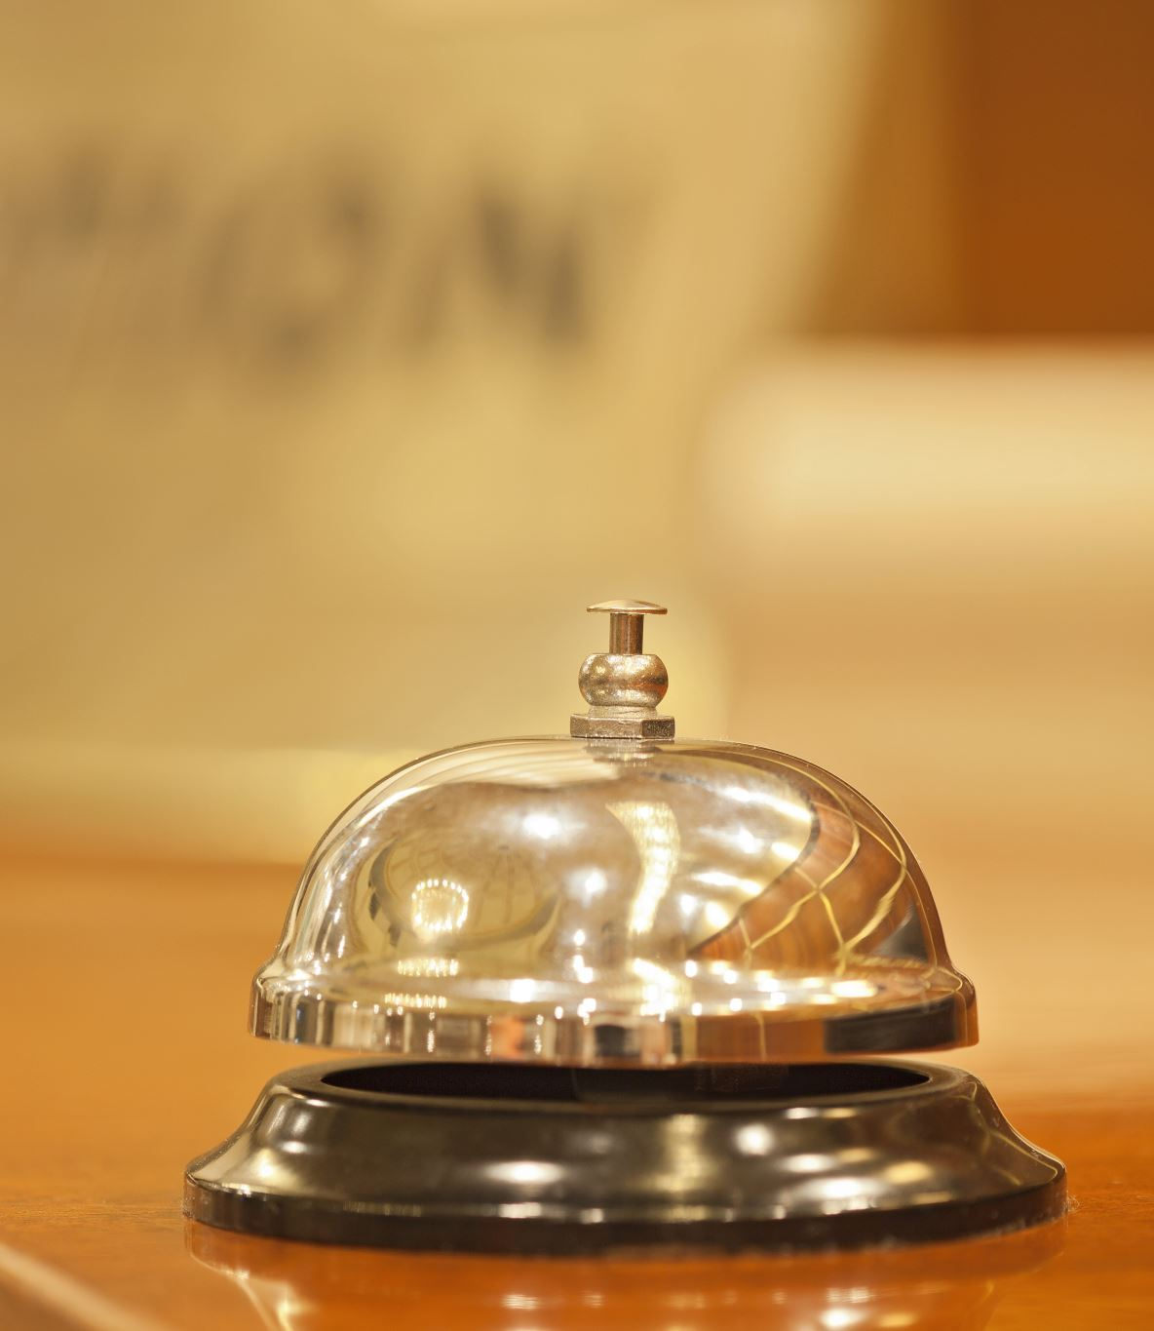
Safeguard unit provides Security Service to Sheraton hotel
An agreement was entered to provide security services to largest hotel chains , Sheraton hotels by SGI Protective Service of safeguard security Holdings,(security today,2021).
z

Slide 20

THANK YOU
Tanjila Haque
2210226@uwtsd.co
www.contoso.com

Slide 21
Reference
Liam.G, Emma .E(2021)''How do you define good service'' BigHospitality, William Reed.available at:https://www.bighospitality.co.uk/Article/2015/11/27/Spotlight-on-service-How-do-you-define-good-service#:~:text=%22Good%20service%20is%20making%20a,to%20make%20the%20guest%20happy last accessed:09/02/2023
Hotello,(2022)''Importance of customer service in the hospitality industry'' site Map.available at:https://hotello.com/en/customer-service-hotels/ last accessed:09/02/2023
Alexander .K,(2022,a.b)''Sheraton brand profile in the uk ''statista.available at:https://www.statista.com/forecasts/1335625/sheraton-hotels-brand-profile-in-theuk last accessed:09/02/2023.

Slide 22
Scurity today,(2021)''Safeguard unit provides security services to Sheraton hotel''1105 Media Inc, Infrastructure solution group. Available at:https://securitytoday.com/articles/2011/05/17/safeguard-unit-provides-security-services-to-sheraton-hotel.aspx?admgarea=mag&m=1 last accessed 09/02/2023
Sheraton catering,(2023)’’passion , perfection ,experience'' Site Map. available at:https://www.sheratoncatering.pl/en last accessed:09/02/20231
Marriott international,(2023)’’Where the world comes together “Sheraton phoenix Downtown, Sheraton.available at:https://sheraton.marriott.com/last accessed:09/02/2023
Tom.O,(2019)''The future of sharaton ''Business Traveller TV. available at :https://www.businesstraveller.com/features/the-future-of-sheraton/ last accessed:09/02/2023.

Slide 23
Deb.W,(2017)''8 must –Have customer service skills when you work in hospitality''hcareers.available at:Https://www.hcareers.com/article/career-advice/8-must-have-customer-service-skills-when-you-work-in-hospitality last accessed:09/02/2023
Lindsey,(2022)'Sheraton hotel and resort 'upgradedpoints. available at https://upgradedpointtels/sheraton-hotels-and-resorts/ last accessed:09/02/2023.
Upasna.K,(2023)'' five reason why Sheraton hotel need a proactive social media approach''Brandanew,Fame Themes.available at:https://www.brandanew.co/5-reasons-why-sheraton-hotel-needs-a-proactive-social-media-approach/ last accessed 09/02/2023.

