Slide 1
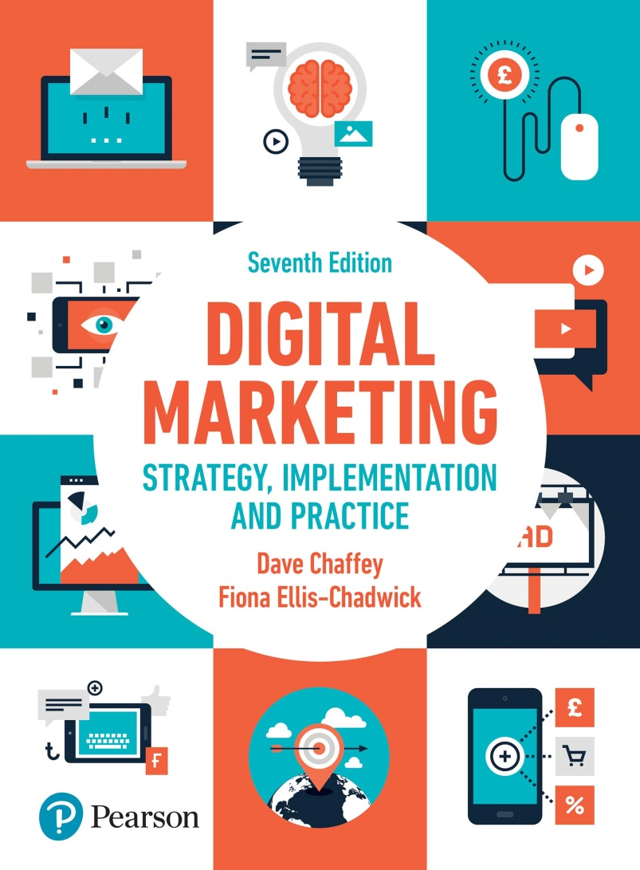
DIGITAL MARKETING
STRATEGY
Digital marketing fundamentals
Introducing Digital Marketing

Slide 2

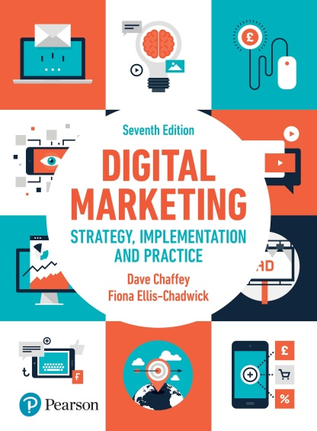
Introducing Digital Marketing
Main Topics:
How digital marketing has transformed marketing
What are digital and multichannel marketing
Introduction to digital marketing strategy
Introduction to digital marketing communications
Case Study: eBay thrives in the global market place.

Slide 3
How digital marketing has transformed marketing
Digital marketing is about:
Audiences
Digital devices
Digital platforms
Digital media
Digital data
Digital technology

Slide 4
Figure 1.1 Customer lifecycle marketing touchpoint summary for a retailer
Source: Smart Insights (2017)

Slide 5
What are digital and multichannel marketing?
Digital marketing can be defined as:
Achieving marketing objectives through applying digital media data and technology

Slide 6
Paid, owned and earned media
Notes:
Figure 1.2 The intersection of the three key online media types

Slide 7
The marketing technology landscape
Source: With permission – Chiefmartec.com
Notes:
Figure 1.3 Scott Brinker’s categorisation of modern marketing technology options – digital platforms include Facebook, Google, LinkedIn and Twitter

Slide 8
Introduction to digital marketing strategy
Key considerations:
Key features of digital marketing strategy
Applications of digital marketing
Benefits of digital marketing

Slide 9
Mini Case 1.2 Zalando exploits the power of digital media and distribution to grow a multi-billion Euro business in less than 5 years.
Notes:
Figure 1.4 The new Zalando campus in Berlin

Slide 10
Figure 1.5 Summary and examples of transaction alternatives between businesses, consumers and governmental organisations

Slide 11
Figure 1.6 The distinction between buy-side and sell side of e-commerce

Slide 12
Strategic framework for developing a digital strategy
Source: Altimeter Consulting (2014)
Notes:
Figure 1.7. The drivers and barriers to digital transformation

Slide 13
Summary of organisations challenges in digital marketing
Strategy
Structure
Systems
Staff
Style
Skills
Superordinate goals

Slide 14
Figure 1.8 A generic digital marketing strategy development process

Slide 15
Introduction to digital marketing communications
Source: Smart Insights (2010)
Notes:
Figure 1.9 RACE: Reach–Act (Interact)–Convert–Engage

Slide 16
Figure 1.10 Six categories of digital communications tools or media channels
Source: Chaffey and Smith (2017)

Slide 17
Figure 1.11 Summary of communication models for (a) traditional media, (b) new media

Slide 18
Figure 1.13 Channels requiring integration as part of integrated digital marketing strategy

Slide 19
Key communication concepts for digital marketing
Permission marketing
Content marketing
Customer engagement
Source: Smart Insights (2015a)
Notes:
Figure 1.15 The content marketing hub

Slide 20
Case study: eBay thrives in a global marketplace
Key content:
Mission
Revenue model
Proposition
Competition
Objectives and strategy
Case Question: Discuss how eBay has had to evolve its online brand proposition and communicate it to achieve continued growth

