Slide 1

Digital Literacy and Safety
Week 1 – LCHS4007_BIRM

Slide 2

Note to Lecturer:
Record the Session/share the recording with the class/ maintain confidentiality/ used only for learning purposes.
Notes:
For Lecturers-All sessions should be recorded using Panopto.
Learn how to operate and save the recording, if facing any problems timely get in touch with the IT team/ Book a tutorial.

Slide 3
During this session
Develop more knowledge about digital literacy
Become more developed as a safe digital learner
Understand how to protect your devices and your information online
Develop a basic understanding of disinformation

Slide 4

Need Help
Digital centre
Self-help available in the university to improve your digital skills
Need one to one
Book an appointment with digital team
Notes:
Lecturers should explore the digi centre with students- Link is available on module - Digital Skills Homepage - The DigiCentre UWTSD
Lecturers should advise student on how to book digital skills session. This can be in person or online- Book an Appointment | UWTSD Intranet

Slide 5
Digital Safety in Health and Social Care
Health and social care organisations hold large amounts of sensitive personal data. This includes medical records, care plans, and financial information. A data breach can harm patients and damage trust.
The UK Data Protection Act 2018 and UK GDPR set out your legal responsibilities when handling patient or service user data. As a practitioner, you are personally accountable.
Common risks include: sharing passwords, using personal devices for work data, accessing records you are not authorised to view, and sending information to the wrong person by email or message.

Slide 6
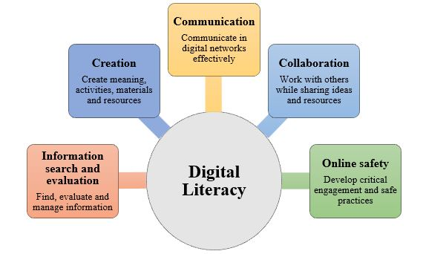
Digital literacy- Group Activity 1
The ability to understand and use digital technologies effectively and meaningfully.
Watch the video and in a group of 2 to 3 identify at least 4 skills that a health and social care professional requires
Notes:
Lecturer should encourage students to identify skills and then use this to evaluate and signpost for further digital skills. Watch video together with students.
Digital Literacy - Explained in 3 Minutes!
Students require digital skills in
1. Using computers – Typing, clicking and navigating
2. Internet skills- Searching for information, browsing websites
3. Critical thinking- Checking out information to see if it is accurate
4. Privacy and security- Creating strong password, identify scams and hacking attempt
5. Communication- Social media and team communication via platforms such as zoom, teams etc

Slide 7
Key digital Safety Skills
Protect your devices
Protecting your personal data
Become critical when accessing websites and new information.
Notes:
https://www.internetlivestats.com/
Students may wish to share their own experience of being hacked or cloned.

Slide 8
Think and discuss…
What risks do you think come with using digital technology in a care setting? Think about patients, staff, and information.

Slide 9
What threats are there?
Protect your devices
Virus and malware
Online scams
Hackers
Notes:
Viruses and malware
Malicious software created to intentionally invade or compromise your device, your apps, files or personal data.
Online scams
These can occur via email, social media or via websites whereby a link may be send that looks reputable but leads to the user downloading a virus or malware without being aware.
Hackers
Individuals or bots that observe your online activity and obtain access to your accounts either by guessing or recording password key strokes, or via personal information that allows the hacker to imitate the genuine user in order to gain bypass security measures (such as mother’s maiden name, date of birth or first pets name).

Slide 10
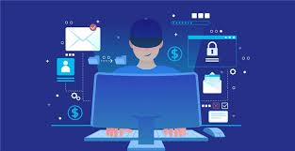
Protect your devices and accounts
Notes:
https://youtu.be/CV39QzFpJx4
Are you surprised by the points raised in the video?
We will expand on personal information further later.

Slide 11
Brainstorming….
Where or when do you think students are most vulnerable to being hacked?

Slide 12
Virus Protection
A virus is an unwanted program that can delete files or slow down your computer, it could even stop it working completely.
An anti-virus or security software program can prevent your computer being affected by malware, (E.g. viruses Spyware, trojan programs)
Often, there is a charge for the software but it may save you money and hassle from potential online virus, as well as protecting your data.
Notes:
Virus protection on personal data is each student’s personal responsibility. The university has expansive virus protection when using onsite UWTSD computer usage which will prevent students from downloading apps or programmes.

Slide 13
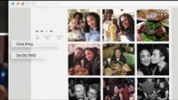
Protecting your personal data
Point of reflection
Have you ever considered how much information you are sharing?
Oversharing personal information
Notes:
https://www.youtube.com/watch?v=w2tW50CD6Aw
This short online video demonstrates how innocently people can be sharing information.

Slide 14
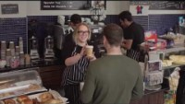
Privacy Settings on accounts
Identity Fraud Website -
Notes:
Watch the video together - https://www.youtube.com/watch?v=yrjT8m0hcKU
Share the identify fraud website - https://www.cifas.org.uk/services/identity-protection

Slide 15
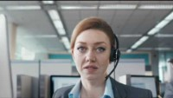
Online banking
Notes:
https://youtu.be/vPJ6irUDmHI
Another example of how passwords can be obtained fraudulently.
How else might you accidently reveal your password? Consider:
-the use of family birthdays as passwords,
-having the same passwords for all accounts, -
using devices in public spaces such as cafes or on trains (people can look over your shoulder), have you password written down.

Slide 16
Break
Notes:
Please move the break to where this is most relevant.

Slide 17
Become critical when accessing websites and new information.
Domain names
Checking websites
Spot misinformation
Notes:
We will look at each in t. urn

Slide 18
Domain names
.org
A non-profit organisation - .org.uk confirms that the organisation is also UK based
.co.uk
A UK based company
.com
A commercial company
.gov
A verified government site
.ac.uk
An academic institution – usually a university
.net
This used to mean ‘network’ and could only be used by a verified network – now it can be used by anyone.
Notes:
Highlight to students what a ‘domain name’ is, how they would spot it in the URL address for a website and which ones from the list would be most reliable?
Highlight the additional importance of – https – to indicate a secure site.

Slide 19
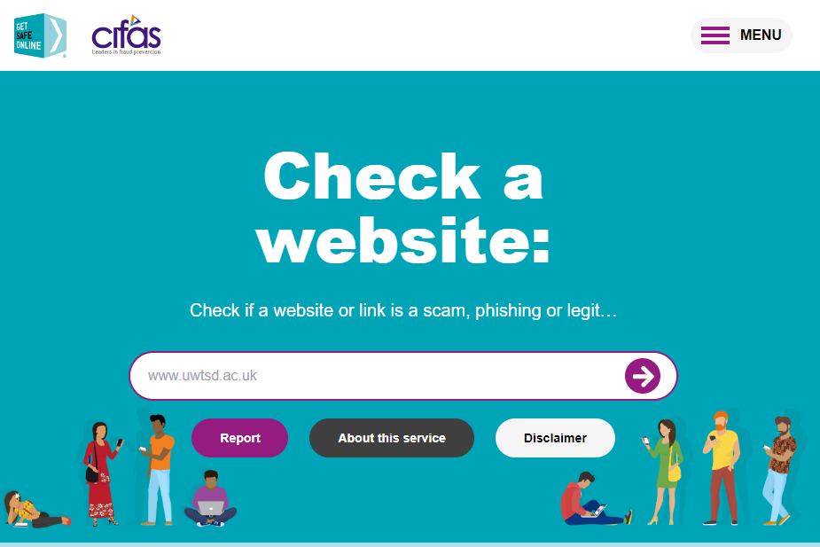
Webpages – can they be trusted?
Not all websites that appear in your searches can be trusted. If you are unsure about a website, there are trusted tools to enable you to check them.
https://check.getsafeonline.org/
Visit together and check the report for the UWTSD website.
Notes:
https://check.getsafeonline.org/

Slide 20
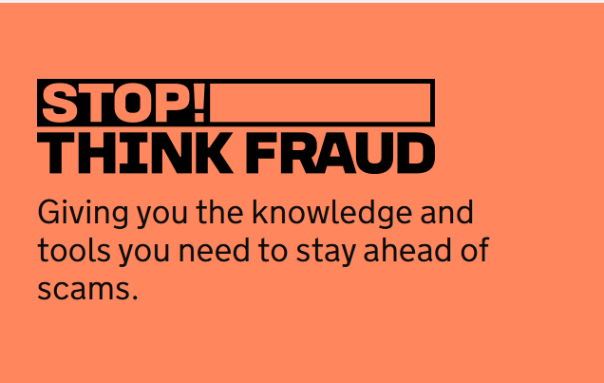
Class Activity-Let’s Learn Together how to stay protected- 15 min
https://stopthinkfraud.campaign.gov.uk/how-to-spot-fraud/how-to-spot-a-fake-website/
Notes:
Read the article and make notes of important points.

Slide 21
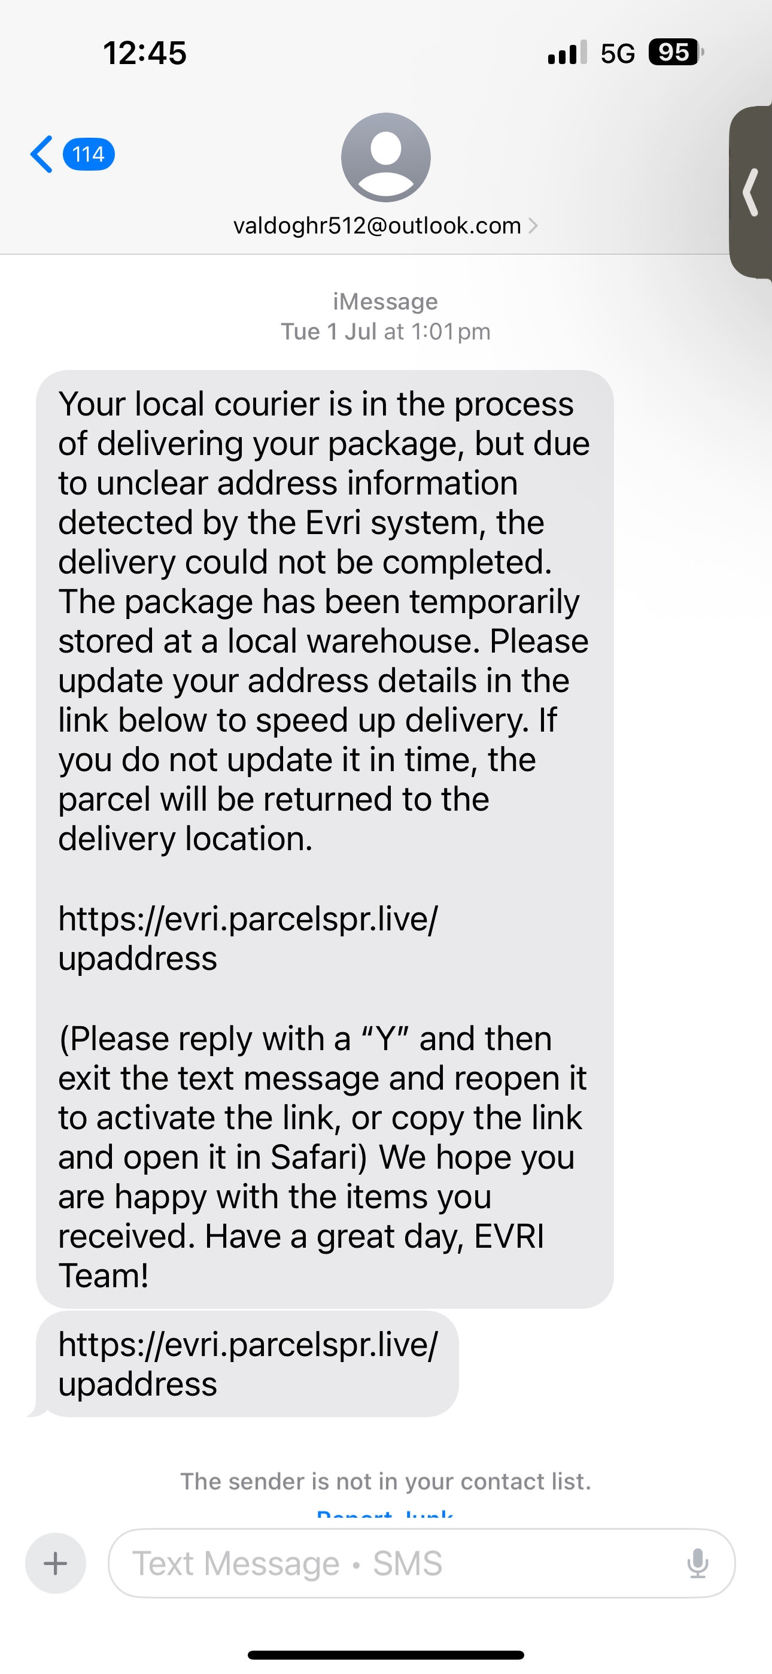
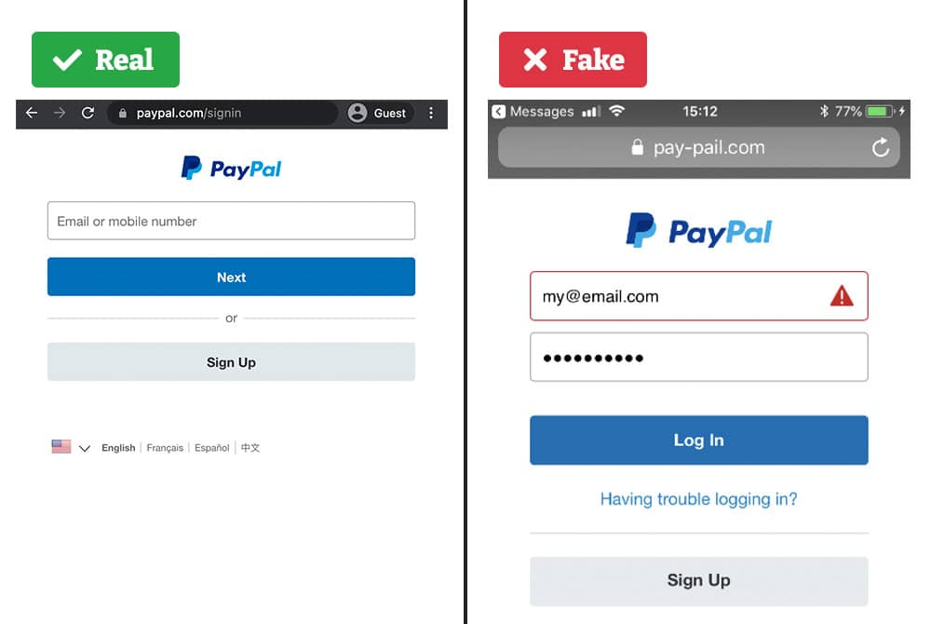
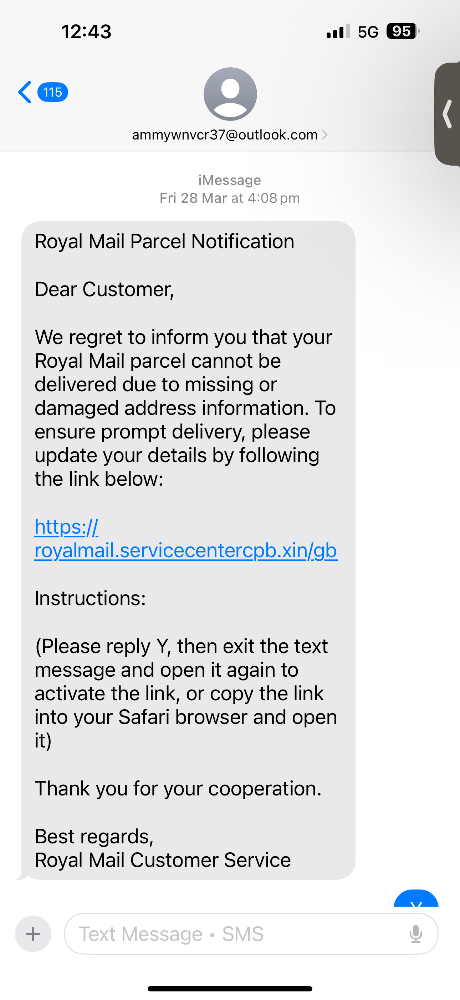
Notes:
Scam examples use these to emphasize digital literacy and digital safety.
Evri
Royal mail
Paypal are daily usage services, how are they being used for scamming common people

Slide 22

Misinformation
Misinformation can be defined as “wrong information, or the fact that people are misinformed or information intended to deceive” Cambridge Dictionary (2022)
Notes:
Short Ted video on misinformation - https://www.youtube.com/watch?v=cSKGa_7XJkg
Longer Ted talk on Misinformation - https://www.youtube.com/watch?v=-7ORAKULel4

Slide 23
Group activity-Lets get creative
(30-60 minutes)
Work together in small groups, choose one task from list below to complete.
Task A – Create an idea board to highlight the risk of sharing personal information on social media.
Task B – Create an idea board about the importance of looking at domain names and checking websites.
Task C – Create an idea board about how hacking can potentially occur.
.
Share your posters with your lecturer.
Notes:
Lecturers note:
Activity will take between 30mins to 60 mins depending on ability of group and time available.
Divide the class into three groups and allocate the tasks
You will need flipchart and pens for this activity.
Encourage students to be creative.
Use the activity to identify issues with knowledge and technical skill.

Slide 24
Share your work
Let’s look at the boards that you have created.
Notes:
Highlight strong technical skills. Engagement with information and formatting.
Allow for peer feedback.
Allow for reflection – what was easy, what was hard.

Slide 25
Weekly Reminder!!!
Bring your LAPTOP next week !!!
Apply for digital bursary if you think you will be eligible
https://www.uwtsd.ac.uk/bursaries/
If you need Digital skills support- Contact Taran Johal- t.johal@uwtsd.ac.uk

Slide 26
Reflection and Q&A

Slide 27
Thankyou

