Slide 1
Problem Solving and Decision Making
Presented By Alex Netoi
Module Code BMSW4004
Task 1

Slide 2
Table of content
INTRODUCTION
Nature and impact of the complex problem on employees and their organisations.
A research-informed cause-and-effect analysis of the complex problem.
Fishbone analysis
A PESTLE analysis of the macro-environmental factors contributing to the complex problem.
An evaluation of alternative solutions to work-related stress with an aim of choosing the most appropriate solution among these alternatives
CONCLUSION
REFERENCES

Slide 3
INTRODUCTION
This report aims to know about the work-related stress in the organisation in the UK.
This stress is a very big problem for any organisation because it reduces the organisation's productivity and increases the employee turnover ratio (Klein and Crandall, 2018).
Notes:
This report aims to understand the work-related stress in the organisation or employee stress. This report includes the cause and effect of work-related stress in the organisation. By PESTEL analysis what effect in this sector company understand or company know about the solution come in this report. It is very important for any organisation to take some powerful decisions for stress management that will increase company productivity or increase goodwill.

Slide 4
Nature and impact of the complex problem
Work-related stress is a growing bigger problem around the world. It affects not only the health but also the work in the environment of an organisation. Organisation productivity is also reduced day by day the result is the organisation's goodwill is down and the employer turnover ratio is increased (Lassoued, Awad and Guirat, 2020).
Work stress when arise demand of various type and combination exceed a person's capacity and capability to cope. It is caused by various events.
Notes:
If the demand for a job is greater than they are comfortable managing and conflict with a co-worker, constant change and threat to job security, potential redundancy is the work-related stress source.
Its effect on employees in two ways first is physical and the second is physiological. Physical stress includes noise, poor office and work layout, poor lighting. The second physiological factor is high job demand, inflexible working hours, job insecurity and harassment, bullying. Workplace stress does not affect the worker but also affects company performance. This stress will result in the form of the disease because when workers did not lead under this stress they affect the body. The stress reduces productivity, increases absenteeism and presentism due to this the employee takes leave from the organisation. Due to this the
Workload come on the other shoulder and other employees will also affect this work-related stress. Work-related stress increases loss in the company. It increases higher turnover and increases worker absenteeism and disability pay-out which reduce the productivity of the company. In the company some other conflict arises, that is lack of two-way communication which also reduces productivity.

Slide 5
Cause-and-effect analysis of the complex problem
Cause of work related stress
Overload of work: Individuals feel demanded of their workload and associated time pressure it is a source of pressure. Unrealistic deadlines and expectations will result in workload due to this company reducing its productivity.
Work relationship: It also affects business productivity. When a company employee did not talk to subordinates there is a lack of communication and lack of support from others (Shoesmith and et.al., 2022).
Notes:
Aggressive management style increase the conflict between management and employees if management is aggressive so the employee didn’t ask any question it will mistake in production.
Job security: Temporary jobs increase tension in an employee when the employer removes the employee. Job change source of pressure due to change the employee not understand the working style of the new company and company hire most talented employee than other it is the biggest insecurity of another employee work relationship: It also affects business productivity. When a company employee did not talk to subordinates there is a lack of communication and lack of support from others. Aggressive management style increases the conflict between management and employees if management is aggressive so the employee didn’t ask any question it will mistake in production.
Effect of work related stress
When the organisation did not control work-related stress that will result in form of reduced health in physical (Walton, Toniolo and Norman, 2020). Many diseases occur with low blood pressure, heart attaché, sleeping disturbance.
Due to stress, an employee is emotionally weak they are depressed anxiety occurs. Lack of concentration occurs due to low morale in the stressful atmosphere because of this poor decision Making arises. Increase employee complaints and increase ill-health.

Slide 6
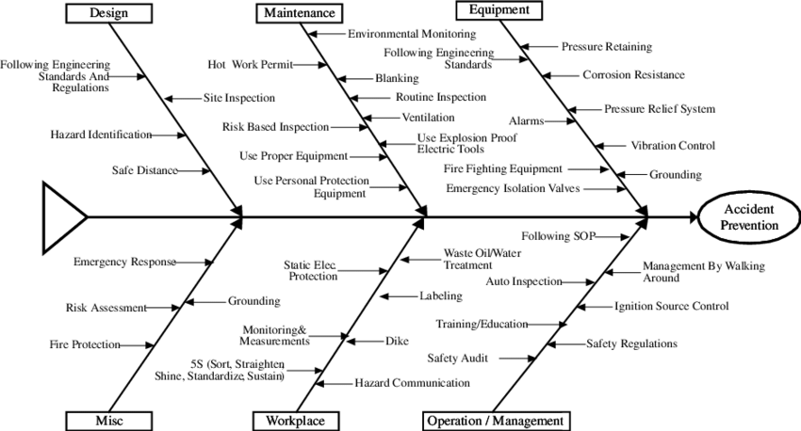
Fishbone analysis
Fishbone analysis is that type of
analysis which is a visual method for
root cause analysis which organises
cause and effect relationship into
categories. It is a more structured
approach than other tools which is
available for brainstorming cause of a
problem.
Notes:
The main cause of stress level at UK organisation is related to work pressure and also have pressure of earning into suitable manner (Hofinger and Buerschaper., 2017). Employees also have stress related to financial aspect as well. Employees have to face higher level of stress in order to achieve their appropriate performance.

Slide 7
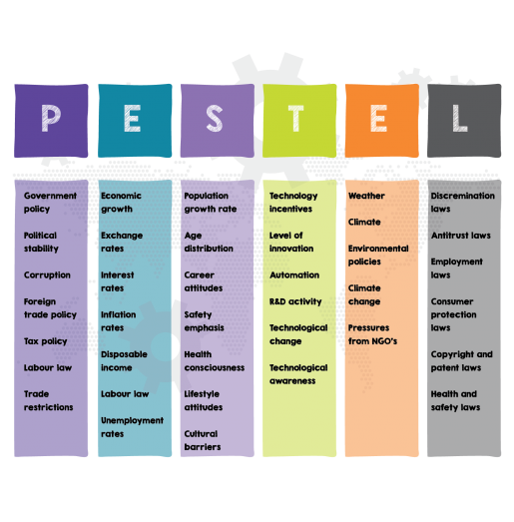
A PESTLE analysis
Political factor: More employees are replacing by the organisation. Employers and organisations are found new talent even they don’t want to replace them. HR implemented talent-based management.
Political factors include the government rules and regulations which imposed on company some time government imposed higher taxation due to company paying higher tax will result stress on the company.
Notes:
• Economical factor: Interest rate, availability of capital, inflation rate, foreign exchange rate affect the supply and demand of the business (Hallo and Nguyen, 2021). It is important to consider this factor because this increased demand and workload in simple terms overload employee.
• Social: It affects hard facts such as population growth rate and demographic. By this factor, the company increase their profitability through the use of holidays.

Slide 8
Continue..
Technology: This factor affects the company's innovation. This factor is very fast-moving because new technology increases the productivity of the company.
Environment Factors: The climate or weather affects the company external environment. Currently, it is identified that sustainability is becoming a trend which is necessary to adopt by each and every organisation. For that reason, it is crucial for every employees that they need to focus on their working style which increases pressure on them in order to achieve the sustainability
Legal: The Company do across border business the legal factor. It increases the stress of workers as they need to handle cross border functions as well.

Slide 9
Alternative solutions to work-related stress
A primary factor that measures to prevent stress removing or reducing potential stress.
First redesigning the work environment and motivated employees. Take a nap time and break between work times.
Increasing employee participation in the working environment and decision-making process. Innovate the working criteria to increase the employee motivation to do extra work without any stress.
Notes:
Cleary design tasks did not give any load on the employee because of this they enjoy their work. An employer must give work to employees according to their job specifications and increase time resources for completing their work. An employer must give an appraisal to an employee regarding their work promotion and reward give also. An employer must eliminate the physical hazard. Employers trained employees according to their work give them new technology. Giving them cognitive behavioural therapy. Routine checks up must be in the working environment. Redesigning the work and giving the small task to complete organisation projects will increase the employee morale they opt decisions according to their work. Every organisation should be providing an employee assistance program to the affected employee.

Slide 10
CONCLUSION
It can be concluded from the above discussion that employees stress is a very big problem and the company want to reduce it effectively. They give some major options to reduce this stress in the above discussion.
By the discussion of PESTEL Analysis, company must understand all factors which affect the company's external and internal environment. The report gives solutions also regarding work-related stress that how to reduce this stress.

Slide 11
References
Hallo, L. and Nguyen, T., 2021. Holistic View of Intuition and Analysis in Leadership Decision-Making and Problem-Solving. Administrative Sciences, 12(1), p.4.
Klein, G. and Crandall, B.W., 2018. The role of mental simulation in problem solving and decision making. In Local applications of the ecological approach to human-machine systems (pp. 324-358). CRC Press.
Lassoued, K., Awad, A. and Guirat, R., 2020. The impact of managerial empowerment on problem solving and decision making skills: The case of Abu Dhabi University. Management Science Letters, 10(4), pp.769-780
Notes:
Shoesmith, W.D., and et.al., 2022. Development of a scale to measure shared problem-solving and decision-making in mental healthcare. Patient Education and Counseling.
Walton, D., Toniolo, A. and Norman, T.J., 2020. Dialectical models of deliberation, problem solving and decision making. Argumentation, 34(2), pp.163-205.

