Slide 1


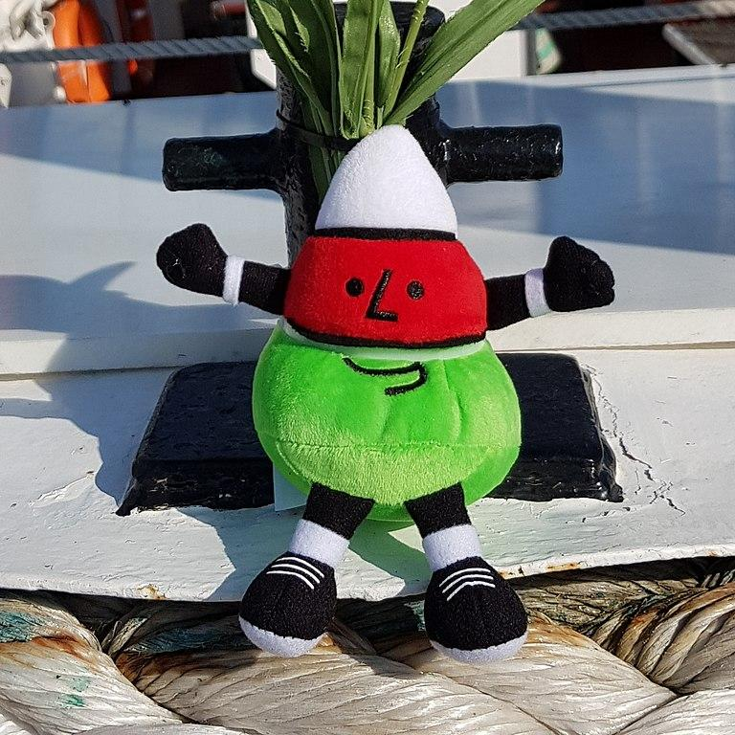
Celebrating Language and Cultural Belonging to Wales
Urdd Gobaith Cymru
By Ceri Donald
Module Code: ECIE5004
Images Urdd Gobaith Cymru

Slide 2
A brief history of the Welsh Language:
Oldest Language in Europe
Industrial Revolution
1900’s
Pre 1850’s 90% 0f people Living in Wales spoke the Welsh Language
Welsh Not
1798
Welsh Language act 1967
Siarter Iaith and Curriculum Cymreig
1995
New curriculum for Wales 2022
Education act 1988/1993
By 2021 Welsh speakers less than 30%
Notes:
Urdd Gobaith Cymru was established by Sir Ifan ab Owen Edwards in 1922. His aim was to protect the Welsh language in a world where the English language dominated every aspect of life outside the home. In an issue of the magazine ‘Cymru’r Plant’ in 1922 Syr Ifan said, ‘These days, in many villages, and in most towns in Wales, children play and read in English. They forget that they are Welsh.’

Slide 3

Urdd Gobaith Cymru
How and Why:
The Urdd Gobaith Cymru was established in 1922 by Sir Ifan ab Owen Edwards, with the aim of protecting the Welsh language where English language dominated.
Llangranog Centre Pentre Ifan Urdd’s environmental
Established Mr Urdd was and wellbeing residential
1939 born 1976 centre opened 2023
Established
1922
!st National Eisteddfod Glan-llyn Centre Cerdiff Urdd centre established
Corwen 1929. Followed in 2004
1950

Slide 4

Residential opportunities
https://www.gov.wales/multi-million-pound-investment-develop-urdd-residential-centres
Today 56% of all Welsh schools attend Urdd centres on residential courses, and of those who visited over the past 3 years, 26% came from the 20% most deprived communities in Wales.
More second language Welsh schools visit the centres than first language Welsh schools, which demonstrates their value as an access point to the Welsh language, and that it is alive and relevant.
Sharing a love for Welsh culture and atmosphere

Slide 5


Urdd Impact on education - The Eisteddfod:
The Eisteddfod involves local communities in the preparation process, which can help build community empowerment.The Eisteddfod can boost the local economy. For example, the 2024 Eisteddfod in Rhondda Cynon Taf was expected to boost the local economy by £16 million.

Slide 6
Urdd Impact on education - Sports and Apprenticeships
The urdd organisation boast over 19 sports based clubs across Wales
Rugby
Football
Surfing
Dance
Golf
Basketball
Climbing
Athletics
Ski-ing
Netball
Apprenticeships:
Schools
Leisure Centres
Sports Clubs
Outdoor Centres
Nurseries
Youthclubs

Slide 7
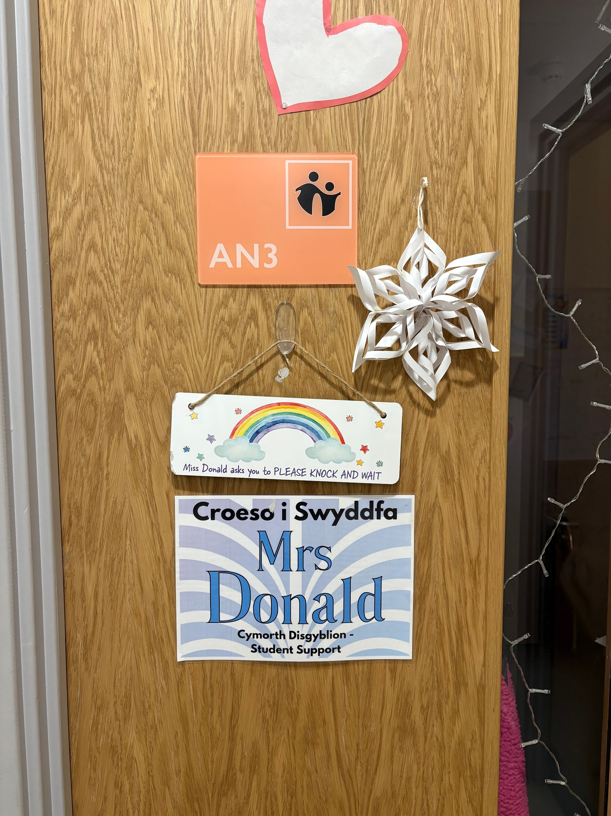
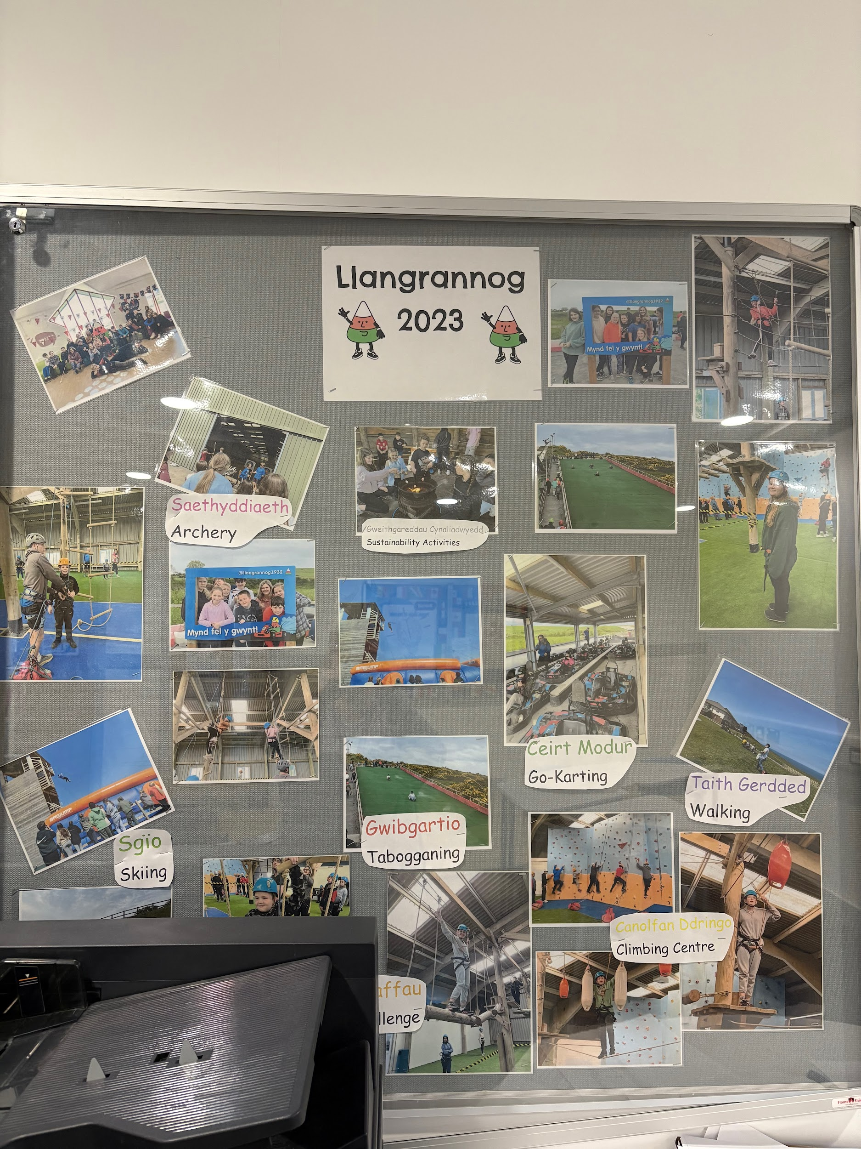
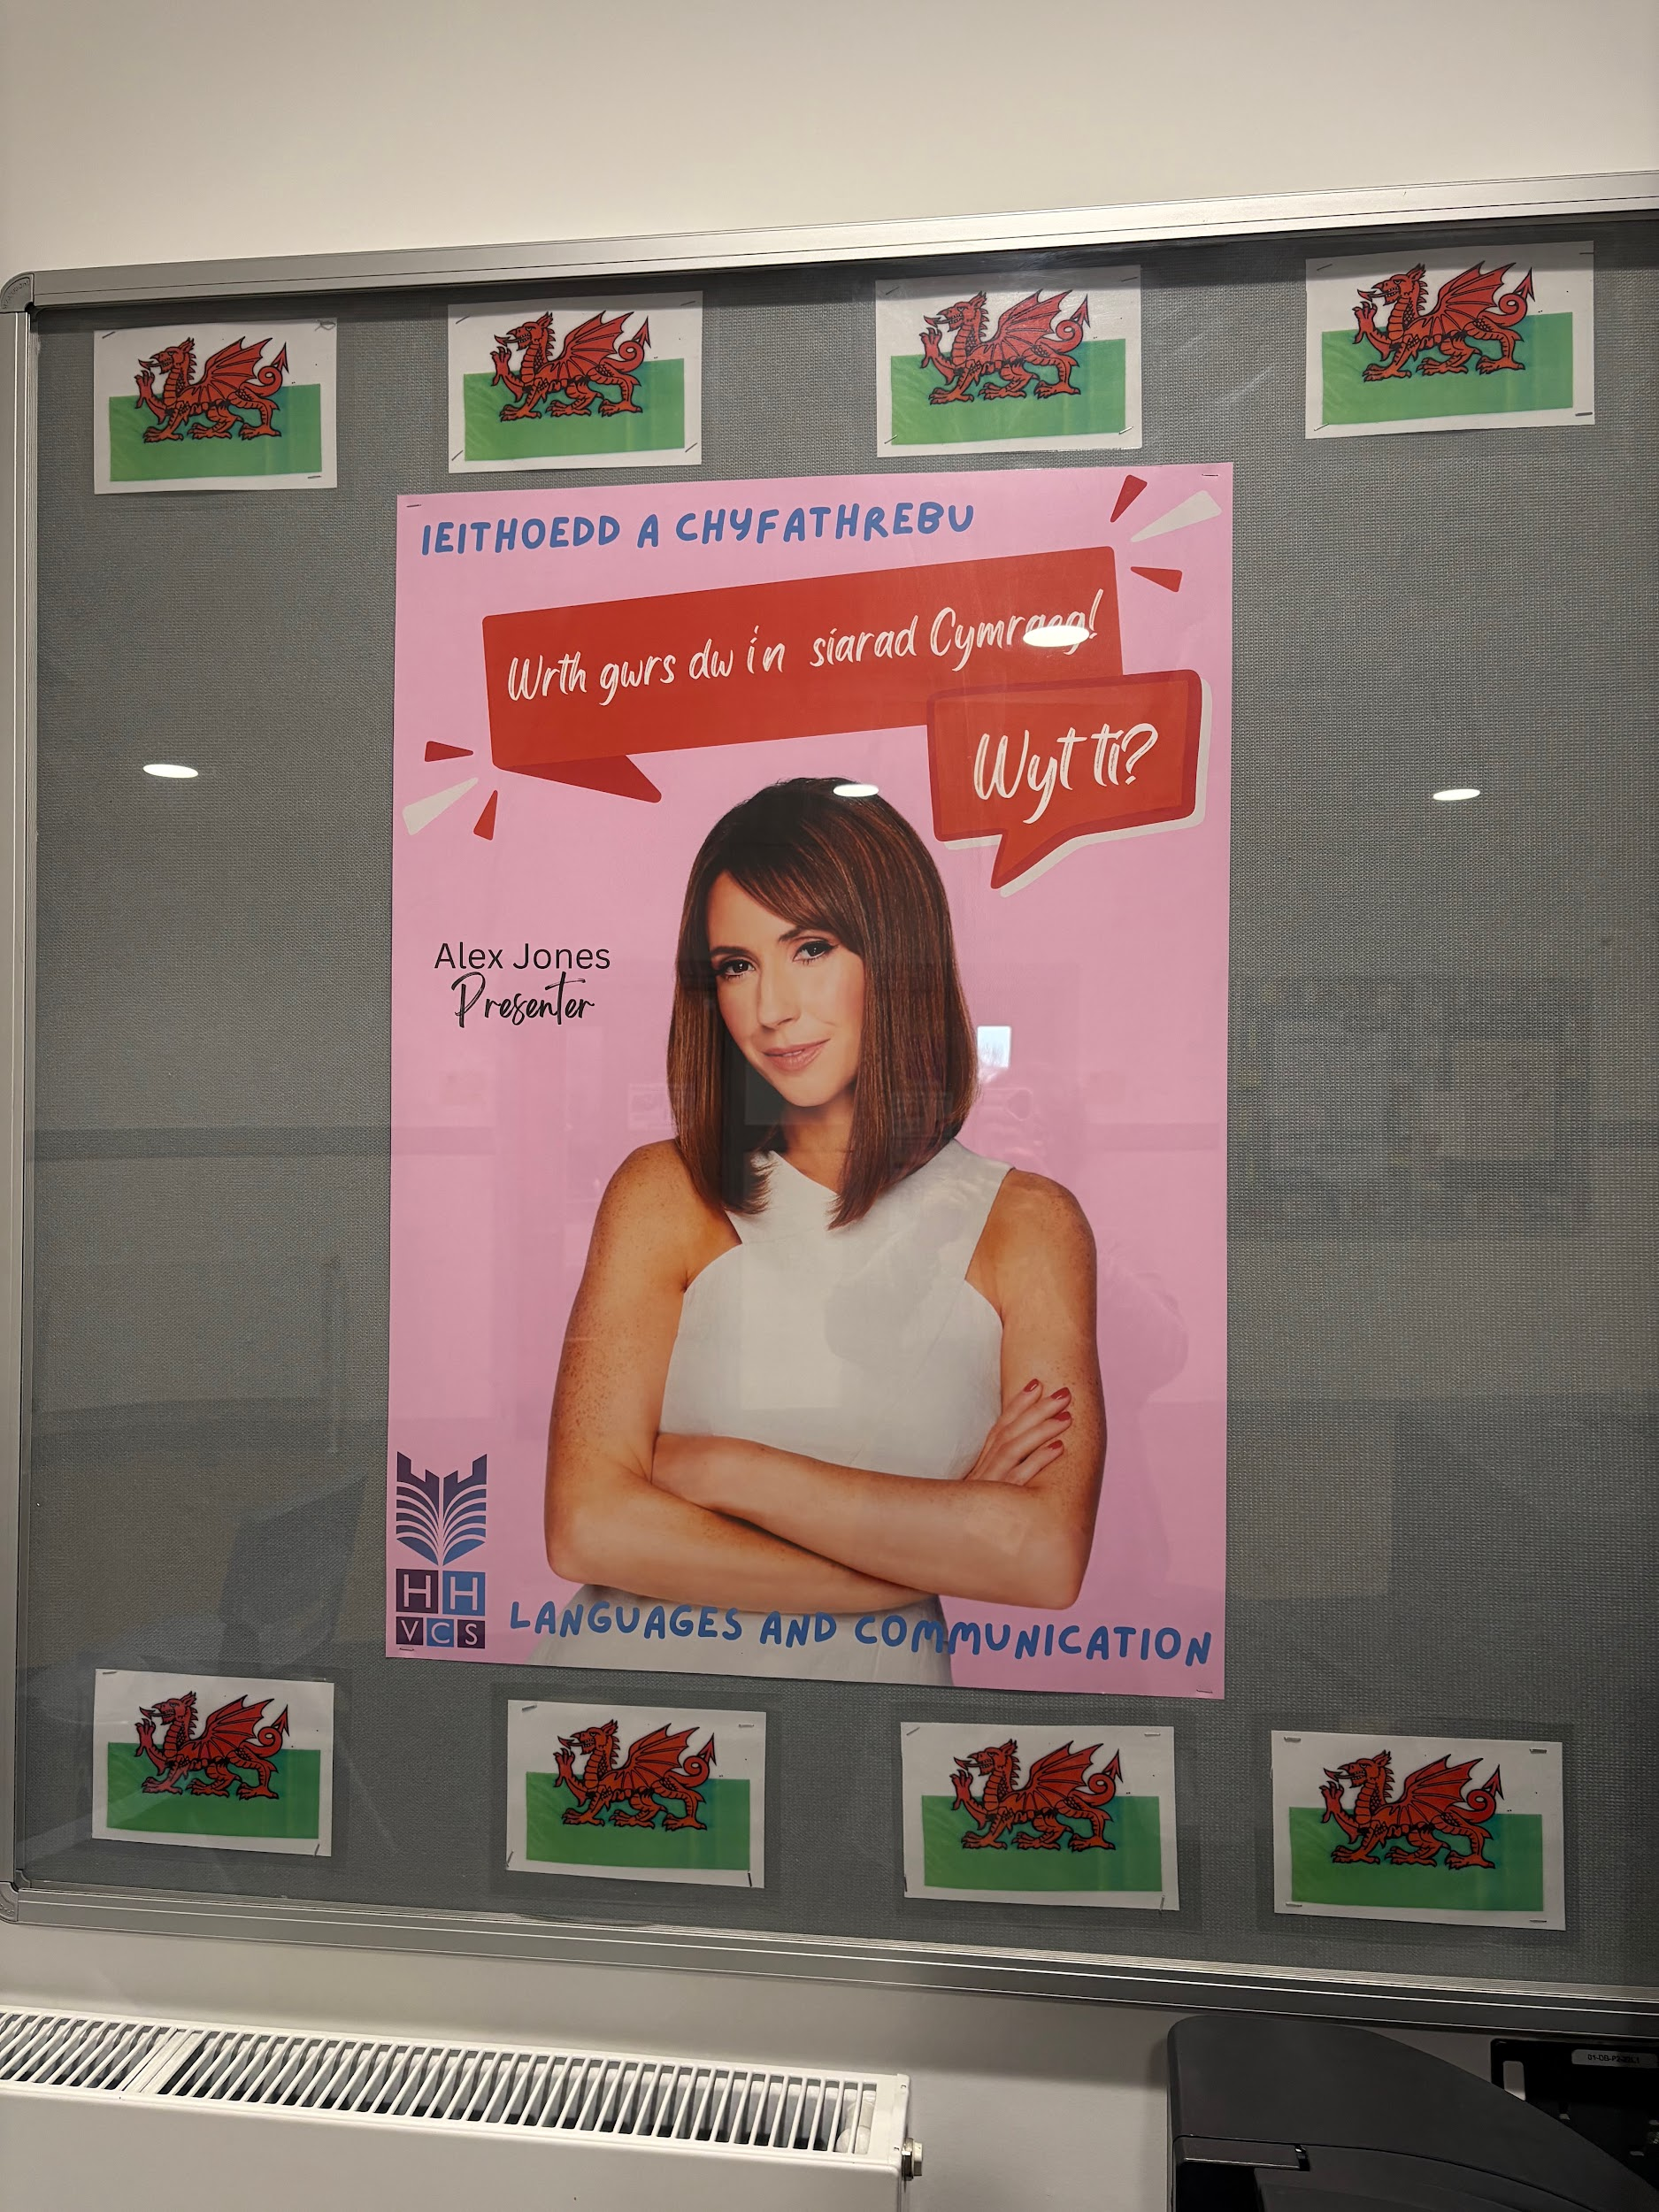
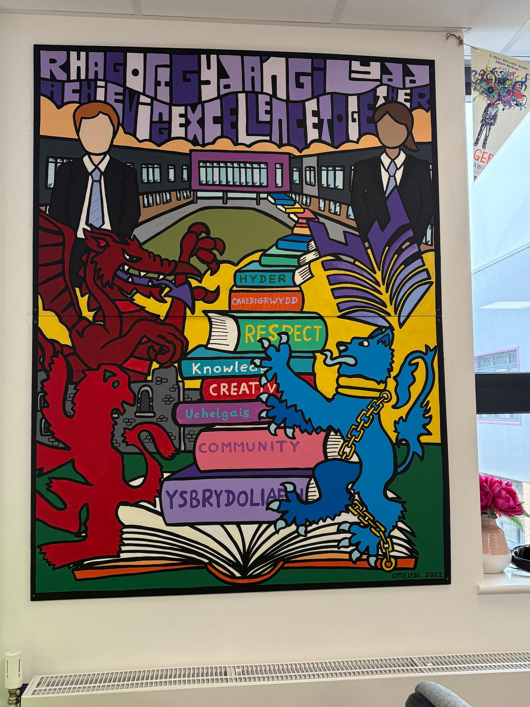
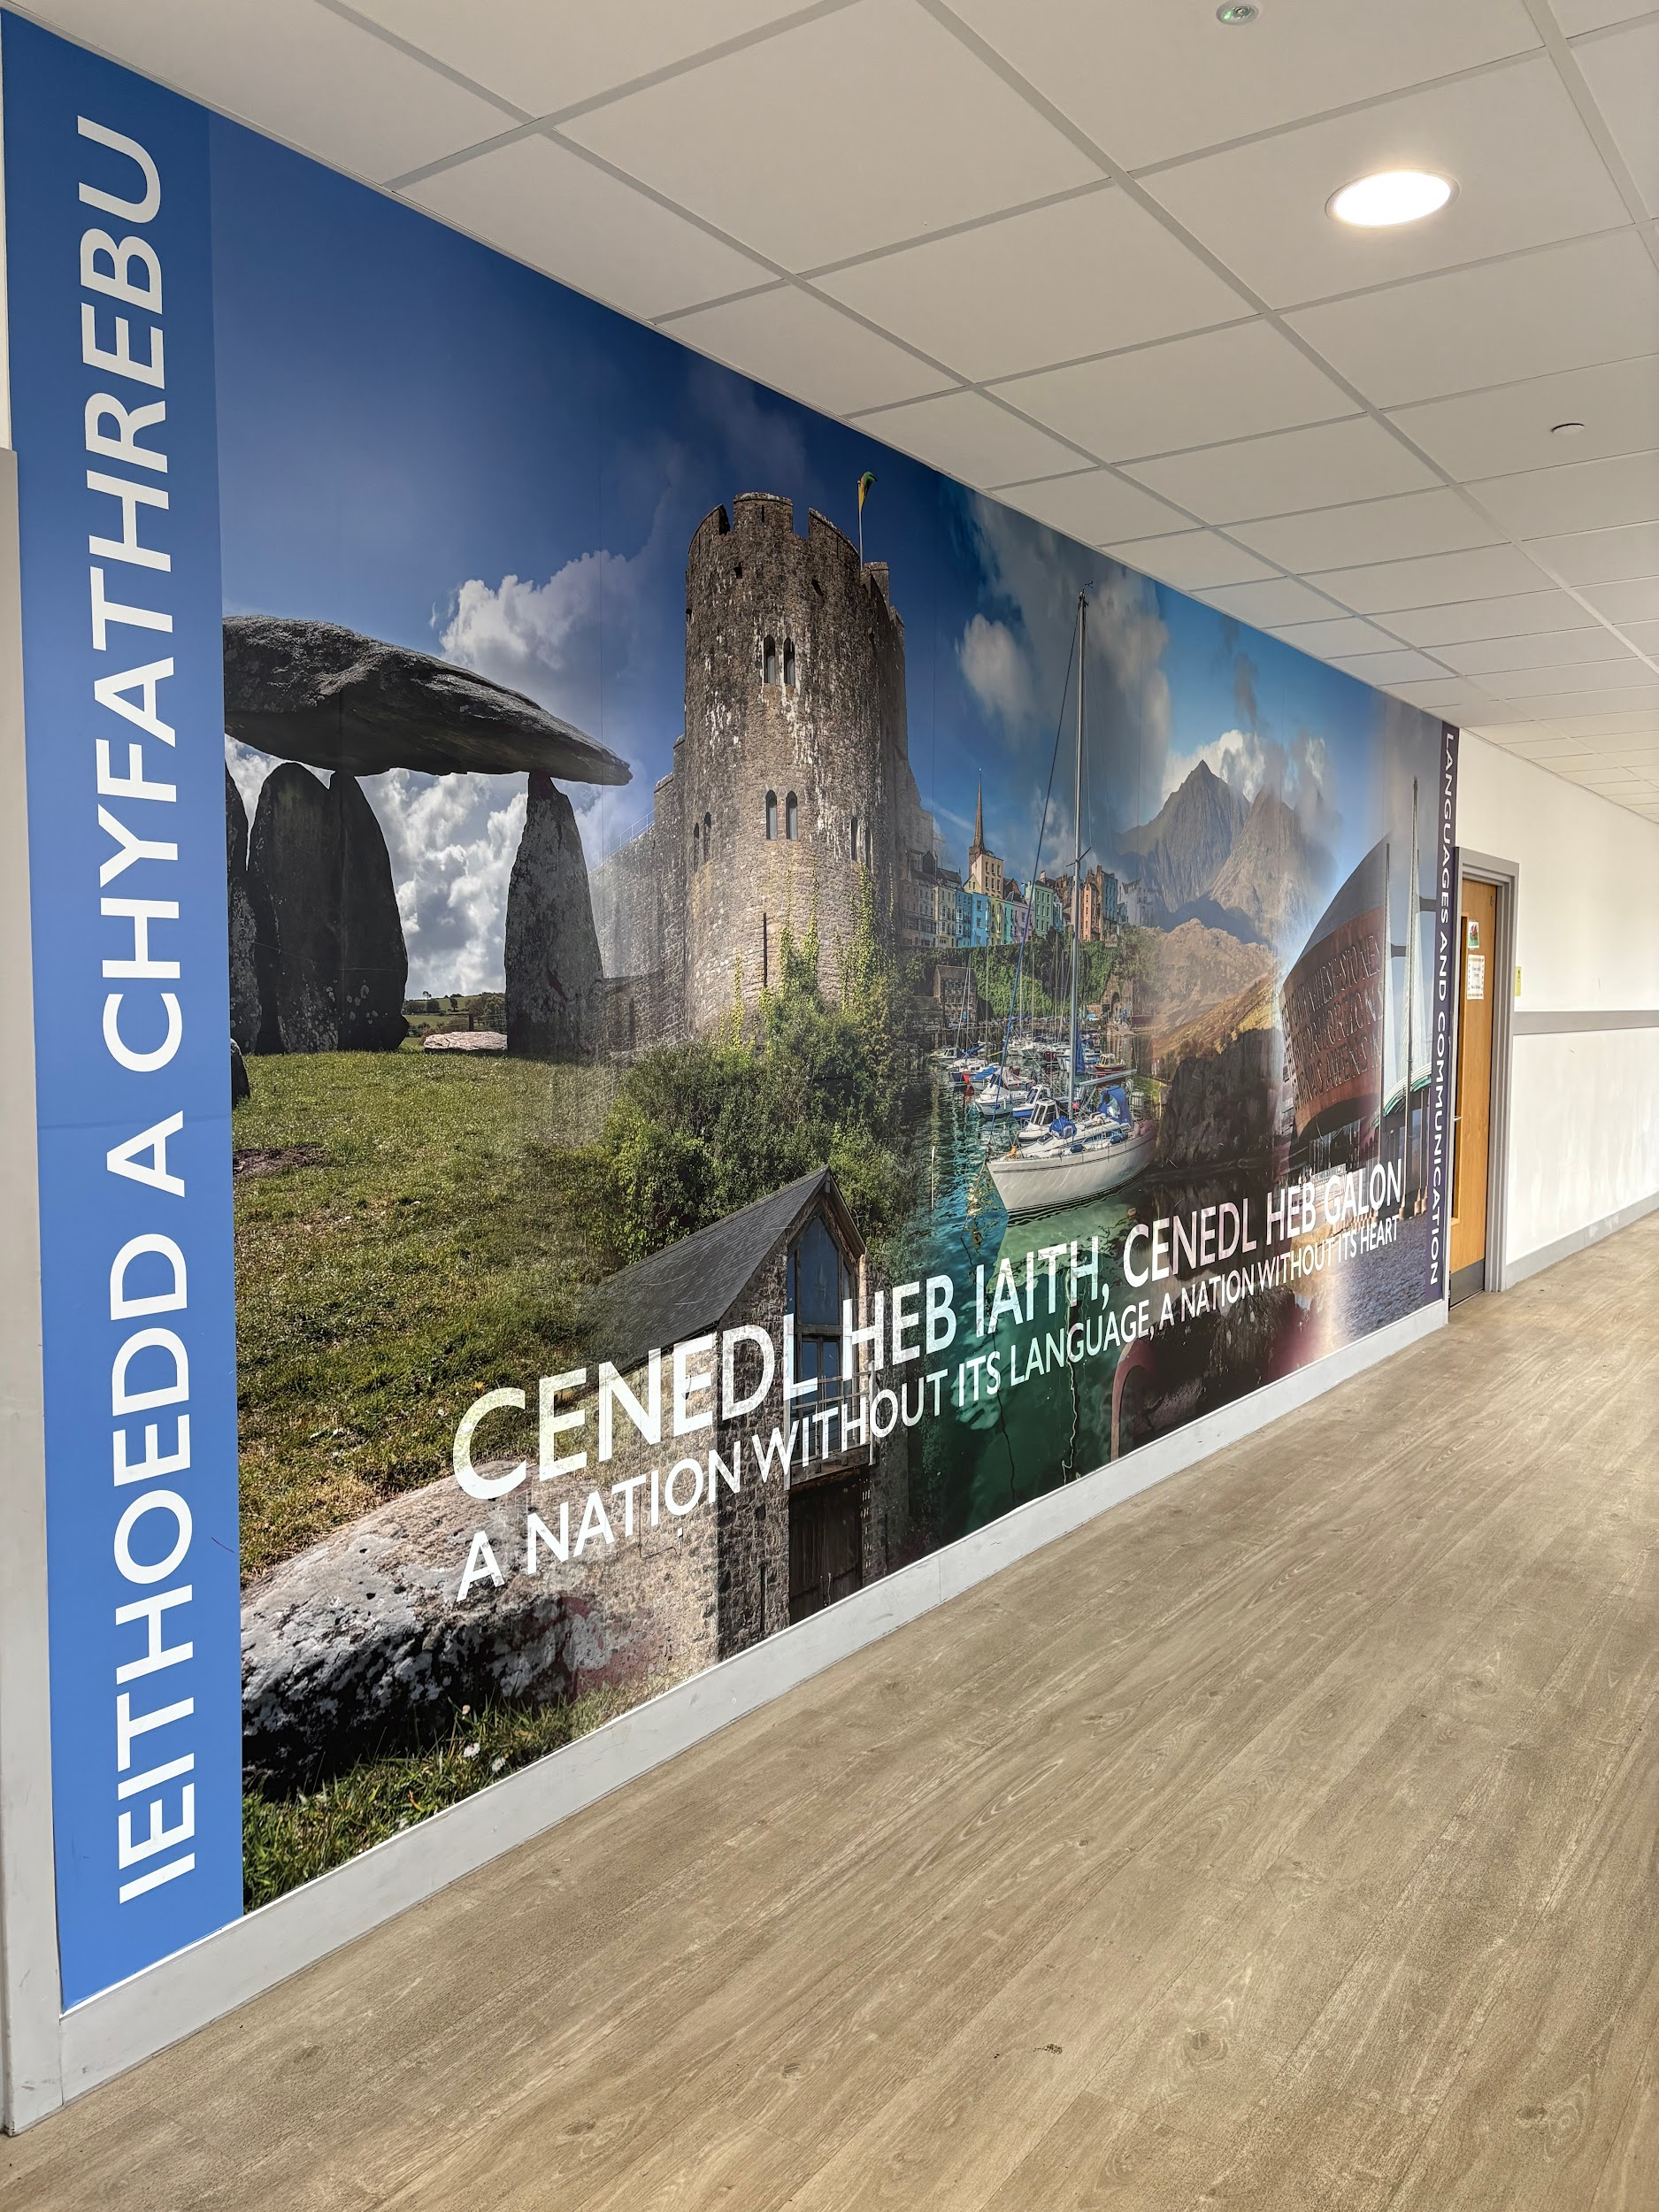
Urdd Impact on education - Personal experiences

Slide 8
Urdd Impact on education - The figures
Martin Shipton
Wales’ largest youth organisation Urdd Gobaith Cymru contributed nearly £45m to the Welsh economy in 2022-23, according to a new report.
In five years, the Urdd’s economic worth has increased from £25.5m to £44.9m, an increase of 76%, and the organisation’s turnover has increased from £10.2m to £19.6m – an 88% increase.Urdd Gobaith Cymru generated an economic value of £44.9m in Wales in 2022-23 (an increase of 76% since 2018)
A direct impact of £15.4m through the Urdd’s expenditure on goods, services and staff in Wales
An indirect impact of £10.6m through expenditure by visitors to Urdd eisteddfods, residential centres and sporting activities

Slide 9
Urdd Impact on education - Conclusion
Over 55,000 members every year
200 apprentices
10,000 volunteers
Up to 100,000 visitors to the Urdd Eisteddfod every year
250 sports clubs, with over 3,500 children taking part weekly
103,000 visit the residential centres every year
17 Development Officers work across Wales in their local areas

Slide 10
References
Background images: Original Tegan Donald
Images: https://www.urdd.cymru/en/about-us/news-press/ymrwymiad-yr-urdd-i-blant-phobl-ifanc-difreintiedig/
Videos: Eisteddfod yr Urdd - S4C (2024). 1af - Ruby Davies - Llefaru Unigol Bl.5 a 6 (D) - Eisteddfod yr Urdd 2024. [online] YouTube. Available at: https://www.youtube.com/watch?v=x33j46qTMWc [Accessed 26 Jan. 2025].
Urdd.cymru. (2025). Urdd Gobaith Cymru / The Urdd’s commitment to disadvantaged children and young people. [online] Available at: https://www.urdd.cymru/en/about-us/news-press/ymrwymiad-yr-urdd-i-blant-phobl-ifanc-difreintiedig/.
Mansfield, M. (2023). Urdd contributed £45m to the Welsh economy last year. [online] Nation.Cymru. Available at: https://nation.cymru/news/urdd-contributed-45m-to-the-welsh-economy-last-year/ [Accessed 26 Jan. 2025].
Mansfield, M. (2023). Urdd contributed £45m to the Welsh economy last year. [online] Nation.Cymru. Available at: https://nation.cymru/news/urdd-contributed-45m-to-the-welsh-economy-last-year/ [Accessed 26 Jan. 2025].
Mansfield, M. (2023). Urdd contributed £45m to the Welsh economy last year. [online] Nation.Cymru. Available at: https://nation.cymru/news/urdd-contributed-45m-to-the-welsh-economy-last-year/ [Accessed 26 Jan. 2025].
‌
‌
GOV.WALES. (2018). Multi-million pound investment to develop Urdd residential centres | GOV.WALES. [online] Available at: https://www.gov.wales/multi-million-pound-investment-develop-urdd-residential-centres [Accessed 26 Jan. 2025].
‌

