Slide 1

Research methodology
Dr caroline jawad 2020

Slide 2
Who would you save?
Ship is sinking !
There is an uninhabited island a few miles away, but the waters are shark-infested.
You get in the only lifeboat, and 6 people can fit in the life boat with you.

Slide 3
Choices
CEO, male, 40 years old
Professional wrestler, male, 28
Farmer, male, 46
Surfer, male, 21
Police Officer, male, 39
Homemaker, female, 35
Nurse, male, 40
Doctor, female, 62
Comedian, male, 35
Handicapped boy, male, 8
Pregnant teenager, female, 17
Lawyer, female, 36
Buddhist Monk, male, 29

Slide 4

CEO, male, 40 years old

Slide 5
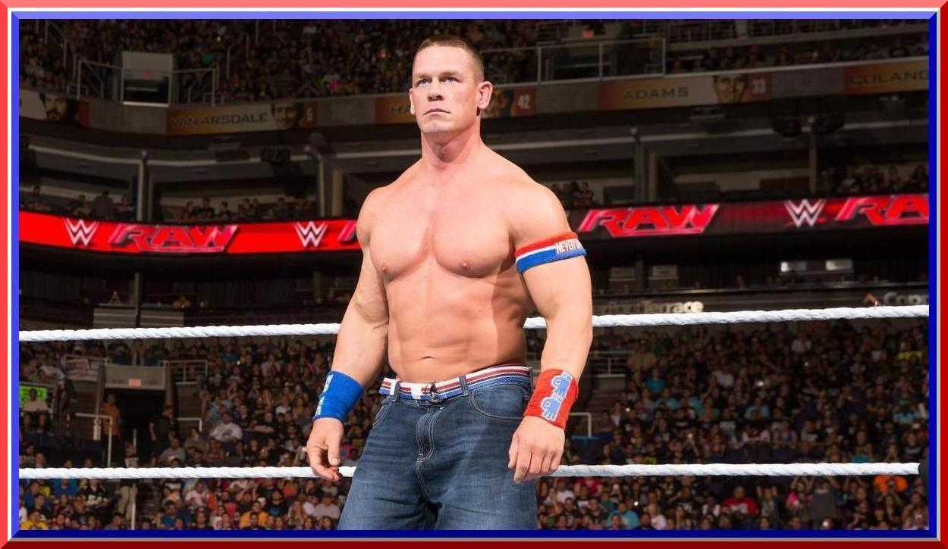
Professional wrestler, male, 28

Slide 6
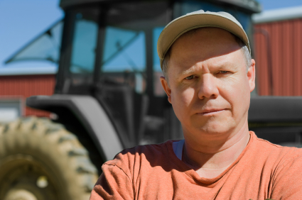
Farmer, male, 46

Slide 7
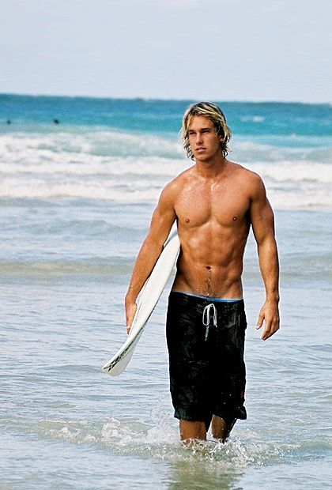
Surfer, male, 21

Slide 8
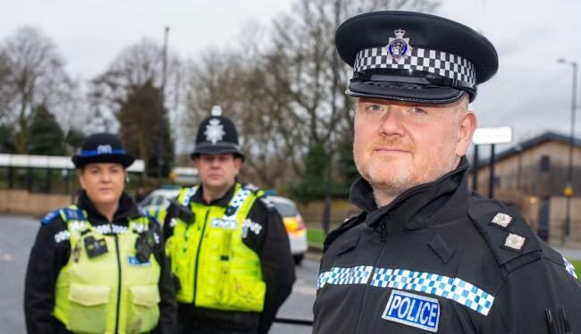
Police Officer, male, 39

Slide 9

Homemaker, female, 35

Slide 10

Nurse, male, 40

Slide 11

Doctor, female, 62

Slide 12
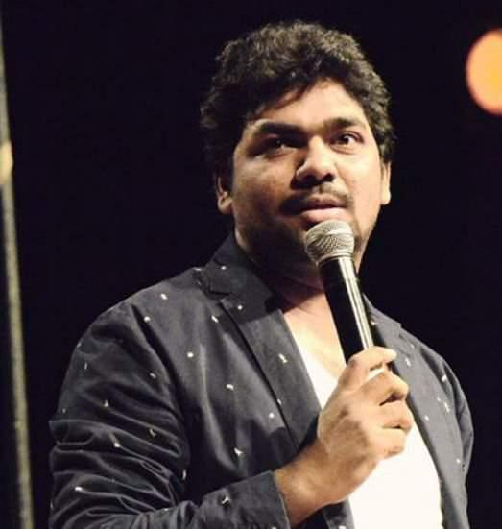
Comedian, male, 35

Slide 13

Handicapped boy, male, 8

Slide 14

Pregnant teenager, female, 17

Slide 15

Lawyer, female, 36

Slide 16
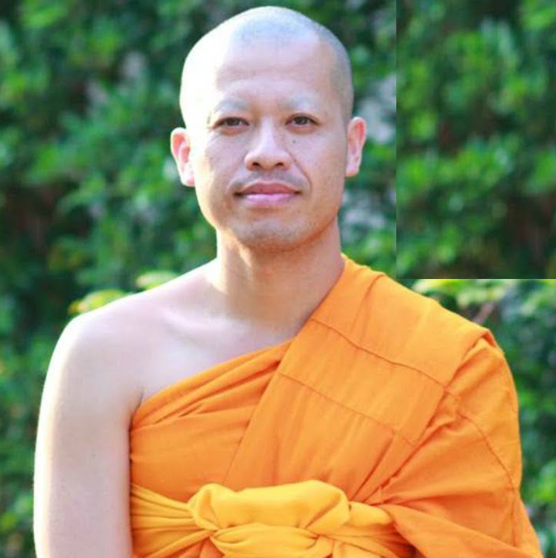
Buddhist Monk, male, 29

Slide 17
Who to save? Who to not save?
AND WHY?
Notes:
Reasons to not save
CEO
doesn’t have money now
Wrestler
he is too heavy/strong
“he is violent”
“because he is trash”
Farmer
“he will eat a lot of food”
“he has little money”
not useful
Surfer
he can swim well, so he can save himself
Police officer
he is supposed to sacrifice himself for others
“because he is unuseful”
“nothing criminal”–no criminals are on the island (obviously they’ve never seen “Lost”)
“He is dangerous”
“There is no use” for him
Homemaker
“We don’t have a house”
no special reason to save her
not useful
she is noisy
Nurse
“because Doctor exist”
“Doctor is enough to cure us”
“We have a Doctor with many experiences”
“The Doctor is in the boat”
Doctor
too old (said several times)
will save Nurse instead
Comedian
the situation will make him sad and he won’t be funny
he is too fat and will eat too much
he is a pig
“there is no use” for him
he is too heavy (for the boat)
Handicapped boy
he can’t get along with others
he is weak
“unuseful”
isn’t help to us
Pregnant teenager
“too young to raise her baby”
“when her baby borne, eat a lot of milk”
“she is too young”
“trash”
Lawyer
“very smart so selfish”
“there is no use” for her
Buddhist Monk
“rebirth”–that is, he will reincarnate
“He can meet Buddha after he dies,” “He is liberated”
we don’t believe in religion–“We believe each other”
not useful
Reasons to save
CEO
smart
affects the world
Wrestler
he’s strong, has power
he can protect us
“He will save us when we are in a dangerous situation”
Farmer
he can grow food
he makes grain
we need food
we need rice to eat
he can make rice
Surfer
good swimmer
“save people in the sea”
“he can swim and young”
“because he is handsome and muscular”
Police officer
he can make people stop fighting, can protect us from our fighting
Homemaker
she can cook, make us good food to eat
she has a family
Nurse
young
help doctor
he can take care of us, cure us
Doctor
she can cure us, cure other sick people, take care of us
Comedian
can make us laugh
Handicapped boy
he is sick and young
too young
he is very young “it is very very useful”
Pregnant teenager
“she has a baby”
pregnant, “she has two lives”
“one body -> two lives”
“She has baby. Then, she has 2 life”
Lawyer
she is smart
helps us when we’re fighting
if we save her she’ll give us money
she can protect us when we will escape
Buddhist Monk
No one wanted to save him…hum. Mostly because he was “not useful.”

Slide 18
Conceptions of social reality

Slide 20
ontology
Ontology Is reality objective?
External & independent of individuals? Is reality subjective?
Constructed by individuals.

Slide 24
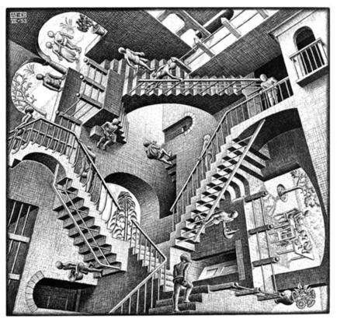

Slide 25
There is a big debate in social sciences as to the nature of facts and therefore, the valid way of conducting research

Slide 26
Ontology is enough to do your head in

Slide 27
EPISTEMOLOGY
How do we know what we know?
What is knowledge?
How do we gain it?
How do we communicate it?
Notes:
19. Suicide Interpretivist perspectives
20. Interpretivists & Social Construction Jack Douglas: Need to interpret meanings given to the action of suicide Notes, diaries, interviews Cultural context Maxwell Atkinson: Problem of statistics Coroner and clues
21. Methodologies
22. Experiment Controlled conditions Manipulation of variable on another
23. Survey Collection of data Measure of a social phenomenon Description of group/ population Testing theories
24. Ethnography Description of people and their cultures Detailed accounts of everyday life Understanding of how people see their world
25. Phenomenology Understanding of the human experience Subjective meanings Attitudes and beliefs
26. Methods of Data Collection Questionnaires Interviews Observation Documents

Slide 28
Comparing Epistemologies
? | ?
Knowledge is objective | Knowledge is subjective
Hard data | Meaning has action
Can be measured | Relies on interpretation
Natural and social world are the same | Social world different to natural world

Slide 29
POSITIVISM
Key Features
Scientific
Objective
Robust Involves identifying causes
Tests hypotheses
Uses the methods of the natural sciences

Slide 30
POSITIVIST
Scientific External reality - need to collect ‘facts’
Methods of natural sciences
Use of statistics (quantitative)
Experiments, surveys

Slide 31
INTERPRETIVIST
Social Scientific Subjective, constructed reality
Relative truths
Need to explore, explain and understand reality
Qualitative

Slide 32
POSITIVISM
Positivism is the view that research can and should use the methods of the _________ ___________ . Positivists do believe that research should use _____________ methods and aim to identify and measure social structures.
Notes:
Positivism is the view that research can and should use the methods of the natural sciences. Positivists do believe that research should use quantitative methods and aim to identify and measure social structures.

Slide 33
INTERPREVISTS
Interpretivists argue the opposite. They take the view that since human beings think and reflect, scientific methods are inappropriate for the study of society. Unlike objects in nature, human beings can change their ___________ if they know they are being observed. So interpretivists argue that if we want to understand social action, we have to delve into the _______________ and ________________which that action has for people. Take the example of crime. A _______________ would argue that researchers can simply measure crime using quantitative methods and identify patterns and correlations. _______________ would argue that we need to understand what people mean by crime, how they come to categorise certain actions as ‘criminal’ and then investigate who comes to be seen as criminal in a particular society.
Notes:
Interpretivists argue the opposite. They take the view that since human beings think and reflect, scientific methods are inappropriate for the study of society. Unlike objects in nature, human beings can change their behaviour if they know they are being observed. So interpretivists argue that if we want to understand social action, we have to delve into the reasons and meanings which that action has for people. Take the example of crime. A positivist would argue that researchers can simply measure crime using quantitative methods and identify patterns and correlations. An interpretivist would argue that sociologists need to understand what people mean by crime, how they come to categorize certain actions as ‘criminal’ and then investigate who comes to be seen as criminal in a particular society.

Slide 34
Research paradigms

