Slide 1
Sports Industry Research Project Proposal

Slide 2
Analysing the Age of Sport Specialisation in three different sports (Football, Rugby and Netball) in college students and understanding the potential impacts relating to this
By Craig Anthony Michael Evans

Slide 3
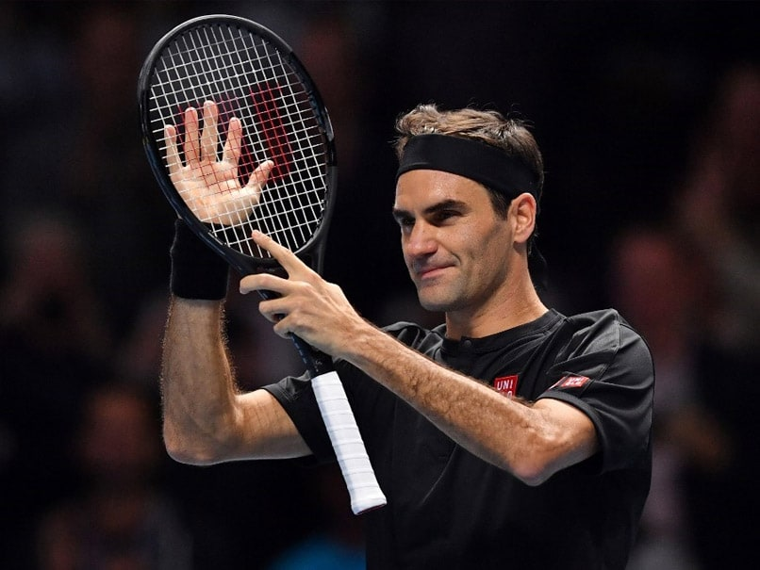
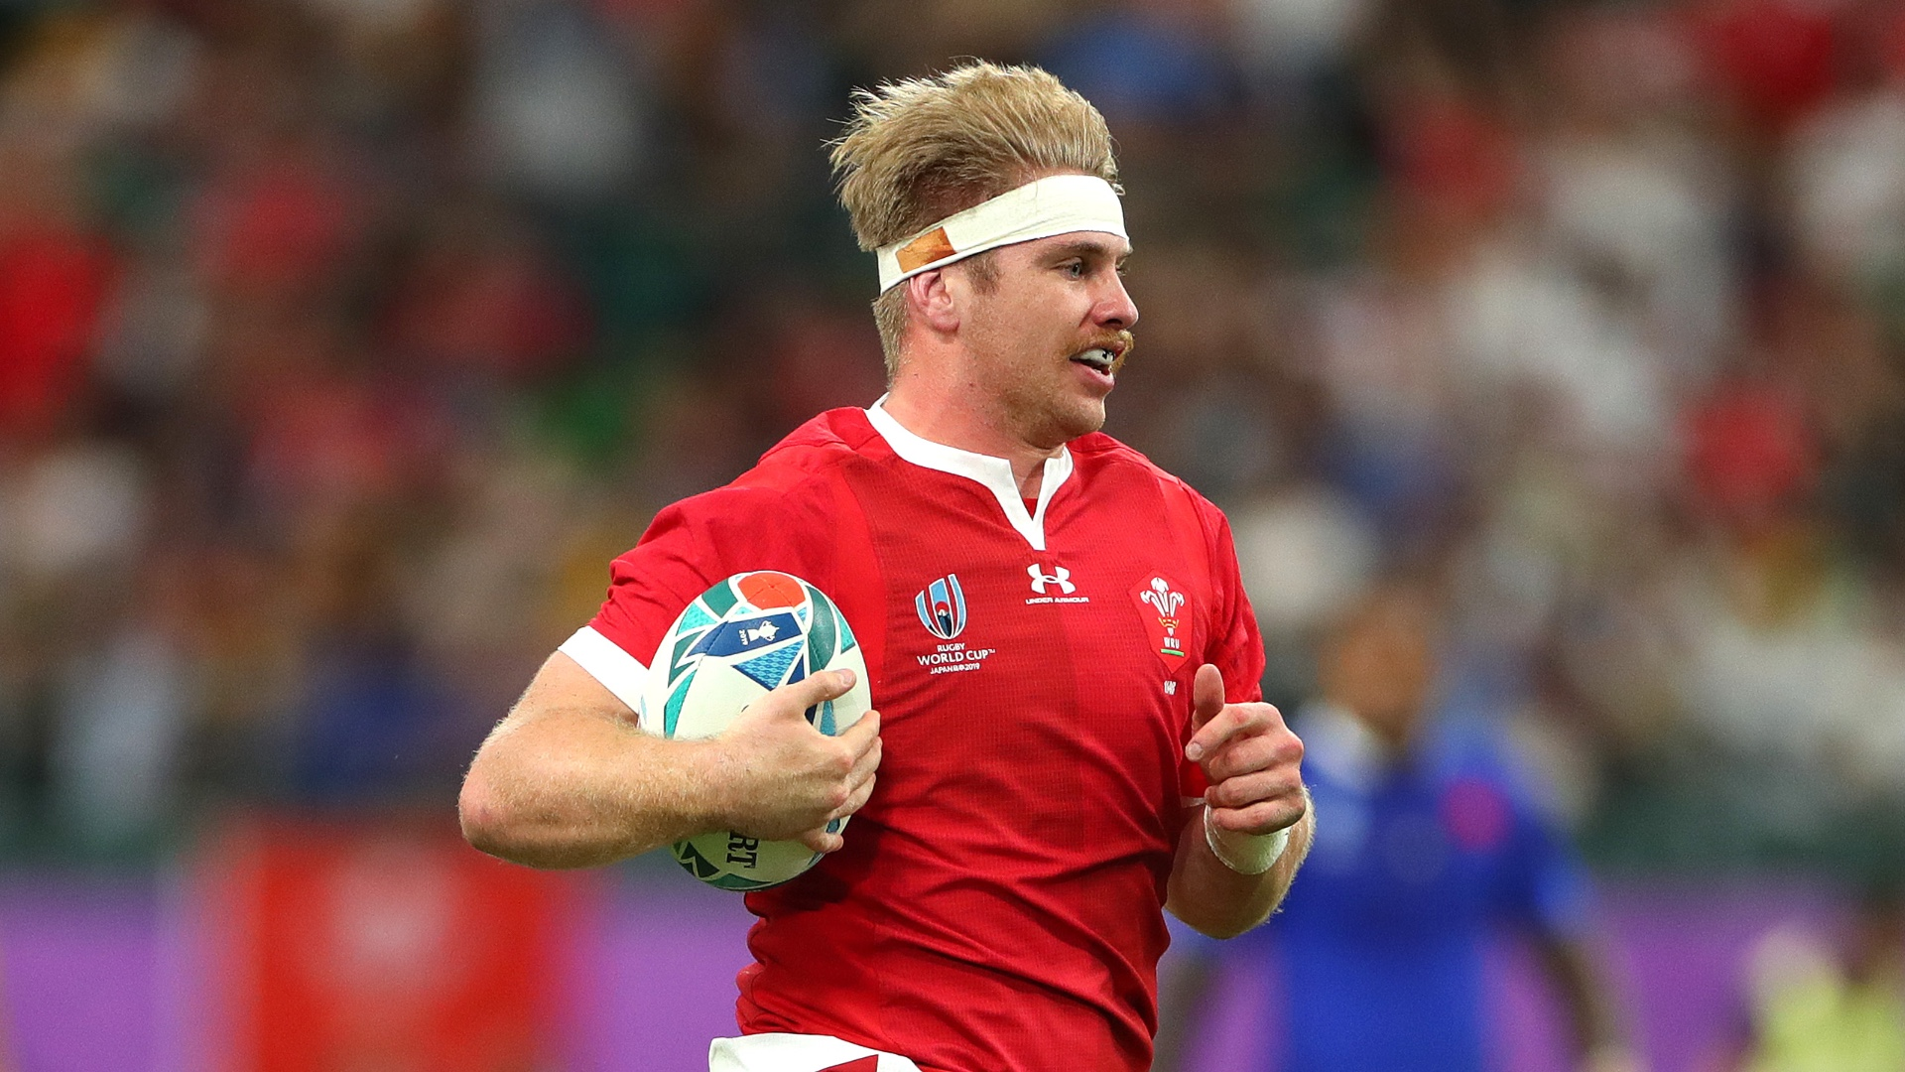
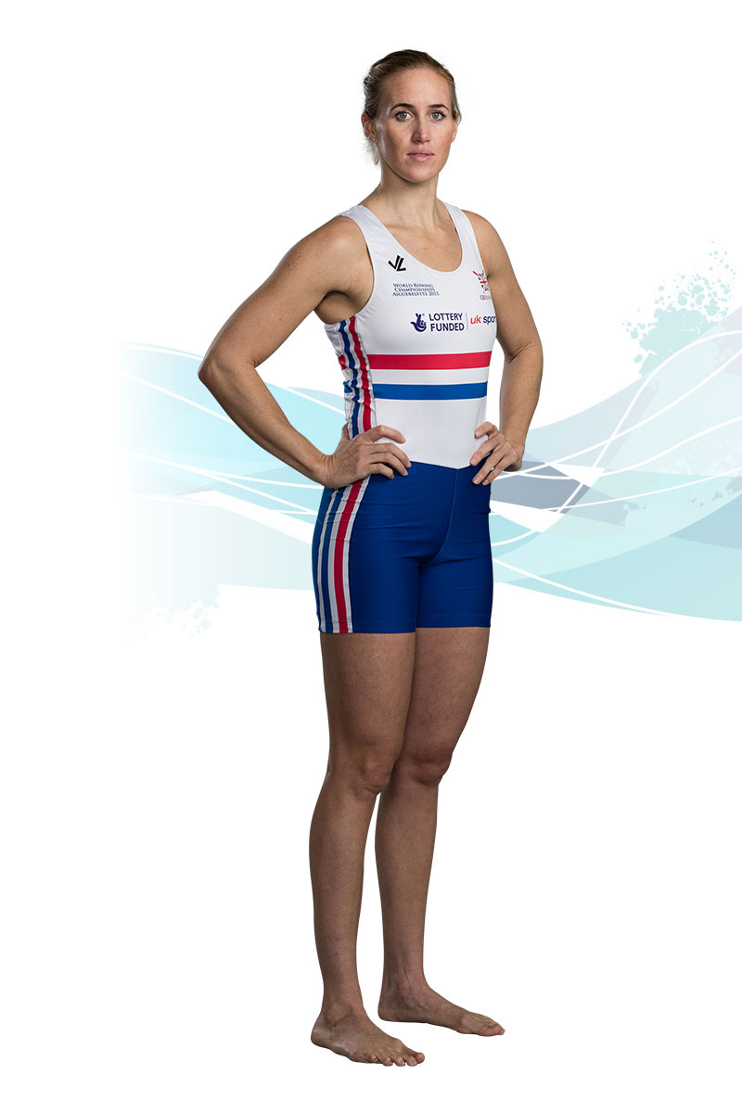


Slide 4
The rationale

Slide 5
Why undertake the research
How do we achieve the highest level of success for our Athletes whilst also ensuring the safety and welfare of them?
I have long believed that success should not be to the detriment of our young athletes mental and physical well being and researching this subject will go some way to hopefully helping myself in my future career.
So in future, are we able to utilise this study to shape and construct our Team and Academy structures to ensure our Athletes are performing at a high level and also physically and mentally at their peak.

Slide 6
Over the years there has been a significant increase in early years specific sporting training at a young age with several factors contributing to this including:
Pursuit of Scholarships or Professional Contracts
Labelling of being talented by parents or coaches
Pressure from Parents or Coaches to achieve an Elite Level of Success
Research has found that early years high performance does not lead to greater success in later years
Latorre-Roman, Pinillos, Robles (2018)
What's even more concerning is the dropout rate associated with this – Both Men and Women Showed dropout rates with the Women’s rate higher.
Factors for this include:
Increase in Injury rates
Increased Psychological Distress
(Corso, 2018)
So what can be done to help prevent this?

Slide 7
Aims & objectives

Slide 8
The Aim
To understand the Physical and Psychological effects of Sport Specialisation in College Athletes at Gower College Swansea

Slide 9
The Objectives
Construct a detailed and informative questionnaire for participants to undertake whereby they are able to evaluate what extent Sporting Specialisation has had on them – both Physically and Psychologically
Undertake a series of focus groups with participants to discuss at greater length whether Sport Specialisation is of increased benefit
Analyse the reasons as to why the participants have chosen to specialise in their sport and is there a difference in age dependant on the sport
Critically evaluate all factors discussed and produce a comprehensive report which aims to find any key themes or trends that may be valuable for future reference

Slide 10
The background

Slide 11
Gower college Swansea
Established in 2010 after a merger between Swansea College and Gorseinon College, Gower College Swansea has been providing educational services to over 4,500 full time and 10,000 part time learners throughout Swansea. There are several locations throughout Swansea including:
Tycoch
Sketty
Gorseinon
The Mission – ‘To inspire and support our learners to achieve their full potential through the delivery of the highest quality of education and training’
The Vision – ‘To be the best choice for learners’

Slide 12
The Sports Academies
Gower College Swansea currently operates 4 different Academies which are as follows:
Men’s Football Academy – offers a strong commitment to coaching, competition and players welfare whilst also offering the opportunity to train and develop using the available facilities at Swansea University.
Ladies Football Academy – As with the Men’s Academy, the ladies are provided with a wide variety of coaching, competition and regular access to a range of facilities which help contribute to pre match preparation and training.
Rugby Academy – All Rugby Academy Players are provided with access to high level coaching, facility usage at Swansea Universities Sports Complex and Sessions are linked with the Ospreys Rugby “Six Pillars of Development” covering Technical, Tactical, Physical, Nutritional, Psychological and Holistic Preparation.
Netball Academy – Players are provided with coaching from a qualified Netball Association Tutor who is able to provide the players with a wide range of coaching elements including technical and match preparation. Players also compete in a wide range of competitions given them a range of competitive experiences.

Slide 13
The Benefits to Gower College Swansea
The Link With Their Strategic Direction:
LEARNER – put the learner at the center of everything we do
QUALITY – deliver the highest quality possible in everything we do
IMPACT – achieve the highest possible positive impact on the economic and social wellbeing of individual learners in Swansea and South West Wales
EXCELLENCE – strive to be an excellent organization, growing sustainably, innovating and investing

Slide 14
Mini literature review

Slide 15
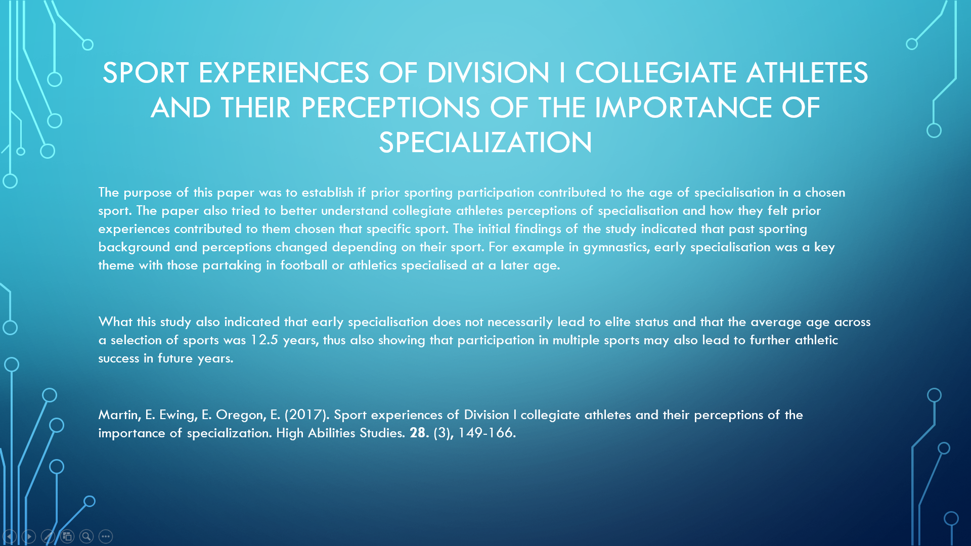

Slide 16


Slide 17
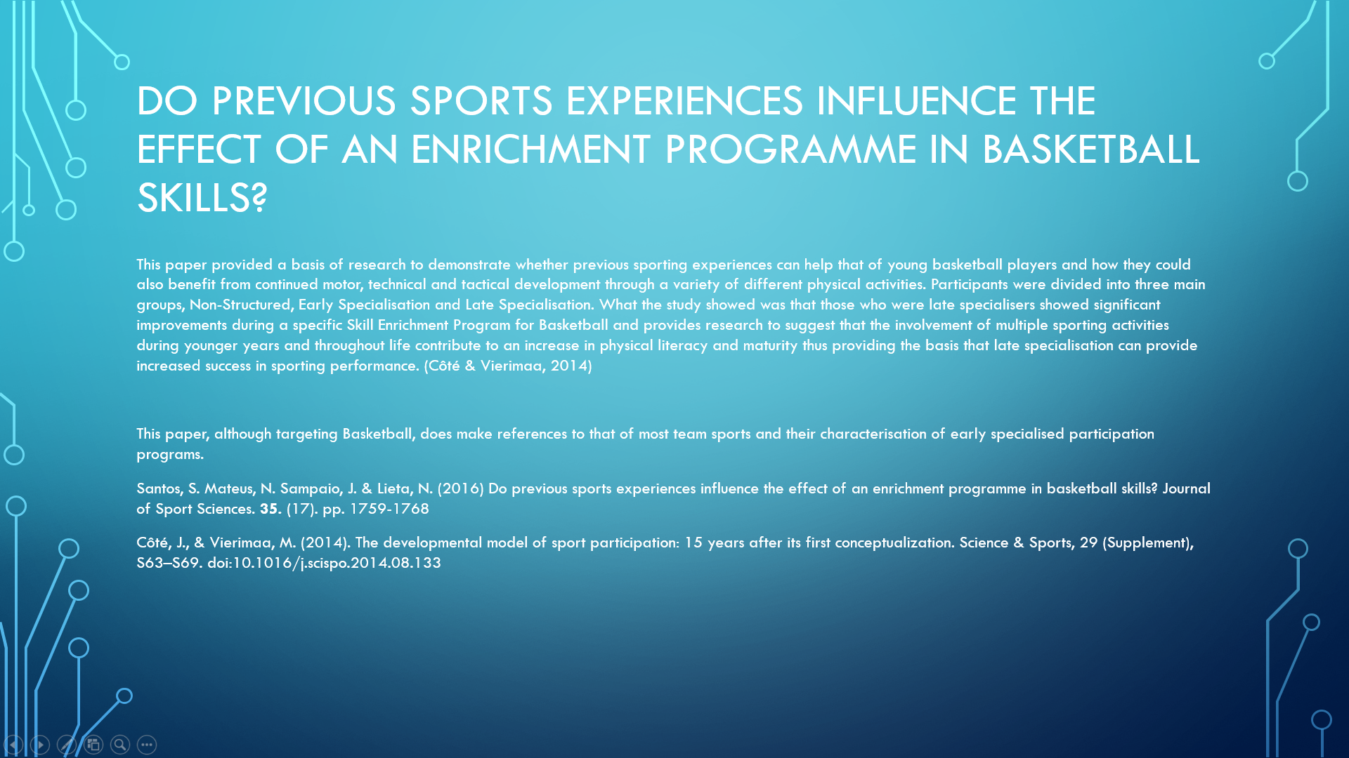

Slide 18
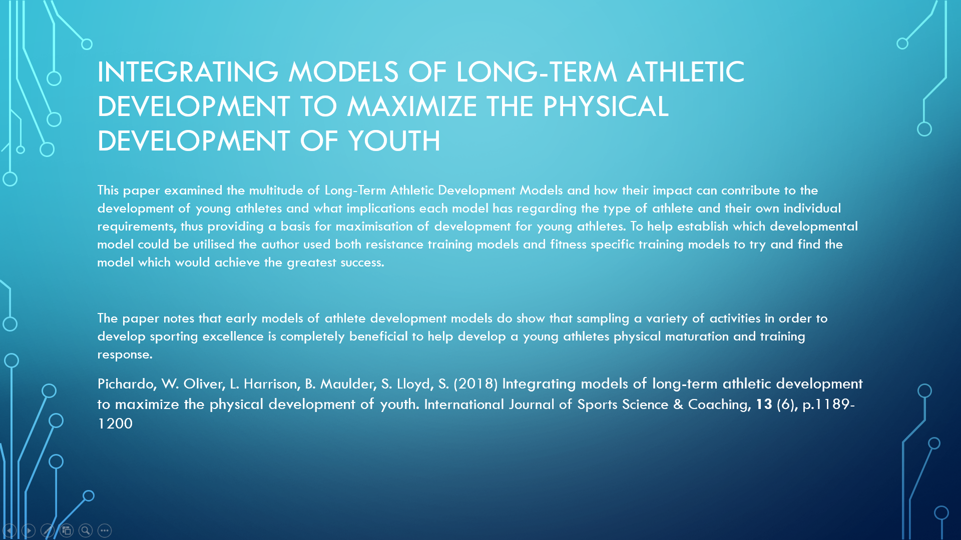

Slide 19
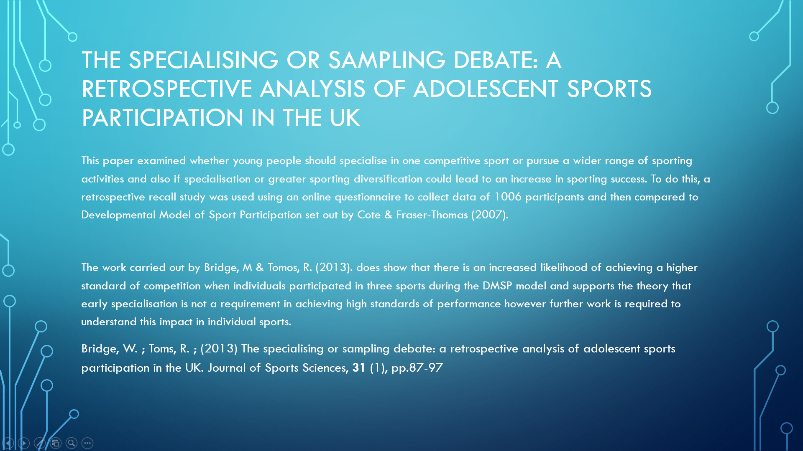

Slide 20
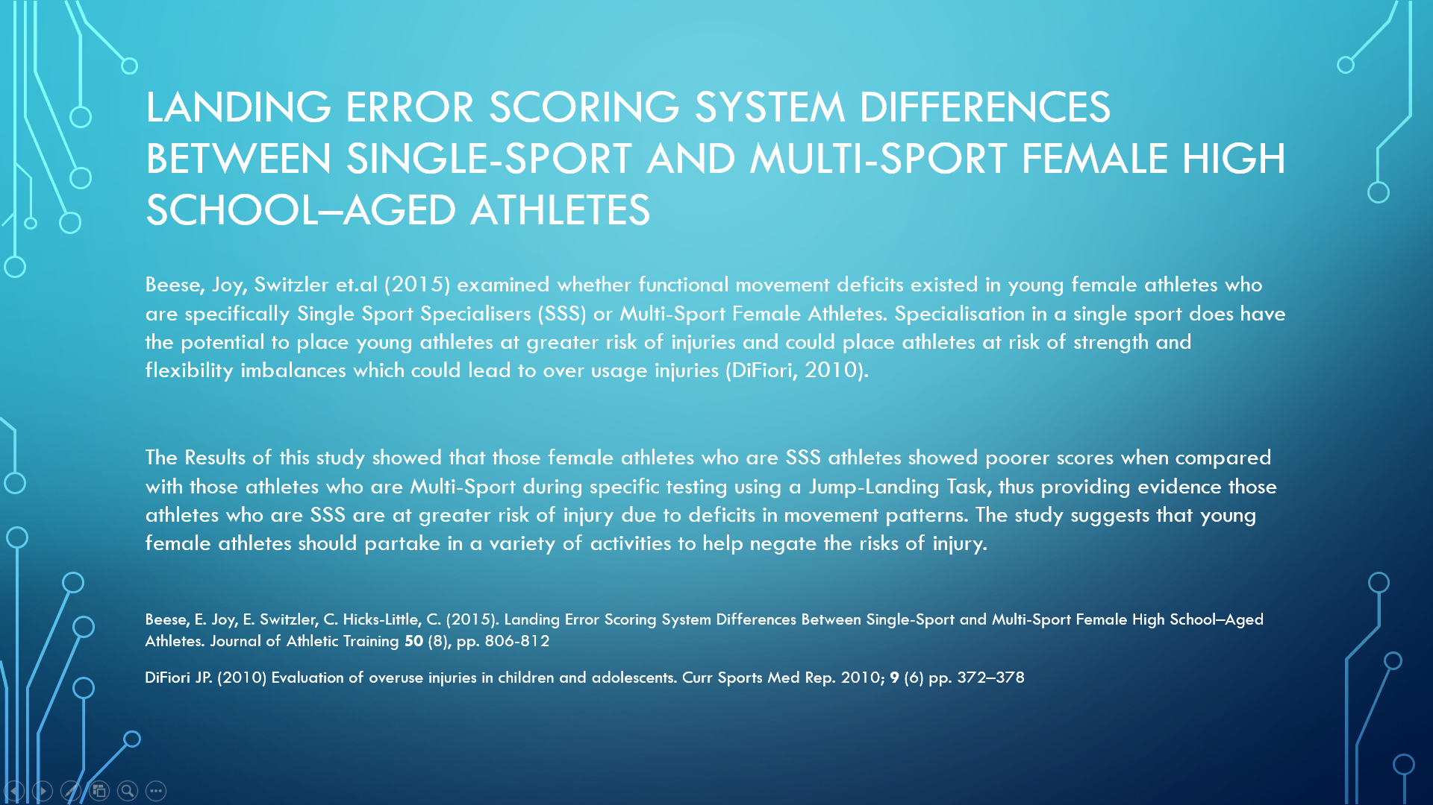

Slide 21


Slide 22
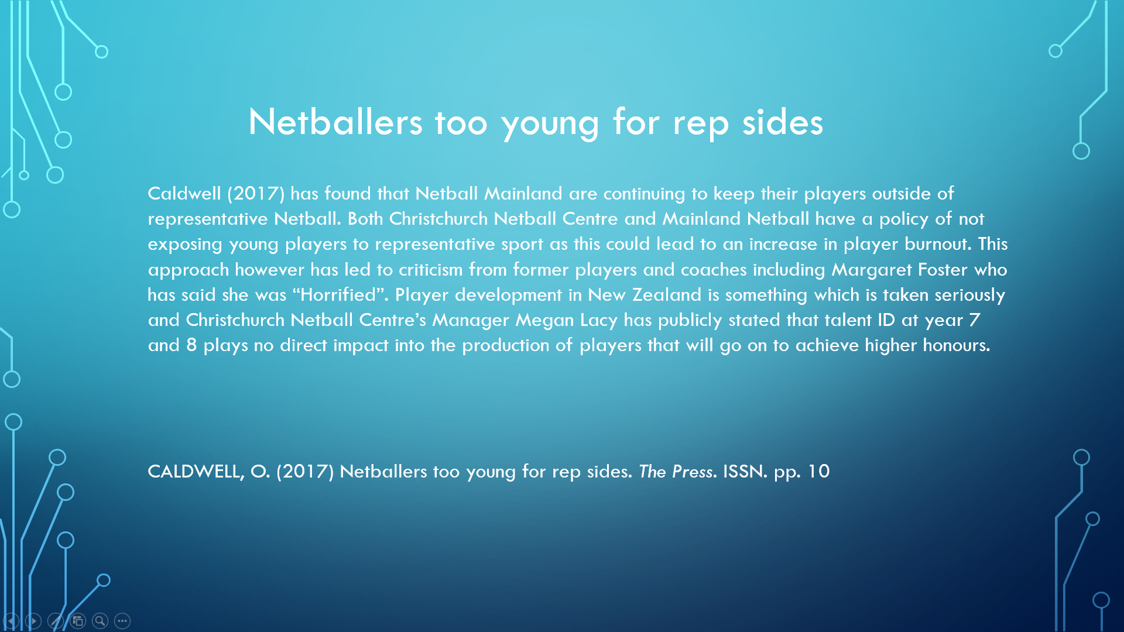

Slide 23
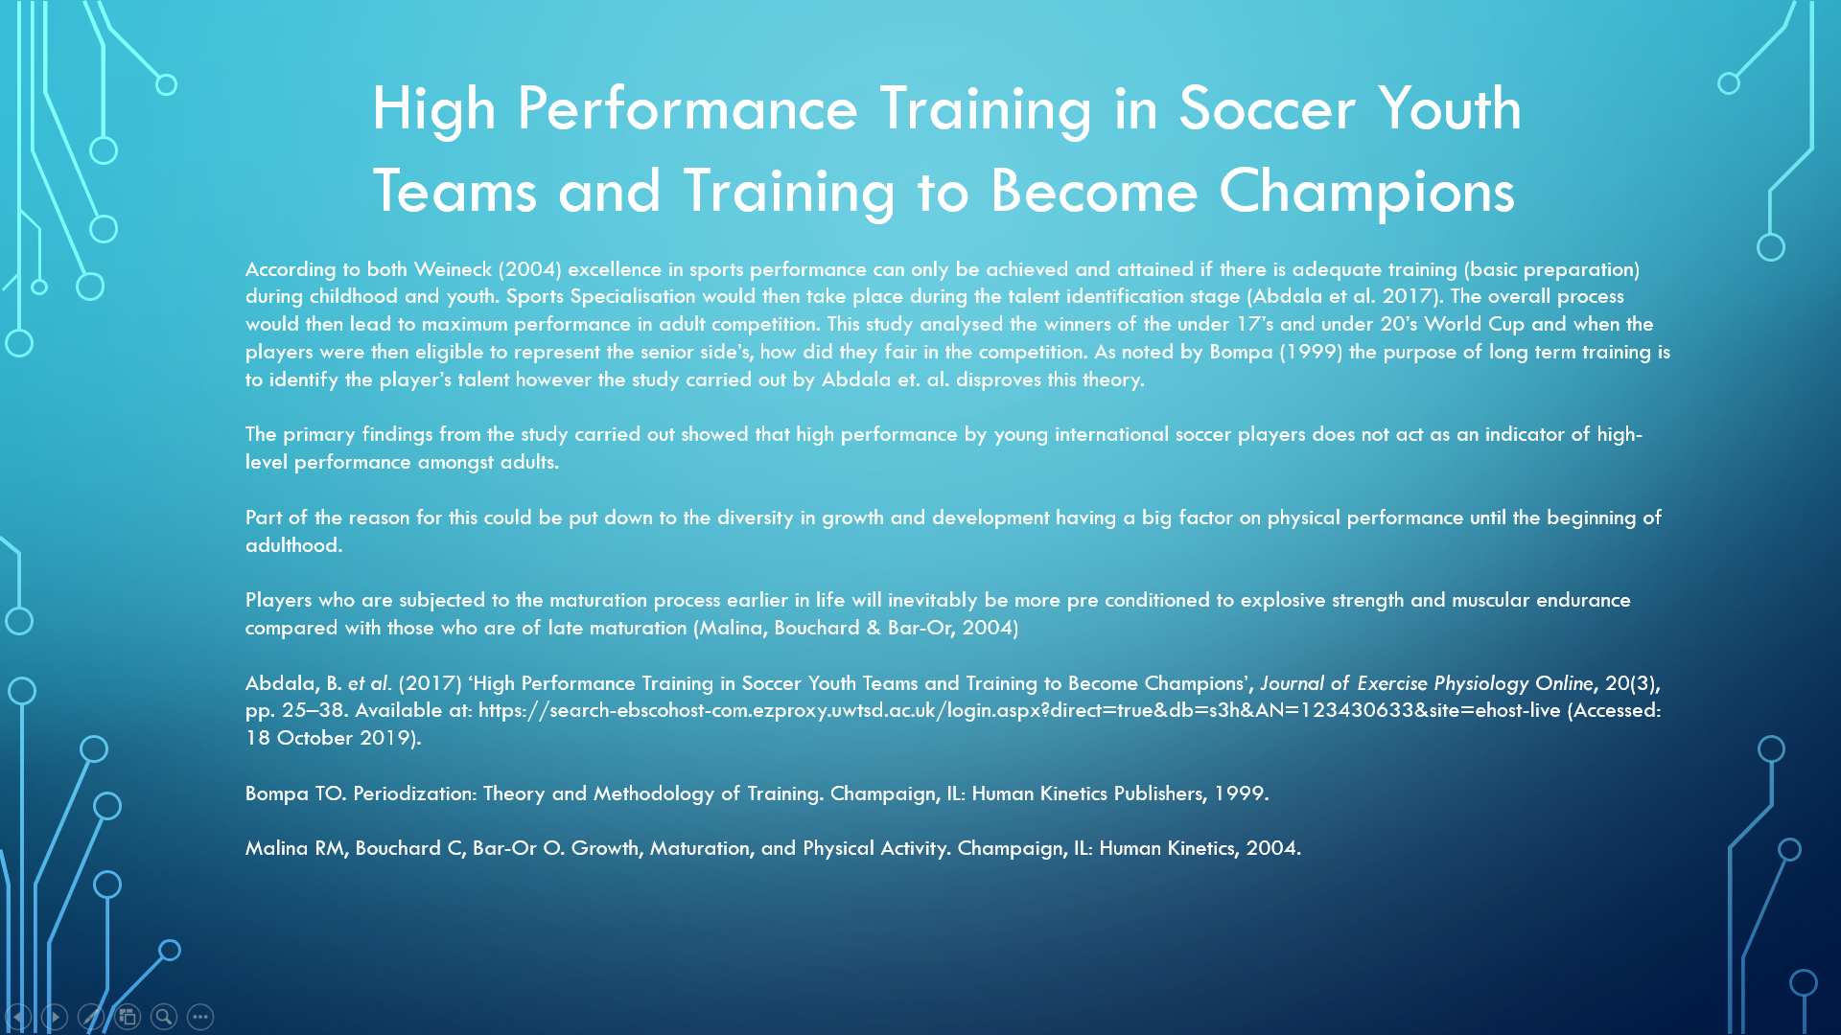

Slide 24
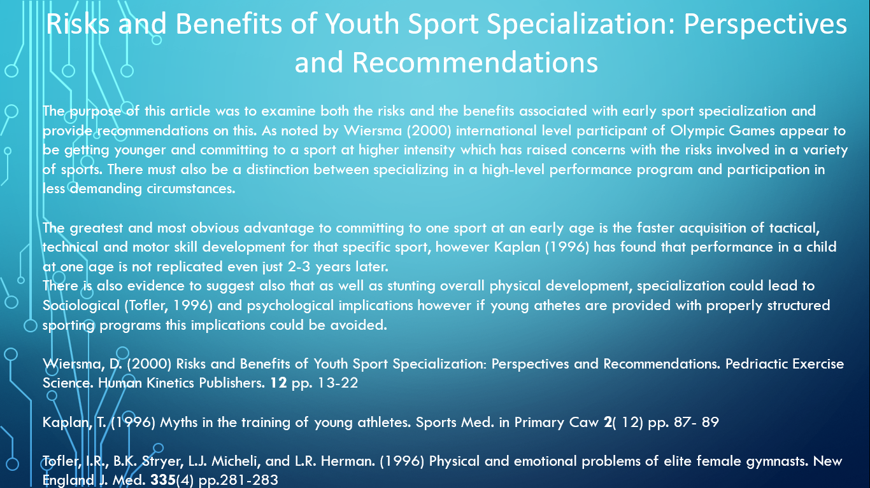

Slide 25
Methodology & access to resources

Slide 26
Research Methodology
Research can be categorised as the process of finding out more information within a particular field, hence enhancing your overall knowledge of that subject. It is also the collection of facts which are then interpreted to help create a more wider knowledge base (Williman, 2011)
Igwengu (2016) classifies Methodology as the systemic, theoretical analysis of the chosen methods applied to a particular field of study and is largely based around quantitative and qualitative techniques (Irny & Rose, 2005). It is important to understand that a methodology is not a method. It is the theoretical reason as to why a set of particular methods have been chosen to calculate a particular result.
Research Methods are the tools which are utilised to help undertake the research. They provide the bases of sorting and analysing the information to help provide a particular study’s conclusions maintain Validity (Williman, 2011)

Slide 27
Subjectivism v Objectivism – which one?
Epistemology
Epistemology can be defined as the theory of knowledge and the philosophical study of the nature, origin and scope of the knowledge. There are four key elements in which Epistemology can be explained
What knowledge consists in ( e.g. a justified true belief)
What knowledge is based on (e.g. sensory experience)
What the extent of our knowledge is (e.g. objective or subjective)
(Moser, 2009)
Subjectivism is based around the presumption of the individual, it means that everyone could interpret the data as how they see fit. Subjective theory is also based upon the intentions of the researcher carrying out the selected work
Objectivism could therefore be categorised as the more factual approach which takes into account the relevant information and avoids the individual making assumptions based on the findings of the study
(Janeþková, 2015)

Slide 28
Data Collection Methods
Questionnaires – These will contain a variety of questions that include how long they have taken part in the sport, at what age they decided to specialise, where there any outside influences contributing to the reason of their specialising and have they experienced any injuries which they have suffered taken part in the sport. Questions will be a mixture of written statements and rating scales.
Focus Groups – These will be held within each academy in order to discuss more at length how each academy feels in regard to specialisation. This will be a chance for each Academy to express their views within a group environment.
One-to-One Interviews – These will be held with a selection of Academy players from each team in order to gain further understanding of their own perspectives. These could be held in conjunction with the questionnaires so that each interview can be tailored specifically to that individual.
Qualitative and Quantitative Data Collection = Mixed Methods

Slide 29
timeline

Slide 30
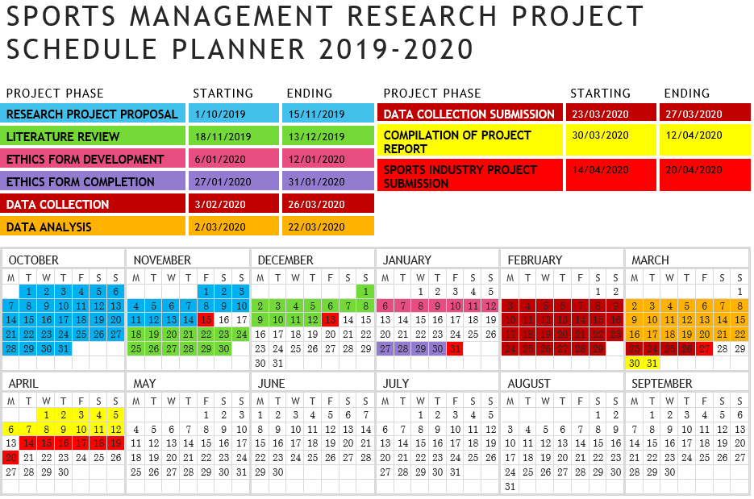

Slide 31
Ethics form

Slide 32
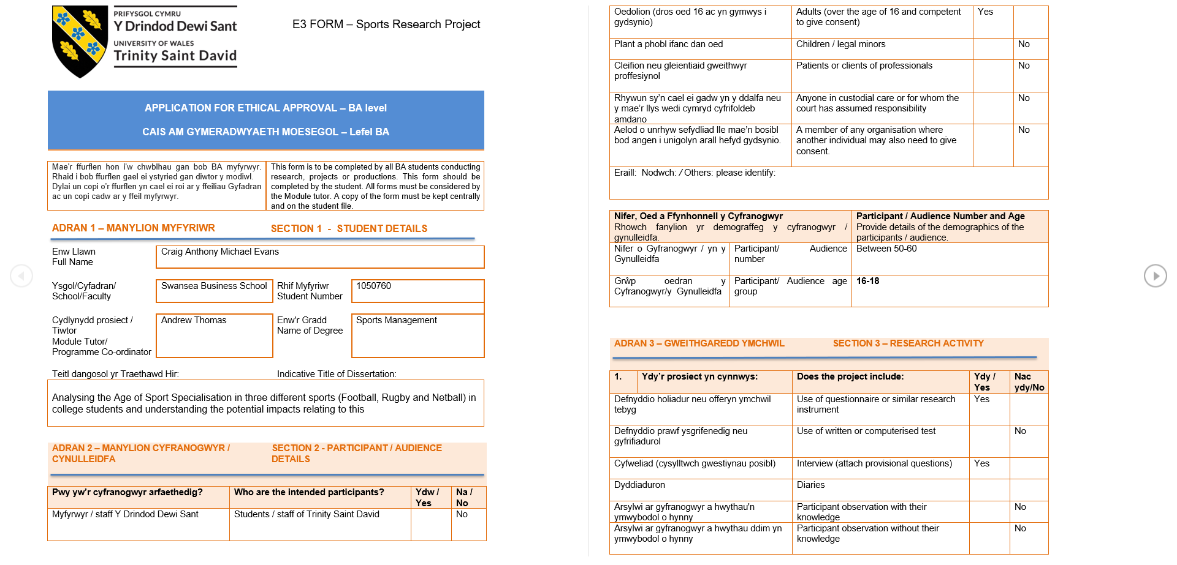

Slide 33
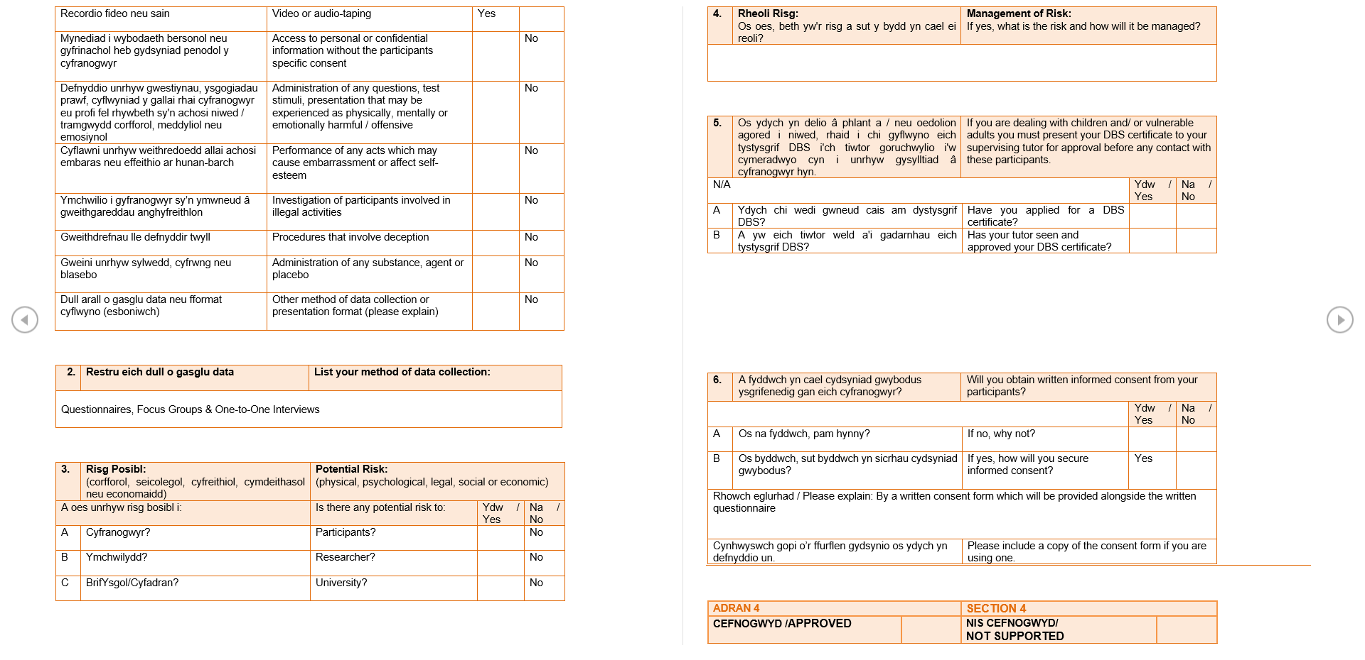

Slide 34
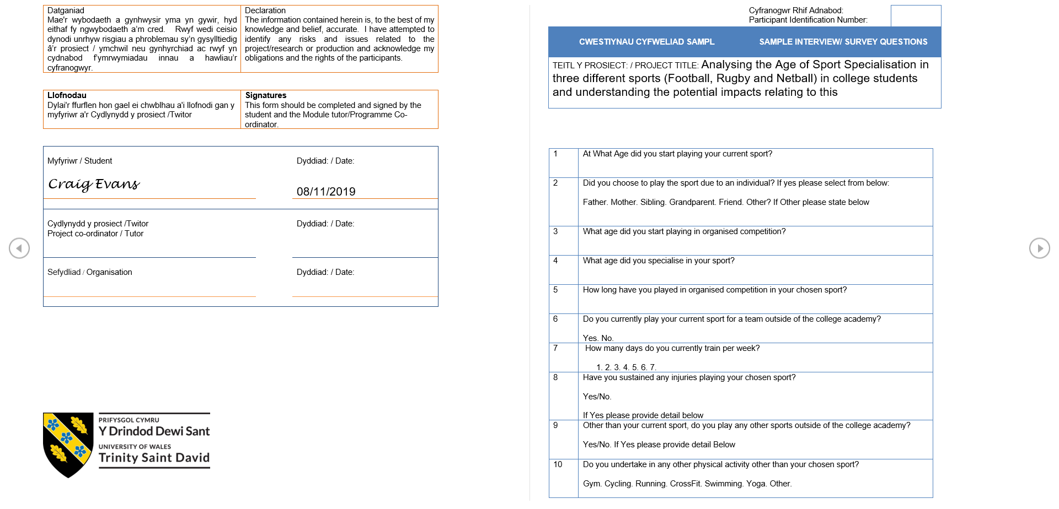

Slide 35
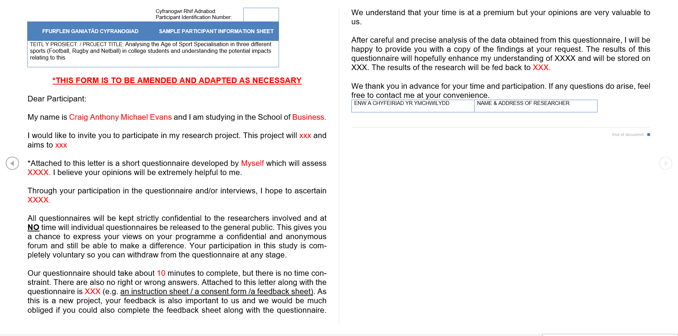

Slide 36
references

Slide 37
Latorre-Román, P ; Pinillos, F ; Robles, López, J. ;Retos: N. (2018) Early sport dropout: High performance in early years in young athletes is not related with later success. Perspectivas de Educación Física, Deporte y Recreación, (33), pp.210-213
Corso, M (2018) Developmental changes in the youth athlete: implications for movement, skills acquisition, performance and injuries.
Journal of the Canadian Chiropractic Association. 62 (3), pp.150-161
Igwenagu, C (2016) Fundamentals of Research Methodology and Data Collection. University of Nigeria. Faculty of Physical Sciences
Irny, S.I. and Rose, A.A. (2005) Designing a Strategic Information Systems Planning Methodology for Malaysian Institutes of Higher Learning. Issues in Information System. 6 (1)
Walliman, N (2011) Research Methods: The Basics. Oxford: Routledge.
Pavlína J. (2015) Objectivism Versus Subjectivism in the process of the interpretation of the Contract. Humanities and Social Sciences Review. 4 (2) pp. 221-226
Bates, M. Maack, M. (2009). Encyclopedia of Library and Information Sciences. Boca Raton: CRC Press
Martin, E. Oregon E. (2017). Sport Experiences of division 1 collegiate athletes and their perceptions of the importance of specialisation. High Ability Studies. 28. (3). Pp. 149-166
Reed, J. Oliver, L De Ste Croix. Myer, M. G. Lloyd, R. (2016) The Scientific foundations and associated injury risks of early soccer specialisation. Journal of Sport Sciences. 34 (24). pp. 2295-2303

Slide 38
Pichardo, W. Oliver, L. Harrison, B. Maulder, S & Lloyd, S. (2018) Integrating Models of Long-Term Athletic Development to maximise the physical development of youth. International Journal of Sports Science & Coaching. 13 (6). pp. 1189-1200
Bridge, W. Toms, R. (2013) The specialising or sampling debate: a retrospective analysis of adolescent sports participation in the UK. Journal of Sport Sciences. 31 (1). pp. 87-97
Beese, E. Joy, E. Switzler, C. Hicks-Little, C. (2015). Landing error scoring system differences between single-sport Female High School-Aged Athletes. Journal of Athletic Training. 50 (8). pp. 806-812
DiFiori, JP. (2010). Evolution of overuse injuries in children and adolecents. Curr sports medicine report. 9 (6). pp. 372-378
Hensch, L. (2006). Specialisation or Diversification in Youth Sport. Strategies. 19 (5). pp. 21-27
Hill, M. Hanson, G. (1987). Sport Specialisation in High School: A Complex Issue. Physical Educator. 44 (4). pp. 422-426
Caldwell, O (2017) Netballers too young for rep sides. The Press. ISSN. pp. 10.

Slide 39
Abdala, B. et. al. (2017) ‘High Performance Training in Soccer Youth Teams and training to become champions’ [online] Journal of Exercise Physiology. 20 (3) pp. 25-38. [Accessed 18th October 2019] Available from: https://www.asep.org/asep/asep/JEPonlineJUNE2017_Costa_Palma.pdf
Bompa, TO. (1999) Periodisation: Theory and Methodology of Training. Champaign, IL: Human Kinetics.
Melina, RM. Bouchard, C. Bar-Or, O. (2004). Growth, Maturation and Physical Activity. Champaign, IL: Human Kinetics.
Wiersma, D. (1999). Risks and Benefits of Youth Sport Specialisation: Perspectives and Recommendations. Pedriactic Exercise Science. 12 pp. 13-22
Kaplan, T. (1996). Myths in the Training of Young Athletes. Sports Medicine in Primary Caw. 2 (12) pp. 87-89
Tofler, I.R., Stryer, B.K., Micheli, L.J., Herman, L.R. (1996). Physical and Emotional problems of Elite Female Gymnastics. New England Journal of Medicine. 335 (4) pp. 281-283
Lloyd, R.S. Oliver, J.L.. Faigenbaum, A.D. Myer, G.D. (2014) Chronological age vs. biological maturation; implications for exercise programming in youth. Journal of Strength and Conditioning Research 28. pp. 1454-1464
Santos, S. Mateus N. Sampaio, J. Leita, N (2016) Do Previous Sports Experiences influence the effect of an enrichment program in basketball skills. Journal of Sport Sciences. 35 (17). pp. 1759-1768
Cote, J. & Vierimaa, M (2014) The development model of sport participation; 15 years after it’s first conceptualization. Science & Sports. 29 (Supplement)

Slide 40
Gower College Swansea (2016) Gower College Swansea Strategic Plan 2016-2020 [online] Gower College Swansea [Viewed 18th October 2019] Available from: (https://www.gcs.ac.uk/sites/default/files/Gower%20College%20Strategic%20Plan%202016-2020%20-%20English.pdf
Gower College Swansea (2019) Mens Football Academy [online] Gower College Swansea [Viewed 19th October 2019] Available from: https://www.gcs.ac.uk/mens-football-academy
Gower College Swansea (2019) Ladies Football Academy [online] Gower College Swansea [Viewed 19th October 2019] Available from: https://www.gcs.ac.uk/ladies-football-academy
Gower College Swansea (2019) Rugby Academy [online] Gower College Swansea [Viewed 19th October 2019] Available from: https://www.gcs.ac.uk/rugby-academy
Gower College Swansea (2019) Netball Academy [online] Gower College Swansea [Viewed 19th October 2019] Available from: https://www.gcs.ac.uk/netball-academy

Slide 41
Thank you for listening

