Slide 1
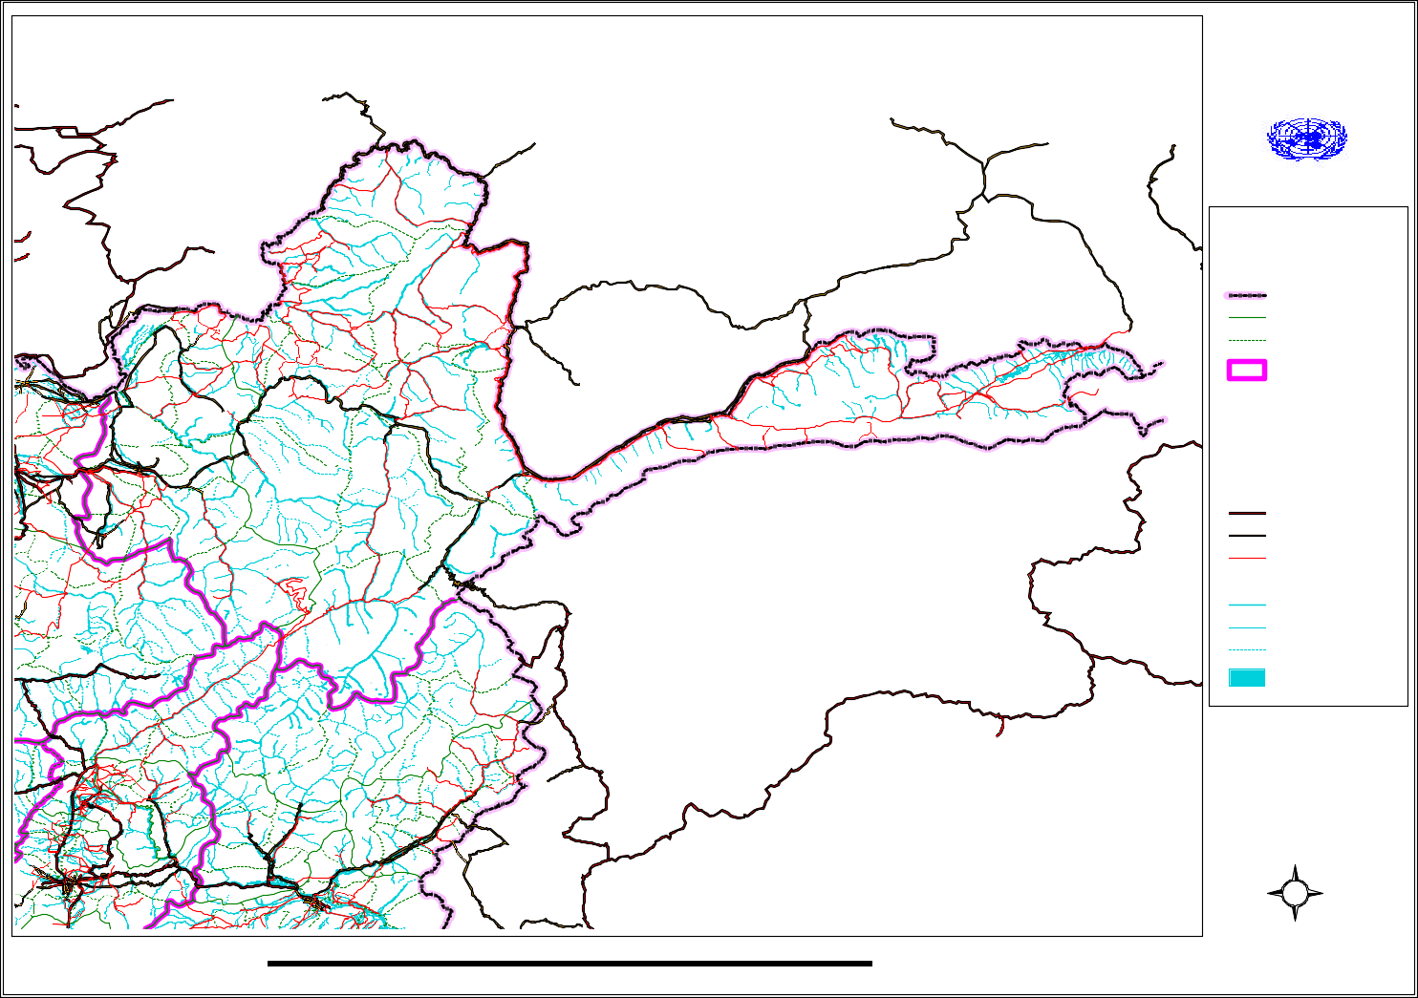
Autotelic Aktion Afganish deconstructing the centrifugal force of gender abuse known as BAACHA bAZI this restricted map (unicef-ocha 2018) identifies the ugaric provinces of UZBEKistan (UPPER/CENTRAL FRAME – Tajikstan). Kabul is in the lower left of frame. The historic pamirs and Karakorum mountains are located to the upper right (see: frame 11)

Slide 2
Zusammenhang Bekkantmachung Köherenz Leitung
Comparative difference (Schwartz 1982, 107-8) requires astute Practical Engagement (see: Kunduz environs by Healey 2010) Juvenile and young adult Male gender Abuse occurs in and adjacent to secularised dancing halls (Bacha Bareesh) at the behest of powerful ‘commanders’ whom have endured and capitalised from decades of extreme, modern warfare. adolescent males are clothed in specialised cloth items (JAAMAN) publicly purchased in the bazaars AND is inclusive of ‘DANCING BELLS’ (mazai). Decisions about whom should be selected to dance in the distinctive Ottoman-Uralic style occurs in a Samowar (tea house). the dance types are; (Atan) or an exotic type (Naz) which may incorporate both ‘pas da basque’ reels and small footwork (Maidan).
The performances are secularised, privately financed and contrast markedly against the nomadic Kuchi style or ‘southern’ kite dance (Khaghadazi). MUSICAL INSTRUMENTS USED TO SUPPLY CADENCE and harmony is PERFORMED IN THE HISTORIC 4:4 Shur or HOMAYUN-ISFAHAN MODES, broadcast through Uzbek and Iranian instruments, such as the two stringed dambura or four stringed mulberry wood rebab. Tempo is admimistered by percussive drums, such as the clay hour glass drum (zerbaghali) and by the TAMBUR AND dhol – a doubled headed wood barrel drum known throughout the semi-nomadic near east (SOAS – EASTERN ARTS (UTAH) 2018)
This frame (After: La Barre 1989) identifies the reflexive approach as applied to the stratified in-situ communities Presently receiving UNICEF care – a consequence of the activities of the warlords controlling the Baacha Baazi abstraction
Displaced persons (2018): Badakshan 33,180 Baglan 38,724 Kunduz 196,217 Takhur 49,317 (UNICEF-OCHA 2018)

Slide 3
Geschlecht Uzbek (Jowzjan Provinz)-Tajik
Schwadron Aufdringlish Mistel-Bolzen, Halt!
Gleichzeitung / Diachronologisch – Gestalt Psycologie
Punctuated equilibrium (phenotypic transformations) – as evidenced by the intrinsic ‘fine structures’ preserved by the gracile apomorphies of the skeleton (see: frame 6). In bovidae and suidae sp. these epoch defining (Cenozoic/Quaternary period) temporal associations, as ‘depth targets’ (see: ‘diffuse (chromatic) bicoloure’ by Kroeber and Holme in Levi-Strauss 1968, 325) are of course retained by specific ‘ossification centres’ or ‘fossa’. These particular landmark osteologies, such as the lower fore-limb bones, oesophagus, lower jaw and specific landmarks of the crania are of contextual relevance, enabling cohesive site context baseline results, further assessing the impact of Functionalism, Reductionism and Anti-Reductionism paradigms (Geertz 3:1983)
How do the developing juvenile and adolescent osteological facts shape up (frame 6) against other comparative frameworks, such as religious experience (frame 4)

Slide 4
Kabul Friede Jirga (131:2009, 3:06.2010) NO CHALLENGE TO Sharia Law, legalises rape as propositioned by Ayatollah Sheikh Asef Mohseni (Hezb e Islami & Tamadon Corp. & enforced by Uzbek Warlord and ‘statesman’ Gen. Abdul Rashid Dostum, opposed by Mullah Omar
(After: holbrook, R. and Admiral Mullen, N. (2008-10) by Gall S. 2012, 337-49)
Usurious-sumptuary factors & non-dualism (After: Ortner, S.B. 1989)
The Dharmakãya /Akşobhya (affine connection (Ω) – Tathatã (∂) the moon of suchness)
Anuttpatikka-dharma-kşanti (neoteny-reality-acceptance)
Samya-Sandodhi – supreme enlightenment
The Vimalakirti Sutra (Nirdeśa – instruction)
Lin Chi (Renzai d.867) Kegon philosophy - Hsuëh-t’ou (Secchõ 980-1052)
China SUNG Dynasty (960 -1279) ‘upãyakauślaya’ or mysterious ways;
The Book Of The Blue Rock or The One Hundred Cases ca. 600 AD
Ch’ang Sha’s (Yuma – uba) Wandering in the Mountains (Western Xia); proposition 29 & Dentorõku – the Book of the Lamp)proposition 36 – connection to neotenous life as vast, water borne and ‘pre-aggregated’
exorheic-endorheic mountain environs – the tea ceremony and statesmanship

Slide 5
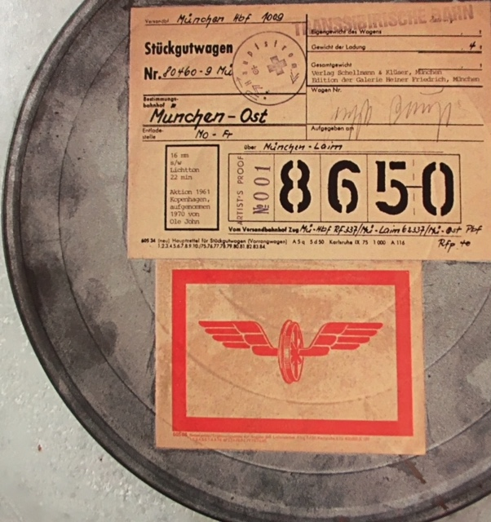
Continuum theorie: Beton einzel
Semantic content/categories of classification & the ethnographic film medium (After: beuys 1970) issues of ‘soverignty’ are further considered to be reflexive, such as the contrasting Gujaret atrocity
(see: 25 Barbary lions killed in Gujaret BBC: 25.09.2018)
Exactly how does the gender abuse ‘context baseline’ as a concrete paradigm shape up against other selective factors?

Slide 6
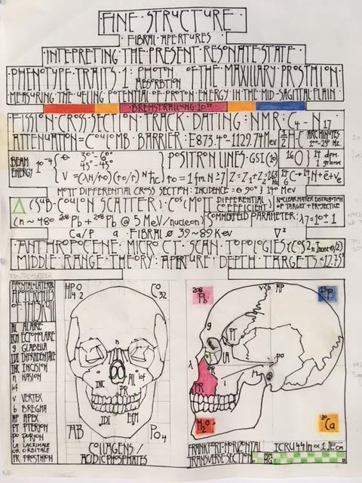
Design Anthropologie Atelier (Binder,T. 2016) proposed engagement through resonance survey topologies

Slide 7
Wuste isohulse GLEICHZEITIG SEIN/DIACHRONOLOGIE
Bateson (1958, 281 in Lipset, S.M. 1960, 147) proposes that quantative ‘abstraction which (names a comparative phenomenon) we make for our own convenience when we set out to describe culture in words’ (frame 2)
Therefore, if the sequence of interpretation diffuses social complexity, it is clear that the dynamic structuralism of Sahlin (1972) seeks out processual quantitate methods such as phenomenological reduction as both rhetorical device and commentary. Thus, by presenting and utilising cohesive, modern natural theology, making sense of the discrete object continuum as standard method fine structures analysis is herewith considered to be of value to all in-situ agencies (see: frames 2, 5 & 6)

Slide 8
Glossary
Autotelic (frame 1) A Chicago School construct (Csikszentmihalyi 1974-8), denotes internal motivation
Köherenz (frame 2) the quantitative Lörentz force telemetry (vacuum equations: Leipzig (1895); intrinsic quanta (q) & it’s velocity (v) retained by an electric field (E) and it’s measurable force (B) on a magnetic field (note: the Bruneval Raid – Op. Biting as surveyed by archaeologist Garrod, D. (RAF Medmenham - Benson) 1942). Thus, Pac - E (parameterised algorithm computation) as ‘scaffold hyperlinks’ signifies the critical significance thereof utilising higher resolution data, as afforded by a ‘whitening signal’ known as a 110 equalising signal: when any integer higher than 2 is squared, divided by itself, then squared..minus 4 x 364.56. Thus, the value (makes visible) another diagnostic line in the (Hydrogen) spectrum, contrasting against diffusionist ‘bicolouere’ this significant, basic modulus makes sense of naturally occurring signal processing (frames 4,7). This ‘coding’ or ‘depth target’ data can be utilised for data storage and is a useful contextual value, contrasted against other contextualised paradigms (see: frames 2-4,6)
(see: Stromberg & Hassner 36(3): 2000,608 figure 4)

Slide 9
Diachronologisch – Gleichzeitung (frame 3) synchronous comparative difference / contrasting identity and relation (Schwarze 1982, 107-8)
Usurious, sumptuary non-dualism (frame 4) immoral monetary practice, Judaic socialist rhetoric (1848) regulates ‘the consumer’ and economic surplus. Non-dualism (see: continuum theory (frame 5) and Kegon philosophy, frame 4)
Beton-Eizel (frame 5) Social Sculpture tertiary construct (Düsseldorf – Berlin ca. 1960-1980)
Parzifal (1865) – ‘Gesamkunstwerk’ (frame 6) abstraction of ‘Werwandten’ (non-perjorative Relativism (ca.1908-16) developing imminent critique (‘Kritik Bevorstahend’ Frankfurt 1922)
Topologies (frame 6) colour depth or spectral analyses, contrasted against diffuse although resonate ‘bicoloure’
Wust isohulse / diachronolgie (frame6- 7) Desert isochronous selective advantage/psychodynamic differentiations, such as semantic controls (symbology – transliteration)

Slide 10
Bibliography
Beuys, J. (1970) Die Sibirischen Bahn. Berlin (2013) Staatliche Museen, Hamburger- Bahnhof
Stucture/Functionalisam
Binder, T., Halse, O.T., Kjaergaard, M-G., Smith, R-C., Vangkilde, K.-T. eds. (2016) Design Anthropology. Bloomsbury Press
Post processual research and collaborative atelier, connecting to Sahlins (1972) – as observed (UCL (London) 2016)
Geertz, C.J. (1972) Local Knowledge: Further Essays In Interpretative Anthropology
Basic Books, NYC
Processual/Interventionalist (1960)
Ortner, S.B. (1989) High Religion, A Cultural And Political History Of Sherpa Buddhism
Princeton Univerity Press
Symbolic – ambiguous – intermediate
Ethnographic Films:
Healey, M (2010) The Dancing Boys Of Afghanistan. Mike Healey Films – BBC World Service, London
Saeen Zahoor (2010) https://m.youtube.com/watch?v=dhY0KkO5ItQ
Uzbek lute (ca. 2008) https://arkwars.ru/watch/XvVVJNCA4ao/film-about-dambura-smotret.html
https://m.youtube.com/watch?v=TL3fDrrh0bc
Analogue title: Gall, S (2012) War Against The Taliban, Why It All Wen Wrong In Afghanistan. Bloomsbury, London

Slide 11


