Slide 1

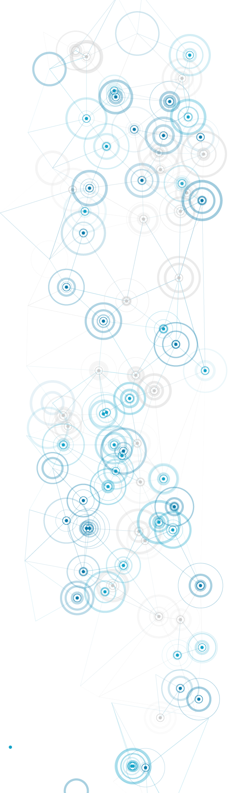


The Digital Professional for Health and Care
Behaviour Change Interventions: Framework, Theory and Examples
Dr Taiwo Adedeji BSc MSc MRes PhD

Slide 2
Learning outcomes
Understand selected frameworks and models that can guide behaviour change interventions in health and care.
Describe selected theories that address information system success and failure in health and social care.
Critically evaluate a practical application of behaviour change theory in a real world example.

Slide 3
Outline
Behaviour framework
IS theory
Real-world example

Slide 4
Behaviour change interventions (BCI)
“‘Behaviour change interventions’ can be defined as coordinated sets of activities designed to change specified behaviour patterns”
(Michie et al., 2011, p. 1)

Slide 5
Evaluation criteria for BCI frameworks
Comprehensiveness
Coherence
Link to a behaviour model

Slide 6
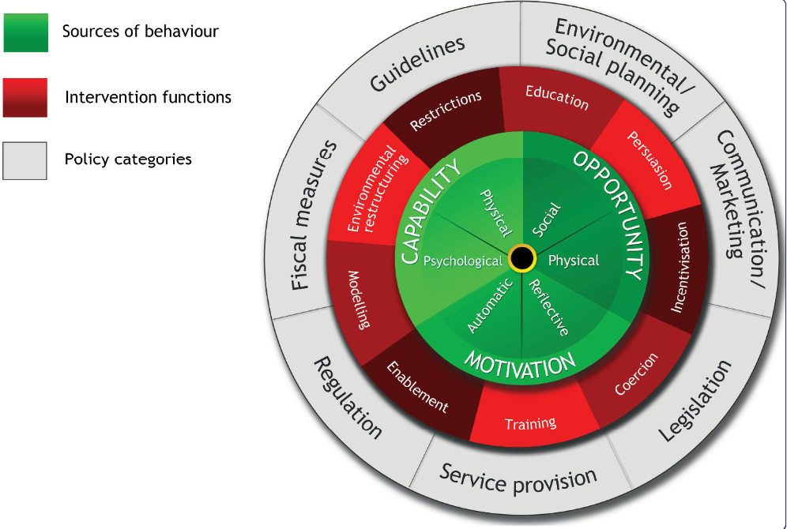
Behaviour Change Wheel (BCW)
Michie et al., 2011
Notes:
BCW: A psychological method for describing and designing behaviour change interventions

Slide 7
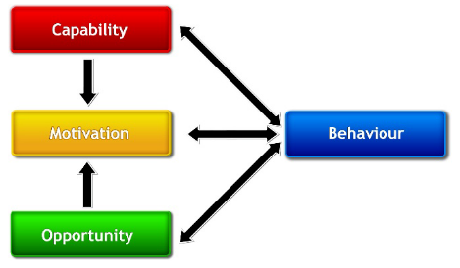
COM-B system
Psychological or physical ability to enact the behaviour
Reflective and automatic mechanisms that activate or inhibit behaviour
Physical and social environment that enables the behaviour
The COM-B system – a framework for understanding behaviour (Michie et al., 2011)

Slide 8
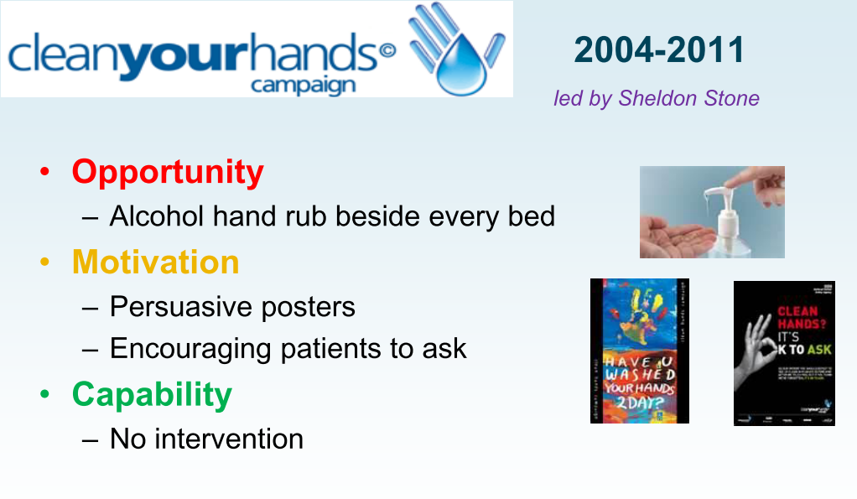
COM-B example
(Michie, 2015)

Slide 9
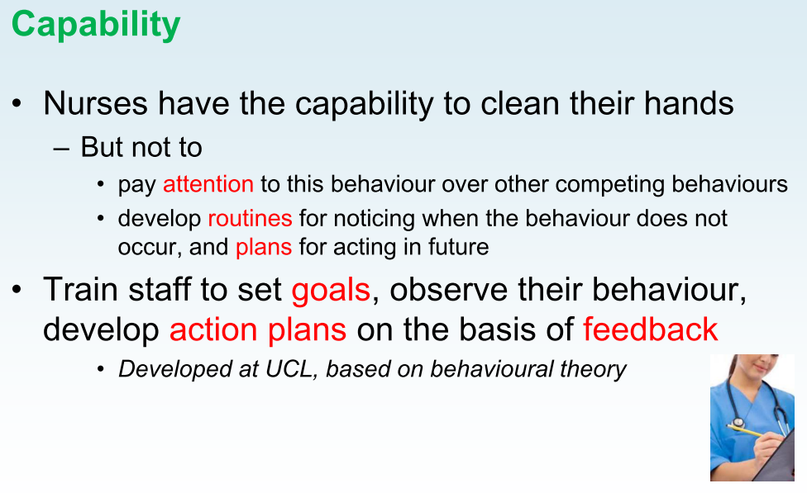
(Michie, 2015)

Slide 10
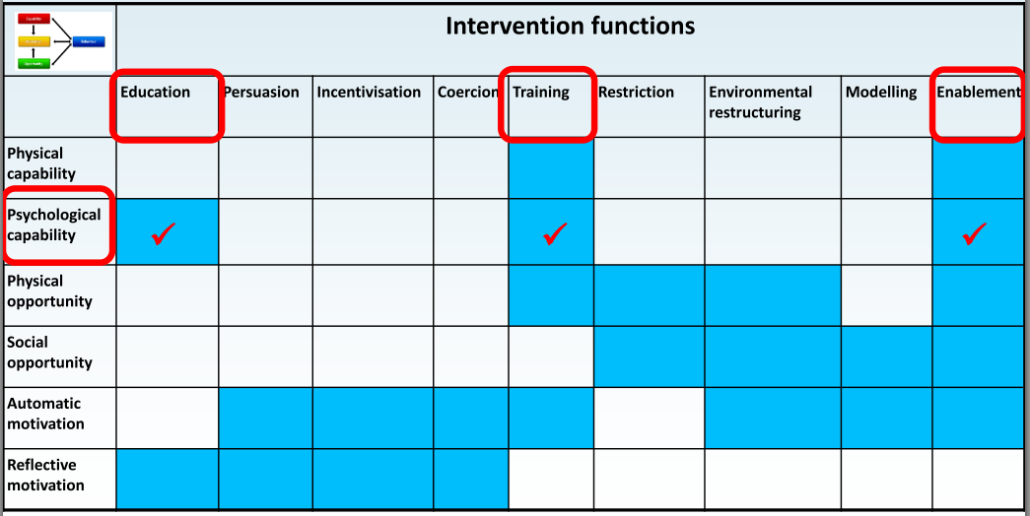
BCW matrix – Selecting relevant intervention functions
(Michie, 2015)
Notes:
The COM-B element that needed to increase was Capability.

Slide 11
BCW example – ParticipACTION App
Funded by Canadian (national) government
BCW-informed app development
Three stages:
  Understanding the problem and user preferences
  Translating research findings into app features
  Identifying app content and implementation options
Truelove et al., 2020

Slide 12
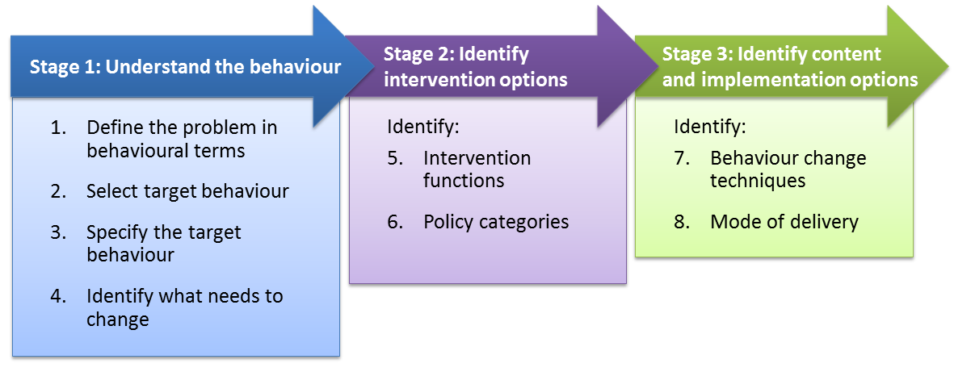
BCW example – ParticipACTION App
Step-by-Step Method for Designing Behaviour Change Interventions (Michie, 2015)

Slide 13
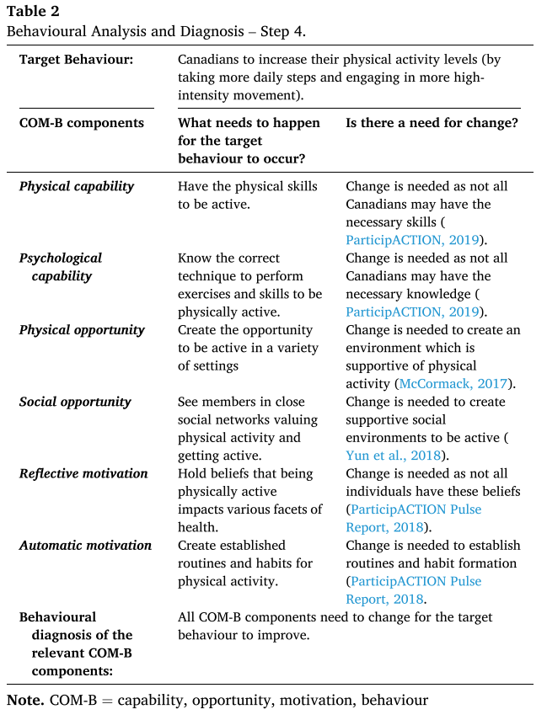
Another COM-B example
Truelove et al., 2020

Slide 14
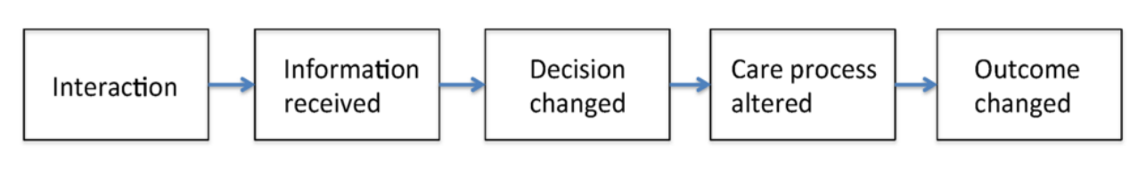
Information Value Chain Theory
Evaluation
System is fit-for-purpose
System is the best choice among alternatives
The information value chain starts with a user interacting with an information system, but must
go through many steps before changing clinical outcomes (from Coiera, 2015)

Slide 15
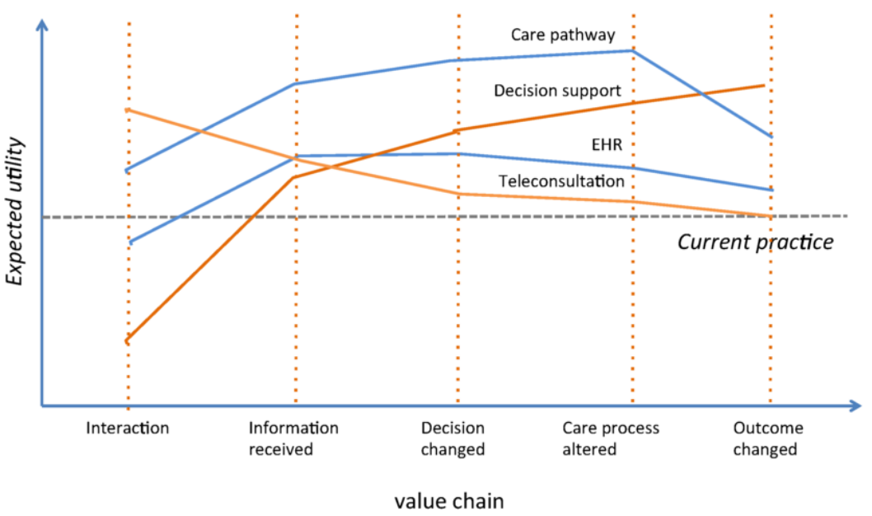
Varying Utility of Health & Care Interventions
The profile of expected utility for an intervention will vary across the steps of the information value chain, depending on the primary purpose of the system (from Coiera, 2015).

Slide 16
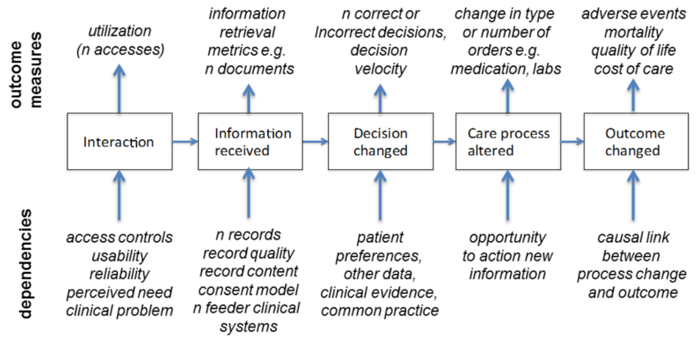
Case study
The information value chain provides a simple causal model connecting EHR use and clinical outcomes. Each step is characterized by different measures, and is dependent on different elements of shared record system design and use (adapted from Bowden and Coiera, 2017)

Slide 17
Behaviour change interventions: Real-world implementation example

Slide 18

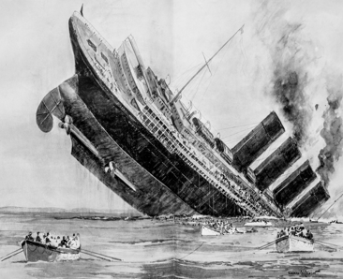




Courtesy of Prof Robbie Foy, University of Leeds
Notes:
There was a range of complexity in the study, including:
Multi-morbidities (among 23% primary care patients; 82% aged 85 years or over)
Multiplying top-down priorities / guidelines (over 100 relevant to GP)
Multiple bottom-up priorities (2.5 problems per 11.9 minutes)
Multiplying demand
Multiple ‘re-disorganisation’

Slide 19

Willis TA, Collinson M, Glidewell L, Farrin AJ, Holland M, Meads D, et al. An adaptable implementation package targeting evidence-based indicators in primary care: A pragmatic clusterrandomised evaluation. PLoS Med 2020: 17(2): e1003045.
Courtesy of Prof Robbie Foy, University of Leeds

Slide 20




‘High impact’ quality indicators
Diabetes control
Blood pressure control
Courtesy of Prof Robbie Foy, University of Leeds
Anticoagulation in atrial fibrillation
Risky prescribing
Rushforth et al. BMC Family Practice 2015; 16:156

Slide 21
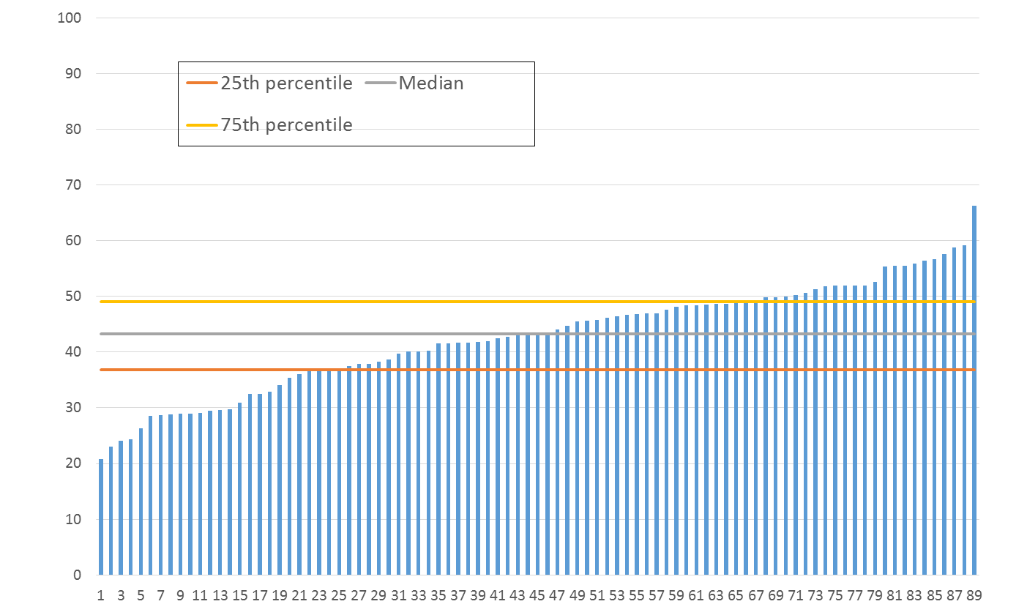
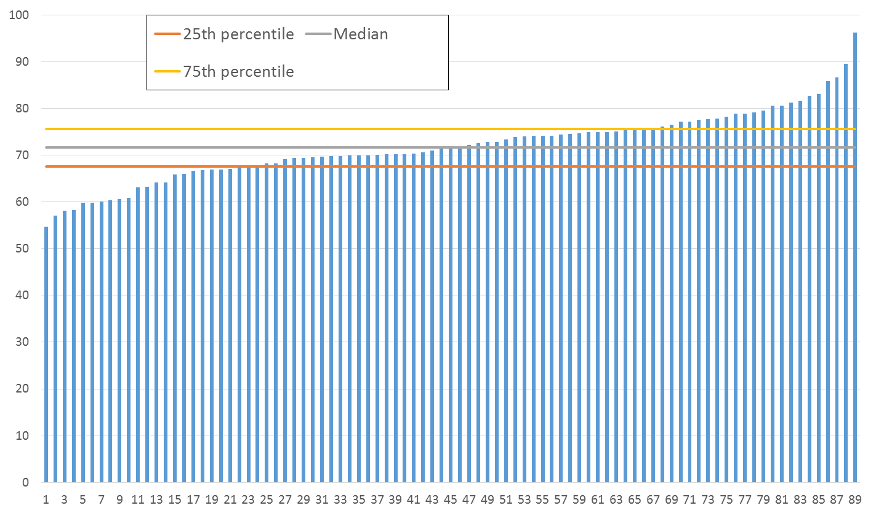
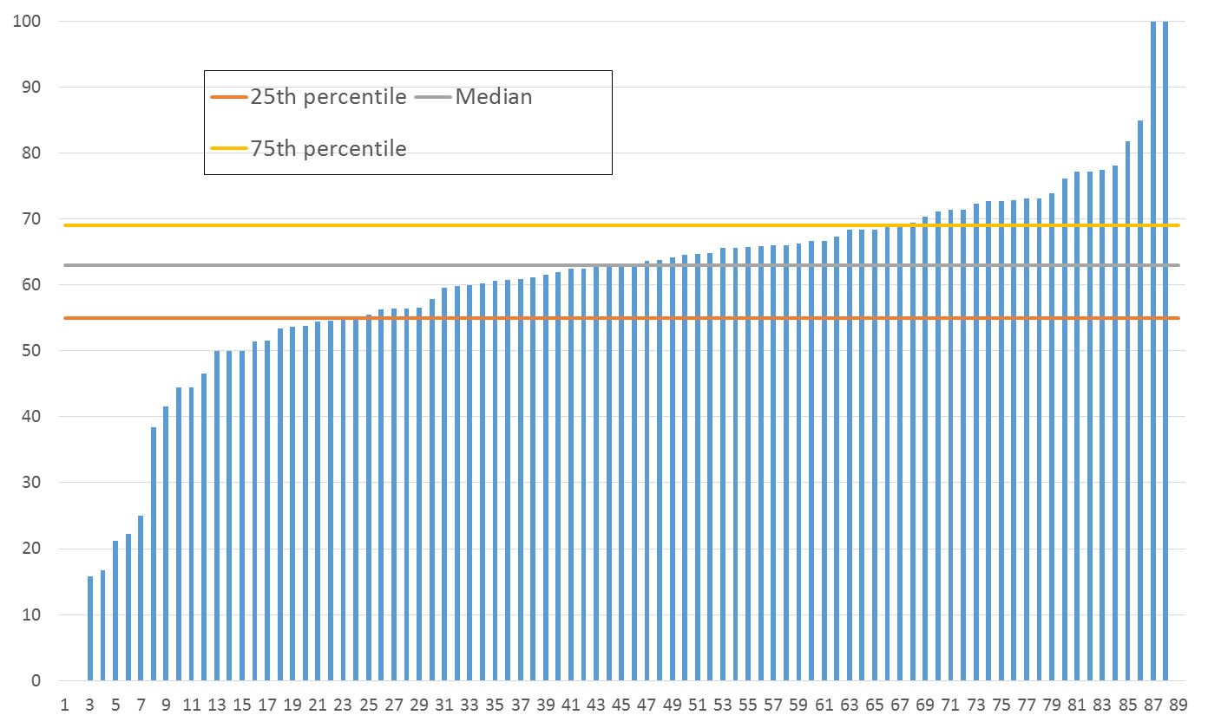
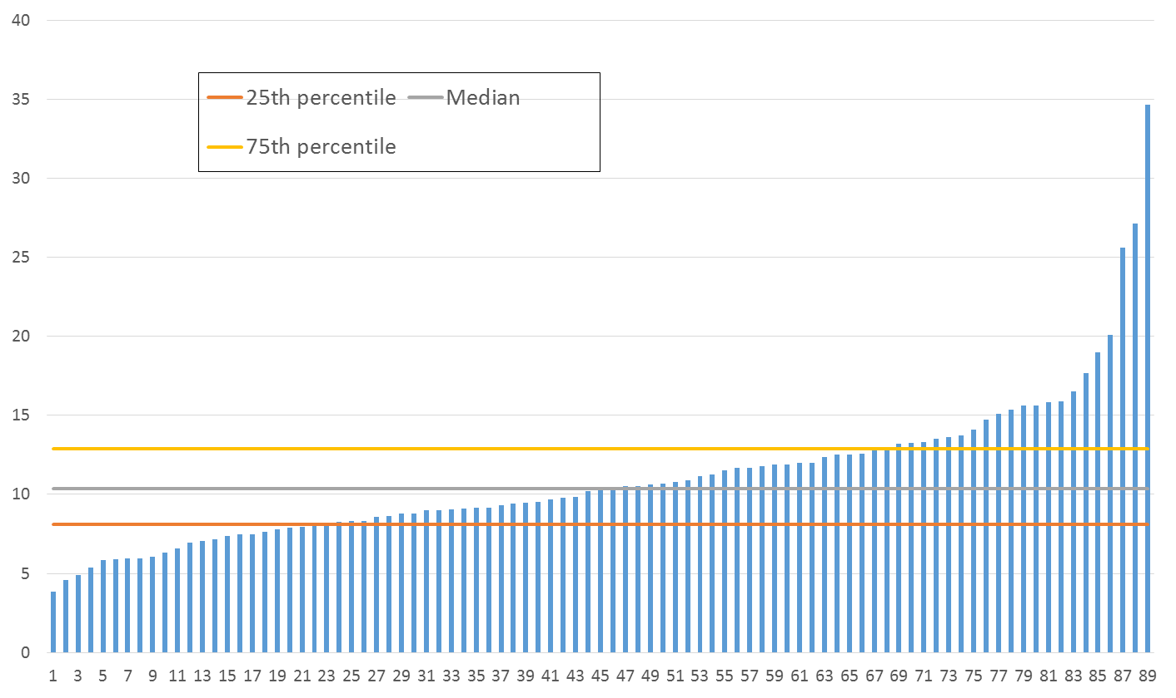
Adherence to ‘high impact’ quality indicators
Courtesy of Prof Robbie Foy, University of Leeds
Diabetes control
Blood pressure control
Anticoagulation in atrial fibrillation
Risky prescribing
Willis et al. PLoS ONE 2017;12: e0177949
Notes:
They studied the adherence to these quality indicators, quantitatively, which formed the basis for another qualitative study.

Slide 22

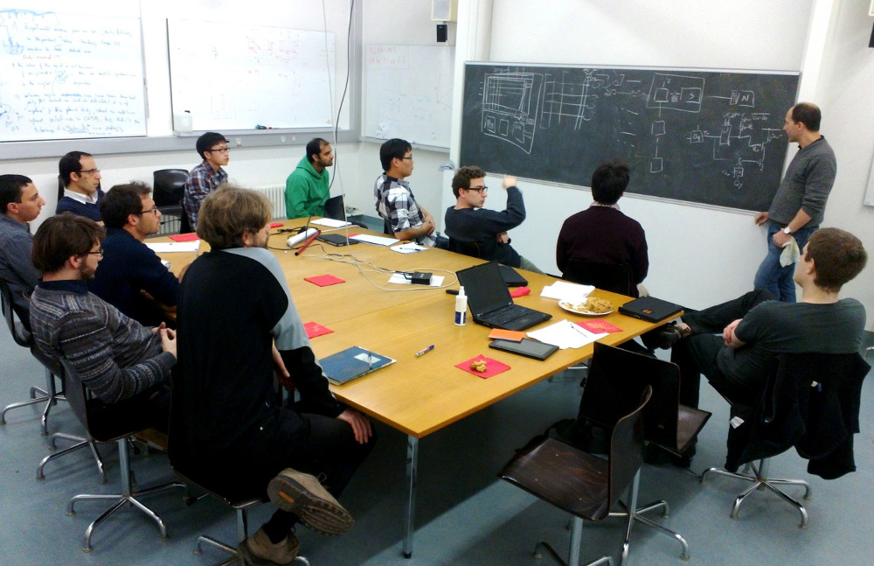


An adaptable implementation package
Interviews
Consensus
Courtesy of Prof Robbie Foy, University of Leeds
Evidence
Theory
Lawton et al. Implementation Science 2016; 11:113
Notes:
Developed an adaptable implementation package:
Interviews: with health professionals
Expert panel: patients, commissioners, clinicians
Evidence: evidence-based interventions widely used
Theory: Guided by current ideas about influences on behaviour – outlines key barriers/enablers to performing behaviour. Embed these within established interventions.

Slide 23


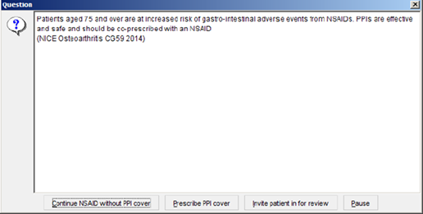
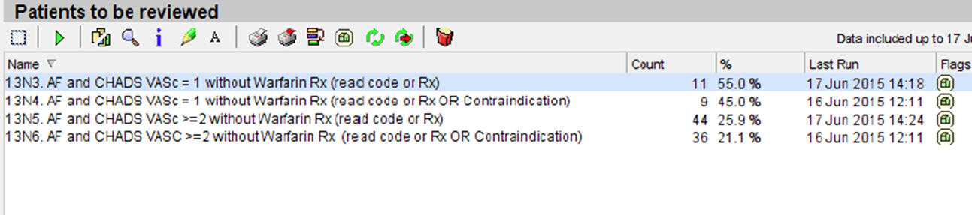
Persuasive messaging
Peer comparison
Problem solving
Courtesy of Prof Robbie Foy, University of Leeds
Goal setting
Action planning
Reinforcement
Glidewell et al. Implementation Science 2018;13:32

Slide 24

They did a rigorous ‘real world’ trial
Courtesy of Prof Robbie Foy, University of Leeds
Willis et al. Implementation Science 2016;11:25

Slide 25





Adapted implementation package | 40 practices | 40 practices
Diabetes control | Intervention | Control
Risky prescribing | Control | Intervention
Courtesy of Prof Robbie Foy, University of Leeds
Adapted implementation package | 32 practices | 32 practices
Blood pressure control | Intervention | Control
Anticoagulation in atrial fibrillation | Control | Intervention
Notes:
Opt out recruitment
Routine data at 11 months

Slide 26

They did an economic evaluation
Courtesy of Prof Robbie Foy, University of Leeds
Notes:
To assess value for money

Slide 27

They did a process evaluation
Courtesy of Prof Robbie Foy, University of Leeds

Slide 28
What worked?
Courtesy of Prof Robbie Foy, University of Leeds
Diabetes control
Blood pressure control
Anticoagulation in atrial fibrillation
Risky prescribing
Notes:
Based on this example, what worked? The risky prescribing quality indicator!

Slide 29

Risky prescribing
Control 6.0%
Intervention 4.9%
Odds ratio 0.81 (97.5% CI 0.67 to 0.99)
Once confounders adjusted for, the odds of a patient achieving outcome in intervention practices was 18.5% lower compared with a patient with same characteristics in control practices
Courtesy of Prof Robbie Foy, University of Leeds
Notes:
Across 18300 patients

Slide 30
Lessons learned?
Courtesy of Prof Robbie Foy, University of Leeds
Notes:
Rigorous evaluation; Real world; Behaviour; Population impact – cumulative small changes = big difference

Slide 31
Summary
Frameworks can be useful in supporting behaviour change interventions.
Relevant theories can also be applied to evaluate the success or failure of health and care IT implementations.
Using implementation toolkits (involving frameworks, theories and evidence) does not guarantee success in real world contexts but can help you understand what works and what does not and why.

Slide 32
References
Bowden T and Coiera E (2017) The role and benefits of accessing primary care patient records during unscheduled care: A systematic review. BMC Medical Informatics and Decision Making 17(1). BMC Medical Informatics and Decision Making: 1–12. DOI: 10.1186/s12911-017-0523-4.
Coiera E (2015) Guide to Health Informatics. 3rd edition. London: Taylor & Francis.
Foy R, Leaman B, McCrorie C, et al. (2016) Prescribed opioids in primary care: Cross-sectional and longitudinal analyses of influence of patient and practice characteristics. BMJ Open 6(5). DOI: 10.1136/bmjopen-2015-010276.
Glidewell L, Willis TA, Petty D, et al. (2018) To what extent can behaviour change techniques be identified within an adaptable implementation package for primary care? A prospective directed content analysis. Implementation Science 13(1). Implementation Science: 1–16. DOI: 10.1186/s13012-017-0704-7.
Lawton R, Heyhoe J, Louch G, et al. (2016) Using the Theoretical Domains Framework (TDF) to understand adherence to multiple evidence-based indicators in primary care: A qualitative study. Implementation Science 11(1). Implementation Science. DOI: 10.1186/s13012-016-0479-2.
Michie S (2015) The Behaviour Change Wheel: a new method for characterising and designing behaviour change interventions. Available at: https://ktcanada.org/education-2/seminar-series/seminar-series-november-12-2015/ (accessed 8 November 2021).

Slide 33
References
Michie S, van Stralen MM and West R (2011) The behaviour change wheel: A new method for characterising and designing behaviour change interventions. Implementation Science 6(1): 1–12.
Rushforth B, Stokes T, Andrews E, et al. (2015) Developing ‘high impact’ guideline-based quality indicators for UK primary care: A multi-stage consensus process Epidemiology and research methodology in primary care. BMC Family Practice 16(1). BMC Family Practice: 1–10. DOI: 10.1186/s12875-015-0350-6.
Truelove S, Vanderloo LM, Tucker P, et al. (2020) The use of the behaviour change wheel in the development of ParticipACTION’s physical activity app. Preventive Medicine Reports 20. Elsevier Inc. DOI: 10.1016/j.pmedr.2020.101224.
Willis TA, Collinson M, Glidewell L, et al. (2020) An adaptable implementation package targeting evidence-based indicators in primary care: A pragmatic cluster-randomised evaluation. PLoS medicine 17(2): e1003045. DOI: 10.1371/journal.pmed.1003045.
Willis TA, Hartley S, Glidewell L, et al. (2016) Action to Support Practices Implement Research Evidence (ASPIRE): Protocol for a cluster-randomised evaluation of adaptable implementation packages targeting ‘high impact’ clinical practice recommendations in general practice. Implementation Science 11(1). Implementation Science: 1–11. DOI: 10.1186/s13012-016-0387-5.
Willis TA, West R, Rushforth B, et al. (2017) Variations in achievement of evidence-based, high-impact quality indicators in general practice: An observational study. PLoS ONE 12(7): 1–18. DOI: 10.1371/journal.pone.0177949.

