Slide 1

DISHOOM
SALES PLAN

Slide 2

BUDGET AND ALLOCATION
30,000 POUNDS IN 3 MONTHS WITH THE EXPECTED ROI OF 90,000 POUNDS

Slide 3
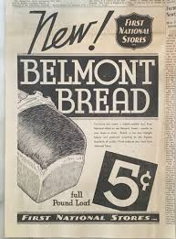
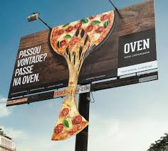
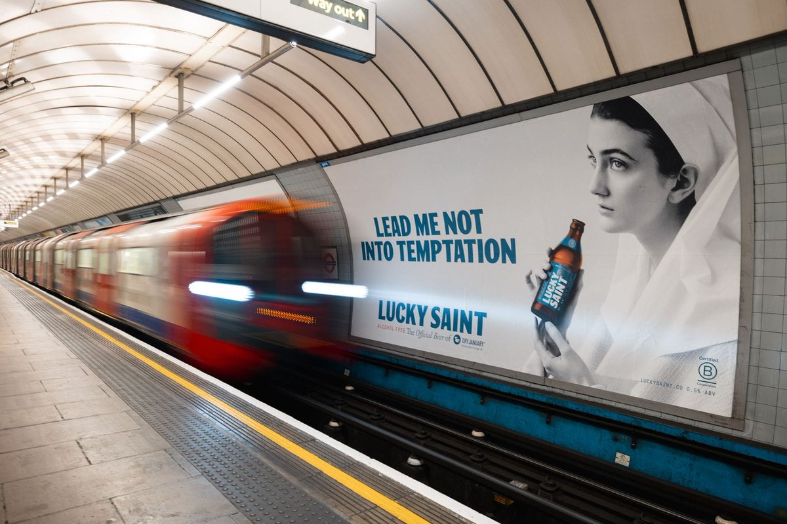
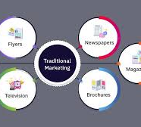
Traditional marketing strategies

Slide 4
Investment and ROI on traditional Marketing Activities
Notes:
Marketing Actiovity investment ROI Local newspapers and maghazines 3000(10%) 7500(5%) Tourist guides and Brochiures 2000(6.67%) 6000(4%) Radio and outdoor Advertising 3500(11.67%) 9000(6%) Billboards and Underground Adverytisement 4000(13.33%) 10500(7%)

Slide 5
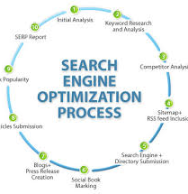


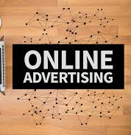
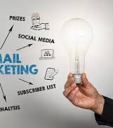
Digital Marketing Strategies

Slide 6
Investment and ROI on Digital Marketing
Notes:
Social media Marketing is expected to give 20% increase in sales with the expected ROI of 30000

Slide 7
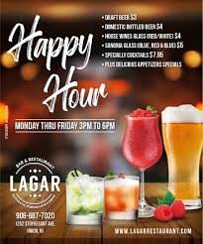
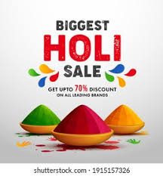
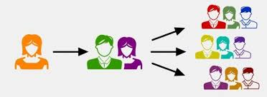
Sales promotion activities

Slide 8

Investment and ROI on Sales promotions

Slide 9

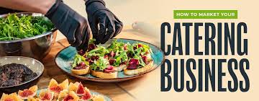
Additional revenue streams

Slide 10
Investment and ROI in Additional revenue streams

Slide 11


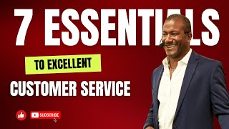
Staff training and development

Slide 12
Investment and Roi on staff training ans development

Slide 13
References
NAIR, J. and PASALA, B., 2023/12//. Dishoom: Building a Distinct Restaurant Brand Using Storytelling and 'Seva' Culture. IUP Journal of Brand Management, 20(4), pp. 43-55.
Dishoom awards: From Bombay with love (no date) Dishoom awards | From Bombay with love. Available at: https://www.dishoom.com/awards-accolades/ (Accessed: 29 May 2024).
Panagopoulos, N.G. and Avlonitis, G.J. (2010) ‘Performance implications of sales strategy: The moderating effects of leadership and environment’, International journal of research in marketing, 27(1), pp. 46–57. Available at: https://doi.org/10.1016/j.ijresmar.2009.11.001.
Vaughan, T. (2010) DISHOOM, Caterer & hotelkeeper. London: Travel Weekly Group, pp. 42-.
(Digital marketing success for Dishoom: From Leeds with love (no date) Engage. Available at: https://engageinteractive.co.uk/work/digital-marketing-success-for-dishoom-from-engage-leeds-with-love (Accessed: 30 May 2024).
(Best companies: Dishoom (no date) Best Companies | Dishoom Company Profile. Available at: https://www.b.co.uk/companies/dishoom (Accessed: 30 May 2024).
Team, T.I. (no date) What is Digital Marketing? types and examples, Investopedia. Available at: https://www.investopedia.com/terms/d/digital-marketing.asp (Accessed: 30 May 2024).
What is SEO - search engine optimization? (2024) Search Engine Land. Available at: https://searchengineland.com/guide/what-is-seo (Accessed: 30 May 2024).
What is online advertising & how many different types are there? (no date) What Is Online Advertising & How Many Different Types Are There? Available at: https://www.tidalmarketing.co.uk/our-services/online-advertising (Accessed: 30 May 2024).

Slide 14

THANK YOU

