Slide 1

Name – Eve Davies
Student Number – 2502376
Module Code – ECEY4005/C
Word count – 3,216
I confirm that I have not used any AI tools in the research and creation of this assignment. I confirm that I have not presented any AI generated materials as my own work. I confirm I have copies of my drafts, notes, and other resources I used, which I may be asked to provide in evidence. ￼

Slide 2
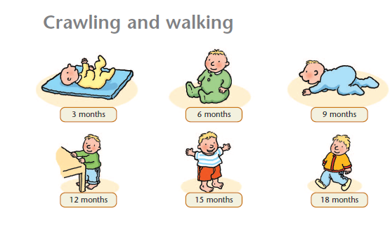
The first 1,000 days
Eve Davies 2502376

Slide 3
Introduction to the first 1,000 days.
The first 1,000 days of a child's life begins from conception to a child’s second birthday. UNICEF (2021) states that this is a crucial window in a child's life. Factors such as nutrition of the mother during pregnancy and healthcare can have profound impact on a child's brain development. During pregnancy, a mother's health and nutrition will have a direct impact on a child's life as undernutrition can cause issues such as stunted growth. Establishing good health within the first 1,000 days paves the way for a child’s cognitive and physical development and these heathy habits can move with them to adulthood.
The importance of exceptional care during this period can be found as giving a child a fair start at life. The effect of positive early achievements allows higher chances for a child to achieve happiness and success (Jeunesse 2017). The reasoning behind the need for care to be exceptional during the first 1,000 days as this is when the production of body and brain development begin. If they are formed well, this can increase life chances for the child.
The purpose of this scrapbook is to delve deeper into the exceptional care needed during the first 1,000 days of a child's life for them to flourish into adulthood. I shall also be looking into the impacts of negative factors during the first 1,000 days and the effects that can have on a child’s development.

Slide 4
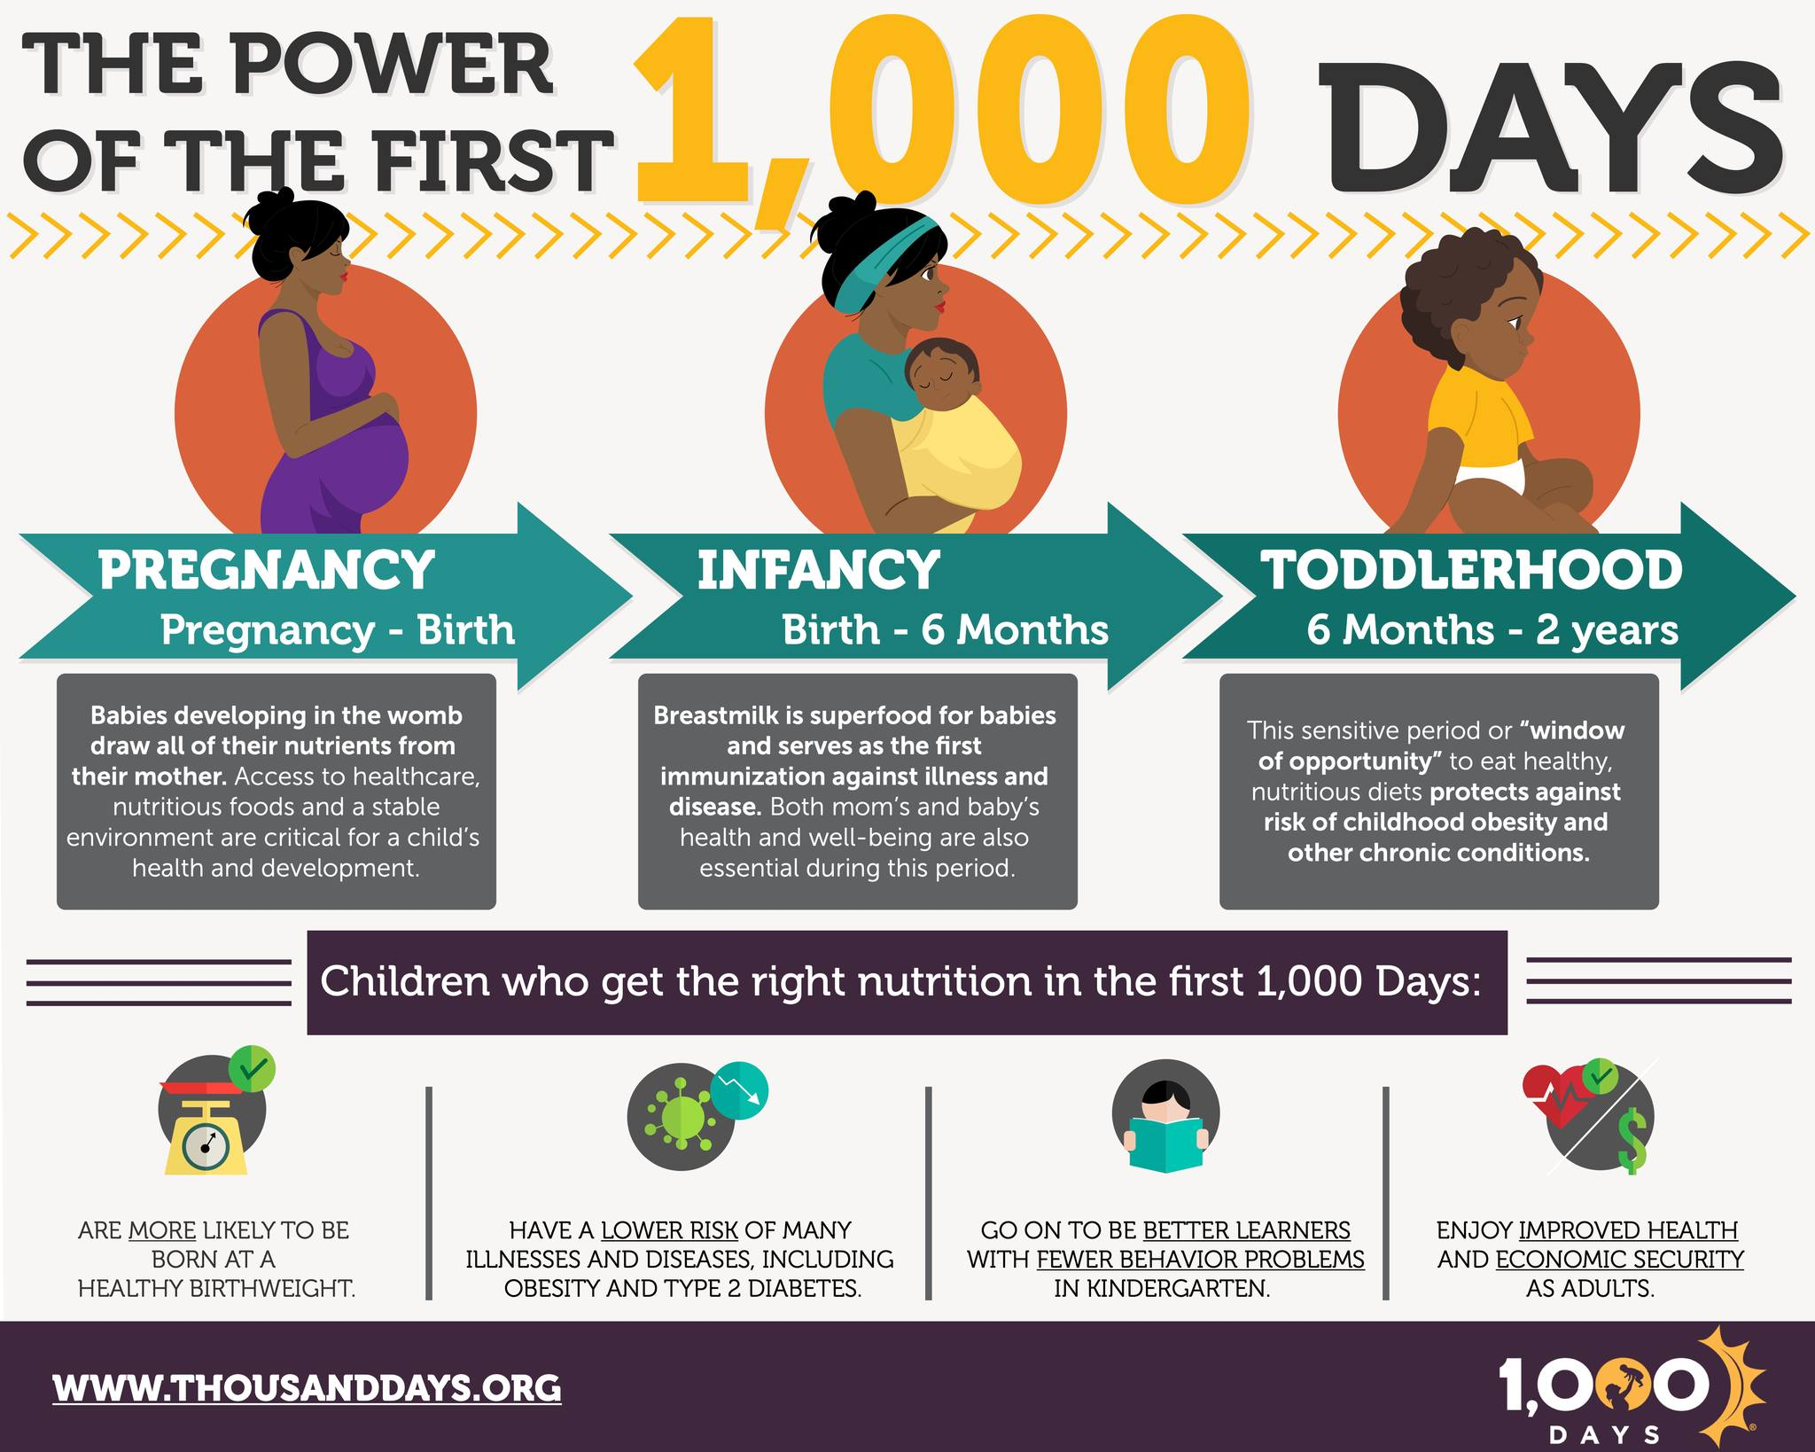
What does exceptional care mean?
During the first 1,000 days of a child’s life, there are 3 factors that play a huge role in a child’s development. Emotional, physical, and social. Even when in the womb, a baby brain begins to create synapses. A synapse is when two neurons meet in the brain and create a gap (BBC 2025). The synapses that are created allow us as humans to connect our brains to our body.
The emotional aspect of a child’s development is crucial for a child to recognise positive interactions with adults. This goes hand in hand with Bowlby's Attachment Theory 1969. Bowlby proposed his attachment theory to explain how the different types of attachments adults/caregivers have with children can impact their future relationship types. The positive interactions between adults and children can strengthen the secure attachment theory, they are able to view themselves and others in a positive way. This enables strong self-esteem and the ability to build trusting relationships (The Institute for Clinical Social Work 2025).
The final aspect is social support during the first 1,000 days. Social support refers to the relationships and interactions that is provided by adults, caregivers and wider community such as educational staff. Again, social supports start before the baby is born through the mother's pregnancy. Having a support network throughout pregnancy is essential as it can reduce stress and anxiety for the mother. Another example is a pregnant mother might feel isolated as they aren’t familiar with any other people with children, which again could make a mother feel alone. There are several prenatal classes that allow mothers to connect (Rockliffe, 2023). According to nidirect (2018), encouraging children to play and explore allows children to explore their own feelings through play and gain a better understanding of how to express themselves in a social setting.
The meaning of exceptional care during the first 1,000 days can be found as a critical time period that significantly influences a child’s future health and well-being. Different experiences, stimulation, nutrition and relationships during this crucial time will have a lasting impact on a child’s cognitive abilities and emotional resilience (The CPD Certification Service, 2025). Not only does it focus on the child’s nutrition and health but focuses on the maternal health and nutrition during pregnancy. Exceptional care during the first 1,000 days of a child’s life is crucial for supporting growth, brain development, emotional well-being. As a result of this, it will pave the way for lifelong health and success. There are several differences between exceptional care and basic needs being met. A main one of those differences is medical needs. Basic needs for a child would be a visit to the GP when unwell but exceptional care differs due to primary caregivers visiting the GP for preventative check-ups. Another difference is nutrition. Basic needs would be to give a child enough food to avoid hunger, but exceptional care would be to ensure the correct nutrients is given to the child. Exceptional care supports growth and brain function.
Physical support during the first 1,000 days of a child’s life is crucial for healthy development including healthy brain development, immunity and overall well-being of the child. Physical support includes meeting a child’s basic needs which includes food, water, hygiene and sleep. This ties in with Maslow’s Hierarchy of Needs 1943 as Maslow states that physiological needs must be met before other aspects of needs can develop (Cherry, 2024). The physical support a child needs begins before the baby enters the world as the mother's nutrition and wellbeing throughout pregnancy impacts the baby. If a mother's nutrition is poor throughout pregnancy, it can lead to things such as a low birth weight, nutrient deficiencies for the baby which can lead to greater issues further down the line (Liverpool John Moores 2021). Another way that a caregiver can support a child physically is through vaccination. The reason for why health boards such as the NHS urge parents and caregivers to give children vaccinations is because these vaccines teach the child’s immune system to make their own antibodies against diseases which strengthen a child’s immune system to diseases that could be deadly (NHS, 2023).

Slide 5
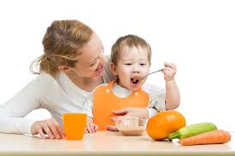
Nutrition in the first 1,000 days
Many articles state that breastfeeding a baby has many benefits for mother and baby; it also has lasting benefits for the child up to adulthood. Another reason that breastfeeding is an important factor to take into consideration when discussing exceptional care is the research behind the emotional bond that breastfeeding creates between mother and baby. Breastfeeding can be more than just providing food for a baby; it can be comfort for the child and provide skin to skin contact which can help develop the secure and safe attachment style (Labhsetwar, 2023). Not only does breastfeeding provide benefits for the baby but also the mother. It can reduce risk of certain types of cancers and cardiovascular diseases (NHS, 2020). Solid foods are usually introduced to a baby at around 6 months old when breast milk alone is not enough to satisfy the child. The added nutrition from the solid food will allow the babies brain to develop rapidly.
Beginning to eat solid foods for a young child is an important milestone, this is when healthy habits begin. Healthy habits such as having 5 fruit or vegetables a day can led to benefits such as healthier and stronger bones, supports brain development and boosts immunity, to name only a few benefits (CDC, 2024). A diet for a young child that lacks nutrients such as protein and iron can lead to delayed physical growth and even long-term developmental issues for the child. Being able to provide the child with a healthy start to life can add long term advantages such as the reduced risk of serious health conditions later in adulthood. Some of these may be type 2 diabetes, heart disease and obesity. Providing the child with a balanced diet that is low in sugar, salt and saturated fats help maintain a healthy weight and reduce this risk of developing preventable diseases (Johnston, 2021).
Baby Sparks, 2019.
When thinking about nutrition within the first 1,000 days of a child's life, it is important to consider that this begins with pregnancy. The importance of the expectant mother eating the correct foods will determine if the baby develops in accordance with the ages of the child. A misconception of pregnancy is that the mother should be ‘eating for 2’ (NHS 2023). This could have more harm than good. Excessively eating can put mother at a risk for high blood pressure and gestational diabetes which can lead to issues at birth and beyond, according to the NHS (2022). There are several different nutrients that serve a purpose when discussing the importance of nutrition in pregnancy. For example, consuming calcium during pregnancy reduces the risk of preeclampsia and iron is another important nutrient as it helps the babies brain develop and growth (Medline Plus, 2024).

Slide 6

Healthcare and medical support.
With these visits from medical professionals such as midwives and health visitors, they can pick up if there are any developmental delays with the child or health conditions. The earlier these are picked up, the greater the outcome and support for the child and family involved. The benefits of them being picked up early is that families can be supported by receiving education and training to help them better understand their child’s needs. Additionally, being able to identify and address the delays early on can optimise a child’s potential by being able to use resources available such as a speech and language therapist (Fielkow, 2023). In situations like these where the child needs external support, professionals can work together to ensure that the child is ready for an educational setting such as school.
As previously mentioned, the health care and wellbeing for the child begins before they enter the world. Checkups throughout pregnancy can provide important information for the mother on the development of the baby in the womb such as early detection of developmental issues (Bali International Hospital,2025). Regular checkups for baby can be a good way to determine if the child is developing in line with their age. According to the NHS (2020) as the child gets older, aspects such as speech and language are monitored and checked with every visit and if they are developing in accordance with their age.
Vaccinations are an effective way that parents and caregivers can protect their young babies and children from serious and harmful diseases. In the United Kingdom, there is a schedule for vaccines for children from the ages of 8 weeks (RCPCH, 2020). The reasoning for vaccinations is since they help to protect babies and children by preparing their immune systems. Babies and children are more at risk for suffering badly from diseases such as measles which can lead to a loss of sight (Public Health Wales, 2024). In 2025, the Government held a survey for parents in relation to vaccinations. 87% of these parents were happy to give their children vaccinations (Uk Health Security Agency, 2025), which would give the children that received these vaccinations a better chance at fighting potentially deadly diseases.
Bright Futures, 2024.

Slide 7

Emotional and psychological support.
Attachment and bonding are one of the many key foundations within the first 1,000 days of a child’s life that helps shape their future relationships and emotional development. The attachment between a baby and its primary caregiver helps build that child’s trust but the lack of this bond can lead to an impact on future relationships. The benefits of a baby and young child having a secure attachment bond is that the caregivers react sensitively to the child's distress and help regulate that child’s emotions. As a result of this, it has a positive impact on the child’s psychological development. Unfortunately, not all babies and children will have a secure attachment, and this has detrimental effects on a child. These can be that the child is more likely to develop behavioural problems such as ADHD (NSPCC, 2021). Bonding with the baby or young child is also another aspect which can shape how they make relationships. Parents and caregivers that give their child love and attention help their babies and young children to develop strong attachments with others (Hawk, 2023). Physical touch is another factor that can help develop a bond with a young baby and child. Holding them, talking to them and comforting them all helps with developing a bond (NHS Inform, 2025).
Another way that a child’s emotional and psychological development can be supported is through responsive parenting. This means responding promptly, appropriately and consistently to the needs of the young baby or child. Doing this lays the foundation for healthy development. As noted by Dewar (2016), parents/caregivers that are responsive to their children allow their child to potentially have a better cognitive outcome than children that might not have a parent/caregiver that is responsive. An example given by Dewar is that children’s language skills develop quicker when parents and caregivers respond swiftly to them. Another benefit of responsive parenting is that young children that are nearing school age will have developed greater attention skills and problem-solving ability. Additionally, responsive parenting also teaches the child that their needs are valued and that they can trust relationships that are made (Hawley, 2021).
Creating a loving and nurturing environment for children is essential for their emotional and psychological development. During the first 1,000 days of a child’s life, they need emotional security to come from a nurturing environment. Having this emotional security for a child will lessen the feeling of ‘flight or fight’ mode and they are more likely to find it easier to discuss their feelings and regulate their own emotions. The way a parent/caregiver can make a child emotionally secure is through showing empathy when they’re upset or hurt and staying calm during emotional situations. A young baby and child need to understand that their chaos cannot be met with more chaos. An adult figure being calm will allow a young child to develop emotional regulation (Parenta, 2024).
NCT, 2026.

Slide 8
Social and environmental influence.
Pregnancy can be a very stressful time for many parents and that is why a strong support system is needed. Having a strong support system can help reduce stress. Stress during pregnancy can be harmful to the unborn child as it can cause a premature labour which can have lasting effects on a child. A support system goes beyond pregnancy to post-partum as Raveco Medical (2025) state that the more emotional support a parent/caregiver has the stronger the bond created with the baby.
In some cases, children do not have a stable family due to different factors such as conflict within the family or a lack of support. This can have a negative effect on a baby/young child as prolonged high levels of the stress hormone cortisol can impact the way a child develops language, decision making and overall well-being of the child, according to Harvard University (2024).
On the other hand, a stable and supportive family environment can allow a child to flourish. From a newborn age, routine helps a child trust their caregivers as they understand that parents/caregivers will respond to their needs. Growing up, young children will then thrive with routine as it begins to grow self-confidence. Having a stable home life also shows that when a child is at an age to go to nursery or another similar setting, they have an easier time learning and creating friendships (Seattle Children’s Hospital, 2019).
The Guardian, 2014.
This image shows the difference between a child that has had an adequate relationship with their parent/caregiver and the other a child that has suffered the effects of extreme neglect due to the lack of a relationship with primary caregivers (The Guardian, 2014). The effects of neglect and lack of relationships for a child can be found as struggling to make healthy relationships with adults due to an attachment disorder that prevent children building healthy relationships with adults (Weir, 2014).

Slide 9

The influence of exceptional care on the future.
As noted throughout this scrapbook, there are several long-term benefits for a child that receives exceptional care during the first 1,000 days of life. The first 1,000 days of a child’s life which starts at conception and leads up until a child’s second birthday is a critical time window for key time for biological and psychological development. Responsive parenting is one of key aspects that helps a child’s social, emotional and communication skills develop through creating a secure bond between the parent/caregiver and the child (Royal Foundation Centre of Early Childhood, 2024). This type of parenting allows the child’s trust to develop as they are aware that the parent/caregiver will respond to their needs. As the child develops into an adult, this has paved the way for future relationships to be made.
Another important aspect to consider for exceptional care during the first 1,000 days is nutrition. Nutrition is arguably one of the most important aspects that supports child development in several different ways. Without proper maternal nutrition and a balanced diet, children won’t get the nutrients they need to grow healthy bones through getting calcium and a strong immune system through getting enough vitamin A (British Nutrition Foundation, 2025). Habits created in childhood normally follows a child into adulthood, that is why creating a healthy balanced diet from a young age will decrease the chances of chronic illness such as type 2 diabetes and cardiovascular diseases (Holden, 2025). These several different aspects of exceptional care within the first 1,000 days will work hand in hand to pave the way for long-term benefits for a child into adulthood.
Early investment in a child’s nutrition, health and responsive parenting will enable to enhance cognitive development and emotional regulation which is essential for school readiness.
BOLD, 2025.

Slide 10
Conclusion.
To conclude this scrapbook, exceptional care throughout the first 1,000 days of a child’s life is the key to establishing the foundations for lifelong health, learning and wellbeing. During the first 1,000 days the physical, psychological and emotional development is when rapid growth happens in these areas and early experiences have a lasting effect on children, especially physically and emotionally. Throughout this scrapbook I have noted that the care for the child begins prior to the child’s arrival in the world, beginning with the mother's nutrition during pregnancy. Unfortunately, there is a knock-on effect to the baby if the mother does not eat the right vitamins and sources of protein during pregnancy, it can lead to a low birth weight. Having a low birth weight can impact the child’s breathing and digestive problems which can be deadly for a young child (Stanford Medicine, 2026). Additionally, the support from health care services for prenatal and postnatal is another key aspect to consider when discussing care during the first 1,000 days, this includes vaccinations against deadly viruses and diseases for children and early screening for illnesses that might prevent developmental delays as early intervention can minimise the negative impact that could have on a family (Early Intervention Foundation, 2018).
Even though physical wellbeing is important the aspect of the first 1,000 days, emotional development is equally important. Responsive parenting fosters the secure attachment and helps develop the child’s language skills as well as growth in social and emotional competence. Brain stimulation is essential for young children to help their brain develop. Not only brain development but also to begin to develop good motor skills and coordination. The actions that are completed whilst children play can also help develop cognitive and emotional skills (OpenMinds Psychiatry, Counselling and Neuroscience Centre, 2022). Together these different aspects of exceptional care during the first 1,000 days work together to ensure that a child has the best start to life and use these further into adulthood.
Psychologs, 2023.

Slide 11
References.

