Slide 1
Managing Change
Richard Beecher 28000985

Slide 2
The only way to make sense out of change is to plunge into it, move with it, and join the dance.
Alan Wilson Watts (6 January 1915 – 16 November 1973)

Slide 3
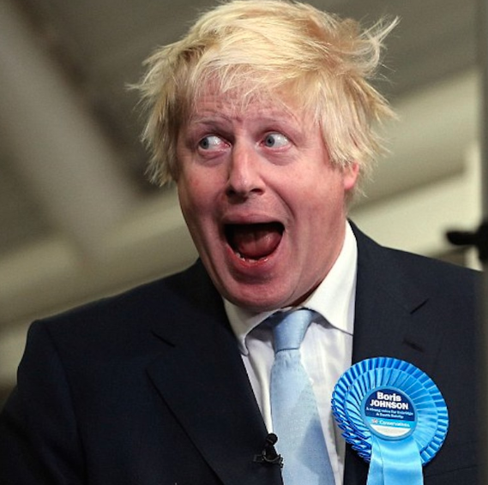
Fear of terror attacks
Brexit
Negative aspects of globalisation
Notes:
After years of sustained growth, various aspects of the tourist industry now face a number of challenges. Amongst these challenges have been: fear of terror attacks, Brexit, and a growing awareness of some of the negative aspects of globalisation

Slide 4
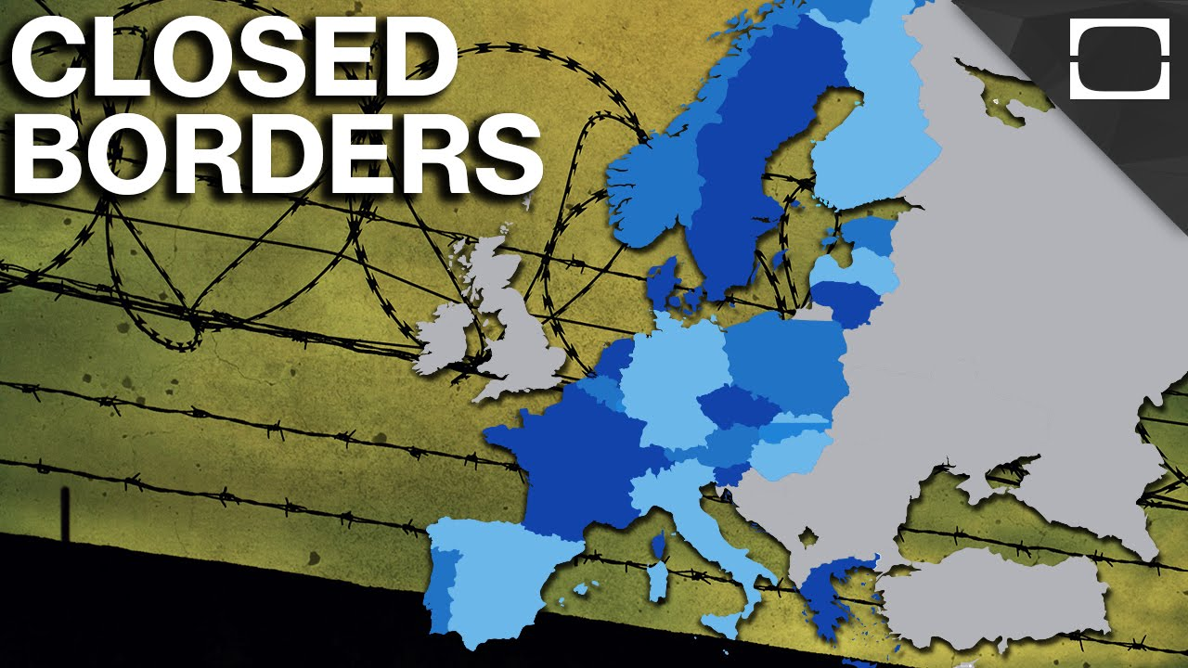

Bacteria and viruses
Borders closing
Notes:
Sustainability and transmission of bacteria and viruses. Across the globe, borders are closing and isolationism growing.

Slide 5

Notes:
On the other hand there is a growing use of mobile applications and the internet has allowed the development of the sharing economy and an increasing number of independent operators - both travellers and hosts.

Slide 6
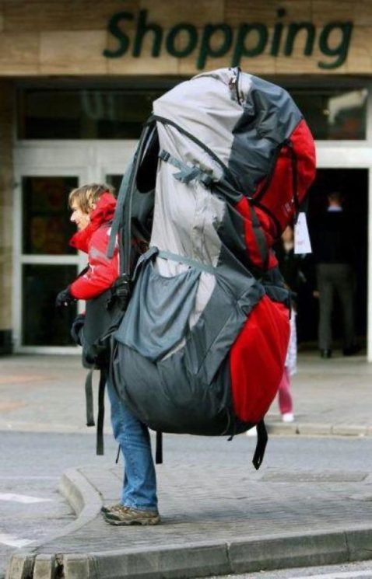
So what is driving independent travel?
Notes:
So what is driving independent travel? Not least is the cost. Hotels are even advertising that direct booking gets the customer a better deal.
So - there is a potential conflict between a desire for security and safety and the desire for independent travel.

Slide 7
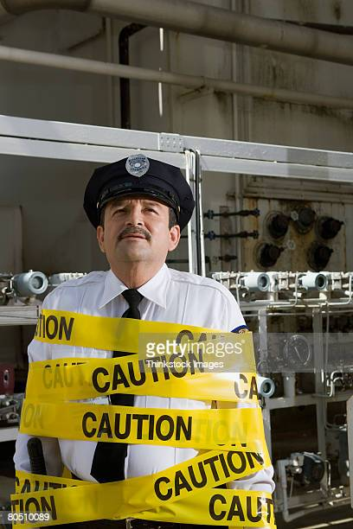
Notes:
It is necessary for tour operators to respond to this challenge to survive. They have the experience to offer safety and security, but need to adapt to accommodate the desire for increased autonomy and low prices.

Slide 8
This presentation will be looking at how one company has tried to and, in the future, could, respond to these changes

Slide 9
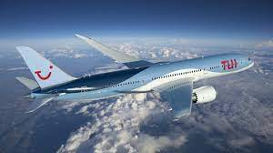
Notes:
Over the past few years, Tui have tried to respond to what they have understood to be the needs of the independent traveller. But I would argue that their understanding has been limited. The emphasis has been on city breaks and quick getaways, believing this to be the market that the independent traveller is interested in. A lack of understanding of the clients' needs can be illustrated by their response to an increasing number of travellers opting to take the ski train from St Pancras. Their belief that this was a purely financial motivation was proved incorrect - it took several years for them to realise that the key motivation was an extra 2 days skiing. Thus proving the need for on-going research - and research across the travelling public, and not just their own customer base.

Slide 10
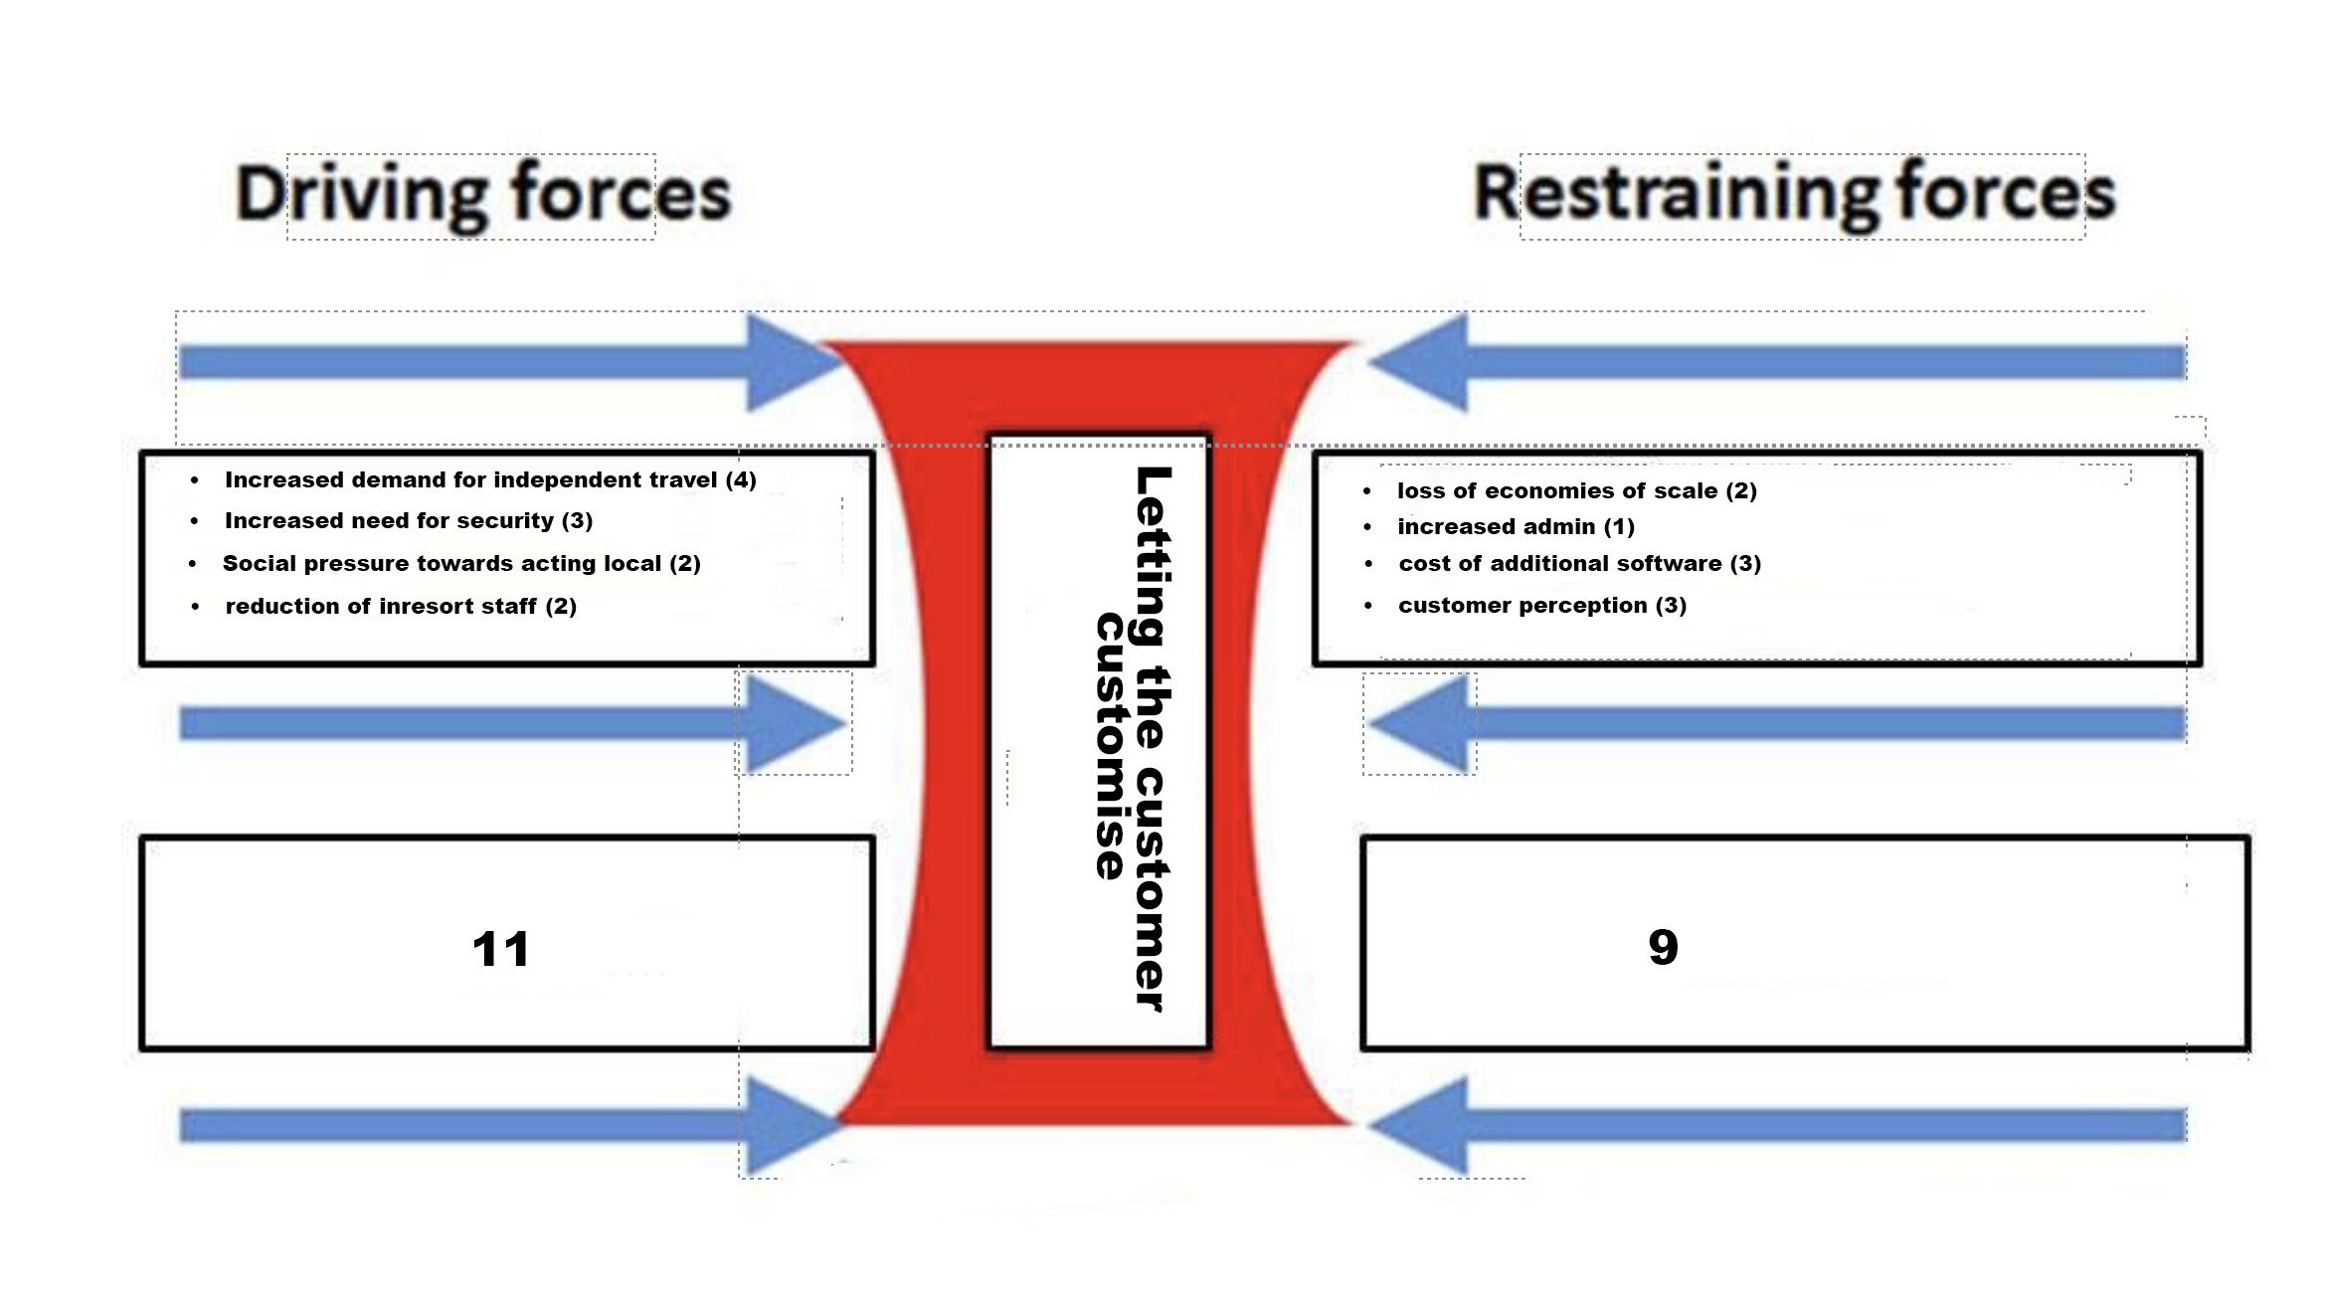
Notes:
The proposal for change is that Tui adopts a pic'n'mix approach to its products: it will still be possible to opt for traditional package holiday options but key to the change will be an increased flexibility for the customer to choose individual components to create their dream holiday.
As we have heard the main drivers are competition from Airbnb, mobile apps, Expedia, Booking.com etc
We have opportunities to change to compete with this market movement.
But what barriers will we have to cross?
Major barriers to change are the initial capital cost of the IT set up - which will also have longer term financial implications in terms of staffing for monitoring and maintenance.
The other major barrier is customer perception, which will place additional demands on the marketing department.
It's clear that the driving forces outweigh the restraining forces - this could be the change that Tui needs.
In terms of management of stakeholders - and let's remember this is a dynamic model and that people with little power or interest often have the most to offer in terms of micro knowledge.

Slide 11
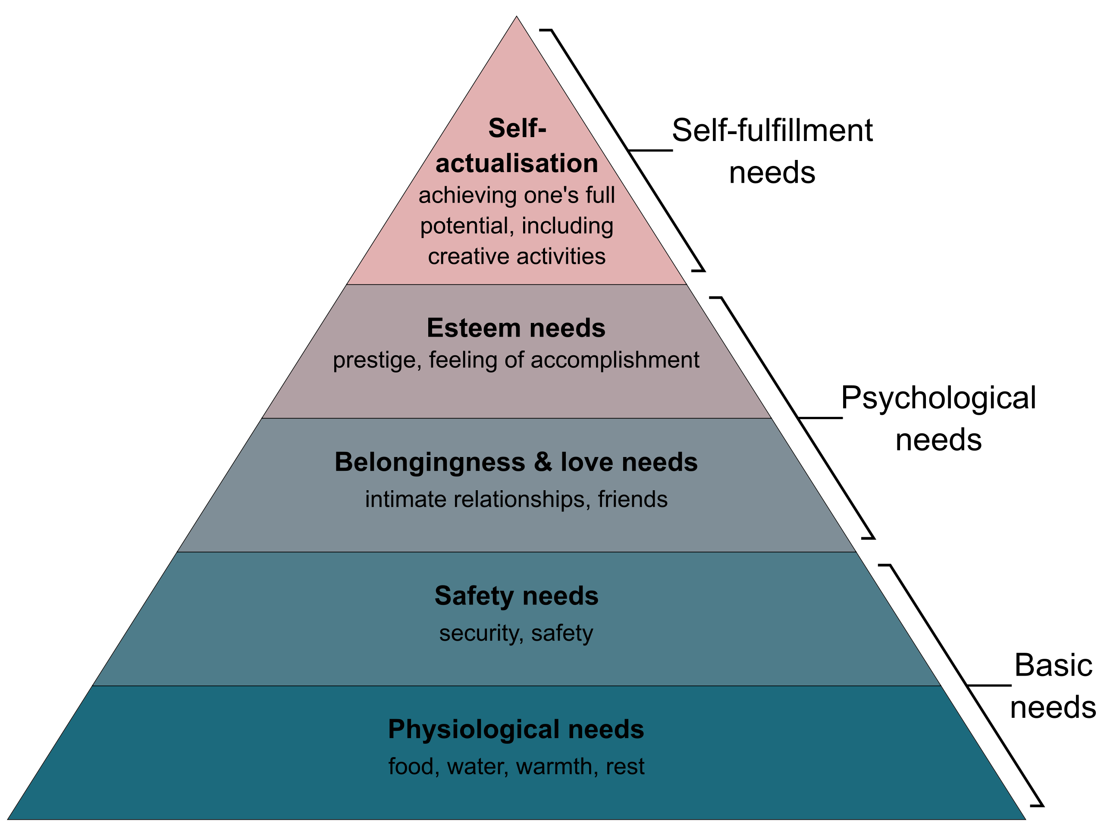
Notes:
Run through of needs

Slide 12
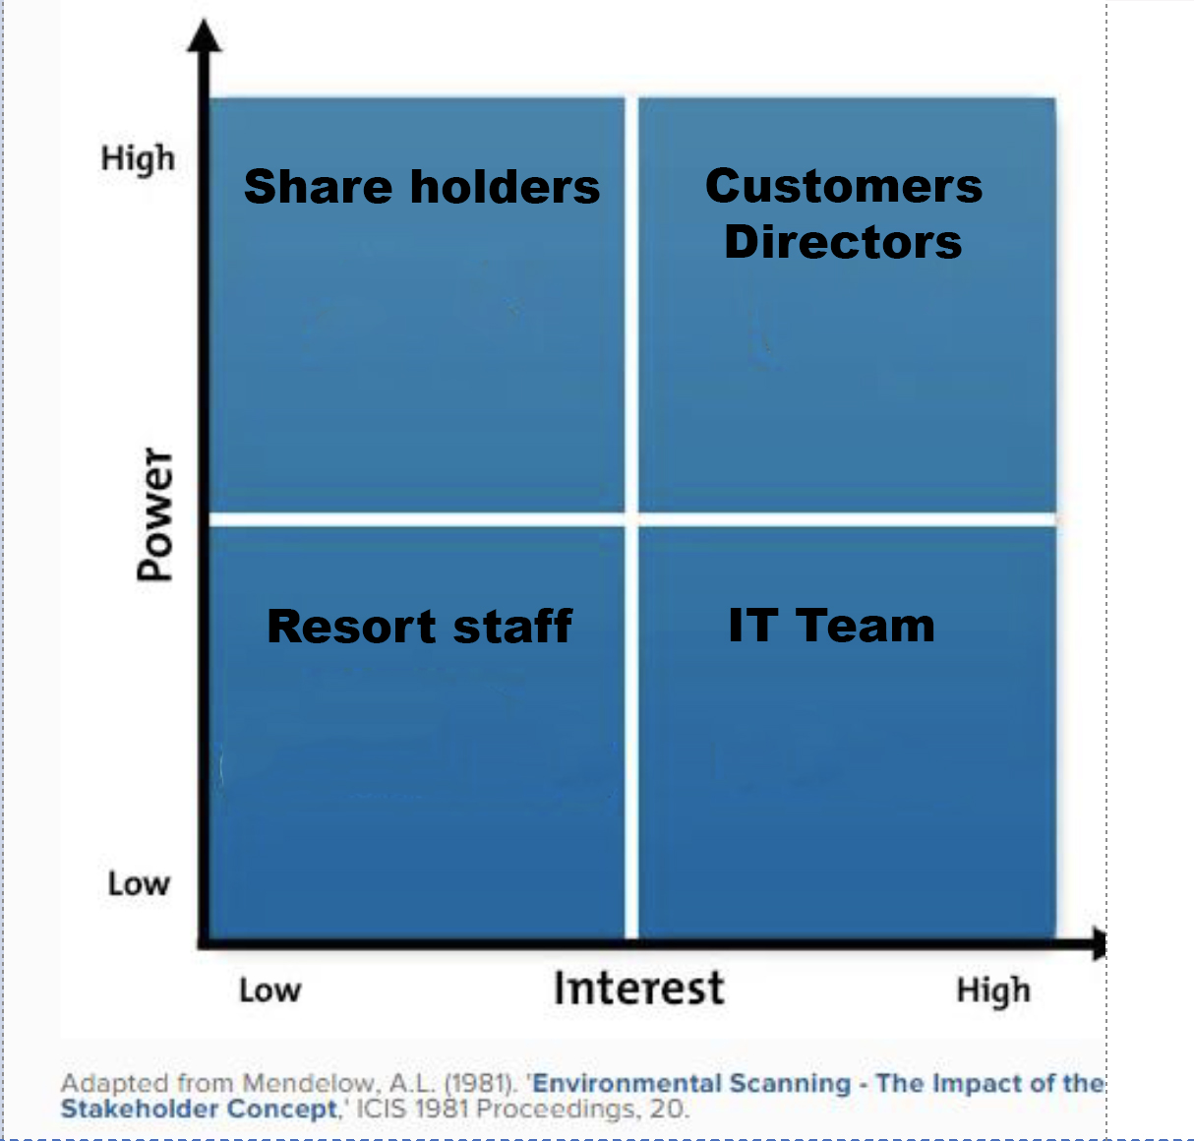
Notes:
High Power: High Interest
I suggest that maximum involvement will be at board level, but equally crucial will be customer involvement - managed through research and focus groups
High Power: Low Interest
Shareholders, while potentially in a powerful position, will need to be kept on board, but their interest is in the bottom line and not the structural changes that are being made to ensure the continuance of a profitable company
High Interest: Low Power
The IT team will need to be informed at every step. While their input is technical, they need to be kept informed about the needs of the company.
Low Power: Low Interest
Local resort staff - who are mainly temporary and casual will need minimum input during the process

Slide 13
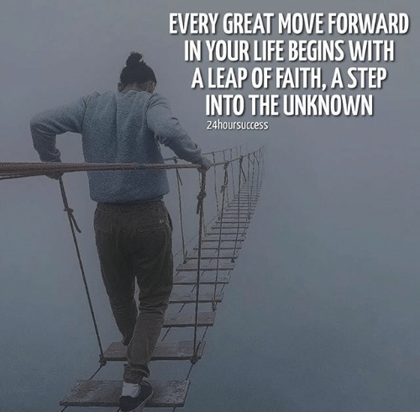
Next steps
Notes:
Acting for Tui as the nominated change agent, I will implement Kotter's Eight Steps Theory.
However, it will need to be preceded by small scale pilots, limited to either particular locations, or within a brand of Tui. At this stage I am thinking of the Tui Blue Family Programme, since it already offers a diverse range of additional buy ins, such as kids' clubs. Since this is already available in non-digital form, it would make an excellent subject for a pilot. In addition to the standard package we could offer airbnb style accommodation as an additional alternative. I believe that separate & flexible accommodation, in addition to a easy to use booking system, with algorithms offering suggestions - much as high end travel agents have done in the past is key to meeting the demands of the independent traveller.
As well as ironing out problems this could be a way of meeting Kotter's 6th step - generating short term wins.
Both customers and staff need to be involved in the pilots.

Slide 14


