Slide 1






Ysgogwyr Newid: Creadigrwydd a Gwerth
Changemakers:
Creativity and Value
Dulliau Creadigol a Dylunio Cwricwlwm
Creative Approaches and Curriculum Design
Notes:
Week 6

Slide 2
Recap
Beth wnaethon ni ei gwmpasu ddydd Llun?
Oes gennych chi unrhyw gwestiynau?
What did we cover on Monday?
Do you have any questions?

Slide 3
Nod ac Amcanion
Aim and Objectives
Nod
Ymchwilio i’r gwahanol fathau o ddyluniad cwricwlwm sy’n berthnasol i ymholiad gwyddonol a chreadigol
Amcanion:
I ddatblygu ymwybyddiaeth o sut y gellir cyflwyno creadigrwydd i ddyluniad cwriwcwlwm
I werthuso’r gwahaniaethau rhwng ddau ddull creadigol o ddysgu
Aim:
To investigate the different types of curriculum design that relate to scientific and creative enquiry
Objectives:
To develop an awareness of how creativity can be introduced to the curriculum design
To evaluate the differences between two creative methods of learning
Notes:
Overall aims

Slide 4
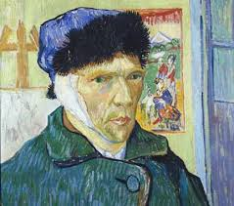
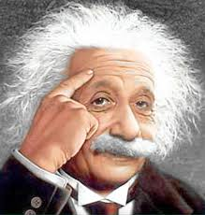
Y Ddadl Celf v Gwyddoniaeth
The Art v Science Debate
Vs
Notes:
Week 4

Slide 5
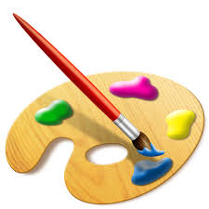

Tasg / Task
Creuwch ddau restr:
Pethau rydych yn perthnasu gyda’r celfyddydau
Pethau rydych yn perthnasu gyda gwyddoniaeth
Create two lists:
Things that you relate to the arts
Things that you relate to science
Notes:
Create two lists; art and science

Slide 6
Nodau celf / The aims of art
I ddarparu profiadau gweledol, cyffyrddol a synhwyraidd a ffordd unigryw o ddeall ac ymateb i'r byd.
I ddisgyblion ddefnyddio lliw, ffurf, gwead, patrwm a gwahanol ddefnyddiau a phrosesau i gyfleu'r hyn maen nhw'n ei weld, ei deimlo a'i feddwl.
Mae'r Cwricwlwm Cenedlaethol yn cynnwys celfyddydau gweledol, cerddoriaeth, drama, dawns a chrefftau.
I feithrin deallusrwydd lluosog a dysgu unigol myfyrwyr
O gyfnodau allweddol 1 i 3 (disgyblion rhwng pump a 14 oed), mae celf, cerddoriaeth, drama (fel rhan o wersi iaith) ac addysg gorfforol (dawns) yn orfodol i bob myfyriwr.
Mynd i'r afael â darllen, ysgrifennu a sgiliau sylfaenol eraill ym mhob maes pwnc
NFER (2008)
To provide visual, tactile and sensory experiences and a unique way of understanding and responding to the world.
For pupils to use colour, form, texture, pattern and different materials and processes to communicate what they see, feel and think.
The National Curriculum includes visual arts, music, drama, dance and crafts.
To cultivate multiple intelligences and students' individual learning
From key stages 1 to 3 (pupils aged five to 14), art, music, drama (as part of language lessons) and physical education (dance) are compulsory for all students.
Address reading, writing, and other fundamental skills within all subject areas
NFER (2008)
Notes:
Focus is on sensory experiences, hands on learning which is experiential. Caters for all intelligences and different types of learners. Promotes experimentation with colour, texture and pattern.

Slide 7
Nodau gwyddoniaeth
The aims of science (DfE, 2013)
i gyffroi a swyno plant sydd â synnwyr o ryfeddod am y byd naturiol.
datblygu gwerthfawrogiad o sut mae gwyddoniaeth wedi cyfrannu at ddatblygiad hanesyddol a diwylliannol ein cymdeithas.
i roi profiad ymarferol o sut mae gwyddonwyr yn arsylwi ar y byd naturiol, meddwl am ddamcaniaethau a gwneud arbrofion i gael tystiolaeth i gefnogi neu wrthbrofi'r damcaniaethau hyn.
achosi i blant ddeall pwysigrwydd tystiolaeth wrth wneud penderfyniadau a gallu barnu a yw honiadau'r cyfryngau, hysbysebwyr, gwleidyddion, newyddiadurwyr, ac ati, yn seiliedig ar dystiolaeth ac yn ddibynadwy.
i roi digon o wybodaeth ar sail tystiolaeth i ddisgyblion allu llunio barnau personol gwybodus er mwyn byw bywydau iach, diogel, cyfforddus ac amgylcheddol gynaliadwy.
datblygu ymwybyddiaeth o gasgliadau damcaniaethau gwyddonol pwysig mewn ffordd bendant a hygyrch
to excite and enthuse children with a sense of awe and wonder at the natural world.
to develop an appreciation of how science has contributed to the historical and cultural development of our society.
to give practical experience of how scientists make observations of the natural world, come up with hypotheses and do experiments to obtain evidence to support or disprove these hypotheses.
to cause children to understand the importance of evidence when making decisions and to be able to judge whether the claims of the media, advertisers, politicians, journalists, etc, are evidence-based and reliable.
to give pupils enough evidence-based knowledge to be able to make informed personal judgements in order to lead healthy, safe, comfortable and environmentally sustainable lives.
to develop awareness of the conclusions of important scientific theories in a concrete and accessible way
Notes:
Aims taken from DFE – mainly focus on England. Can be seen from the aims that Science plays a key part in everyday life. Appears that learning about science will set them up for their future. Importance on evidence based and practical activities. Similar features to the aims of art?

Slide 8
Gwyddoniaeth a thechnoleg
Science and technology
Caffael gwybodaeth trwy arsylwi ac arbrofi, a thechnoleg yn cymhwyso gwybodaeth wyddonol mewn ffyrdd ymarferol.
Yn manteisio ar chwilfrydedd plant a phobl ifanc am ein byd naturiol, corfforol a'n bydysawd wrth ymchwilio, deall ac egluro.
Plant yn cynhyrchu ac yn profi syniadau, yn casglu tystiolaeth, yn arsylwi, yn cynnal ymchwiliadau ymarferol, ac yn cyfathrebu ag eraill.
Acquiring knowledge through observation and experimentation, and technology applies scientific knowledge in practical ways.
Capitalises on children and young people’s curiosity about our natural, physical world and universe though investigating, understanding, and explaining.
Children generate and test ideas, gather evidence, make observations, carry out practical investigations, and communicate with others.

Slide 9
Ystyrir Gwyddoniaeth fel…
Science is viewed as…
Pwnc statudol (craidd) yng Nghyfnodau Allweddol 3 a 4.
Ynghlwm yn ein penderfyniadau o ddydd i ddydd
Yn bwnc sy’n cynorthwyo plant i ddatblygu deallusrwydd, sgiliau rhesymu ac agweddau o fewn byd sy’n newid yn barhaol
Ceir dulliau gwahanol o addysgu gwyddoniaeth mewn ysgolion cynradd ac uwchradd
(Harlen and Qualter 2014)
A compulsory (core) subject area in KS2 and KS3
Being involved in our everyday life choices
A subject that helps children to develop understanding, powers of reasoning and attitudes in the ever changing world.
There is a different approach to teaching science in primary and secondary schools
(Harlen and Qualter 2014)
Notes:
Compulsory in education whereas art can be dropped in y9
Viewed as important as it provides us with scientific thinking skills which we use in every day life. Cooking – follows scientific methods.
Promotes inquiry – encourages the asking of questions and being inquisitive.
Secondary – teaching takes place in a laboratory, type of teacher changes from a generalist to a specialist (more of a formal investigative approach in secondary), problems occur in secondary : pupils may repeat work done in primary, scientific language and to teaching style can become too complex for children, science teachers often fail to refer to pupils previous experiences

Slide 10

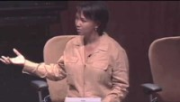
Mae Jemison
Ystyriwch negeseuon Mae yn y fideo isod. Sut maent yn berthnasol i addysgu disgyblion cynradd?
Consider Mae’s points in the video. How do they relate to teaching today?
Notes:
Astronaut, doctor, dancer, art collector – first women in America to travel to space
http://www.ted.com/talks/mae_jemison_on_teaching_arts_and_sciences_together?language=en

Slide 11
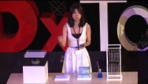
Yoko Shimizu
Ystyriwch negeseuon Yoko yn y fideo isod. Sut maent yn berthnasol i addysgu disgyblion cynradd?
Consider Yoko’s points in the video. How do they relate to teaching today?

Slide 12
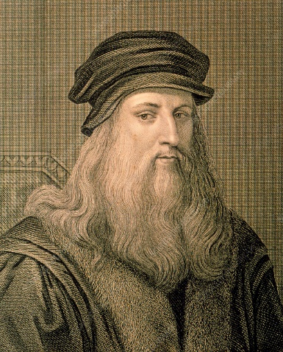
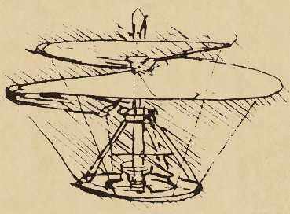
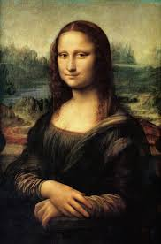

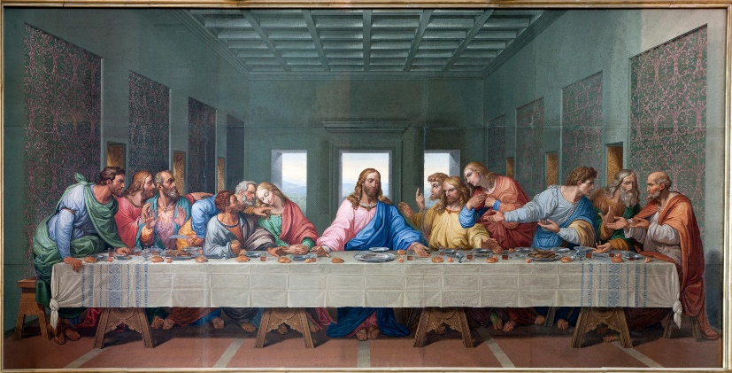
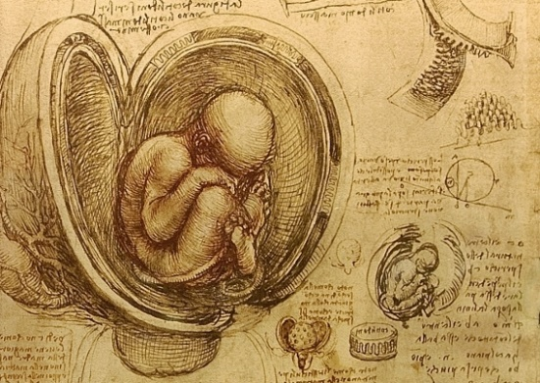
Leonardo Da Vinci
(1452 – 1519)
Artist neu Wyddonydd?
Artist or Scientist?
Pam? / Why?
Ymchwiliwch i geisio ddod i’ch barn eich hun.
Research to make your own judgement.
Notes:
Discuss which one and reasons why in groups
Debate going on between the National gallery and queens galley in London. NG believes artist, QG believes scientist. - both correct. Da Vinci started out as an artist but referred to himself as a scientist in later life.

Slide 13
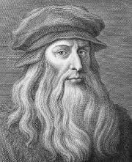
Leonardo Da Vinci
(1452 – 1519)
Gwyddoniaeth y cyfnod; daeth gwybodaeth wyddonol o Feibl neu waith gwyddonydd arall
Gwyddonydd cyntaf oedd yn cysylltu mathemateg a gwyddoniaeth
Dechreuodd chwyldro gwyddonol
Ei luniadau anatomegol yn dal i gael eu defnyddio gan feddygon heddiw
Atalay (2014)
Science of the time; scientific knowledge came from the Bible or work of another scientist
First scientist that correlated maths and science
Started a scientific revolution
His anatomical drawings are still used by doctors today
Atalay (2014)
Notes:
Born 1452 –
Most famous piece of work – Mona Lisa
Inventions and anatomy
To understand his significance you must understand the science of the time – over 500 years ago –knowledge from bible (they believed that science that involved experiments were full of errors
He was the first to see clearly that knowledge of science would have to come from repeated experiments done, not unproven ideas.
One of the reasons that he did fail in scientific investigations was because many of the mathematic laws that he needed had not yet been discovered.

Slide 14
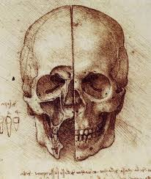
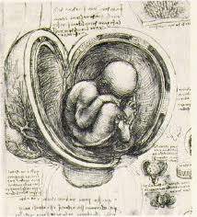
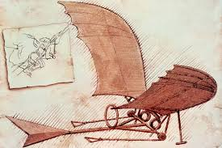
Leonardo Da Vinci
(1452 – 1519)
Cysylltu Celf a Gwyddoniaeth
  Anatomeg: Mae llawer o'r lluniadau mor gywir â delweddau technoleg digidol heddiw.
  Mae rhai lluniadau yn dal i gael eu defnyddio gan y proffesiwn meddygol heddiw.
Dyfeisiadau
  Roedd yn dymuno hedfan….felly ddyfeisiodd beiriant hedfan.
  Cynhyrchodd fwy na 35,000 o eiriau a 500 o frasluniau yn ymwneud â pheiriannau hedfan.
  Mae’r ‘Codex on the Flight of Birds’ yn amlinellu nifer o arsylwadau a chysyniadau cychwynnol a fyddai’n dod o hyd i le yn natblygiad awyren lwyddiannus ar ddechrau’r ugeinfed ganrif.
Linking Art and Science
  Anatomy: Many of his drawings are as accurate as digital imaging technology today.
  Some drawings are still used by those in the medical profession.
Inventions
  Desired to fly….so invented a flying machine.
  He produced more than 35,000 words and 500 sketches related to flying machines.
  the Codex on the Flight of Birds outlines a number of observations and beginning concepts that would find a place in the development of a successful airplane in the early twentieth century.

Slide 15
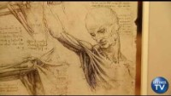

Slide 16
Y cysylltiad rhwng y celfyddydau a’r gwyddorau mewn addysg
The link between art and sciences in education
“to develop a complex mind, study the science of art, study the art of science, learn how to see.” (Leonardo Da Vinci).
Mae Celf a Gwyddoniaeth yn rhannu ‘chwilfrydedd’ cynhenid ​​i wybod, i ddeall a mynegi.
Pum prif gategori o gyffredinedd:
  Dulliau Ymholi
Meysydd Astudio
  Arbrofi;
  Creadigrwydd
  Dychymyg
Robson et al (2005)
Art and Science share an inherent ‘curiosity’ to know, to understand and express.
Five main categories of commonality:
  Modes of inquiry
Fields Of Study
  Experimentation;
  Creativity
  Imagination
Robson et al (2005)
Notes:
Thoughts are that art and science should be combined, possibly this is already done unknowingly . Both art and science promote inquiry – this is why these subject are focused on the most when looking at enquiring minds.
Both subjects encourage exploration and the engagement of pupils in sessions.
From categories it can be seen that both subjects promote a hands on approach to learning. Pupils guided by own interests? Does this increase imagination?
Experiment: Either Rain cloud or Lava Lamp

Slide 17
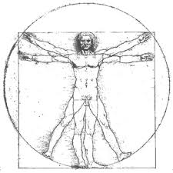
Effaith Leonardo
The Leonardo Effect
Methodoleg addysgu sy'n integreiddio pynciau ac yn datblygu sgiliau disgyblion
Llenyddiaeth yn ysgrifennu am y tebygrwydd rhwng celf a gwyddoniaeth, mae Effaith Leonardo yn dangos hyn ar lefel gwricwlwm
Athroniaeth = i ganiatáu i blant gymryd rhan lawn yn y broses gynllunio
Pwyslais ar chwarae
Mae'r athro yn hwylusydd sy'n arwain
Hickey and Robinson (2013)
Effaith Leonardo - Ynystawe
A teaching methodology that integrates subjects and develops pupils skills
Literature writes about the similarities between art and science, the Leonardo Effect demonstrates this at curricular level
Philosophy = to allow children to fully participate in the planning process
Emphasis on play
Teacher is a facilitator that guides
Hickey and Robinson (2013)
Leonardo Effect - Ynystawe
The Leonardo Effect
Notes:
The Leonardo effect – is an approach to teaching that focuses on the integration of all subjects
A bit emphasis on the arts and sciences and creativity
Encourages experiential learning
Teacher facilitates – pupils become more confident and eager to learn as education is based on their ideas and concepts
Great emphasis on the importance of play based activities throughout all phases – exploration linked to play (children are likely to be more engaged and interested in playing)

Slide 18
Effaith Leonardo/The Leonardo Effect
Mae’n hybu dysgu annibynnol, drwy sicrhau cyfleoedd i ddisgyblion wneud cysylltiadau ar draws y cwricwlwm a thu hwnt.
4 cam:
1. Cam ymchwilio/arsylwi thema newydd
2. Cam arbrofi/delweddu/
dychmygu
3. Cymhwuso gwybodaeth a sgiliau blaenorol i dasg newydd a galluogi disgyblion i fynegi eu hunain mewn ffyrdd gwahanol
4. Gwerthusiad beirniadol o berfformiad gan ddisgyblion ac adnabyddiaeth o sgiliau newydd a ddatblygwyd
Stimulates autonomous learning, critically enabling children to make connections across the learning landscape.
4 stages:
1. Research/observation of new topic stage
2. Experimentation stage to experiment, visualise, imagine
3. Applying previous knowledge and skills to new task allowing pupils to express themselves in different ways
4. Critical evaluation of performance by pupils and identification of new skills developed

Slide 19
Astudiaeth Rhagarweiniol
Preliminary Study
Methodoleg wedi ei brofi gyntaf ym Melfast yn ystod 2004-2005 (Flights of Imagination: Synchronised Integration of Art and Science in the Primary School)
Wedi peilota wedyn ym Mhrydain rhwng 2006-2007
Y peilot wedi cynnwys 1100 disbybl o 18 ysgol gynradd a 179 disgybl o un ysgol uwchradd
Deilliannau positif iawn wedi eu harddangos am gynnydd disgyblion gyda un pennaeth yn awgrymu cynnydd mewn wythnos cystal a chynnydd dros tymor yn flaenorol.
(Hickey and Robinson 2013)
Methodology first tested in Belfast during 2004-2005 (entitled – Flights of Imagination: Synchronised Integration of Art and Science in the Primary School)
Subsequently piloted in Britain in 2006-2007
The pilot involved 1100 pupils from 18 primary schools and 179 pupils from one secondary school
Very positive outcomes demonstrated regarding pupil progress with one headteacher suggesting progress in 1 week equivalent to previous progress over a term.
(Hickey and Robinson 2013)
Notes:
Research funded by Paul Hamlin and ESCalate. NESTA funded project in British Isles in 2006-2007 – ESCalate = the education subject centre for advanced learning and teaching in education
NESTA National Endowment for Science, Technology and the Arts
- geographical locations allowed the impact of the approach to be assessed in schools using related but not identical curricula. Schools selected were from a variety of environments (large cities, small towns, rural settings) – both affluent and deprived areas. Two SEN schools were included - pilots lasted 6-12 weeks – overall schools saw improvement in learning

Slide 20

Darllenwch a thrafodwch y buddiannau a’r heriau o’r dull yma. Byddwch yn barod i roi adborth.
Read and discuss the benefits and challenges of this approach. Prepare to provide feedback.
The Leonardo Effect Takes Flight (Hepburn, 2008)
The Times Education Supplement

Slide 21

Tasg / Task
Find one piece of research that links the teaching of art and science in education
Prepare a creative task that blends art and science that can be used in the classroom.
Notes:
Students may need to get creative in their search terms to find an appropriate research article.
Shaving foam clouds – Example - https://www.primroseschools.com/blog/rain-cloud-activity/ Run this and discuss, what other areas does it link to?

Slide 22
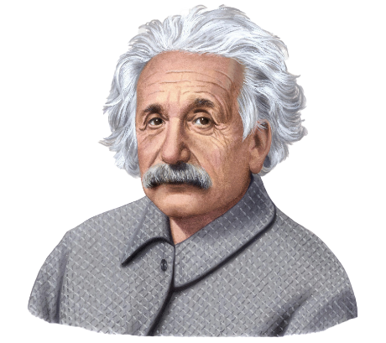
Ystyriwch ddyfyniad Albert Einstein mewn perthynas â chynnwys y sesiwn hon. Sut mae'n berthnasol i addysg?
Consider Albert Einstein’s quote in relation to the content of this session. How does this relate to education?
“The most beautiful thing that we can experience is the mysterious. It is the source of all true art and science.” (Einstein, n.d.)

Slide 23
Beth yw ymholiad?
What is enquiry?
Children need to experience paradox and uncertainty, they need lessons that produce an effective surprise. (Fisher and Williams, 2004)
Enquiry is the way that children explore and experience the environment around them. (Jeffrey, 2006)
Notes:
Fisher and Williams - a combination of approaches which are developed in an environment where pupils and teachers are encouraged to be more creative can develop more creative people – creative enquiry about children finding out things and teaching staff facilitating it.
Fisher and Williams – knowledge and problem solving will be key to survival – creative enquiry promotes this.
Jeffery considered that creative enquiry focuses on children asking questions about the world around them – problem based, experiential learning

Slide 24
Ymholiad Creadigol
Creative Enquiry
Pupils encouraged to actively ‘take control’ of their own learning (Fisher, 2003)
Enquiries should be about something that students don’t know the answer to. Following rigid instructions in order to arrive at a desired result doesn’t develop enquiry skills (Jones and Carter, 2009)
Creativity involves both practitioner and children participating in risk taking activities (Jones and Wyse, 2012)
Notes:
Creative enquiry- practical thinking skills and problem solving skills are develop problem solving skills
Pupils are actively involved and engaged in learning – promote children (as our future citizens) to be confident and creative enquirers.
Pupils need to find out knowledge for themselves and should have the freedom to do so – does this happen in all schools?

Slide 25
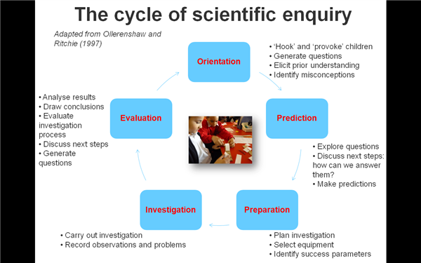
cyfeiriadedd
gwerthusiad
rhagfynegiad
ymchwiliad
paratoad
Notes:
Question is asked – how will that question be found out? – prepare to answer question – answer question – evaluate answers

Slide 26
Tasg / Task
Meddyliwch am weithgaredd (rhywbeth y mae angen i chi ymchwilio ar ei gyfer e.e. pobi cacen, ysgrifennu aseiniad)
Cwblhewch eich diagram ymholiad gwyddonol eich hun
Think of an activity (anything you have to research for e.g baking a cake, writing an assignment)
Complete your own diagram of scientific enquiry

Slide 27
Ymholiad Gwyddonol
Scientific Enquiry
Mathau o Ymholiad:
  Archwilio,
  Profi Teg,
  Dosbarthu/Adnabod,
  Chwilio Patrymau,
  Ymchwilio Modelau
  Gweithio Pethau
  (Watson et al, 1998).
A process of investigation and observation (Phipps, 2000)
Mae cystadleuaeth economaidd a'r gallu i arloesi yn dibynnu arno.
Types of Enquiry:
  Exploring,
  Fair Testing,
  Classifying/Identifying,
  Pattern Seeking,
  Investigating Models
  Making things
  (watson et al1998).
A process of investigation and observation (Phipps 2000)
Economic competitiveness and capacity for innovation depends on it.
Notes:
By rooting learning in real-life investigations, learning is contextualised and purposeful.
The future economies of these children depend on well these children are able to exercise creative and scientific enquiries – how well are other economies nurturing children’s creativity (creative industries more advanced than others?)
Ongoing cycle in which children are always finding out information – see cycle
Types of enquiry - Firstly, some ‘ways of finding out’ are more accessible
to primary and foundation phase children than others; for
example, although teachers do use models to develop children’s
scientific understanding, children rarely have opportunity to test
their suitability.

Slide 28
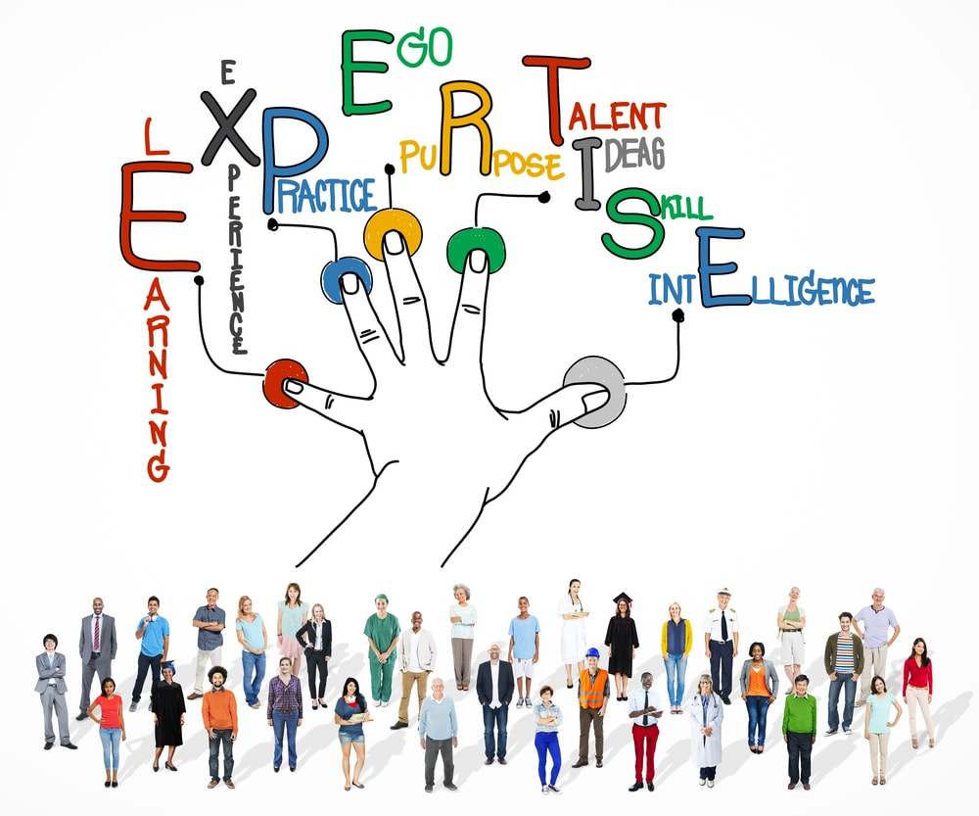
Mantle of the Expert

Slide 29
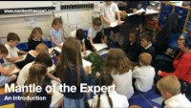

Gwyliwch / Watch

Slide 30
Mantell yr Arbenigwr
The Mantle of the Expert
Dull dramatig sy'n seiliedig ar addysgu drwy ymholiad
Dyfeisiwyd a datblygwyd gan yr Athro Dorothy Heathcote yn yr 1980au
Prif gysyniad: disgyblion yn gwneud eu holl waith cwricwlwm fel 'arbenigwyr' dychmygol
Yn ymwneud â meddwl 'byd go iawn'
A dramatic enquiry based approach to teaching
Invented and developed by Professor Dorothy Heathcote in 1980’s
Main concept: pupils do all their curriculum work as imagined ‘experts’
Relates to ‘real world’ thinking
Notes:
Developed by Dorothy Heathcote in at the University of Newcastle upon Tyne in 1980’s = Dorothy was a drama teacher and academic. She had no initial qualifications and failed her 11 + - a test to decide whether you got into grammar school or elementary school.
Main idea of approach is to get class to complete work as if they are ‘experts’ on the subject (could be scientists, archaeologists etc). - Because they behave like the experts children work from a specific point of view as they explore their learning - this brings special responsibilities, language needs and social behaviours.
Real world thinking – problem solving skills, communication skills

Slide 31
Strwythur Addysgegol
Pedagogical Structure
Enquiry Learning
Expert Framing
Drama for Learning
Dysgu drwy Ymholiad
Drama ar gyfer Dysgu
Fframio’r Arbenigwr
Notes:
Child is at the centre of learning
The MoE draws on three teaching modalities: enquiry learning, drama for learning and expert framing
Enquiry learning – problem solving, involves asking questions and conducting research
Drama for learning – both students and teachers are working in and out of a role – requires students to think beyond their own points of view.
Expert framing - - this frame asks children to think about their learning in a new way.
The teacher needs to be conscious of all three modes of learning in order for learning to work best.

Slide 32
Y prif gysyniadau
The main concepts
Defnyddir fel dull o ymdrin â'r cwricwlwm cyfan
Mae'n dod ar draws sawl agwedd ar gwricwlwm ysgolion
Canolbwyntio ar 'fenter'
Disgybl yng nghanol y dysgu
(Prendiville and Toye 2013)
Used as an approach to the whole curriculum
It encounters many aspects of school curriculum
Focus on ‘enterprise’
Pupil at centre of learning
(Prendiville and Toye 2013)
Notes:
Types of enterprise – ecological, service, manufacturing, research.
Pupil is at centre of learning but learning is not child led as the teacher plans the initial idea of the session and the learning session has a clear direction (where the teacher wants it to go)
Better suited to older children rather than younger children as it takes time and maturity to build up expertise.
Pupil led- teachers role is either as one of the ‘experts’ or the co-ordinator of experts. Important for teacher not to give any knowledge of subject away and must let students take responsibility of their learning

Slide 33
Mewn Ymarfer / In Practice
Cynyddu lefelau ymgysylltu – plant yn gyfrifol am reoli eu llwybr dysgu eu hunain.
Gwella medrau allweddol
Gwella cyrhaeddiad disgyblion
(McGuinn 2014)
Increases levels of engagement – children are in charge of controlling their own learning path.
Improves key skills
Enhances pupil attainment
(McGuinn 2014)
Notes:
Big in practice in New Zealand
Research has shown that overall MoE conquers disengagement through experiential learning.
Improves key skills - communication, literacy, numeracy , working with others and problem solving – feedback from pupils was that they were improving numeracy etc . Without even noticing and they were more focused on the ‘real life’ situation
Pupil attainment enhanced because all pupils are engaged and interested in what they are doing. If not engaged in overall topic pupils should still be able to play a role project that interested them – e.g calculating costs or drawing plans/

Slide 34
Y ffatri esgidiau/The shoe factory
http://www.youtube.com/watch?v=bBzSYEY9eQs
https://www.youtube.com/watch?v=jGvOuEan6go
Notes:
Video
Dorothy Heathcote – founder of Mantle of the Expert

Slide 35
Y 4 Cam / The Four Stages
Cyn-gynllunio: casglu syniadau i sicrhau bod elfennau craidd MoE yn eu lle
Mapio: cynllunio trosolwg o ble allai’r Mantle fynd
Meicro gynllunio: confensiynau drama, cwestiynau a strategaethau yn cael eu dewis
Storia: helpu cyfranogwyr i ddilyn llwybr yr antur sy’n datblygu
Pre-planning: ideas are gathered to ensure that core elements of MoE are in place
Mapping: plan an overall sense of where the Mantle might go
Micro planning: drama conventions, questions and strategies are selected
Storying: helps participants to follow the flow of the unfolding adventure

Slide 36

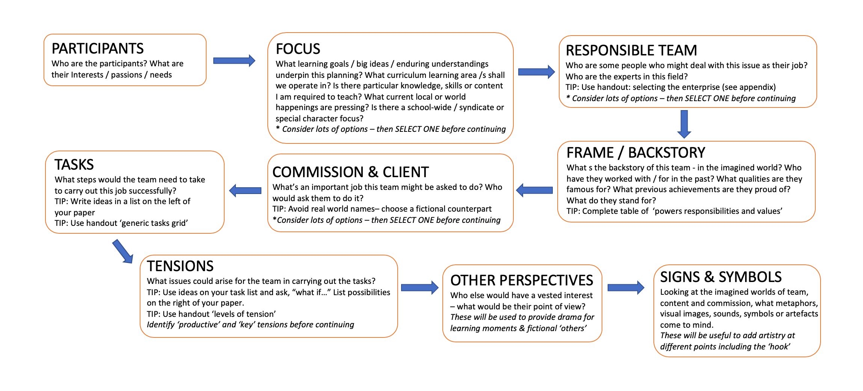
Yr elfennau craidd/
The core elements

Slide 37
Tebygolrwydd a Gwahaniaethau
Similarities and Differences
Mewn grwpiau:
Trafodwch y tebygolrwydd a’r gwahaniaethau rhwng y ddau ddull o ddysgu
Paratowch i roi adborth i weddill y dosbarth
In groups:
Discuss the similarities and differences of the two approaches to learning
Feedback to rest of the class
Notes:
discuss

Slide 38
Tebygrwydd a Gwahaniaethau
Similarities and Differences
Tebygrwydd / Similarities | Gwahaniaethau / Differences
Notes:
Similarities
Integrate all areas of the curriculum
Child at centre of learning
Teacher is facilitator
Experiential learning
Encourages student engagement
Clear process with results
Differences
Pupils are involved from the initial idea in the Leonardo Effect but not in MoE
More emphasis on Art and Science in Leonardo Effect and on Drama in MoE

Slide 39

Darllen Pellach/Further Reading
The Paradox of Mantle of the Expert
Sut gall blant fod yn arbenigwyr?
How can children be experts?

Slide 40
Rhestr Gyfeirnodi/Reference List
Hickey, I. and Robinson, D. The Leonardo Effect, Oxon:Routledge
McGuinn, N. (2014) The English Drama Teacher’s Book, Oxon:Routledge
Prendiville, F. and Toye, N. (2000) Drama and Traditional Story for the Early Years. Oxon: Routledge

