Slide 1
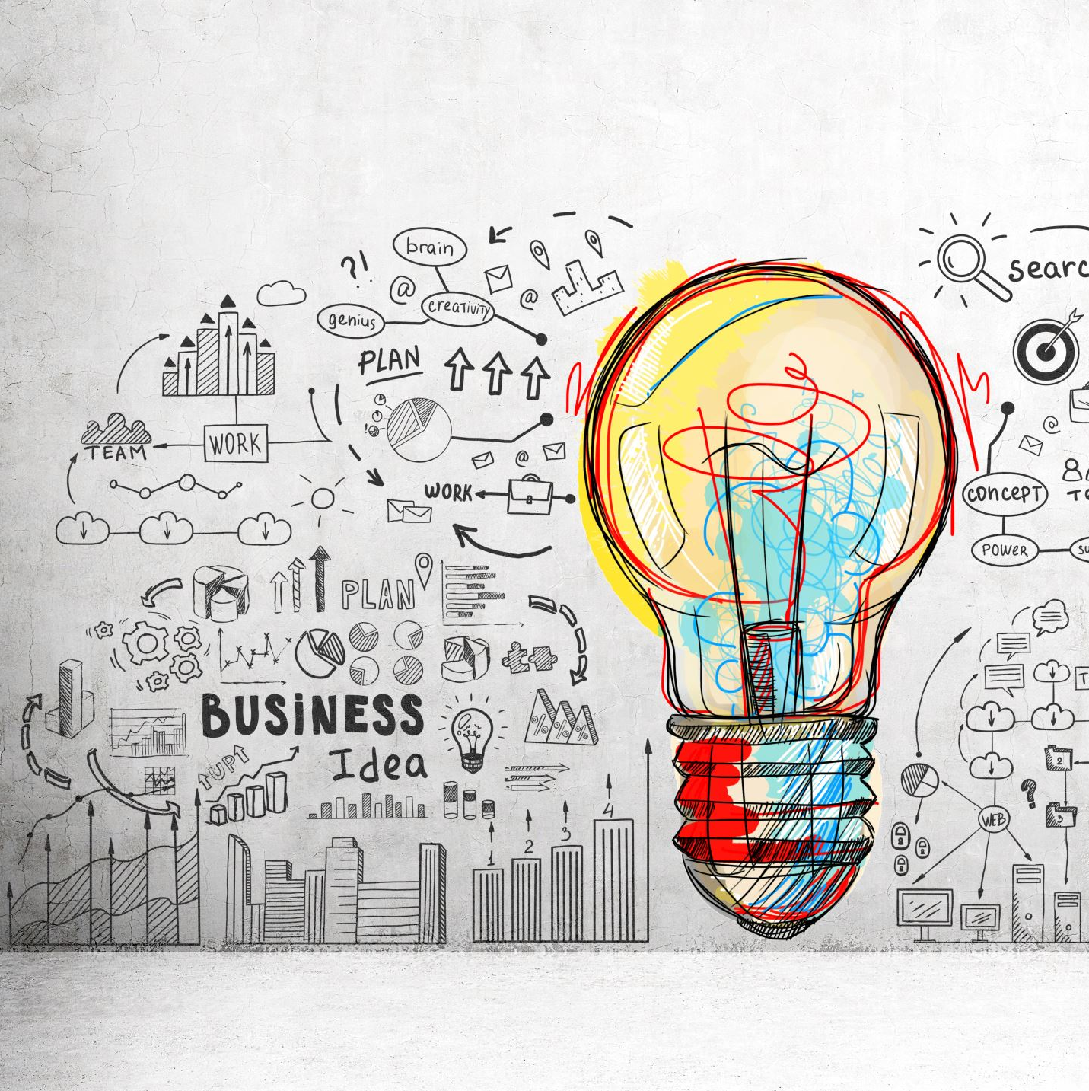
The Role of Influencers in Modern Marketing
Influencer marketing frequently aims for large numbers of followers, but authenticity should be the primary objective. (Ilieva et al., 2024).
Evelyn Ramirez

Slide 2
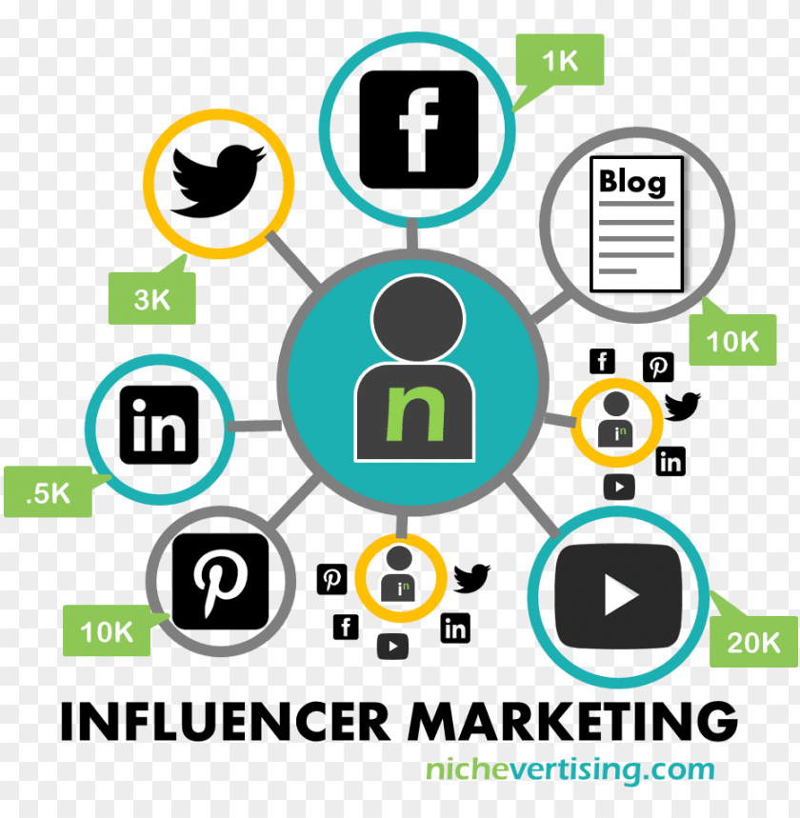
Who are influencers and why does influencer Marketing matters?
Influencers are individuals who can shape followers’ decisions and have built audiences through their content (Enke & Borchers, 2019).
Major business strategy.
Influencers shape consumer decisions.
Reach wider audiences.
Notes:
IM has become a major business strategy due to the rise of social media.
Influencers shape consumer decisions through relatable content and personal connections.
Modern marketing strategies rely on influencers to reach wider audiences, build trust, and increase loyalty.

Slide 3
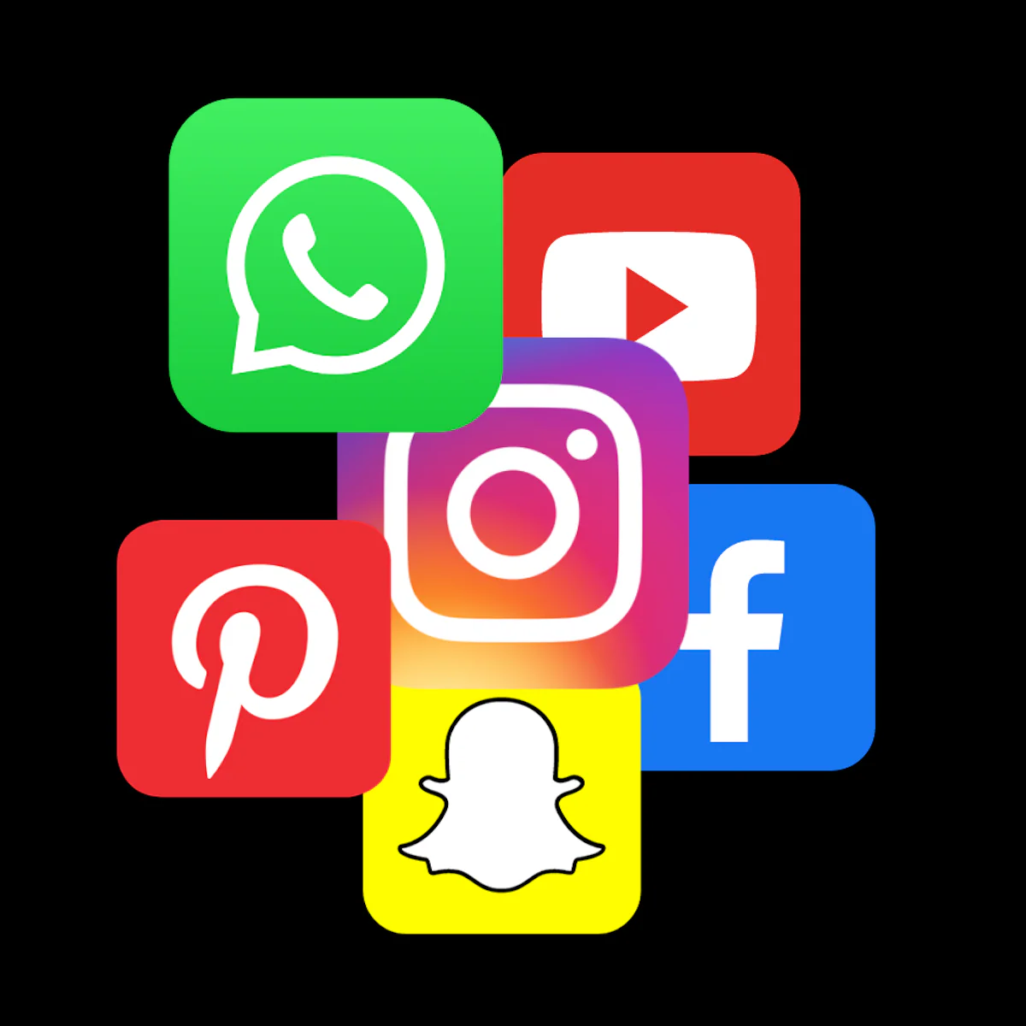
Key Insights from my research?
Parasocial interaction.
Authenticity.
Online presence and brand perception.
Reach versus higher engagement.
Ethical Concerns.
Notes:
Parasocial interactions create a strong emotional bond between influencers and followers, so the followers think that they know the influencer.
Authenticity is crucial: real experiences increase trust and engagement, dishonesty harms credibility.
Influencers’ lifestyle, appearance, and knowledge enhance online presence and brand perception.
Macro influencers provide reach; micro influencers provide higher engagement and Return on Investment, which measures how much profit a campaign generates compared with its costs, involves analysing every stage of the customer process, from initial awareness to the final purchasing conversion
Ethical concerns include misinformation, unrealistic beauty standards, and fake followers.

Slide 4
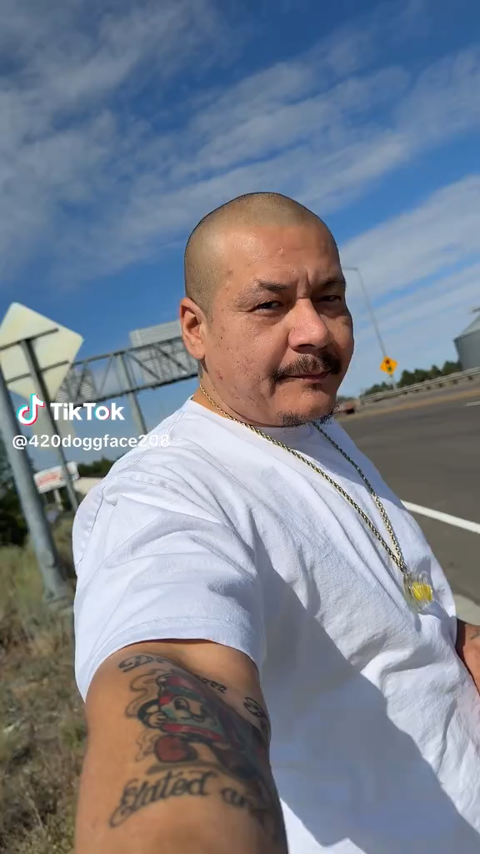
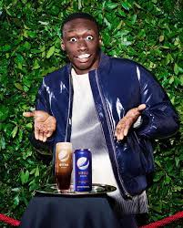
Real-world Examples
The influencer 420doggface208 shared a video on TikTok where he was skating while drinking juice and listening to Dreams by Fleetwood Mac (Savage 2020).
The famous TikToker Khaby Lame, who has over 160 million followers, partnered with Pepsi in 2022 to promote Nitro Pepsi.
Notes:
Nathan Apodaca posted a spontaneous video skateboarding while drinking Ocean Spray. The video went viral with over 96 million views, boosting Ocean Spray sales, brand visibility, and song streams on Spotify.
Demonstrates how authentic, relatable content can create a massive marketing impact even unintentionally. It shows how audiences respond more to genuine moments than to staged ones in advertisements.
The campaign was able to reach a greater audience than Pepsi’s own social media because of its authentic attitude and strong connection with followers.
These examples show how collaborating with influencers is an effective strategy for connecting with customers.

Slide 5
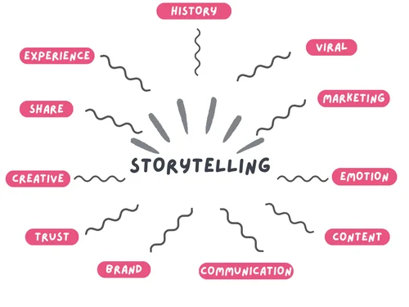
Effectiveness of this approach
Authentic content follows the AIDA model: Attention, Interest, Desire, Action.
Emotional connection.
Credibility.
Following the Code of Non-broadcast Advertising (CAP Code)
Notes:
Authentic content follows the AIDA model, grabs attention, builds interest, creates desire and drives action. In the Ocean Spray example, the influencer went viral to create attention, shared a relatable story to generate interest, built an emotional connection to create desire, and led to action with an increase in product sales
Emotional connection and relatability make influencer marketing more persuasive than traditional ads.
Credibility and personal storytelling increase consumer confidence and purchase intention.
In the UK, the Code of Non-broadcast Advertising (CAP Code) says all ads must be “legal, decent, honest and truthful” (Advertising Standards Authority, 2025), and influencers must follow it. These rules help to reduce risk and promote trustworthiness, helping to protect both brands and customers. People often trust a message when they see the communicator as knowledgeable and reliable, according to Source Credibility Theory.
This ability to generate interaction is one of the key reasons why influencer marketing has become so effective

Slide 6
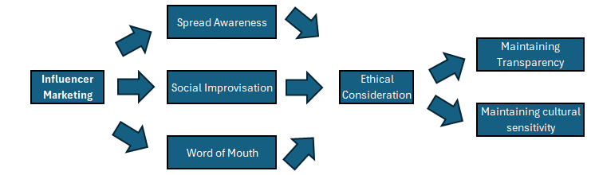
Evaluation: Benefits and Problems
Benefits: High Engagement, viral potential, strong trust-building, and effective persuasion of customers.
Problems: Risk of dishonesty, fake followers harm product; misleading content.
Conclusion
Notes:
Benefits: high engagement, viral potential, strong trust building, and effective customer persuasion.
Problems: risk of dishonesty, fake followers, harmful product promotion, and legal/ethical issues.
Misleading content (e.g., edited beauty promotions) can damage both brand and influencer reputations.
That is why influencers and consumers must follow ethical and legal standards. Consumers need to evaluate products to make informed choices.
Overall, Influencer marketing is highly effective when companies choose the correct influencer according to their values and the campaign objectives, when it is authentic and ethical, but problematic when credibility is compromised.
IM will spread awareness by adapting and creating interactions through social improvisation, transmitting information with ethical considerations. Maintaining transparency and cultural sensitivity while respecting diverse cultures will be key to the campaign's success.
The relationship between influencers, brands and followers will continue to be important as digital marketing advances, showing the value of trust and moderated consumption.

Slide 7
References
Aw, E.C.-X. and Agnihotri, R. (2024) ‘Influencer marketing research: review and future research agenda’, Journal of marketing theory and practice, 32(4), pp. 435–448. Available at: https://doi.org/10.1080/10696679.2023.2235883.
Enke, N. and Borchers, N.S., 2019. Social media influencers in strategic communication: A conceptual framework for strategic social media influencer communication. International Journal of Strategic Communication, 13(4), pp.261–277. Available at: https://doi.org/10.1080/1553118X.2019.1620234
Ilieva, G. et al. (2024) ‘Social Media Influencers: Customer Attitudes and Impact on Purchase Behaviour’, Information (Basel), 15(6), p. 359. Available at: https://doi.org/10.3390/info15060359
Savage, M. (2020) ‘Fleetwood Mac’s Dreams get streaming boost from viral TikTok video’, BBC News,6 October. Available at: https://www.bbc.co.uk/news/entertainment-arts-54432900 (Accessed: 19 October 2025).
Wong, I.H.S. et al. (2024) ‘Social media celebrities’ influence on youths’ diet behaviours: a gender study based on the AIDA marketing communication model’, Aslib journal of information management, 76(5), pp. 778–799. Available at: https://doi.org/10.1108/AJIM-11-2022-0495.

