Slide 1
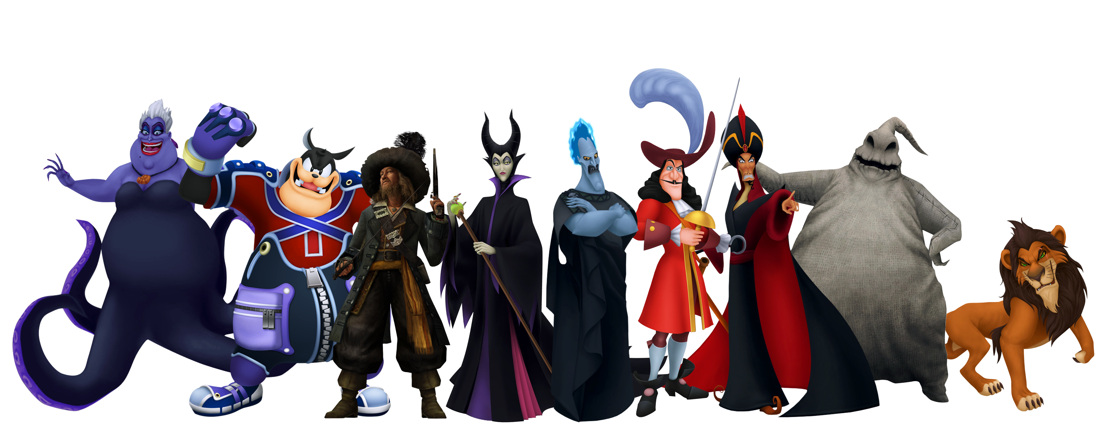
Which classic Disney villain best matches your personality?
https://villains.fandom.com/wiki/Council_of_Disney_Villains

Slide 2
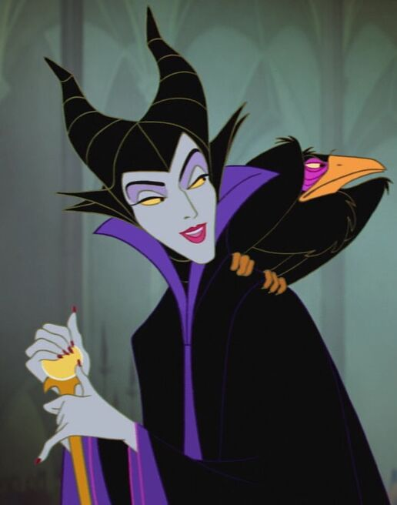
Why this test?
I love Disney.
Villains are fun
Commonly used/popular
https://disney.fandom.com/wiki/Maleficent

Slide 3
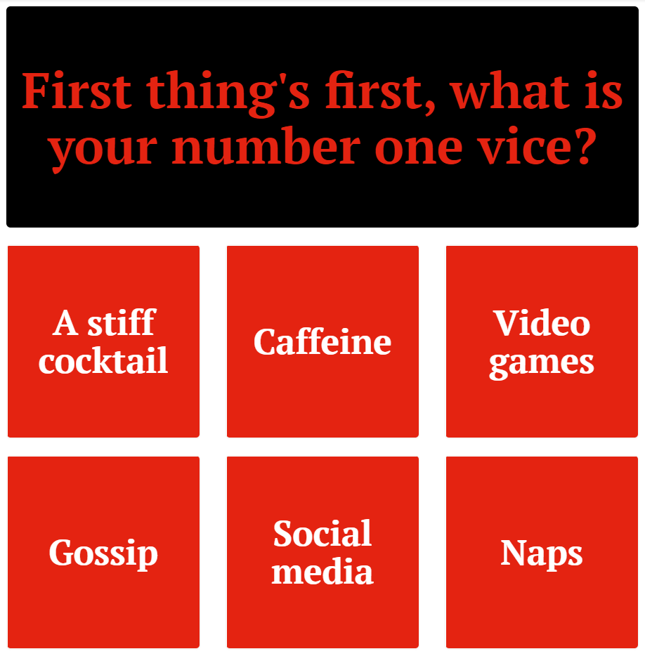
The Questions
Vague
Random
No apparent reasoning
https://www.buzzfeed.com/ehisosifo1/the-cast-of-cruella-found-out-which-disney-villain-they-are

Slide 4
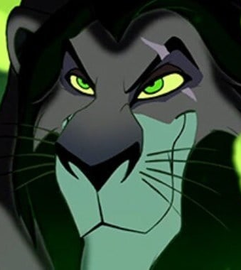
My Result
“You’re wickedly savvy, extremely smart, an devilishly charming – which, all together, is a combination that makes people admire you and fear you juuuuuust a little bit.” (Osifo, et al., 2021)
https://news.disney.com/scar-quotes-lion-king

Slide 5
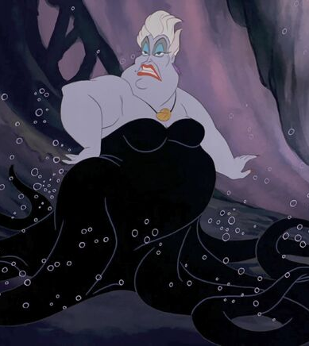
Opposite Results
“People can say what they want about you, but they can’t deny that you keep your word. If you say you’re going to do something, you 100% follow through, and that’s pretty admirable.” (Osifo, et al., 2021)
https://disney.fandom.com/wiki/Ursula

Slide 6
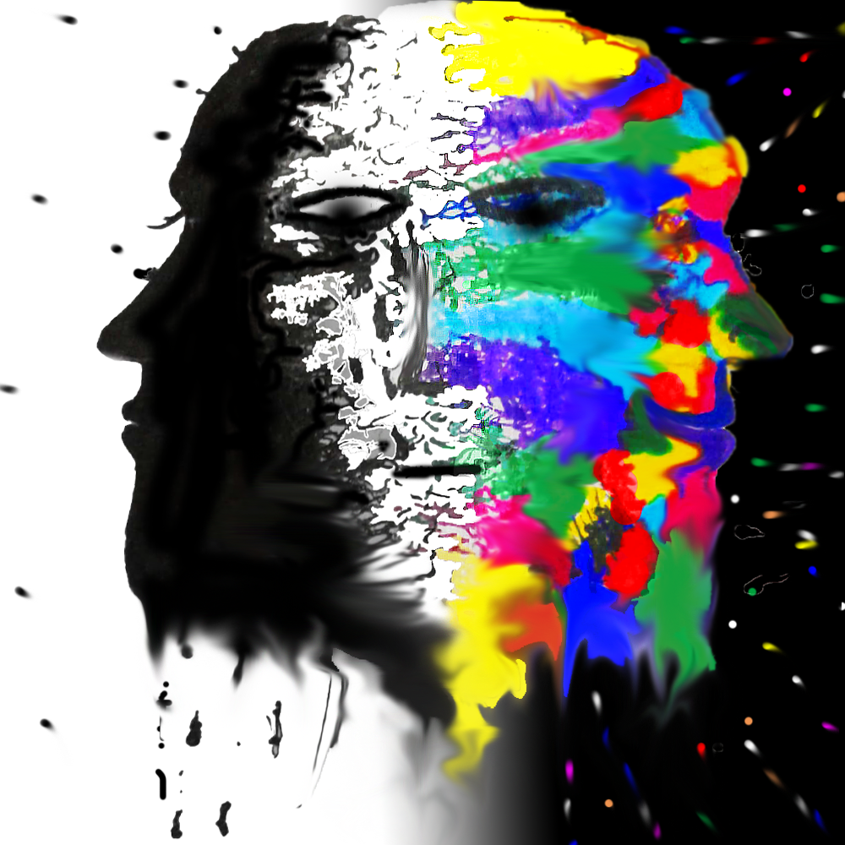
Personality – What is it?
“Personality refers to individual differences in characteristic patterns of thinking, feeling and behaving. The study of personality focuses on two broad areas: One is understanding individual differences in particular personality characteristics, such as sociability or irritability. The other is understanding how the various parts of a person come together as a whole.” (American Psychological Association, 2021)
https://steemit.com/psychology/@arc.angel/many-minds-many-personalities-in-one-body-inspired-by-the-artist-with-multiple-personality-disorder

Slide 7
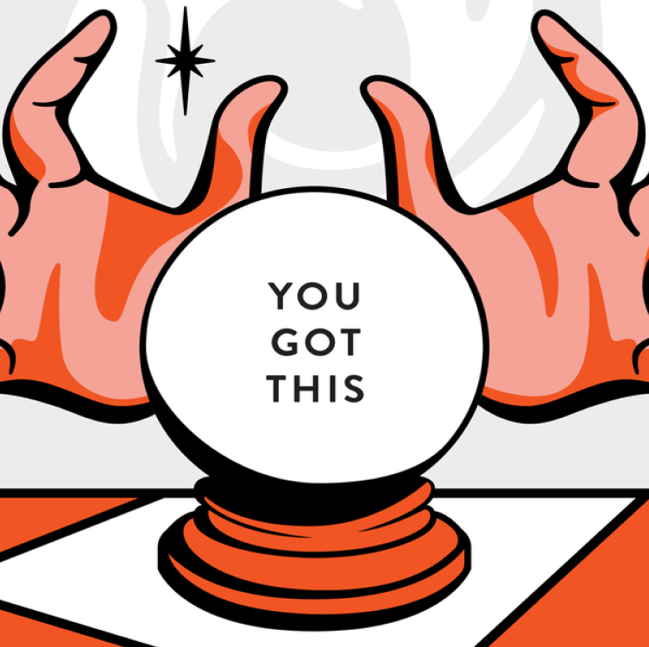
The Barnum Effect
Attributed to P.T. Barnum – A sucker born every minute.
Using peoples gullibility to convince them that the response is personal and unique.
Responses are generic, generalized and could quite easily apply to anyone.
Mostly positive phrases.
(Vohs, 2016)
https://uxdesign.cc/the-barnum-effect-and-the-sweet-nothings-of-astrology-c363e1f3754d

Slide 8
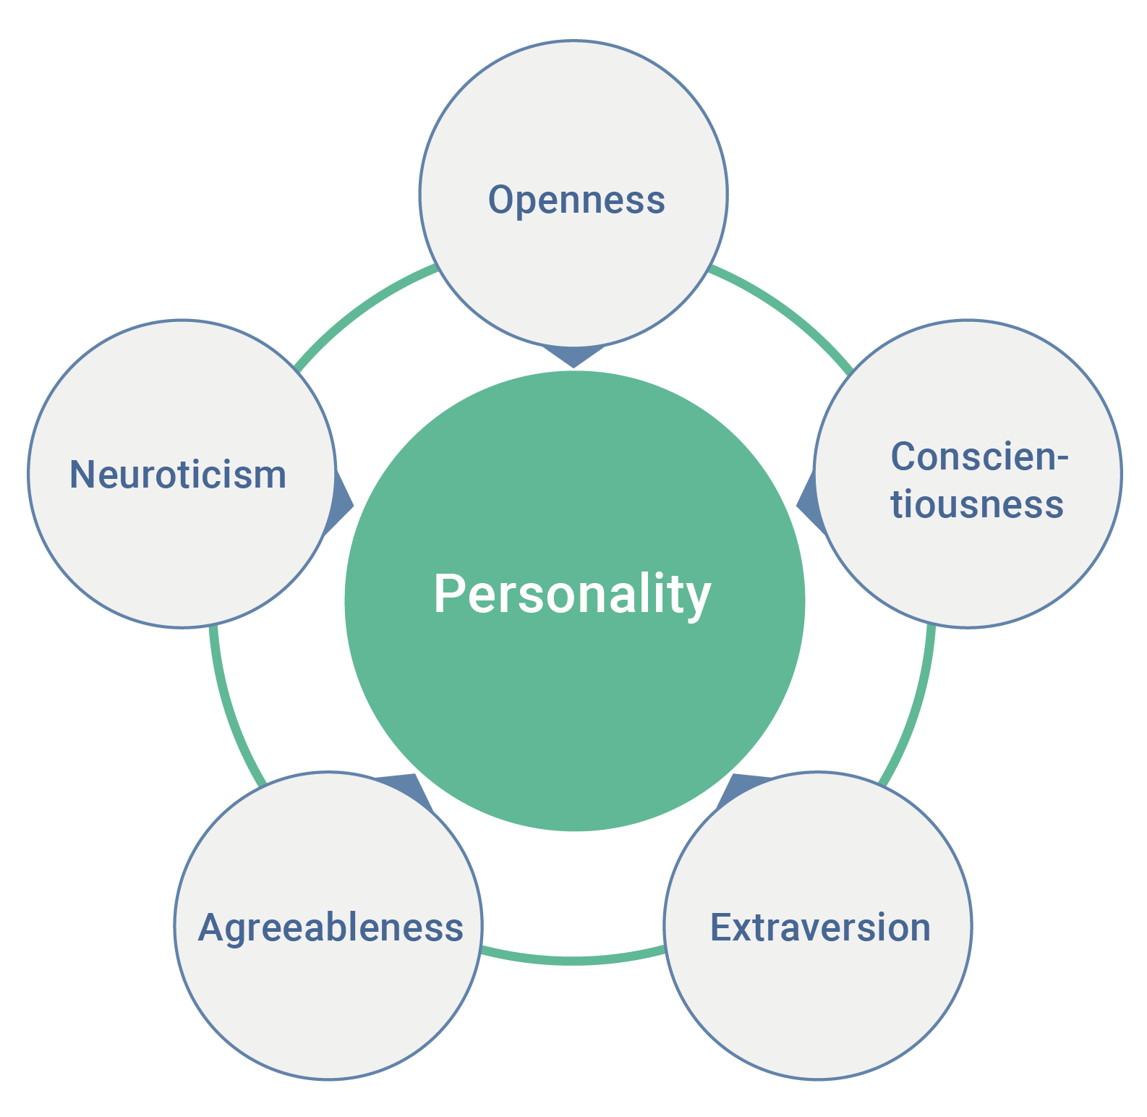
The Big 5
Savvy, smart, admired, charming, honourable.
All traits are a spectrum.
4,500 down to 16, down to 5 traits.
Most widely accepted due to broadness.
Stable throughout lifetime.
Nature and nurture
Relationships, health, education, work.
(Lim, 2020)
(Costa & McCrae, 1999)
https://en.wikipedia.org/wiki/Big_Five_personality_traits

Slide 9
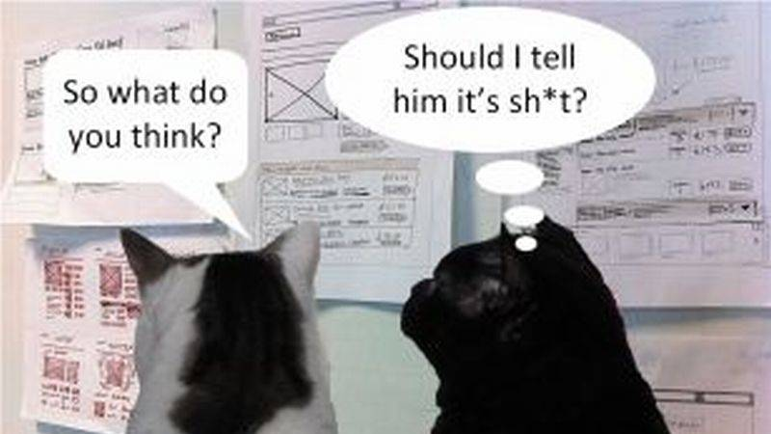
Critiques
Doesn’t account for mood/mental health.
How much is Barnum Effect?
Does it actually do anything?
Cross-cultural validity?
Context?
(Lim, 2020)
http://www.uxforthemasses.com/design-critiques/

Slide 10
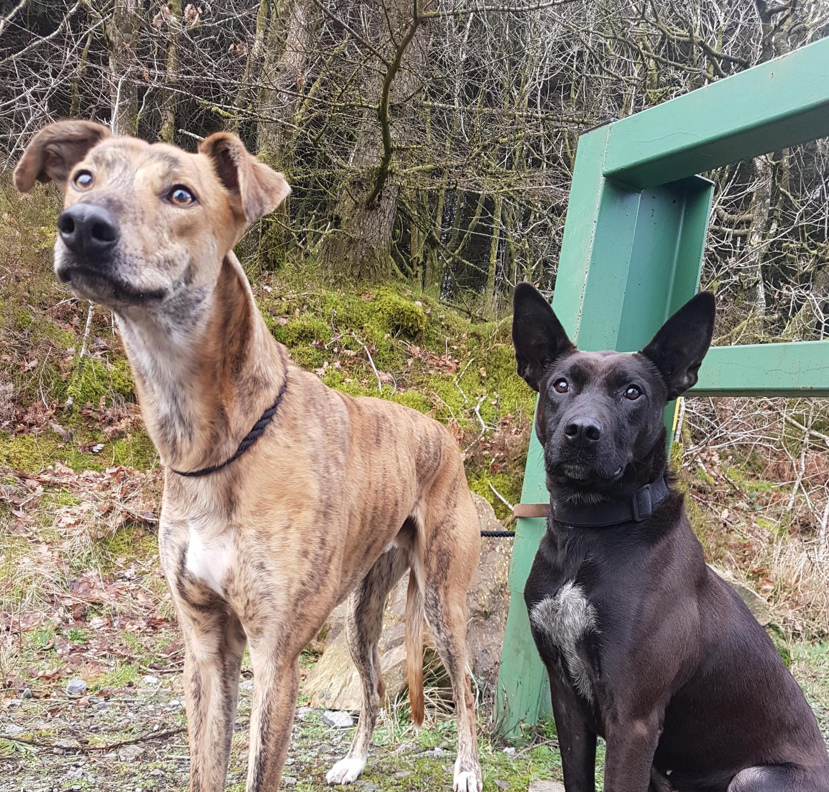
Thank you for listening! Any Questions?

Slide 11
References
American Psychological Association, 2021. Personality. [Online]
Available at: https://www.apa.org/topics/personality#:~:text=Personality%20refers%20to%20individual%20differences,such%20as%20sociability%20or%20irritability.
[Accessed 30 May 2021].
Costa, P. & McCrae, R. R., 1999. A Five-Factor Theory of Personality. In: L. A. Pervin & O. P. John, eds. Handbook of Personality: Theory and Research. New York: Guilford, pp. 139-153.
Lim, A., 2020. The Big Five Personality Traits. [Online]
Available at: https://www.simplypsychology.org/big-five-personality.html#ev
[Accessed 31 May 2021].
Osifo, E., Chen, V., Zamora, C. & Dahle, B., 2021. Which Classic Disney Villain Best Matches Your Personality?. [Online]
Available at: https://www.buzzfeed.com/ehisosifo1/the-cast-of-cruella-found-out-which-disney-villain-they-are
[Accessed 30 May 2021].
Vohs, K. D., 2016. Barnum Effect. [Online]
Available at: https://www.britannica.com/science/Barnum-Effect
[Accessed 31 May 2021].

