Slide 1
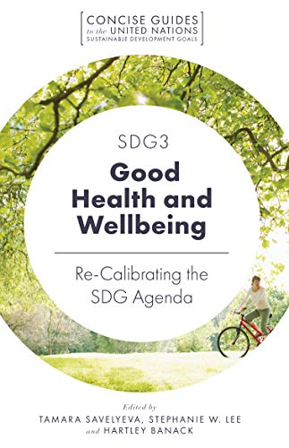
Module Name: Health, Wellbeing and Sustainable Development
Module Code: BMHP6030
Student Name: Petronela Bucur
Student ID: 2240860
Lecturer Name: Zakiyyah Ahmed

Slide 2

Introduction
• Global health and social care systems are now operating in complex environments influenced by chronic diseases, aging populations, social inequalities, and environmental pressures.
• Modern healthcare policies have evolved from a narrow focus on treating illnesses to a broader emphasis on health, wellbeing, and sustainable development.
• This comprehensive approach is crucial for effective health and care service provision, shaping policy priorities, service models, and governance at local, national, and global levels.
• The presentation critically discusses key concepts, assesses their theoretical and policy foundations, and evaluates their integration.
• The impact of these ideas on service delivery, public health outcomes, and equity in health and social care sectors is explored.
Notes:
The health and social care systems around the world are working in more complicated environments which are marked by an increase in prevalence of chronic diseases, aging, social inequalities and environmental pressures. In turn, modern healthcare policy and practice has shifted the paradigm of the previously limited focus on treating illnesses to a more comprehensive approach of considering health, wellbeing, and sustainable development. These inter-related ideas have become the key to the effective provision of health and care services, policy priorities, service models, and governance structures at the local, national, and global levels. In this presentation, these concepts are critically discussed, their theoretical and policy basis assessed, and their combination with each other, the effects on service delivery, public health outcomes, and equity in contemporary health and social care sectors are evaluated.

Slide 3
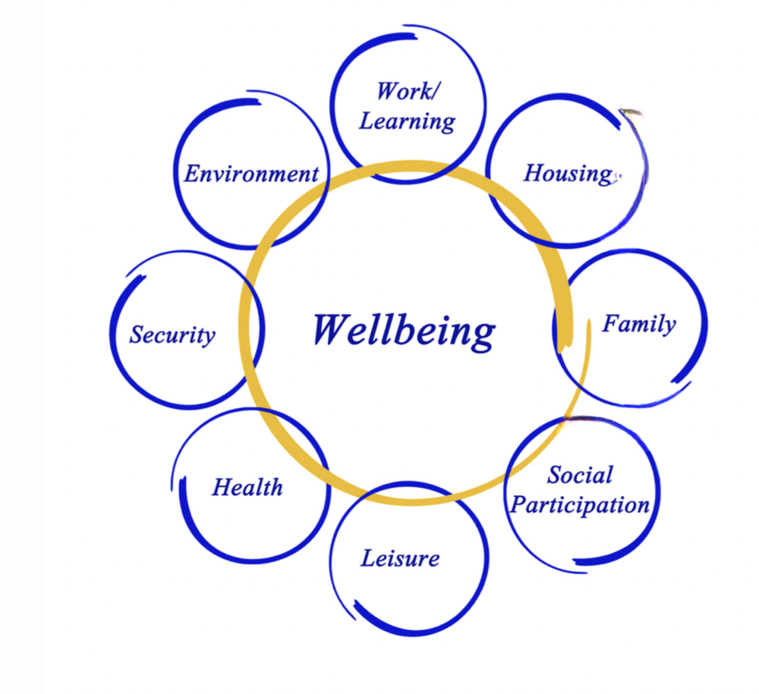
a) Definition and Discussion of Key Concepts
• Health is defined as a state of complete physical, mental, and social wellness, as recognized by the World Health Organization (WHO), moving beyond merely the absence of disease. To me, health is feeling physically strong, mentally calm, and emotional stable so I can enjoy life and cope with challenges.
• This definition encourages a shift in health and social care systems from reactive, disease-focused interventions to proactive, person-centered, and community-based approaches aimed at improving long-term health outcomes.
• Wellbeing encompasses physical, mental, emotional, and social dimensions, reflecting individuals' ability to function effectively and maintain meaningful relationships, as well as an acceptable quality of life.
• Wellbeing is increasingly acknowledged as a significant determinant and outcome of health, influencing patient interactions, healing processes, and overall health resilience.
• There is a growing emphasis on mental health, social inclusion, and life satisfaction in healthcare policies, alongside traditional clinical outcomes.
Notes:
Health has been extensively understood as a condition of complete physical, mental and social wellness and not only the absence of disease or infirmity.To me, health is feeling physically strong, mentally calm, and emotional stable so I can enjoy life and cope with challenges.
This definition, which has been developed by World Health Organization (WHO) stresses on a positive and multidimensional view of health (Barranca-Enríquez and Romo-González, 2022). In addition to the academic definition, interpretation definition of health has also been incorporated to show reflective knowledge. Health is also expounded as being physically fit, mentally relaxed, and emotionally stable so that people can make the most out of life and can effectively meet the demands of their daily experiences. In health and social care systems, this view promotes the change of reactive, disease-based interventions to preventive, person-centred and community-based interventions that facilitate long-term health outcomes.
Wellbeing
Wellbeing is a holistic approach that is inclusive of physical, mental, emotional and social aspects of human experience. It is a measure of the capacity of individuals to operate effectively, to have significant relationships as well as ensure an acceptable quality of life (Jiwattanasuk, Pannavoravat and Sirikanchana, 2022). Wellbeing is now a recognised determinant and outcome of health in healthcare settings, with impact on patient interactions, healing and subsequent health resilience. Mental health, social inclusion, and life satisfaction are beginning to be given serious consideration in policies by them, along with clinical outcomes.

Slide 4
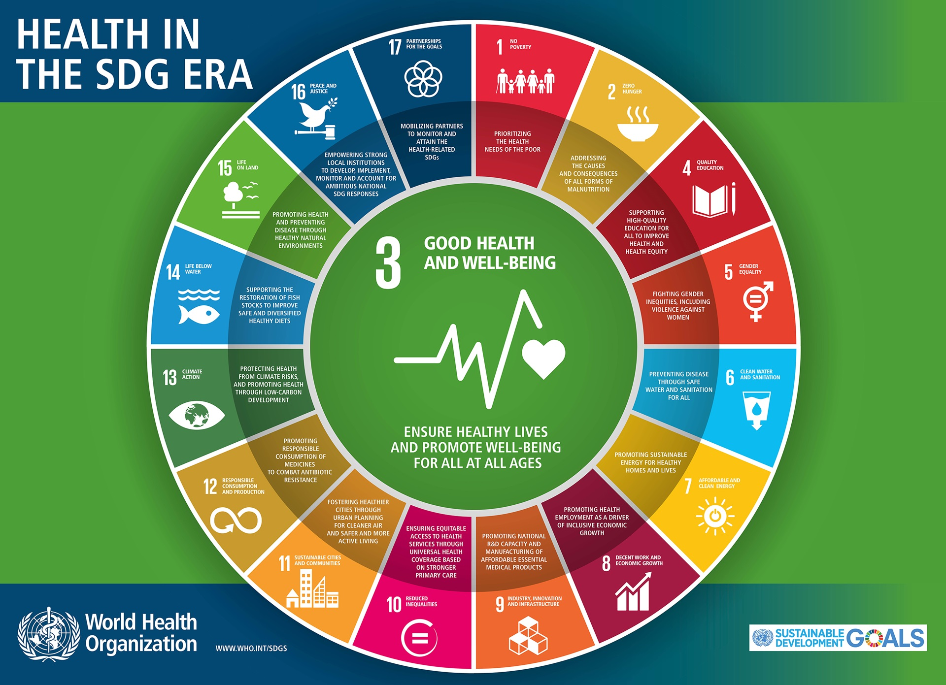
a) Definition and Discussion of Key Concepts
• Sustainable development is the ability to meet current needs without compromising future generations (Litvinenko et al., 2022).
• In healthcare, it encompasses environmental protection, economic feasibility, and social equality.
• Sustainable health systems aim for high-quality care, sustainable resource management, reduced environmental impact, and addressing health disparities.
• The relevance of sustainable development in healthcare is emphasized by global frameworks like the Sustainable Development Goals (SDGs) of WHO (Long, 2022).
• SDG 3 focuses on the health and wellbeing of all individuals, highlighting the links between health outcomes, social circumstances, and environmental sustainability.
• Modern healthcare policy increasingly prioritizes prevention, inter-sector collaboration, and long-term system resilience.
Notes:
Sustainable Development
Sustainable development can be defined as the capacity to fulfil the current needs without affecting the capacity of the future generation to achieve their needs (Litvinenko et al., 2022). In medical practice, this idea does not just cover the protection of the environment, but also economic feasibility and social equality. Sustainable health systems strive to provide high quality care and manage resources sustainably, reduce environmental impact and deal with health disparities.
Growing Importance in Healthcare Policy
The increasing importance of health, wellbeing, and sustainable development is demonstrated by global policy frameworks, specifically, the Sustainable Development Goals (SDGs) of WHO (Long, 2022). The SDG 3 that dwells on healthy lives and wellbeing of all people shows the interdependence of health outcomes, social circumstances as well as the sustainability of the environment. Because of this, contemporary healthcare policy tends to focus more on prevention, collaboration across sectors, as well as system resilience in the long term.

Slide 5

b) Integration of Health and Wellbeing Approaches
• Holistic health strategies are now foundational in modern healthcare, focusing on psychological wellbeing and social support alongside physical health.
• Health outcomes are influenced by social factors such as housing, employment, education, and interpersonal relationships.
• Sustainable development frameworks, like the WHO program Health in All Policies (HiAP), integrate health considerations into various policy areas, including transport, housing, and environmental planning.
• HiAP promotes sustainable development by fostering intersectoral cooperation and making policy choices that enhance population health and welfare while mitigating long-term risks.
Notes:
Holistic Health and Wellbeing in Healthcare
Incorporating holistic health and wellbeing strategies have come to be the hallmark of modern healthcare provision. Instead of treating the physical symptoms in isolation, health and social care specialists are paying more attention to the psychological wellbeing, support in the forms of social interactions, lifestyle, and environmental factors (Aizaz, Khattak and Toru, 2023). This combined strategy acknowledges that social factors like housing, employment, education, and social relationships play a huge role in the health outcome.
Sustainable Development Frameworks in Health Policy
The frameworks of sustainable development were incorporated into the health policy by the means of initiatives like the WHO program of Health in All Policies (HiAP). HiAP encourages incorporation of health in all its policies such as transport, housing, education and environmental planning (Moldovan et al., 2022). The reason is that this framework promotes sustainable development, as it facilitates intersectoral cooperation as well as policy choices that will help to positively affect the population health and welfare and reduce the long-term risks.

Slide 6
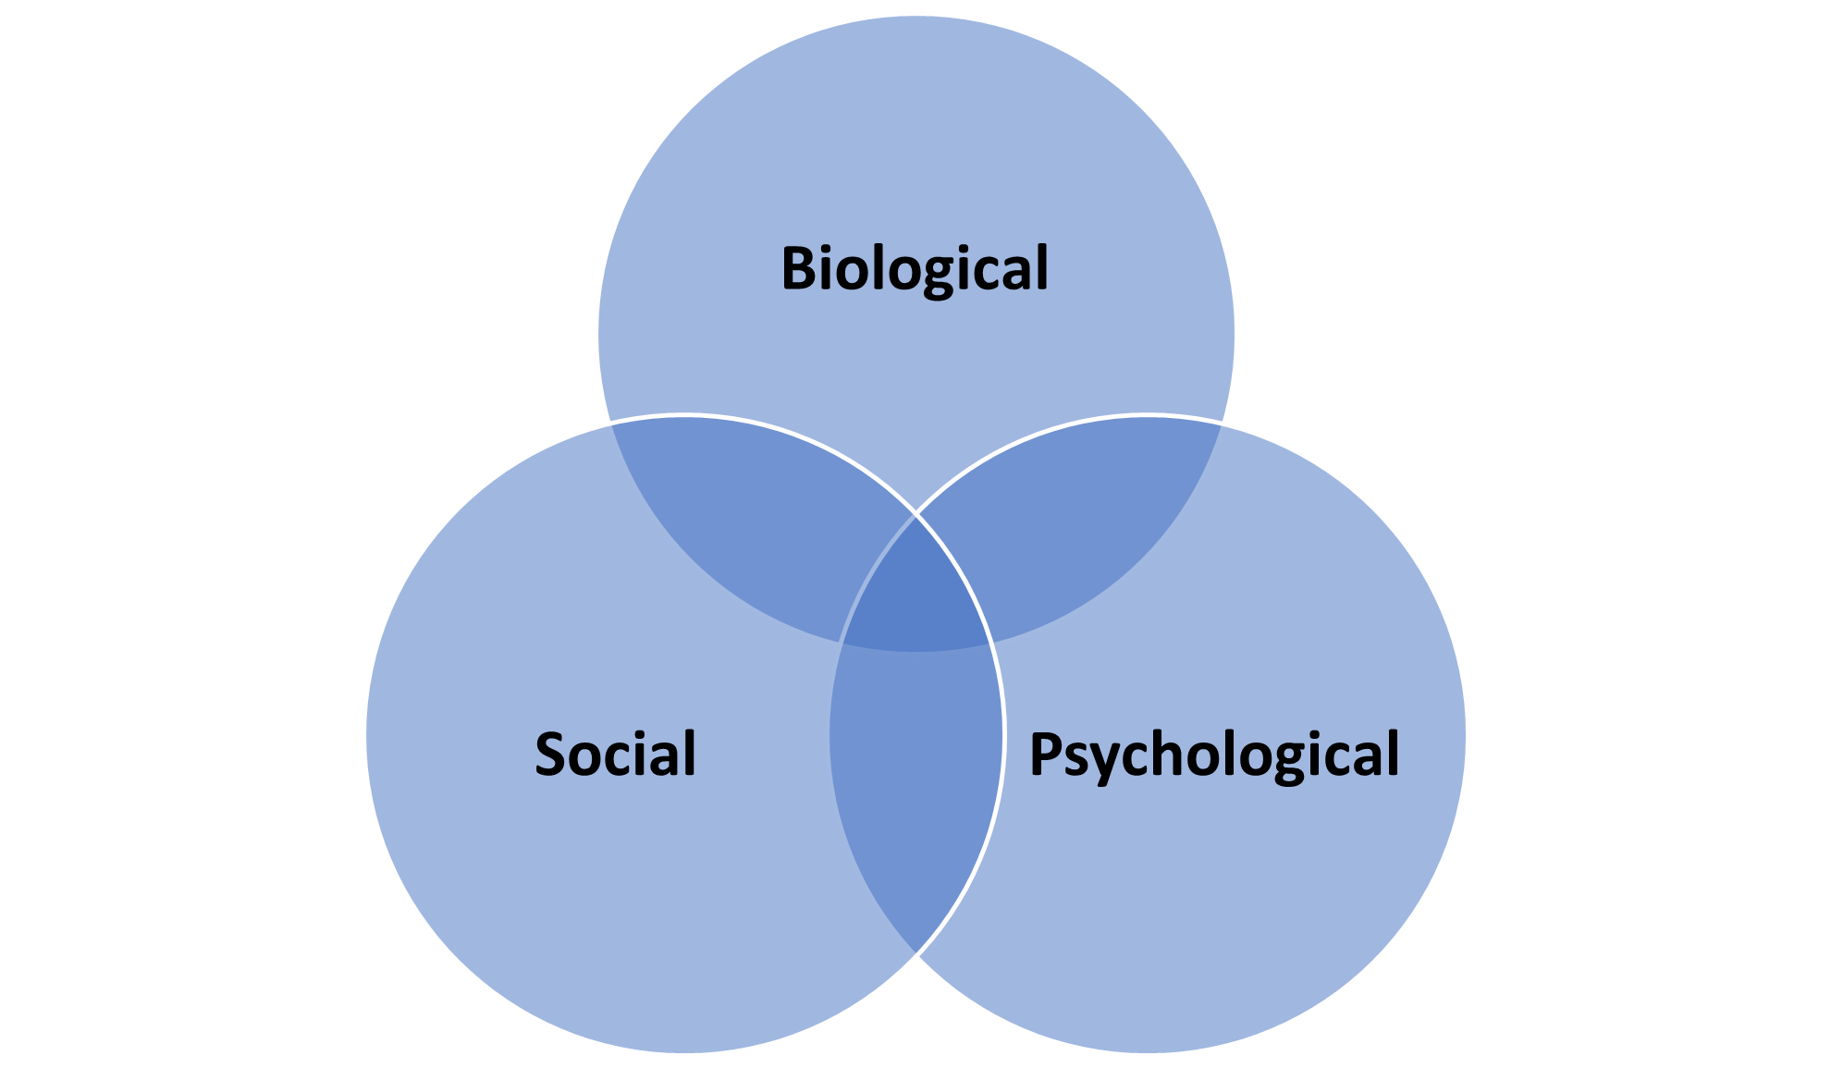
c) Theoretical Perspectives
• The Biopsychosocial model integrates health, well-being, and sustainable development through a comprehensive approach considering biological, psychological, and social factors impacting health.
• Biological factors include genetics and physical health, psychological factors encompass emotions and behavior, while social elements involve family dynamics, culture, socioeconomic status, and living environments.
• This model overcomes the limitations of biomedical approaches by promoting whole-person evaluation and encouraging interventions to enhance clinical outcomes and quality of life.
• Systems and ecological perspectives further enhance the integration of health and sustainability by analyzing relationships among individuals, communities, institutions, and policy environments.
• Key determinants of health include housing quality, employment conditions, environmental sustainability, and access to social support.
• The theoretical framework aligns with sustainable development principles by promoting cross-sectoral approaches and preventative, population-level health planning.
Notes:
Biopsychosocial Model
Incorporation of health, wellbeing, and sustainable development has a strong support of theoretical views that focus on complexity, interdependence, and holistic understanding. Biopsychosocial model offers an alternative approach to health and illness because of its ability to examine health and illness in relation to the joint impact of biological, psychological, and social elements (Childerhose et al., 2023). The biological factors are genetic predisposition and physical health conditions, psychological factors are emotions, cognition, behaviour, while social factors are family relationships, cultural norms, socioeconomic status, and living environments. These dimensions make the model oppose the shortcomings of biomedical approaches, which define disease only by pathology. Instead, it encourages whole-person evaluation and intervention strategies that take into account the larger factors that influence health and well-being. In health and social care services, the model aids in person-centred care where practitioners are encouraged to develop interventions that can enhance the clinical outcomes as well as the general quality of life.
Systems and Ecological Perspectives
Also systems and ecological perspectives are also useful in enhancing the integration of health, wellbeing and sustainable development as they highlight the relationship between people and broader social, economic and environmental systems. These schools of thought consider health outcomes as being the outcome of dynamic relationships between individuals, communities, institutions, and policy environments (Vaz Serra, Seabra and Caldeira, 2022). Housing quality, employment conditions, environmental sustainability and access to social support are identified as determining factors to health. This theoretical framework is quite consistent with the principles of sustainable development, as it emphasizes the importance of cross-sectoral and integrated reactions to the issues of health. Systems and ecological theories enable the establishment of resilient healthcare systems by considering long-term, preventative, and population-level planning to tackle the fundamentals of ill health as well as preserve resources to serve future generations.

Slide 7

d) Policy and Governance
• National and local health policies prioritize holistic health, focusing on preventive care, mental health programs, and community-based services.
• Initiatives include community-based mental health programs, early intervention, and healthy ageing policies aimed at easing the burden on acute services and improving population well-being.
• Challenges persist despite policy support, including regulatory restrictions and inadequate governance frameworks.
• Short-term budget cycles favor immediate service needs over long-term preventive investments.
The Marmot Review has been directly associated with the debate of health policy.
• Lack of coordination among health, social care, and environmental agencies hampers the achievement of integrated policy objectives.
Notes:
Policies Supporting Holistic Health
National and local health policies are in favour of holistic health that is more of prevention based care strategies, mental health programs or initiatives, and community-based services (Piroddi et al., 2022). These include community based mental health programmes, early intervention, and healthy ageing policies. The Marmot Review has been directly associated with the debate of health policy. The content elaborates how the Marmot Review sees the need to focus on the social determinants of health such as income, education, employment and gender equality. The initiatives are expected to alleviate the load on acute services and enhance the overall population wellbeing.
Governance Challenges
Much remains to be overcome in spite of the policy commitment. The incorporation of health, wellbeing and sustainability agendas may be obstructed by regulatory restrictions, inadequate governance frameworks and insufficient funding (Anderson et al., 2022). The short term budget cycles tend to give precedence to the immediate service requirements as compared to the long term preventive investments. The priorities and issues of SDG 3 are properly defined. These objectives consist of bettering population health, enhancing mental health services, decreasing avoidable mortality, and universal health coverage. This is then succeeded by a conversation on the key issues, which include increased rate of mental health disorders, disparities with access to healthcare facilities, shortage of workforce, and inadequate long term financing.

Slide 8
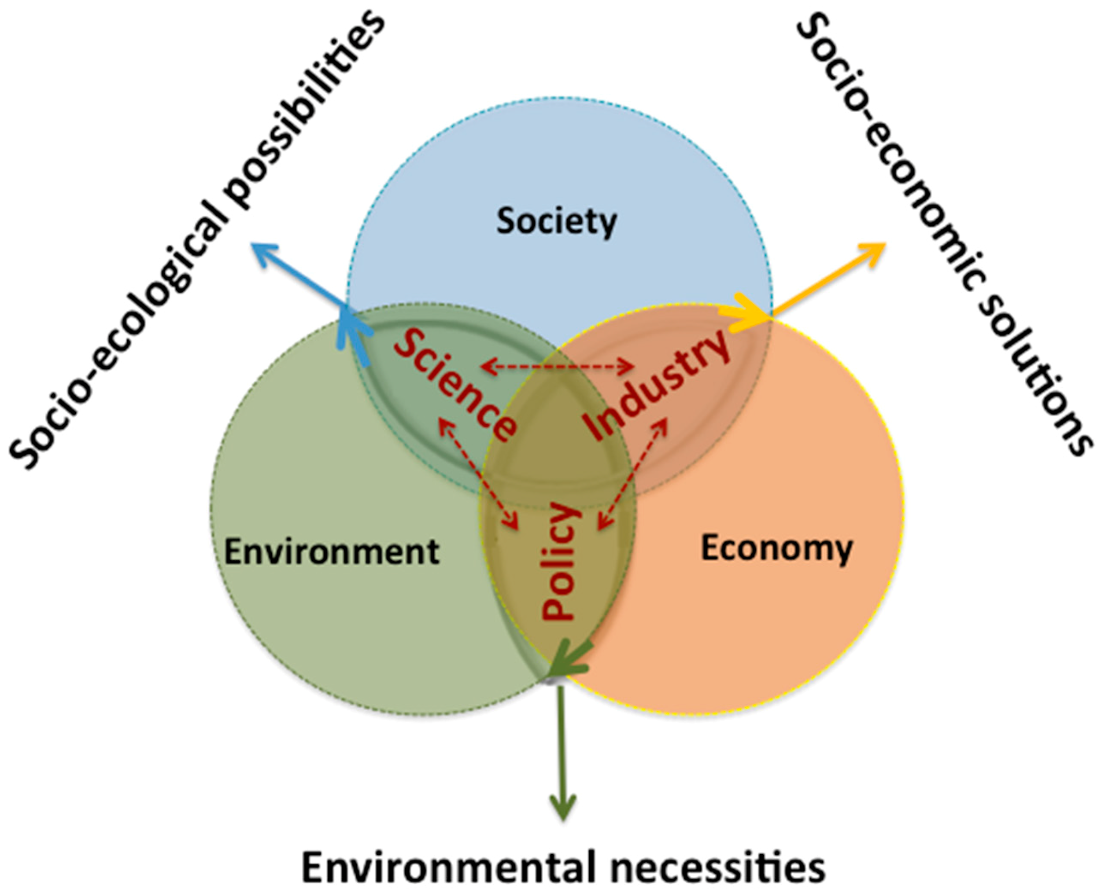
e) Service Delivery
• Integrated service models in health and social care combine clinical care with wellbeing support, including physical activity, nutrition, and mental health programs.
• The rise of telehealth has improved care accessibility, effectiveness, and reduced environmental impacts related to travel.
• Community health programs are essential for addressing social determinants of health and ensuring sustainable service delivery.
• Examples of integrated approaches improving patient outcomes and efficiency include holistic care models in hospitals that utilize multidisciplinary teams and patient-centered care planning.
• These models align health services with wellbeing goals and promote long-term sustainability.
Notes:
Integrated Service Models
The provision of services in health and social care has saw the introduction of integrated models whereby clinical care is integrated with wellbeing support. Physical activity, nutrition and mental health wellness programmes are now widely integrated into the healthcare environment (Yang et al., 2022). Telehealth has also increased the accessibility of care, enhanced the effectiveness of the service, and minimized the environmental effects related to travelling.
Community and Holistic Care Examples
Community health programs are very important in dealing with social determinants of health and in sustainable service delivery. Examples of the ability of integrated approaches to enhance patient outcomes, satisfaction and system efficiency include holistic care models in hospitals including multidisciplinary teams and patient-centred care planning (Jackson, Turner and Paterson, 2023). These models put health services in line with the goals of wellbeing as well as long term sustainability.

Slide 9

f) Public Health Initiatives
• Focus on public health initiatives for integrating health, wellbeing, and sustainable development.
• Prevention campaigns target physical exercise, healthy eating, smoking, and mental health to reduce disease and healthcare burden.
• Environmental programs promote active transportation and address air quality issues for sustainable health.
• Secondary data indicates that well-designed public health campaigns can significantly enhance population health and reduce health disparities.
• These programs tackle behavioral and environmental determinants, improving societal wellbeing and helping to create sustainable healthcare systems by reducing reliance on acute services.
Notes:
Promotion of Healthy Lifestyles
The major focus of health, wellbeing, and sustainable development integration lies in public health initiatives. Prevention campaigns on physical exercise, health eating, smoking and mental health are designed to prevent disease and ease the long-term burden of health care (Emsley et al., 2022). Sustainable health is also achieved through environmental programs like the encouragement of active transportation and air quality issues. The rhetoric of mental health has been enlarged with the help of clear and pertinent examples. These are community based counselling, stress management programmes, workplace wellbeing programmes and early intervention against anxiety and depression. The presence of these examples proves that mental health promotion is a contributor to overall wellbeing, decreases the burden of healthcare systems in the long term, and facilitates the idea of sustainable development goals.
Impact on Societal Wellbeing
Secondary data evidence proposes that properly designed public health campaigns may have the potential of greatly improving population health and decreasing health disparities (Campbell et al., 2022). Through targeting behavioural and environmental determinants, these programs improve the wellbeing of the society, as well as, assisting in the creation of sustainable healthcare systems by minimizing the use of acute services.

Slide 10

g) Equity and Access
• Healthcare access and quality disparities exist across socioeconomic, geographic, and demographic groups.
• Disparities in income, education, and living conditions impact health outcomes, undermining system effectiveness and sustainability.
• Initiatives to reduce inequality include universal healthcare systems, public health measures, and policies addressing social determinants of health.
• Efforts to improve access for underserved populations involve digital health solutions, culturally sensitive services, and community outreach programs.
• These initiatives support wellbeing and sustainable development by fostering inclusive and resilient health systems.
Notes:
Healthcare Disparities
Nevertheless, healthcare access and quality disparities continue to exist between socioeconomic, geographic, and demographic groups (Pujolar et al., 2022). The disparities in the income, education, and living conditions still affect health results, which reduces the effectiveness and sustainability of the entire system.
Initiatives to Reduce Inequalities
Some attempts at equity are universal healthcare systems, specific public health measures, and social determinants of health policies (Wilson et al., 2024). To improve access to underserved populations, it has been utilising digital health solutions, culturally sensitive services, and community outreach programs. The initiatives also contribute to the wellbeing and sustainable development through inclusive resilient health systems.

Slide 11

Conclusion
• Health, wellbeing, and sustainable development are now central values in health and social care systems.
• There is increased recognition of the need to address physical, mental, social, and environmental determinants of health.
• Holistic theoretical models, supportive policy frameworks, and innovative service delivery approaches are being utilized.
• Challenges remain in governance, investment, and inequality within healthcare.
• Additional investment in integrated, preventive, and equitable solutions can improve population health and ensure the sustainability of health and care services.
Notes:
Health, wellbeing and sustainable development have become a core value that informs the current health and social care systems. Healthcare systems are becoming more aware of the necessity to work on physical, mental, social, and environmental determinants of health through holistic theoretical models, supportive policy frameworks, and new service delivery approaches. Though there are still issues to do with governance, investment, and inequality, further investment in integrated, preventive, and equitable solutions has a great potential to enhance population health and guarantee long-term sustainability of health and care services.

Slide 12
References
Aizaz, M., Khattak, A.A. and Toru, H.K., 2023. Holistic Healthcare: Transforming Patient Care in the NHS: ISBN: 9798879213034. THE STETHO, 4(4).
Anderson, M., Pitchforth, E., Edwards, N., Alderwick, H., McGuire, A. and Mossialos, E., 2022. United Kingdom: health system review.
Barranca-Enríquez, A. and Romo-González, T., 2022. Your health is in your mouth: A comprehensive view to promote general wellness. Frontiers in oral health, 3, p.971223.
Campbell, F., Blank, L., Cantrell, A., Baxter, S., Blackmore, C., Dixon, J. and Goyder, E., 2022. Factors that influence mental health of university and college students in the UK: a systematic review. BMC public health, 22(1), p.1778.
Childerhose, J.E., Cronin, R.M., Klatt, M.D. and Schamess, A., 2023. Treating chronic pain in sickle cell disease—the need for a biopsychosocial model. New England Journal of Medicine, 388(15), pp.1349-1351.
Emsley, E., Smith, J., Martin, D. and Lewis, N.V., 2022. Trauma-informed care in the UK: where are we? A qualitative study of health policies and professional perspectives. BMC health services research, 22(1), p.1164.
Jackson, N., Turner, M. and Paterson, C., 2023. What are the holistic care impacts among individuals living through the COVID‐19 pandemic in residential or community care settings? An integrative systematic review. International journal of older people nursing, 18(5), p.e12557.
Jiwattanasuk, N., Pannavoravat, P. and Sirikanchana, P., 2022. The holistic well-being concepts in relation to quality of life. ABAC ODI Journal Vision. Action. Outcome, 10(1), p.28.
Litvinenko, V., Bowbriсk, I., Naumov, I. and Zaitseva, Z., 2022. Global guidelines and requirements for professional competencies of natural resource extraction engineers: Implications for ESG principles and sustainable development goals. Journal of Cleaner Production, 338, p.130530.
Long, D., 2022. SDG 3: Ensure healthy lives and promote well-being for all at all ages. EU Centre and Social and Global Studies Centre at RMIT University.
Moldovan, F., Blaga, P., Moldovan, L. and Bataga, T., 2022. An innovative framework for sustainable development in healthcare: the human rights assessment. International journal of environmental research and public health, 19(4), p.2222.
Piroddi, R., Downing, J., Duckworth, H. and Barr, B., 2022. The impact of an integrated care intervention on mortality and unplanned hospital admissions in a disadvantaged community in England: A difference-in-differences study. Health Policy, 126(6), pp.549-557.
Pujolar, G., Oliver-Anglès, A., Vargas, I. and Vázquez, M.L., 2022. Changes in access to health services during the COVID-19 pandemic: a scoping review. International journal of environmental research and public health, 19(3), p.1749.
Vaz Serra, P., Seabra, C. and Caldeira, A., 2022. Smart tourism ecosystem perspective on the tourism experience: a conceptual approach. EAI Endors. Trans. Smart Cities, 6(4), pp.e3-e3.
Wilson, S., Tolley, C., McArdle, R., Hassan, N., Slight, R. and Slight, S., 2024. Strategies to advance digital health equity: a qualitative study with underserved groups. The Lancet, 404, p.S37.
Yang, X., Chen, A., PourNejatian, N., Shin, H.C., Smith, K.E., Parisien, C., Compas, C., Martin, C., Costa, A.B., Flores, M.G. and Zhang, Y., 2022. A large language model for electronic health records. NPJ digital medicine, 5(1), p.194.
Notes:
Aizaz, M., Khattak, A.A. and Toru, H.K., 2023. Holistic Healthcare: Transforming Patient Care in the NHS: ISBN: 9798879213034. THE STETHO, 4(4).
Anderson, M., Pitchforth, E., Edwards, N., Alderwick, H., McGuire, A. and Mossialos, E., 2022. United Kingdom: health system review.
Barranca-Enríquez, A. and Romo-González, T., 2022. Your health is in your mouth: A comprehensive view to promote general wellness. Frontiers in oral health, 3, p.971223.
Campbell, F., Blank, L., Cantrell, A., Baxter, S., Blackmore, C., Dixon, J. and Goyder, E., 2022. Factors that influence mental health of university and college students in the UK: a systematic review. BMC public health, 22(1), p.1778.
Childerhose, J.E., Cronin, R.M., Klatt, M.D. and Schamess, A., 2023. Treating chronic pain in sickle cell disease—the need for a biopsychosocial model. New England Journal of Medicine, 388(15), pp.1349-1351.
Emsley, E., Smith, J., Martin, D. and Lewis, N.V., 2022. Trauma-informed care in the UK: where are we? A qualitative study of health policies and professional perspectives. BMC health services research, 22(1), p.1164.
Jackson, N., Turner, M. and Paterson, C., 2023. What are the holistic care impacts among individuals living through the COVID‐19 pandemic in residential or community care settings? An integrative systematic review. International journal of older people nursing, 18(5), p.e12557.
Jiwattanasuk, N., Pannavoravat, P. and Sirikanchana, P., 2022. The holistic well-being concepts in relation to quality of life. ABAC ODI Journal Vision. Action. Outcome, 10(1), p.28.
Litvinenko, V., Bowbriсk, I., Naumov, I. and Zaitseva, Z., 2022. Global guidelines and requirements for professional competencies of natural resource extraction engineers: Implications for ESG principles and sustainable development goals. Journal of Cleaner Production, 338, p.130530.
Long, D., 2022. SDG 3: Ensure healthy lives and promote well-being for all at all ages. EU Centre and Social and Global Studies Centre at RMIT University.
Moldovan, F., Blaga, P., Moldovan, L. and Bataga, T., 2022. An innovative framework for sustainable development in healthcare: the human rights assessment. International journal of environmental research and public health, 19(4), p.2222.
Piroddi, R., Downing, J., Duckworth, H. and Barr, B., 2022. The impact of an integrated care intervention on mortality and unplanned hospital admissions in a disadvantaged community in England: A difference-in-differences study. Health Policy, 126(6), pp.549-557.
Pujolar, G., Oliver-Anglès, A., Vargas, I. and Vázquez, M.L., 2022. Changes in access to health services during the COVID-19 pandemic: a scoping review. International journal of environmental research and public health, 19(3), p.1749.
Vaz Serra, P., Seabra, C. and Caldeira, A., 2022. Smart tourism ecosystem perspective on the tourism experience: a conceptual approach. EAI Endors. Trans. Smart Cities, 6(4), pp.e3-e3.
Wilson, S., Tolley, C., McArdle, R., Hassan, N., Slight, R. and Slight, S., 2024. Strategies to advance digital health equity: a qualitative study with underserved groups. The Lancet, 404, p.S37.
Yang, X., Chen, A., PourNejatian, N., Shin, H.C., Smith, K.E., Parisien, C., Compas, C., Martin, C., Costa, A.B., Flores, M.G. and Zhang, Y., 2022. A large language model for electronic health records. NPJ digital medicine, 5(1), p.194.

Slide 13


