Slide 1
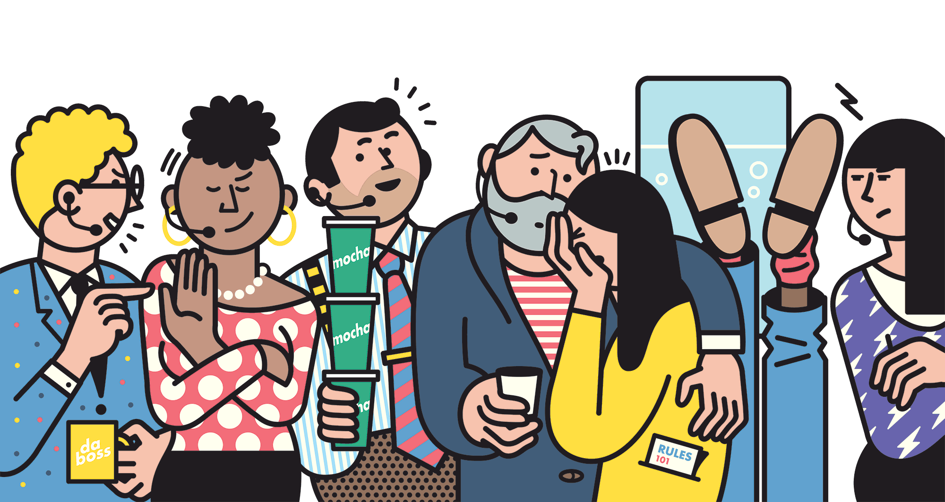
Appraisal of guest service experience
STUDENTS NAME:
Elena Bogdan -1814439
Celia McClelland – 1813622
Munteanu Dumitrita- 1813611
Iuliana Andronic -1813619
LECTURER NAME:
Oluwaseun Adegbite

Slide 2
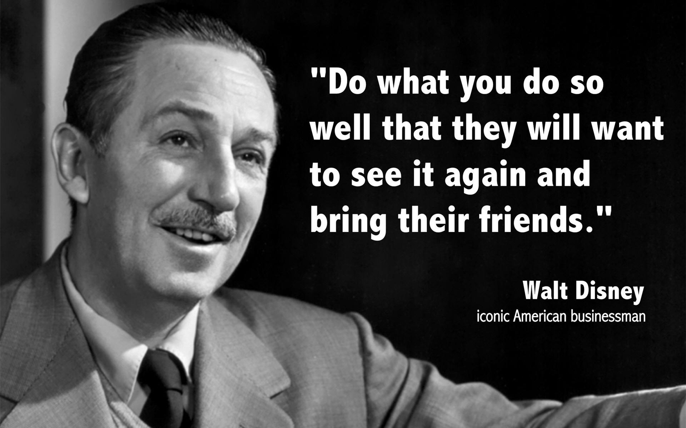
Guestology
Guestology is a word designed by Bruce Laval of The Walt Disney Company.
It discusses guests performance inside a welcoming society , which staff sensibly observe their guest ,on understanding their needs for example the guests wants, needs, capabilities, and expectations.
(Fottler, Ford and Heaton, 2002)

Slide 3
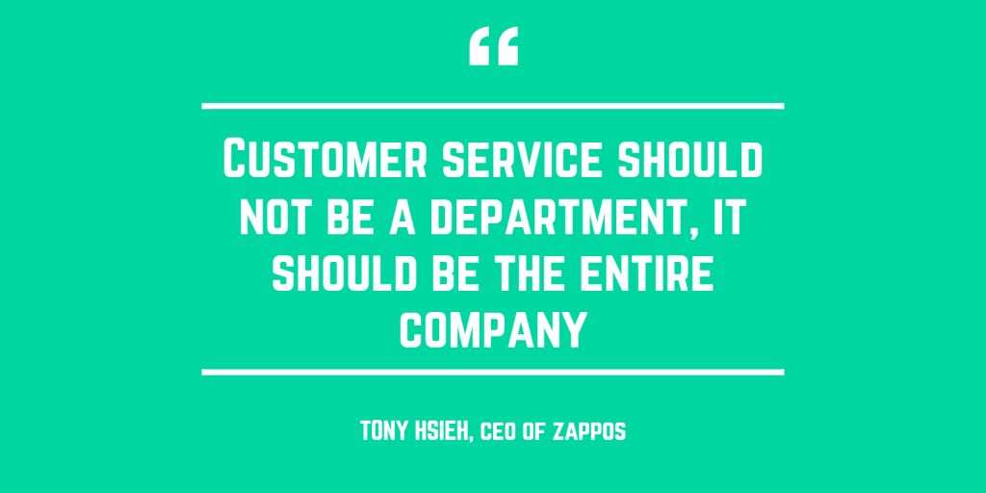
INTRODUCTION
Taking care of the guest is the heart of the hospitality business;
Guest service is meeting the needs and desires of any guest;
Customer satisfaction is crucial in maintaining loyalty;
Guest loyalty ensure repeat business;

Slide 4
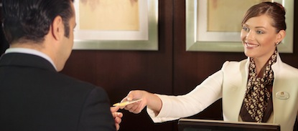
The basic rules for verbal communication are
Use a proper greeting;(depends of the age);
Personalize the conversation(use the guest’s name);
Be attentive;
Thank the guest;

Slide 5
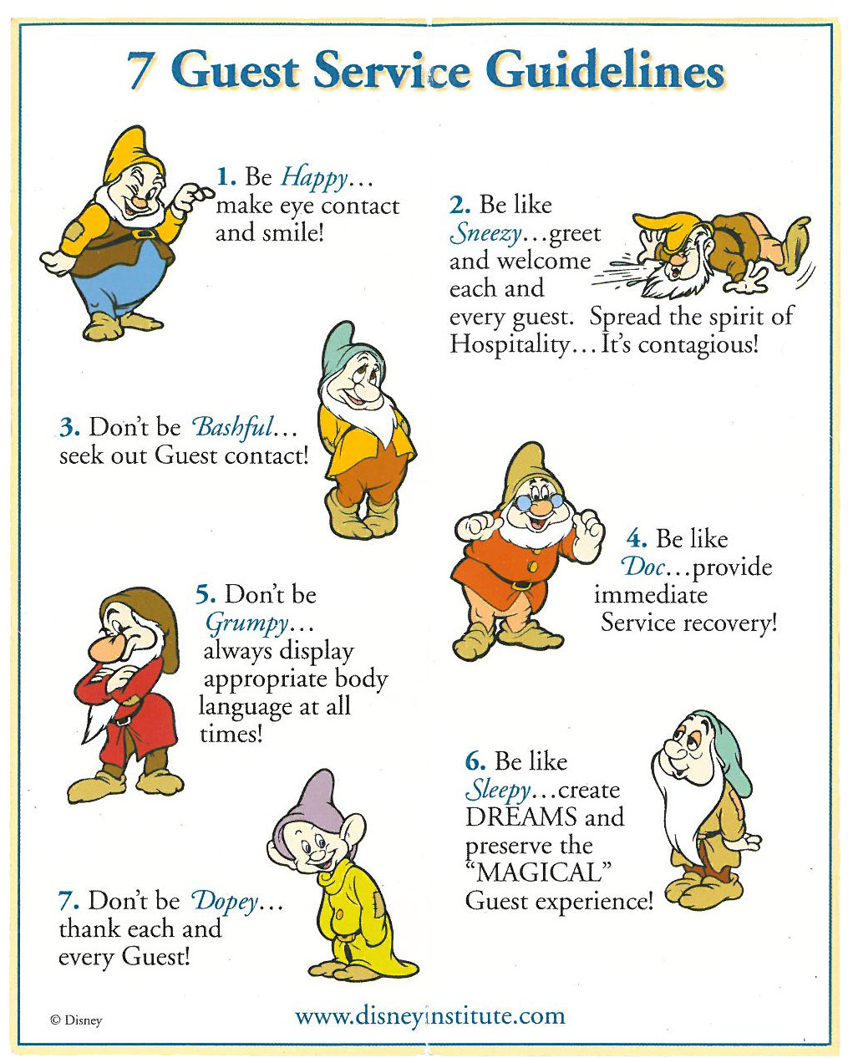
Guest service

Slide 6

Seven deadly sins of service to avoid
Laziness
Rejection
Emotionlessness
Lack of respect
Acting mechanical
Following the Guidelines
Creating excuses to not meet the customers needs
(Stewart and Bonifant, 2008)

Slide 7

Service product
Knowing the cliental which the company is aiming to reach
Knowing the correct category of pricing strategies
Understanding the needs of different cultures
Knowing how to improve services with customer feedback

Slide 8
Service setting
Offering a variety of local transportation e.g taxi firms , hire cars/ mini buses , transfers from and to the airport
Offering a variety of different food and beverages to meet the individuals needs based on internationality ect.
Offering knowledge on the area , by advising the customers on a local guides
(Walsh, 2002)

Slide 9

Example of service settings

Slide 10
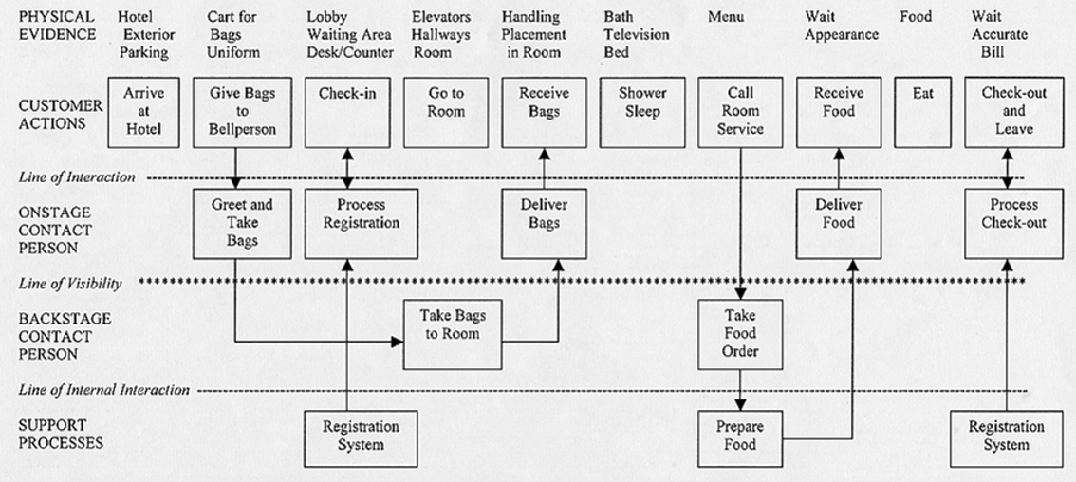
Service delivery

Slide 11
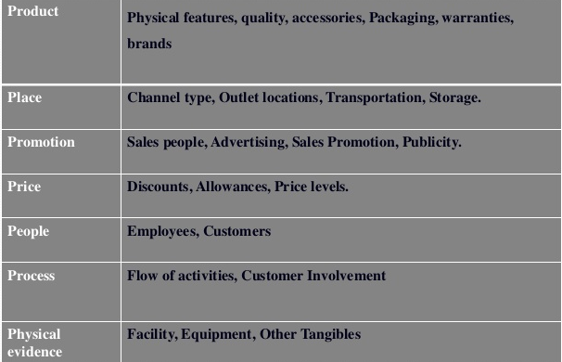
Service model of the 7P’s
(Rajpal,2013)

Slide 12
service strategies
Step 1 – know the product
Step 2 – know the client – understanding the guest
Step 3 – know yourself – the hospitality / travel professional
Step 4 – blend the goals to best meet the desired goals of all
Examples of our experiences
Dumi – Airline
Julia – Salons
Elena – Restaurant
Celia - Hotel
(Nykiel, 2011)

Slide 13
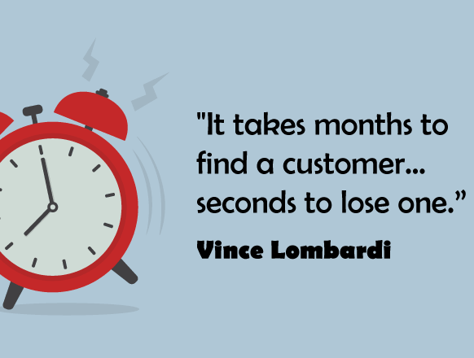
Conclusion
Be always be careful with the guest, the quality of the experience will be remembered long after price has been forgotten.

Slide 14
References
Neagu V,2009,published in Jun 5^{th ;2011 Bucharest;} https://www.academia.edu/2009/05/03Lucrarede-licenta-managementul-serviciilor-hoteliere [accessed in March 2019]
Fottler M and Ford R.2007 published in May 2nd ,2009 ,Chicago, https://achieving-service-excellence-second-edition-ache-management.html [accessed in March 2019]
Ladhari, R. (2006) published in 22.04.2008,Oxford;Service quality, emotional satisfaction, and behavioural intentions. Managing Service Quality: An International Journal, 19(3), pp.308-331.
Stewart, J. and Bonifant C, published in 10.01.2008 ,UK;https://realbusiness.co.uk/the-seven-deadly-sins-of-business-planning.
Rajpal, N. (2013). Published in 12 October, New Delhi ;https://Guestservice management-New Delhi- Anmol Publications.
Nykiel, R. (2011). Marketing in the hospitality industry. East Lansing, Mich.: American Hotel & Lodging, Educational Institute, pp.p78-98.

Slide 15


