Slide 1
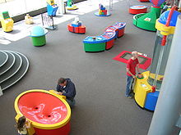
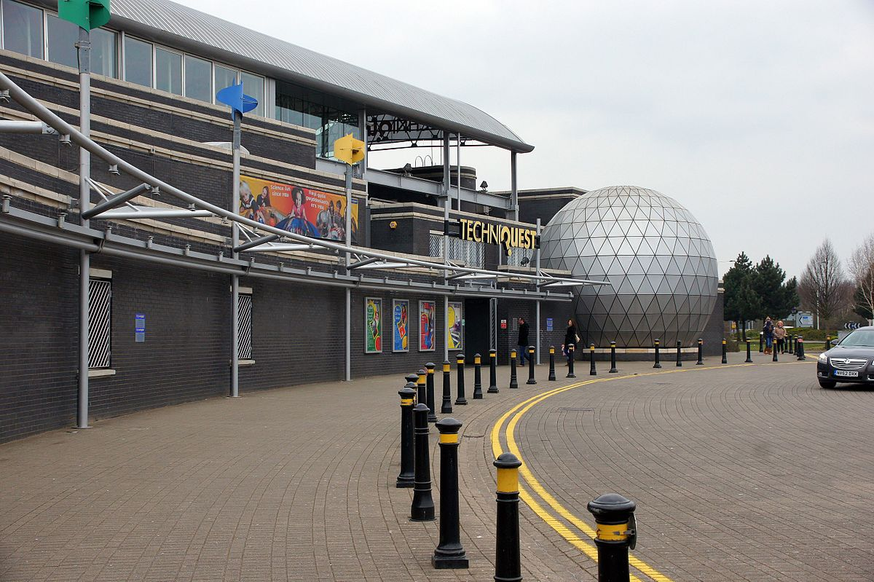
Techniquest
Demonstrate how outdoor contexts can support learning
Leonie Mills (2000637)
Lauren Greenhill (2012008)
Olivia Insole (2011589)
Lucy Jayne Davey (1601745)

Slide 2
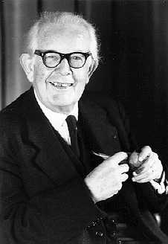
What does Techniquest have to offer?
Techniquest has a wide array of learning outlets, such as a water play area for aimed at younger children, a floor piano, a wormery and many more.
The broad number of hands-on activities certainly offer the idea that Techniquest is for most age groups, showing consideration towards Piaget's four stages.
Sensory motor period from 0-2, where a child may use it's senses to learn.
Pre-operational period from 2-7, where a child uses language and symbols to learn.
Concrete operations period from 7-11. Children are able to understand and "conserve".
Formal operations period from 11 upwards, where logical thinking is now used to understand.
Leonie Mills

Slide 3

Techniquest's target audience
85% believed Techniquest was aimed at primary school aged children
11% believed Techniquest was aimed at secondary school aged children
However, Techniquest prides itself in having a wide array of activities for all ages, including an 'After Hours Evening' for adults.
In making a survey for children and adults, the children gave an overwhelmingly positive response with 80% stating they preferred learning in this facility. 95% of adults thought it was a good learning facility, however a criticism was that some thought it could cause distraction rather than focused learning.
Leonie Mills

Slide 4
92% of children shared that they found Techniquest to be helpful in giving what they already knew a deeper understanding.
This gives reference to Piaget's constructivist teaching approach:
"I hear, I forget; I see, I remember; I do, I understand"
It can also be supported by Vygotsky's theory of cognitive development, where he states that children learn through social interactions.
Techniquest encourages hands-on involvement alongside peers, therefore this can certainly be proven to show benefitted learning.
It also provides a real-world context for its users, therefore putting the children at an advantage where they can use their knowledge in real life situations further on in life. Vygotsky's theory would approve of this, as it states that "minds are shaped by cultural context."
Leonie Mills

Slide 5
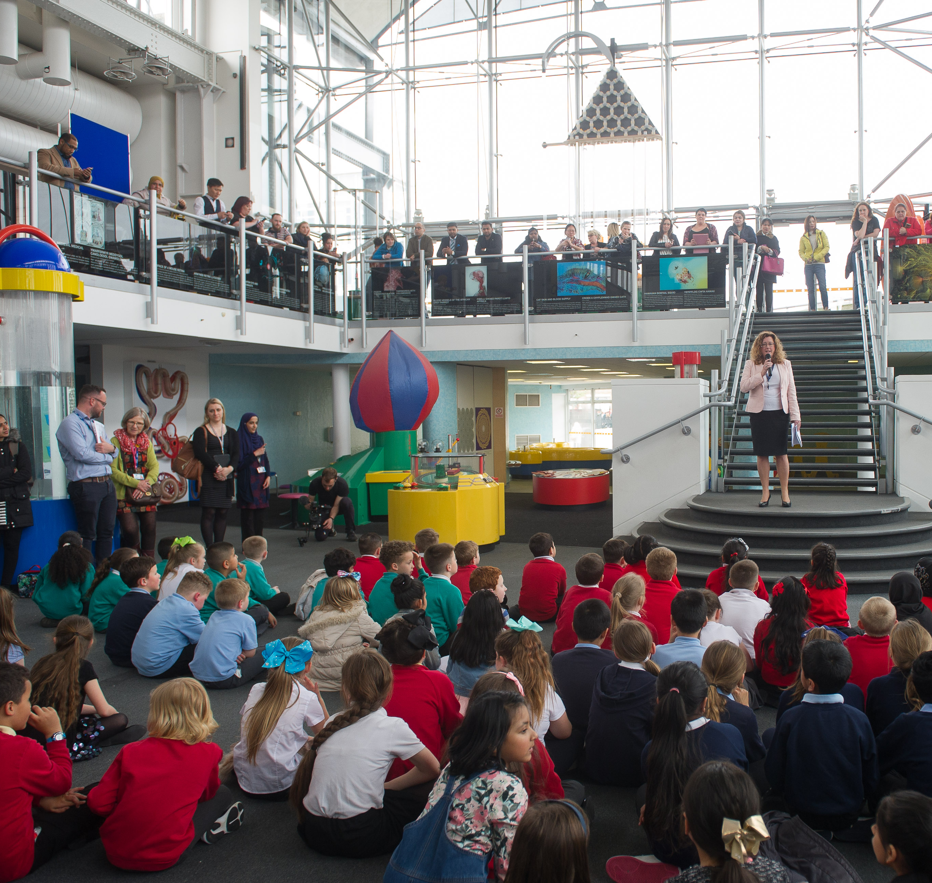
What Techniquest has to offer for schools
From my survey results, I also found that around half of the visits taken were with schools or for an educational purpose, and the other half were taken with family or for a leisurely trip.
Techniquest often has events and shows open for schools to attend, as well as the chance for pupils to explore the institution on their own.
As an example, one respondent mentioned a star dome, where children could enter dome, and be taught about stars and the universe.
In my own research, I did in fact find an exhibit called secret life of stars, which was offered to key stage 3 students to further their understanding of physics and stars specifically.
I believe Secret Life of Stars links with Piaget's Concrete Operational stage, as it requires understanding, and in this stage the child has the ability to understand the information.
Leonie Mills

Slide 6
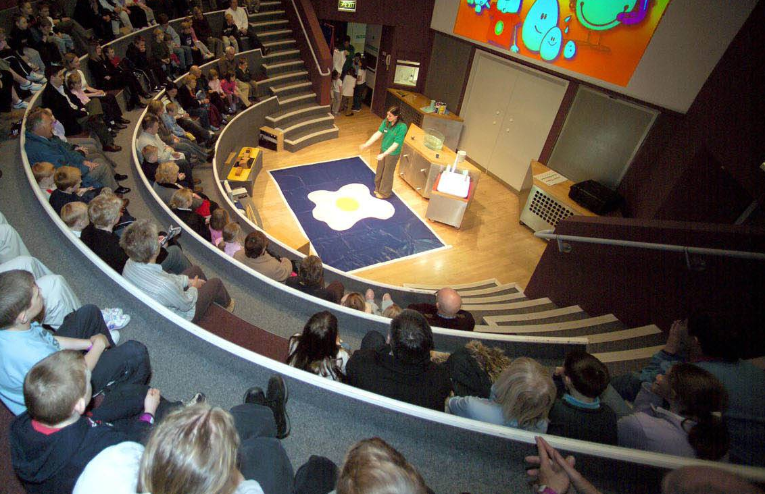
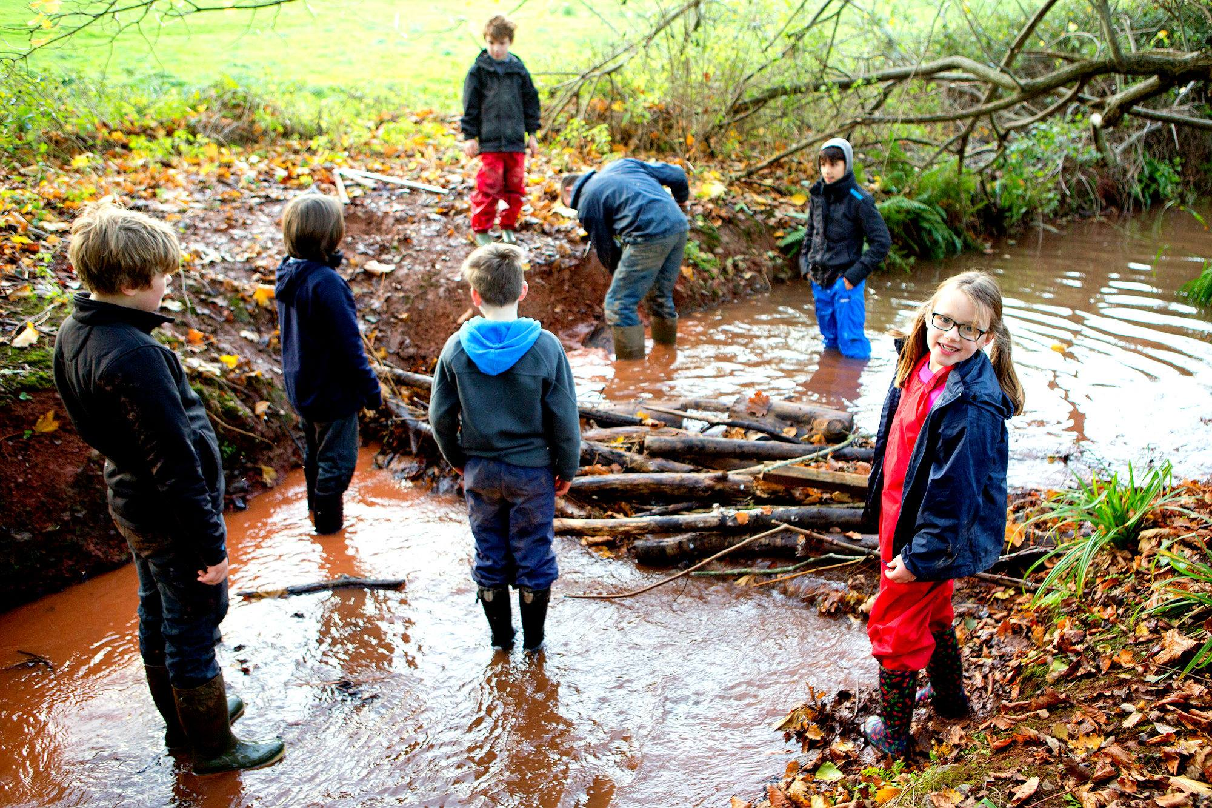
On the other hand, I also found an event called Woodland Wonders, aimed at children in the foundation phase.
This followed two characters, Delyth and Dilwyn, through the woods to get back home, along with the help of the children who would be taught about animals that live in the woods, as well as other features of the woodland.
I think that this is an extremely good example of out of classroom learning, especially for younger children. It focuses on an area which the child may be aware of and familiar with already, as well as teaching them more about it.
Many children may already be aware of the woodland through schemes such as Forest Schools in their own school, therefore they may be enthusiastic in learning about this. In this way, it links with Piaget's preoperational stage as it is based on an idea the children may know a lot about already.
Leonie Mills

Slide 7
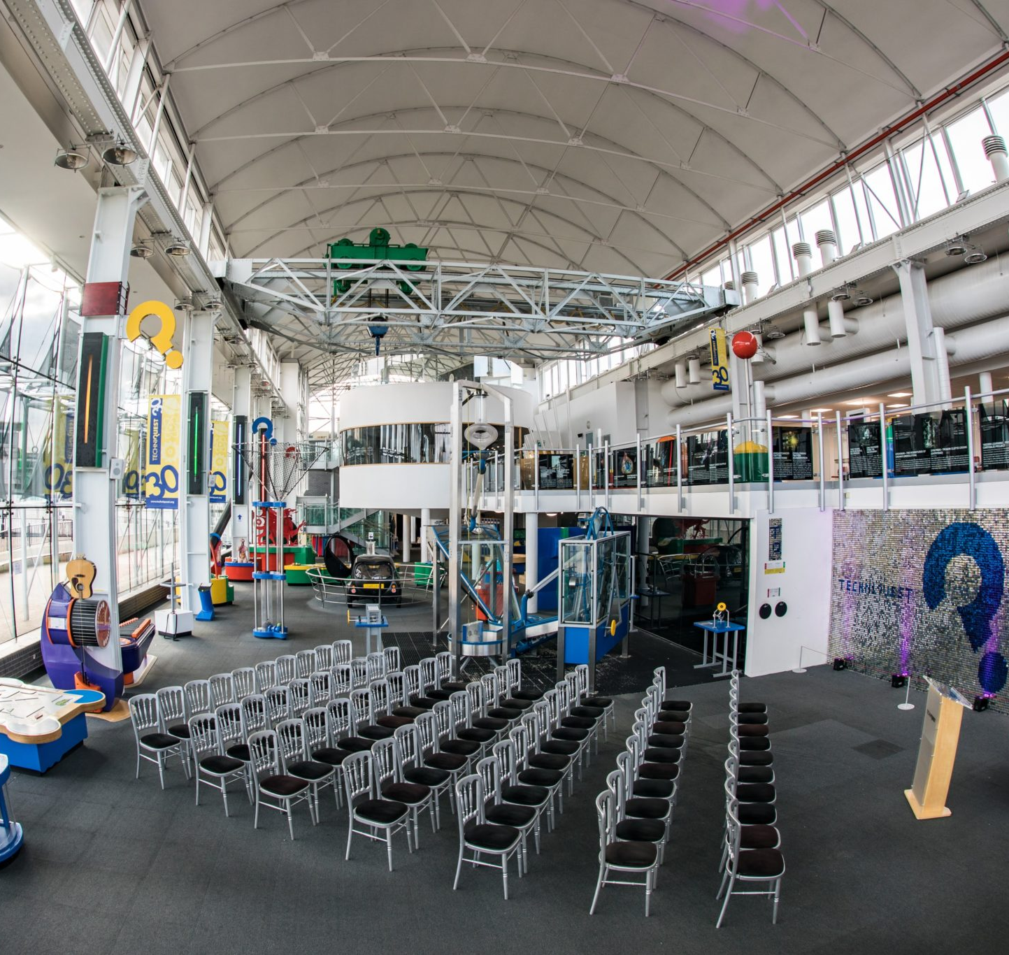
Techniquest's "Out of this World" exhibition is an exhibition specifically aimed at Key Stage 2 pupils.
It delivers information about astronaut Tim Peake's mission, as well as encouraging children to get involved in building rockets, how astronauts are kept safe on missions, and even learning how rocket fuel is burned.
This exhibit once again takes focus on a topic area that children of this age group may take great fascination.
This is an activity which could link to Piaget's Concrete operational period, as it again considers logical thought.
In this stage, children can also consider how others feel so this comes into play when considering how astronauts felt on their mission in the activity.
Leonie Mills

Slide 8
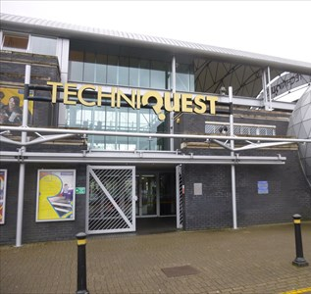
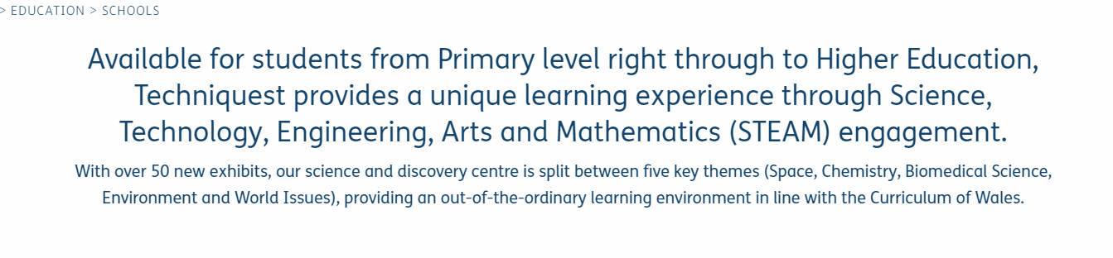
Techniquest is a fantastic outlet for schools, and greatly encourages an educational experience in a social environment, along with a fun day out for children of all ages.
On their website, it is largely advertised that the exhibits are "available for students from primary level right through to higher education"
It also mentioned new exhibits from many areas of the STEM field. (As seen below)
The idea that the exhibits are new, and are designed to be attractive, large and colourful links with the goal of the Montessori method, which is to adhere to a child's instinct to learn.
Leonie Mills

Slide 9
What techniquest has put in place to ensure its accessible to all
Essential carers go free
Wheelchair access to all floors
Disabled toilets on each floor
Wheelchairs available to use whilst you visit!

Slide 10
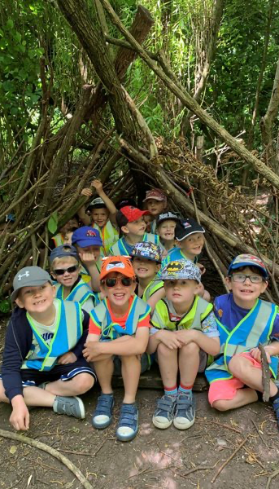
Benefits of learning outside of classroom.
According to the council for learning outside of the classrooms webside - "Young people who experience learning outside the classroom as a regular part of their school life benefit from increased self-esteem, and become more engaged in their education both inside and outside the classroom walls"
It also shows information from the 2008 ofsted report into learning outside of classroom where ofsted "highlighted the positive benefits and impact on raising achievement"

Slide 11
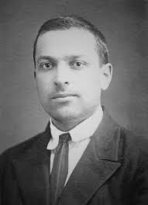
Lev Vygotsky (1986-1934)
Vygotskys was a sociocultural pysycologist
Vygotsky believed children could do very little independently, and that only through interaction and communication does theyre development and learning proceed. Techniquest very much considered vygotsky’s theory with most of their exhibits being interactive and lots of events with communication taking place.
Techniquest describe their purpose on theyre website as “Techniquest’s mission is to embed science in Welsh culture through interactive engagement”
Vygotsky also believes in a “more knowledgeable other” suggests this could be a older pier or parent or carer and that’s who children learn from. However, at techniquest there and multiple staff around building to show you how each exhibition works, I think they’re reflecting vygotskys theory here.

Slide 12
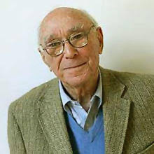
Jerome Bruner (1966)
Bruner was a social constuctivist like Vygotsky however focus on stages simular to piaget
Bruner believed that children of any age where able to learn any topic so long as it was arranged appropriately, techniquest replicates this as they support learning of all ages and off toddler days, primary, comprehensive and higher education visits aswell as being open to visits of members of the public of all ages.
Bruner proposed 3 modes of thinking
Enactive representation (action based)
Iconic representation (image based)
Symbolic representation (Launguage based)

Slide 13
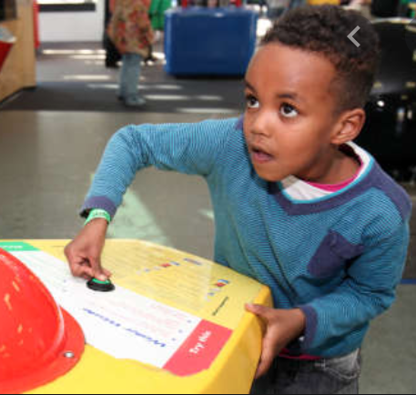
Techniquest and Inquiry-Based Learning
Inquiry-Based Learning: when a learner of any age has a burning question that they wish answered.
Children are filled with questions throughout a trip to Techniquest in relation to many areas.
In Techniquest, a learner can see and experience something that sparks their curiosity leading them to question the how and the why.
Lucy Davey

Slide 14
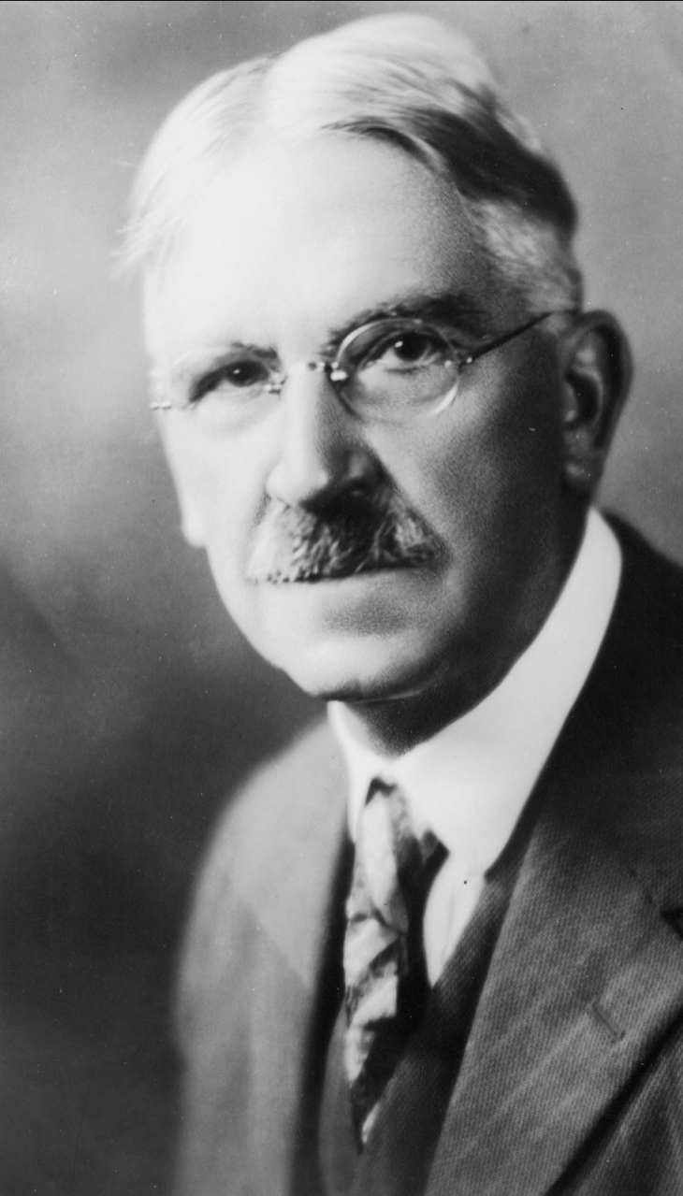
Advocate John Dewey
"Give the pupils something to do, not something to learn; and the doing is of such a nature as to demand thinking; learning naturally results."
Experience and Education (Dewey 1938)
Dewey expresses that traditional classrooms of the past may have given learners poor experiences of learning.
Skills such as counting in 5's may have been mastered through rote learning, but when faced with the need of this in a wider world, children struggled.
Experience maturity – when one is able to share knowledge with a less experienced individual to.
Techniquest staff are a great example of experience maturity in action during Inquiry-Based Learning.
Lucy Davey

Slide 15
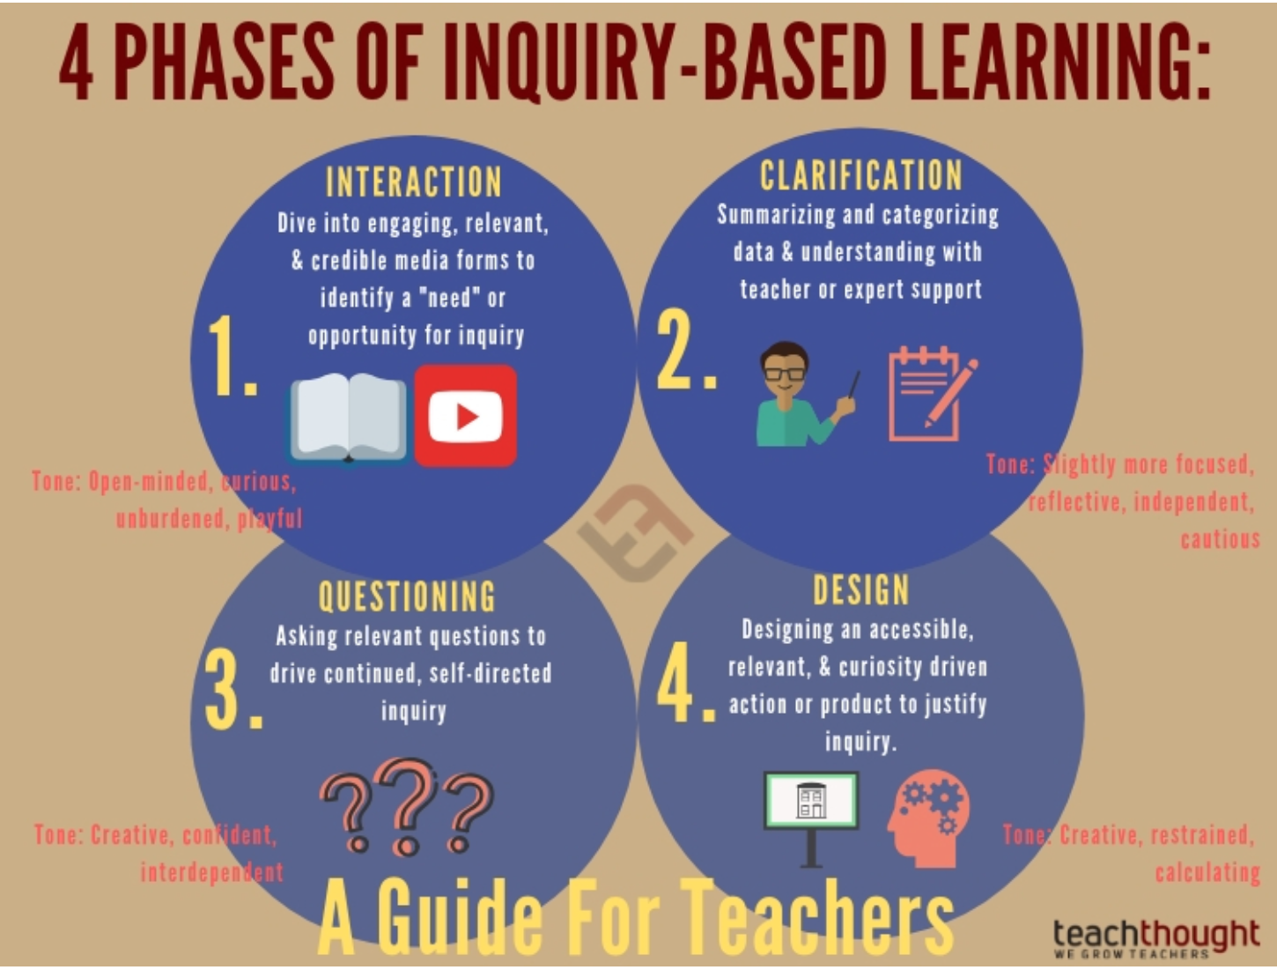
Phases and assessment of Inquiry-Based Learning
Of the 4 phases, does Techniquest really meet the design phase to allow for IBL?
1 in 5 pupils that I supported were able to link what they had learnt at Techniquest to elements of the curriculum.
All 5 pupils were able to discuss exhibits in some detail allowing staff to assess their learning at Techniquest.
The enjoyment and engagement pupils had with their learning experience allowed for a secondary questioning phase through discussion with each other.
Heike, T (2019) 4 Phases of Inquiry-Based Learning: A guide for teachers Available at:https://www.teachthought.com/pedagogy/4-phases-inquiry-based-learning-guide-teachers/ (Accessed: 12 January 2020)
Lucy Davey

Slide 16



Impact of Science and Discovery Centres
Provides memorable learning experiences;
Lasting impact on attitudes and behaviour;
Increases the visitors’ knowledge and understanding of science;
Promote inter-generational learning and provides wide-ranging personal and social impacts.
(ECSITE UK)
Oliva Insole

Slide 17
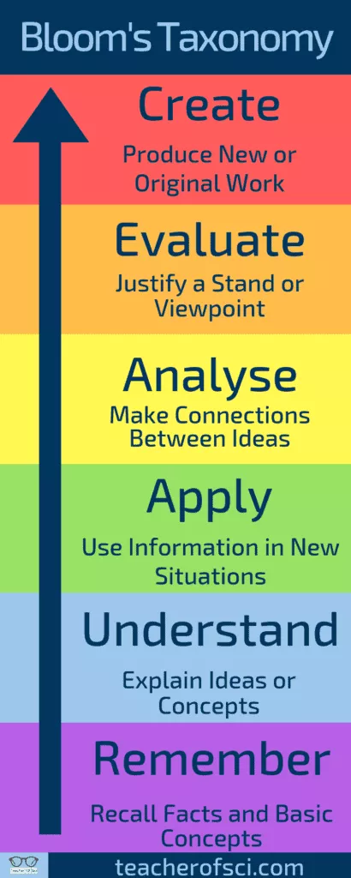
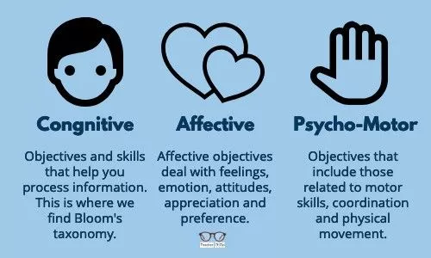
Bloom’s Taxonomy of Learning Domains
Oliva Insole​

Slide 18
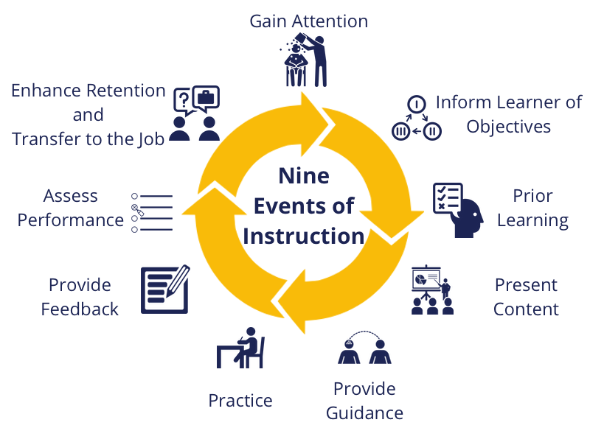
Gagné’s 9 events of instruction

Slide 19



Affective Learning
Emotion influences a human’s cognitive processes, including
Memory;
Perception;
Attention reasoning;
Learning;
Problem solving.
Emotion facilitates efficient encoding and aids the retrieval of information.
Science & Discovery Centres invoke powerful emotions which can have lasting impacts on the visitor's attitudes, sustaining values and patterns of behaviours.
Oliva Insole​​

Slide 20

Outreach Programmes
Delivering STEM provision to pupils across Wales, serving an outreach population of 43,000 (2007-8)
Developed highly innovative Wales-wide schools outreach services including;
Shows, workshops, Starlab, and Kits, all delivered to schools via a network of hubs.
Cardiff Bay and in Wrexham (TQ@Glyndwr) together welcome more than 280,000, people annually.
One of the UK's leading exhibit builders, working on over 250 contracts in more than 30 countries, supplying more than 700 exhibits since 1986.
(Techniquest 2017)
Oliva Insole​​​

Slide 21

The need for digital transformation
Dynamic methods that engage more children with science;
Enjoyable digital outreach;
Drive to mobilise the STEAM curriculum for Wales (Science, Technology, Engineering, the Arts and Mathematic)
Support for teachers;
Development of Techniquest’s Science Capital;
Pupils will receive (as close to as possible) a science theatre experience at their school without associated transport costs of visiting Techniquest;
Techniquest will develop bilingual resources; enhancing scientific literacy knowledge in Welsh students, as well as supporting the increase in confidence in science teaching in primary schools.
Oliva Insole​​​

