Slide 1
Module 2 : Day 4
Delegation Prioritisation Planning

Slide 2
Welcome / Croeso
Aim of Today
To explore and develop awareness Delegation
Introduction to Prioritisation
Introduction to planning – skills matrix and RACI

Slide 3
Topics/themes
Delegation
Prioritisation
Planning

Slide 4
Prioritisation

Slide 5
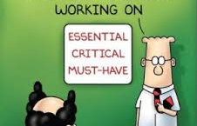

Slide 6
Planning

Slide 8
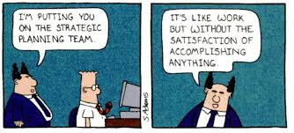
Planning

Slide 9
Delegation

Slide 10
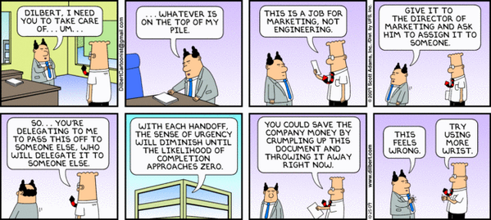

Slide 11
Delegation
“The transfer of responsibility
for the performance of a task
from one individual to another
while retaining accountability for the outcome”
(American Nurses Association)

Slide 12
“Develop your ability to implement
the process of clinical delegation with confidence and completeness so that you have the time to do what you do best.”
              Hansten and Washburn (2004)

Slide 13

Pairs activity
Spend 5 to 10 minutes thinking about delegation and answer the following questions?
Why would you do it?
When would you do it?
With who would you do it?

Slide 14
WHY DELEGATE?
• To maximize efficiency.
• To take control of your time.
• To support the growth of others.
Notes:
Virtual Team
Groups of geographically and/or organizationally dispersed coworkers who interact using a combination of telecommunications and information technologies to accomplish an organizational task.
Virtual teams may be temporary, existing only to accomplish a specific task. Or they may be permanent and address ongoing matters.
Membership is often fluid, evolving according to changing task requirements.

Slide 15
The 5 RIGHTS of DELEGATION
Right Task
• Right Circumstance
• Right Person
Right Direction/Communication
• Right Supervision

Slide 16
RIGHT TASK
When the task is intended for a specific patient it needs to be:
• Appropriate for job description
• Based on desired outcome
• Within the scope of practice
• Competency verified
Notes:
Through Supervision sessions

Slide 17
RIGHT CIRCUMSTANCES
Setting
Staffing/Supervision
Client’s needs
Equipment
Resources

Slide 18
RIGHT PERSON
Education or certification/licensure
Job description
Skills checklist
Demonstrated skills

Slide 19
Knowing Your Delegate
Competency
Training
Accountability
Job description
Strengths and weaknesses
Motivation
Preferences
Cultural differences

Slide 20
When delegating to a teammate, it is important to communicate:
Effectively
Clearly
Concisely
Correctly
Completely
Make sure:
• To describe task
• To state expectations.
• Validate their understanding and needs.
Listen to the words
Listen to the intent.
Clarify if necessary.
Assess non-verbal communication

Slide 21
You can delegate authority but not responsibility.
It is still up to you to make sure the task is done.
Don’t forget to provide appropriate monitoring, evaluation, intervention, if needed, and feedback:
• Supervise
• Guide
• Evaluate

Slide 22
Group activity
(2 or 4 groups depending on class size)
Spend 30 to 40 minutes critiquing the articles on delegation guidelines from the NHS and the American Nursing Association?
Pros and Cons
Suitability for your workplace

Slide 23
Prioritisation

Slide 24
If you chase two rabbits, both will escape.’
unknown
One of the biggest problems people have when trying to find focus is having too many tasks competing for their time.
It can be tough to prioritize.
Let’s break this problem into three smaller problems:
too many tasks
tough to prioritize
tasks compete for your time
And with that, let’s discuss three strategies for dealing with these smaller problems.

Slide 25
1. Reduce your tasks
If you have too many tasks, the solution is to simplify your task list.
Take 10 minutes to list everything you need to do — now just pick the 3-5 most important tasks.
All the small tasks will go on a “do later” list, and you’re not going to worry about them now.
A good way to deal with the smaller, routine tasks that must be done (check email, pay bills, fill out paperwork, and so on) is to schedule a block of time later in the day to deal with them — perhaps the last 30 minutes of your day, or something like that. Early in the day, focus on the important tasks.

Slide 26
2. Choose the task that excites you
Now that you’ve simplified your task list, look at the 3-5 tasks left and pick one task. Just one.
How do you pick? Choose the task that most excites you, that feels compelling, that you’re most passionate about.
If you’re dreading the task, put it aside for now, and pick something more interesting.
If you have several tasks you’re excited about, you might also consider which task will have the biggest effect on your life. What will make the biggest impact?

Slide 27
3. Single-task
Now that you’ve chosen one task, put the others aside for now and just focus on that one task.
Clear away all distractions, including your mobile device and the Internet. Just have the application open that you need to work on that task.
Now get to work. Throw yourself into it, and do it for at least 10 minutes. After that, you can take a break, but try to immerse yourself for at least 10 minutes.
And have fun doing it.

Slide 28
Eisenhower's Urgent/Important Principle helps you quickly identify the activities that you should focus on, as well as the ones you should ignore.
When you use this tool to prioritize your time, you can deal with truly urgent issues, at the same time as you work towards important, longer-term goals.
To use the tool, list all of your tasks and activities, and put each into one of the following categories:
Important and urgent.
Important but not urgent.
Not important but urgent.
Not important and not urgent.
Then schedule tasks and activities based on their importance and urgency.

Slide 30
What Are "Urgent" and "Important" Activities?
In a 1954 speech to the Second Assembly of the World Council of Churches, former U.S. President Dwight D. Eisenhower, who was quoting Dr J. Roscoe Miller, president of Northwestern University, said:
"I have two kinds of problems: the urgent and the important.
The urgent are not important, and the important are never urgent."
This "Eisenhower Principle" is said to be how he organized his workload and priorities.

Slide 31
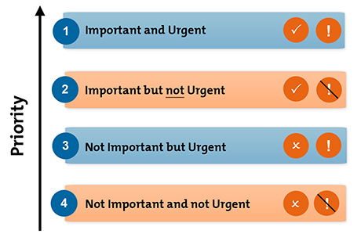
https://www.youtube.com/watch?v=suGXZ1869qc

Slide 32
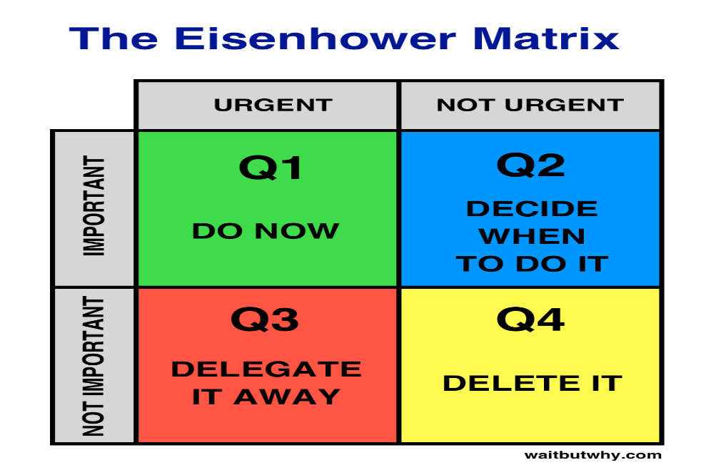
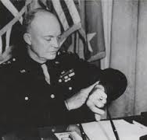
Important activities have an outcome that leads to us achieving our goals, whether these are professional or personal.
Urgent activities demand immediate attention, and are usually associated with achieving someone else's goals. They are often the ones we concentrate on and they demand attention because the consequences of not dealing with them are immediate.

Slide 33
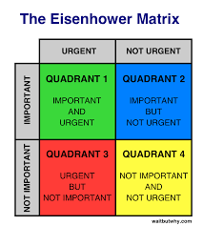

Slide 34
Planning

Slide 35
A Chinese Perspective on Growth
"If you are planning for one year, grow rice.
If you are planning for 20 years, grow trees.
If you are planning for centuries, grow men”.
(a Chinese Proverb, unknown)
Planning for Your Business
"When you begin planning, do what has to be done immediately. Don't try to get done in a hour something that's realistically going to take a week. Plan out on paper what you have to do, what you want to do and when you are going to do it. Then get right on each project without procrastination.”
(unknown)

Slide 36
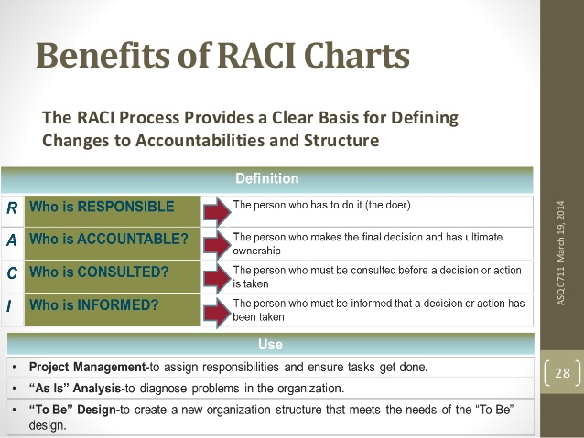

Slide 37
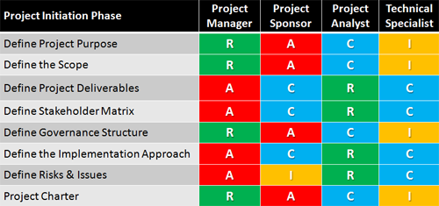

Slide 38
Action plan
When writing an action plan to achieve a particular goal or outcome, you can get much help from the following steps:
Clarify your goal. Can you get a visual picture of the expected outcome? How can you see if you have reached your destination? What does make your goal measurable? What constraints do you have, like the limits on time, money, or other resources.
Write a list of actions. Write down all actions you may need to take to achieve your goal. At this step focus on generating and writing as many different options and ideas as possible. Take a sheet of paper and write more and more ideas, just as they come to your mind. While you are doing this, try not to judge or analyze.
Analyze, prioritize, and prune. Look at your list of actions. What are the absolutely necessary and effective steps to achieve your goal? Mark them somehow. After that, what action items can be dropped from in the plan without significant consequences for the outcome. Cross them out.
Organize your list into a plan. Decide on the order of your action steps. Start from looking at your marked key actions. For each action, what other steps should be completed before that action? Rearrange your actions and ideas into a sequence of ordered action steps. Finally, look at your plan once again. Are there any ways to simplify it even more?
Monitor the execution of your plan and review the plan regularly. How much have you progressed towards your goal by now? What new information you have got? Use this information to further adjust and optimize your plan.

Slide 39
RACI explanation

Slide 40
What is a Skills Matrix?
A ‘skills matrix’ falls within the ‘skills management’ process. A skills matrix is a grid or table that clearly and visibly illustrates the skills and competence held by individuals within a team. Its primary aim is to help in the understanding, develop, deployment and tracking of people and their skills. Well-implemented skills matrices should identify the skills that job roles require, the skills of individual employees, and any gap between the two.
The benefits are widespread and can easily be categorised into three core areas, namely;
Benefits to the Individual / Employee
Benefits to the Organisation / Company
(Mainly team leaders, managers, function owners or business owners)
c. Benefits to the Customer / End-Client

Slide 41
a) Benefits to the individual
Increased competencies – a feeling of investment into their role and their development
Decreased stress levels – work competencies increase thus removing uncertainty
Full awareness of what their ‘role’ entails including the relevant skills competencies required
Full awareness of the desired areas of growth and where they need to focus their training efforts
Can; within some organisations be used within employees Personal Development Plans (PDP)
Employees gain from improved identification and understanding of their own strengths and weaknesses
Aid in understanding the value they bring to the organisation (which in turn can boost morale)

Slide 42
b) Benefits to the organisation / company
Enables managers, function or business owners to understand the skill strengths and weaknesses of employees reporting to them.
Increased capacity – by addressing skills shortages and increasing employee competencies companies can release real capacity into their businesses without incurring the heavy costs of recruitment
Creates the ability to search for desired skills and talents across the organisation (e.g. to help fill a role or to assist with either short or long term increased requirements of a task from an end-client)
A rolled-up view of skills and skills gaps across an organization can enable its executives to see areas of skill strength and weakness.
Enables proficient future planning against projected availability of staff.
When used company-wide creates management consistency to drive an organisation forward
Customers experience a quality of product/service increasing the likelihood of them returning and advertising your products/services.
Customers experience a quality of product/service increasing their loyalty levels

Slide 43
c) Benefits to the customer / end-client
The customer should largely be unaware of the existence of a skills matrix. The customer will however benefit from the increased levels of competency of your staff, their ability to resolve queries in a timely manner and on first touch (i.e. avoiding the ‘I’ll call you back’ scenario). Simply put the benefits are endless.
Faster response rates (decreased lead times)
Increased rate of quality in service or products (reduced defect and return rates)
Increased employee competencies leads to speed which can result in ‘faster to market’ products and services
Customers feels valued
Customers experience a very easy and smooth transaction with company

Slide 44
https://www.youtube.com/watch?v=Skills Matrix

Slide 45
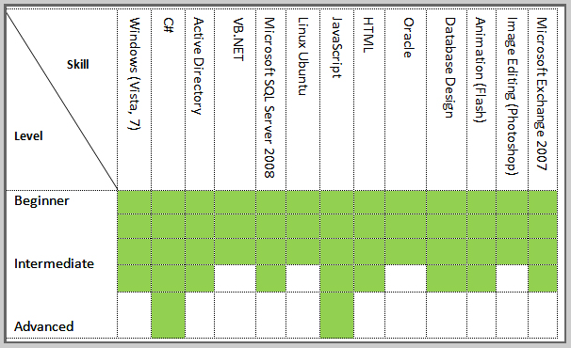

Slide 46
References
Dream Works Animation, 2008. You Tube - Madagascar 2 : Air Penguin (Crash Landing Scene). [Online]
Available at: https://www.youtube.com/watch?v=DI4zp7yeuMU [Accessed 24th May 2016].
Dream Works Animation , 2008. You Tube - Madagascar 2: Penguins Steal Jeep. [Online]
Available at: https://www.youtube.com/watch?v=DI4zp7yeuMU [Accessed May24th 2016].
Hansten, R. and Washburn, M. (2004) Clinical Delegation Skills: A Handbook for
Professional Practice, 3rd Edition, Aspen.
“Successful Delegation: How, When and Why”. Retrieved June 10th, 2016.
http://www.mindtools.com.

