Slide 1
Temuulen Khorloo
Student ID: 1706450
LEVEL 7 SEMESTER 2
MODULE CODE: SBTY7004
Presentation
New Technology in Music and
Creative Entertainment
MODULE TUTOR: JOHN ZOZZARO

Slide 2


Tokit
The first blockchain entertainment crowdfunding platform

Slide 3

Introducing Tokit.
Tokit / "Tokenise it" is the first decentralised multi-smart contract token based crowdfunding application launched as part of SingularDTV and Ethereum on the blockchain.
A part of three main applications designed for entertainment industry to create a new type of entertainment industry economy utilising the blockchain technology. (SingularDTV 2018)

Slide 4

Tokit Introduction Video.
https://www.youtube.com/watch?time_continue=2&v=SRB357OirJ8

Slide 5


3 Applications designed to leverage artist creations. Those are:
Tokit: It is an IP rights management gateway.
SingularX: a peer to peer content and value exchange application.
EtherVision: a distribution application.
This is a first step towards implementing blockchain technology in the Music Industry. (SingularDTV 2018)

Slide 6
These 3 applications are in essence designed to implement 3 categories:
Development / Tokit
Production / SingularX
Distribution / EtherVision
Used all 3 applications together to empower artists to build their own ecosystem economies.
A new type of entertainment industry without the gatekeepers and intermediaries. (SingularDTV 2018)

Slide 7
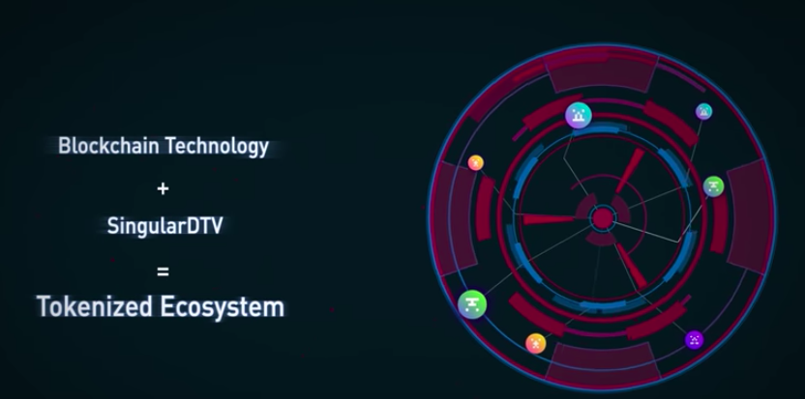
An alternative industry:
transparent
uncensored
peer to peer
Generates instantaneous
revenue
rewards and
results in real time.
It is for anyone who got a creative idea to start their very own tokenised ecosystem project campaign within minutes.

Slide 8
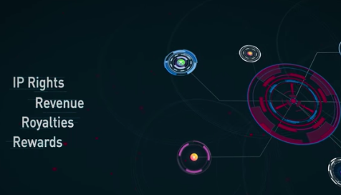
Tokens
Represent artist's IP:
It Embeds their IP rights:
Revenue
Royalties
into the programmable tokens.
It is made possible by the blockchain's
data-network convergence and consensus algorithm.
These applications together provide users:
unprecedented control over exploitation of their art.

Slide 9
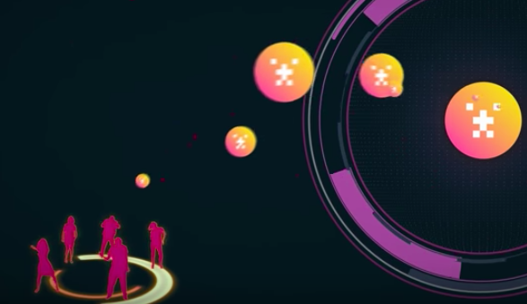
A New lifelong Super-fans:
The platform provides an opportunity for fans to buy into their favourite artist's tokens enabling them to become a part of the creative work process.
By purchasing the project tokens,
Fans are not only helping their artists to complete their projects without financial tires but also get to have a chance to invest in their favourite artists.

Slide 10
Fans enjoy rewards and royalties as the tokens start to generate revenues and rewards.
Word-of-mouth marketing will have a real value.
This interaction help build a lifelong Super-fan base
Sustainable and extensive as the reciprocal bond created between the fan and artist is robust.

Slide 11
What are the main competitors and why choose us?
Kickstarter
Patreon
Indiegogo
The key differentiator: These are a “one-way” crowdfunding platforms.
Tokit
A new type of token-based crowdfunding.
The Tokens represent IP rights
Linked with the revenue streams
By offering a portion of their tokens
Ownership portion of their art to the public.
Mutually beneficial relationship between fans and artists.
(SingularDTV 2017)

Slide 12
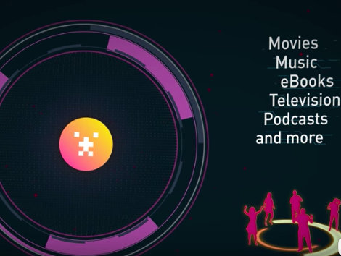
Tokenised Ecosystem:
In the centralised world businesses
run by:
Corporations
Banks
Other intermediary companies…
In the digital world of blockchain technology of Ethereum and SingularDTV:
The business model is created by a new decentralise tokenised ecosystem. The tokens are programmable with different features and it is approved by the smart contracts.

Slide 13

SingularDTV:
An EnTech (entertainment technology) company employing blockchain technology by creating a token based entertainment economy to empower creators and their fans.
It solely designed for the entertainment industry to implement blockchain technology.

Slide 14

SingularDTV presents:
Content creators:
Filmmaker
Composers
Music producers
All content creators
By creating direct connection between fans and artists, producers and consumers by facilitating decentralised transparent world where results happen instantaneously by utilising blockchain technology:
Help content creators:
Fund
Distribute
Market
their work without the middlemen companies.

Slide 15


The blockchain is revolutionary for two main reasons:
1. It convergence data and network for the first time
2. Consensus algorithm that provides every user with the same transparency thanks to its permanent digital records. (SingularDTV 2018)

Slide 16

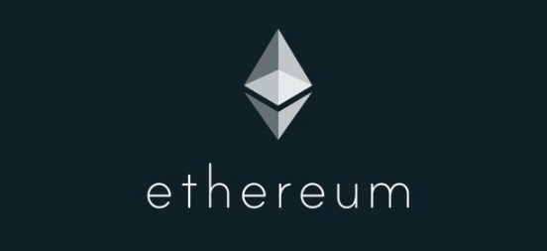
A blockchain protocol designed:
Support new complex applications softwares by utilising the blockchain's data network convergence and consensus algorithm.
Launched in 2015. (SingularDTV 2018)

Slide 17


The projects created in the SingularDTV blockchain system aims:
Generate revenue. They added to “EtherVision” a distribution platform of the SingularDTV’s blockchain.
All the revenue generated are added into the project tokens.
The embedded royalty percentages distributed to the token shareholders automatically and the revenue generated in the tokens can be withdrawn in the form of ETH.

Slide 18
Upon creating project a content creator is asked to make a one off payment equivalent of:
$75 by SNGLS (SingularDTV token)
$100 by ETH.
(Zach LeBeau 2018)
Tokens are
ERC20 standard tokens and they possess several properties derived from the Ethereum blockchain standard:
They are
Transferable
Based on Ethereum smart contracts
With specific rewards.
Programmed:
Reward share properties
Claimed by token holders pro-rata, with no middleman involved.” (SingularDTV 2018)

Slide 19


Distribution platform created for artists on SingularDTV blockchain entertainment economy:
Find their audience
Decentralised distribution portal.
A new way of connecting consumers with the content creators directly. Also gives a chance to consumers to curate, share and engage directly with the artists creative work.
Uncensored and transparent.

Slide 20
What is the future vision of the company?
Become a primary global entertainment blockchain economy
Implement blockchain technology into the global music industry.
Bring back the power to content creators and cut out intermediaries by creating transparent and accountable entertainment ecosystem.

Slide 21
Market analysis
“In all, crowdfunding platforms have raised some $2.7 billion and successfully funded more than a million campaigns in 2012, according to a Massolution report, with an 81% increase to $5.1 billion expected for 2013. By 2025, the global crowdfunding market could reach between $90 billion and $96 billion — roughly 1.8 times the size of the global venture capital industry today, according to a 2013 study commissioned by the World Bank.”
And in March, Kickstarter surpassed $1 billion in pledges made.
(KATHERINE NOYES 2014)

Slide 22
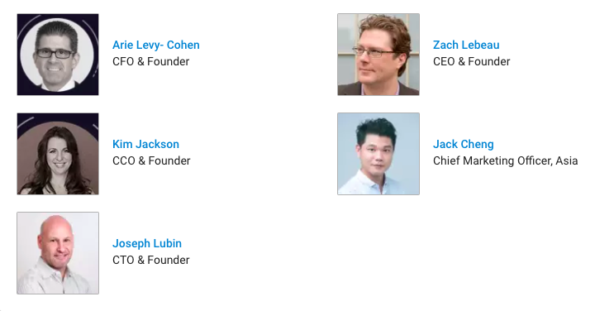
The team behind Tokit:
(Crunchbase 2018)

Slide 23
SingularDTV is strategic priorities and critical factors for growth:
To create more applications that support this blockchain ecosystem:
Rentalist :—
Airbnb style application
Peer-to-peer entertainment equipment rental
Crew hiring
Location hiring
Rentalist module within our SingularDTV ecosystem
Paycheck
Payroll application for the crypto world.
for ETH and ERC20 tokens.

Slide 24
Blockeeper
Blockchain application for artists and creators to organise their accounting.
EtherVision (EV)
Peer-to-peer
Decentralised
Distribution portal.
Artists, creators, distributors, who create their channel and connect with audiences globally.

Slide 25
The Funds for the project
Is been raised by Initial Coin Offering:
SingularDTV raised $7.5M:
Announced Date Oct 3, 2016
Funding Type:
Equity Crowdfunding
The funds will go towards the business development.

Slide 26
Bibliography:
SingularDTV “About Tokit” 2018
https://tokit.io/
[Accessed 1 April 2018]
Jamie Redman 7178
“SingularDTV Raises $7.5M to Incentivize Creative Output” 2016
https://news.bitcoin.com/singulardtv-raises-7-5m-creative-output/
[Accessed 2 April 2018]
Crunchbase “Equity Crowdfunding - SingularDTV” 2016
https://www.crunchbase.com/funding_round/singulardtv-equity-crowdfunding--fbd7a559
[Accessed 4 April 2018]
SingularDTV “2018 Strategic Priorities” 2018
https://medium.com/singulardtv/singulardtv-2018-strategic-priorities-329c9e89e11d
[Accessed 8 April 2018]
SingularDTV “How to video guide” 2018
https://tokit.io/guides
[Accessed 8 April 2018]

Slide 27
Jason Tyrrell, Shreesh Tiwari “SingularDTV: Welcome to EtherVision” 2018
https://medium.com/singulardtv/singulardtv-welcome-to-ethervision-4ee659d03921
[Accessed 15 April 2018]
SingularDTV “TOKIT is Here! The Evolution of Entertainment Begins…” 2017
https://medium.com/singulardtv/tokit-is-here-the-evolution-in-entertainment-begins-1d3e9eaff348
[Accessed 11 April 2018]
G. Thomas Esmay “Tokit Vs Kickstarter
Why Tokit Isn’t Just Another Crowdfunding Platform” 2017
https://medium.com/singulardtv/tokit-vs-kickstarter-d0344af8b373
[Accessed 17 April 2018]
SingularDTV “TOKIT, Ethereum's First Blockchain Application Launches” 2017
https://www.prnewswire.com/news-releases/tokit-ethereums-first-blockchain-application-launches-300549801.html
[Accessed 20 April 2018]
SingularDTV “Current Team” 2018
https://www.crunchbase.com/organization/singulardtv/current_employees/current_employees_image_list
[Accessed 29 April]

