Slide 1

HPFY3001: Academic Survival Skills
Session 6: Taking notes
Dr Rhian Elinor Keyse
Lecturer in Global Historical Studies

Slide 2
Last session - review
Reading skills

Slide 3
In this session:
Taking notes from reading
Taking notes in lectures/classes

Slide 4

Why do we take notes? When?

Slide 5

Why do we take notes?
Actively engage with the material, and begin to process it
Develop our knowledge and understanding of a topic
Identify most important/relevant points – need-to-know versus nice-to-know
Remember key points so we can use notes later – e.g. for writing assignments.
Capture our thoughts/reactions
Summarise longer/complex texts

Slide 6
Evaluating your own note-taking
What strategies do you use?
How well do they work?
What are the strengths/limitations?
What challenges do you encounter when taking notes?

Slide 7
Potential pitfalls
It’s not just about learning/remembering information
You don’t need to take notes on everything
Remember the purpose of your notes – a specific assignment? General overview?
You will use the material you read to:
Support your points in assignments
Answer questions you’re set

Slide 8

Making notes from reading

Slide 9

Start with the bibliographic information…
Keep a note of the bibliographic information for anything that you use in your research - you will need to reference these appropriately in your work.
Author’s surname and first name or initials
Date of publication
Title of book/article/essay
Name of journal (if a journal article) or book (if an edited collection)
Name and location of publisher (if a book)
Page numbers (if an essay or article)

Slide 10
Note-taking strategies
Clear system for indicating which notes are direct quotations, your own paraphrases, and your own thoughts.
Don’t just record what the text says, but also your own reactions to it

Slide 11
What might our notes include?
Information, data, statistics
Direct quotes from text.
Paraphrases, outlines, summaries of key ideas and arguments.
Your own questions and responses to the text.
Connections to ideas/evidence from elsewhere.
Key words and phrases with relevant page numbers to help you find them later.

Slide 12
SQ3R Approach
Survey: skim text for outline/overview, work out which parts might be useful. Consider headings, subheadings, figures, tables, and surmmaries.
Question: What questions do you have? It could be ‘what does that term mean?’ or ‘how might I use that information?
Read: Using your specific questions, you can read actively to find the answers.
Retrieve: Process and understand the information by recalling the main points as if you were explaining them to someone else.
Review: review the material by repeating the key points back to yourself in your own words.
Useful for:
Keeping on track: formulating specific questions to address with your reading encourages you to read strategically and can help you keep focused.
Processing learning: putting what you’ve read into your own words helps develop and check understanding.

Slide 13
Cornell method
Splitting page into two columns
Detailed noted in right-hand side column
Your own reflections, questions, key points etc noted in the left-hand column

Slide 14
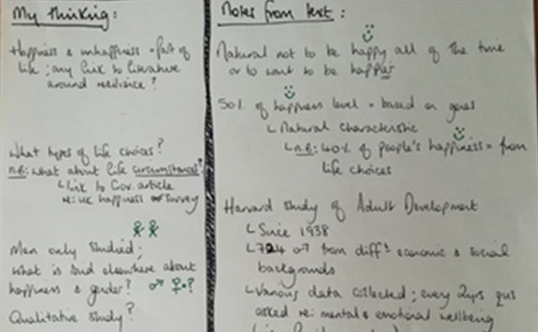

Slide 15
Critical note-taking
Not just what the text says, but your reaction to it.
Is it relevant for your purpose? How might you use it in your assignment?
What do you think of it? Is it convincingly argued and well-evidenced?
Do you agree or disagree?
How does it relate to other things you’ve read? Does it support/add to/contradict/provide a different perspective?
Is there anything you don’t understand or need to know more about?

Slide 16
Taking notes in lectures/class

Slide 17
Notes in class/lectures
Writing everything in case you miss something?
Not taking notes because it’s recorded anyway?
Notes in lectures/classes aren’t just a passive transcript – actively selecting what you record helps you retain and understand it better.
Consider:
What to note
How much detail
Why you’re noting it - what you might use it for?

Slide 18
Reasons to take notes in lectures (even if they’re recorded!)
Absorb and make sense of information at the time – making them helps you process your understanding
Get an overview of information
Helps you remember the lecture’s content
Extracting information for later use e.g. assignments
Note things to follow up for future research – questions/areas you’re not sure of, aspects you want to research more.
Noting your own response
Keeping focus in lectures

Slide 19

Reviewing your notes
Soon after taking them – clarify anything that doesn’t make sense, while you still remember
Amend anything that’s incorrect/partial
Follow up on notes about questions or further research you want to do.

Slide 20
Note-taking – paper or digital?
Paper
Digital
Rough prose/doodling/freewriting
Helps avoid social media etc when listening to a lecture
Might be neater
Software to help note-taking – speech-to-text/text-to-speech
Can rearrange notes more flexibly
Searchable

Slide 21
Other things to consider…
Use of colour – to categorise/highlight etc
Use symbols/images

Slide 22

Over to you: any questions?

Slide 23
Next time: Approaching essay questions
Please do email me if you have questions between classes!

