Slide 1
SUPPLY CHAIN STRATEGIES
Impact of Culture and the Environment

Slide 2
Journal of Intercultural Management Vol. 1, No. 2, November 2009, pp. 5–16
20161026 Impact on Culture_Laskowska-Rutkowska2.pdf
“The impact of national and organizational culture on the cooperation of firms – a supply chain perspective” Aleksandra Laskowska-Rutkowska

Slide 3
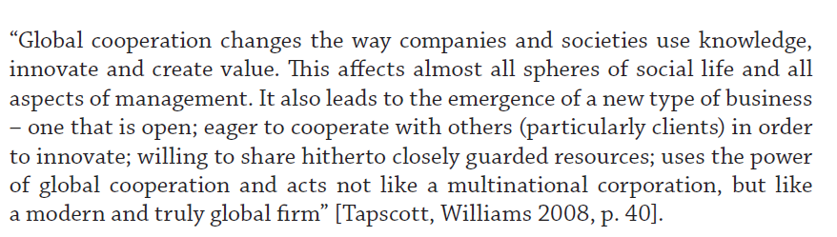


Slide 4
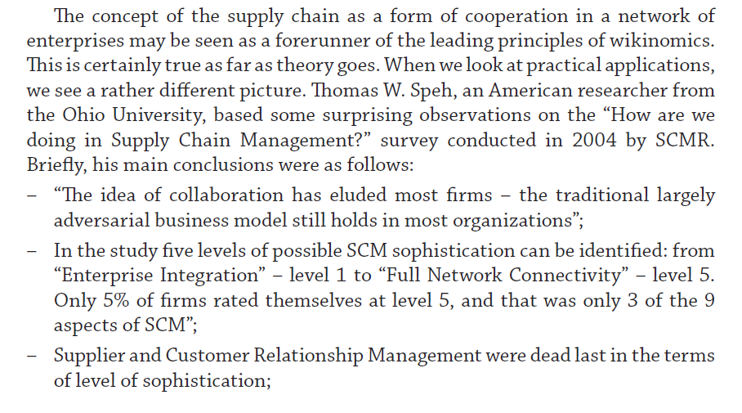

Slide 5
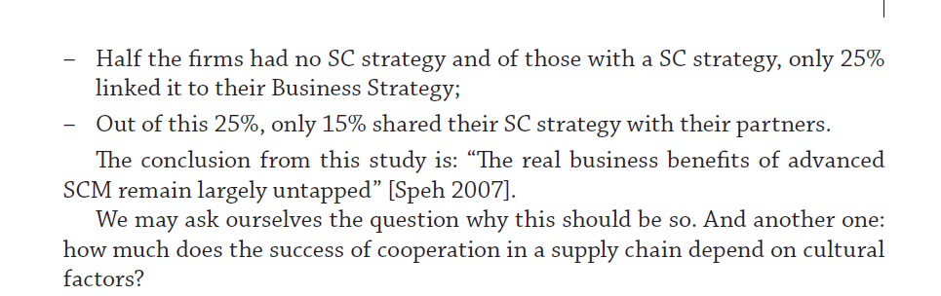

Slide 6
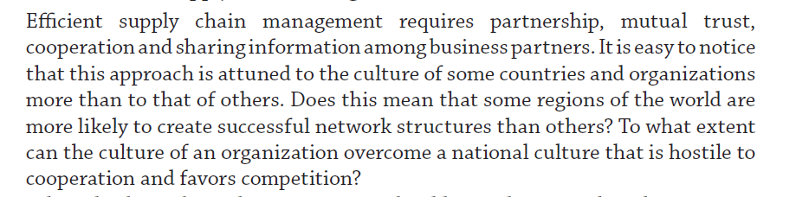

Slide 7
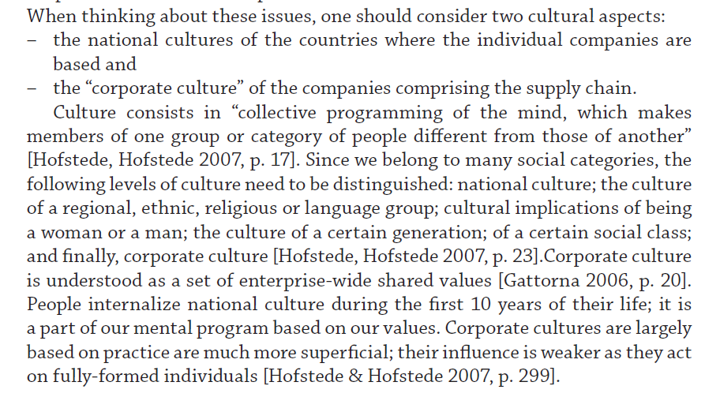

Slide 8
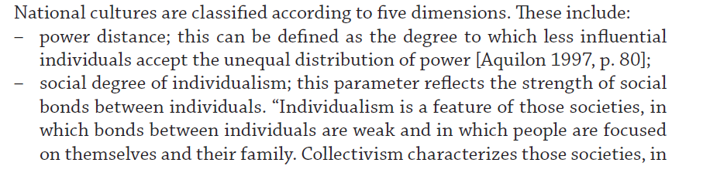

Slide 9
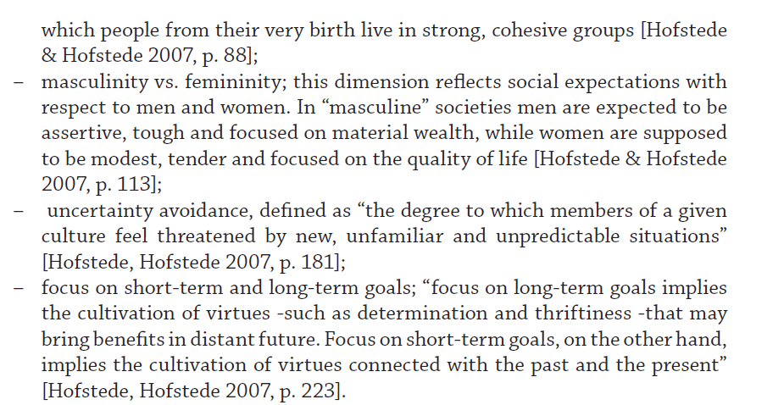

Slide 10
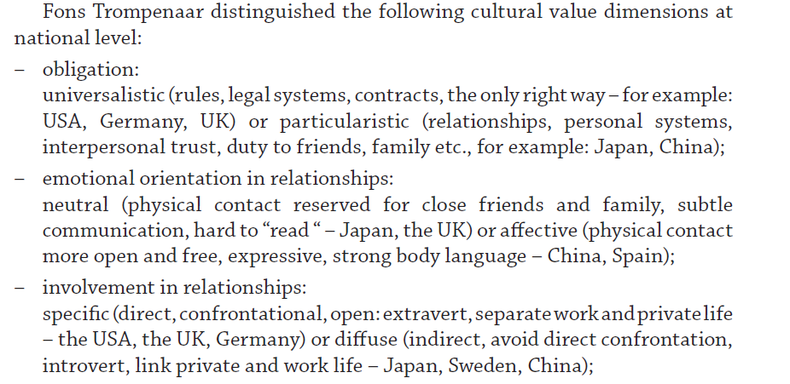

Slide 11
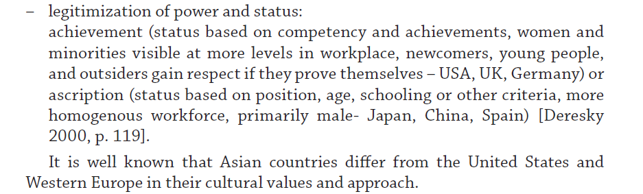

Slide 12
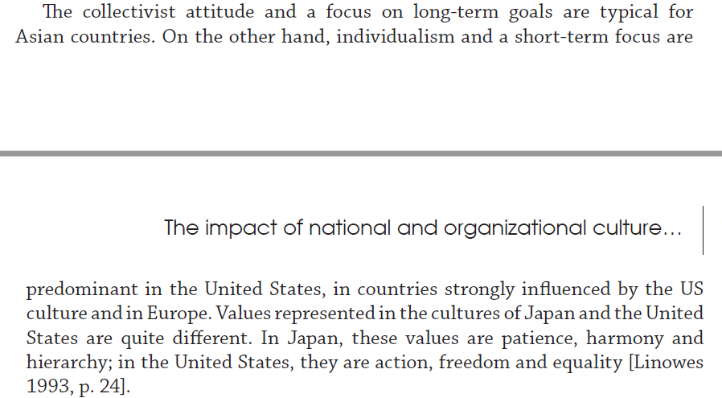

Slide 13
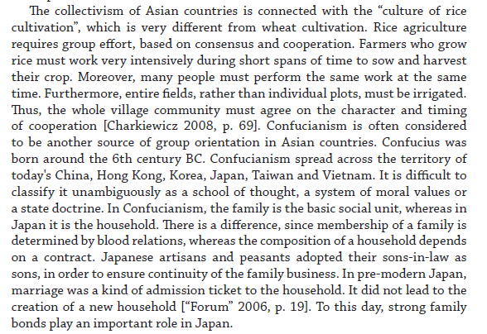

Slide 14
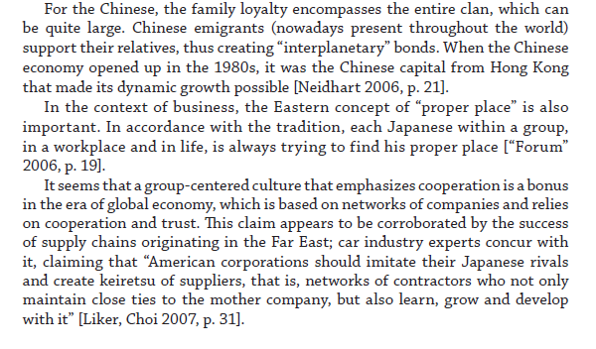

Slide 15
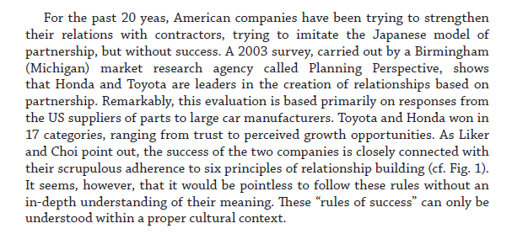

Slide 16
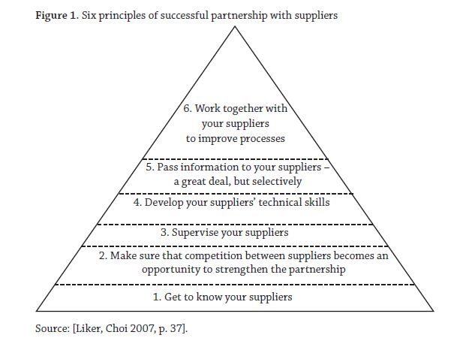

Slide 17
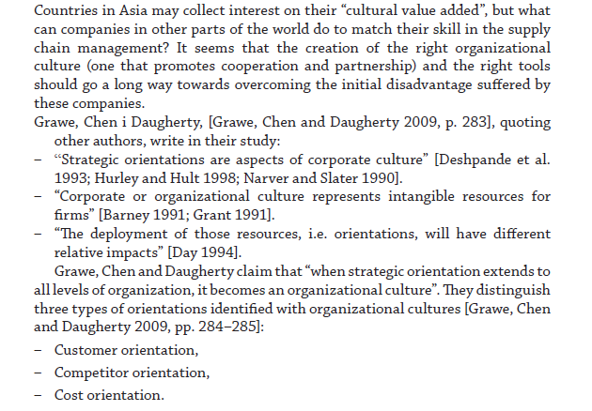

Slide 18
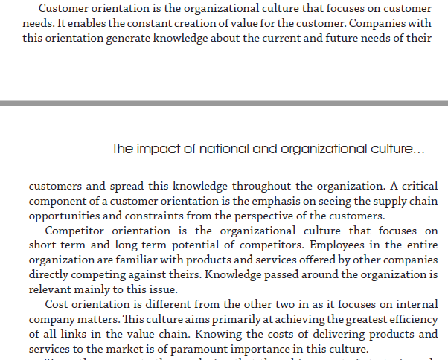

Slide 19
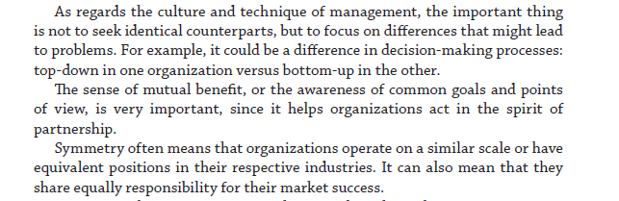

Slide 20
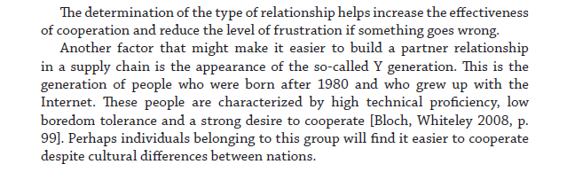

Slide 21
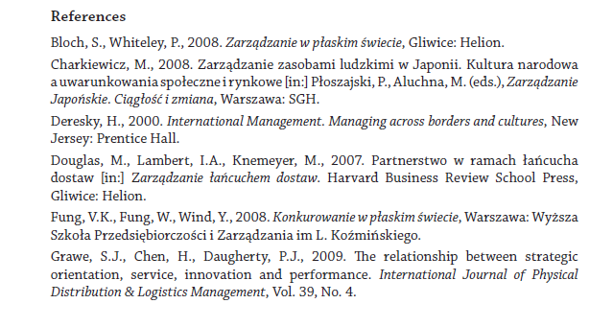

Slide 22
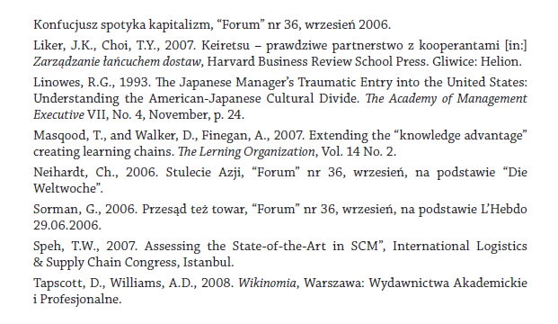

Slide 23
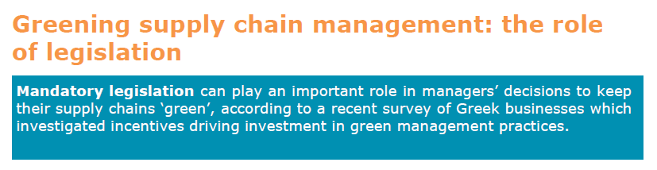
20161026 Green Environmental Policy Green Supply Chain Management.pdf

Slide 24
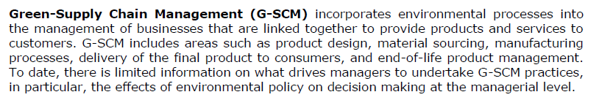

Slide 25
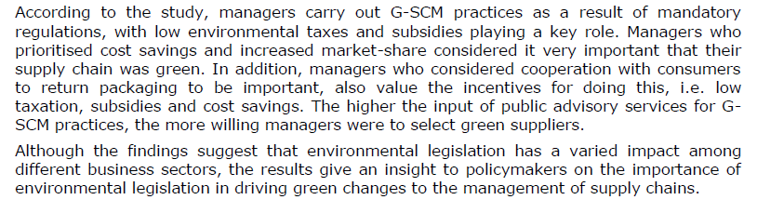

Slide 26
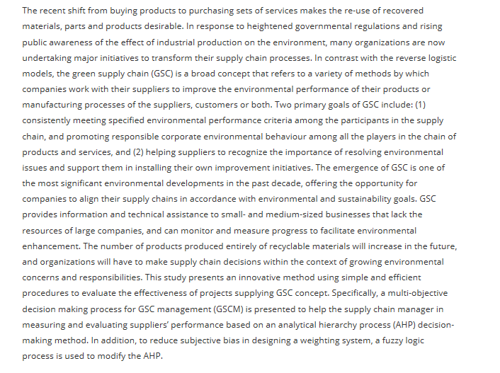
http://www.tandfonline.com/doi/full/10.1080/00207540701472694?scroll=top&needAccess=true

Slide 27
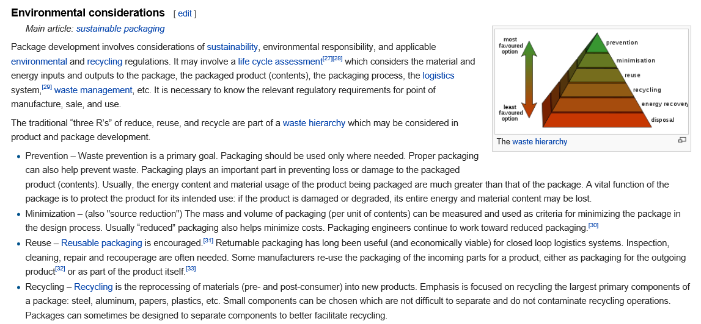

Slide 28
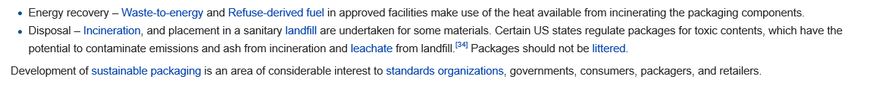

Slide 29
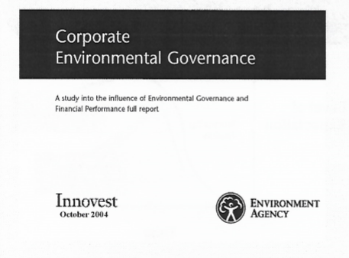
Defence Academy of the United Kingdom – Cranfield University

Slide 30
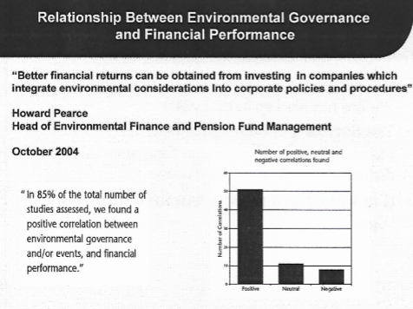

Slide 31
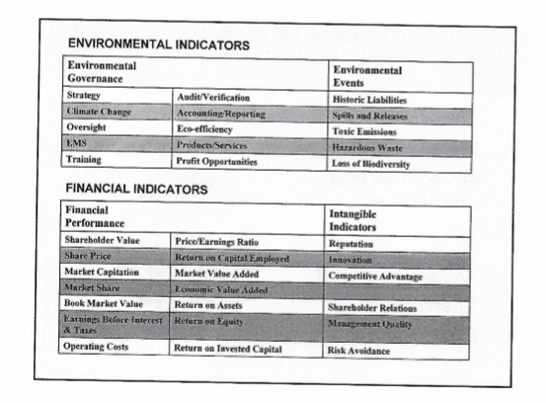

Slide 32
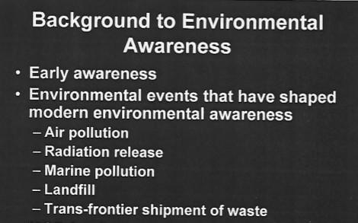

Slide 33
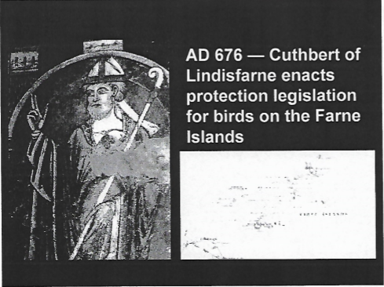

Slide 34
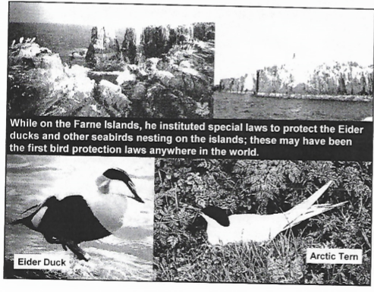

Slide 35
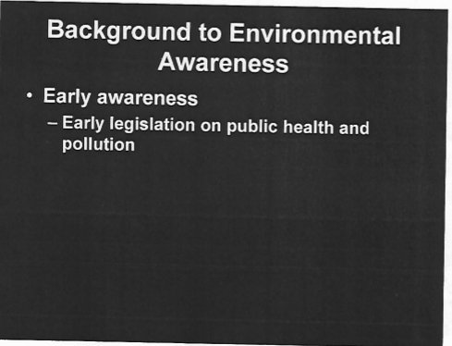
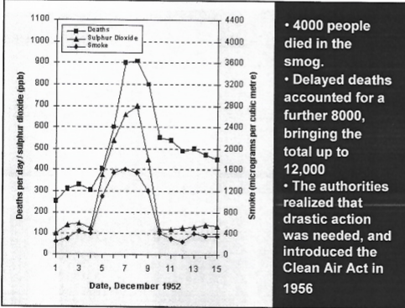

Slide 36
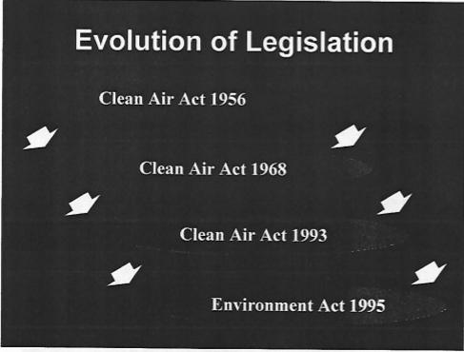

Slide 37
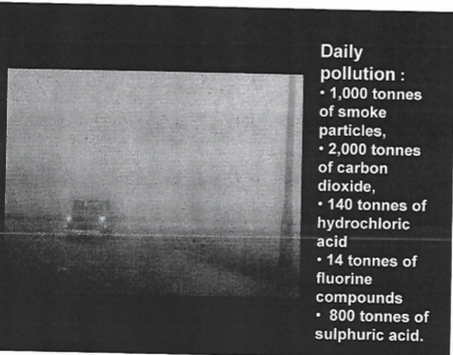

Slide 38
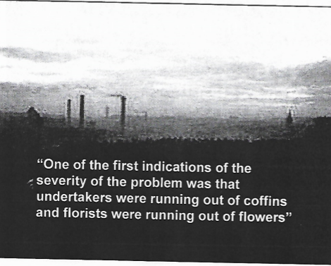

Slide 39
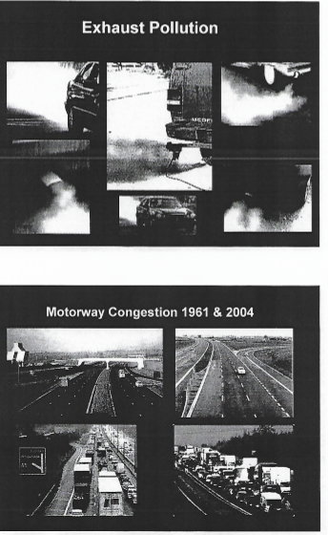

Slide 40
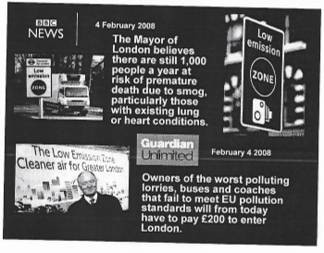

Slide 41
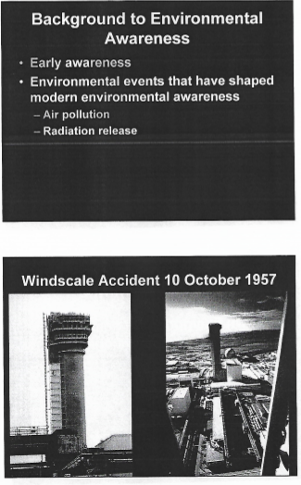

Slide 42
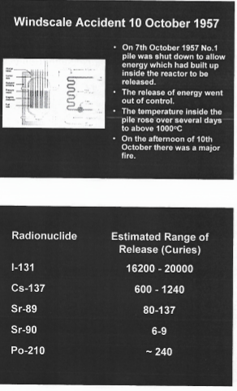

Slide 43
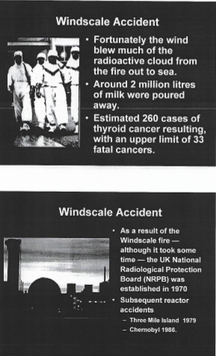

Slide 44
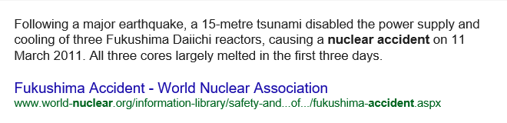

Slide 45
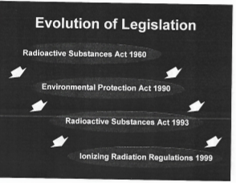

Slide 46
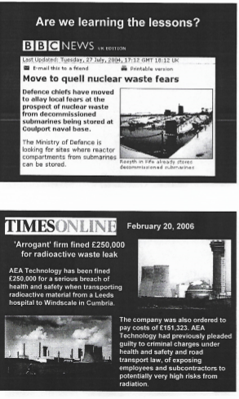

Slide 47
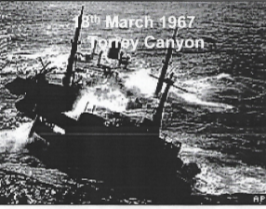

Slide 48
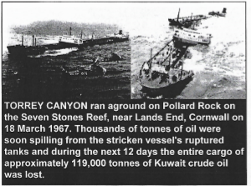

Slide 49
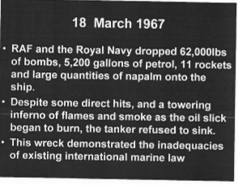

Slide 50
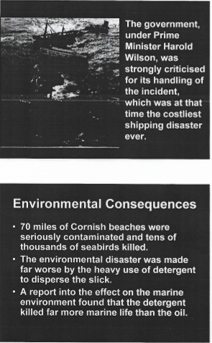

Slide 51
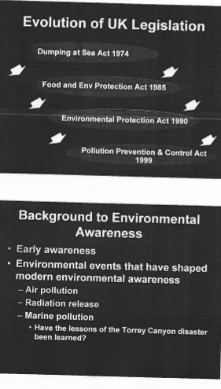

Slide 52


Slide 53


Slide 54


Slide 55


Slide 56


Slide 57


Slide 58


Slide 59


Slide 60


Slide 61


Slide 62


Slide 63


Slide 64


Slide 65


Slide 66


Slide 67


Slide 68


Slide 69


Slide 70


Slide 71


Slide 72


Slide 73


Slide 74

QUESTIONS

