Slide 1


Sesiwn 1
Cyflwyno Aseiniad & CBT
ECES6020C
Gwaith Therapiwtig Gydag Unigolion
Therapeutic Work With Individuals

Slide 2
Nodau ac amcanion​
Aims and objectives​
Nodau
Aims​
  Introduction to assignment​
  Explore therapeutic approaches​
  Consider personal and professional qualities to facilitate therapeutic work.​
​
Objectives​
  Gain an insight to therapeutic interventions​
  Identify personal and professional qualities required to facilitate.
  Cyflwyno'r Asesiad​
  Archwilio Dulliau Therapiwtig​
  Meddwl am rhinweddau personol a therapiwtig i hwyluso’r gwaith.
Amcanion
  Dangos dealltwriaeth o ddulliau therapiwtig.
  Adnabod rhinweddau proffesiynol a phersonol sydd angen i hyrwyddo therapiau.

Slide 3
Asesiad: Traethawd​ (4000 o eiriau)
Assignment: Essay (4000 words)​
​
Trafodwch yn feirniadol effaith mae profedigaeth, trawma a chamdrin yn cael ar iechyd a datblygiad unigolyn dros ei hoes. Dadansoddwch yn feirniadol y cymorth a’r rhaglenni ymyrraeth sydd ar gael i blant ac awgrymwch pa ymyrraeth sydd fwyaf addas
Dyddiad Cyflwyno : 31/03/25
Dyddiad adborth : 13/05/25
Critically discuss the impact that bereavement, trauma, or abuse has on a child’s health and development across the lifespan. Critically analyse the support and invention(s) available for the child and suggest which intervention (s) would be most appropriate.​
Submission date: 31/03/25​
Feedback date: 13/05/2025​

Slide 4
Asesiad: Traethawd​ (4000 o eiriau)
Assignment: Essay (4000 words)​
​
Mae angen dewis un o’r canlynol ar gyfer eich aseiniad.
Profedigaeth
Trawma
Cam-drin
Trafodwch yn feriniadol yr effaith mae hyn yn ei chael ar iechyd a datblygiad unigolyn dros ei fywyd cyfan.
For the essay you are required to choose one of the following:
Bereavement
Trauma
Abuse
And critically discuss the impact this has on an individual’s health and development across the lifespan.

Slide 5
Aseiniad
Assignment​
  Yn yr aseiniad yma mae angen i chi ddadansoddi’n feirniadol y gefnogaeth a’r ymyrraeth sydd ar gael i blant/ unigolion ac awgrymu pa ymyrraeth sydd yn berthnasol.
  Mae rhaid i’ch dewis cael ei gefnogi gan lenyddiaeth gyfredol, mae angen ysgrifennu’n feirniadol trwy gydol yr aseiniad.
  In the essay you are required to critically analyse the support and interventions available for the child/individual and suggests which intervention(s) would be most appropriate.​
  Your choice should be supported by current literature and you should write critically throughout. ​

Slide 6
Aseiniad
Assignment​
Pethau i ystyried:
  Sut mae nail ai profedigaeth, trawma, neu gam-drin, yn effeithio ar iechyd a datblygiad, yn syth ac yn hwyrach yn eu bywydau.
  Pa fath o gefnogaeth/ ymyrraeth sydd ar gael ar unwaith.
  Beth gall ddigwydd os nad ydy plentyn yn derbyn cefnogaeth.
  Mae angen ystyried pryd bydd unigolion angen cefnogaeth/ ymyrraeth yn ei bywydau.
​Things to think about: ​
  How either bereavement, trauma or abuse impacts on health and development immediately and later on in life. ​
  What support/interventions are available for the child immediately​
  What may happen if child does not receive required support​
  You should also consider when in life the individual may need the support/intervention

Slide 7
Pa ddulliau therapiwtig sydd ar gael i blant a phobl ifanc ? / Which types of therapeutic approaches for children and young people do you know?​

Slide 8
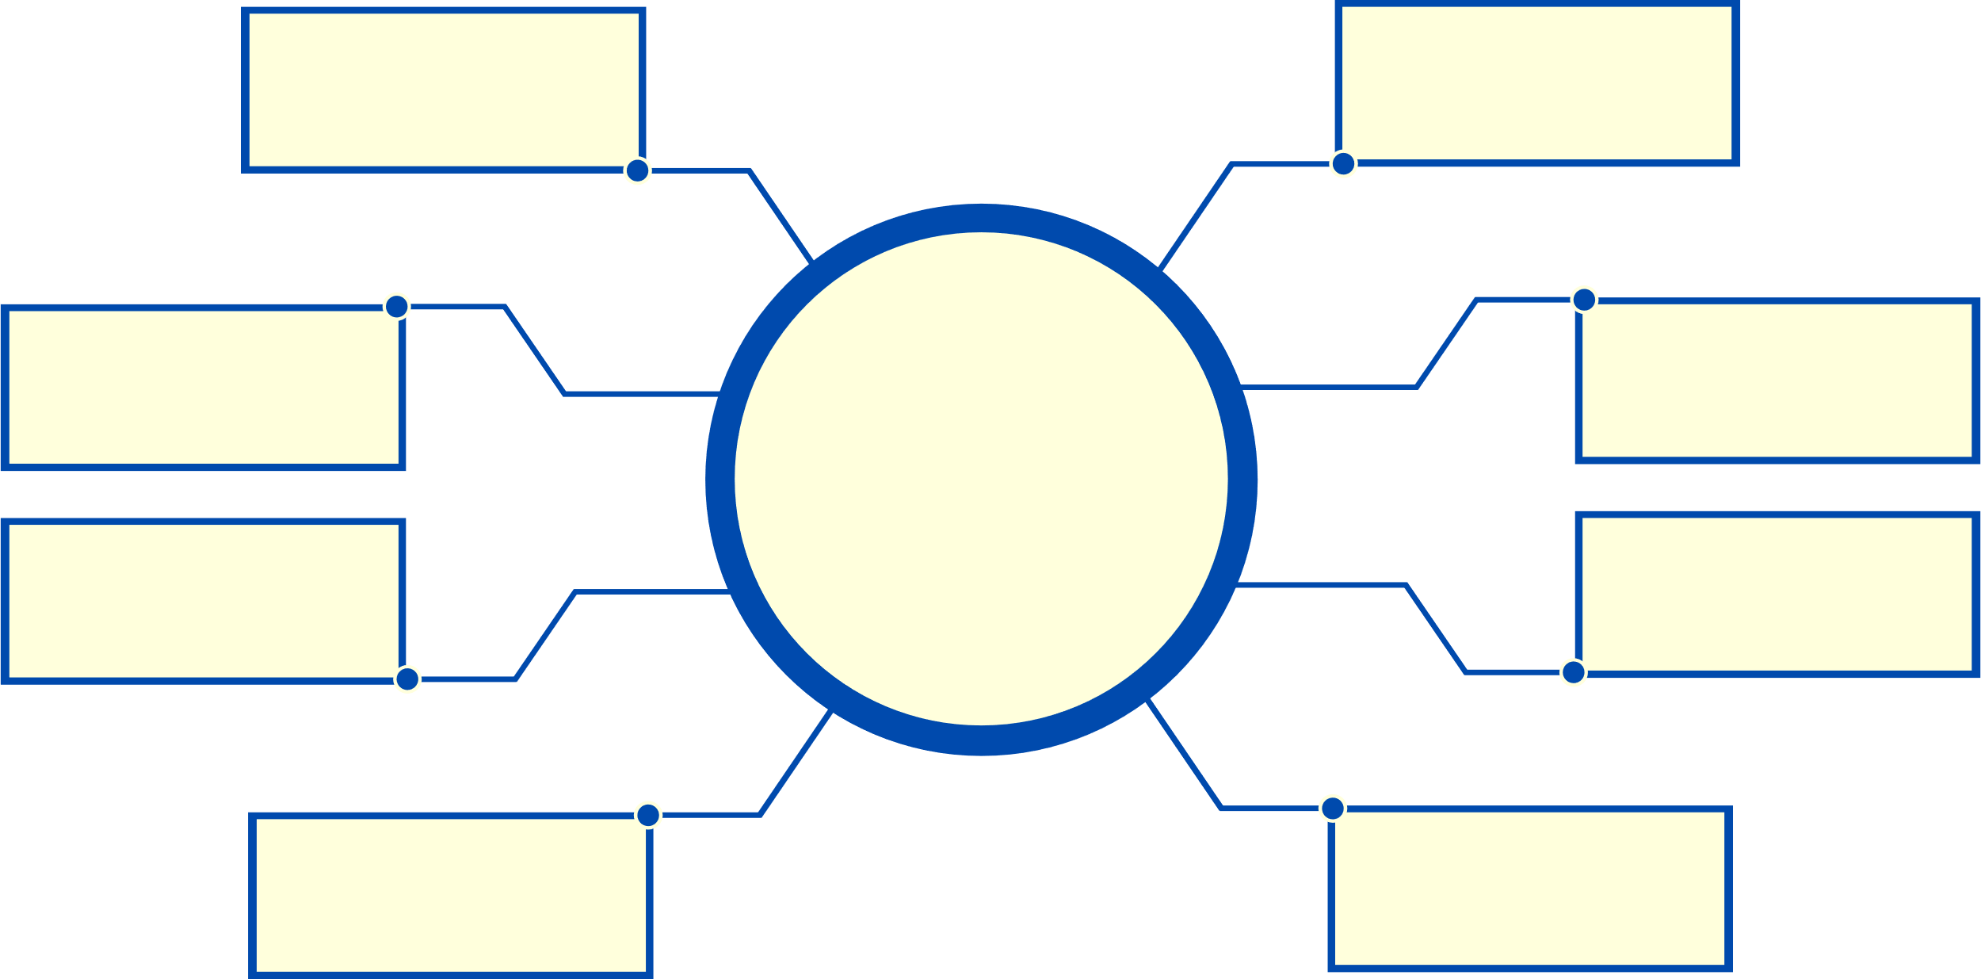
Grwpiau anogaeth
Therapi ymddygiad gwybyddol.
Therapi Chwarae
SEAL / ELSA
Dulliau Therapiwtig
Therapi Celf
Therapi Lego
Ysgolion Gwybodus am : Trawma a lles meddyliol
Therapi Teuluol

Slide 9
Cognitive-behavioural therapy (CBT)​
Nurture groups​
Play therapy​
SEAL / ELSA
Some Therapeutic Approaches​
Art therapy​
Lego Therapy
Trauma and Mental Health- Informed Schools​
Family Therapy

Slide 10


Problemau emosiynol
Problemau seicolegol
Dulliau therapiwtig sy’n cefnogi
Problemau ymddygiadol
Problemau iechyd a iechyd meddyliol
Pryderon rhyngbersonol a chymedithasol

Slide 11
Emotional problems​
A group of therapeutic approaches can support
Psychological problems
Behaviour problems​
Health and mental health problems​
Interpersonal and social concerns

Slide 12
Hanes therapi ymddygiad gwybyddol
Cognitive Behaviour Therapy​ (CBT)​ History
Mae ymyrraeth gynnar y therapiau yma yn deillio yn ôl i B.F. Skinner, datblygodd cyflyru gweithredydd , yn esbonio sut mae unigolion yn dysgu ymddygiadau yn seiliedig ar wobrwyon a chanlyniadau.
Mae’r therapi yma yn adeiladu ar hyn a’r nod yw newid ymddygiadau trwy ail-lunio sut mae unigolyn yn meddwl, helpu nhw datblygu patrymau meddwl iachach.
Some early interventions in CBT trace back to B.F. Skinner, who developed operant conditioning, explaining how individuals learn behaviors based on rewards and consequences.
CBT builds on this by aiming to change behaviors by reshaping how a person thinks, helping them develop healthier thought patterns

Slide 13
Hanes therapi ymddygiad gwybyddol
Cognitive Behaviour Therapy​ (CBT)​ History
Chwaraeodd Albert Ellis ac Aaron Beck rhan allweddol yn y dull yma:
•Datblygodd Ellis therapi ymddygiad emosiynol rhesymegol, trwy ffocysu ar adnabod a herio credoau afresymol.
•Cyflwynodd Beck therapi gwybyddol, helpu unigolion adnabod ac ail-werthuso meddyliau negyddol
Therapi gwrando ( gwrando gweithredol a myfyrio) yn cael ei ddefnyddio yn gyson yn y therapi i gefnogi unigolion sylweddoli ac addasu patrymau meddwl negyddol.
Albert Ellis and Aaron Beck played key roles in this approach:
• Ellis developed Rational Emotive Behavior Therapy (REBT), focusing on identifying and challenging irrational beliefs.
• Beck introduced Cognitive Therapy, helping clients recognize and reframe negative thoughts.
Listening therapy (active listening and reflection) is often used in CBT to support clients in recognizing and modifying unhelpful thought patterns.

Slide 14
MANTEISION THERAPI YMDDYGIAD GWYBYDDOL / BENEFITS OF COGNITIVE BEHAVIOUR THERAPY
FFEITHIAU CBT YN NGHYMRU 2022 - 2023
Most common therapy, making up 41.3% of all therapy courses used in Wales
  Gwella dulliau ymdopi gyda stress a galar./ Improving coping mechanisms for stress and grief.
  Dysgu sut i adbabod a herio patrymau meddwl negyddol. / Learning to identify and challenge negative thought patterns.
  Cynyddu hunan-barch, datblygu ymddygiadau iachus / Enhancing self-esteem, developing healthier behaviours.
  Rheoli iechyd corfforol fel insomnia a phoen, a hybu gwydnwch. / Managing physical health issues like insomnia and chronic pain and promoting resilience.
41.3%
56%
All-Wales Online CBT has a recovery rate of 56%
43% of CBT patients reported at least a 50% reduction in depression symptoms over 46 month
43%

Slide 15
Counselling Skills activity​
 | Sefyllfa / Situation | Meddwl / Thought | Teimladau / Feelings | Ymddygiad / Behaviour
Heb CBT / Without CBT | Rydych yn derbyn gradd lai na ddisgwylir ar aseiniad / You get a lower grade than expected on an assignment | “Rwy’n ofnadwy yn y pwnc yma” / “I’m terrible at this subject” | Rhwystredig, digalon, trist / Frustrated, Discouraged and Upset | Ddim yn trial yn y gwersi. / Stop trying as hard in class
Gyda CBT / With CBT | Rydych yn derbyn gradd lai na disgwylir ar aseiniad / You get a lower grade than expected on an assignment | “Rwy’n gallu dysgu a gwella o’r profiad” / “I can learn from this and improve” | Penderfynnol / Determined | Gofyn am adborth ac adolygu gwahanol ar gyfer tro nesaf / Ask for feedback and study differently next time

Slide 16
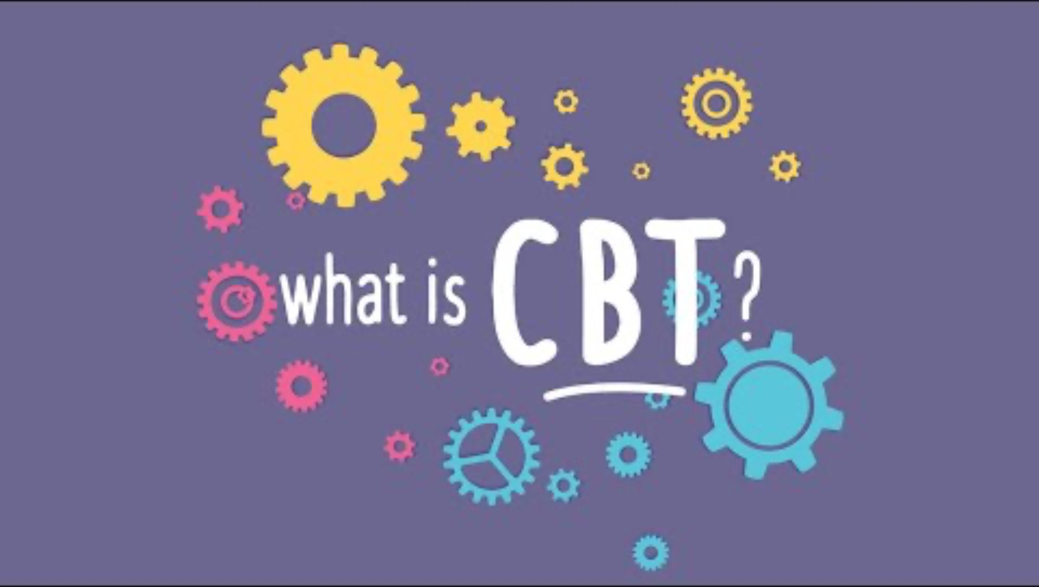
Cognitive-behaviour therapy (CBT)
https://www.youtube.com/watch?v=bMI0riMVhJg

Slide 17
Rhinweddau proffesiynol i hwyluso gwaith therapiwtig. / Professional qualities to facilitate therapeutic work​
Adnabod pa rinweddau proffesiynol sydd angen i fod yn llwyddiannus wrth weithredu therapi. / ​Identify what professional qualities are required to be successful at therapeutic work

Slide 18
Rhinweddau proffesiynol
Professional qualities
• Counselling Training - A background in mental health and formal training in counselling techniques.
• Therapeutic Expertise - In-depth training in therapy, often requiring years of study and practice.
• Self-Awareness - An understanding of personal triggers and emotional responses to maintain professional boundaries.
• Goal-Oriented Approach - The ability to help clients identify and work towards meaningful improvements.
• Hyfforddiant cwnsela - Cefndir mewn iechyd meddyliol a hyfforddiant mewn technegau cwnsela.
• Arbenigedd-Therapwitig - Hyfforddiant trylwyr, fel arfer yn cymryd blynyddoedd o astudiaethau ac ymarfer.
•Hunan ymwybyddiaeth - Dealltwriaeth o beth sy’n pryderu ac ymatebion emosiynol i gynnal ffiniau proffesiynol.
• Dull sy’n canolbwyntio ar nodau - Y gallu i helpu unigolion adnabod a gweithio tuag at welliannau ystyrlon.

Slide 19
Rhinweddau proffesiynol
Professional qualities
•Barn gadarnhaol - Adnabod bod hyfforddiant yn darparu sylfaen, ond mae meddwl yn feirniadol a phrofiad yn chwarae rol allweddol.
•Ymrwymiad i ddatblygiad personol - ymgysylltu gyda gweithdai, cynadleddau a dysgu parhaus i wella sgiliau.
• Cymhwysedd Diwylliannol - Y gallu i weithio’n effeithiol gydag unigolion o wahanol gefndiroedd a pharchu gwahanol werthoedd a safbwyntiau.
• Sound Judgement - Recognising that training provides a foundation, but critical thinking and experience play a key role.
• Commitment to Personal Development - Engaging in workshops, conferences, and continuous learning to refine skills.
• Cultural Competence - The ability to work effectively with individuals from diverse backgrounds, respecting different values and perspectives.

Slide 20
Rhinweddau personol / Personal qualities​
Pa rinweddau personol sydd angen i fod yn therapydd da. / What personal qualities do you think a person needs to be a therapist?

Slide 21
Rhinweddau Personol
Personal qualities​
•Empathi - Cefnogi a chredu mewn pobl, hyd yn oed pan nad ydych yn cytuno gyda’i safbwynt.
• Gwrando gweithredol - gwrando yn astud nid yn unig ar beth sy’n cael ei ddweud ond hefyd beth sydd ddim trwy ddefnyddio sgiliau arsylwadol
•Sgiliau cyfathrebu a chymdeithasol - creu amgylcheddau diogel, cyfforddus ble mae unigolion yn teimlo’n gyfforddus i rannu teimladau.
•Gosod ffiniau - Cynnal ffiniau proffesiynol a moesegol, rydych yn therapydd, nid ffrind.
• Empathy – Supporting and believing in people, even when you don’t personally agree with their perspective.
• Active Listening – Paying attention not only to what is said but also to what is left unsaid, using strong observational skills.
• Social & Communication Skills – Creating a safe, comfortable environment where clients feel at ease and able to open up.
• Boundary Setting – Maintaining professional and ethical boundaries; you are a therapist, not a friend.

Slide 22
Rhinweddau Personol
Personal qualities​
• Critical Thinking – Assessing client needs to develop appropriate treatment plans rather than making assumptions.
• Business Management – Running a professional and reliable practice, ensuring both sustainability and ethical responsibility.
• Neutral Guidance – Providing structured treatment plans rather than personal opinions or unsolicited advice.
•Meddwl yn feirniadol - Asesu unigolion sydd angen datblygu cynlluniau triniaeth perthnasol yn lle creu tybiaethau.
Rheolaeth busnes - Rhedeg arfer profesiynol a dibynadwy, trwy gadarnhau cyfrifoldebau moesegol a chynaladwyedd.
•Arweiniad Niwtral - Darparu triniaeth strwythuredig, yn lle barn personol neu gyngor digymell.

Slide 23
Anawsterau gall therapydd wynebu? / What difficulties might a therapist encounter?

Slide 24
Anawsterau gall therapydd wynebu?
Difficulties a therapist may encounter​;
  Gofynion emosiynol - Cefnogi unigolion yn gyson trwy feddyliau trallodus yn gallu fod yn flinedig yn feddyliol ac yn emosiynol.
  Rhwystredig gydag unigolion yn gwrthod - Mae’n gallu bod yn digalonnus pryd mae unigolion yn gwrthod newidiadau neu yn cael trafferth i ymrwymo i’r therapi
  Teimlo’n llethol - Rheoli nifer o unigolion gyda gofynion cymhleth yn gallu bod yn flinedig yn arwain at ‘burnout’.
  Emotional Demands – Constantly supporting clients through distressing thoughts can be mentally and emotionally exhausting.
  Frustration with Resistance – It can be discouraging when clients resist change or struggle to engage in therapy.
  Feeling Overwhelmed – Managing multiple clients with complex needs can be mentally draining and lead to burnout.

Slide 25
Anawsterau gall therapydd wynebu?
Difficulties a therapist may encounter​
  Pwysau i fod yn effeithiol - Mae therapydd yn teimlo’n gyfrifol am gynnydd unigolion ac yn gofidio os nad ydynt yn cael effaith arnynt.
  Cydbwysedd rhwng empathi a ffiniau - I gael cydbwysedd clir wrth ddangos empathi a deall y sefyllfa ac aros yn broffesiynol a chadw pellter yn gallu bod yn anodd.
  Pressure to Be Effective – Therapists may feel responsible for their clients’ progress and worry about whether they’re making a real impact.
  Balancing Empathy and Boundaries – Staying compassionate while maintaining professional detachment can be challenging.

Slide 26
Sesiwn Nesaf / Next session
(Bore fory / tomorrow morning)​
Trawma Plentyndod
Childhood trauma​
​
Asynchronous session​
Trauma –informed practices​
https://wakelet.com/wake/E3QsdUmxoI0mP5b9OcM2C

Slide 27
Reference list​
Ackerman, C. (2019). Child Therapy: 19 Counseling Techniques & Worksheets for Kids [+PDF]. [online] PositivePsychology.com. Available at: https://positivepsychology.com/child-therapy/.
Anwar, B. (2023). 11 Challenges That Counselors & Therapists Face. [online] Talkspace. Available at: https://www.talkspace.com/blog/counselor-challenges/.
BACP (2018). Careers in counselling and psychotherapy. [online] Bacp.co.uk. Available at: https://www.bacp.co.uk/careers/careers-in-counselling/.
Macdonald, G., Livingstone, N., Hanratty, J., McCartan, C., Cotmore, R., Cary, M., Glaser, D., Byford, S., Welton, N.J., Bosqui, T., Bowes, L., Audrey, S., Mezey, G., Fisher, H.L., Riches, W. and Churchill, R. (2016). Types of Interventions. [online] Nih.gov. Available at: https://www.ncbi.nlm.nih.gov/books/NBK385382/.
Mind (2024). Cognitive Behavioural Therapy (CBT). [online] www.mind.org.uk. Available at: https://www.mind.org.uk/information-support/drugs-and-treatments/talking-therapy-and-counselling/cognitive-behavioural-therapy-cbt/.
NHS (2022). Cognitive Behavioural Therapy (CBT). [online] NHS. Available at: https://www.nhs.uk/mental-health/talking-therapies-medicine-treatments/talking-therapies-and-counselling/cognitive-behavioural-therapy-cbt/overview/.
NHS (2024). Additional analysis of therapy-based outcomes in IAPT services. [online] NHS Digital. Available at: https://digital.nhs.uk/data-and-information/publications/statistical/nhs-talking-therapies-for-anxiety-and-depression-annual-reports/2022-23/therapy-based-outcomes.
https://pthb.nhs.wales/services/adult-and-older-peoples-mental-health-services/silvercloud-online-mental-health-support/silvercloud-documents/all-wales-online-cbt-service-evaluation-report/

