Slide 1
Library & Online Library

Slide 2
The Library and Learning Resources service provides a high quality learning resources.
Library 1st Floor Business Campus
Library SA1 Building
Online Library which can be accessed from any computer

Slide 3
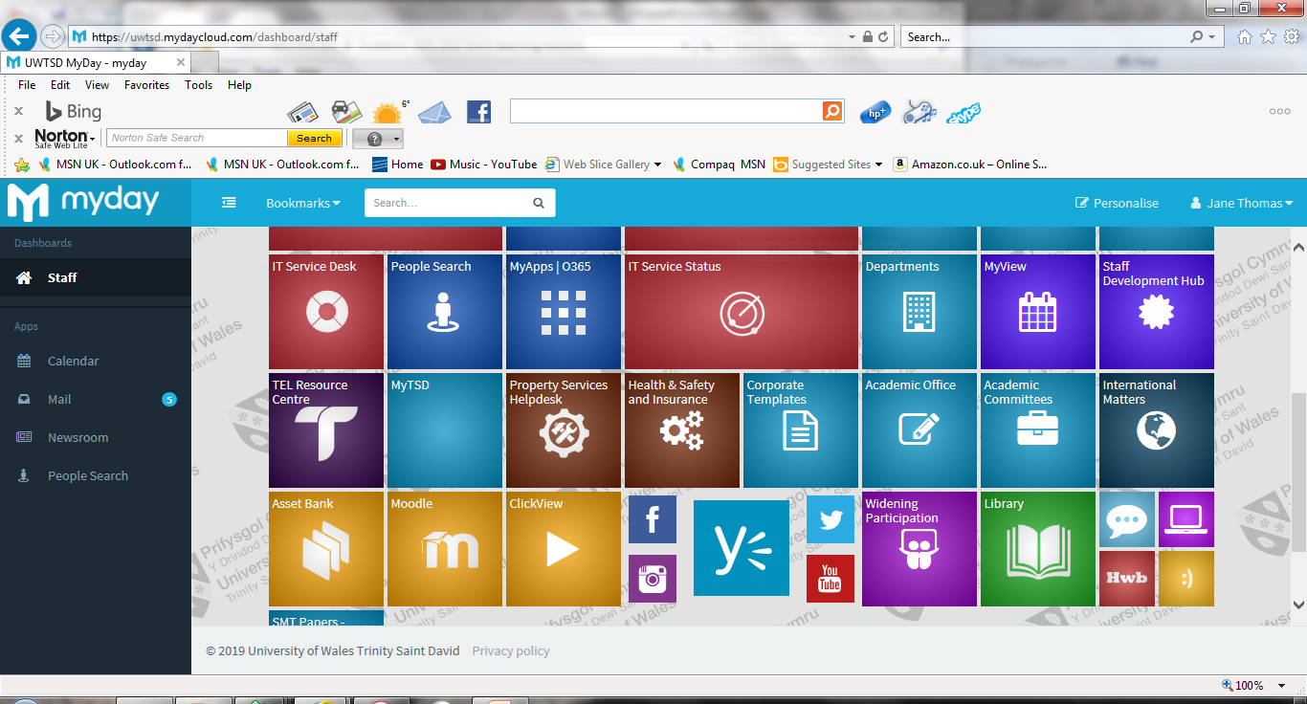

Slide 4

Navigating the library website
Catalogue
Online library
Access your account
Contact information
Opening hours
Library guide
Services
Report a problem
http://uwtsd.ac.uk/library/

Slide 5

The Online Library includes…
Library catalogue
Specialist databases
E-Books
Full-text Journals
Full-text newspapers
And much more…!

Slide 6

But did you know you can also…
Build a personalised e-shelf
Receive publication alerts
Save favourite resources
Access your search history
View citation help
Access resources from your mobile device

Slide 7




The benefits of your UWTSD Online Library…
Notes:
Not physical books
Round the clock availability - can gain access 24/7 to the information.
Multiple access. ...
Information retrieval. ...
Preservation and conservation. ...
Space. ...
Added value. ...
Easily accessible.

Slide 8
Different types of Information
JOURNALS
TECHNICAL PAPERS
COMPANY REPORTS
STANDARDS
BOOKS
LEGISLATION
CONFERENCE PROCEEDINGS
NEWSPAPERS
INDUSTRY REPORTS
STATISTICS
Video – What is a journal?

Slide 9

Evaluating Information
Currency (Is it up-to-date?)
Relevance (Who is the intended audience?)
Authority (What are the author’s credentials?)
Accuracy (Can the information be verified?)
Purpose (Is the information objective/impartial?)
https://youtu.be/N58OZjdoO34

Slide 10

Finding and accessing E-books
Many core texts are available as e-books
24/7 multiple user access
View in browser or download
Contents search by keyword
Locate them via the catalogue…
…or via online library/e-books/search
http://www.uwtsd.ac.uk/library/online-library/e-books/

Slide 11

Need More?
Can’t find what you need
Need advice
Book an appointment
Request a resource
Report a fault
Borrowing schemes
http://www.uwtsd.ac.uk/library/library-guide/need-more/

Slide 12
Now it’s your turn!
Go to the library catalogue here: http://librarycatalogue.uwtsd.ac.uk
Sign in using your UWTSD login & password
Search for the following book titles
Pears, R. and Shields, G. (2016) Cite them right: the essential referencing guide. 10th edn. London: Palgrave Macmillan.
Cottrell, S. (2013) The study skills handbook. 4th edn. Basingstoke: Palgrave Macmillan.
Make a note of their shelf number and location.
Save them to your e-shelf

Slide 13


