Slide 1

Welcome
Croeso

Slide 2
Activity
Who can remember what we did last time…?

Slide 3
Learning Plan day 1
Introduction to the Professional Practice Framework
Introduction to the module (Description, specific and generic marking criteria)
CV
Job description
SWOT
Learning styles
  Honey and Mumford
  Vark
Library, Student Services
Moodle
Training needs analysis
Referencing
Study skills

Slide 4
Agenda
CV and JD progress report (You)
Personal Development Plan
Develop your TNA (If not already done)
Develop your PDP
Start writing and structure for your reflective essay
Action plan
Reminder of dates

Slide 5

CV and JD – progress?

Slide 6
Personal Development Plan

Slide 7
The benefits of Personal Development Plans
They provide a structured approach to identifying and planning training and development
They can be used as a tool to measure individual progress and development
They can provide evidence of training planned and completed, e.g. for CPD
They aid planning and organisation of work
They clarify training and development objectives
They set timescales for development
-

Slide 8
Key questions
Where am I now?
Where do I want to be?
How am I going to get there?

Slide 9
What should be in a personal development plan?
Training and development needs
Learning objectives
Learning methods
People involved – e/g manager,coach
Timing
Review methods and dates

Slide 10
Organisational factors in personal development planning
Organisation training policy – what’s allowable?
Budgets – what’s affordable?
Corporate priorities – what’s most important?
Releasability – can you be spared?
Timescales – is the timing good?
Location – where will it happen?
Equality of opportunity

Slide 11
Personal factors in PDP
Personal circumstances
Time commitment
Learning styles
Resources
Study skills

Slide 12
Training Needs Analysis

Slide 13
Activity
Take 20 minutes to look at
  Your TNA or your PDP
Start developing them…

Slide 14

An Introduction to Critical Reflection…
Notes:
DEFINE IT CLASS?
Let me disabuse you of something at the outset reflection is not sitting on the edge of a beach & dreaming.
M&S Galaxy milk chocolate
Impacts upon every aspect of modern working
Engages with our need to make sense of the world in which we work
Engages with the two uppermost needs in Maslow’s
As such it impacts on most aspects of our professional and organisational lives
Widely used in professions – so much so that some practitioners abuse it (junior doctor – the dark side) me included – BUT it gives us an insight into our organisations as well as us personally
My purpose is to introduce the concept of critical thinking & to outline some of the available tools to enable you to include original and critical thinking into your course work. So, the key prefix for us at the outset is…
14

Slide 15
Aim:
Discuss the concept of reflection as a learning strategy
Objectives:
Discuss:
  The concept and purposes of reflection;
  Models of reflection;
  Levels of reflection.
Notes:
15

Slide 16

Q – What is self-reflection?
A – Self reflection involves reviewing teaching and learning.
‘Looking at ourselves and our work with a critical eye and responding to what we see in a positive and professional way.’ (Tolley et.al.1996)
Notes:
16

Slide 17
Q – What is reflective writing?
Reflective writing is evidence of reflective thinking. It may involve:
Looking back at something (often an event but it could also be an idea or object.
Analysing the event or ideas (thinking in depth from different perspectives, and trying to explain, often with reference to a model or theory)
Thinking carefully about what the event or idea means for you and your ongoing progress as a learner and/or practising professional.
Notes:
17

Slide 18
Some theorists...
Gibbs
Dewey
Kolb
Boud
Schon
Reynolds
Mezirow
Woerkom
Notes:
R
Dewey – past experience and relevant knowledge are applied to resolve uncertain situations
Kolb -
Boud - Attending to feelings
Schon - Reflection in action and reflection on action
Reynolds - Woerkom -
Mezirow - A commitment to questioning the taken for granted assumptions
18

Slide 19

Definitions
Dewey (1933)
An active persistent and careful consideration of any belief or supposed form of knowledge in the light of the grounds that support it and the further conclusion to which it tends.
Dewey, J., How we think, Chicago 9:Henrey Regney, 1933.
Notes:
19

Slide 20
Definitions
Boud et al (1985) take a different perspective and define it as:
A generic term for those intellectual and effective activities in which individuals engage to explore their experiences in order to lead a new understanding and appreciation.
Boud D., Keough, R., Reflection: Turning Experience into Learning, London: Kogan Page, 1985.
Notes:
20

Slide 21
Definitions
Schön (1987) in his work identifies two types of reflection, these are reflection-in-action (thinking on your feet) and reflection-on-action (retrospective thinking). He suggests that reflection is used by practitioners when they encounter situations that are unique, and when individuals may not be able to apply theories or techniques previously learnt through formal education.
Schön, D., Educating the reflective Practitioner, San Francisco: Josey Bass, 1987.
Notes:
21

Slide 22
Definitions
Reid (1993) in her definition also noted reflection as an active process rather than passive thinking. She states: ‘Reflection is a process of reviewing an experience of practice in order to describe, analyse, evaluate and so inform learning about practice’.
Reid, B., “But we’re doing it already” Exploring a response to the concept of reflective practice in order to improve its facilitation. Nurse Ed Today 13:305-309, 1993.
Notes:
22

Slide 23
Models of Reflection
Peters (1991) describes a four-step
protocol called “DATA”
(Describe, Analyse, Theorise, Act)
Describe – the basic elements of the problem, task or situation;
Analyse – identify assumption, beliefs, rules, motives and any other factors underlying the current approach;
Theorize – what alternatives are possible? Comparative merits and drawbacks?
Act – try out a new approach, evaluate the results.
Peters, J., “Strategies for Reflective Practice.” In Professional Development for Educators of Adult and Continuing Education. No.51, edited by R. Brockett. San Francisco: Jossey-Bass, Fall 1991.
Notes:
23

Slide 24
Gibbs’ Model of Reflection (1988)
Description
(What happened?)
Feelings
(What were you thinking & feeling)
Action Plan
(What will happen next time?)
Conclusions
(What else could you have done?)
Evaluation
(What was good & bad about the experience?)
Analysis
(What sense can you make of what happened?)
Notes:
All models share similar elements – eg Kolb – Lewin cycle in which we have four steps
CONCRETE EXPERIENCE / REFLECTIVE OBSERVATION / ABSTRACT CONCEPTUALISING / ACTIVE EXPERIMENTATION
Much of the literature on reflection refers to situations that learners had issues with, what Dewey called ‘ a state of perplexity, hesitation, doubt ‘
What I have referred to in the past as ‘crucible moments’.
So we move on to critical reflection:
EXAMPLE BAGLAN:
Class to consider inspector’s perspective, sergeant’s perspective, constables’ perspective, family’s perspective.

Slide 25
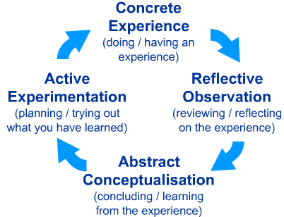
Kolb’s Learning Cycle (1984)

Slide 26
The What? Model of Structured Reflection
The model (Driscoll 1994, 2000), contains three elements of reflection:
What? A description of the event
So What? An analysis of the event
Now What? Proposed actions following the event
Driscoll, J., Practising clinical supervision. Edinburgh: Balliere Tindall, 2000.

Slide 27
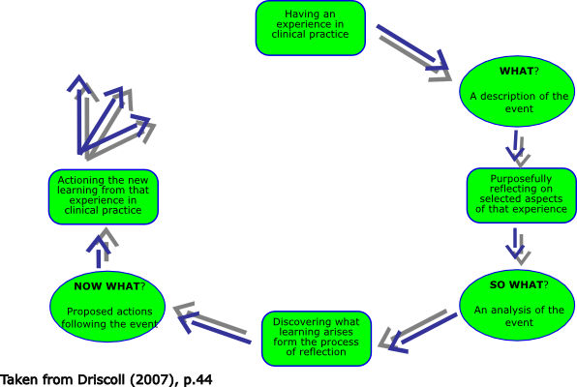

Slide 28
Levels of Reflection:
Descriptive
Descriptive with some reflection/evaluation
Catalogue reflection with some practical evidence/examples
Critical reflection with recommendations and practical and literary evidence

Slide 29
Focus on Learning
S Set learning objectives – what would you like to get out of this?
H How did it go? What went well and why?
A Address concerns what went wrong & why?
R Review learning points – was S achieved above?
P Plan ahead – how can we improve in future?
  From Imperial London deanery – review in a medical setting saved to diamond stick

Slide 30
Critical (Reflective) Writing
What argument am I making?
Are my claims supported by evidence?
How credible and appropriate is my evidence?
Are my conclusions logical and reasonable?
Have I clarified expressions, claims and meanings of key terms and concepts?
Have I considered alternative arguments?

Slide 31
Characteristics of critical reflection
Selection: of an appropriate experience etc.
Changing perspective: analysed from a different point of view or level of detail
Returning to experience: as best fits the issue
Analysis of own role: look at reasons for and consequences of your actions
Drawing on received wisdom: make use of theory, research, best practice
Deepening your understanding: look actively for meaning by recognising what is significant
Using insight to effect change: ideally to the benefit of others and yourself

Slide 32
Reflecting on non routine actions
What is the usual course of action in these circumstances?
What is the rationale for doing things that way?
What was different on this occasion such that these guidelines were inappropriate?
What might have been the impact of such a change?
Which aspects could/should still have been followed?
Why was it essential to do so?
Which aspects could be over-ruled or adapted?
What could have happened – what were the risks & to whom?
What were the immediate effects & consequences?
What if anything would you do differently next time?

Slide 33
Knowing your Audience
(1st and 2nd Markers /External Examiner)
Attitudes – fair (concerned only with the argument)
Sceptical but empathetic
Knowledge of the field – variable, that’s why they …
Like - logic, referencing, evidence that you’ve met the criteria
Signposting – the bits fit together
Pet hates – waffle, insufficient justifications, avoidable errors, generalisations, plagiarism
A belief that – everything should be relevant, conclusions must be warranted
Notes:
As a student you need to know something about us when planning your writing – here’s a summary

Slide 34
Richard Boyatzis Theory of Self Directed Learning
1. My Ideal Self
Who do I want to be?
4. Experimenting
New behaviours & thoughts
5. Trusting relationships
Building networks
2. My Real Self
Who am I?
3. My Learning Agenda
Building on my strengths & reducing my gaps
My Strengths
Where my ideal & real selves overlap
My Gaps
Where my real and ideal selves differ
Notes:
How can I focus on what needs to be done amidst all this complexity?
34

Slide 35
Structure / questions for the essay
Introduction
Using the Learning Plan module as the platform for the qualification in Professional Practice, I intend to use this Reflective Review to explore….
  What am I aiming to achieve from completing the Professional Practice qualification? (My motivation)
  How have I arrived at this point in my own personal development? (My journey so far)
  Where am I coming from in terms of my own personal type and preferences? (My own personal type, style and preferences)
  What development do I need for my current role? (Current skills gap)
  Where do I want to go & what development do I need to get there? (My future development)
  How I intend to get there? (Covered in your PDP)

Slide 36
Activity
Start writing your reflective essay
45 minutes

Slide 37
Agenda
CV and JD progress report (You)
Personal Development Plan
Develop your TNA
Develop your PDP
Structure for your reflective essay

Slide 38
Action Plan
Annotated CV
Annotated JD
Training needs analysis
Reflection
  Read out aloud
  Spell-check
  References – check
  Learning styles
Personal Development Plan

Slide 39
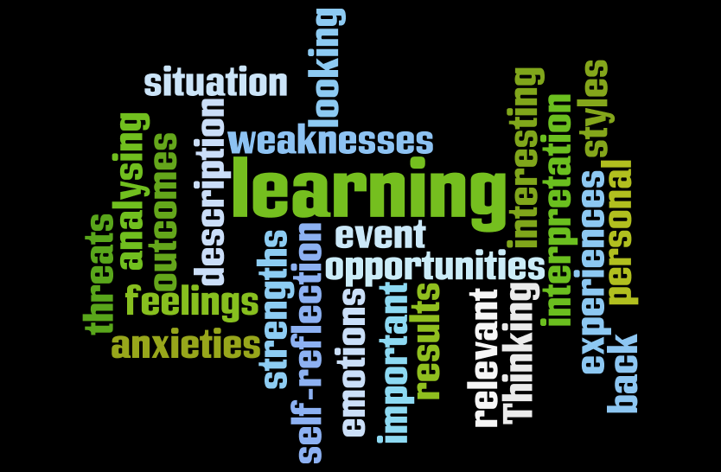
Notes:
In summary
1. Reflection is an exploration and an explanation of events – not just a description
2. Reflective writing often involves ‘revealing’ anxieties, errors and weaknesses, as well as strengths and successes. This is fine as long as you show some understanding of possible causes, and explain how you plan to improve.
3. When reflecting on an event or an idea - select just the most significant parts. If you try to tell ‘the whole story’ you will use exceed your number of words allocation.

