Slide 1


Market Research and Validation for Business Development
Learn essential skills for conducting market research and validating business ideas. Understand primary and secondary research, data gathering techniques, and market trend analysis.

Slide 2
Primary vs. Secondary Market Research
Primary Research
Secondary Research
Data collected directly from the source. Includes surveys, interviews, and focus groups. Customizable but time-consuming.
Pre-existing data from published sources. Includes industry reports and academic studies. Cost-effective but may lack specificity.

Slide 3

Surveys as a Research Tool
1
Purpose
2
Techniques
Collect data from a large sample of potential customers or target audiences.
Use online platforms like Google Forms or SurveyMonkey for quick distribution.
3
Applications
Gather preferences, understand purchase behavior, and measure brand awareness.

Slide 4

Conducting Effective Interviews
1
Purpose
Collect in-depth, qualitative data through open-ended questions in one-on-one or small group settings.
2
Technique
Use semi-structured interviews to allow flexibility while staying focused on key insights.
3
Applications
Understand motivations, explore customer pain points, and obtain detailed feedback on prototypes.

Slide 5

Utilizing Industry Reports
Purpose
Sources
Access extensive data about industry trends, competitive landscapes, and demographics.
Use platforms like IBISWorld, Statista, and government data sources for comprehensive information.
Applications
Validate assumptions about market size, identify trends, and understand customer segments.

Slide 6




Analyzing Market Trends
Identify Industry Trends
Customer Trends
Emerging Trends
Focus on shifting customer preferences, purchasing behavior, and technology adoption.
Consider increased demand for sustainability, digital-first services, and AI in customer service.
Examine industry reports, news articles, and competitor analyses to spot market patterns.

Slide 7




Validating Business Ideas
Testing Assumptions
Use surveys or interviews to test assumptions about demand, pricing, or customer needs.
Pilot Programs
Launch a pilot or MVP to gather real customer feedback.
Benchmarking
Analyze competitors' offerings and how customers respond to them.

Slide 8

Designing Effective Surveys
Question Type
Purpose
Likert Scale
Measure agreement or satisfaction levels
Multiple Choice
Gather specific preferences or behaviors
Open-ended
Collect detailed, qualitative responses

Slide 9

Conducting Semi-Structured Interviews
1
Preparation
Develop a list of key questions and topics to cover.
2
Execution
Allow for flexibility in the conversation while guiding it towards research objectives.
3
Analysis
Identify common themes and insights from the interviews.

Slide 10

Accessing Industry Reports
1
University Resources
2
Online Platforms
Utilize the university library's access to premium databases and reports.
Explore platforms like IBISWorld and Statista for comprehensive industry data.
3
Government Sources
Access free reports and statistics from government agencies and departments.

Slide 11
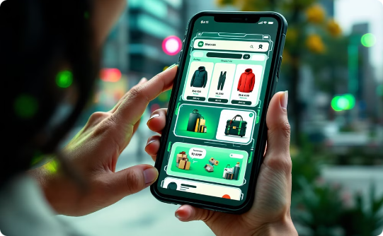


Identifying Customer Trends
Digital-First Services
Sustainability Focus
AI Integration
Rising acceptance of AI-powered customer service and personalized experiences.
Increasing preference for mobile and online interactions across various industries.
Growing demand for environmentally conscious products and services.

Slide 12




Launching a Pilot Program
Define Objectives
Clearly outline what you aim to learn from the pilot.
Create MVP
Develop a minimum viable product with core features to test.
Gather Feedback
Collect and analyze user feedback to inform future development.

Slide 13
Benchmarking Against Competitors
Identify Competitors
Analyze Offerings
Evaluate Performance
Research and list direct and indirect competitors in your market.
Compare features, pricing, and customer experiences of competitor products or services.
Assess market share, customer reviews, and overall success of competitors.

Slide 14

Group Activity: Market Research Plan
Target Audience
Research Techniques
Define customer demographics and preferences for the hypothetical business.
Select appropriate primary and secondary research methods for the business.
Validation Strategy
Develop a plan to validate the business idea using customer insights and trends.

Slide 15

Key Takeaways
1
Research Balance
2
Data-Driven Decisions
Combine primary and secondary research for comprehensive market insights.
Use market research to validate business ideas and minimize risks.
3
Continuous Learning
Stay updated on industry trends to identify new opportunities and challenges.

