Slide 1
Religions in Africa
Prof Bettina E. Schmidt

Slide 2
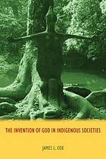
Topic today
The God Controversy
  The debate about the existence of a supreme being in pre-Christian indigenous religions

Slide 3
Suggested Readings:
Cox, J.L., The Invention of God in Indigenous Societies (Durham: Acumen, 2014).

Slide 4
Structure today
Introduction – What is the Problem?
Shona in Zimbabwe

Slide 5
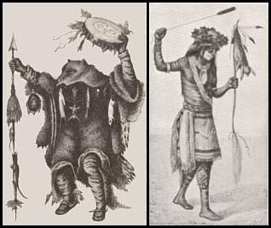
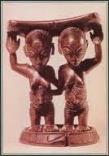
1. Introduction
What is the God controversy?
  Feature of deities in indigenous religions
    in comparison to god in monotheistic religions
  Origin of the idea of god as creator
    Pre-Christian or later?

Slide 6
Okot p’Bitik (Ugandan philosopher)
“When students of African religions describe African deities as eternal, omnipresent, omnipotent, omniscient, etc. they intimate that African deities have identical attributes with those of the Christian God.”
But such conclusions, as he writes later, are “absurd and misleading.” (quoted in Cox, p. 1)

Slide 7
Invention of Tradition?
But can we conclude from his comments that …
“The African deities of the books, clothed with the attributes of the Christian God, are, in the main, creations of the students of African religions.” (p’Bitek, quoted in Cox, p. 1)

Slide 8
Is the presence of a creator God the result of missionaries asking the question “who created you?” which was difficult to translated into local languages?

Slide 9
p’Bitek criticised in particular African theologians such as John Mbiti who insisted that African traditional religions contained a universal belief in the Supreme Being.
Mbiti and others had two reasons (according to p’Bitek):
  To prepare ATR for the Christian message
  To show that followers of ATR are not ‘inferior’

Slide 10
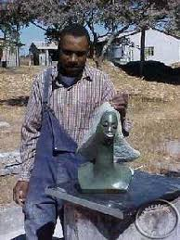
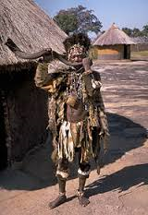
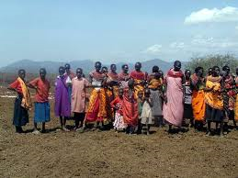
The Shona in Zimbabwe

Slide 11
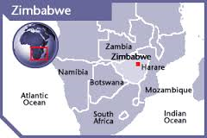
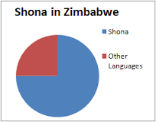
Shona speaking population makes the majority of Zimbabwe’s 13 million people (80% are Shona)
  But sub-divided in various groups

Slide 12
History
In the early 1400s Shona groups formed a state separate from Zimbabwe under the Mutapa dynasty
Portuguese traders arrived at the East African coast in the 16th century and weakened the state
  -> lost influence in the 17th century though existed until the late 19th century

Slide 13
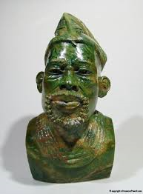
Today
Traditional social organization still in place
  Chief on top of hierarchy, looks after traditional religious practices with headsmen (village level) and elders (family level)
  Social hierarchy mirrored by hierarchy in the spirit world with the chief’s ancestors on top

Slide 14
Mwari
= used since the 1960s by Shona-speaking Christians as equivalent to God the Father of our Lord Jesus Christ, the Supreme Being, God the Creator

Slide 15
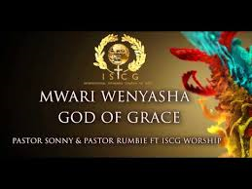
Used also by new African churches who refer to God as Mwari Baba (God the Father) or Mwari Wokudenga (God of Heaven)

Slide 16
Equating Mwari with a universal God has expanded beyond churches into academic writings
  e.g. the historian Nwagi Bhebe writes that the Shona had a long developed ‘cult’ centred on the High God Mwari
  Also included in school curriculum in Zimbabwe (see Cox, p. 68)

Slide 17
But ….
Was Mwari just an indigenous god who has been taken over into Christianity and elevated to the position of the highest source of the Christian faith?

Slide 18
Michael Bourdillon (1976)
States that the Shona uses numerous names for the High God, including Mwara which is a personal name
However, the High God played traditionally little or no role in the religious practice which focused on spirits instead
  In particular territorial spirits associated with a chief’s ancestor lineage

Slide 19
However …
Other scholars connect Mwari with the prior state or dynasties that existed in Zimbabwe earlier
  e.g. D.N. Beach writes that Mwari was a specifically Rozvi High God who was a combination of sky god and ancestral spirit and later it spread from the North to other parts of Zimbabwe

Slide 20
James Cox
Based on Beach and others Cox concludes that Mwari was linked to fertility “in the sense that the senior ancestor spirit is seen as the source of the lineage or kinship group, who continues to care for his children by producing rain that causes crops to come to fruition and the cattle to prosper” (p. 74)

Slide 21
Christian transformation
The traditional understanding of Mwari as fertility deity and original ancestor has been transformed then into a now universally accepted use of Mwari for God the Creator (Cox, p. 75).

Slide 22
Identification of Mwari with the Christian God by missionaries, followed by African theologians and local church leaders
In order to construct an imaginary line of continuity between pre-Christian religious life and the Christian message

