Slide 1

Anti-Social Behaviour and Crime: can history inform the future?
(National Business Crime Centre 2023)
Module code: BMPL5013
By Morgan Jones
(Morgan Jones & Ryan thomas)

Slide 2
Contents
Introduction
In the context of policing is it reasonable to say that the more things change the more they stay the same
Do the principles and powers attached to the tackling of anti-social behaviour hold the chance to make dramatic difference in challenged communities?
In the context of policing is it reasonable to say that the more things change the more they stay the same
Conclusion
Reference list

Slide 3
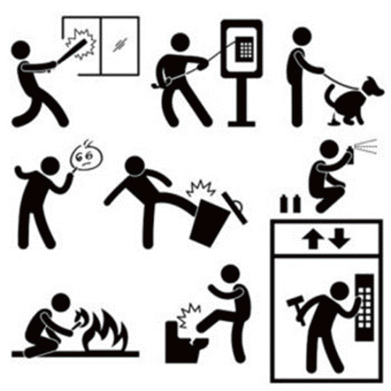
Introduction
(The Shropshire Community Safety Partnership, 2024)
"Personal anti-social behaviour is when a person targets a specific individual or group.
Nuisance anti-social behaviour is when a person causes trouble, annoyance or suffering to a community.
Environmental anti-social behaviour is when a person’s actions affect the wider environment, such as public spaces or buildings." (Metropolitan Police 2023)
Notes:
So what is Anti-Social Behaviour, According to the metropolitan Police there are 3 types of Anti social behaviour which are (read quote) and examples of each with help from this reference noise
shouting, swearing and fighting
intimidation of neighbours and others through threats or actual violence
harassment, including racial harassment or sectarian aggression. More about harassment
verbal abuse
bullying of children in public recreation grounds, on the way to school or even on school grounds, if normal school disciplinary procedures do not stop the behaviour "abusive behaviour aimed at causing distress or fear to certain people, for example, elderly or disabled people, driving in an inconsiderate or careless way, for example, drivers congregating in an area for racing, dumping rubbish, animal nuisance, including dog fouling, vandalism, property damage and graffiti."

Slide 4
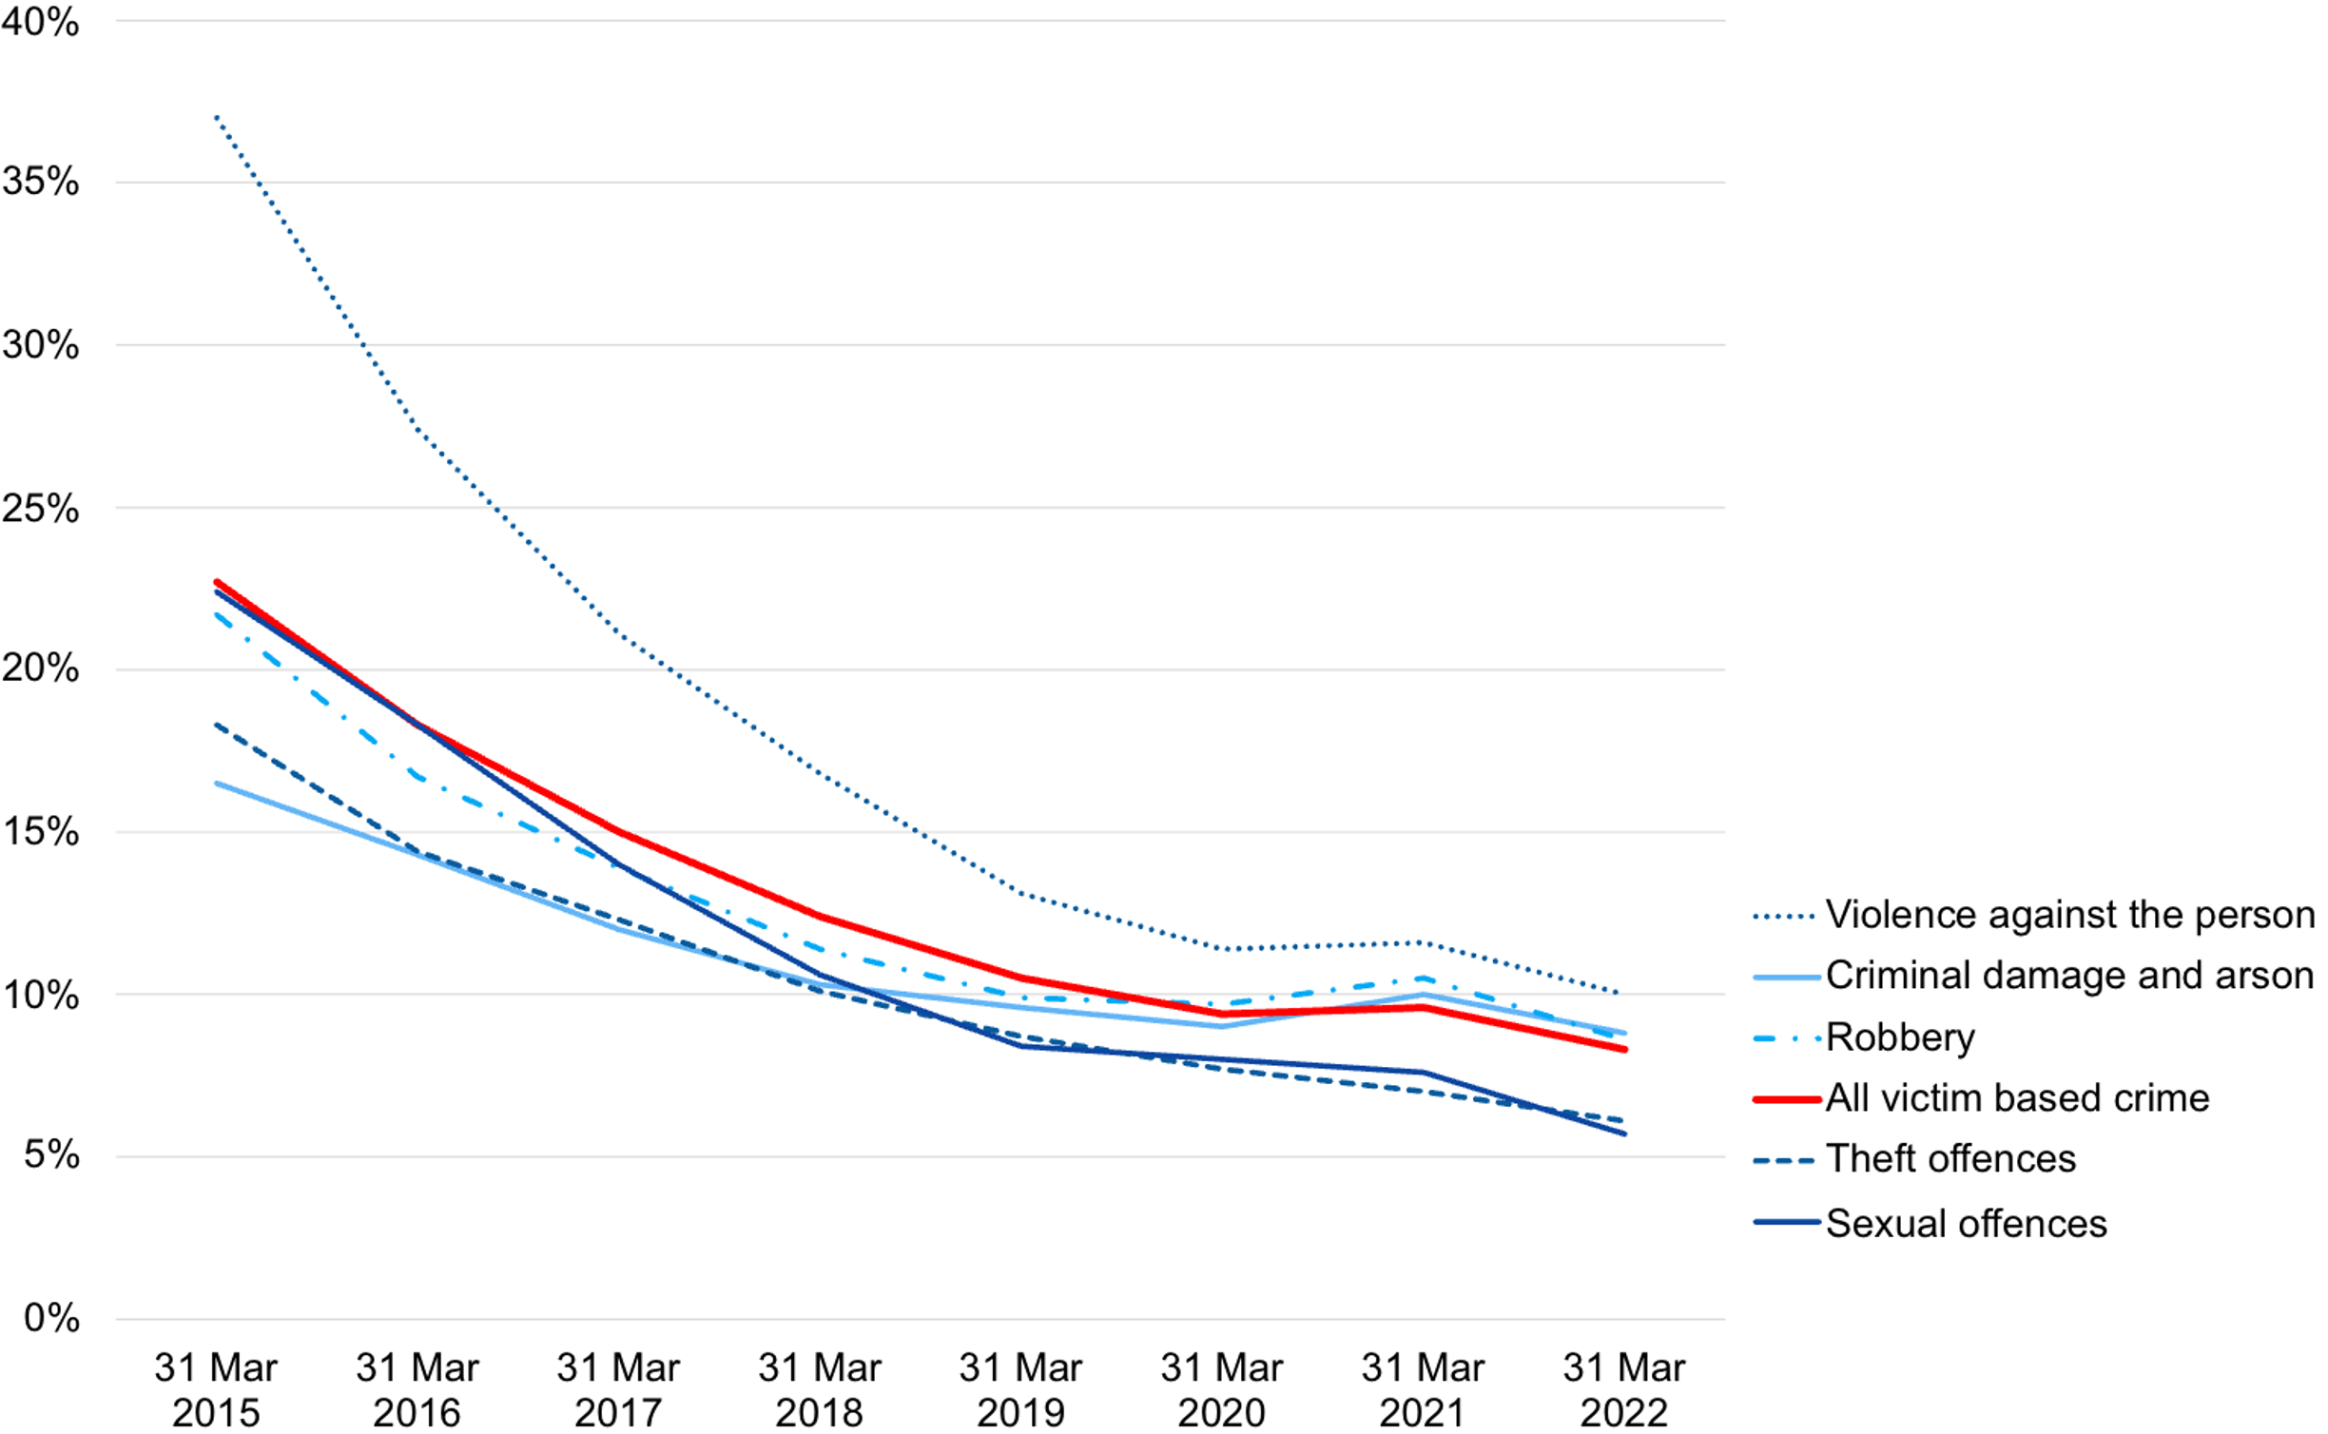
In the context of policing is it reasonable to say that the more things change the more they stay the same?
Corruption in policing
'a graph about individual
crimes police officers have
committed over the years'
(His Majesty's Inspectorate
of Constabulary and Fire
& Rescue Services 2023)
Notes:
Samuel Peeps

Slide 5
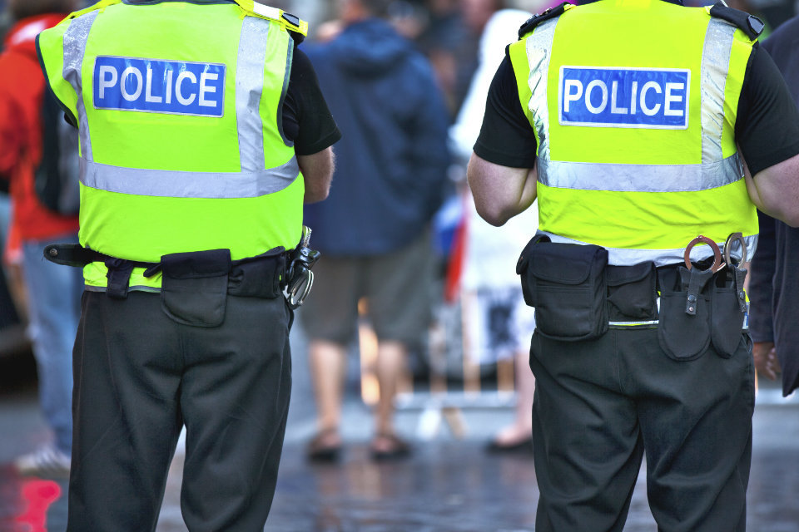
Do the principles and powers attached to the tackling of anti-social behaviour hold the chance to make dramatic difference in challenged communities?
(Home Office and The Rt Hon Victoria Atkins MP, 2021)
Notes:
"civil injunctions, criminal behaviour orders, community protection notices, public spaces protection orders, new closure powers and dispersal powers" are the powers attached to ASB which are made to tackle anti-social behaviour
'1 million anti-social behaviour crimes sent to the police in 2023 and good examples of conflict resolution techniques used and experienced officers put to the task.

Slide 6
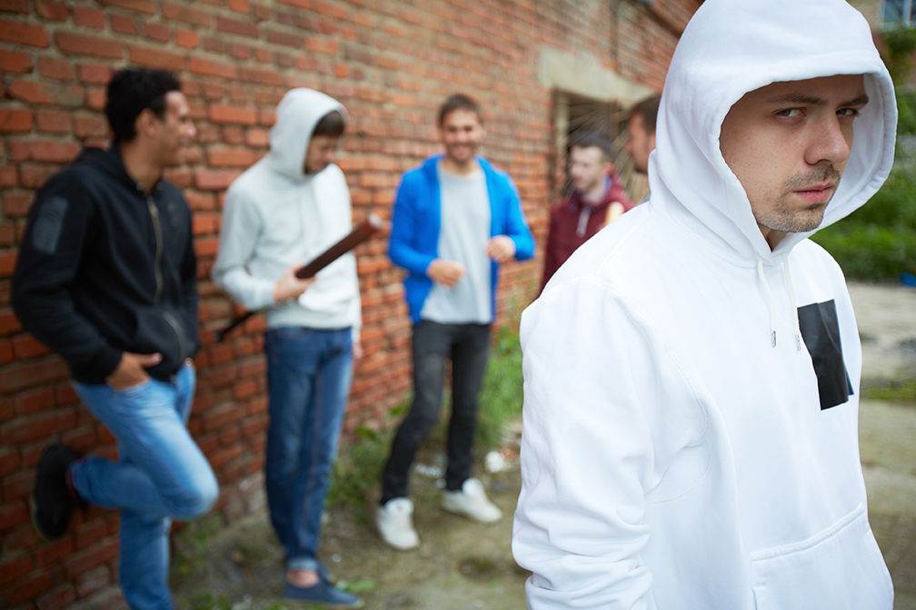
What aspects of anti-social behaviour offer the most pressing challenges?
"Anti-social behaviour (ASB) can result in a range of negative emotional, behavioural, social, health and financial impacts" (Home Office 2023)
"not only does anti-social behaviour leave people feeling unsafe, but it can also be a gateway into
serious criminality"
(Neighbourhood Watch 2023)
(Vice 2017)
Notes:
Home Office 2023 says that (Read first quotation) so as we can see Anti-social behaviour causes many issues which could be very serious to an individual family or community especially because anti-social behaviour is a crime that is committed repeatedly and can draw in more serious crime (next quote)

Slide 7

Conclusion
History can inform the future
Notes:
History could inform the future because there are various patterns seen through time that show certain crimes will always be a trend therefore the police can always be prepared for example "Each year, there is a 40% to 50% increase in criminal activity on business during Halloween." According to Get Licensed (2021)

Slide 8
Reference list
Home Office, 2023. Accessed on: https://www.gov.uk/government/publications/impacts-of-anti-social-behaviour-on-individuals-and-communities/anti-social-behaviour-impacts-on-individuals-and-local-communities#:~:text=Despite%20often%20being%20described%20as,behaviours%20and%20decreased%20economic%20productivity. Accessed on: 08/11/2024
The Shropshire Community Safety Partnership, 2024. Available at: https://www.shropshiresafeguardingcommunitypartnership.co.uk/partnership-priority-areas/community-safety-practice/anti-social-behaviour/ Accessed on: 08/11/2024
National Business Crime Centre, 2023. Available at: https://nbcc.police.uk/news/anti-social-behaviour-survey-report-released Accessed on: 08/11/2024
Vice, 2018. Available at: https://www.voicenorthants.org/restorative/tackle-anti-social-behaviour-using-restorative-justice/ Accessed on: 08/11/2024
Citizens Advice Scotland, 2024. Available at: https://www.citizensadvice.org.uk/scotland/housing/housing-antisocial-behaviour-s/antisocial-behaviour-s/ Accessed on:

Slide 9
Reference list continued
Neighbourhood Watch, 2023. Available at: https://www.ourwatch.org.uk/news/action-plan-crack-down-antisocial-behaviour-and-restore-pride-communities#:~:text=There%20is%20no%20such%20thing,a%20gateway%20into%20serious%20criminality. Accessed on: 08/11/2024
Home Office and The Rt Hon Victoria Atkins MP, 2021 Available at: https://www.gov.uk/government/news/government-strengthens-anti-social-behaviour-guidance-to-ensure-protection-for-victims Accessed on: 08/11/2024
Get Licensed, 2021. Available at: https://www.get-licensed.co.uk/get-daily/crime-increases-by-40-on-halloween-is-it-time-you-followed-this-advice/ Accessed on: 08/11/2024

