Slide 1
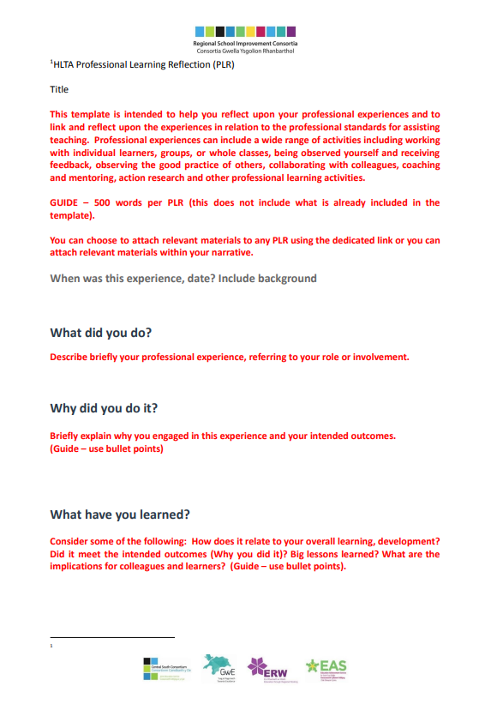
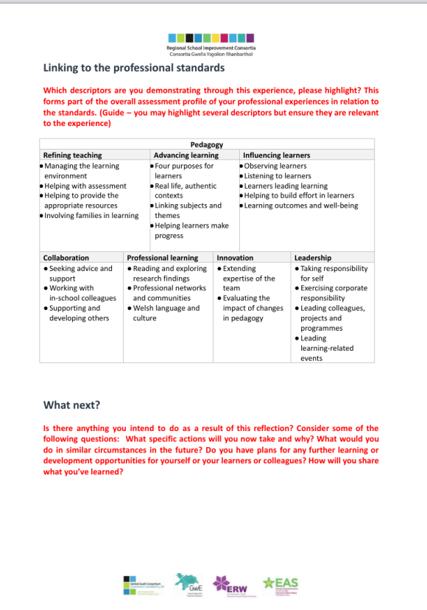
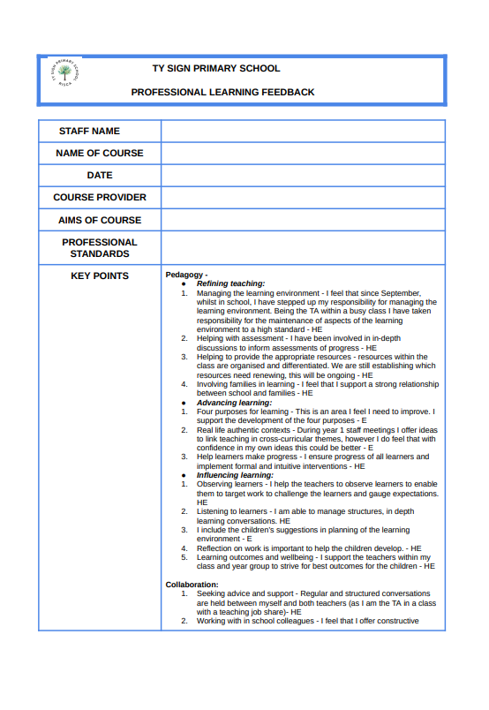
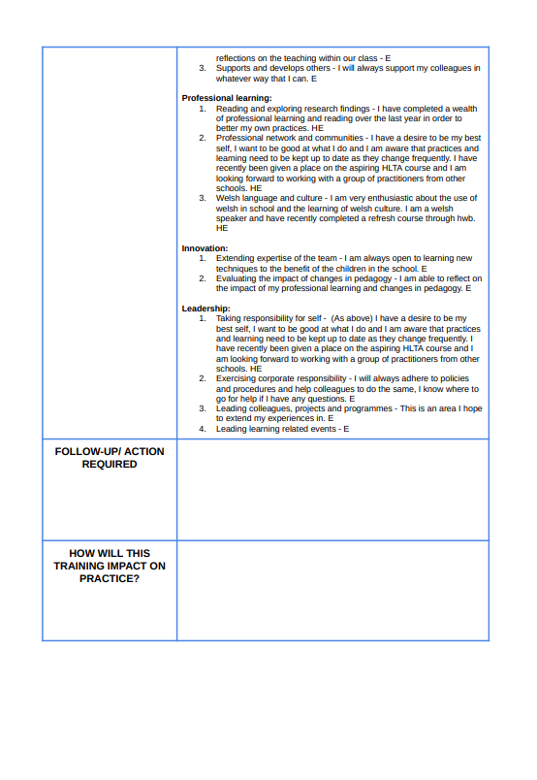
The significance of reflective practice as an Early Years Practitioner.
Hannah Newman – Student Number 2216693.
Theories of reflection.
Schon (1992) explains the need for reflection by stating that in order to plan actions going forward when in any given situation one must harp back to past events to gather from those the similarities and dissimilarities to the current situation. Schon (1992) discusses the subconscious reflections made in-the-moment which he calls Knowing-in-Action. That is a practitioner engaging in practice without forethought, an action familiar as it is learned through experience and becomes instinctive or routine. This is also referred to as Tacit Knowledge which is also discussed by Klein (2018) who describes Tacit knowledge as a knowing without intentional forethought. Schon (1992) continues with Reflection-in-Action, which is the process of assessing the impact during the teaching experience and making allowances as and when necessary. And finally Schon (1992) proposes Reflection-on-Action which takes place after learning experience. This would include an in depth assessment of the pros and cons of a learning experience.Dewey (cited in Brock,2015) describes reflection as making a continuous, conscious effort to review anything thought or known, as more information comes to light, whether this is in agreement or conflicting with one's own thoughts. Dewey (cited in Brock,2015) theory suggests that to become better practitioners it is essential to engage in open, honest reflection of practice, values and beliefs and that we gain knowledge from our reflections:We do not learn from experience, we learn from reflecting on experience. Dewey, 1933 (Cited in Brock, 2015)
What is reflective practice?
Moon (1999) discusses the meaning of reflection, looking for a plainspoken definition. Moon (1999) suggests it is to look back with the aim of thinking about it in greater detail. Reflective practice is the process of looking back over how well something went and to interpret the knowledge, values and skills displayed (Hallet, 2013) and thinking about ways it could have gone better and things that worked and would be taken forward to the next experience. That is to take some lessons from the experience. Within this paper I will discuss the history, theories, models and uses of reflection within the Early Years Workforce.
Why reflect in the Early Years?
Hallet (2013) says that there is a recent shift for practitioners to reflect on practice which may be due to the Early Education Code of Ethics (2011) as this sets out a practitioner's responsibility to carry out reflection. Gasper (2015) also discusses a practitioner's responsibility to be reflective and to attribute prior learning and experience to next steps in order to improve the effectiveness of practice.
Schon (1992) explains that every situation carries its own unique set of circumstances which can be reflected on and the method adjusted. That is to say that practitioners can learn from reflection. Hallet (2013) states that the reason for reflection is so that improvements can be made. Moon (1999) states that reflection allows practitioners not only to think about areas which need enhancing but also to find areas of effectiveness. Cambridge University Press & Assessment. (2022) echoes this in stating that reflection enables practitioners to get to grips with barriers to learning through reflection on the strengths and weaknesses of practice.
However, Schon (1992) discusses the possibility that reflection may be perceived as displays of incompetence amongst practitioners. Hallet (2013) counters this by explaining the need for reflection within Early Years in order to offer a superior learning environment and goes on to say that practitioners should openly and honestly review the experiences offered, making changes to the way in which they work to enhance the quality of the setting.
Cambridge University Press & Assessment (2022) describes reflection as a fundamental aspect to education and discusses the benefits to practitioners which include gaining a strong understanding of their own teaching style which may highlight areas for professional development, problem solving and self belief in professional ability. Brock (2015) suggests that there needs to be a cycle of reflection embedded in practice which is ongoing. Brock (2015) suggests that reflection is a skill which needs to be learned through the process of doing so. Reflection is a process which should be repeated (Cambridge University Press & Assessment., 2022) which is also supported by Brock (2015).
Reflective account forms.
One way to approach reflection is by using reflective account forms. This is another tool for practitioners to organise their reflections. An example of a reflective account form which was issued by South East Wales Education Advice Service for use in the HLTA process. This looks at the who, what, when, why and what next questions.
Staff training records can also use a similar format and allow practitioners to reflect on their professional learning and to consider the next steps. An example issued by Ty Sign Primary School enables practitioners to consider how they can use this learning to inform their future practice.
Once again these forms offer a tool for practitioners to think logically and in a well ordered fashion, using prompts. They allow practitioners to briefly describe the events, to think about the circumstances surrounding the events and to discuss how these events will impact on practice. ​
South East Wales EAS (No date).
HLTA Personal Reflection Form.
Ty Sign Primary School (No date)
Professional Learning Feedback Form.

Slide 2
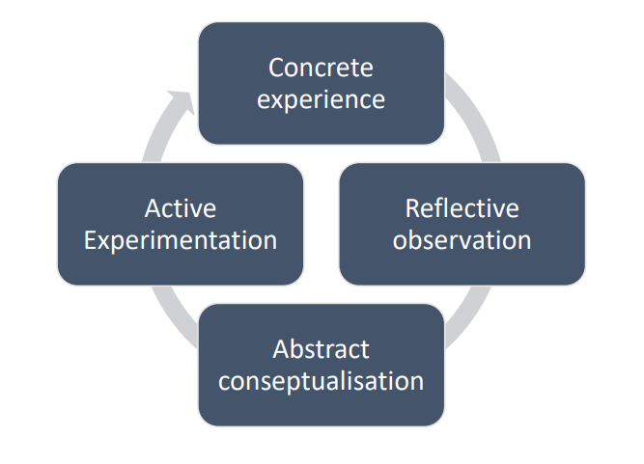
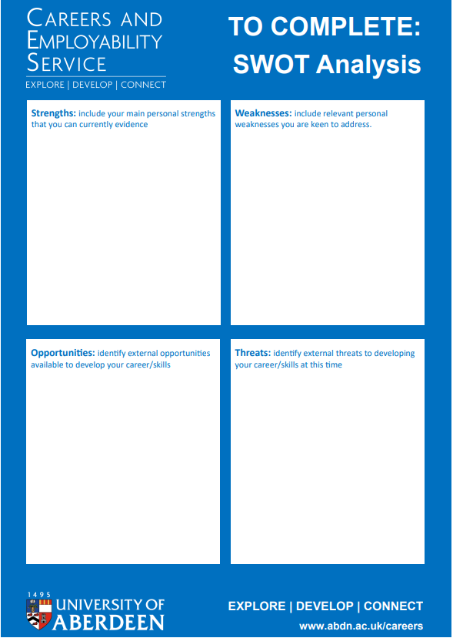
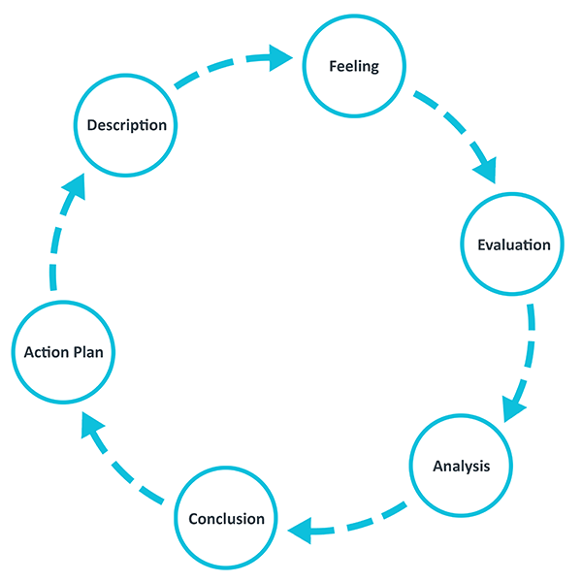
Models of reflection.​​
There are numerous models to aid the process of reflection, all of which have distinct advice on how to reflect and these models can help to increase understanding from an event (University of Hull, 2022). However, Cambridge University Libraries (no date) explains that there is no one size fits all approach to reflection, it states that this is fundamental to remember when reflecting. It is important to use a model which suits the individual’s approaches and the situation being reflected on. Klein (2018) discusses the importance of asking the right questions in order to draw out all of the available information surrounding events, looking for information. Models provide questions to help aid reflection.​​
Driscoll's model of reflection:
Driscoll’s model of reflection is a simplified model with only three questions: What? So What? What now? This could be viewed as a good basis for reflection as the questions are simplified and easy to follow. By asking “What?” it is looking for the information surrounding the event, a description of what has happened. Moving on to “So what?” to discuss what has been learned, what were the barriers faced? And Finally “What now?” What will be changed as a result of the experience? What will be taken forward into practice?
Driscoll’s model is very similar to Jasper (2013)’s ERA cycle which also contains 3 stages: Experience - what happened, Reflection - how did it go, Action - what has been learned.
Kolb’s experiential learning cycle​​
Kolb’s experiential learning cycle has four stages to reflection. It is considered to be one of the most familiar models (Brock, 2015), however thi model has more complex language than the ERA and Driscoll's model and an added stage which is putting to the test the learning to take forward. The stages in Kolb’s model are: Concrete Experience - what happened, Reflective Observation - analysing the experience, why did it happen in such a way, Abstract Conceptulisation - making sense of the experience, what has been learned and Active Experimentation - testing the learning. University of Cumbria (2020) explains that not only can this model be entered into at any of the stages but that it is also ongoing and once an experience has been reflected on and new learning is in place, it can continue into cycle two.
Gibbs’ model of reflection​​
Gibbs’ model of reflection which Brock (2015) also considered to be a familiar model, an opinion supported by The University of Edinburgh (2020), is a more in-depth model containing six stages to reflection. This may be viewed as more work however can lead to a better understanding of the scenario and so a deeper reflection. The stages of the Gibbs’ model are: Description - What were the circumstances surrounding the event? The University of Edinburgh (2020) suggests using the five w questions in order to get the full picture. Feelings - Gibbs’ model adds a stage to really think about the feelings surrounding the event. This is so as to consider how feelings can alter an experience. Evaluations - What were the positive and negative outcomes of the experience? Analysis - as with Kolb's Abstract Conceptulisation this is to understand what occurred and to find the significance of the learning. Conclusion - What can be taken forward, what are the next steps or further professional development needed. Brock (2015) discusses the ability of Gibbs’ model to walk through the description to a deep enquiry and next steps. ​​
University of Cumbria. (2020) Kolb’s experiential learning cycle (1984) [Image]
SWOT Analysis:​​
Moon (1999) also discusses the use of SWOT analysis to reflect on the strengths, weaknesses, opportunity and threats of an experience or situation. Here is an example of a SWOT analysis: ​​
University of Aberdeen. (No date) Guide to: SWOT analysis [Image]
Swansea University (No date) discusses the need to follow up a SWOT analysis. This is so as to find further actions needed to enhance practice.
Conclusion
To conclude, reflection is vital to practitioners in order to facilitate the process of continuous professional development by highlighting the areas of improvement in skills and areas for change in beliefs or values as well as highlighting areas of good practice. This enables practitioners to share good practice with others in their settings and improve the overall practice of settings.. Early years is ever changing and it is important that practitioners remain abreast of the most recent values, processes and procedures and frameworks, which can only be achieved through continuous reflection both individually and as settings/in groups.
​Pros and cons to reflective models and account forms:
As previously stated these models offer a coordinated approach to reflection, they offer questions to draw all information from the circumstances, as suggested by Dewey (cited in Brock, 2015) and they give practitioners a definitive end to the process of reflection. However as previously stated these models do not provide a one size fits all approach. That is to say that not all models will be suitable for all circumstances, nor will every practitioner regard each model as being suitable. Hanson and Appleby (2015) suggest in fact that such models may be too rigid and oppressive as they do not support collective viewpoints.
​
​
Group reflection:
Gasper (2015) acknowledges the benefits of shared reflection, discussing with colleagues views and opinions on situations, to gather a breadth of viewpoints in order to improve practice. Hanson and Appleby (2015) discuss the “‘Colleagues’ / ‘peers’ lens’” which describes practitioners working collaboratively to reflect on situations, so as to discuss different strategies used by colleagues who face comparable experiences and broaden approaches and ideas. Hallet (2013) states that collaboration while reflecting openly and honestly within a trusting environment enables the setting to improve. Hallet (2013) also states that by partaking in dialogue with other professionals to reflect, practitioners are able to reflect from many perspectives and consider alternative ways of thinking. This results in further learning.
Gibbs reflective Cycle (2020) Reflection Toolkit. [image]

