Slide 2
Today’s Discussion
Multi-Area OSPF

Slide 3



While we are waiting to begin our discussion…..
Get ready by scanning the Padlet in your Mobile Phone!!!
Open Shortest Path First Routing Protocol!!!
What is it?
How does this protocol work?
Advantages and Disadvantages?
Comparing EIGRP, RIP, Static Routing?
Neighbour Discovery?

Slide 4
Areas - the benefits and functions of areas within an Open Shortest Path First (OSPF) routing domain.
Link-State Announcements - how OSPF stores, communicates, and builds a topology from the link-state announcements (LSAs).
Discontiguous Networks - explains why such a network cannot distribute routes to all areas properly.
OSPF Path Selection - how OSPF makes path selection choices for routes learned within the OSPF routing domain.
Summarization of Routes - how network summarization works with OSPF.
The (OSPF) protocol scales well with proper network planning. IP addressing schemes, area segmentation, address summarization, and hardware capabilities for each area should considered when designing a network.

Slide 5
OSPF Area
An OSPF area is a logical grouping of routers or, more specifically, a logical grouping of router interfaces.
Area membership is set at the interface level, and the area ID is included in the OSPF hello packet.
An interface can belong to only one area.
All routers within the same OSPF area maintain an identical copy of the link-state database (LSDB).
An OSPF area grows in size as the number of network links and routers increase in the area.
While using a single area simplifies the topology, there are trade-offs:
  Full shortest path first (SPF) tree calculation runs when a link flaps within the area.
  The LSDB increases in size and becomes unmanageable.
  The LSDB for the area grows, consuming more memory, and lengthening the SPF computation process.
  No summarization of route information occurs.
Proper design addresses each of these issues by segmenting the routers into multiple OSPF areas, thereby keeping the LSDB to a manageable size. Sizing and design of OSPF networks should account for the hardware constraints of the smallest router in that area.

Slide 6
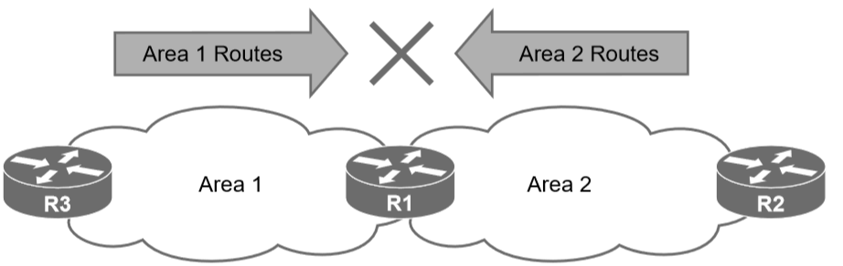
OSPF Area
In essence, an OSPF area hides the topology from another area but enables the networks to be visible in other areas within the OSPF domain.
Segmenting the OSPF domain into multiple areas reduces the size of the LSDB for each area, making SPF tree calculations faster, and decreasing LSDB flooding between routers when a link flaps.
Just because a router connects to multiple OSPF areas does not mean the routes from one area will be injected into another area. Figure shows router R1 connected to Area 1 and Area 2. Routes from Area 1 will not advertise into Area 2 and vice versa.

Slide 7
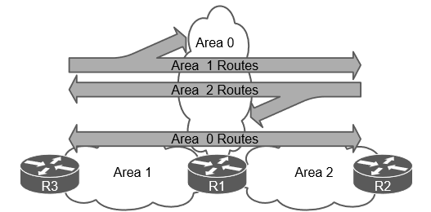
OSPF Area
Area 0 is a special area called the backbone.
By design, all areas must connect to Area 0 because OSPF expects all areas to inject routing information into the backbone, and Area 0 advertises the routes into other areas.
Area border routers (ABRs) are OSPF routers connected to Area 0 and another OSPF area.
ABRs are responsible for advertising routes from one area and injecting them into a different OSPF area.
R1 is connected to Area 0, Area 1, and Area 2. R1 is a proper ABR because it now participates in Area 0

Slide 8
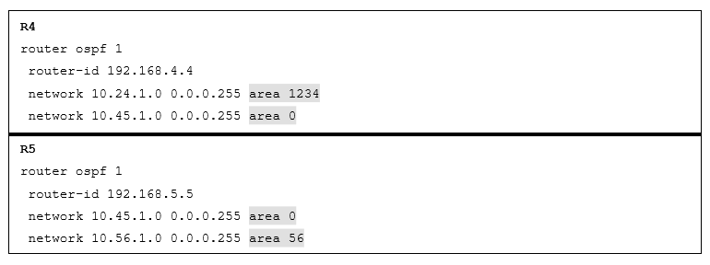
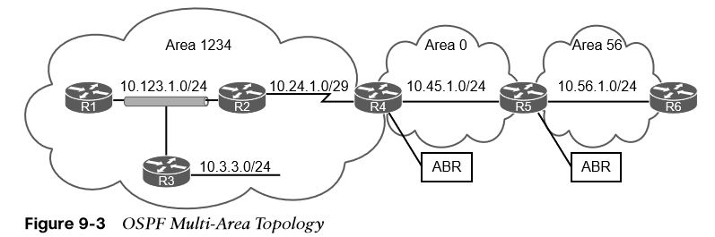
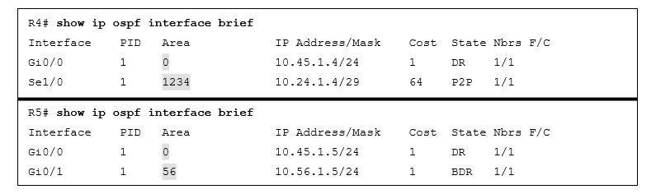
OSPF Area
OSPF configuration for the ABRs R4 and R5.
Multi Area OSPF
A larger-scale OSPF multi-area topology. In the topology:
R1, R2, R3, and R4 belong to Area 1234.
R4 and R5 belong to Area 0.
R5 and R6 belong to Area 56.
R4 and R5 are ABRs.
Area 1234 connects to Area 0, and Area 56 connects to Area 0.
Routers in Area 1234 can see routes from routers in Area 0 and Area 56 and vice versa.
This verifies that interfaces on R4 belong to Area 1234 and Area 0 and that interfaces on R5 belong to Area 0 and Area 56.

Slide 9
OSPF Area
The area ID is a 32-bit field and can be formatted in simple decimal (0 through 4,294,967,295) or dotted decimal (0.0.0.0 through 255.255.255.255).
During router configuration, the area can use decimal format on one router and dotted-decimal format on a different router, and the routers can still form an adjacency.
OSPF advertises the area ID in dotted-decimal format in the OSPF hello packet.
Network routes that are learned from other OSPF routers within the same area are known as intra-area routes.
Network routes that are learned from other OSPF routers from a different area using an ABR are known as interarea routes.

Slide 10
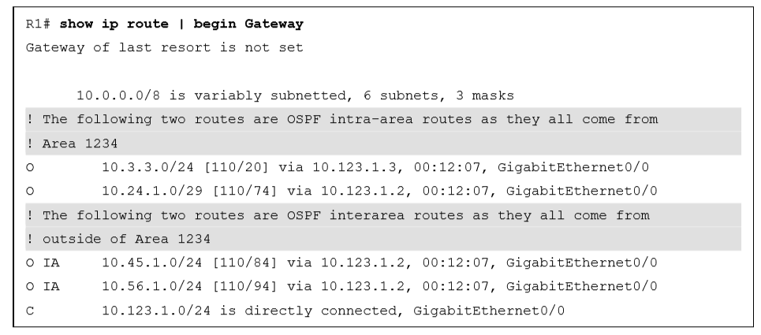
OSPF Area
Here, the network link between R2 and R4 (10.24.1.0/29) is an intra-area route to R1.
The IP routing table displays OSPF intra-area routes with an O.
Notice that R1’s OSPF routing table shows routes from within Area 1234 as intra-area (O routes) and routes from Area 0 and Area 56 as interarea (O IA routes).

Slide 11
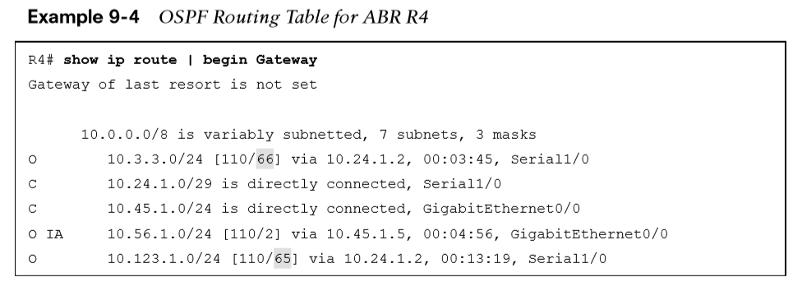
OSPF Area
Here, notice that R4’s routing table shows the routes from within Area 1234 and Area 0 as intra-area and routes from Area 56 as interarea because R4 does not connect to Area 56.
Notes:
The metric for the 10.123.1.0/24 and 10.3.3.0/24 networks has drastically increased compared to the metric for the 10.56.1.0/24 network.

Slide 12
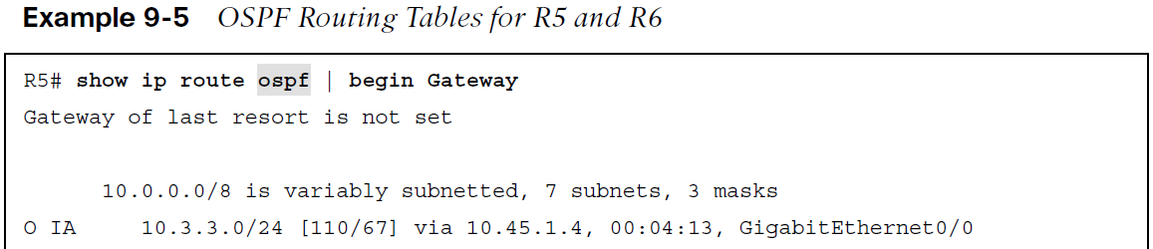
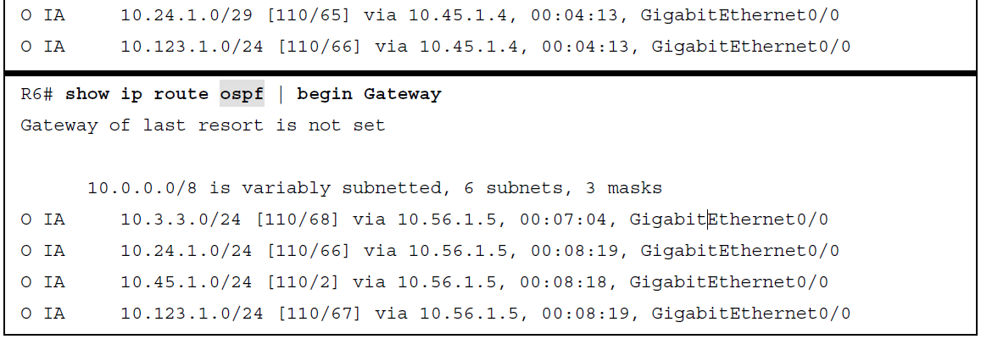
OSPF Area
The routing tables with filtering for OSPF for R5 and R6.
R5 and R6 only contain interarea routes in the OSPF routing table because intra-area routes are directly connected.
External routes are routes learned from outside the OSPF domain but injected into an OSPF domain through redistribution.
External OSPF routes can come from a different OSPF domain or from a different routing protocol.

Slide 13
OSPF – LSA’S
When OSPF neighbors become adjacent, the LSDBs synchronize between the OSPF routers.
As an OSPF router adds or removes a directly connected network link to or from its database, the router floods the link-state advertisement (LSA) out all active OSPF interfaces.
The OSPF LSA contains a complete list of networks advertised from that router.
Types of LSA’s: OSPF uses six LSA types for IPv4 routing
  Type 1, router LSA Advertises the LSAs that originate within an area.
  Type 2, network LSA - Advertises a multi-access network segment attached to a DR.
  Type 3, summary LSA - Advertises network prefixes originating from a different area.
  Type 4, ASBR summary LSA - Advertises a summary LSA for a specific ASBR.
  Type 5, AS external LSA - Advertises LSAs for routes that have been redistributed.
  Type 7, NSSA external LSA - Advertises redistributed routes in NSSAs.
LSA types 1, 2, and 3, which are used for building the SPF tree for intra-area and interarea routes

Slide 14
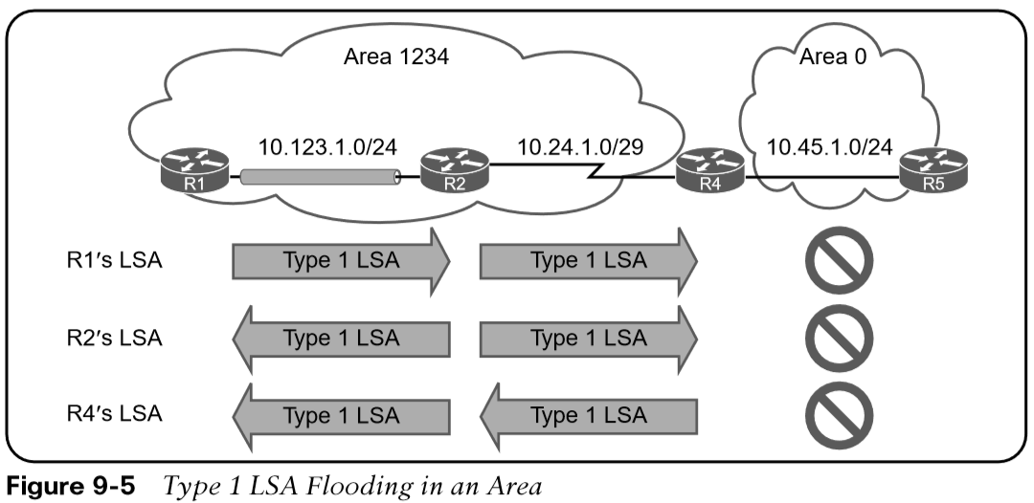
OSPF – LSA’S
Type 1
Every OSPF router advertises a type 1 LSA.
Type 1 LSAs are the essential building blocks within the LSDB.
A type 1 LSA entry exists for each OSPF-enabled link.
Type 1 LSAs for an area are shown with the command show ip ospf database router.
the type 1 LSAs are not advertised outside Area 1234, which means the underlying topology in an area is invisible to other areas.

Slide 15
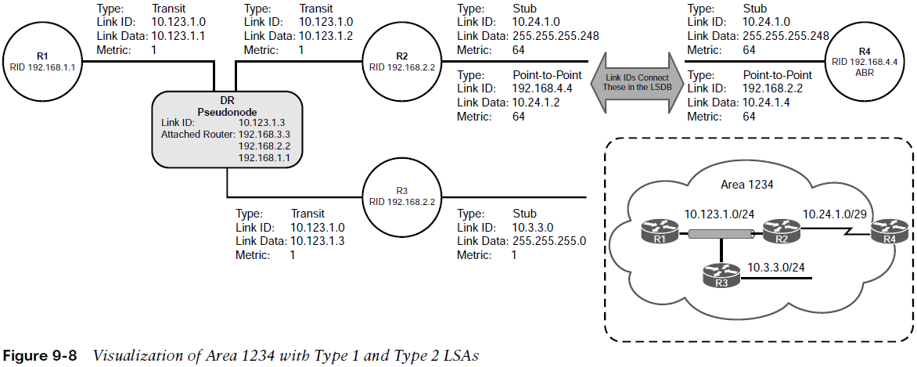
OSPF – LSA’S
Type 2
A type 2 LSA represents a multi-access network segment that uses a DR.
The DR always advertises the type 2 LSA and identifies all the routers attached to that network segment.
If a DR has not been elected, a type 2 LSA is not present in the LSDB because the corresponding type 1 transit link type LSA is a stub.
Like type 1 LSAs, type 2 LSAs are not flooded outside the originating OSPF area.
Detailed type 2 LSA information is shown with the command
show ip ospf database network.

Slide 16
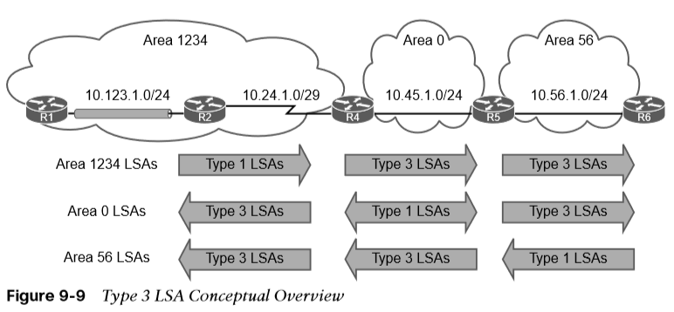
OSPF – LSA’S
Type 3
Type 3 LSAs represent networks from other areas.
The role of the ABRs is to participate in multiple OSPF areas and ensure that the networks associated with type 1 LSAs are reachable in the non-originating OSPF areas.
Figure 9-9 demonstrates the concept of a type 3 LSA interaction with type 1 LSAs.

Slide 17
OSPF – LSA’S
There are three fundamental rules ABRs use the for creating type 3 LSAs:
    Type 1 LSAs received from an area create type 3 LSAs into the backbone area and nonbackbone areas.
    Type 3 LSAs received from Area 0 are created for the nonbackbone area.
    Type 3 LSAs received from a nonbackbone area only insert into the LSDB for the source area. ABRs do not create a type 3 LSA for the other areas (including a segmented Area 0).
The simplest fix for a discontiguous network is to ensure that Area 0 is contiguous. There are other functions, like virtual link or usage of GRE tunnels that are not covered in this course.
Real-life scenarios of discontiguous networks involve Area 0 becoming partitioned due to hardware failures.

Slide 18
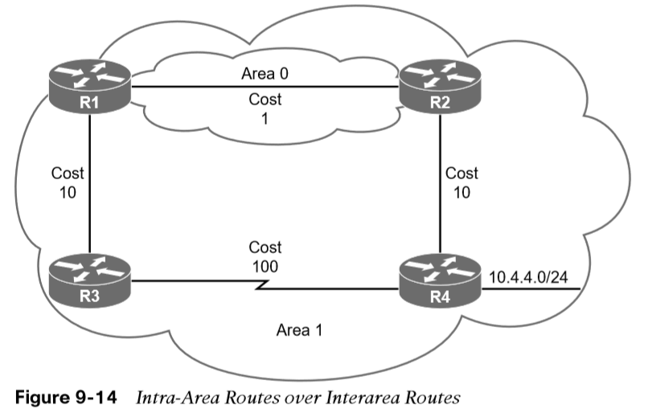
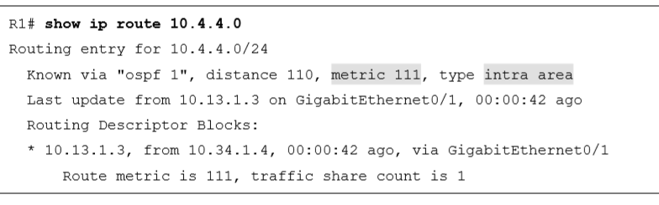
OSPF – Intra Area Routes
OSPF executes Dijkstra’s shortest path first (SPF) algorithm to create a loop-free topology of shortest paths.
All routers use the same logic to calculate the shortest path for each network.
Path selection prioritizes paths by using the following logic: intra-area, interarea, and external routes (which involves additional logic and not covered here)
  Routes advertised via a type 1 LSA for an area are always preferred over type 3 LSAs.
  If multiple intra-area routes exist, the path with the lowest total path metric is installed in the OSPF Routing Information Base (RIB), which is then presented to the router’s global RIB.
  If there is a tie in metric, both routes install into the OSPF RIB.
R1 is computing the route to 10.4.4.0/24.
Instead of taking the faster Ethernet connection, R1 takes the path across the slower serial link to R4 because that is the intra-area path.
Notes:
Here, notice that the metric is 111 and that the intra-area path was selected over the interarea path with the lower total path metric.

Slide 19
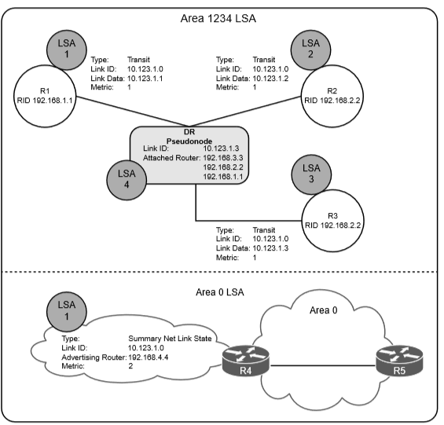
OSPF – Summarisation
Route scalability is a large factor for the IGP routing protocols used by service providers because there can be thousands of routers running in a network.
Splitting up an OSPF routing domain into multiple areas reduces the size of the LSDB for each area.
While the number of routers and networks remains the same within the OSPF routing domain, the detailed type 1 and type 2 LSAs are exchanged for simpler type 3 LSAs.
Referencing our topology for LSAs, for Area 1234, there are three type 1 LSAs and one type 2 LSA for the 10.123.1.0/24 network. Those four LSAs become one type 3 LSA outside Area 1234. This illustrates the reduction of LSAs through area segmentation for the 10.123.1.0/24 network.

Slide 20
Any Questions?
Applied Computing - WISA

