Slide 1
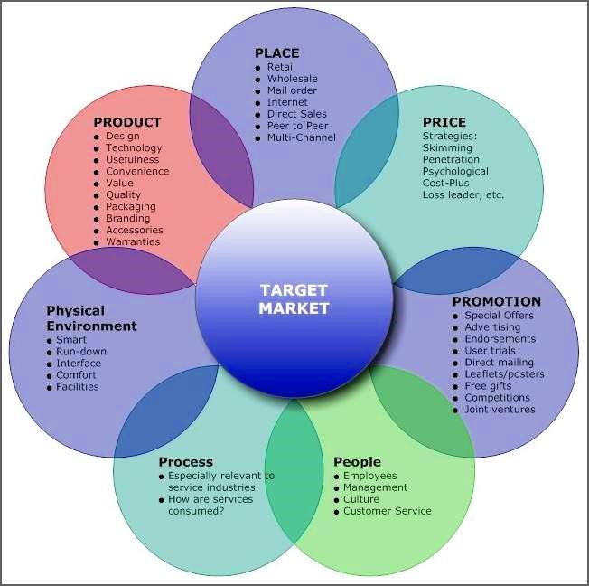
Marketing Planning & Practice
The “RIGHT” Marketing Mix
Product
By Will Fleming

Slide 2
From last week
In your own words state what you understand as “strategy”.
Now find a definition of strategy, does it fit? [note: look for Johnson, Scholes & Whittingdon].
Does strategy follow structure or does structure follow strategy?
How do we know which one is the right one for the organisation?

Slide 3
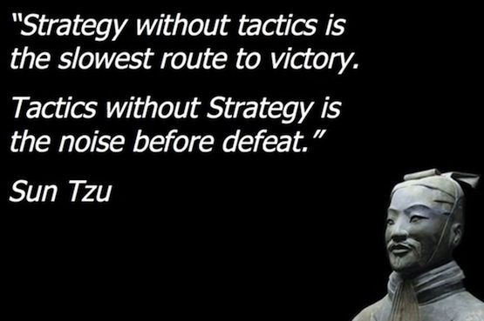
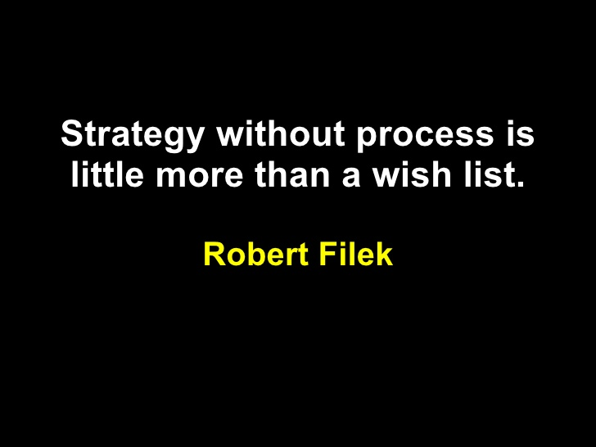
Strategy and implementation

Slide 4
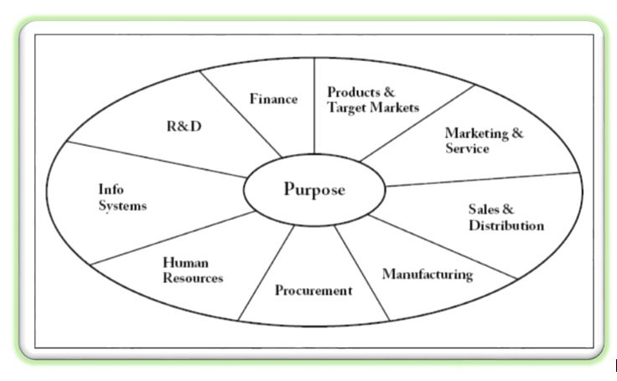
Strategy Implementation
-general the strategic wheel
The Wheel uses the Core Purpose to concentrate on differentiation.
The Strategy Wheel is a visual framework for deciding how every aspect of your business will add value and support its core purpose.
The core purpose bubble “says why you exist – what you do better than others – and the unique activities and resources around the rim show what will be enable you to deliver on that promise.”
In other words, how you will create the value in the centre.

Slide 5
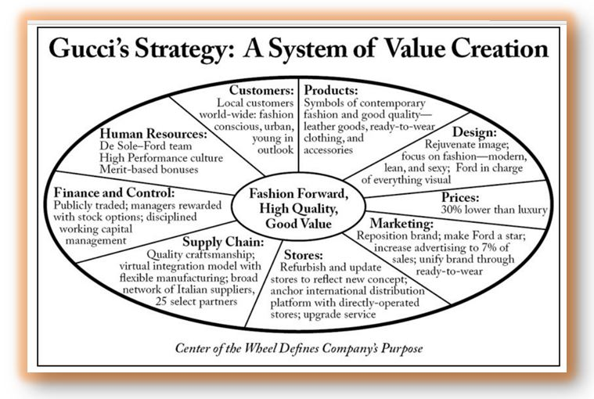
The Strategic Wheel an example

Slide 6
Strategy Implementation
- Marketing
The marketing mix is a key concept for marketers.
For EACH and EVERY segment that we target we MUST produce a distinct Marketing mix.
The process for implementing marketing relies on the marketing mix.
The marketing mix are the marketing managers “tools” of the trade.
Initially the 4P’s it was later extended to the 7P’s.

Slide 7
IMPLEMENTATION
- the “right” marketing mix
Product
Price
Place
Promotion
People
Processes
Physical evidence… or the 7P’s!

Slide 8
THE MARKETING MIX AS A COMPETITIVE ADVANTAGE
PRODUCT
ISSUES INCLUDE:
the augmented product
packaging
the product range & the product portfolio
branding
quality

Slide 9
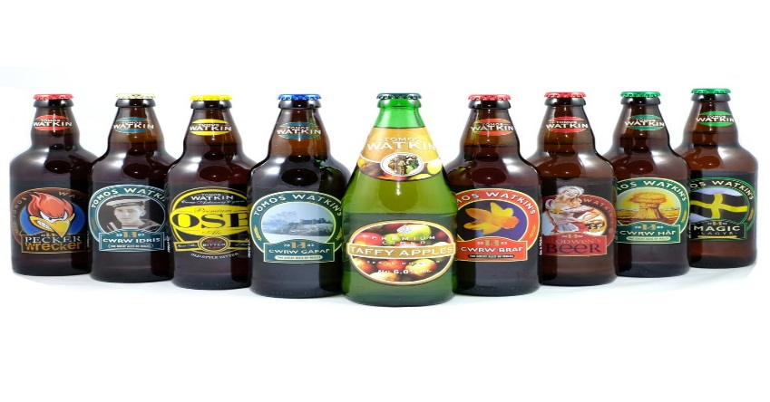
What is a product?
A definition
“ anything offered to a market for attention, acquisition, use or consumption that might satisfy a need or want.” (Kotler & Armstrong 2001:291)
It now even includes physical objects, services, events, persons, places, organisations, ideas or any mix of the above.
Can be either Consumer or Industrial

Slide 10
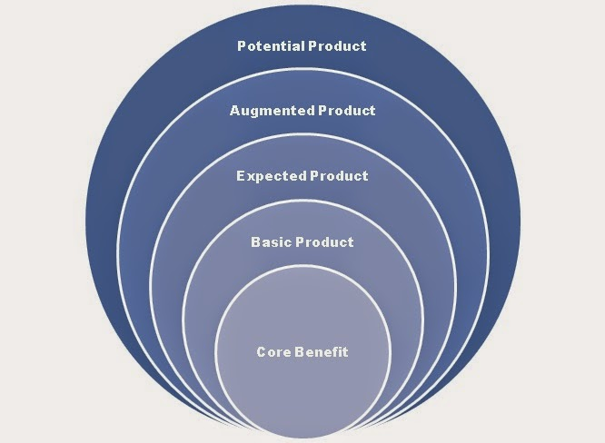
The Augmented Product- the layers of a product
Core benefit – a mode of transport you control
Basic Product – a car
Expected Product – brand, model, colour
Augmented Product – guarantees, warranties, interest free finance
Potential product – hybrid/ electric, sensored/driverless,

Slide 11
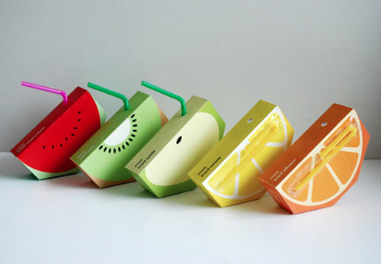
Packaging
Material | Advantages | Disadvantages | Uses
Glass | - reusable - heat-resistant - recyclable - keeps shape - low cost | - fragile - safety issues - heavy | - baby foods - salad cream - pickles
Metal | - recyclable - lightweight - impermeable - withstands heat processing | - may react with food | - soup cans - take-away containers - bottle tops
Card/paper | - easy to print on - cheap to produce - biodegradable - recyclable - can be moulded - can be coated - lightweight | - not water-resistant - easily damaged | - fruit-juice cartons - egg boxes

Slide 12
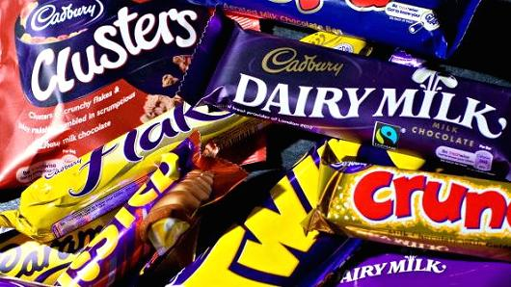
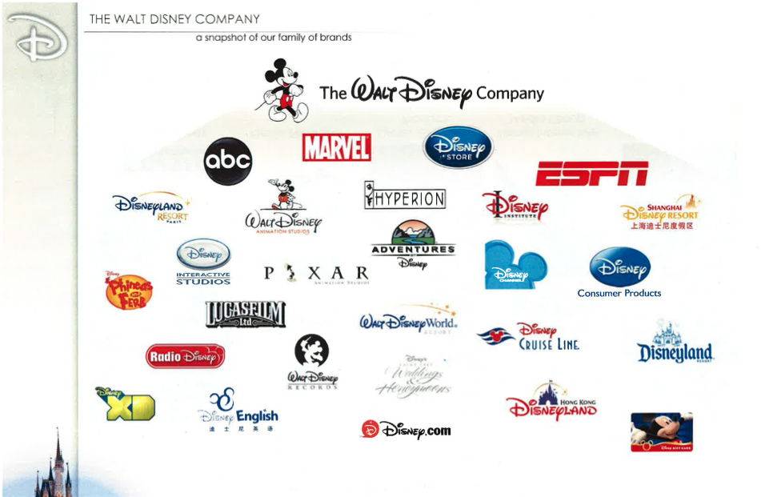
Product Portfolios
It is very rare for any organisation to produce only a single product.
So most have a number of products.
The question is; is it better have a similar range or a diverse range?

Slide 13
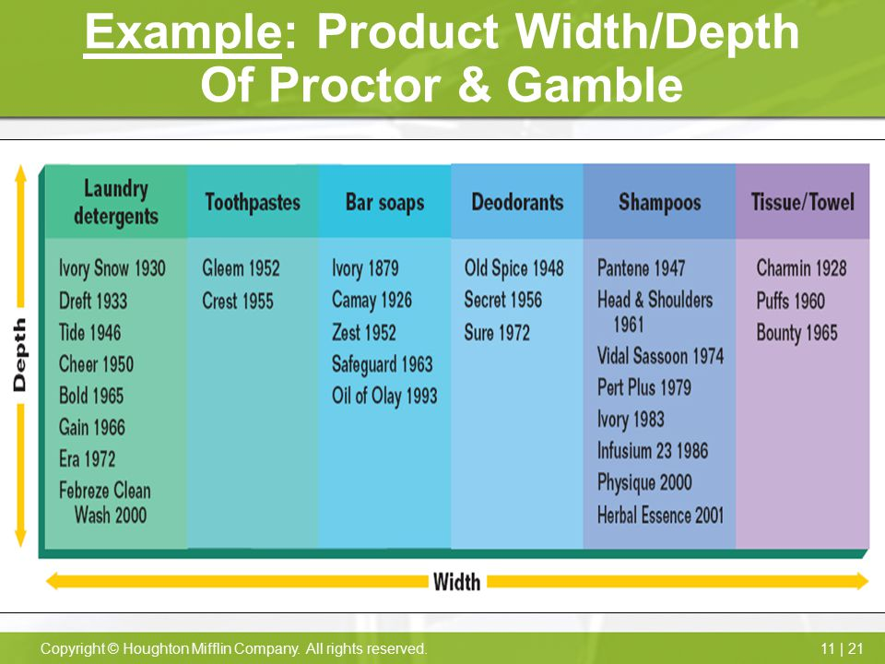
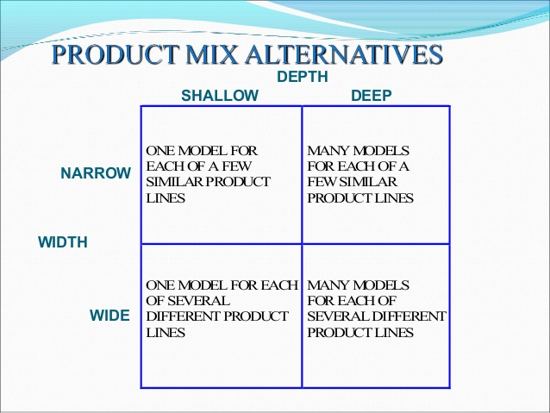
Product Portfolio: width and depth

Slide 14
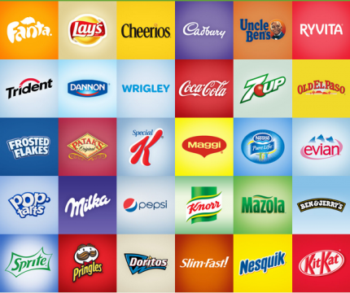
What is a brand?
A definition
“ A brand is a name, term, sign, symbol, design, or any combination of these, that identifies the maker or seller of a product or service” (Kotler & Armstrong 2001:301)
Arguably the single most important asset for a marketing manager: we sell brands, consumers connect with brands, for me it is all about brands!!!

Slide 15
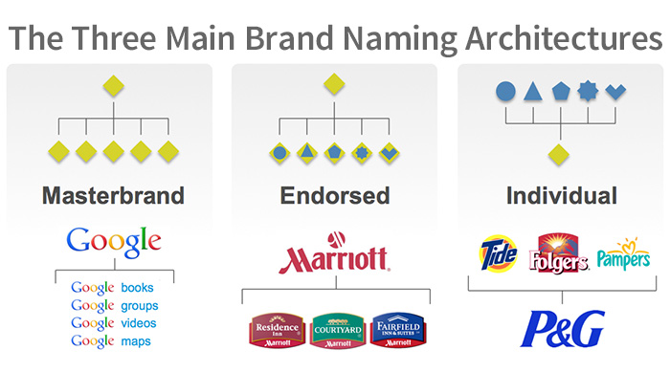

Slide 16
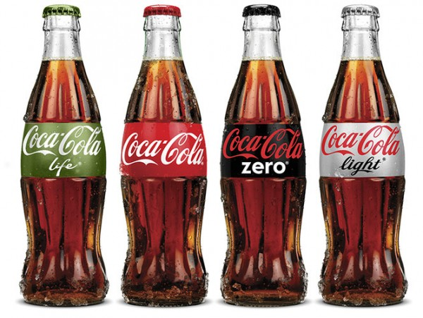
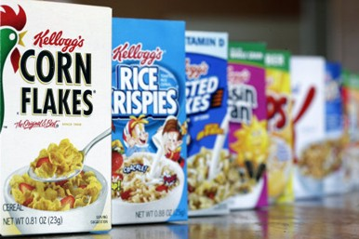
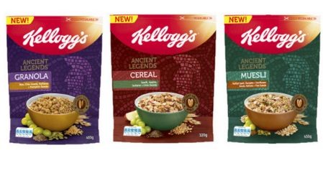
Family Brands
A definition:
Main (most well established) brand under which several new products are introduced to take advantage of its credibility, identity, and name-recognition.
Read more: http://www.businessdictionary.com/definition/family-brand.html

Slide 17
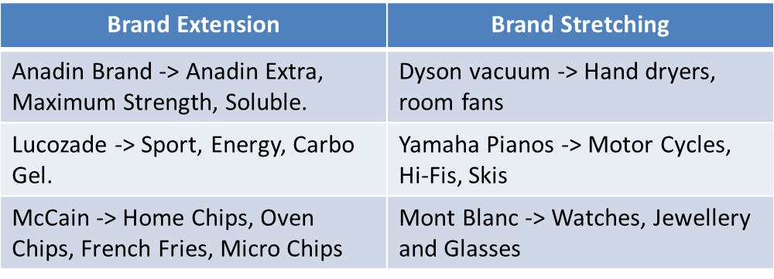
Brand Strategies
However, as well as marketing brands under a family name marketers can also employ two specific strategies for the market called;
Brand Extensions and
Brand Stretching

Slide 18
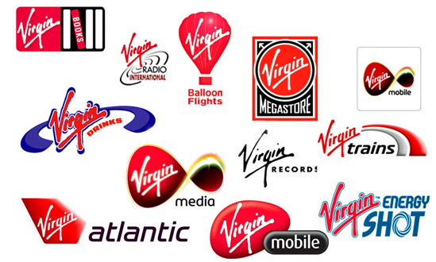
Brand Stretching
Virgin is a classic example of brand stretching as it uses the corporate brand to move into different and distinct businesses with no apparent overlap. A form of Diversification if you will.

Slide 19
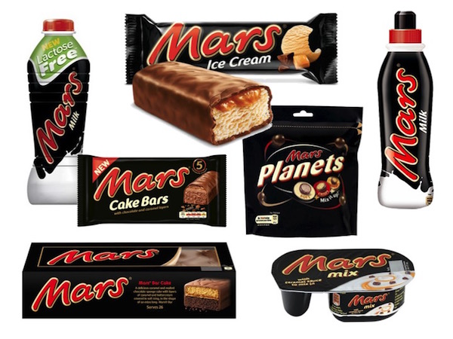
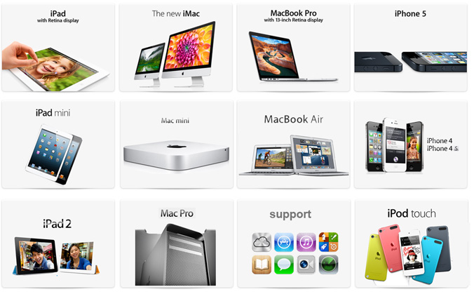
Brand Extensions
Brand extensions on the other hand tend to have a clear link with the original brand and the development represents a clear connection to the brand personality. When it is done you think this makes sense.

Slide 20
THE MARKETING MIX AS A COMPETITIVE ADVANTAGE
NEW PRODUCT DEVELOPMENT
Majority of new products - FAIL
Commitment of company
Leader or follower
New or tweak
Responsibility
the process

Slide 21
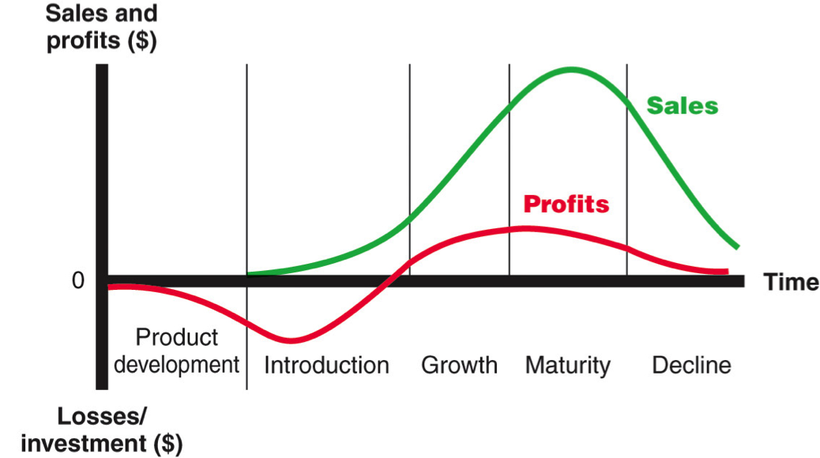
The Product Life Cycle
Research suggests that products, just like people, have a lifecycle. The graph shows a standard situation but it takes many shapes because the unknown part is just how long can they live? Now Steve Jobs has died will Apple continue to succeed in the market?
The PLC is at the heart of NPD, Ansoff and the GE matrix

Slide 22
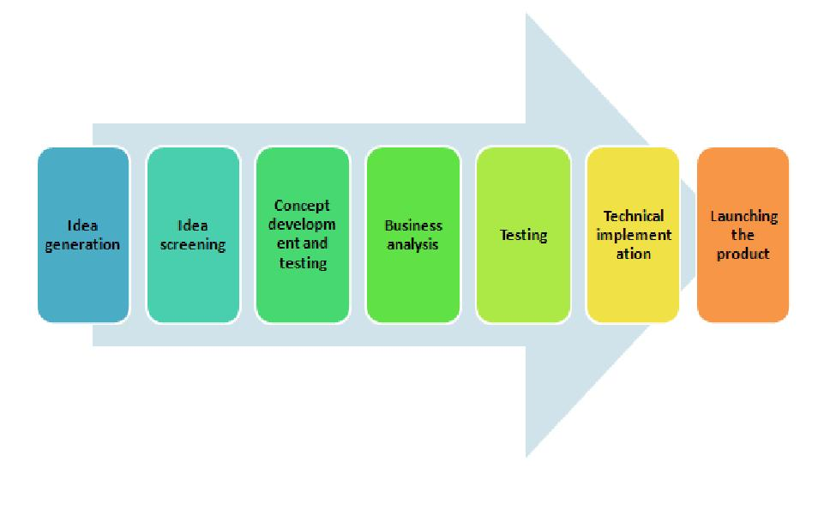
NEW PRODUCT DEVELOPMENT
Majority of new products - FAIL
Explains why seldom really new, mostly they are merely tweaks
Reflects the commitment of the company
Can be a Leader or a follower
Orgn needs to decide who is se responsible for it
There is a recognised process for NPD…..

Slide 23
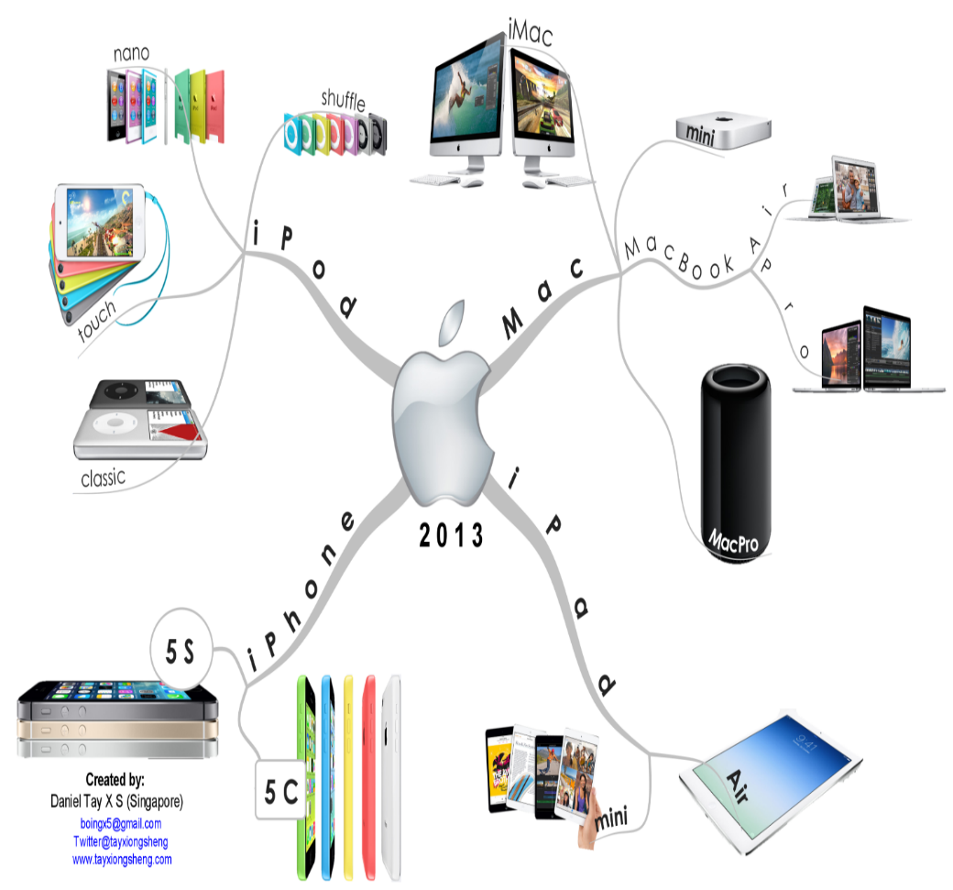
New Product Development
How we do it.
Find the “right” opportunities
Encourage creativity
Use market research
Trade sources
Past projects
Production variation
Use specialists

Slide 24
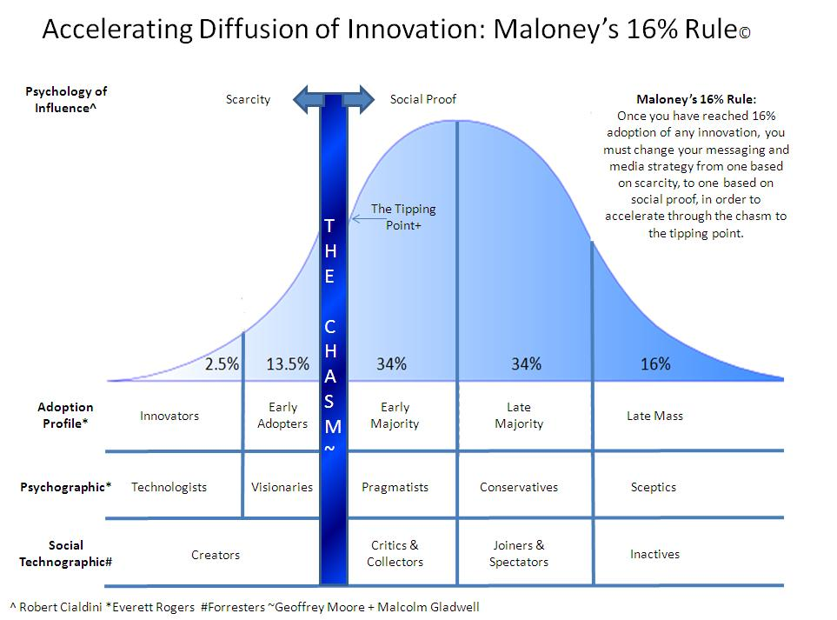
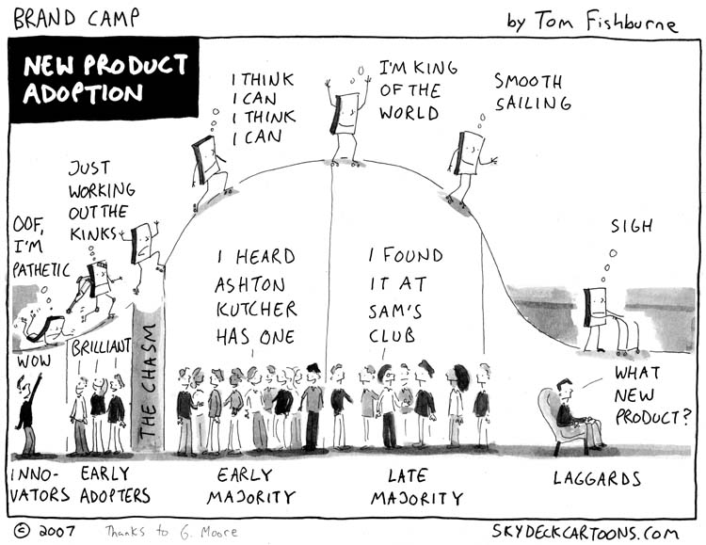
Diffusion of Innovation
– or how quickly we adopt NPD’s

Slide 25
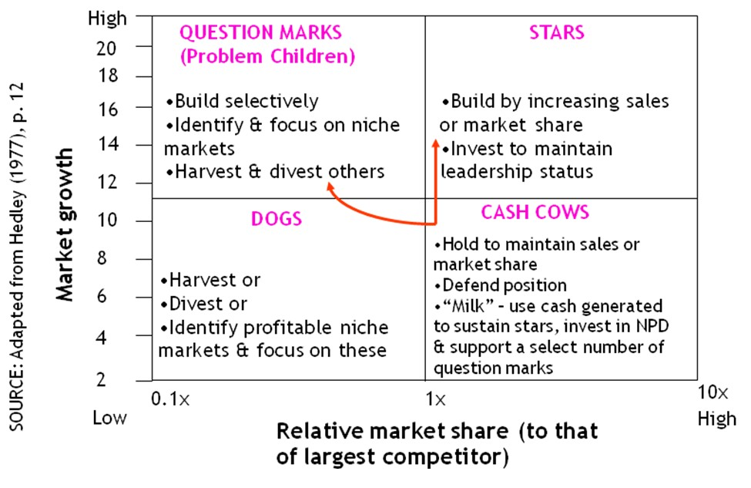
BCG Matrix
Developed form the extensive data held by Harvard Business School researchers were able to establish that market share and market growth were key indicators for businesses to use to evaluate the performance of their brands.
In placing their brands within this matrix marketers were able to make recommendations regarding investment and actions for individual brands within their portfolio.

Slide 26
Task
How can you present the way that Product is used in your company for the assignment?
Is it right?
Is it moving in the right direction?
Could it move in another direction?

