Slide 1
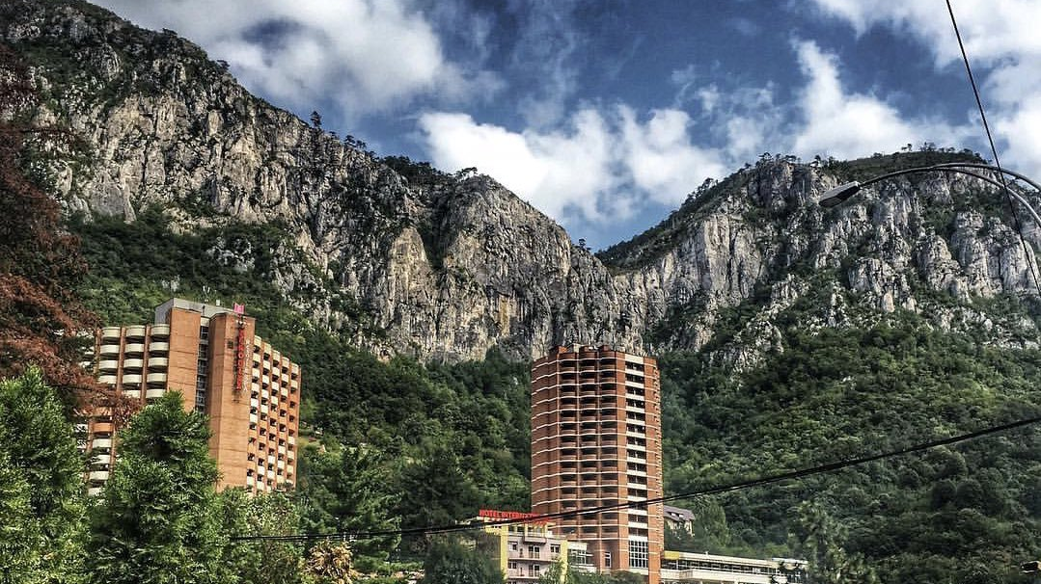
Presented by
Radu
Elisei
Costica
Andrei
Grand Hotel Minerva
Relaxation &Treatment base & SPA

Slide 2
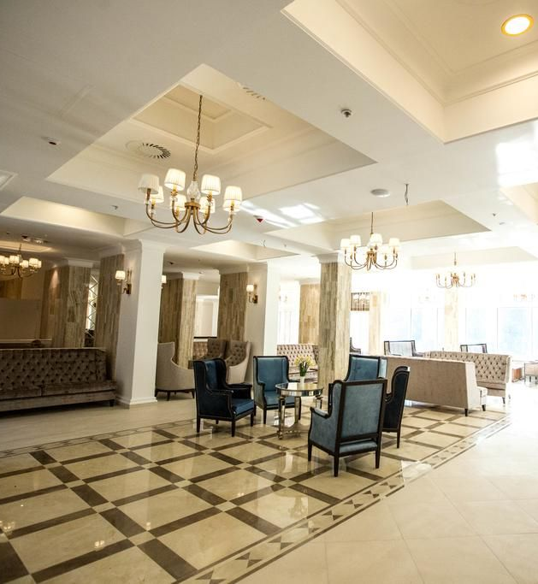
About us
Grand Hotel Minerva
Invites you to discover in Baile Herculane in the refinement, the hospitality and the comfort of a 4 star hotel, a special concept for one of the oldest balneo resorts in the world.

Slide 3
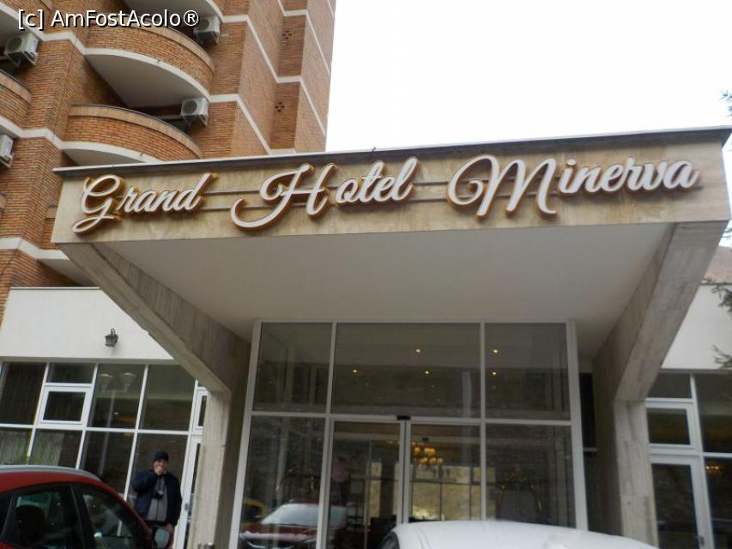
Overview
LANGUAGES SPOKEN BY STAFF
ENGLISH
FRENCH
GERMAN
ITALIAN
SPANISH
PET POLICY
WE WELCOME GUIDE DODS
CAR PARKING
FREE CAR PARK FOR GUESS
DISABILITY ACCES

Slide 4
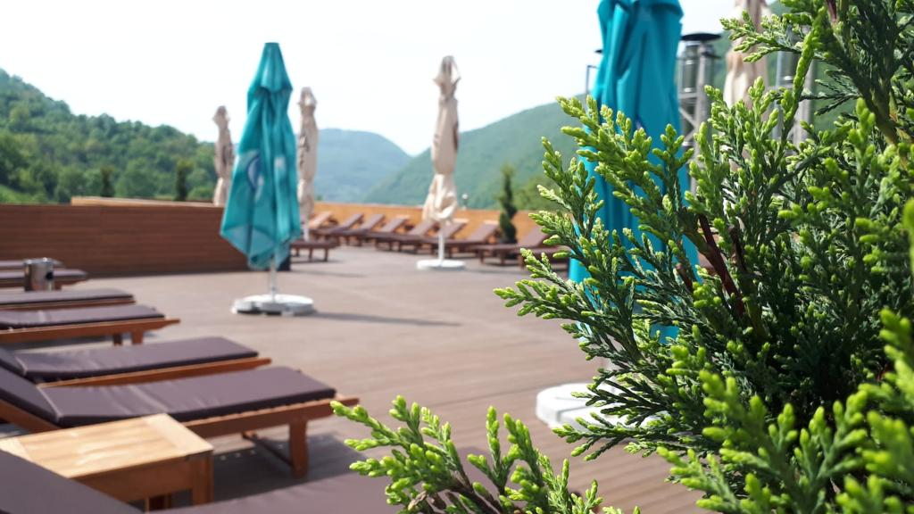
Grand Hotel Minerva is situated in the center of Baile Herculane resort in Romania , one of the oldest spa resorts in the world, famous for the miraculous thermal waters. It offers 185 guest rooms. Atmosphere, refinement and quality amenities will accompany you throughout the Grand Hotel Minerva experience.

Slide 5
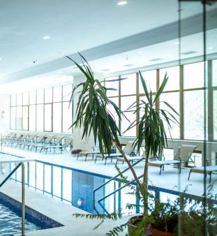
Services
We offer you medical examination like
Procedures that can be performed on our treatment base: Laser, Ultrasound, Magnetotherapy, Radiofrequency Therapy, Paraffin, Streams, Sulfur Baths, CO2 Baths, Galvanic Baths, Underwater Shower, Aerosols, Physical Therapy, , mud packing, of which:
Procedures with extra charge : ozonotherapy, tecar, laser. relaxing massages, mud packs, thermal wrapping,
The procedures are established directly by the balneo doctor, they can be changed only at the request and under the approval of the balneo physician.
Guests will receive the referral from their family doctor or specialist doctor(recommendation for balnear treatment )
Treatments take place from Monday to Saturday inclusive
Free access to Armonia Spa http://hotelminerva.ro/armonia-spa/
(swimming pools, fitness, Jacuzzi, kneipp baths, 5 saunas.
Guests receive dinner on check-in and breakfast on the check-out day

Slide 6
References:
Juwaheer T.D. and Ross, D. L., (2003). A study of hotel guest perceptions in Mauritius,international journal of contemporary hospitality management , Vol. 15, 2
Ford , R.C., Heaton, C., P., and Brown, S. W. (2001) Delivering excellent services. Lessons from the best firms , California Managements review , 44 (1): 39 - 56

Slide 7
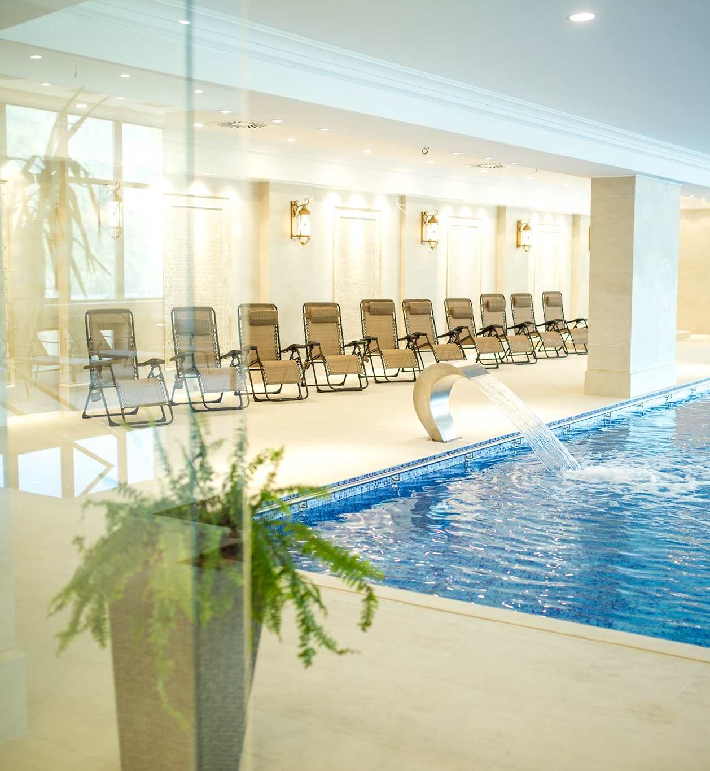
GUEST ROOM SERVICE
Whether you want to reward yourself at the end of an exhausting week, whether you are on holiday with your family or colleagues at teambuilding at Grand Hotel Minerva, you get rid of all the stress that drives you. Both matrimonial and twin rooms invite you to a good mood by warm colours and personalized furniture.
Classic Room ,Suite ,Apartaments-including
LCD – TV cable
Minibar
Air conditioning
Hairdryer
Slippers
Dressing
Phone
WiFi Internet

Slide 8
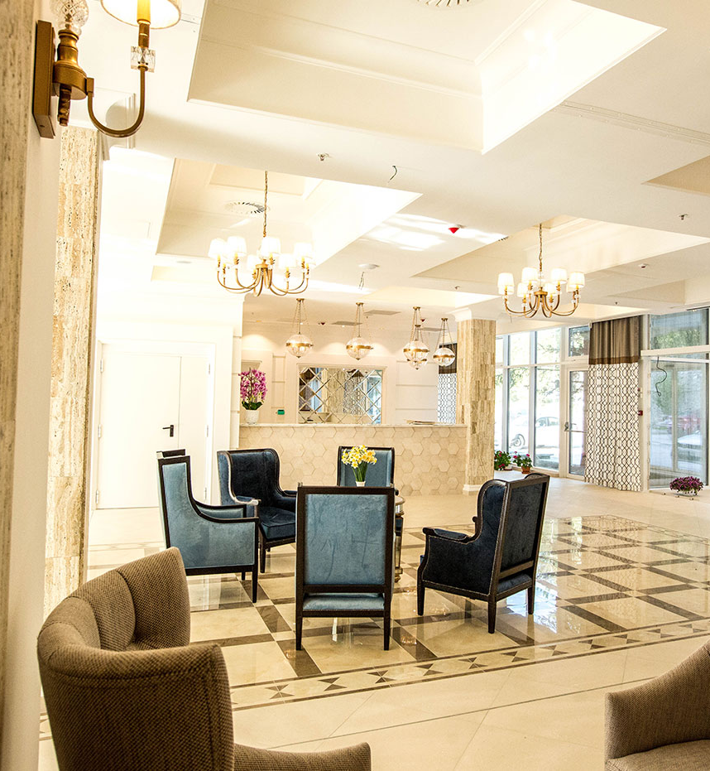
Product
We have for our guests more different types of accommodation
13 GHM Apartments
114 Matrimonial Rooms
50 Twin Rooms
8 Suite
2 restaurants and 2 terraces

Slide 9
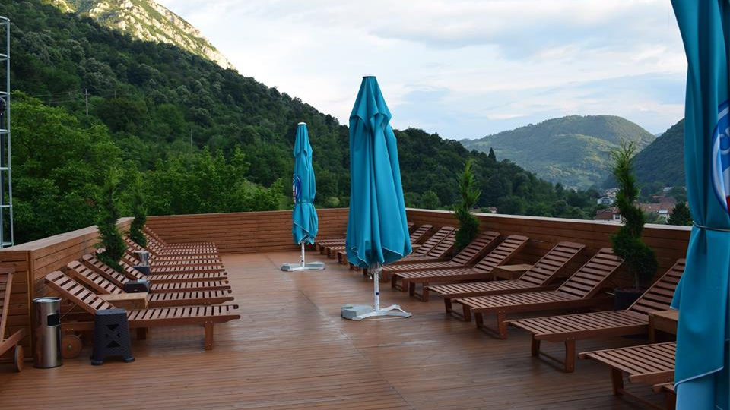
Guest Services
We welcome all guest
Smile to them
Offering what they need
Help them with any information
Talk with respect

Slide 10
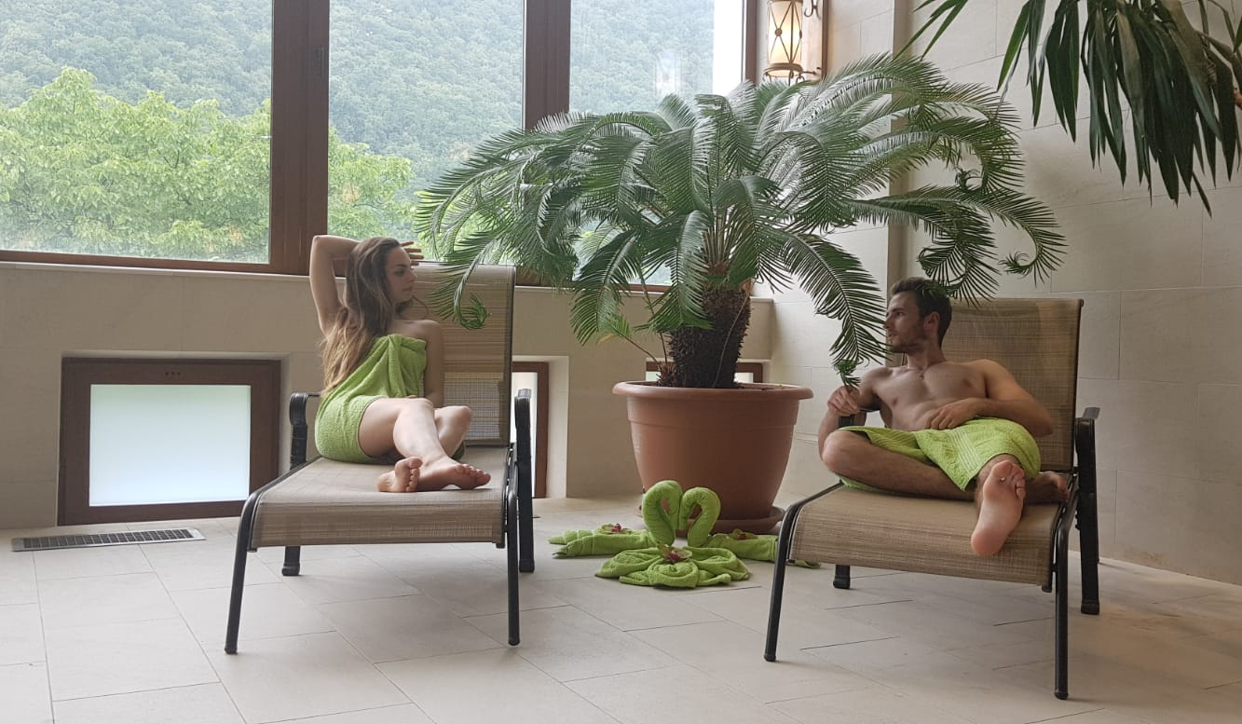
Strategies for guest service Experience
Everything was great! - meals (breakfast and dinner) served in buffet style. Although at first glance the options seemed limited, everything was delicious and fresh and you soon realized that no more needed. - the cleanliness was irreproachable, the linen was changed to two days, the towels daily. - Very clean and well-organized spa with massages and varied therapies. - very friendly and welcoming staff with children, even having a playground where they can spend their time.

Slide 11
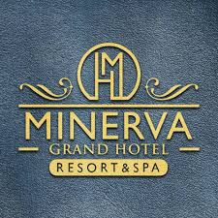
Conclusiuon
This hotel is also rated for the best value in Băile Herculane! Guests are getting more for their money when compared to other properties in this city.
Also has one of the best-rated locations in Băile Herculane! Guests are happier about it compared to other properties in the area.

