Slide 1
Name: Md Saidur Rahaman
Student ID:2541515
Subject: DS3 portfolio

Slide 2
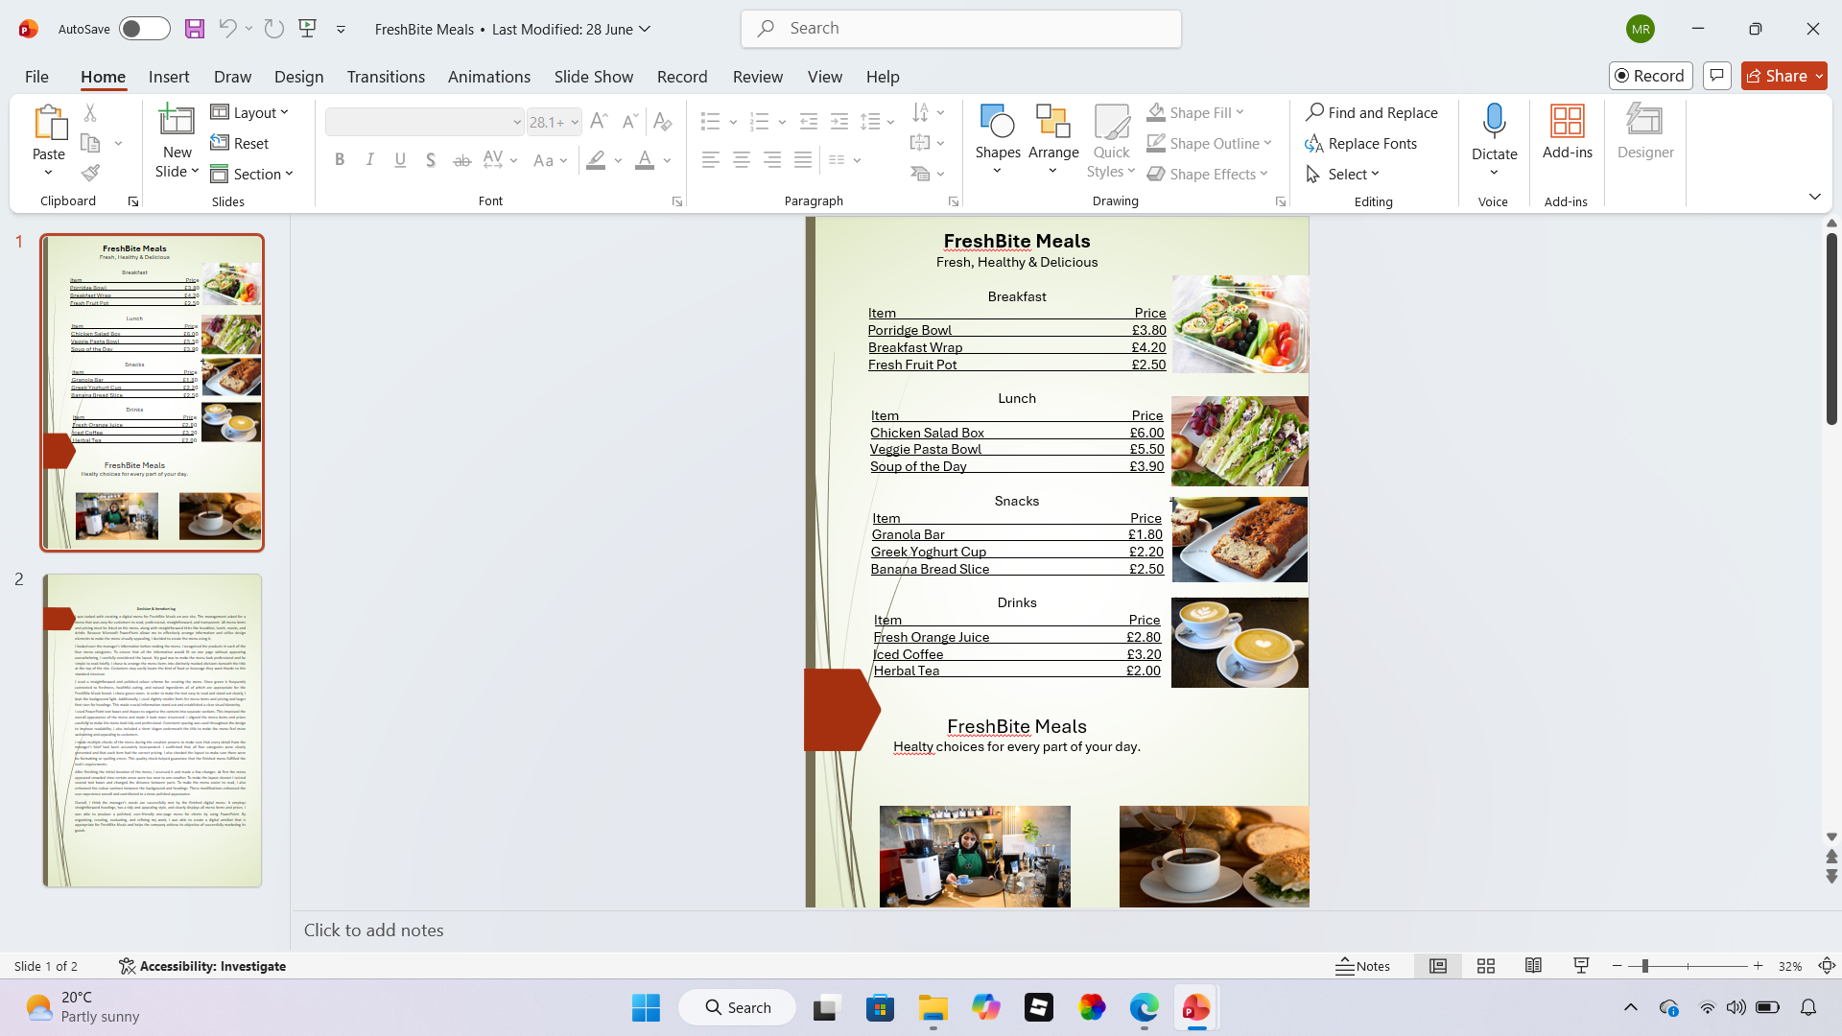
FreshBite Meals- Disital Menu Design
What the work is:
Created a one-page digital menu for FreshBite Meals.
Designed using Microsoft PowerPoint.
Included food items, prices, and images.
What skill it shows:
Graphic design and layout skills.
Use of Microsoft PowerPoint.
Clear presentation and visual communication.
What I learned:
How to create a professional menu design.
How to organise information clearly.
The importance of using colours, fonts, and images to attract customers.
This Photo by Unknown Author is licensed under CC BY-NC

Slide 3
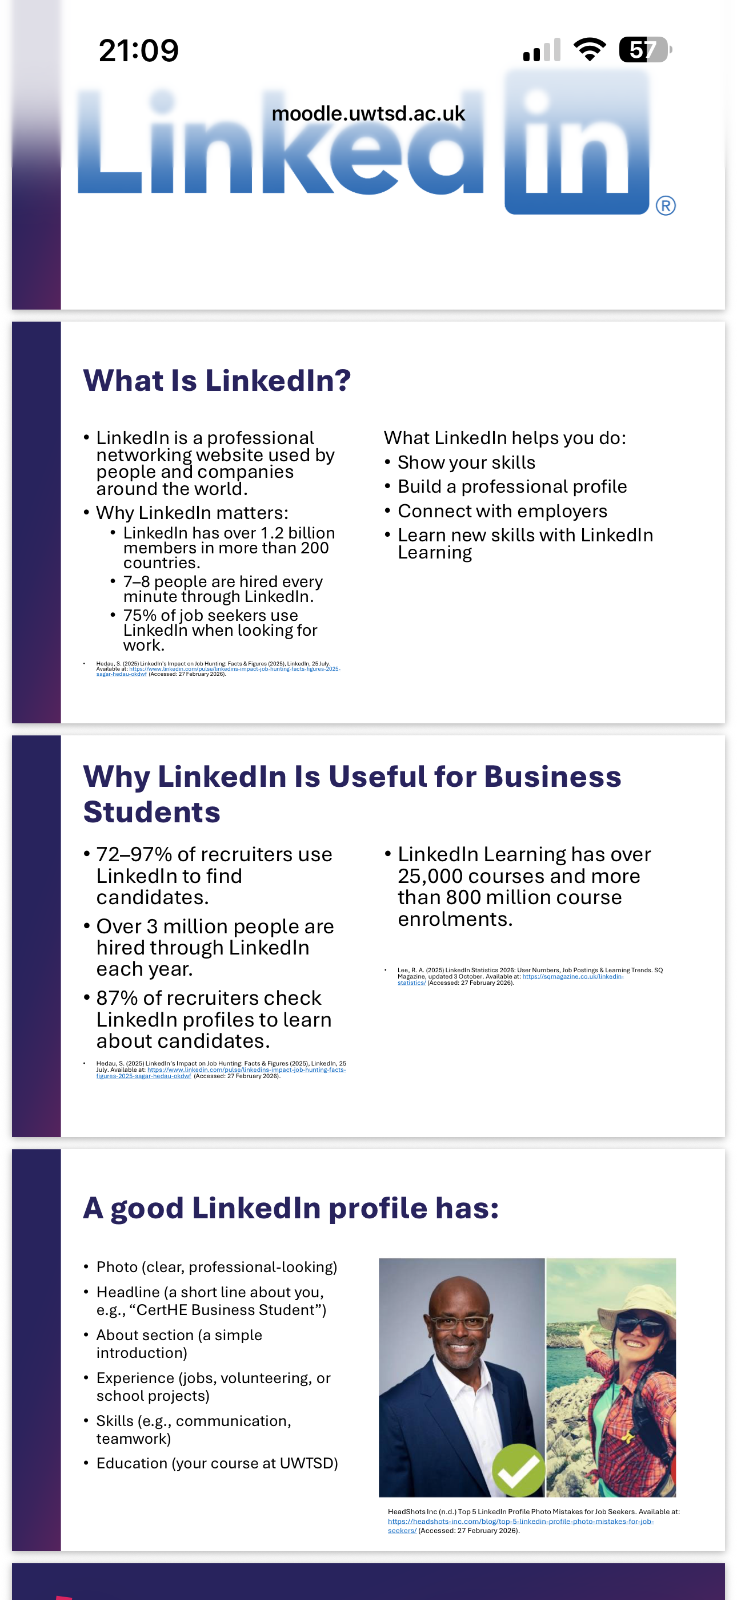
LinkedIn Presentation
What the work is:
A presentation explaining what LinkedIn is and why it is useful.
Covers how to create a professional LinkedIn profile.
Shows how LinkedIn can help students with careers and networking.
What skill it shows:
Presentation and communication skills.
Research and information gathering.
Digital literacy and professional networking knowledge.
What you learned:
How LinkedIn helps people connect with employers and professionals.
What makes a strong LinkedIn profile, such as a good photo, headline, skills, and experience.
How LinkedIn can improve job opportunities and support career development.

Slide 4
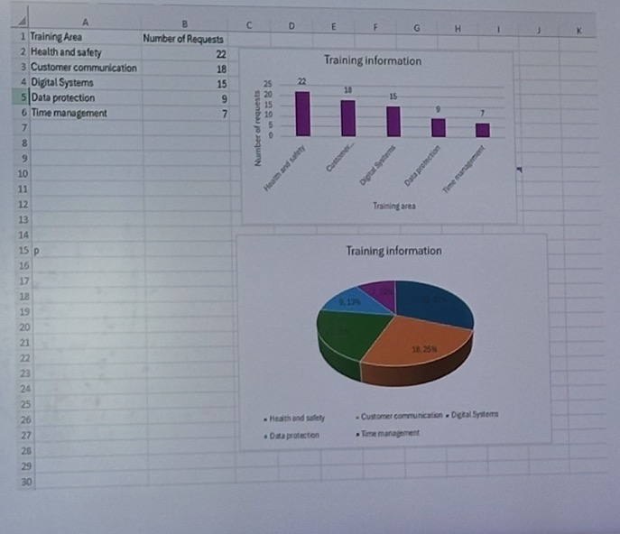
Excel Training Information Charts
What the work is:
  Created a data table in Microsoft Excel.
  Produced a bar chart and a pie chart to display training requests.
  Organised information to compare different training areas.
What skill it shows:
  Data entry and organisation.
  Creating and formatting charts in Excel.
  Presenting data clearly using graphs and charts.
What you learned:
  How to create different types of charts in Excel.
  How to choose the best chart to present data.
  How to make data easier to understand through visual presentation.

Slide 5
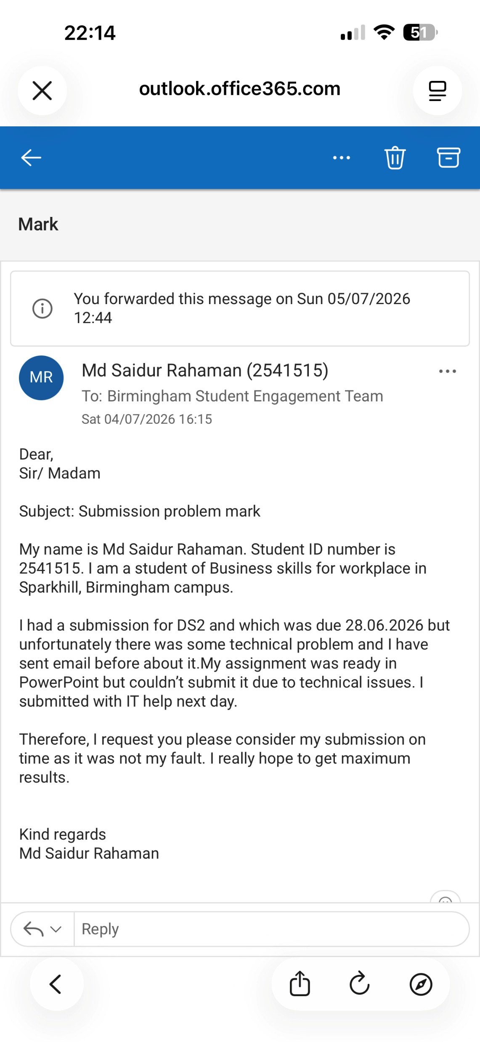
Writing formal email
What the work is:
This is the formal request email sent to the Birmingham Student Engagement Team.
The email asks for the late submission to be marked as on time.
What skill it shows:
Professional written, clear, polite, and formal correspondence for an academic writing.
Problem reporting and advocacy
Explaining circumstances accurately, providing supporting details, and making a reasonable request
What I learned:
How to structure a formal request email to get the right outcome.
The importance of keeping records of issues and contacting support promptly when problems arise.
How to explain technical delays clearly without being overly emotional.
It is wise to test submission systems well ahead of deadlines to leave time for unexpected issues.

Slide 6
Thank you

