Slide 1
GROUP NAME 3​
ANTHONIA AKPAN: 2026998​
SOCORRO ALAM: 2029042​
MOHAMMED AJMAL: 2112398 ​
LECTURER: JOANNE DAVIES​
MODULE CODE: BMSW 4002​
​
MODULE TITLE: EFFECTIVE TEAM WORKING AND COMMUNICATION
ASSIGNMENT TITLE: PRESENTATION – STRATEGIES FOR EFFECTIVE COMMUNICATION IN A BUSINESS SETTING .TASK 1 AND 2 "TEAMWORK EVALUATION"

Slide 2

INTRODUCTION
Communication can be defined as a medium of exchanging information via verbal and non- verbal methods.
It is a way People create affinity to chat with each other (Bramhall, 2014).
This has been the case in Rainbow Children's Hospital, where lack of effective communication has led to poor care given to Patients.
How can effective communication be restored in the Hospital to ensure positive change in the level of care to Patients?

Slide 3

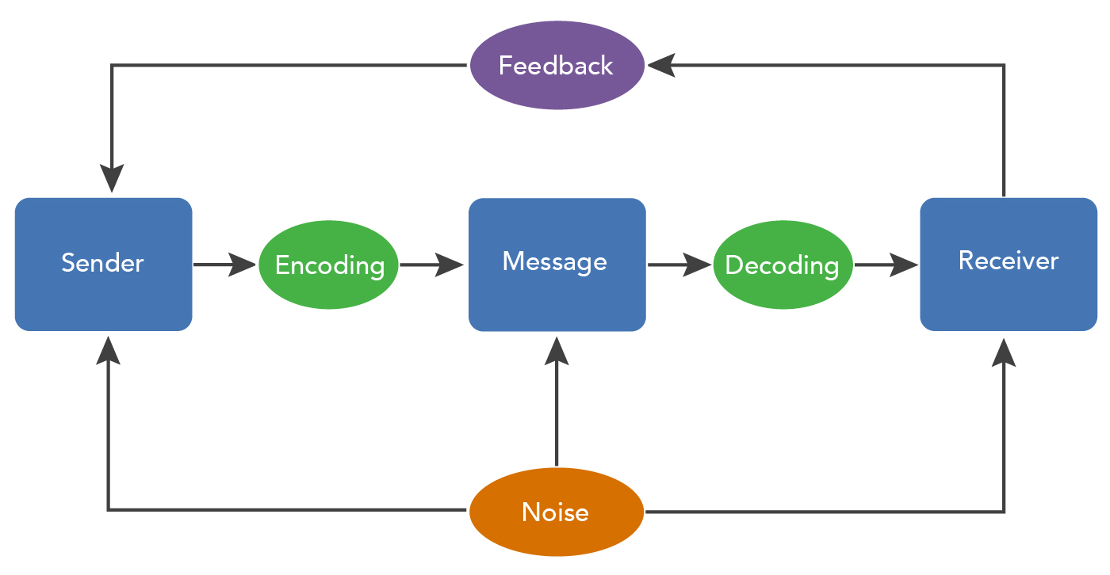
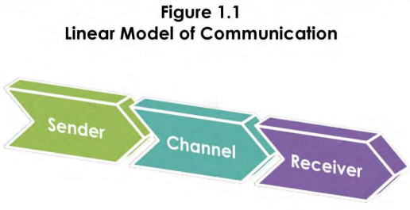
THEORIES RELATING TO MODELS OF COMMUNICATION
Shannon , and Weaver (1949)
This Photo by Unknown author is licensed under CC BY-NC-ND.
This Photo by Unknown author is licensed under CC BY.

Slide 4
THE CHANNELS OF COMMUNICATION USED BY THE ORGANISATION AND CHANNELS THAT CAN BE USED TO IMPROVE COMMUNICATION
The channels of communication in the Organisation is determined based on the structure of an Organisation (Lunenburg, 2010).
This structure are in three ways, Downward, Upward and Horizontal ( Lunenburg, 2010).
Channels that can be used to improve communication are numerous .
Face to face, rate as ( high rich) can meet physically .
Video conferencing, Telephone conversation.
E-mails, blogs, memos, written letters (med rich).
Formal doc , spreadsheet ( low rich) format is often rigid and standardized.

Slide 5
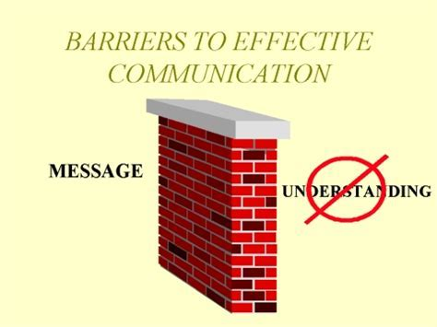
THE TYPE OF BARRIERS THAT CAN PREVENT EFFECTIVE COMMUNICATION BETWEEN THE ORGANISATION AND THEIR EXTERNAL STAKEHOLDERS
Barriers can be defined as anything that hinder an effective communication (Timothy, 1995).
Types of barriers includes external and internal noise.
Language, culture, Information overload Emotion.
Knowledge about the subject that will be communicated (Hogan,(2003).
Filtering, defensiveness, national culture, Insufficient attention.

Slide 6
THE IMPACT OF EFFECTIVE COMMUNICATION ON THE STAFF AND PATIENTS
Effective communication between Staff and Patients has many benefits such as -
Reducing mis-communication thus reducing complaints from Patients and their Parents.
Reducing stress on Staff and Patients.
Much improvement in the Patient experience.
Creates more transparency and openness between Staff and Patients.
Creates a better working environment for the Staff.

Slide 7
CONCLUSION
It has been ascertained in this presentation that communication is very essential in an Organisation.
Effective Communication in an Organisation is bound to lead to higher goal achievement and productivity.
It is recommended to the Management of The Rainbow Children's Hospital to utilise Schramm's model of communication (Schramm, 1949) in order to improve communications between the Staff, Patients and their Parents.
This method of communication is the best one due to its facility of feedback which other methods of communication do not have.

Slide 8
REFERENCES
Berlo,K.(1960) The Process of Communication: An Introduction
to Theory and Practice. New York: Holt, Rinehart and Winston.
Blythe, J,(2010) "Trade fairs as Communication: A New Model".
Journal of Business and Industrial Marketing.
Bramhall, E.(2014) Effective Communication Skill in Nursing Practice. Journal of Nursing Standard. Vol29,pp.53.
Hogan, K. and Stubbs, C.(2003) Can't Get Through: 8 Barriers to Communication. Louisiana: Pelican Publishing Company.
Lunenburg, F.(2010) Formal Communication Channels: Upward,
Downward, Horizontal and Eternal. Focus on Colleges, Universities and Schools vol.4, pp. 1-5.
Narula, U.(2006) Communication Models: New Delhi. Atlantic Publishers and Distributors (P) Ltd.

Slide 9
Schramm, ,W.,(1949) Mass Communication .Urbana: University of Illinois Press
Shannon, E. and Weaver, W.( 1949) The mathematical Theory of Communication: Urbana IL: University of Illinois Press.
Quill, T. E. ( 1995) "Barriers to Effective Communication" In the Medical Interview )pp.110-121) Springer, New York, NY.

Slide 10
Teamwork Evaluation | Team responses.
Who was in your team? | Anthonia Akpan, Socorro Alam and Mohammed Ajmal
What were the key strengths of your team? | We worked very well together. We had mutual respect for each other.
What were the challenges that you overcame as a team? | The only challenge we had was to get together before lecture start time as two out of three of us live very far from Birmingham. We overcame this by meeting up an hour before lecture started.
What would you do differently if you worked as a team again? | Nothing. We worked so well together.
How would you rate your team working? Out of 10? | 10

