Slide 1

Llwybr y Gymraeg
Welsh Pathway
ECAD6013
Grŵp C – Darlith/Lecture 2
Catrin Evans-Thomas

Slide 2
Llwybr y Gymraeg
Welsh Pathway ECAD6013
Sut cyrhaeddon ni yma / How did we get here?
Y Cwricwlwm Newydd
Y Fframwaith – ble ydw i? / The Framework – where am I?
Y Portffolio / The Portfolio
Nod Ac Amcanion
Aims and Objectives
Sesiwn 2

Slide 3
Sut cyrhaeddon ni yma?
How did we get here?

Slide 4


Slide 5
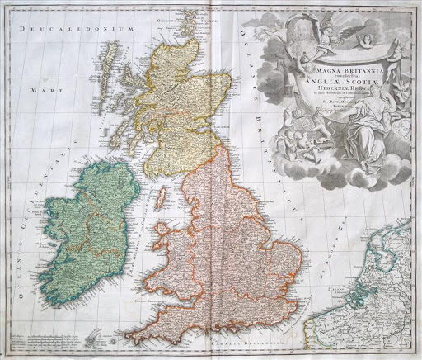
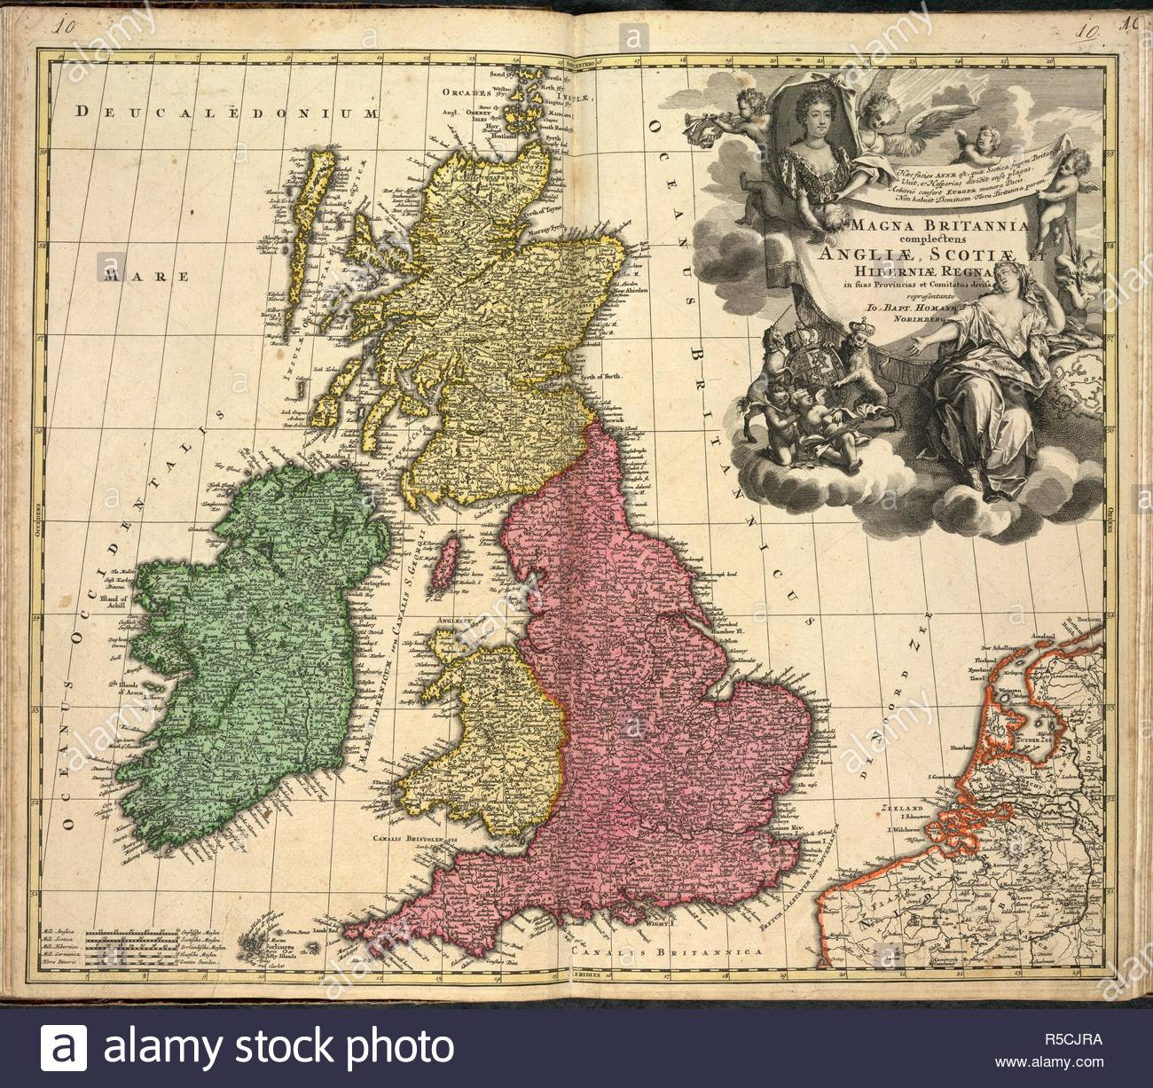
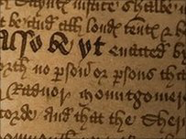
1536 | Deddf Uno Act of Union | Mae Harri Tudur eisiau unffurfiaeth rhwng Cymru a Lloegr, er mwyn undod a gweinyddiaeth effeithiol. | In order to create unity and effective administration between Wales and England, Henry Tudor orders this Act of Union.
1542 | Deddf Uno Second Act of Union | Ail Ddeddf Uno | Second Act of Union
Notes:
Doedd dim digon o fanylder yn y ddeddf gyntaf felly roedd rhaid cael ail ddeddf I lenwi’r bylchau.
The people of Wales... do daily use a speech nothing like the natural mother tongue used in England... From henceforth no persons that use the Welsh speech or language shall enjoy any... office or fees within this realm of England and Wales.

Slide 6
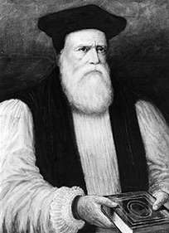
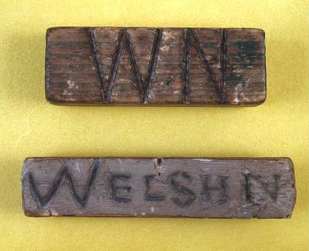
1588 | Beibl Cymraeg Welsh Bible | Cyhoeddir Beibl Cymraeg William Morgan | Bishop William Morgan’s Welsh Bible is published
1847 | Brad y Llyfrau Gleision Treason of the Blue Books | Dyma’r enw a roddir ar gyfnod adroddiad ar gyflwr addysg yng Nghymru a gomisiynwyd gan llywodraeth Lloegr a’i effeithiau. Gwelwyd arfer y “Welsh Not” a chosb gorfforol am gyfathrebu yn y Gymraeg yn sgil argymhellion yr adroddiad. YouTube | This is the name given to the period of the reports into education in Wales commissioned by the government in England, and its effects. The use of the Welsh Not and physical punishment were used to prevent the use of Welsh in schools as a result of the report.
Notes:
Roedd fersiynau, ond dyma’r tro cyntaf I’r Beibl cael ei gyfeithu yn ei gyfanrwydd.

Slide 7

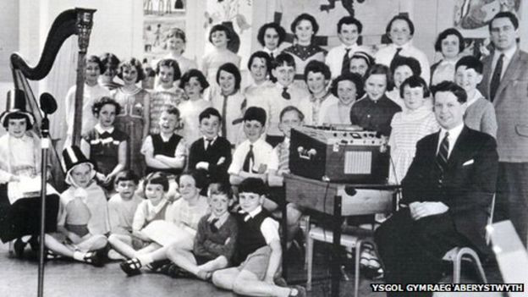
1922 | Urdd Gobaith Cymru | Sefydlir Urdd Gobaith Cymru “Nod yr Urdd yw sicrhau cyfle, trwy gyfrwng yr iaith Gymraeg, i holl ieuenctid Cymru (rhwng 8 a 25 oed) ddatblygu’n unigolion cyflawn; a’u galluogi i chwarae rhan adeiladol yn y gymdeithas gan feithrin sgiliau personol a chymdeithasol.” | Urdd Gobaith Cymru (Welsh Youth Movement) is founded. “Urdd Gobaith Cymru's aim is to provide the opportunity, through the medium of Welsh, for the children and young people in Wales to become fully rounded individuals, developing personal and social skills that will enable them to make a positive contribution to the community.”
1939 | Ysgol gynradd gyfrwng Gymraeg gyntaf First Welsh language private primary school | Agorir Ysgol Lluest yn Aberystwyth. Ysgol breifat. | Ysgol Lluest in Aberystwyth opens. Private school.

Slide 8
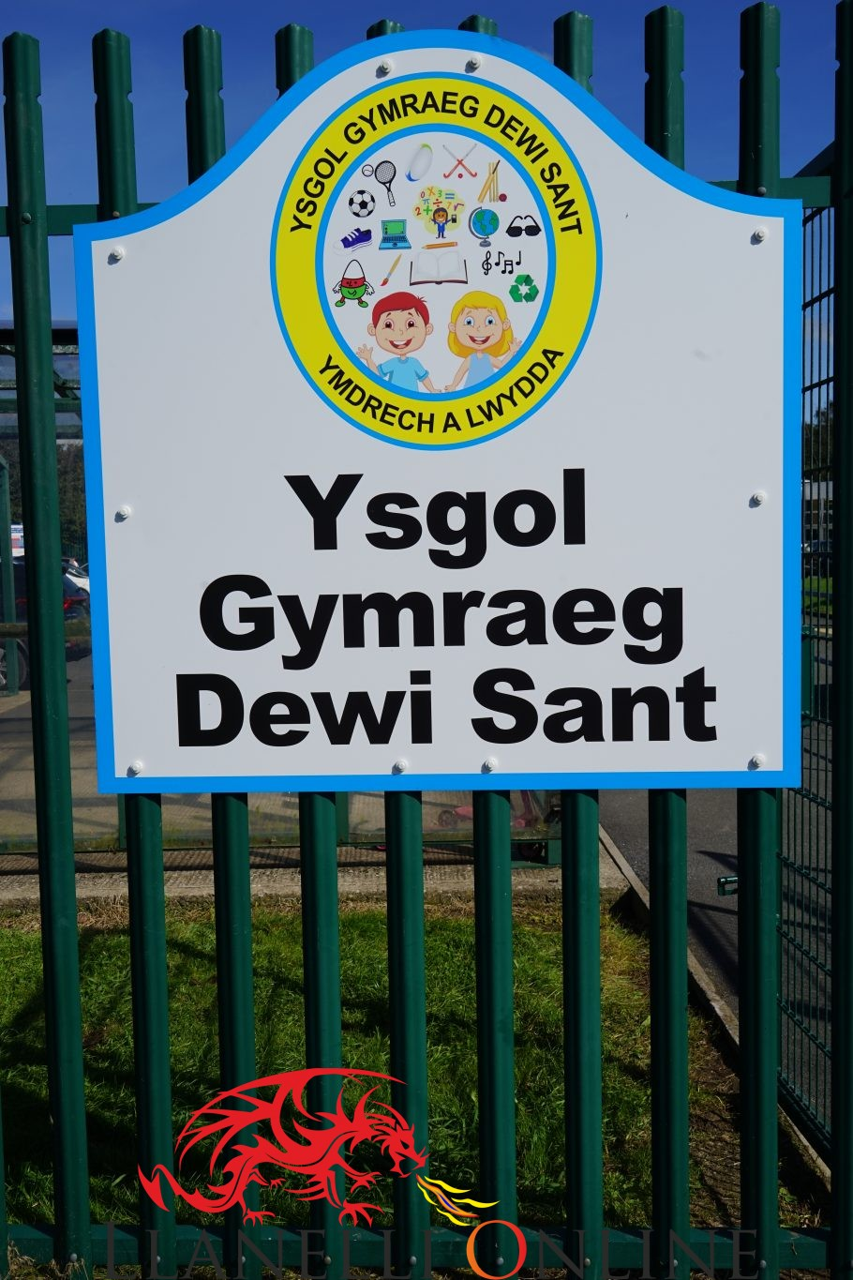

1947 | Ysgol gynradd Gymraeg gyntaf First Welsh language state primary school | Agorir Ysgol Dewi Sant, Llanelli. Ysgol o dan yr awdurdod lleol. | Ysgol Dewi Sant, Llanelli opens. Local authority school.
1956 | Ysgol Uwchradd Gyfrwng Cymraeg gyntaf First Welsh language state secondary school | Agorir Ysgol Glan Clwyd, Y Rhyl. | Ysgol Glan Clwyd, Y Rhyl opens.

Slide 9
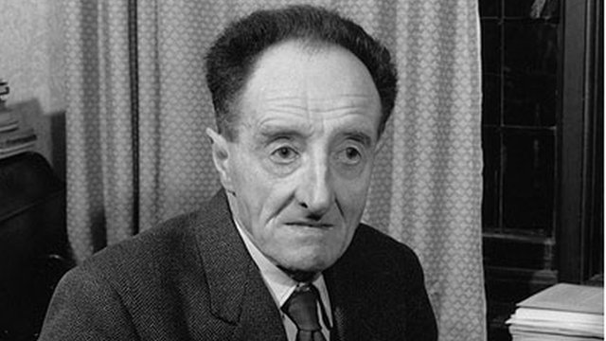
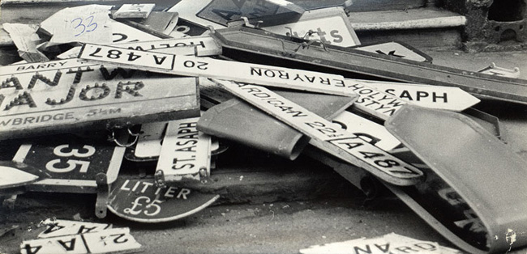
1962 | ‘Tynged yr Iaith’ The Fate of the Language’ | Darlledir darlith Saunders Lewis ‘Tynged yr Iaith’ yn annog sefydlu Cymdeithas yr Iaith Gymraeg. Mae Lewis yn rhagweld marwolaeth y Gymraeg yn gynnar yn yr unfed ganrif ar hugain. | Saunders Lewis delivers his lecture ‘The Fate of the Language.’ This encourages the formation of the Welsh Language Society. Lewis foresees the death of the Welsh Language by the start of the 21st century.
1962 | Cymdeithas yr Iaith Gymraeg Welsh Language Society | Sefydlir Cymdeithas yr Iaith er mwyn codi proffil a statws y Gymraeg, gan ganolbwyntio yn bennaf ar wysion Cymraeg, gwasanaeth swyddfeydd post a thrwyddedau cerbydau a gweld arwyddion dwyieithog yn cael eu codi. | Cymdeithas yr Iaith Gymraeg is established to raise the profile of Welsh, by focussing primarily on Welsh services, post office services and licenses, as well as bilingual signs.
https://www.youtube.com/watch?v=aKhvyg79mVo
https://www.youtube.com/watch?v=x5L6L-1UgjQ
https://www.youtube.com/watch?v=WCr8_TgdS60
https://www.youtube.com/watch?v=upkDEvGMzc8
https://www.youtube.com/watch?v=qlBiVv_alSs
https://www.youtube.com/watch?v=qta9Z1gXHr0
https://www.youtube.com/watch?v=GsA2jUUv9lY

Slide 10
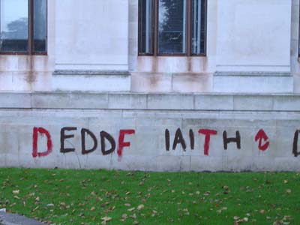
1967, 1993 | Deddfau’r Iaith Gymraeg Welsh Language Acts | Rhoddir dilysrwydd cyfreithiol i’r Gymraeg ac i’r Saesneg. | Legal validation is given to both Welsh and English.
1993 | Deddf yr Iaith Gymraeg | Mae’r Gymraeg yn cael yr un statws â Saesneg ym mywyd cyhoeddus Cymru. | Welsh given equal status to English in public life in Wales

Slide 11

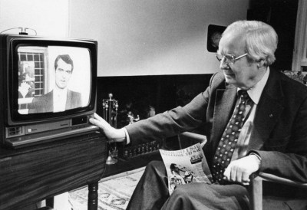
1971 | Mudiad Meithrin | Sefydlir (Mudiad Ysgolion Meithrin gynt) er mwyn hybu addysg feithrin Gymraeg. | Formerly, Mudiad Ysgolion Meithrin. The movement is established to promote Welsh medium nursery education.
1982 | S4C | Mae S4C yn dechrau darlledu | Welsh medium television channel starts broadcasting.

Slide 12

1997 | Pleidlais datganoli Devolution referendum | Mae Cymru’n pleidleisio’n agos o blaid datganoli. | Wales votes narrowly for devolution.

Slide 13
Deddfwriaeth a pholisi
Legislation and policy
2003 Iaith Pawb
2008 Statws yn Ewrop
Mesur yr Iaith Gymraeg (Cymru) 2011
Mesuriadau Ansawdd Estyn
Strategaeth Addysg Cyfrwng Cymraeg
Iaith Fyw: Iaith Byw, Llywodraeth Cymru 2012
2017:
Cymraeg 2050, Miliwn o Siaradwyr Cymraeg
2003 National action plan.
2008 Status in Europe
Welsh Language (Wales) Measure 2011
Estyn’s Quality Indicators
Welsh Medium Education Strategy
A Living Language: a Language for Living, Welsh Government 2012
2017:
Cymraeg 2050, a million Welsh speakers
Notes:
Deddfwriaethau a pholisïau pwysig…
Mesur yr Iaith Gymraeg
Mesuriadau Answadd Estyn

Slide 14


Ffilm – Hanes y Gymraeg
History of the Welsh Language
Ffilm 1: Cysgodion Ddoe
PWYNTIAU TRAFOD / DISCUSSION POINTS
Pam oedd gostyngiad yn nifer y siaradwyr Cymraeg
yn ystod yr 20fed ganrif?
Why did the number of Welsh speakers decrease so much
during the 20th century?
· Beth yw effeithiau hir dymor y Deddfau Uno
a Brad y Llyfrau Gleision.
What are the lasting effects of the Acts of Union
and the Treason of the Blue Books?
Diolch i Golegau Cymru a Llywodraeth Cymru.
With thanks to Colegau Cymru and the Welsh Government.
Notes:
Moving on now to focus on the Welsh language itself… Maybe go back to the 'post-its' to see what they wrote there - were there any facts about the language? Someone might have written something about the Welsh Not, for example. Let's say we now want to understand more about the history of the Welsh language through this film.
Cwestiynau Sbardun
Ffilm gyntaf Colegau Cymru
• Beth ydy Cymreictod i chi?
What does being Welsh mean to you?
• Pa fath o bobl sy’n siarad Cymraeg?
Who do you think speaks welsh?
• Oeddwch chi’n gwybod bod 1 o bob 5 yn siarad Cymraeg?
1 in 5 speak Welsh? Did you know this?
• Mae ½ poblogaeth Cymru â rhywfaint o Gymraeg...
½ population has some knowledge...
• Ydy’ch teulu’n siarad Cymraeg? Oedd Cymraeg yn cael ei siarad yn eich
teuluoedd?
Is there Welsh in your family? Was there Welsh?
• Beth yw dy farn am yr hyn a ddigwyddodd i’r Gymraeg? Oedd e’n
angenrheidiol i’r genedl uno â Lloegr?
What do you think about what happened to the Welsh language? Was it
necessary to unify Wales and England?
• Pam oedd gostyngiad yn nifer y siaradwyr Cymraeg yn ystod yr 20fed
ganrif?
Why did the number of Welsh speakers decrease so much during the
20th century?
• Beth yw effeithiau hir dymor y deddfau uno a brad y llyfrau gleision.
What are the lasting effects of the acts of Union and the Welsh not?

Slide 15



Ffilm – Mwy o’r Gymraeg
More History of the Welsh Language
Ein Hiaith: Ffilm 2
· Beth oedd y trobwynt a gwelwyd yn ystod yr 20fed ganrif?
What was the turnng point in the 20th century?
· “For the Welsh Language to survive it needed to be valued.”
Trafodwch/ Discuss.
· Oeddech chi’n ymwybodol o hanes sefydlu S4C? Oeddech chi’n gwybod am fygythiad Gwynfor Evans?
Did you know about S4C? Gwynfor Evans’ hunger strike threat.
· Pa mor bwysig oedd sefydlu S4C yn eich barn chi?
How important in S4C in your opinion?
Diolch i Golegau Cymru a Llywodraeth Cymru.
With thanks to Colegau Cymru and the Welsh Government.
Notes:
B

Slide 16
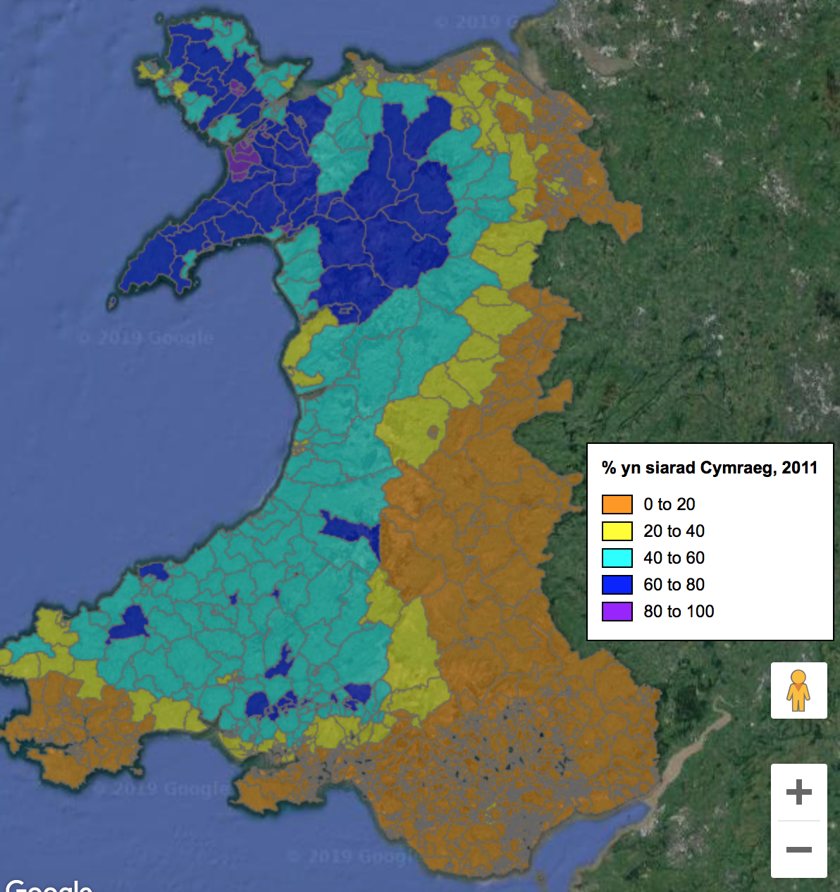
Nifer o siaradwyr Cymraeg yn ôl cyfrifiad
2011 (%)
Number of Welsh speakers according to 2011 census (%)

Slide 17
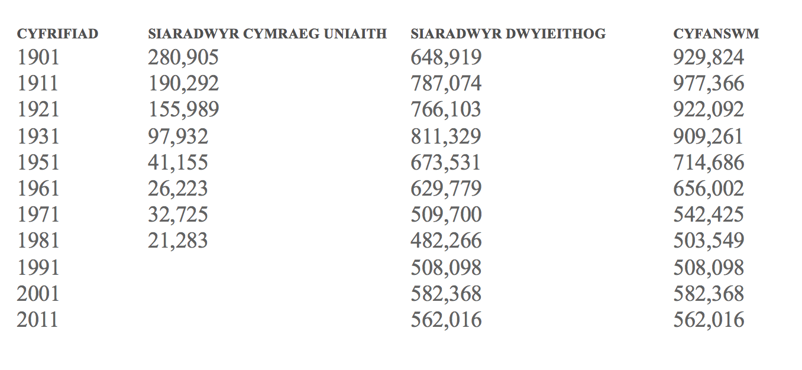
Y ganrif hon / This century

Slide 18
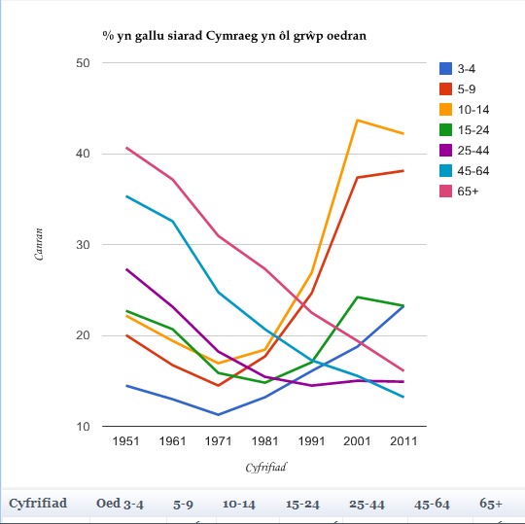
Nifer o bobl â pheth gallu i siarad Cymraeg
Number of people with some ability to speak Welsh
2011
Sir Gaerfyrddin / Carmarthenshire 105,032
Gwynedd 88,853
Caerdydd / Cardiff 54,504
Sir Fon / Anglesey 47,821
Abertawe / Swansea 45,085
RhCT / RCT 44,911
Conwy 44,614
Ceredigion 43,366
*Diolch i https://statscymru.llyw.cymru/Catalogue/Welsh-Language
Notes:
Niferoedd y cyfrifiad yn dangos bod nifer o Gymry yn nodi bod peth gallu ganddynt i siarad Cymraeg… Efallai y bydd y ffigyrau yn peri syndod.

Slide 19
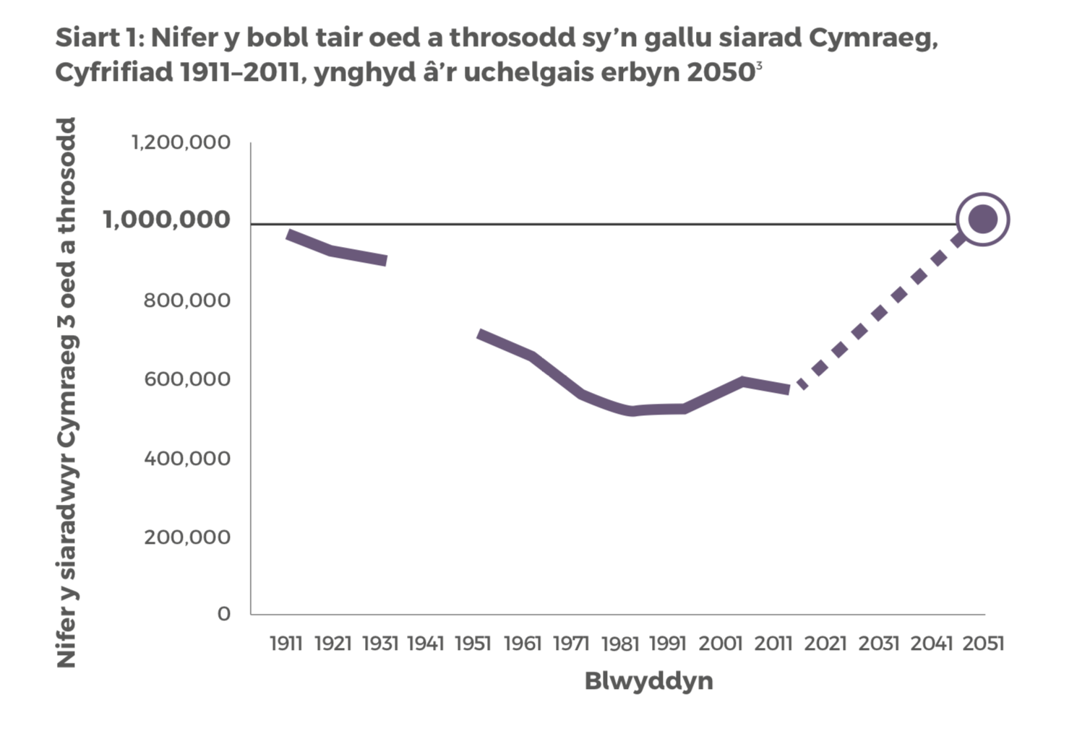

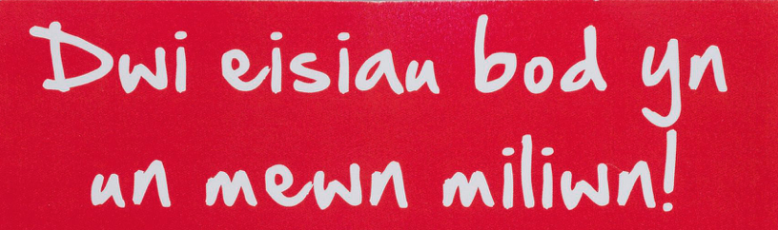

Slide 20

Ond, sut mae cael mwy o siaradwyr Cymraeg?
But, how do we get more Welsh speakers?

Slide 21
Beth amdanon ni? What about us?
“… y system addysg a hyfforddiant yw’r prif ddull o greu siaradwyr Cymraeg newydd.”
(tud 31, Cymraeg 2050 Miliwn o Siaradwyr)
"….since there is a limit to the additional number of Welsh speakers which can be created by language transmission from one generation to the next, the education and training system is the principal method of creating new Welsh speakers."
(page 31, Cymraeg 2050 A million Welsh speakers)
Notes:
One answer is on page 31 of the document itself and it reads ……
So, we have a HUGE responsibility on OUR shoulders!

Slide 22
Y cwricwlwm newydd
The new curriculum

Slide 23
Cwricwlwm i Gymru 2022
Curriculum for Wales 2022
Mae wedi cael ei ddatblygu yng Nghymru gan ymarferwyr ar gyfer ymarferwyr, gan ddwyn ynghyd arbenigedd addysgol ac ymchwil a thystiolaeth ehangach.
It has been developed in Wales, by practitioners for practitioners, bringing together educational expertise and wider research and evidence.
Cliciwch ar y llun i weld y ddogfen.
Click on the picture to view the document.
https://hwb.gov.wales/api/storage/afca43eb-5c50-4846-9c2d-0d56fbffba09/curriculum-for-wales-guidance-120320.pdf
Notes:
At the moment we are in the transitioning period between our current Curriculum and the new Curriculum which will be established in September 2022.
But, what you will find is that schools are experimenting with new ways of teaching and new ways of organizing classes and subjects.
The most important facts to remember about this curriculum is that it is NOT a translation is a new Curriculum written for Wales with Wales and the Welsh language central to its vision.
Some of the main differences between our current curriculum and the new curriculum is that the education system will be driven by four purposes. The aim of the school’s curriculum is to support its learners to become:
1. ambitious, capable learners, ready to learn throughout their lives;
2. enterprising, creative contributors, ready to play a full part in life and work;
3. ethical, informed citizens of Wales and the world;
4. healthy, confident individuals, ready to lead fulfilling lives as valued members of society.
And another huge change, especially when teaching in the secondary sector is that the curriculum is lead by six different Areas of learning and Experiences and NOT by the traditional 11 or 12 subjects.
1. Expressive Arts
2.Health and Well-being
3. Humanities
4.Languages, Literacy and Communication
5.Mathematics and Numeracy
6.Science and Technology
Mandatory curriculum elements:
Religion, values and ethics.
Relationships and sexuality education (RSE)
WELSH
English Mandatory cross-curricular skills are Literacy, Numeracy and digital competence. So, as you can see WELSH is stated clearly as in integral part of the new curriculum for Wales.

Slide 24

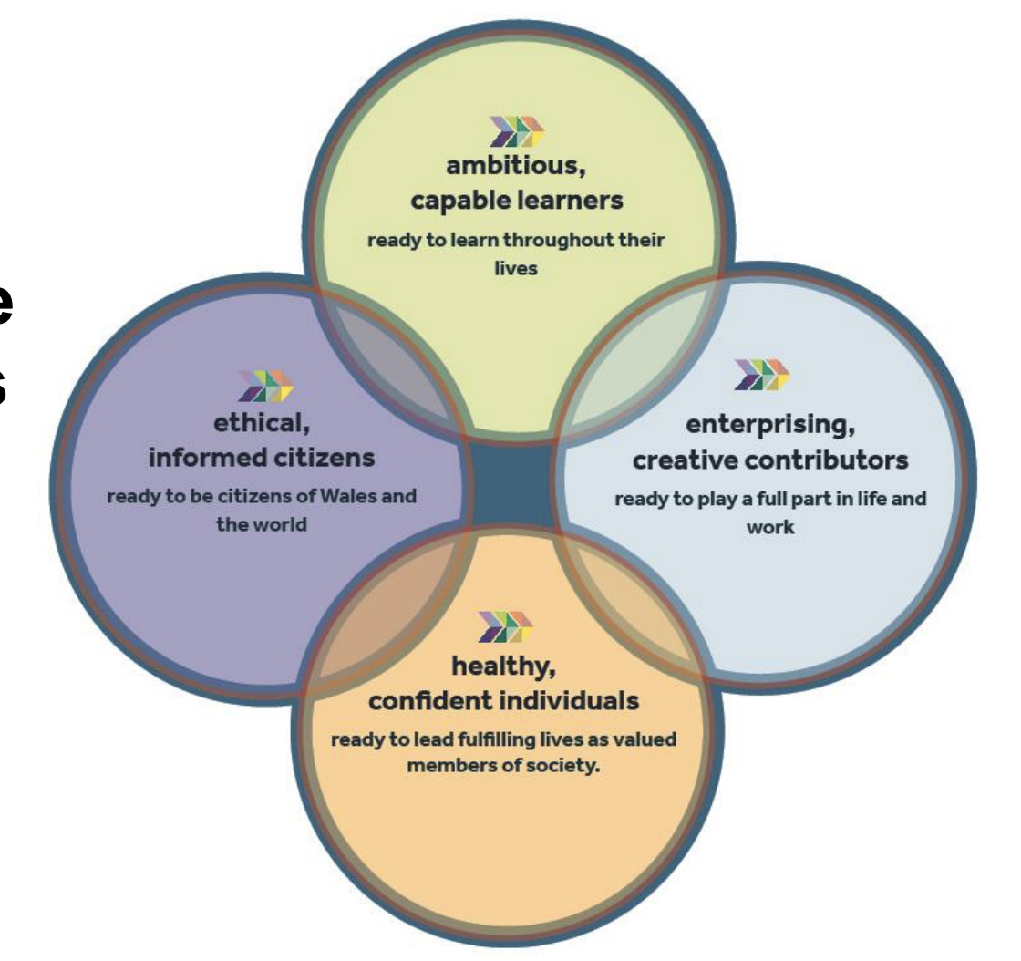
Y Pedwar Diben
The Four Purposes

Slide 25
Cwricwlwm i Gymru 2022
Curriculum for Wales 2022
Gwella addysg yw ein cenhadaeth genedlaethol. Does dim yn fwy hanfodol na bod pob plentyn a pherson ifanc yn caffael addysg ac yn cael mynediad cyflawn at y profiadau, yr wybodaeth a’r sgiliau y mae eu hangen arnyn nhw ym myd gwaith, ar gyfer dysgu gydol oes ac er mwyn bod yn ddinasyddion gweithredol.
Mae canllawiau Cwricwlwm i Gymru yn datgan yn glir beth sy’n bwysig wrth ddarparu addysg eang a chytbwys. Gweledigaeth ar y cyd yw’r pedwar diben, a dyma’r dyhead ar gyfer pob plentyn a pherson ifanc. Wrth wireddu’r rhain, rydym yn gosod disgwyliadau uchel i bawb, yn hyrwyddo lles personol a chenedlaethol, yn herio anwybodaeth a ffug-wybodaeth, ac yn annog dysgwyr i chwarae eu rhan fel dinasyddion effro a beirniadol.
Cwricwlwm yr ysgol yw popeth mae dysgwyr yn ei brofi ar drywydd y pedwar diben. Mae’n fwy na’r hyn rydyn ni’n ei addysgu yn unig. Mae hefyd yn ymwneud â sut rydyn ni’n ei addysgu ac, yn allweddol, pam ydyn ni’n ei addysgu.
Improving education is our national mission. Nothing is so essential as universal access to, and acquisition of, the experiences, knowledge and skills and that our young people need for employment, lifelong learning and active citizenship.
The Curriculum for Wales guidance is a clear statement of what is important in delivering a broad and balanced education. The four purposes are the shared vision and aspiration for every child and young person. In fulfilling these, we set high expectations for all, promote individual and national well-being, tackle ignorance and misinformation, and encourage critical and civic engagement.
A school’s curriculum is everything a learner experiences in pursuit of the four purposes. It is not simply what we teach, but how we teach and crucially, why we teach it.

Slide 26
Maes Dysgu a Phrofiad Ieithoedd, Llythrennedd a Chyfathrebu
Languages, Literacy and Communication
Area of Learning and Experience
Mae Maes Dysgu a Phrofiad Ieithoedd, Llythrennedd a Chyfathrebu (Maes) yn ymwneud ag agweddau hanfodol cyfathrebu rhwng pobl. Ei nod yw cefnogi dysgu ar draws yr holl gwricwlwm a galluogi dysgwyr i ennill gwybodaeth a sgiliau yn Gymraeg, Saesneg, ac ieithoedd rhyngwladol yn ogystal â llenyddiaeth.
The Languages, Literacy and Communication Area of Learning and Experience (Area) addresses fundamental aspects of human communication. It aims to support learning across the whole curriculum and to enable learners to gain knowledge and skills in Welsh, English and international languages as well as in literature.
Notes:
Mae’r GYMRAEG yn cael lle amlwg yn y cyflwyniad i’r Maes Dysgu a Phrofiad Ieithoedd, Llythrennedd a Chyfathrebu.
In the introduction to the “Languages, Literacy and Communication Area of Learning and Experience – WELSH language is obvious and plays a central role.

Slide 27
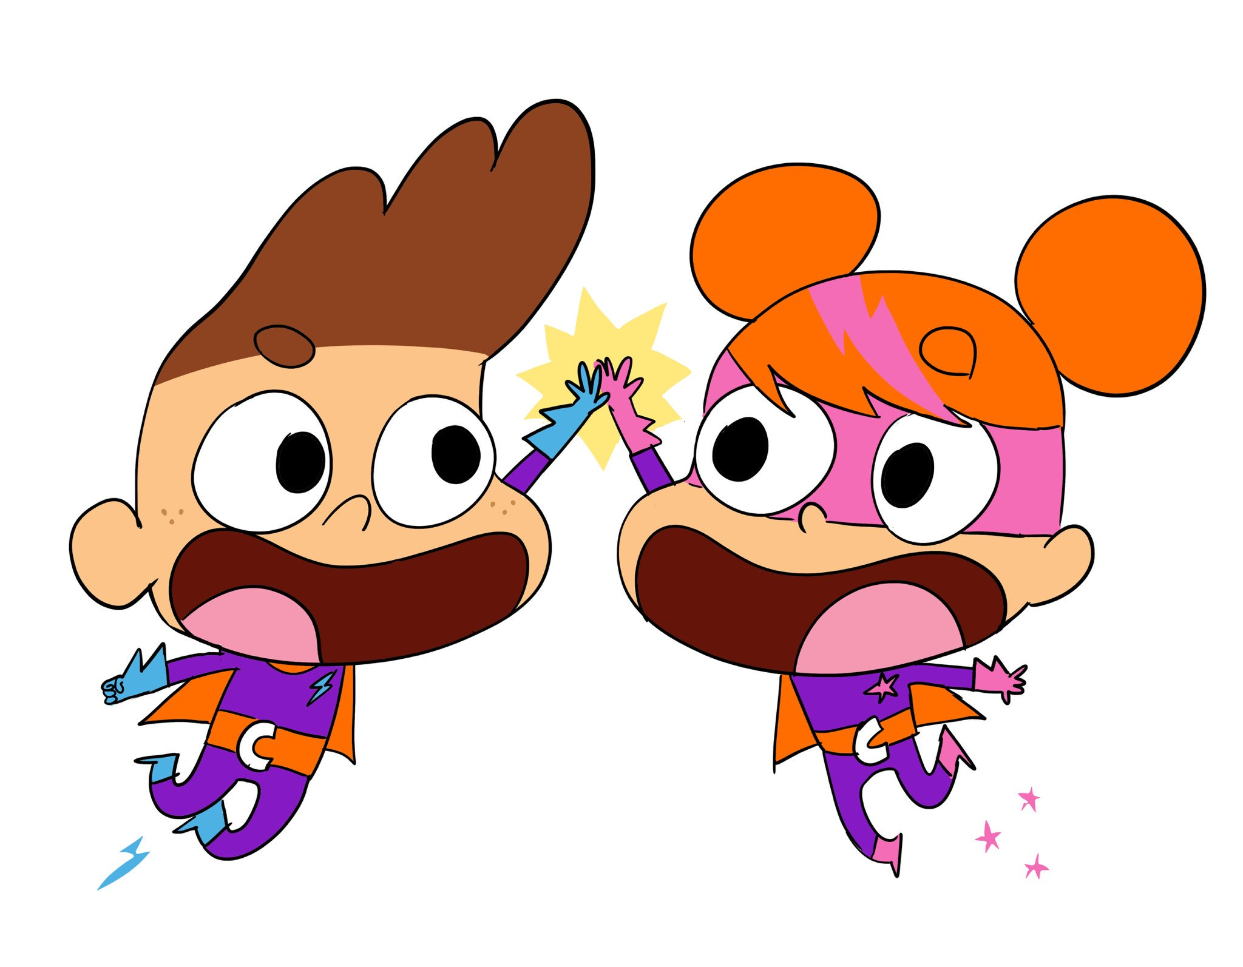

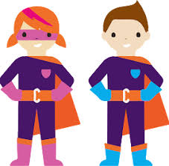
Y Siarter Iaith Gymraeg
Welsh Language Charter
The Welsh Charter is a new project to encourage
the use of Welsh socially in primary schools in
Wales with two new heros Seren and Sbarc.
Each individual school completes a baseline exercise to determine current language use before developing an action plan to work towards a bronze, silver or gold award.
It encourages participation from every member of the school community - pupils, parents, school governors and the wider community.
In secondary schools, they have been
given extra support to develop school
driven projects to increase the social
use of the Welsh language.
Mae Siarter Iaith yn gynllun newydd er mwyn hybu’r defnydd o Gymraeg yn gymdeithasol yn ysgolion cynradd Cymru gyda dau gymeriad Newydd, Seren a Sbarc.
Mae pob ysgol unigol yn cwblhau ymarfer sylfaenol i bennu defnydd o'r iaith cyn datblygu cynllun gweithredu i weithio tuag at wobr efydd, arian neu aur.
Mae'r cynllun yn annog cyfranogiad gan bob aelod o gymuned yr ysgol - yn ddisgyblion, rhieni, llywodraethwyr ysgol a'r gymuned ehangach.
Mewn ysgolion uwchradd, maent wedi derbyn cefnogaeth ychwanegol i ddatblygu prosiectau ar lefel ysgol i annog y defnydd o’r iaith Gymraeg gan y dysgwyr.
Notes:
In schools (Primary and Secondary sectors) you will see the Welsh Language Charter gaining momentum with the whole school community working together to develop all aspects of what it is to be Welsh.
Welsh will probably be quite visible in schools with bilingual posters and signs but we need to move towards HEARING Welsh in schools – in classrooms, in the corridor, staffroom, playing fields, etc.

Slide 28
Beth amdanoch chi? What about you?
You as trainee teachers, will have access to extra support, both at University and in school, with your developing Welsh skills.
You will be assessed against the Welsh Competency Framework levels.
A member of school staff (Welsh mentor) will assess your developing Welsh skills against the Framework.
You will be asked to keep a portfolio of evidence to show the way you have developed your Welsh skills.

Slide 29
y Fframwaith – ble ydw i?
The Framework – where am I?

Slide 30
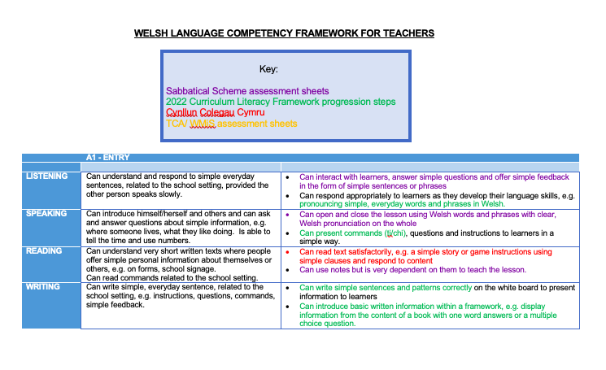
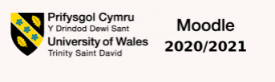
Linc i’r ddogfen ar Moodle. / Link to the document on Moodle :

Slide 31
Y Portffolio
The Portfolio

Slide 32
BA Ed3 Portfolio Requirements
The portfolio will include the following.
A complete pack which includes:
Film evidence – up to 10 minutes of a lesson which you have presented on location in school (evidencing oral, reading and listening skills)
Tutor notes/observation report on your use of Welsh language during your period on location
A lesson plan that focuses specifically on developing learners' literacy skills in Welsh
Written self-reflection by the student along with response to the tutor’s report (up to 1000 words with medium of work depending on student’s linguistic ability)
It should also include:
Three lesson plans or weekly plans that demonstrate the best example of the student developing learners' literacy skills in Welsh and/or improving personal language skills
Formative assessments/tasks from language lessons – school and university
Original resources that show evidence of developing learners' literacy skills and differentiation
Evidence of correcting a learner's work.

Slide 33






