Slide 1
Feminism and Feminist Theory
By Pearle Morha

Slide 2
What is feminism?

Slide 3
Where did it originate from?
The French and American revolutions in the late 18th century.
In Britain late 19th century A ‘second wave’ of feminism arose in the 1960s,
A ‘third wave’ was identified in the late 1980s and 1990s, a

Slide 4
What is feminist theory?

Slide 5
Is feminism portrayed in Shakespeare's Hamlet?

Slide 6
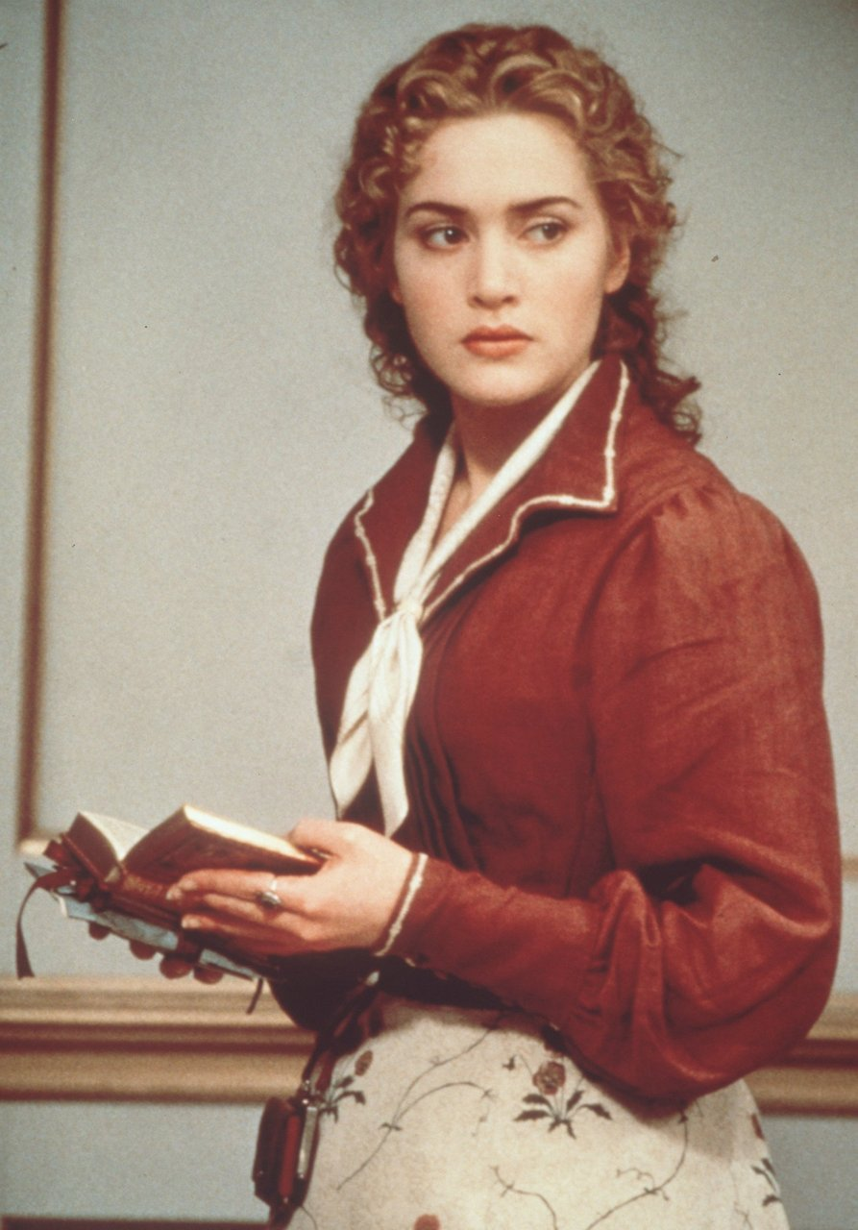
Ophelia
She is viewed as a sexual object by Hamlet
Hamlet blames her for his madness
Her father treats her like a puppet
She is used to gather information and though the men around her do as they please she doesn't

Slide 7
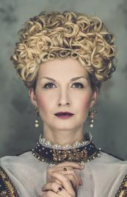
Gertrude
She is used by the men around her.
She is still submissive even though she is a queen.
She acts like claudius puppet
The only time she thinks for herself she drinks poison and dies. coincident?

Slide 8
Quotes
KING : 'Tis sweet and commendable in your nature, Hamlet, To give these mourning duties to your father. […] but to persever. In obstinate condolement is a course. Of impious stubbornness. 'Tis unmanly grief. It shows a will most incorrect to heaven, A heart unfortified, a mind impatient, An understanding simple and unschooled: (1.2.90-92; 96-101)
HAMLET: Why, what an ass am I! This is most brave, That I, the son of a dear father murdered, Prompted to my revenge by heaven and hell, Must, like a whore, unpack my heart with words And fall a-cursing, like a very drab, A stallion!(2.2.611-616)
OPHELIA: By Gis and by Saint Charity, Alack and fie for shame, Young men will do 't, if they come to 't; By Cock, they are to blame. Quoth she, 'Before you tumbled me, You promised me to wed.' So would I 'a done, by yonder sun, An thou hadst not come to my bed. (4.5.63-71)

Slide 9
Shakespeare’s THeme

Slide 10
There is a pattern in his writing
The need to dominate
The fear of growing old
2. Macbeth
Woman was dominate
Led to death

Slide 11
NO

Slide 12
Thank you for listening…
Any questions?

