Slide 1
I acknowledge the use of UWTSD copilot throughout my work for research and supporting my findings.
I used the prompt(s) such as:
1.Find an article on Flying start and health in Wales
2.Find an article on support in Wales for deprived areas
3. Find me definitions on health
ECEY5009 2405809 Wordcount- 1917

Slide 2
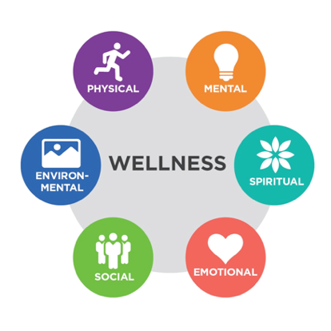

Introduction
In this poster the concepts of health, wellbeing and lifestyle will be explored to support and develop an understanding of them. The poster will highlight the holistic aspects of the concepts and show how they interlink. It will draw focus on how to promote a healthy style for Early Years (EY) and how practitioners can help to support this within early years settings. The poster will consider relevant theorists and applications whilst considering legislations, frameworks, and the Welsh Curriculum.
Health
Health is an abstract idea, making it a difficult concept to define (Rambihar, 2023; Musgrave, 2017; van Druten et al., (2022). Musgrave (2017) suggests one reason understanding health is so challenging may that there is not one singular definition, but multiple ways of how it is viewed. World Health Organisation (WHO, 2025) describe health as a condition in which a person is physically, mentally, and socially complete, and not just free from illness or disability. van Druten et al (2022) believe that definition is outdated as it implies people with chronic illnesses or disabilities are considered unhealthy and therefor never being able to achieve complete wellbeing. Britannica (2025) holds the same view but add that these factors contribute to how a person can cope with their environment. On the other hand, Armitage (2023) disagrees with WHO, explaining the definition is unrealistic because it describes a perfect state that cannot be fully achieved. Marmot (2010) states most physical, intellectual, and emotional development begins with experiences having lifelong impacts ranging from physical and mental health to educational success.
The first one thousand days (including conception) represent a critical period of rapid brain development, with substantial evidence indicating that early experiences influence brain formation and establish the foundations for later health, well-being, and learning (Public Health Wales (PHW, 2023a). Likewise, Martorell (2016) discusses how poor nutrition within the first one thousand days will have short- and long-term effects on health and function. Despite the evidence, The Academy of Medical Sciences (AIMH, 2024) draws attention to the fact that although the early years is crucial to the populations health and wellbeing, it is often overlooked in policy development across Government. PHW (2023b) reported that the cost-of-living crisis is harming children’s health, particularly those in poverty, with lasting effects on their future outcomes. Human Rights Careers (no date, par. 5) describes poverty as when ‘someone lacks the income and resources necessary to maintain a good standard of living.’ However, people’s opinions of basic needs change over time, making it problematic resulting in many describing it in the relative sense as having the least amount of income (LLeras- Munay, Schwandt and Wherry, 2025). Poverty in Wales has consistently stayed high in the last few years (Joseph Rowntree Foundation, 2025; PHW, 2023c) resulting in negative effects in early childhood development, increase in risk of physical and mental health problems, and places children at a disadvantage prior to entering school (NSPCC, 2024). There is a strong correlation with poverty and health as according to WHO (2024) higher income, social status and education levels are linked to better health. The Health Foundation (2024) notes experiencing poverty at any point in childhood is linked to poorer health outcomes, with the strongest effects seen among children who experience long-term poverty.
Wales offers a Flying Start programme which offers extra support to children under four who live in the most deprived areas (Welsh Government, 2024a). Welsh Government (2017) state one of Flying Starts aims is children are healthy and thriving. In Flying Start areas, Health Visitors can spend more time with families, providing additional support and guidance during pregnancy and throughout the early years of a child’s life (Neath Port Talbot Council, no date).
Wellbeing
Statham and Chase (2010) describe the concept of wellbeing as multi-dimensional, including physical, emotional, and social aspects, and considers children’s present experiences and future outcomes.
Like health, wellbeing is often a subject many will spend lots of time trying to define and examine (Laffan, 2023) and although widely discussed, there is no agreed, clear, and practical definition of what wellbeing is or how it should be understood and measured (Jarden and Roache, 2023). WHO (2026) describes it to be a positive state experienced by individuals and communities. They continue to identify the similarities to health, supporting everyday living and is shaped by social, economic, and environmental factors. Wellbeing is increasingly central to many discussions, with growing recognition that, unlike illbeing, is essential for everyone (Jarden and Roache,2023). The Well-being of Future Generations (Wales) Act 2015 aims to enhance Wales’s social, economic, environmental, and cultural well-being. Early years practitioners can work in line with this by creating nurturing and inclusive environments.
Comer, cited in Pierson (2023,1:00) declares no significant learning can occur without a meaningful relationship. Thoilliez (2011 p.346) also recognises the importance of relationships maintaining that the ‘natural habitat of happiness is in human relationships.’ From building relationships (Department of Health, 2014) and following the Welsh curriculum, it is believed early year practitioners can positively influence children’s wellbeing by providing consistent care and modelling compassion and kindness (Welsh Government, 2024b). The Welsh curriculum looks at the child holistically and takes into consideration the health and wellbeing of a child and not just what they are learning academically. It considered articles from the UNCRC such as Bowlby (1971) attachment theory discusses how secure attachments help children model trust, empathy, and positive social behaviour. Creating positive relationships with the children will support them to learn and develop as they feel safe to explore their surroundings.
Like with health, wellbeing is important within the early years as children’s early experiences, particularly in the first five years, have long-term effects on their wellbeing (Department of Health, 2014). Haughton, Khandker and Shahidur (2009 p.1) stated poverty to be ‘pronounced deprivation in wellbeing’. Mind (2024) reported that people living in material deprivation produced a lower wellbeing score of 40.8 compared to the average of 48.2 (out of 70). The adult's wellbeing score is likely to impact the children's wellbeing as ‘parenting stress is considered an important risk factor affecting early child development’ (Pan et al. 2025, par.2). Early years frameworks influence children’s wellbeing by shaping the quality of relationships, environments, learning experiences, and support systems around them.
If someone is in poverty it is important understand how meeting different needs affects people’s wellbeing, and to identify which needs are being overlooked so they can be given more attention (Rojas, Méndez, and Watkins-Fassler, 2023). Cary (2025) suggests some attributes to a child’s wellbeing from school culture are relationships and belonging. In December 2024, the Children’s Wellbeing and Schools Bill were presented to Parliament, containing multiple proposals related to wellbeing in schools such as provisions on breakfast clubs (Cary, 2025). The importance of this can be seen in Maslow’s theory of hierarchy of needs. According to Maslow (1943), the bottom level of the hierarchy being physiological needs need to be satisfied and only then can individuals be motivated to work towards the next level. With the government providing breakfast for children, they are helping fulfil part of the children’s physiological need.
Source: Roseanna Davison Nutrition (2015)
Source: Learn Muscles (2017)

Slide 3
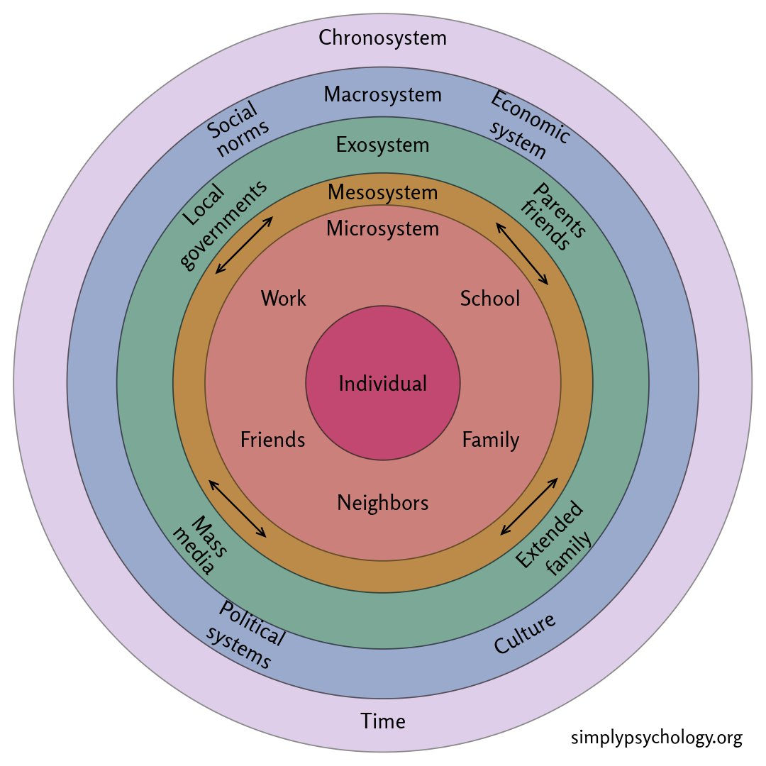
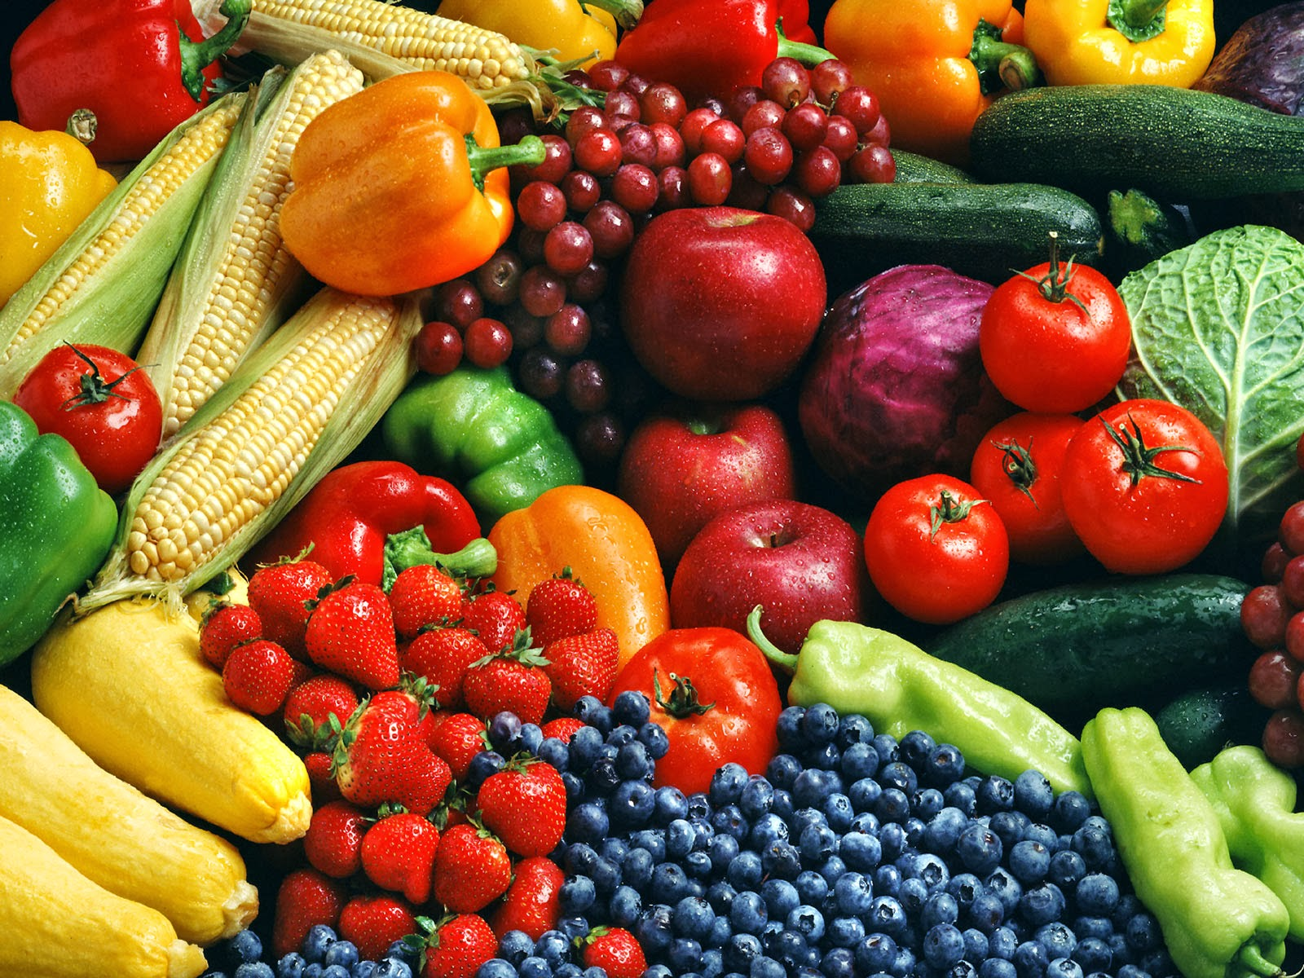

Lifestyle
The concept of lifestyle can be understood as the pattern of choices, behaviours, and habits that shape how a person lives their daily life (Jensen, 2008). However, Jensen (2008) highlights that the term is often used casually to mean a way of living, but attains in research on health, it has a more specific and meaningful role. According to Science News Today (2025) healthy lifestyle is not defined by a single decision; it is formed through many small, everyday choices that, over time, create a balanced and fulfilling life. Kumar (2017, p.1) states ‘In sociology, a lifestyle is the life of a person’.
It is widely considered that a healthy lifestyle consists of a balanced diet, regular exercise, and adequate rest (NHS, 2022; Sonal 2024). Solan (2024) believes forming the foundation of a healthy lifestyle is creating long term habits that includes all the above plus managing mental health and attending regular routine medicals. According to the NHS (2022), a balanced diet consists of consuming the right amount of a variety of foods, to maintain a healthy body weight. Kumar (2017) promotes lifestyle is an important part in staying healthy. These are all aspects that can be modelled by early years practitioners to instil the importance of health into children.
The curriculum for non‑maintained nursery settings considers these factors and creates a holistic approach.
Combining aspects from health and wellbeing will contribute to a healthy lifestyle. Health and wellbeing are often associated together, giving a holistic view of a healthy lifestyle. There are many factors that can contribute to whether someone lives a healthy lifestyle (WHO, 2024). WHO (2024) mentions some factors being where a person lives, the state of our environment, genetics, household income and education level, and relationships with friends and family. These can be seen in the categories of the microsystem, where someone lives, the mesosystem and exosystem which involves relationships, the macrosystem including poverty and environment (Christensen, 2016).
People are motivated to adopt healthy lifestyles in mid-life that support wellbeing in older age and help reduce mental decline (Government Office for Science, 2008).
Application
Under section 17 of The Children Act 1989, local authorities have a duty to ‘to safeguard and promote the welfare of children within their area who are in need’. The Working Together to Safeguard Children (HM Government 2023) guidance states that part of safeguarding is ‘preventing impairment of children’s mental and physical health or development’ (p. 8).
McDowall Clark (2013, cited in Musgrave 2017), in her adaptation of Bronfenbrenner’s systems theory for early childhood, explains that children experience two key microsystems: their home environment and their early years setting. Practitioners can support during setting time but once the child is at home the influences are from parents. According to Gubbels, Gerards and Kremars (2015) and Loth et al. (2018) early years practitioners are an important part of early years settings and have a considerable influence on children’s health habits. EY practitioners can shape children’s eating habits and the amount of activity they participate in through various ways (Gubbels, Gerards and Kremars, 2015). Anundson et al. (2017) suggest offering children multiple fruits and vegetables to enhance children’s consumption of niutrients This is something early years settings can introduce during snack time.
Welsh Government (2024b) states their curriculum for funded non-maintained nursery settings is heavily focused on children’s wellbeing and was created to enhance mental and emotional wellbeing through the development of confidence, resilience, and empathy. The early years framework highlights the importance of children being confident and active explorers, supporting them to understand their learning and enhancing their wellbeing.
Source: The Healthy Mermaid (2013)
Conclusion
From the research provided there is compelling evidence that health, wellbeing, and lifestyle are all interlinked and needed to provide a holistic approach when supporting children with their development. It is apparent that Early Years practitioners can have a strong influence on children and are in a privileged situation to be able to be a positive role model and model a healthy lifestyle. Furthermore, creating strong relationships will support the children’s wellbeing and working in line with the Welsh curriculum will enable Early Year practitioners to work in accordance with legislations and provide the holistic learning that children require. Taking into consideration the theorists that have been discussed will provide an understanding to why and how to better support within the Early Years settings and take into consideration of the ever-changing environment and expectations.
Source: Adobe Images

Slide 4
Reference List
The Academy of Medical Sciences (2024) Prioritising Early Childhood to Promote the Nation’s Health, Wellbeing and Prosperity. Available at: https://aimh.uk/wp-content/uploads/2024/02/The-Academy-of-Medical-Sciences-Prioritising-early-childhood-to-promote-the-nations-health-wellbeing-and-prosperity-Feb-24.pdf (Accessed 30 December 2025)
Anundson, K., Sisson, S. B., Anderson, M., Horm, D., Soto, J., Hoffman, L. (2018) ‘Staff Food-Related Behaviours and Children’s Tastes of Food Groups during Lunch at Child Care in Oklahoma’. Journal of the Academy of Nutrition and Dietetics. 118 (8) pp.1399-1407. Available at: https://www.sciencedirect.com/science/article/pii/S2212267217311449?casa_token=8XOR6oVQeRsAAAAA:gxJgVJCdGQC0R3pKxKEsUcex1zNNUx_T3HeGG0Hh7R3bCLC2INlSa19pcNIDM2VGayAJZGHEPSW1 (Accessed 05 January 2026).
Bowlby, J. (1971) Attachment and loss. Harmondsworth: Penguin.
Britannica (2025) Health. Available at: https://www.britannica.com/topic/health (Accessed 30 December 2025).
Cary, E. (2025) Children's Wellbeing in Schools. Available at: https://researchbriefings.files.parliament.uk/documents/POST-PN-0739/POST-PN-0739.pdf?utm_source (Accessed 04 January 2026).
Children Act 1989. C. 41. Available at: https://www.legislation.gov.uk/ukpga/1989/41/section/17 (Accessed 05 January 2026).
Christensen, J. (2016) ‘A Critical Reflection of Bronfenbrenner’s Development Ecology Model’. PROBLEMS OF EDUCATION IN THE 21st CENTURY. (69)22. Available at: https://www.diva-portal.org/smash/get/diva2:1401552/FULLTEXT01.pdf. (Accessed 06 January 2026).
Department of Health (2014) Health Improvement Analytical Team Department of Health. Available at: https://assets.publishing.service.gov.uk/media/5a7c08d8ed915d41476225b3/Wellbeing_-_why_it_matters_to_health_summary_of_key_points.pdf (Accessed 04 January 2026).
The Government Office for Science (2008) Foresight Mental Capital and Wellbeing Project. Final Project report – Executive summary. Available at: https://assets.publishing.service.gov.uk/media/5a7c59eced915d6969f44488/mental-capital-wellbeing-report.pdf (Accessed 05 January 2025).
Haughton, J. and Khandker, S.R. (2009) Handbook on Poverty and Inequality. Washington, DC: World Bank. Available at: https://doi.org/10.1596/978-0-8213-7613-3. (Accessed 04 January 2026).

Slide 5
The Health Foundation (2024) Relationship Between Persistent Poverty and Health. Available at: https://www.health.org.uk/evidence-hub/money/relationship-between-persistent-poverty-and-health?utm_source (Accessed 04 January 2026).
Gubbels, J. S., Gerards, S. M. P. L., & Kremers, S. P. J. (2015).’ Use of Food Practices by Childcare Staff and the Association with Dietary Intake of Children at Childcare.’ Nutrients, 7(4). Available at: https://www.mdpi.com/2072-6643/7/4/2161 (Accessed 05 January 2026).
Human Rights Careers (no date) What is Poverty? The Causes, Facts, and Ways to Take Action. Available at: https://www.humanrightscareers.com/issues/what-is-poverty-the-causes-facts-and-ways-to-take-action/ (Accessed 04 January 2026).
Jarden, A. and Roache, A. (2023) ‘What Is Wellbeing?’, International journal of environmental research and public health, 20(6), p. 5006. Available at: https://doi.org/10.3390/ijerph20065006. (Accessed 04 January 2026).
Jensen, M. (2007) ‘Defining lifestyle’. Environmental Sciences. 4(2), 63-73. Available at: https://www.tandfonline.com/doi/pdf/10.1080/15693430701472747 (Accessed 05 January 2026).
Joseph Rowntree Foundation (2025) Poverty in Wales 2025. Available at: https://www.jrf.org.uk/poverty-in-wales-2025?utm_source=copilot.com (Accessed 30 December 2025).
The Kings Fund (2024) Poverty Taking a Heavy Toll on UK’s Health and NHS Services. Available at: https://www.kingsfund.org.uk/insight-and-analysis/press-releases/poverty-health-nhs-services?utm_source (Accessed 04 January 2026).
Kumar, K. (2017) ‘Importance of Healthy Lifestyle in Healthy Living’. Juniper Online Journal of Public Health. 2 (5) Available at: https://www.researchgate.net/profile/Kamakhya-Kumar/publication/322267516_Importance_of_Healthy_Life_Style_in_Healthy_living/links/5a79abb5aca2722e4df3e076/Importance-of-Healthy-Life-Style-in-Healthy-living.pdf (Accessed 05 January 2025).
Laffan, K. (2023) What is Wellbeing? Available at: https://youtu.be/vv4cW-NKjWI?si=T8oUWUV3XWY0xwj4 (Accessed 4 January 2025).
LLeras- Munay, A., Schwandt, H., and Wherry, L. (2025) ‘Poverty and Health’. Annual Review of Economics. Available at: https://www.annualreviews.org/docserver/fulltext/economics/17/1/annurev-economics-081624-083218.pdf?expires=1767537017&id=id&accname=guest&checksum=49365772A6B47967ECDD13CC24BE3AE6 (Accessed 04 January 2026).
Loth, K., Shanafelt, A., Davey, C., Anfinson, A., Zauner, M., Ayers Looby, A., Frost, N., Nanney, M. (2019) ‘Provider Adherence to Nutrition and Physical Activity Best Practices Within Early Care and Education Settings in Minnesota, Helping to Reduce Early Childhood Health Disparities’. Health Education & Behaviour. Available at: https://journals.sagepub.com/doi/pdf/10.1177/1090198118780458?casa_token=3XwLLaeYj-QAAAAA:ynLFm2Y7_xyjZ_BlEibvIdNsy0G1LTqed79Pf3cdjohvQZWUj0qh6De8ebcEibriERUZ6exU6kx_Mw (Accessed 05 January 2026).
Marmot, M. (2010) Fair Society, Healthy Lives: Strategic review of health inequalities in England Post-2010, The Marmot Review. Available at: https://www.parliament.uk/globalassets/documents/fair-society-healthy-lives-full-report.pdf (Accessed 30 December 2025).

Slide 6
Maslow, A. (1943). A Theory of Human Motivation. Psychological Review, 50(4), 370–396. Available at: Available at: https://doi.org/10.1037/h0054346. (Accessed 05 January 2026).
Musgrave, J. 2017. Children’s Health is Every Professional’s Responsibility. In: Supporting Children’s Health and Wellbeing. 55 City Road, London: SAGE Publications Ltd. pp. 1-8 Available at: https://doi.org/10.4135/9781529715040.n1 (Accessed 5 Jan 2026).
Neath Port Talbot Council (no date) About Flying Start. Available at: https://www.npt.gov.uk/children-and-families/flying-start/about-flying-start/#section_b4a257f6-86f2-4dc5-9fd4-5768a622be57_fd31600f-b19d-4721-b41a-b912dffaea54 (Accessed 04 January 2026).
NHS (2022) Eating a Balanced Diet. Available at: https://www.nhs.uk/live-well/eat-well/how-to-eat-a-balanced-diet/eating-a-balanced-diet/ (Accessed 06 January 2026).
NSPCC (2024) Families living in poverty struggling to access early childhood services. Available at: https://www.nspcc.org.uk/about-us/news-opinion/2024/families-in-poverty-struggling-to-access-early-childhood-services/?utm_source=copilot.com (Accessed: 30 December 2025).
Martorell, R. (2017) ‘Improved nutrition in the first 1000 days and adult human capital and health’, American journal of human biology, 29(2), p. np-n/a. Available at: https://doi.org/10.1002/ajhb.22952. (Accessed: 30 December 2025).
Mind (2024) The Big Mental Health Report. Available at: https://www.mind.org.uk/media/vbbdclpi/the-big-mental-health-report-2024-mind.pdf (Accessed 04 January 2026).
Pan, B., Gong, Y., Wang, Y., Miao, J., Zhao, C., Li, Y. (2025) ‘The impact of maternal parenting stress on early childhood development: the mediating role of maternal depression and the moderating effect of family resilience’. BMC Psychol. 13(1):277. Published 2025 Mar 20. Available at: doi:10.1186/s40359-025-02575-6 (Accessed 06 January 2026).
Pierson, R. (2013) Every kid needs a champion. TED. (1:00) Available at: https://www.ted.com/talks/rita_pierson_every_kid_needs_a_champion (Accessed: 30 December 2025)
Public Health Wales (2023a) First 1000 Days A Public Health Approach to Supporting Parents. Available at: https://phw.nhs.wales/topics/the-first-1000-days-programme/resources/a-public-health-approach-to-supporting-parents-summary-report/ (Accessed 30 December 2025).
Public Health Wales (2023b) The Current and Future Health of Children in Wales is Being Harmed by the Cost of Living Crisis. Available at: https://phw.nhs.wales/news/the-current-and-future-health-of-children-in-wales-is-being-harmed-by-the-cost-of-living-crisis/ (Accessed 30 December 2025).
Public Health Wales (2023c) Children and the Cost-of-living Crisis in Wales. Available at: https://phwwhocc.co.uk/wp-content/uploads/2023/09/PHW-Children-and-cost-of-living-report-ENG.pdf (Accessed: 30 December 2025).

Slide 7
Rambihar (2023) ‘Time to Ban the Word “Prevention”’. BMJ. 382 p.2212. Available at: https://www.bmj.com/content/382/bmj.p2212/rr-2?utm_source (Accessed 05 January 2026).
Rojas, M., Méndez, A. and Watkins-Fassler, K. (2023) ‘The hierarchy of needs empirical examination of Maslow’s theory and lessons for development’, World development, 165. Available at: https://doi.org/10.1016/j.worlddev.2023.106185.
Science News Today (2025) The Ultimate Guide to a Healthy Lifestyle. Available at: https://www.sciencenewstoday.org/the-ultimate-guide-to-a-healthy-lifestyle (Accessed 05 January 2025).
Solan, M. (2024) 10 Habits for Good Health. Available at: https://www.health.harvard.edu/staying-healthy/10-habits-for-good-health (Accessed 06 January 2026).
Statham, J and Chase, E (2010) Childhood Wellbeing: A brief overview. Loughborough: Childhood Wellbeing Research Centre.
Thoilliez, B. (2011) How to Grow up Happy: An Exploratory Study on the Meaning of Happiness from Children’s Voices. Child Ind Res: 4:323–351 Available at: https://doi.org/10.1007/s12187-011-9107-5. (Accessed: 30 December 2025).
van Druten, V.P., Bartels, E. A., van de Mheen, D., de Vries, E., Kerkchoffs, A. P. M and Nahar- van Venrooij, L. M. W. (2022) ‘Concepts of health in different contexts: a scoping review’. BMC Health (22)389. Available at: https://link.springer.com/article/10.1186/s12913-022-07702-2?utm_source=copilot.com (Accessed 05 January 2026).
Well-being of Future Generations (Wales) Act 2015 https://www.gov.wales/well-being-future-generations-act-essentials-html (Accessed 04 January 2026).
Welsh Government (2017) Flying Start Health Programme Guidance. Available at: https://www.gov.wales/sites/default/files/publications/2019-07/flying-start-health-programme-guidance_0.pdf?utm_source=copilot.com (Accessed 04 January 2026).
Welsh Government (2024b) Flying Start programme. Available at: https://www.gov.wales/flying-start-programme (Accessed 4 January 2026).
Welsh Government (2024b) A curriculum for funded non-maintained nursery settings. Available at: https://hwb.gov.wales/api/storage/1f581142-6b91-41e4-845d-3d6c7765df20/a-curriculum-for-funded-non-maintained-nursery-settings.pdf (Accessed: 30 December 2025).
World Health Organisation (2024) Determinants of health. Available at: https://www.who.int/news-room/questions-and-answers/item/determinants-of-health (Accessed 06 January 2026).
World Health Organisation (2025) Constitution. Available at: https://www.who.int/about/governance/constitution (Accessed 30 December 2025).
World Health Organisation (2026) Promoting Wellbeing. Available at: https://www.who.int/activities/promoting-well-being (Accessed 04 January 2026).

