Slide 1

LCBB5013: Entrepreneurship
BA (Hons) Business Management
Portfolio - 6 elements
TASK 2: Business Plan Presentation
Student name: Vasilica Duta
Student ID: 2526525

Slide 2
Agenda
Slide number | Contents
1 | Cover page
2 | Agenda
3 | Introduction
4 | Business plan summary
5 | Conclusion
6 | References

Slide 3
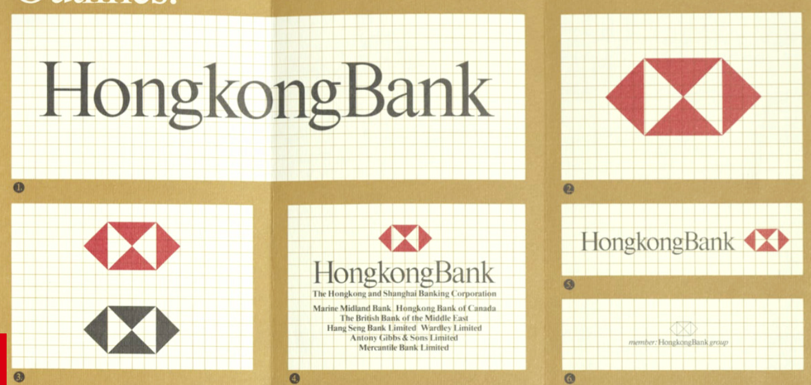
Introduction
Selected company: HSBC.
HSBC has grown to be active in 56 countries with strategic acquisitions (HSBC, 2026).
Figure 1: Revolution of HSBC
(Source: HSBC, 2026)
Notes:
HSBC Holdings plc is one of the world's leading international financial service groups with a wide variety of financial services to retail, commercial, corporate and wealth management customers. Since their founding in 1865, HSBC has grown to be active in 56 countries with strategic acquisitions, innovation and global knowledge of banking. It has a positive point due to its international links, tech-savvy and sophisticated digital banking systems and sustainable banking capabilities.

Slide 4
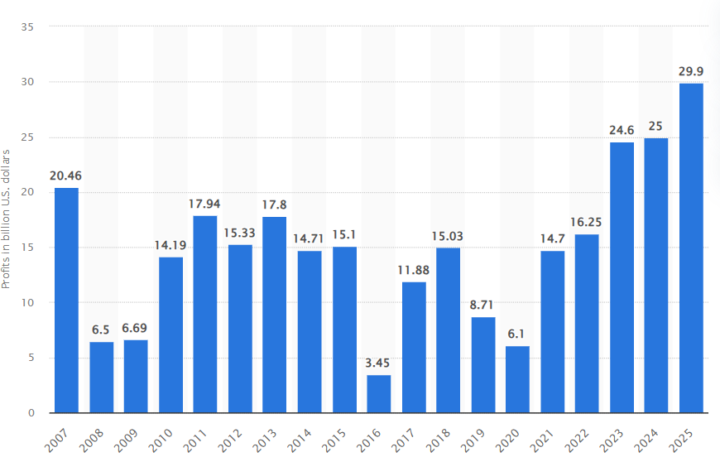
Business plan summary
HSBC has brand value and technological strength; whereas, pressure on regulators and high competition are challenges.
HSBC earned US$65.9 billion (£49.16) in revenues and made a profit before tax of US$32.3 (£24.09) billion during 2024 (Scholle, 2026).
Figure 2: Profit revenue of HSBC
(Source: Scholle, 2026)
Notes:
The business is defined along the programme segments of business, i.e. individuals, professionals, multi-national companies and institutional customers, and financial products and marketing strategies are focused on these segments of business. From the SWOT analysis, positive aspects for HSBC are brand value and technological strength; whereas, pressure on the regulators and high competition points should be taken into consideration. The opportunities for digital transformation, AI and a personalised banking experience, along with the opportunities for sustainable investment, are significant opportunities. As for financial growth, HSBC has proven to have come a long way from where it started, earning US$65.9 billion in revenues and making a profit before tax of US$32.3 billion during 2024. The merchants from across the globe invested their money early, which enabled successful business development and growth of the branches, as well as trade finance services and business development.

Slide 5
Conclusion
The banking operation of HSBC incorporates technology, customer experience and responsible banking investments.
HSBC's efforts to ensure financial strength, global reach, innovation, and sustainability.
Notes:
Technology, customer experience and responsible banking investments are done continuously, have yielded better execution and value addition to the shareholders. In conclusion, HSBC's efforts to ensure financial strength, global reach, innovation, and sustainability will continue to be vital as the company strives to remain competitive over time.

Slide 6
References
HSBC (2026) Our history Supporting our customers for 160 years. Available at: https://www.hsbc.com/who-we-are/our-strategy-and-values/our-history (Accessed: 12 July 2026).
Scholle, K. (2026) HSBC profits 2007-2025. Available at: https://www.statista.com/statistics/224577/hsbcs-profit/?srsltid=AfmBOopyl1DFWKJG4baliNU8U6jlDH_djE1n_fif-D8HIfYyD82IxIBk (Accessed: 10 July 2026).

